Slide 1

Chapter 1
Chapter 13
BUDGET AND CONTROL
MK 312 Marketing Planning
By
Ajarn Suwalya K.

Slide 2
Budget and Control
An organization needs to budget in order to ensure that its expenditures does not exceed planned revenue.
The productivity of an operation is related to how effectively the resources that are input in a process (manufacturing process, service process) are transformed into economic results for the service provider and value for its customers.

Slide 3
Budget and Control
Control is the process of ensuring the global marketing activities are carried out as intended. It involves monitoring aspects of performance and taking corrective action where necessary.
The global marketing control system consists of deciding marketing objectives, setting performance standards, locating responsibility, evaluating performance against standards, and taking corrective or supportive action in each single country and overall.

Slide 4

Productivity defined (in general)

Slide 5
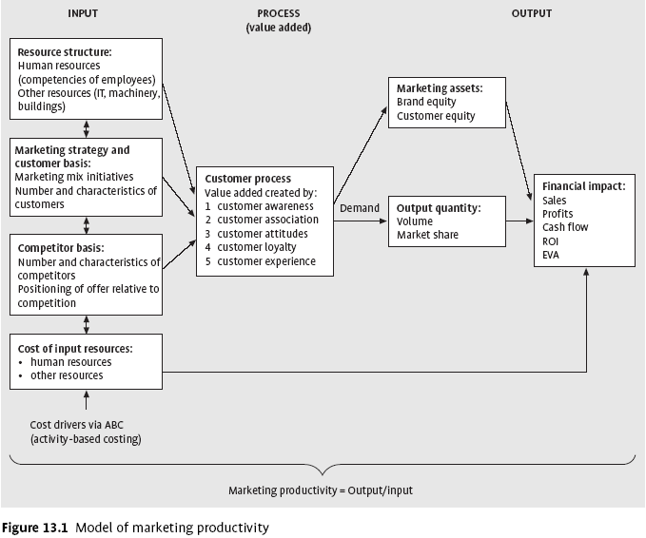
Marketing productivity

Slide 6
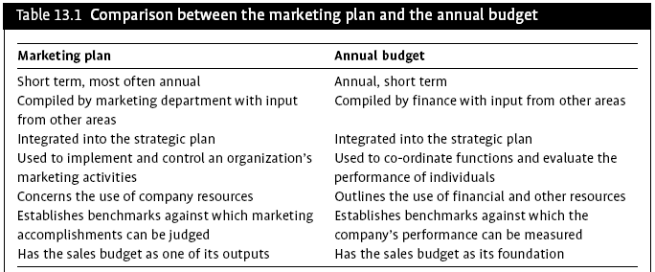
Marketing plan and the annual budget

Slide 7
Three ways of building a marketing budget
There are three ways to build a marketing budget that is based on a specific strategic market plan and the tactical marketing strategy designed to achieve the target level of performance:
1 Top-down budget: a new marketing budget based on projected sales objectives is determined, using past marketing expenses as a percentage of sales.
2 Customer mix budget: the cost of customer acquisition and retention, and the combination of new and retained customers are used to derive a new marketing budget.
3 Bottom-up budget: each element of the marketing effort is budgeted for specific tasks identified in the marketing plan.

Slide 8
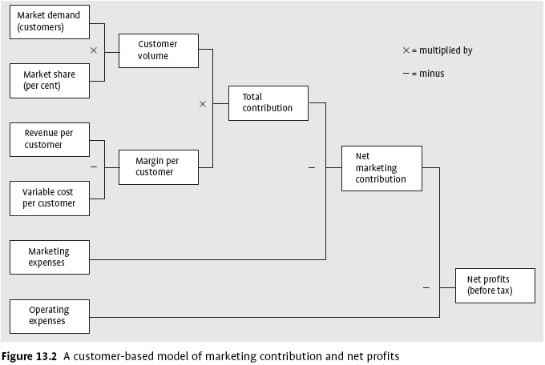
Customer marketing contribution and net profits

Slide 9
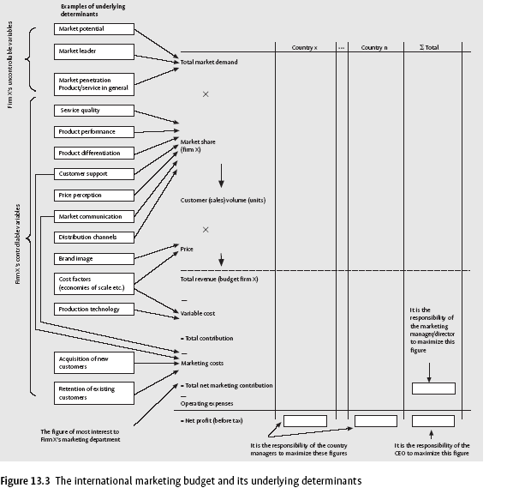
The international marketing budget

Slide 10
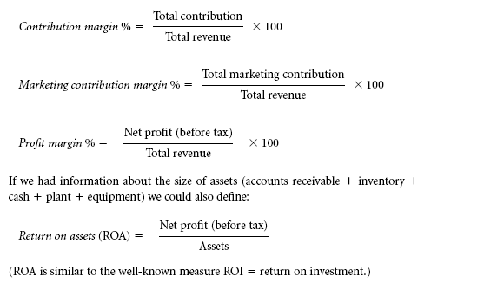
Measures of marketing profitability

Slide 11
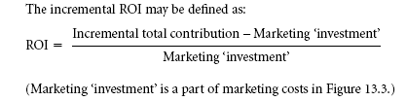
Incremental ROI

Slide 12
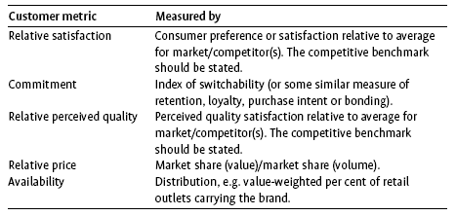
Exhibit 13.1 External marketing metrics

Slide 13
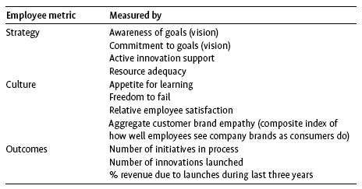
Exhibit 13.1 Internal marketing metrics

Slide 14
Controlling the marketing programme
In preparing a marketing plan, marketers
need to plan for three types of marketing
control:
Annual control
Profitability control
Strategic control

Slide 15
Annual Control
The basis of annual-plan control is managerial objectives—that is to say, specific goals, such as sales and profitability, that are established on a monthly or quarterly basis. Organizations use five tools to monitor plan performance.
The first is sales analysis, in which sales goals are compared with actual sales and discrepancies are explained or accounted for.
A second tool is market-share analysis, which compares a company’s sales with those of its competitors. Companies can express their market share in a number of ways, by comparing their own sales to total market sales, sales within the market segment, or sales of the segment’s top competitors.
Third, marketing expense-to-sales analysis gauges how much a company spends to achieve its sales goals. The ratio of marketing expenses to sales is expected to fluctuate, and companies usually establish an acceptable range for this ratio. In contrast, financial analysis estimates such expenses (along with others) from a corporate perspective. This includes a comparison of profits to sales (profit margin), sales to assets (asset turnover), profits ...

Slide 16
Profitability Control
Profitability control and efficiency control allow a company to closely monitor its sales, profits, and expenditures. Profitability control demonstrates the relative profit-earning capacity of a company’s different products and consumer groups. Companies are frequently surprised to find that a small percentage of their products and customers contribute to a large percentage of their profits..

Slide 17
Strategic Control
Strategic control processes allow managers to evaluate a company’s marketing program from a critical long-term perspective. This involves a detailed and objective analysis of a company’s organization and its ability to maximize its strengths and market opportunities.

