Slide 1

BA 291 – Business model Example
By Aj. Parichat Jantori

Slide 2
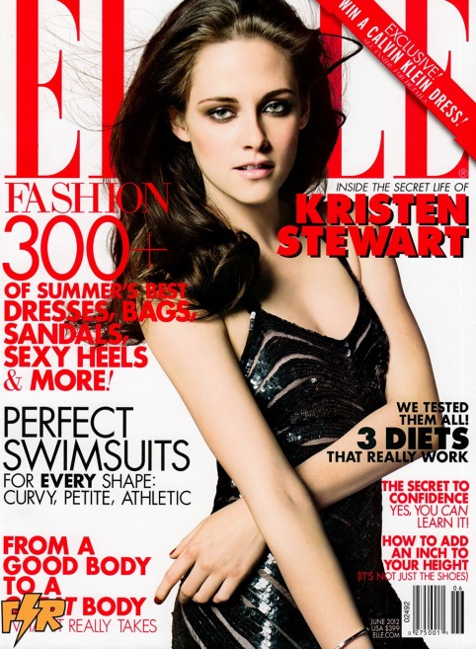
The subscription business model
A business model where a customer must pay a subscription price to have access to the product/service. The model was pioneered by magazines and newspapers, but is now used by many businesses and websites.
Rather than selling products individually, a subscription sells periodic (monthly or yearly or seasonal) use or access to a product or service, or, in the case of such non-profit organizations as opera companies or symphony orchestras, it sells tickets to the entire run of five to fifteen scheduled performances for an entire season. Thus, a one-time sale of a product can become a recurring sale and can build brand loyalty. It is used for anything where a user is tracked in both a subscribed and unsubscribed status.
Membership fees to some types of organizations, such as trade unions, are also known as subscriptions.

Slide 3
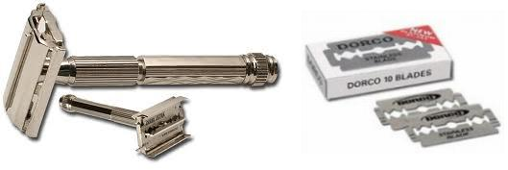
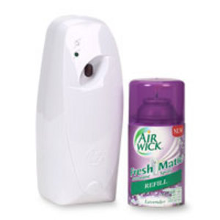

Razor and Blades
A business model wherein one item is sold at a low price (or given away for free) in order to increase sales of a complementary good, such as supplies (inkjet printers and ink cartridges, "Swiffers" and cleaning fluid, mobile phones and service contracts) or game consoles (accessories and software). It is distinct from loss leader marketing and free sample marketing, which do not depend on complementarity of products or services.
Though the concept and its proverbial example "Give 'em the razor; sell 'em the blades" are widely credited to King Camp Gillette, the inventor of the disposable safety razor and founder of Gillette Safety Razor Company.

Slide 4
Low cost carrier
Refers to an airline that generally has lower fares and fewer comforts. To make up for revenue lost in decreased ticket prices, the airline may charge for extras like food, priority boarding, seat allocating, and baggage etc.
Read more: http://en.wikipedia.org/wiki/Low-cost_carrier
Variant: Discount store

Slide 5
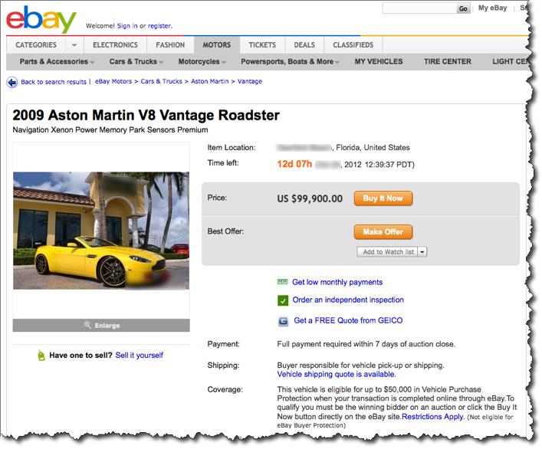
Online Auction business model
An online auction is an auction which is held over the internet.

Slide 6
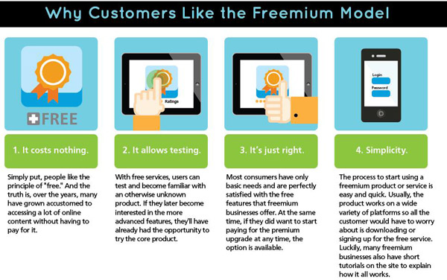
Freemium
A business model by which a proprietary product or service (typically a digital offering such as software, media, games or web services) is provided free of charge, but money (premium) is charged for advanced features, functionality, or virtual goods.

Slide 7
Bricks and Clicks
A bricks and clicks business model (or sometimes called clicks and bricks) is one where a company conducts business both offline and online. Offline refers to doing business in person, such as having store locations or buildings; so this is where the “bricks” part of the title comes from. The word “clicks” relates to the clicking of a computer for online purchases and transactions.

Slide 8
Groupon
Groupon (a portmanteau derived from "group coupon") is a deal-of-the-day website that features discounted gift certificates usable at local or national companies.
The company offers one "Groupon" per day in each of the markets it serves. The Groupon works as an assurance contract using ThePoint's platform: if a certain number of people sign up for the offer, then the deal becomes available to all; if the predetermined minimum is not met, no one gets the deal that day.
Variant : Ensogo in Thailand – buying deal at a discount price

