Slide 1
Human and social development
EE463 Globalization and international development
Faculty of economics
Thammasat university

Slide 2
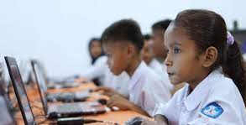
The importance of health and education
Health and education are basic objectives of development; both are fundamental to the broader notion of expanded human capabilities and both comprise human capital

Slide 3
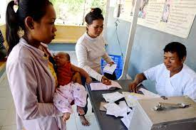
The importance of health and education
Health is a prerequisite for increases in productivity. Greater health capital improves returns to investment in education and lowers the rate of depreciation of educational capital
Greater education capital may improve returns to investment in health for example basic health skills learned at school, sanitation and hygiene and education of health personnel

Slide 4

The importance of health and education
“The impressive rise in earnings of workers in advanced industrialized countries was due to the growth in human capital; a limiting factor in the advance of poor countries was insufficient investment in people”
Major categories of human investments:
Formal education (primary, secondary, tertiary)
Health services
On–the job training
Government and sponsored training programs

Slide 5
Education ‒ definitions
Gross enrollment rate: total number of children enrolled in a given school category divided by the number of children of that age group
Net enrollment rate: total number of children enrolled relevant to the of the age group divided by the number of children in that age group
Grade survival rate: estimate of how many children actually complete a certain grade level
Example GER: for primary school there are 1 million children enrolled. However there are 1.2 million children aged 6-12 years old. GER=1/1.2= 83.3%
If there are many children enrolled that are older than 12 years, GER can be more than 100%

Slide 6

Education ‒ definitions
Educational attainment: the highest degree of education by a single individual
Stocks: amount of schooling embodied in a population
Flows: the net change in stocks as a result of school enrollment patterns

Slide 7
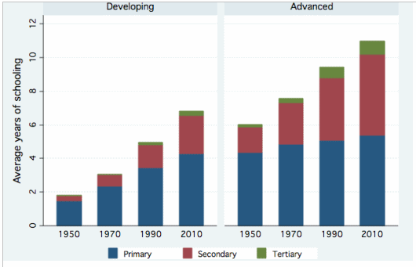
Education: Trends and patterns
In general more people worldwide are getting more education.
Educational attainment worldwide is uneven; gross enrollment rate in tertiary education:
Advanced countries: 67%
Middle income countries: 25%
Low income countries: 7.5%

Slide 8
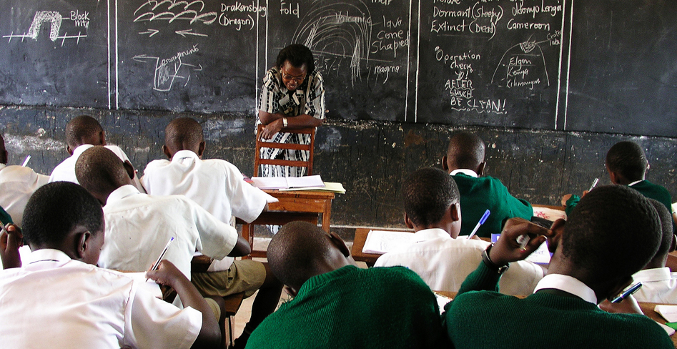
Education: Trends and patterns
Some comparisons:
In the US, only 6% of adults (25 years and older) did not complete primary school
In Brazil: 25% of adults did not complete primary school
In Bihar and Uttar Pradesh (India) with a population of 250 million, 50% of adults did not complete primary school

Slide 9
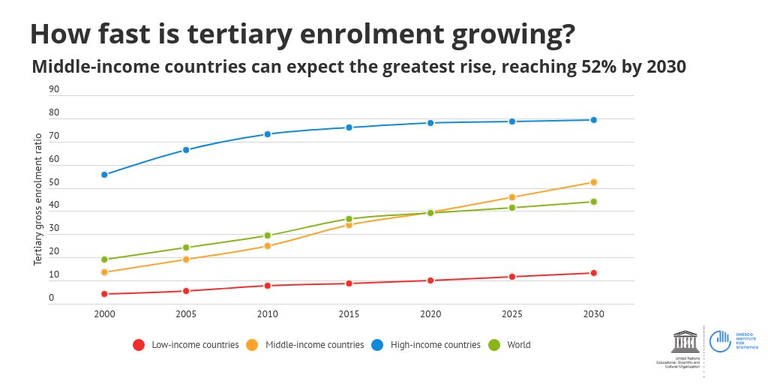
Education: Trends and patterns
The situation is changing, however:
For primary education, gross enrollment rate has been high in East Asia, Central Asia and Latin America
Middle income countries can expect a great rise in tertiary education, reaching 52% by 2030
However, close to 70 million children worldwide are not in school.

Slide 10
Education: Trends and patterns
Changes in Schooling, Gross Enrollment Rates by Region, 1975-2005
 | Primary |  | Secondary |  | Tertiary
Region | 1975 | 2005 | 1975 | 2005 | 1975 | 2005
Asia and Pacific | 113 | 111 | 37 | 73 | 2.5 | 20
Europe and Central Asia | 97 | 97 | 85 | 88 | 33 | 55
Latin America and Carribean | 109 | 118 | 38 | 90 | 13 | 30
Middle East and North Africa | 82 | 106 | 31 | 76 | 11 | 26
South Asia | 77 | 110 | 27 | 50 | 4.5 | 10
Sub-Saharan Africa | 59 | 92 | 11 | 32 | 1.2 | 5.3
High Income Economies | 98 | 100 | 79 | 98 | 34 | 62
Source: UNESCO Institute of Statistics 2006

Slide 11
Gender in education
Favoring education of boys over girls is a long-standing and pervasive practice throughout much of the world; however this practice is changing
The gender gap has decreased over time; in 1960, the average schooling for males in developing countries was 3.1 years and for females, 2.0 years. In 2010, the figures were 7.6 years for males and 6.5 years for females.
There are still some gender disparities in South Asia, the Middle East and Sub-Saharan Africa, but the gender gap is narrowing.

Slide 12
Challenges
Achieving primary education remains an important goal
Expanding secondary and tertiary education
Governments need to decide on whether to allocate resources to achieving universal primary education or expanding either secondary or tertiary educational opportunities

Slide 13
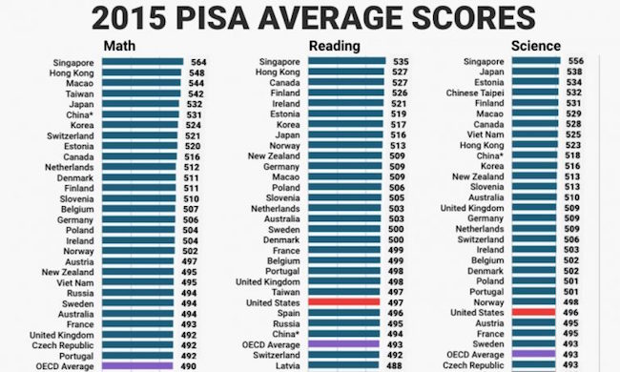
Schooling vs. education
Schooling is a means to an end. The ultimate goal is education – skills acquired from time spent studying and learning
One method of how is learning measured is through PISA (Programme for International Student Assessment)
Industrialized countries have advantages over lower income countries to educational investments; however this is changing

Slide 14
Education as investment
Rate of return of schooling
Individuals who complete secondary school will likely earn more than those who complete primary school. But how much more?
As primary school graduates (aged 11 years) will begin to work, the individual attending secondary school will incur direct cost (tuition, transport) and indirect costs (foregone earnings). These combined costs constitute opportunity cost for attending secondary school.
However upon graduating, the individual receives higher earnings, which yield benefits
In deciding whether to pursue secondary education the benefits should exceed costs

Slide 15
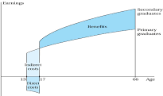
Earnings
Secondary graduates
Benefits
Primary graduates
Indirect costs
16
66
Age
Direct costs

Slide 16
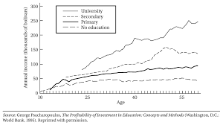
Age earning profiles by level of education
People with higher levels of education tend to earn more at the same age level

Slide 17
summary
During the past three decades, significant changes in terms of educational attainment has been achieved worldwide, particularly in primary education
The investments in education have resulted in improvements in human capital and improving the well-being of millions of people
Challenges remain; more than 4 out of 5 children live in low and middle income countries without proper education and learn very little
Investments in education yield good returns; however the investment is long term, while the poor have more, immediate needs

