Slide 1
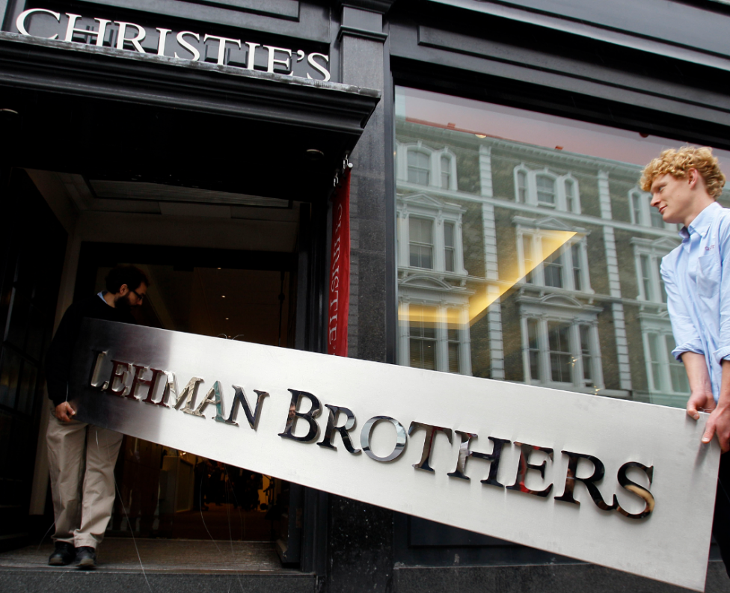
The Fall of Lehman Brothers
Group 5

Slide 3
Overview
Causes
The Fall of Lehman Brothers
Suggestions
and Solutions
Impacts

Slide 4


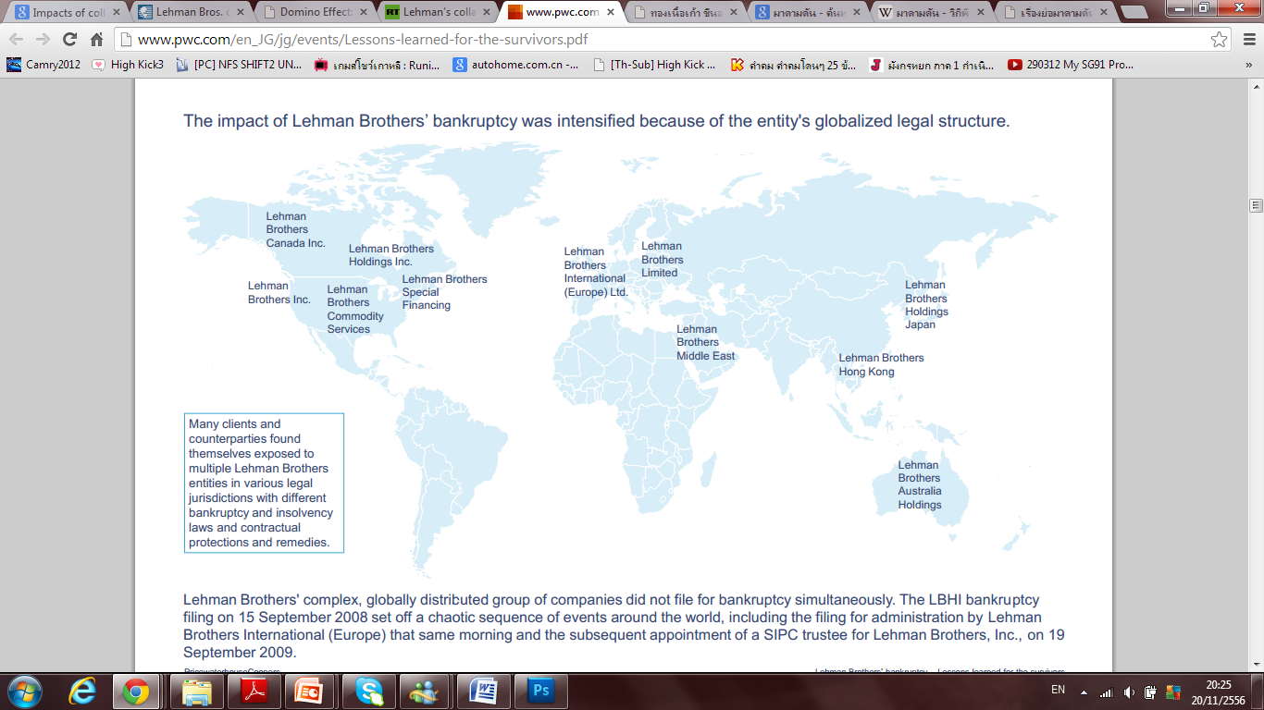
Introduction
WHAT IS LEHMAN BROTHERS ?
Lehman was a global financial services firm serving corporations, local federal and state governments, institutions, and high net worth customers. Its focus was largely in equities and fixed income products, trading and research, investment banking and asset management

Slide 5
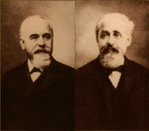
Introduction
WHAT IS LEHMAN BROTHERS ?
Worldwide financial services firm that specialized in investment and financial services
Founded in 1850 by Henry Lehman, Emmanuel Lehman and Mayer Lehman
Lehman had faces with challenges over the years and survived them all such as the railroad bankruptcies of the 1800s, the Great Depression of the 1930s, and the Long Term Capital Management collapse and Russian debt default of 1998.

Slide 6
Introduction
However, the collapse of the U.S. housing market ultimately brought Lehman Brothers to its knees, as its headlong rush into the subprime mortgage market proved to be a disastrous step.
The company was one of the many financial firms that were forced to file bankruptcy during the financial crisis of 2008. At that time, Lehman's Chapter 11 bankruptcy filing was one of the largest in the history of the United States.
WHAT IS LEHMAN BROTHERS ?

Slide 7
Introduction
TIMELINE
September,15 2008
“Bankruptcy”
Founded in 1850
By Henry Lehman Emanuel Lehman
1969-1984 Evolving Partnership
1984-1994 Merger with American Express
1994-2008 Divestment and Independence

Slide 8
The Fall of Lehman Brothers
POOR ASSETS AND RISK MANAGEMENT
FRAUD
(REPO 105)
MANAGERIAL PROBLEMS
BAD REGULATION

Slide 9
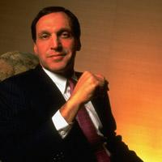
The Fall of Lehman Brothers
Richard J. Fuld
Chairman of Lehman Brothers at that time
Fuld like to take big risks and reaping large rewards
His motto was "never surrender"
He rarely listen or accepted counsel from senior managers
Solo management style
Miscalculated and make his company fail
Notes:
มีคนเคยเตือนว่าอย่าไปเล่นลิกกี้แอสเสร็จไม่ฟัง
ถ้าเตรียมการไว้ก่อนหน้านี้ซัก 1 เดือนว่าจะเจ๋งก็อาจจะไม่เจ๋ง

Slide 10
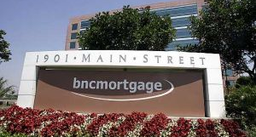

The Fall of Lehman Brothers
2001 : FED reduce interest rate to 1% to recover from economic recession, i.e. from 911
2004 : U.S experience booming in real estate. Lehman Brothers took over BNC mortgage and Aurora Loan Service to join issuing subprime loan.
Since the regulation is not highly regulated, about 70,000 mortgage banks and broker aggressively issue subprime loan also because that the trend of house prices are rising in the past years.
Notes:
(as the low rate of interest, by doing these investment banking and financial companies are willing to generate higher profit. Since the regulation is not highly regulated, about 70,000 mortgage banks and broker aggressively issue subprime loan also because that the trend of house prices are rising in the past years.)

Slide 11
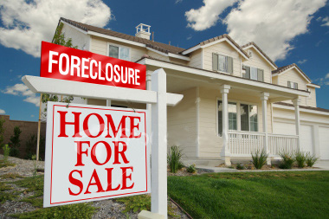
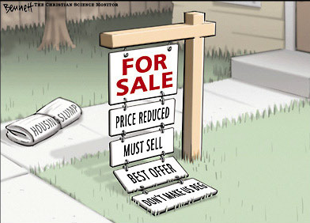
The Fall of Lehman Brothers
2005 : Lehman began to enter this business in early in 2005 ignoring warnings that the U.S. housing market had become dangerously overheated and mortgage brokers were handing out money to individuals who could never pay.

Slide 12
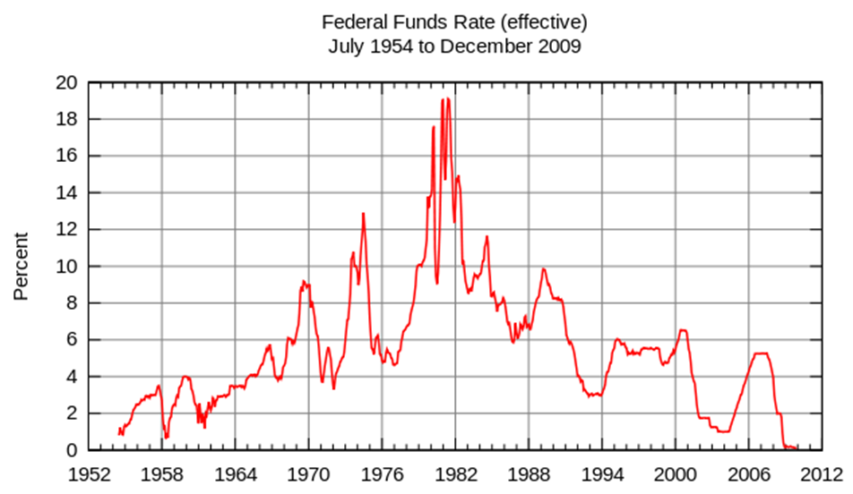
The Fall of Lehman Brothers
2006: Starting in 2006 that FED try to increase the interest rate to be 5.25%.

Slide 13
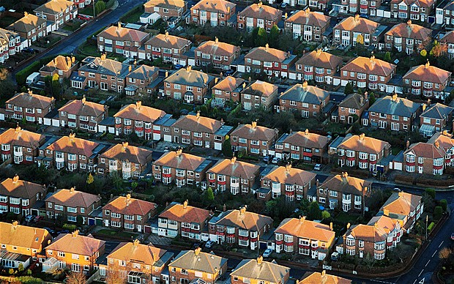
The Fall of Lehman Brothers
2006: House price starting to fall
- Interest rate increases cost of funding increases Liquidity drops
House price drop (Since house price based on floating rate(ARMs)
Loan to Value increases residential mortgage tend to have default
risk non-repayment increase NPL increases
Notes:
Lehman began to enter this business in earnest in 2005 ignoring warnings that the U.S. housing market had become dangerously overheated and mortgage brokers were handing out money to individuals who could never pay.

Slide 14
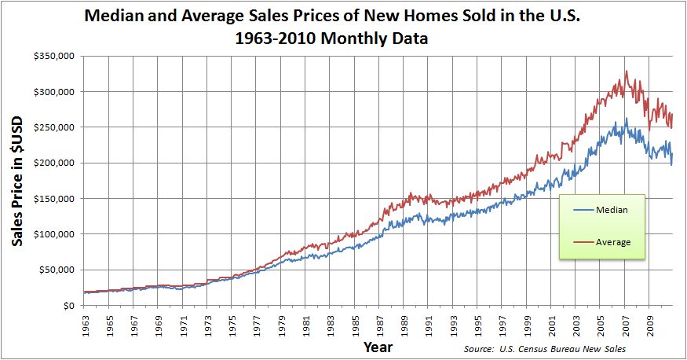
The Fall of Lehman Brothers
U.S Value Housing (1963 - 2009)

Slide 15
The Fall of Lehman Brothers
There was a high demand for Mortgage Backed Securities (MBS) and Collateralized Debt Obligations (CDO) which began to worsen lending standards . And the demand for CDS trading also increase.
MBS are a pool of loans packaged into a set of securities and sold to the general public in the securities market.
However, MBS are were not safe and secure, therefore as the loans defaulted
Lehman Brothers was required to cover the debt based on its assets which was difficult due to the high levels of leverage for purchasing these securities.
Notes:
the firm selling the MBS was required to cover the debt based on its assets which was difficult due to the high levels of leverage used to purchase these securities.

Slide 16
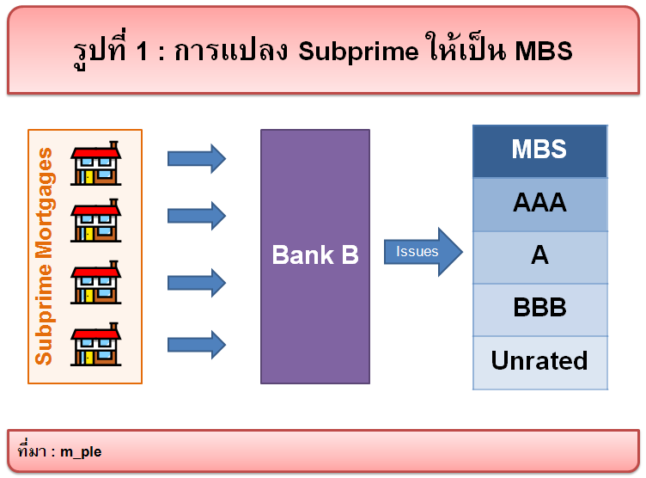
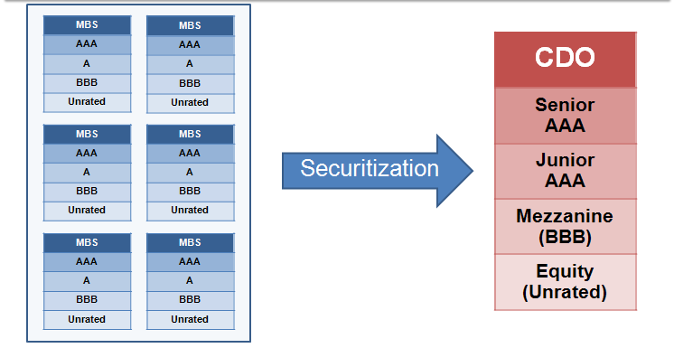
The Fall of Lehman Brothers
SUBPRIME LOAN TO MBS
MBS TO CDOs
Notes:
the firm selling the MBS was required to cover the debt based on its assets which was difficult due to the high levels of leverage used to purchase these securities.

Slide 17
The Fall of Lehman Brothers
June2008 : Lehman announced its 2nd quarter losses about 2.8 billions which are harshly than expected( Low Capital Adequacy Ratio : risky asset > reserved capital)
Sep10 2008 : Lehman announced its 3nd quarter losses about 3.9 billions
Sep12 2008 : Large withdrawal by clients ,and running out of cash
Notes:
Lehman started to exit the business in August 2007 right after the collapse of two hedge funds sponsored by Bear Stearns that were invested in complex derivatives backed by home mortgages.

Slide 18
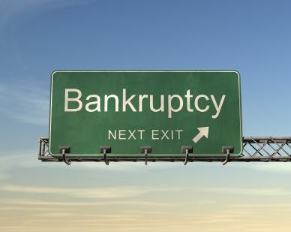
The Fall of Lehman Brothers
Sep12 2008 : In evening, FED ask CEO of the 4 large investment banking for the meeting. Secretary of the Treasury Henry Paulson said that “there will be no public bailout”
Sep13 2008 : The meeting was reassemble and still have no one to bailout Lehman
Sep15 2008 : Lehman Brothers filled of chapter11 bankruptcy
Notes:
Lehman started to exit the business in August 2007 right after the collapse of two hedge funds sponsored by Bear Stearns that were invested in complex derivatives backed by home mortgages.

Slide 19
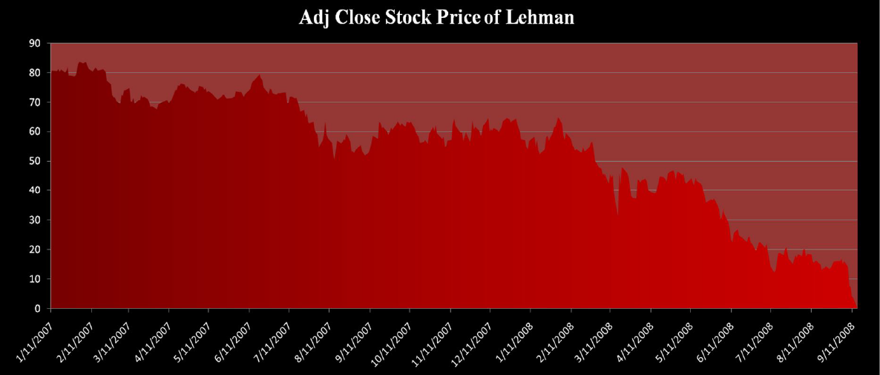
The Fall of Lehman Brothers
Lehman Brothers stock prices

Slide 20
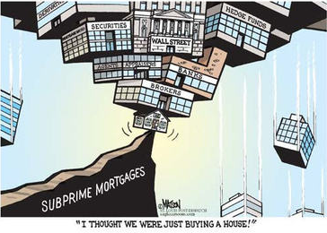
Subprime Crisis
A subprime mortgage is a type of loan granted to individuals with poor credit histories who as a result of their deficient credit ratings.
There are several different kinds of subprime mortgage structures available. The most common is the adjustable rate mortgage (ARM).

Slide 21
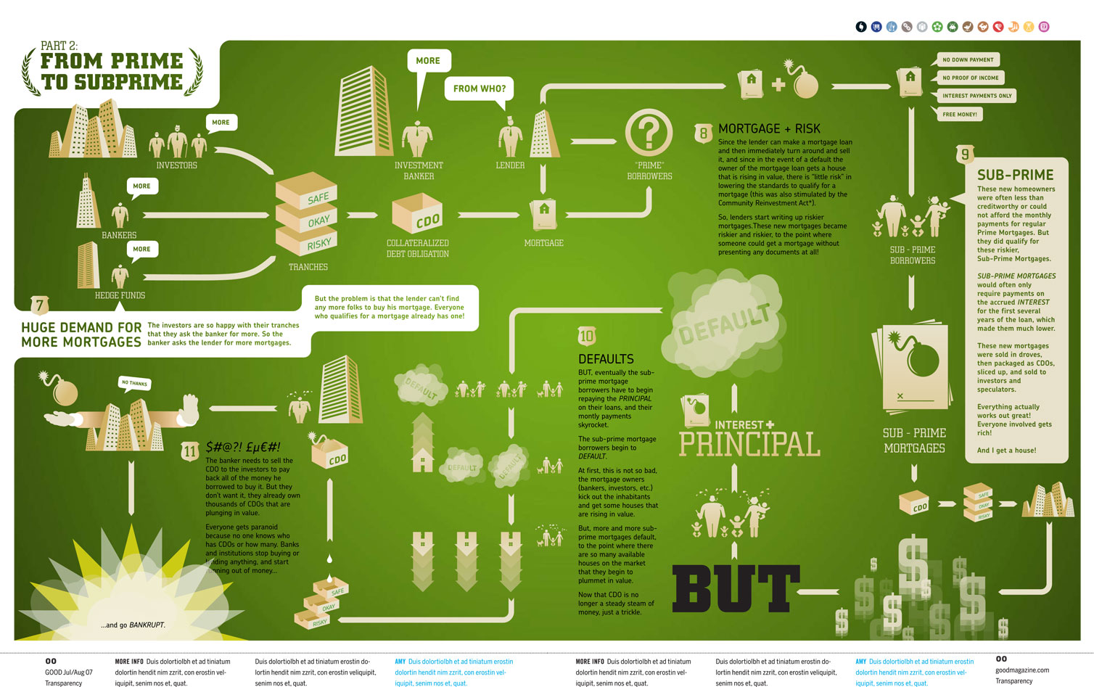
The Fall of Lehman Brothers

Slide 22
The Fall of Lehman Brothers
REPO 105
REPO
Accounting maneuver where one company transfers an asset to another company in exchange of short-term cash, borrower will pay back the cash and take back the asset at a specific date, usually within a week

Slide 23
The Fall of Lehman Brothers
REPO 105
  L.B. used repo 105 to get bad assets off books appearing to reduce its leverage and creating a misleading of its financial health.
  In fact instead of categorizing these transactions as a loan they described them publicly as a sale never disclosing that they had to pay back the cash that they borrowed for those assets.
That’s illegal !

Slide 24
The Fall of Lehman Brothers
REPO 105
  L.B. used repo 105 three times to improve its balance sheet during
  the issue of the quarterly reports:
      Q4 of 2007 $39 billions
      Q1 of 2008 $49 billions
      Q2 of 2008 $50 billions
  The effect was that LB had $50 billions more in cash on its book and
  $50 billions less in dangerous mortgage assets.

Slide 25
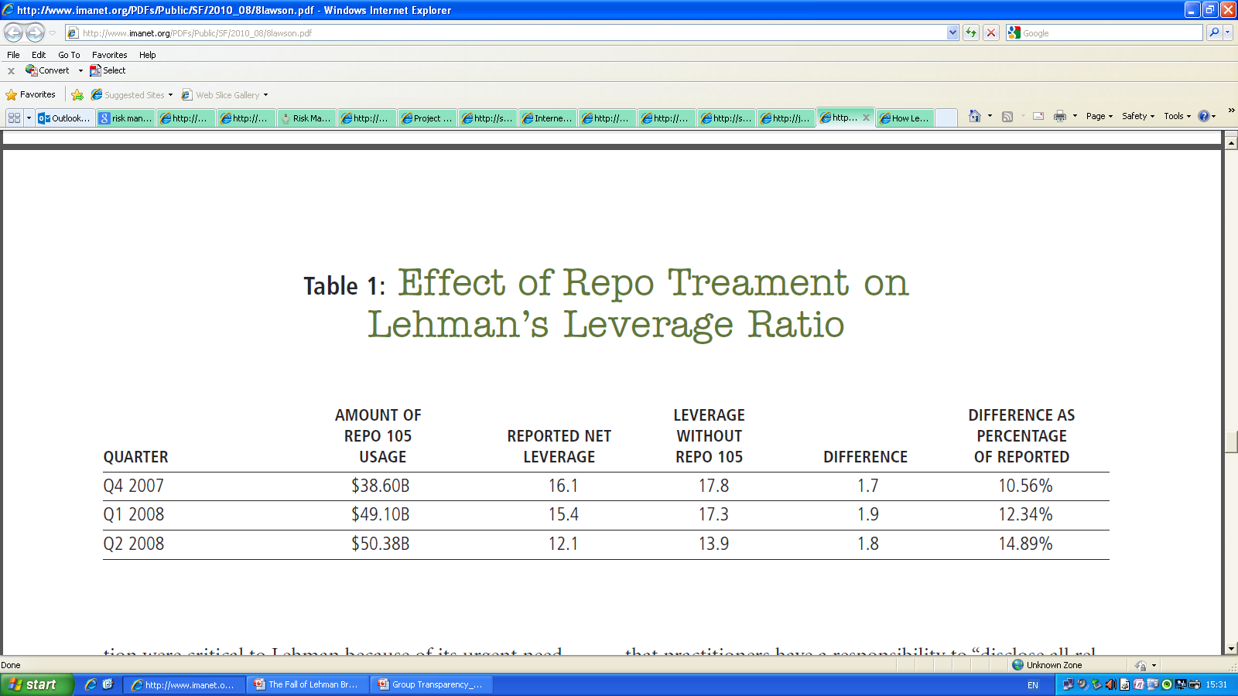
The Fall of Lehman Brothers
REPO 105

Slide 26

Conclusion : The Fall of Lehman Brothers
Subprime loan
  Liquidity Problems
Repo 105 ( manipulate balance sheet)
  Balance Sheet warnings from the sell securities for short term liquidity.
  Lehman used repo method to get bad assets off books.
Poor risk and credit management (CDO)
Managerial problem
  Richard Fuld , chairman, with the Solo management style
Notes:
A typical Repo 105 would begin with Lehman’s European unit transferring $105 million or $108
million worth of securities to a counterparty in exchange for $100 million in cash. Lehman would
then use the money to pay down other short-term liabilities, so that it could report quarterly
leverage numbers low enough to satisfy the ratings agencies, and thus investors. A few days after
the quarter ended, Lehman would repay the cash, plus interest, and get its collateral back.
Lehman was meant to go bankrupt considering its excessive leverage, huge losses, liquidity drain, and low level of market confidence, speculative investments, and the accounting gimmicks under Repo 105. สาเหตุหนึ่งที่ท�าให้
Lehman Brothers พยายามน�าหนี้สินไปไว้นอกงบดุลเป็น
เพราะบริษัทมี Financial Leverage Ratio ในระดับสูงมาก
จนกระทั่งอาจถูกลดอันดับความน่าเชื่อถือซึ่งจะส่งผลให้ราคา
ซื้อขายหุ้นของบริษัทในตลาดหลักทรัพย์ลดลง

Slide 27
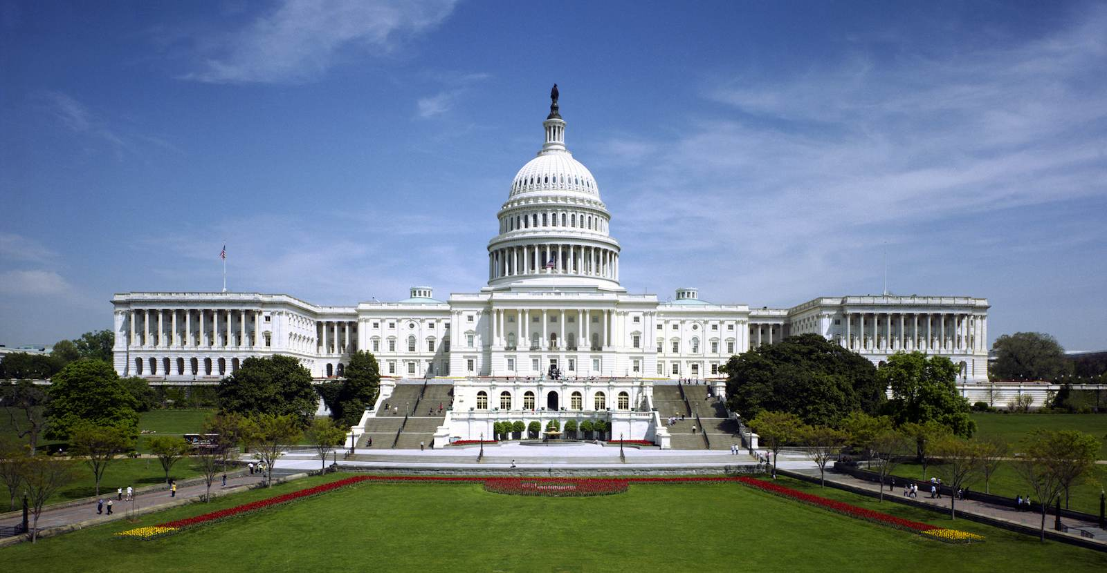
Why did the US government let it fail ?
Fed don’t bailout Lehman Brothers because…..
  Fed would like to reduce Moral Hazard problems and
  restored market discipline
  Lehman did not have the adequate collateral that Fed
  requires to provide a guarantee. Thus, Fed wouldn’t use
  the taxpayer money to prevent a Lehman collapse.
Notes:
ในกรณี Lehman Brothers ธนาคารกลางสหรัฐกลับไม่ได้ให้ความช่วยเหลือ แต่พยายามให้ภาคเอกชนเป็นผู้รับผิดชอบความเสียหายที่ตัวเองก่อขึ้น ซึ่งแสดงให้เห็นว่าธนาคารกลางสหรัฐพยายามจะลดผลของ Moral hazard ที่เกิดจากผลที่ภาครัฐเข้าอุ้มภาคเอกชนทุกครั้งที่เกิดความเสียหาย จนทำให้ภาคเอกชนขาดความรอบคอบในการดำเนินกิจการ เนื่องจากมั่นใจว่าภาครัฐจะเข้ามาช่วยเหลือหากเกิดปัญหาขึ้น
Due to the Moral Hazard Problems, FED are not willing to bail out each single investment banking , unless the impacts of the collapse are significantly enough.

Slide 28
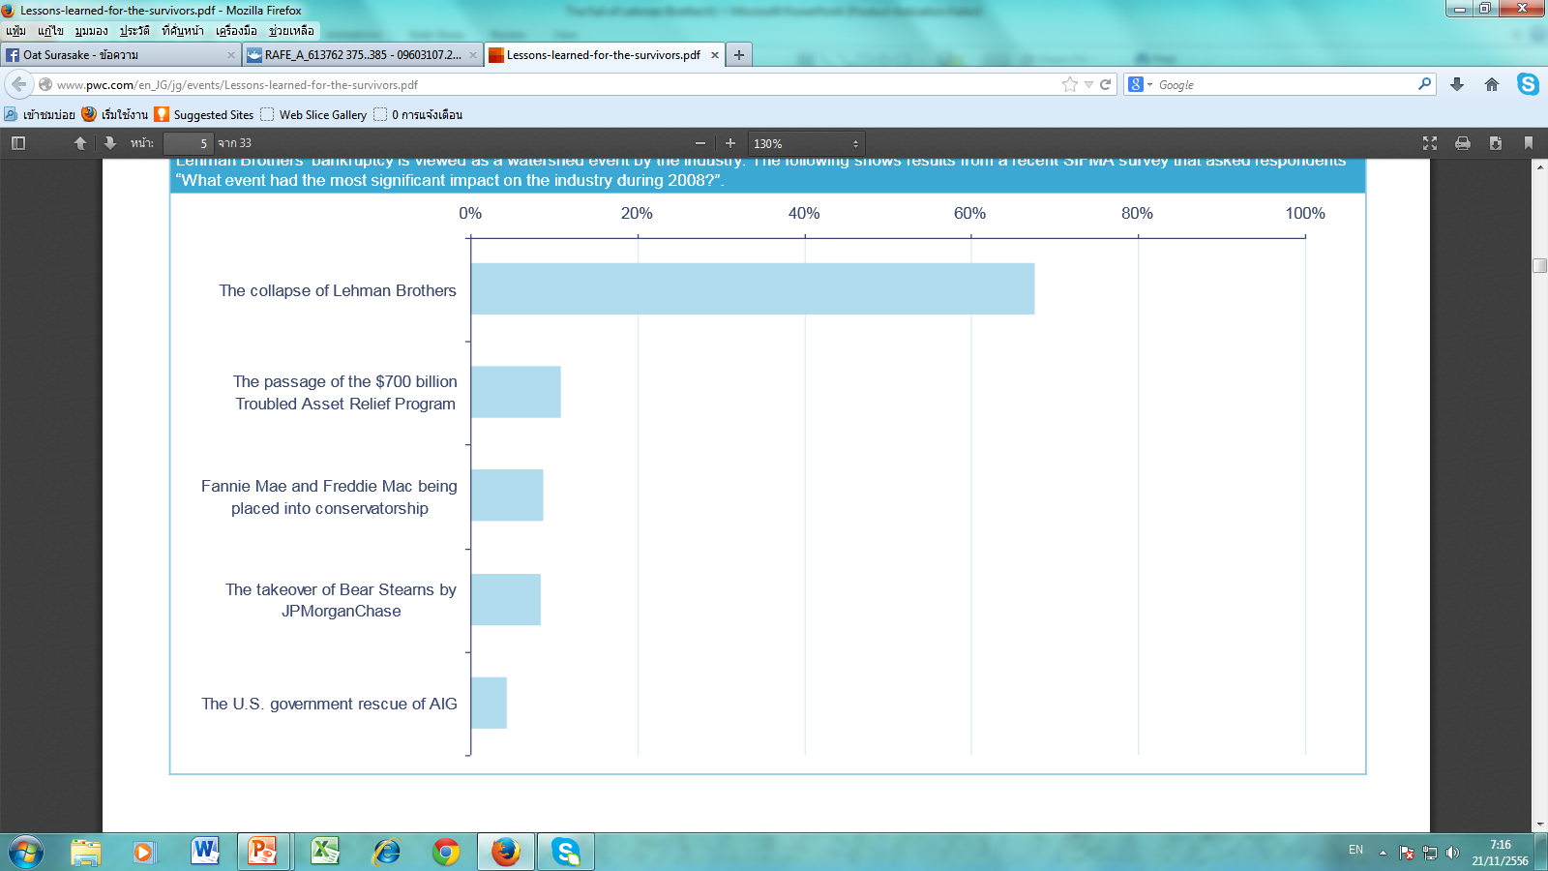
Impacts From the Collapse
What event had the most impact on the industry during 2008?
Many people have lost their faith in the bank.

Slide 29
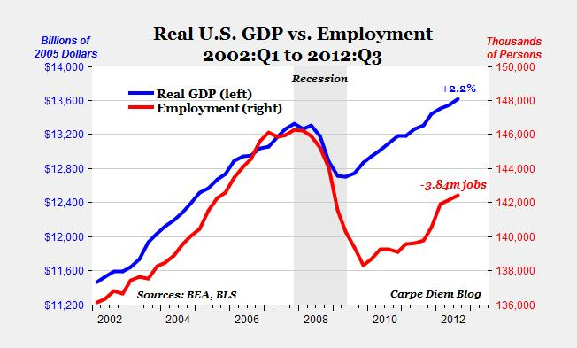
Impacts From the Collapse
The Effects on U.S economy

Slide 30
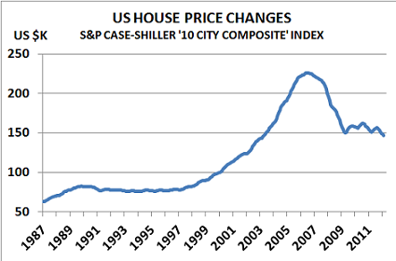
Impacts From the Collapse
The Effects on U.S economy

Slide 31
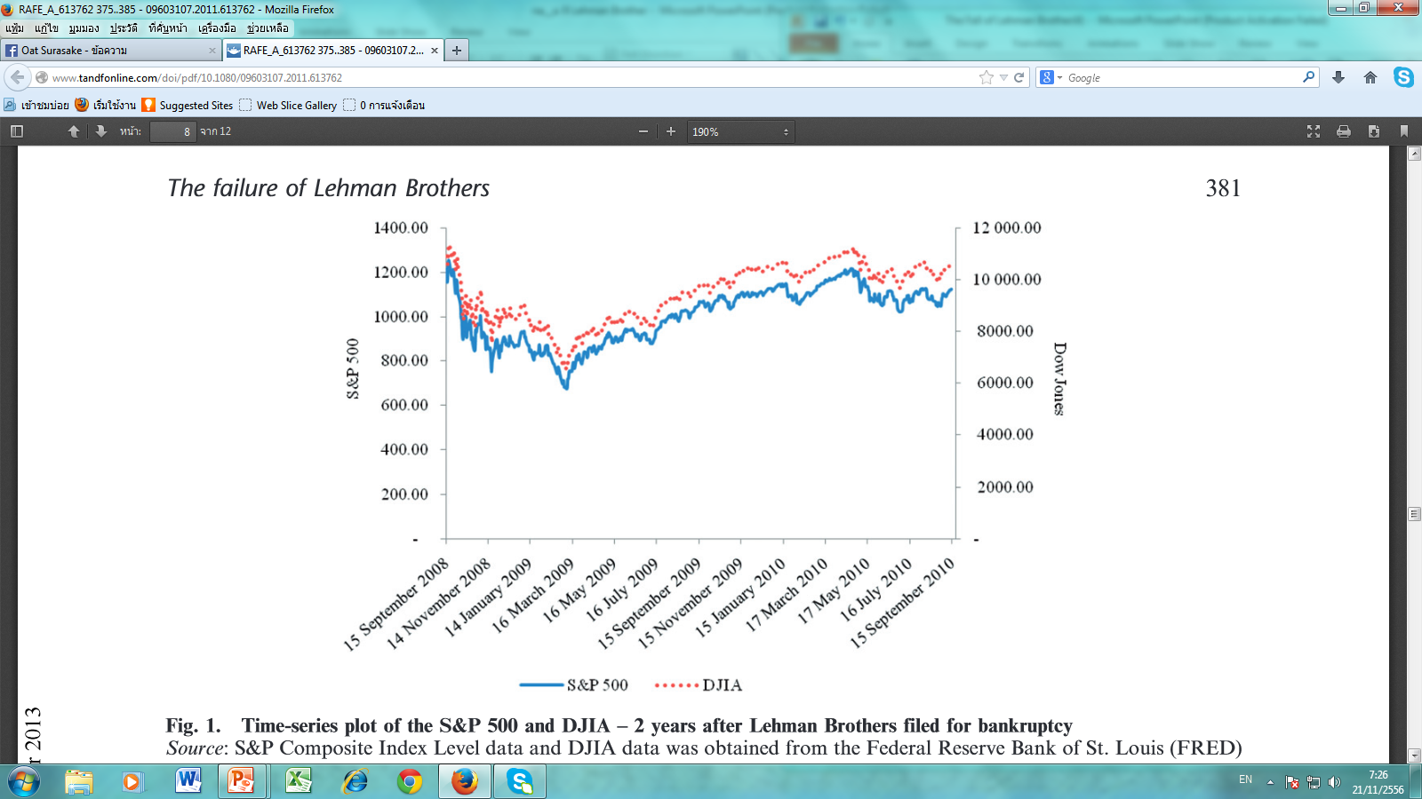
Impacts From the Collapse
The Effects on stock market

Slide 32
Impacts From the Collapse
The Impacts on the world

Slide 33
Impacts From the Collapse
The Fall of Lehman Brother also affect other banking
industries such as …
  Corporate issuers
  Insurance companies
  Money market funds
  Debt issuers
  Hedge funds
  Mortgage banks
Nowadays most of the investment banking have to bundle them
self with the bank.
Notes:
อินเวอสเม้นปิดไปหลายที่
การลงทุนฃะลอตัวลง
อินเวสเม้นแบ้งที่อื่นได้กำไล

Slide 34
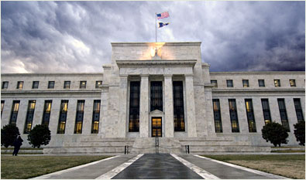
Suggestions and Solutions
FEDERAL RESERVE
  Fed should not let investment banking to have so
  much risky loan.
  Fed should improve more monitoring and
  screening of the investment banking.

Slide 35

Suggestions and Solutions
Transparency
  REPO 105
  Lehman Brothers should not lie to the public
  Lehman Brothers should present their real
  document to let the public know their real
  situation.(knowing real financial capability)

Slide 36
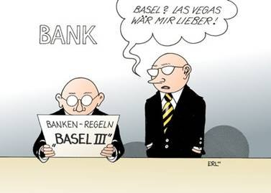
Suggestions and Solutions
Regulation by Basel III
  Require banks to hold more equity and liquid
  assets in order to leverage themselves less.
  Rely less on short term funding.

Slide 37
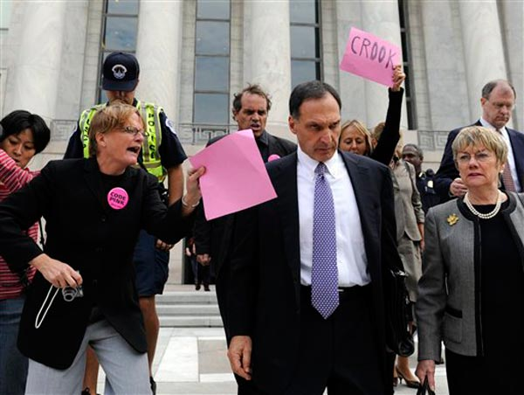
Suggestions and Solutions
Business leader should seek and listen more
expert advice
  Richard Fuld ,chairman of Lehman Brothers ,rejects
  the advice and continued down the path of self
  destruction.
  Then, Lehman brothers had fallen.

Slide 38
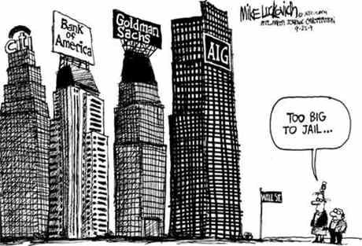
Suggestions and Solutions
Too big to fail
  The owner of largest banks believed that federal reserve
  will not let them fail.
  Then, Lehman brothers take more risk than desirable.
Don’t think that you cannot FAIL

Slide 39
Too Big To Fail
Notes:
IS NOT TO ANYMORE. The owner of largest banks believed that federal reserve will not let them fail. But Lehman brothers collapse already. No one want to bail out.

Slide 40
THANK YOU

