Slide 1
Product Life Cycle

Slide 2

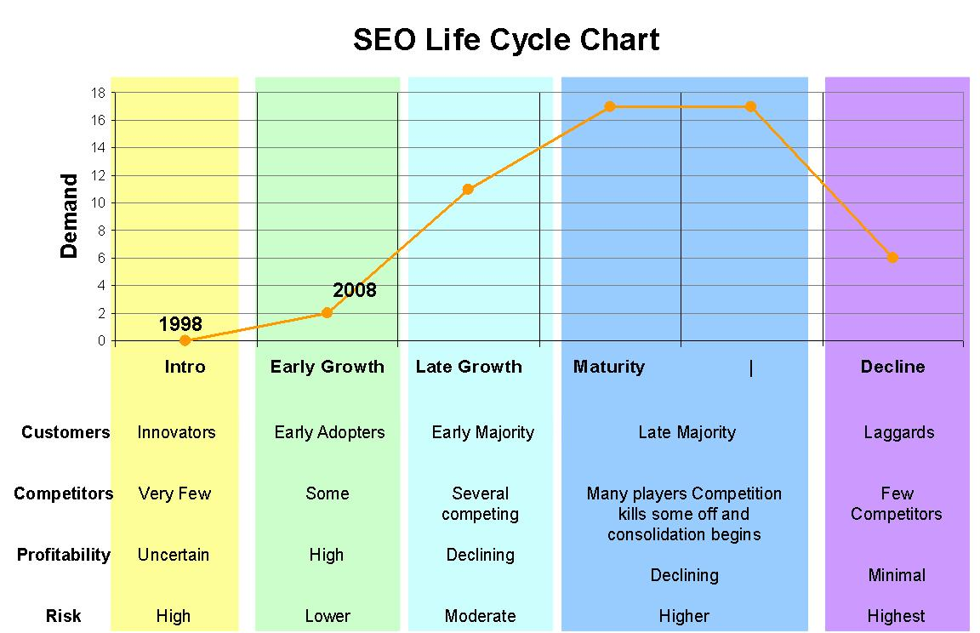
Product Life Cycle
A marketing theory in which products or brands follow a sequence of stages including : introduction, growth, maturity, and sales decline

Slide 3
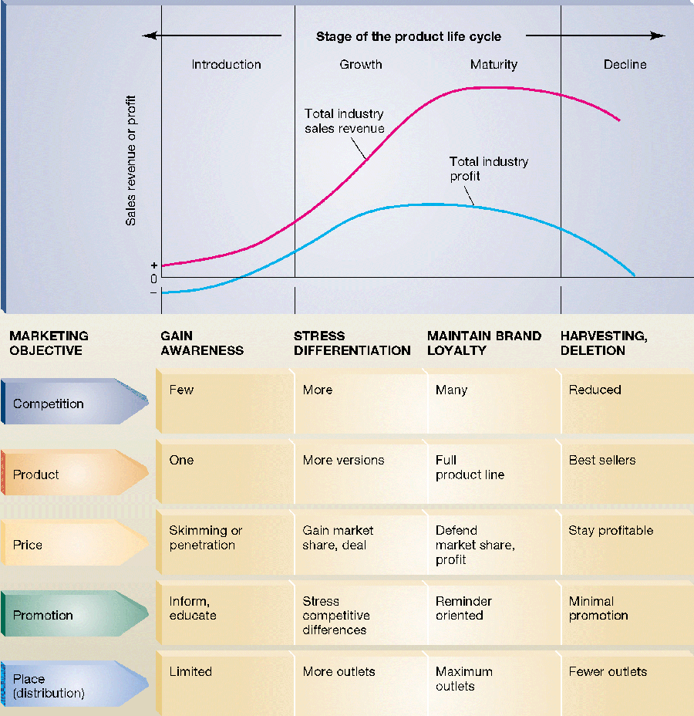
Product Life Cycle

Slide 4
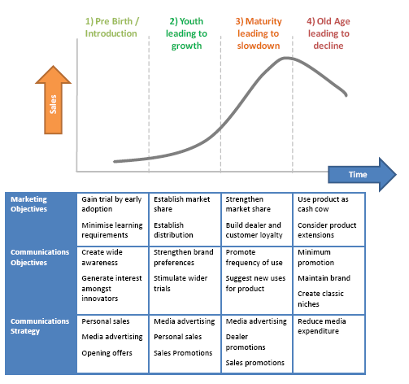
Product Life Cycle

Slide 5
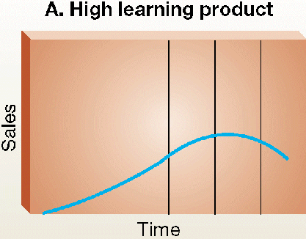
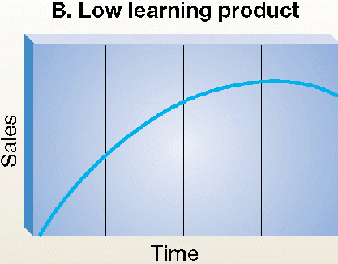
Shape of the Product Life Cycle
Significant education of the customer is required.
Extended introductory period
Sales begin immediately
Little learning is required by the consumer
Benefits of purchase are readily understood

Slide 6
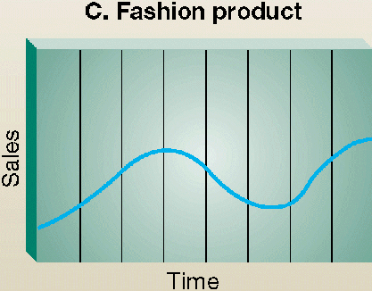
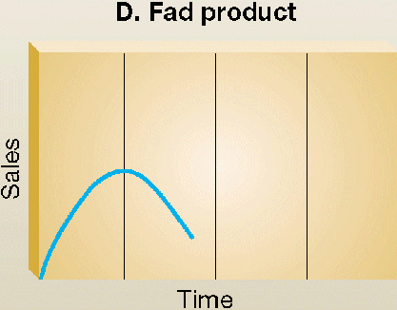
Shape of the Product Life Cycle
Most often appear in women’s and men’s clothing styles.
Length of the cycles may be years or decades
Rapid sales on introduction
Equally rapid decline.
Often novelties and have a short life cycle.

Slide 7
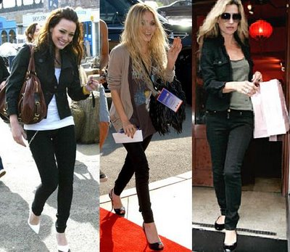



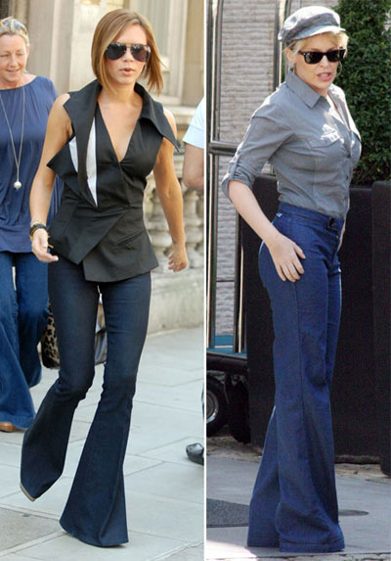

Slide 8




Slide 9
CHOOSING AMONG MAJOR MEDIA TYPES
Target audience
Product
Message
Cost
Notes:
http://www.managementparadise.com/forums/introduction-media-studies/204568-choosing-among-major-media-types.html
Target –audience media habits:
This is the most important factor. Housewives watch more of television, whereas, working women go for magazines. Again television programmes have different viewers. For instance,” world this week” is viewed by teenagers and young adults. Therefore, it would be advisable to advertise during” World this week” such products which are of interest to teenagers and young adults.
❖ Products:
Products that require demonstration can suit for television. Financial advertising such as new issue of shares is good in newspapers. Again there are media restrictions on certain products. For instance, alcoholic drinks cannot be advertised in press as well as on DD and AIR.
❖ Message:
The type of message dictates the type of media. For example, an ad that features technical information is best suited for specific magazines. Again, an ad from retailer announcing major sale on discount requires more of local newspapers.
❖ Cost Factor:
Television is very expensive, where as, radio is very economical. However, cost is not the only factor, even if it is calculated on the basis of cost per- person reached. The impact of the media is to be taken into account.
❖ Other factors:
There are several other factors such as media life, media flexibility, etc.

Slide 10
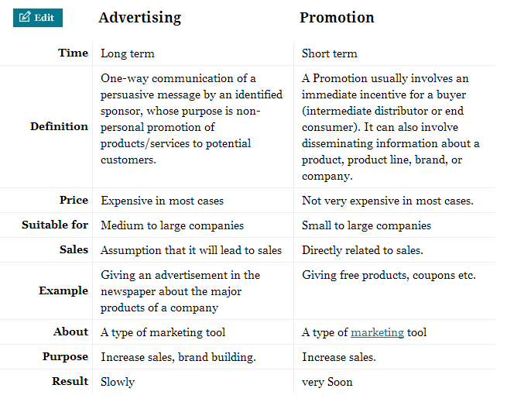
Advertising vs. Sales promotion

