Slide 1

Bancassurance Products
Definition & Case in Thailand
Chanipa Srisomboonkul 5204640121
Haritsadee Soponpana 5204640220
Kamonchanok Kulpunyalert 5204640337
Kanyanat Chavasirikultol 5204640378
Orawin Janewattananone 524640634
Wisarut Sirinimnualkul 5204641426

Slide 2

What is Bancassurance ?
“the provision of Life insurance services by banks and building societies” (LIMRA’s)
“the involvement of banks, savings, banks and building societies in the manufacturing, marketing or distribution of insurance products” (Alan Leach)
“Bancassurance is the provision of insurance and banking products and services through a common distribution channel and/or to the same client base.”
In simple term we can say Bancassurance tries to exploit synergies between both the insurance companies & banks.

Slide 3

Bancassurance in Thailand
In Thailand, ฺBanccassurance is legal, but it may be illegal in some countries. Bank of Thailand allows commercial banks to do more insurance related activities such as insurance consulting service, promoting insurance product, and acting as an insurance broker. In order to do this, commercial banks need to have license from Office of Insurance Commission (OIC) first, and need to comply with the rules and regulations from Office of Insurance Commission and Bank of Thailand.
In Thailand, the insurance products might be sold by both bank staffs and bank tellers, who are well trained about the product, or insurance salespersons, through the insurance firm’s booth in bank’s branch.

Slide 4
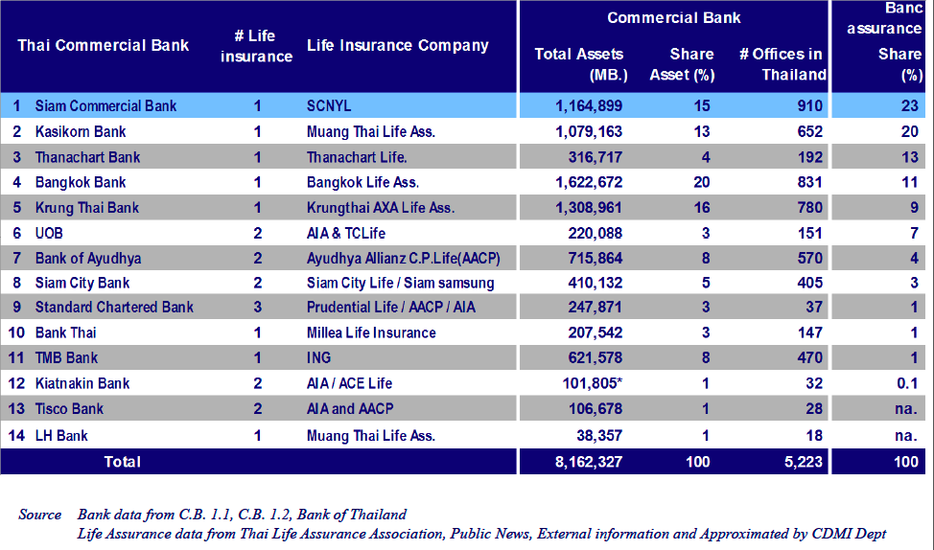
Thai Commercial Banks & Life Insurance Companies

Slide 5
Types of Bancassurance Products
1. Finance and repayment products
Credit Insurance
Overdraft Insurance
2. Depositor’s Products
Depositors’ insurance
Objective achievement insurance
Capital Repayment
Pure investment products
3. Other Products
-Whole life
-Endowment
-Unit-linked products
-Term insurance products
-Family income benefit -Waiver-of-premium benefit
-Permanent total disability benefit
-Income replacement benefit
-Accident and sickness products
-Hospitalization products
-Pension products

Slide 6

Example: Bancassurance Products Bangkok Bank (Bangkok Life Assurance)
Auto 1st 2Plus: Cost-effective vehicle insurance with wide range of benefits
Cancer Protection 1st: help to alleviate the costs of treatment and ensure that you and your beloved ones have the best chance to overcome the illness.
Smart 1st 550:financial stability in your retirement

Slide 7
Advantages of Bancassurance
Bank
Insurers
Expand customer base
Higher income stability.
More productive use of customer database and branch network.
Banks can cross sell insurance products.
Productivity of the employees increases.
Improved customer satisfaction resulting in higher customer retention levels.
More effective product design and marketing efforts.
Quick establishment of new markets
Lower distribution costs as compared to traditional distribution network.
Customers
Greater access to all financial services
Get cheaper insurance products than through traditional channels.
Premium payment methods are simplified
Tax exemption

