Slide 1
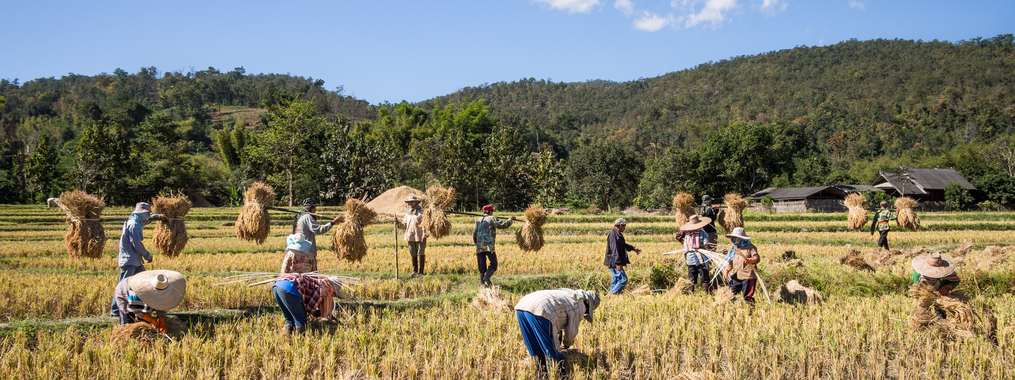
Agricultural Production
EE390
Chol Bunnag
Faculty of Economics
Thammasat University

Slide 2
Outline
General characteristics of agricultural production
Elements and characteristics of Thai agricultural production unit
Theories of production and its application on agricultural production

Slide 3


Questions
What are the main differences between agricultural and industrial production ?

Slide 4


General Characteristics of Agricultural Production
Agricultural production is significantly different from industrial production.
1. Long production period
Farmers need money for investment and consumption during the waiting period.
The longer the production, the higher the cost (increasing interest rate or opportunity cost of money).
Long-term expectation can be wrong so easily due to uncontrollable factors such as price, global market and government policies.
4-5 months
10-12 months
7 years

Slide 5




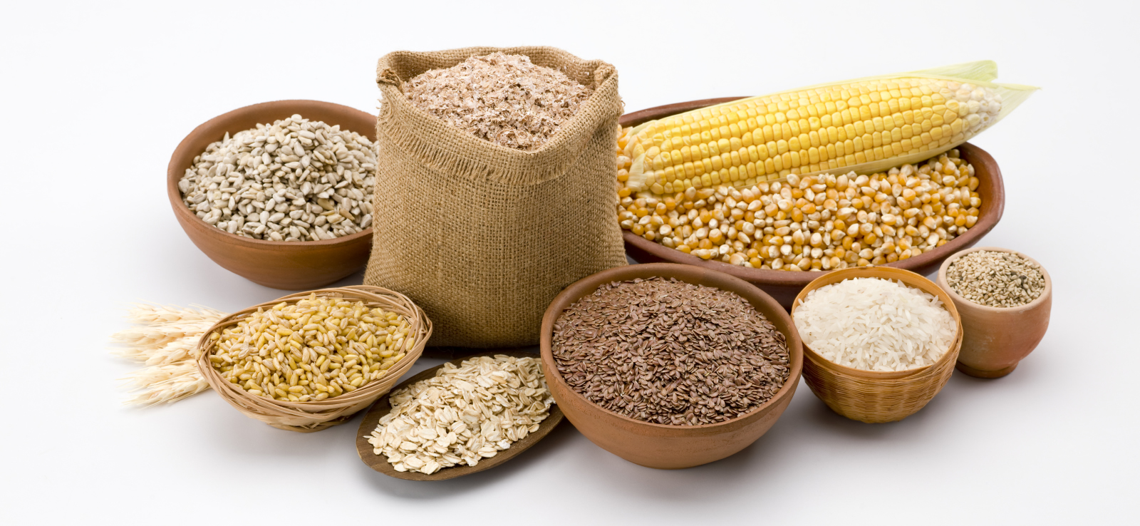
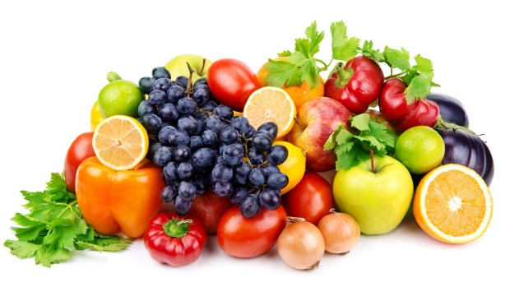
General Characteristics of Agricultural Production
Agricultural production is significantly different from industrial production.
2. Environmental and natural resources dependent
3. Seasonal dependent → Market and price problems
4. Perishability → Unable to store or high storage cost
5. Output and Price Fluctuation
- Weather fluctuation → Output fluctuation
- Output fluctuation → Price fluctuation
- Increasing demand from increasing population or industrial sectors

Slide 6




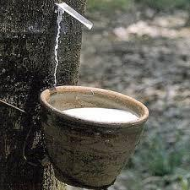
Elements and Characteristics of agricultural production units
Agricultural product
Objectives
Decision
Information
Bear the risk and cost of production
Factors of Production
Farm manager
Production Unit

Slide 7
Characteristics of Thai agricultural production units
Most of the production units are small.
  Using family labor, no division of labor but everyone contributes to every process.
  Household head is usually the farm manager.
Competitive Market
  Small production unit, small amount of output
  Price Taker
A unit may produce one or more agricultural products in one period of time. It may also produce non-agricultural product. This depends on …
  Physical, knowledge, and financial factors
  Risk preference
  Whether the secondary product affects labor allocation in the primary (agricultural) product.

Slide 8


Characteristics of Thai agricultural production units
Characteristics of rural settlement may indicate characteristics of its agricultural products.
What could be agricultural products of village A and B?
Village A
Village B

Slide 9
Theories of production and applications on agricultural production
Assumptions
The unit’s objective is profit maximization.
No risk in production process
Factors of Production
Production Units
Output
Natural Resources
Human Resources
Man-made/Manufactured Resources

Slide 10
Theories of production and applications on agricultural production
Input
Output
Input
Input
Output
Output
Input-Output relationship
Input-Input relationship
Output-Output relationship

Slide 11
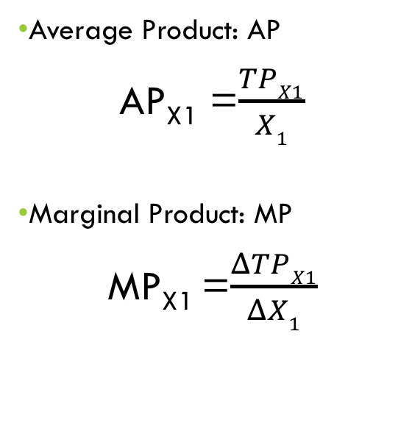
Economic Theory explaining Input-Output Relationship
Short-Run production: The production theory explains effect of change in one input on the output while other inputs are constant.
Input output relationship
  TP = f (X₁, X₂, …… X_{n}, U)
  TP = Total Product
  X₁….X_{n} = Inputs
  U = Random Inputs
  If X₁ is the only variable input and X₂ …. X_{n} are fixed inputs, assuming no risk
  TP = f (X₁ / X₂ …. X_{n})
  TP = f (X₁)
Average Product: AP
AP_{X1} =$\frac{TPX1}{X1}$
Marginal Product: MP
MP_{X1} =$\frac{ΔTPX1}{ΔX1}$

Slide 12
Input-Output Relationship
X₁ | TP_{X1} | AP_{X1} | MP_{X1} | MP_{X1}/AP_{X1}
0 | 0 | 0 | - | -
1 | 5 | 5 | 5 | 1.00
2 | 14 | 7 | 9 | 1.29
3 | 21 | 7 | 7 | 1.00
4 | 26 | 6.5 | 5 | 0.77
5 | 30 | 6 | 4 | 0.67
6 | 33 | 5.5 | 3 | 0.55
7 | 35 | 5 | 2 | 0.40
8 | 36 | 4.5 | 1 | 0.22
9 | 36 | 4 | 0 | 0.00
10 | 35 | 3.5 | -1 | -0.29

Slide 13
Total Product, Average Product and Marginal Product
Output
TP_{X1}
Phase 1
Phase 2
Phase 3
AP_{X1}
Input (X₁)
0
H
I
MP_{X1}

Slide 14
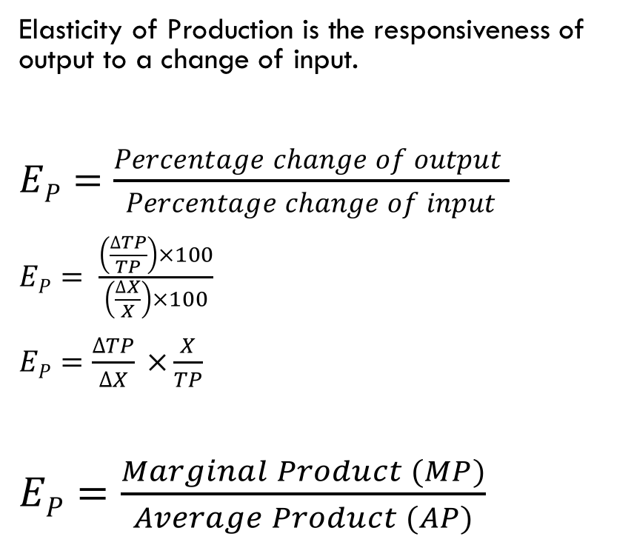
Elasticity of Production: E_{p}
Elasticity of Production is the responsiveness of output to a change of input.
$EP=\frac{Percentage change of output }{Percentage change of input}$
$EP= \frac{\left(\frac{∆TP}{TP}\right)×100}{\left(\frac{∆X}{X}\right)×100}$
$EP=\frac{∆TP}{∆X} ×\frac{X}{TP}$
$EP=\frac{Marginal Product (MP)}{Average Product (AP)}$
Phases of Production
Phase 1: E_{P} > 1
Phase 2: 0 < E_{P} < 1
Phase 3: E_{P} < 0
What do the E_{P} values say about efficiency in each phase?

Slide 15
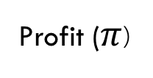
Relationship between Total Cost, Total Revenue, Profit, and Profit Maximization
Baht
Total Cost (TC)
Total Revenue (TR)
Profit ($π$)
Output
H
I
J

Slide 16
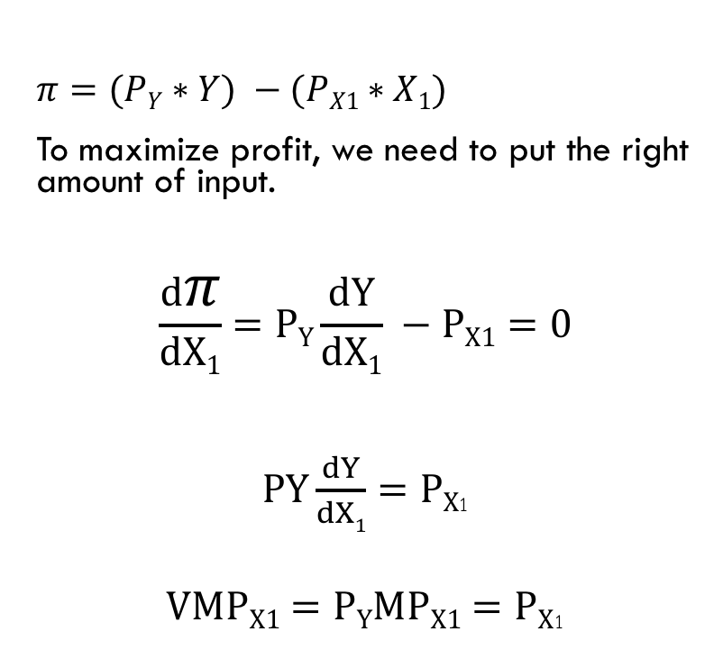
Inputs and Profit
Value
$PYMPX1$ = Value of Marginal Product of X₁ (VMP_{X1})
$π=(PY∗Y) −(PX1∗X1)$
To maximize profit, we need to put the right amount of input.
$$\frac{dπ}{dX1}=PY\frac{dY}{dX1} −PX1=0$$
$PY\frac{dY}{dX1}=PX$₁
$VMPX1=PYMPX1=PX$₁
P_{X1}
VMP_{X1}
I
Input X₁

Slide 17
Number of Inputs that maximize profit
Value
$PYMPX1$ = Value of Marginal Product of X₁ (VMP_{X1})
What would happen to the profit-maximizing number of input if price of input increases?
P’_{X1}
P_{X1}
VMP_{X1}
H
I
Input X₁

Slide 18
Number of Inputs that maximize profit
Value
$PYMPX1$ = Value of Marginal Product of X₁ (VMP_{X1})
What would happen to the profit-maximizing number of input if price of product (P_{Y}) decreases?
P_{X1}
VMP_{X1}
H
I
Input X₁

Slide 19
Number of Inputs that maximize profit
Value
$PYMPX1$ = Value of Marginal Product of X₁ (VMP_{X1})
What would happen to the profit-maximizing number of input if productivity of X₁ increases?
P_{X1}
VMP_{X1}
I
H
Input X₁

Slide 20
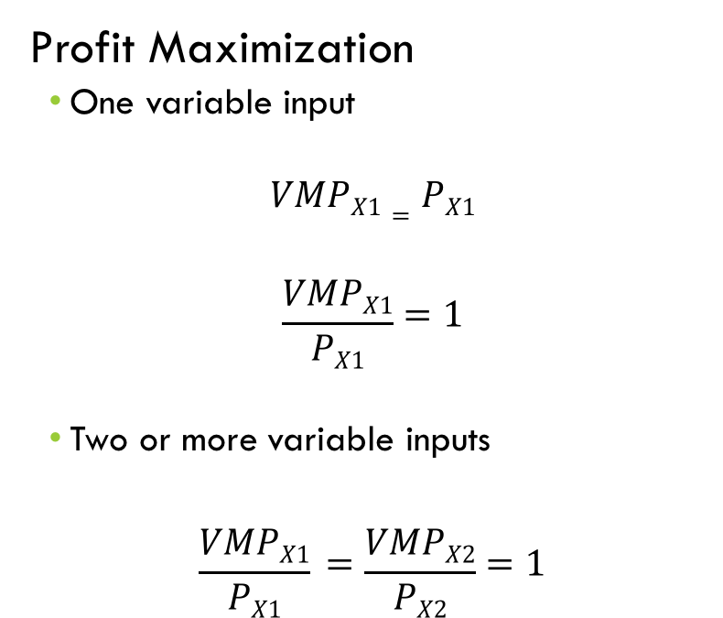
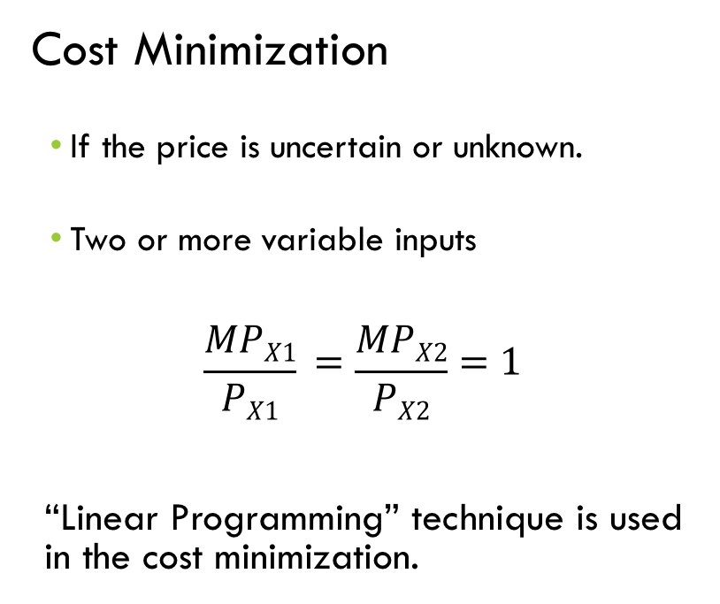
Profit Maximizing & Cost Minimization Conditions
Profit Maximization
  One variable input
$$VMPX1=PX1$$
$$\frac{VMPX1}{PX1}=1$$
  Two or more variable inputs
$$\frac{VMPX1}{PX1} =\frac{VMPX2}{PX2}=1$$
Cost Minimization
  If the price is uncertain or unknown.
  Two or more variable inputs
$$\frac{MPX1}{PX1} =\frac{MPX2}{PX2}=1$$
“Linear Programming” technique is used in the cost minimization.

Slide 21
Output – Output Relationships
In practice, farmers may produce more than one products in a period of time, for example, growing corn and cassava, growing plants and raising livestock.
Chosen products may be competing for factors of production, using the factors complimentarily, or jointly produced.
Applying “Production Possibility Curve”
Assumptions:
  Farmer has certain number of factors of production.
  The farmer uses all factors of production to produce two products (Y₁ and Y₂).
  No technological change.
  No risk producing the two products.

Slide 22
Competitive Relationship
Y₂
Marginal Rate of Product Substitution (MRPS) or Marginal Rate of Transformation (MRT) is negative, meaning that the increasing of Y1 will result in decreasing of Y2 as two of them are competing for factors of production.
A
Y’₂
C
D
For example:
Y”₂
B
Y”₁
Y₁
Y’₁

Slide 23
Complementary Relationship
Y₂
B
Complementary range, in which the increasing of Y₁ also results in the increasing of Y₂, is AB. MRPS or MRT is positive. Afterwards, in the range of BC, the two products are back in the competitive relationship. MRPS or MRT is negative.
Y’₂
A
D
Y”₂
For example:
C
Y”₁
Y₁
Y’₁

Slide 24
Enhancing Relationship
Y₂
B
Enhancing range is AB, where increasing output of Y₁ has neutral effect on Y₂. Subsequently, the two products are back in the competitive relationship, where BC is the competitive range.
A
Y’₂
For example:
D
Y”₂
C
Y₁
Y’₁
Y”₁

Slide 25
Joint Products
Y₂
B
In this case, Y₁ (or Y₂) is by-product of Y₂ (or Y₁). Increasing production of one product will always result in increasing of production of the other.
Y”₂
A
Y’₂
For example:
C
Y₁
Y’₁
Y”₁

Slide 26
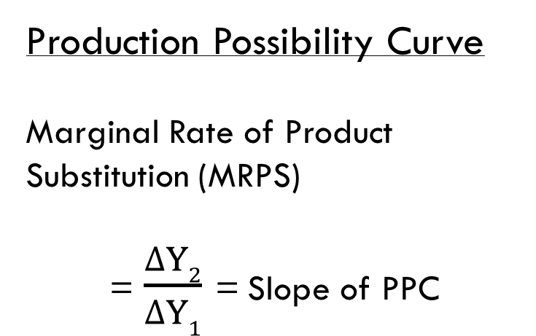
Revenue Maximization: PPC
Y₂
A
Production Possibility Curve
Marginal Rate of Product Substitution (MRPS)
= $\frac{∆Y2}{∆Y1}$ = Slope of PPC
Y’₂
C
D
Y”₂
B
Y”₁
Y₁
Y’₁

Slide 27
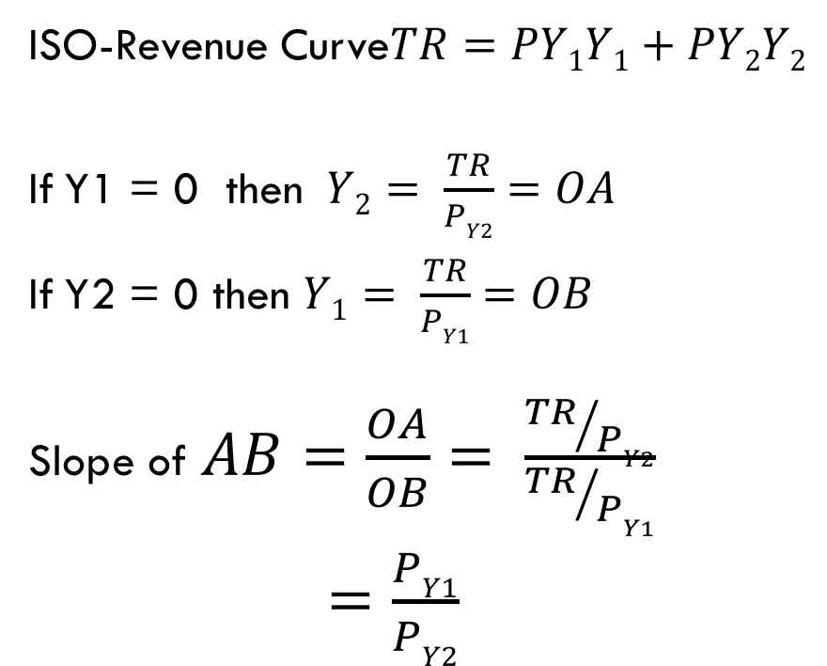
Revenue Maximization: ISO-Revenue Curve
Y₂
ISO-Revenue Curve$TR=PY1Y1+PY2Y2$
If Y1 = 0 then $Y2= \frac{TR}{PY2}=OA$
If Y2 = 0 then $Y1= \frac{TR}{PY1}=OB$
Slope of $AB=\frac{OA}{OB}= \frac{{TR}/{PY2}}{{TR}/{PY1}}$
$=\frac{PY1}{PY2}$
A
Y₁
B

Slide 28
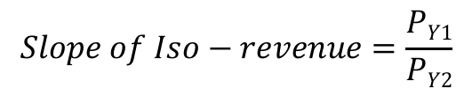
Revenue Maximization: ISO-Revenue curve
Y₂
$$Slope of Iso−revenue=\frac{PY1}{PY2}$$
A
Price of Y₁ increases and price of Y₂ constant,
Slope of Iso-Revenue curve increases.
Y₁
C
B

Slide 29
Revenue Maximization: ISO-Revenue curve
Y₂
$$Slope of Iso−revenue=\frac{PY1}{PY2}$$
A
Price of Y₁ increases and price of Y₂ constant,
Slope of Iso-Revenue curve decreases.
Y₁
C
B

Slide 30
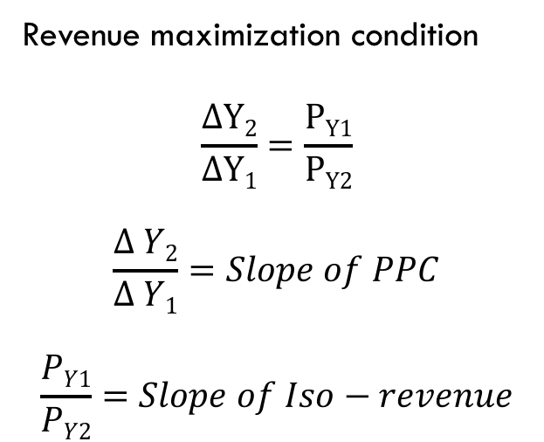
Revenue Maximization: The Condition
A₁
Revenue maximization condition
$$\frac{∆Y2}{∆Y1}=\frac{PY1}{PY2}$$
$$\frac{∆ Y2}{∆ Y1}=Slope of PPC$$
$$\frac{PY1}{PY2}=Slope of Iso−revenue$$
A₀
E₀
Y’₂
E₂
Y”’₂
Y”₂
E₁
Y’₁
Y”₁
B₁
Y₁
Y”’₁
B₀

Slide 31
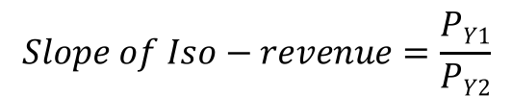
Revenue Maximization
Y₂
A
$$Slope of Iso−revenue=\frac{PY1}{PY2}$$
P
Price of Y₁ increases and price of Y₂ constant, Slope of Iso-Revenue curve increases.
Revenue maximization combination changes from E₀ to E₁.
E₀
Y’₂
E₁
Y”₂
Y’₁
Y”₁
P
B
Y₁
D

