Slide 1
Lecture 2

Slide 2
Finance Within the Organization
Board of Directors
Chief Executive Officer (CEO)
Chief Financial Officer (CFO)
Chief Operating Officer (COO)
Marketing, Production, Human Resources, and Other Operating Departments
Accounting, Treasury, Credit, Legal, Capital Budgeting, and Investor Relations

Slide 3
Corporate Finance, Capital Markets, Investment
Financial Management
  How to raise funding (stocks , bonds, cash)
Capital Markets
Investments

Slide 4
Jobs in Finance
Banking
Investments
Insurance
Corporations
Government
Finance is important to everyone regardless of their jobs

Slide 5
Investment Banks
https://www.youtube.com/watch?v=eTqT0psuSjk

Slide 6
Introduction to Trading Commodities
Orange Juice Trading

Slide 7
Stock market
https://www.youtube.com/watch?v=5iyvvhipL68
Bulls VS Bears

Slide 8
Stock Prices and Intrinsic Value
In equilibrium, a stock’s price should equal its “true” or intrinsic value.
Intrinsic value is a long-run concept.
To the extent that investor perceptions are incorrect, a stock’s price in the short run may deviate from its intrinsic value.
Ideally, managers should avoid actions that reduce intrinsic value, even if those decisions increase the stock price in the short run.
Notes:
-What exactly is intrinsic value?

Slide 9
Determinants of Intrinsic Values and Stock Prices
Managerial Actions, the Economic Environment, Taxes, and the Political Climate
“True” Investor Cash Flows
“True” Risk
“Perceived” Investor Cash Flows
“Perceived” Risk
Stock’s
Intrinsic Value
Stock’s
Market Price
Market Equilibrium:
Intrinsic Value = Stock Price
Notes:
-Don’t fully understand

Slide 10
Intrinsic Value and Price
intric value by Warren Buffet

Slide 11
Corporate Governance
The system of rules, practices and processes by which a company is directed and controlled
Balancing the interests of the many stakeholders in a company
Notes:
DEFINITION of 'Corporate Governance'
The system of rules, practices and processes by which a company is directed and controlled. Corporate governance essentially involves balancing the interests of the many stakeholders in a company - these include its shareholders, management, customers, suppliers, financiers, government and the community. Since corporate governance also provides the framework for attaining a company's objectives, it encompasses practically every sphere of management, from action plans and internal controls to performance measurement and corporate disclosure.
Read more: Corporate Governance Definition | Investopedia http://www.investopedia.com/terms/c/corporategovernance.asp#ixzz3wzuRxfBO
Follow us: Investopedia on Facebook

Slide 12
The US housing market
the big short
One of the largest fraud in the history of finance
It led to the worst financial meltdown since the second world war
It still has an impact on us today

Slide 13
What is a market?
A market is a venue where goods and services are exchanged.
A financial market is a place where individuals and organizations wanting to borrow funds are brought together with those having a surplus of funds.

Slide 14
Types of Financial Markets
Physical assets vs. Financial assets
Spot vs. Futures
Money vs. Capital
Primary vs. Secondary
Public vs. Private
Notes:
-Explanation of each types; one for one slide

Slide 15
Types of Financial Institutions
Commercial banks
Investment banks
Notes:
-Definition and examples.
http://www.investopedia.com/ask/answers/061615/whats-difference-between-investment-banks-and-commercial-banks.asp

Slide 16
The Capital Allocation Process
In a well-functioning economy, capital flows efficiently from those who supply capital to those who demand it.
Suppliers of capital: individuals and institutions with “excess funds.” These groups are saving money and looking for a rate of return on their investment.
Demanders or users of capital: individuals and institutions who need to raise funds to finance their investment opportunities. These groups are willing to pay a rate of return on the capital they borrow.

Slide 17
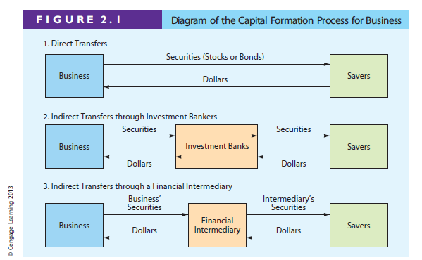

Slide 18
Securitization and Its Importance to a Bank
Solution to banks’ limited funds and local market conditions
Help banks to diversify their risks
An agent bank buy a large no. of loans from other banks
Issue securities backed by these loan payments
Notes:
-May be some clearer explanation? simplier?

Slide 19
Stock Market Transactions
Applesauce Computer decides to issue additional common stock. An investor purchases some of the newly issued shares from the underwriter. Is this a primary market transaction or a secondary market transaction?
  Since new shares of stock are being issued, this is a primary market transaction.

Slide 20
Types of Financial Institutions
Pension funds
Mutual funds
Exchange traded funds (ETFs)
Hedge funds
Private equity companies

Slide 21
What is meant by stock market efficiency?
Securities are normally in equilibrium and are “fairly priced.”
Investors cannot “beat the market” except through good luck or better information.
Efficiency continuum
Highly
Inefficient
Highly
Efficient
Small companies not followed by many analysts. Not much contact with investors.
Large companies followed by many analysts. Good communications with investors.

Slide 22
What are derivatives? How can they be used to reduce or increase risk?
A derivative security’s value is “derived” from the price of another security (e.g., options and futures).
Can be used to “hedge” or reduce risk. For example, an importer, whose profit falls when the dollar loses value, could purchase currency futures that do well when the dollar weakens.
Notes:
May spend some more time to explain these

Slide 23
What are derivatives? How can they be used to reduce or increase risk?
Also, speculators can use derivatives to bet on the direction of future stock prices, interest rates, exchange rates, and commodity prices. In many cases, these transactions produce high returns if you guess right, but large losses if you guess wrong. Here, derivatives can increase risk.
Notes:
May spend some more time to explain these

Slide 24
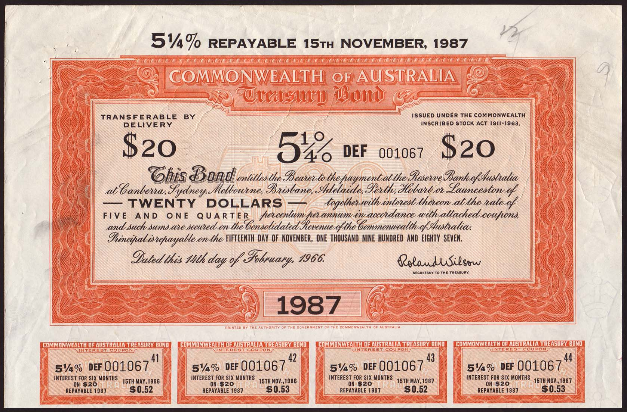

Slide 25
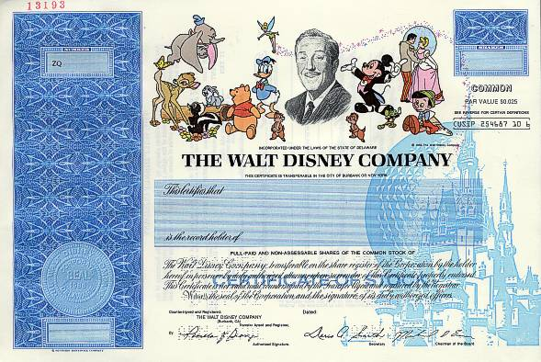

Slide 26
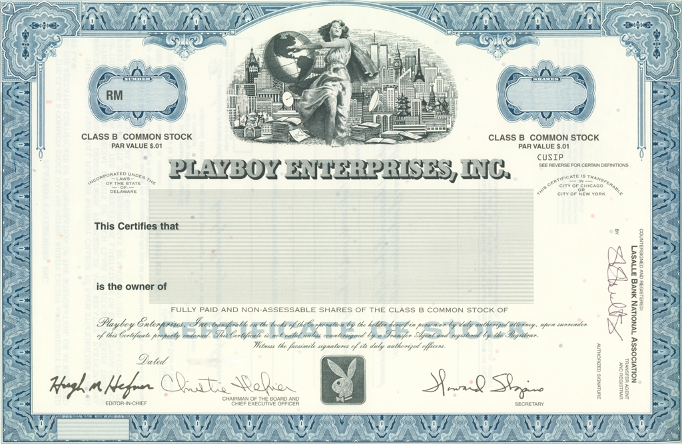

Slide 27
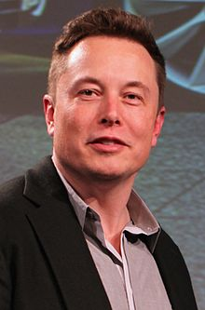
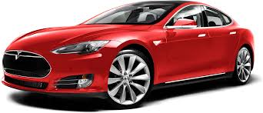
Elon Musk and his Tesla

Slide 28
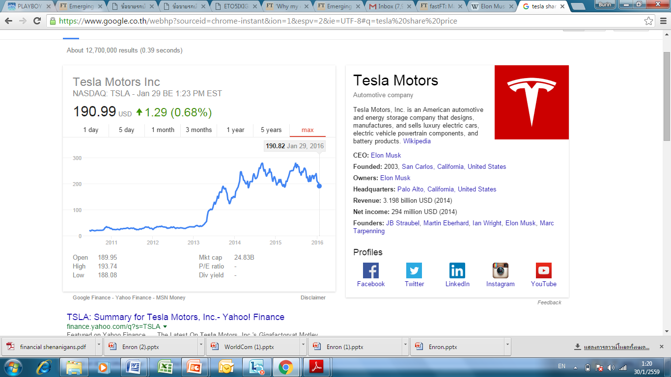

Slide 29
Enron and Worldcom Scandal
The scandals led to the Sarbanes-Oxley Act (SOX)
These are accounting fraud. Which we will later learn about basic accounting
Sarbanes Oxley

