Slide 1
Introduction to psychology
Psychological disorders

Slide 2
Overview
Abnormal Behaviour
  Definition
  Perspectives in Psychology
Psychological Disorders
  Anxiety Disorders: Phobia/ Panic Disorder
  Posttraumatic Stress Disorder (PTSD)
  Obsessive Compulsive Disorder (OCD)
  Mood Disorders: Major Depression/ Bipolar Disorder
  Schizophrenia
  Dissociative Disorders: Dissociative Amnesia/ Depersonalization-derealization disorder/ DID
  Personality Disorders

Slide 3
Psychopathology
The scientific study of mental, emotional, and behavioral disorders;
also, abnormal or maladaptive behavior.

Slide 4
Abnormal behaviour: What do we mean?
Statistical abnormality
  Defined on the basis of an extreme score on some dimension
Social nonconformity
  Failure to conform to societal norms or the usual minimum standards for social conduct.
Maladaptive behavior
  Behavior arising from an underlying psychological or biological dysfunction that makes it difficult to adapt to the environment and meet the demands of day-to-day life.

Slide 5
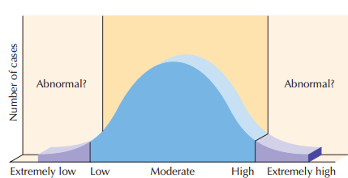
Statistical abnormality
Statistical abnormality tells us nothing about the meaning of deviations from the norm?
Statistical definitions also can’t tell us where to draw the line
between normality and abnormality

Slide 6
Social nonconformity
A young woman ties a thick rubber cord around her ankles, screams hysterically, and jumps headfirst off a bridge. Is this normal?
Is it abnormal for a grown man to remove his pants and expose himself to another man or woman in a place of business?
Notes:
situational context (social situation, behavioral setting, or general circumstances)

Slide 7
Social nonconformity
Situational context
  social situation, behavioral setting, or general circumstances
Cultural relativity
  the idea that judgments are made relative to the values of one’s culture

Slide 8
Subjective discomfort
Subjective discomfort
  Private feelings of pain, unhappiness, or emotional distress
But couldn’t a person experience serious distress without psychopathology?
Couldn’t someone be seriously disturbed without feeling discomfort?

Slide 9
Maladaptive behavior
Maladaptive behavior most often results in
  serious psychological discomfort
  disability and/or
  loss of control of thoughts, behaviors, or feelings
Become danger to oneself or others

Slide 10
Three Criteria for Abnormality
Maladaptive Behavior: Behavior that makes it difficult to function, to adapt to the environment, and to meet everyday demands
Significant impairment in psychological functioning: Those with mental illness lose the ability to control thoughts, behaviors, or feelings adequately
Atypical behavior: behavior that is not typical of the majority of the population
*Unjustifiable – There is no good reason

Slide 11
Historical Perspective
Perceived Causes
  movements of sun or moon
    lunacy- full moon
    Lunatic
  evil spirits
Ancient Treatments
  exorcism, caged like animals, beaten, burned, castrated, mutilated, blood replaced with animal’s blood

Slide 12
Perspectives on psychological disorders
  Psychodynamic: Disordered behavior is controlled by unconscious forces shaped by childhood experiences.
  Behavioral: Disordered behavior is caused by identifiable factors in the person’s environment and results from learning.
  Cognitive: ineffective or inaccurate thinking is the root cause of mental illness

Slide 13
Perspectives on psychological disorders
  Humanistic: blocked personal growth/ incongruence between real-self and ideal-self
  Biological: Disordered behavior is caused by biological conditions, such as genetics, hormone levels, or neurotransmitter activity in the brain.
  Sociocultural: Dysfunctional society, dysfunctional family interactions, socioeconomic status (poverty), homelessness, overcrowding, stressful living conditions
Notes:
Disorders are caused by the environment (the family
systems perspective suggests dysfunctional family
interactions)
Disorders are caused by distorting oneself to obtain
approval from others

Slide 14
Perspectives and Disorders
Diathesis-stress model: People biologically predisposed to a mental disorder (diathesis) will tend to exhibit that disorder when particularly affected by stress.

Slide 15
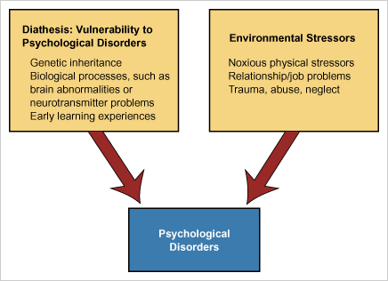
The Diathesis-Stress Model

Slide 16
Perspectives and Disorders
Bio-Psycho-Social Perspective: assumes that biological, sociocultural, and psychological factors combine and interact to produce psychological disorders.

Slide 17
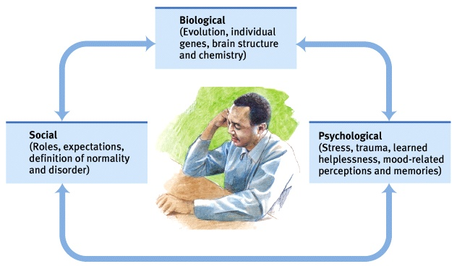

Slide 18
Classifying Abnormal Behavior
The Diagnostic and Statistical Manual of Mental Disorders.
The DSM-5 (American Psychiatric Association, 2013) provides a complete list of mental disorders, with each category painstakingly defined in terms of significant behavior patterns.
Today, it is the most widely used classification of psychological disorders.
Notes:
Psychological Disorders:
Patterns of behavior or mental processes that are connected with emotional distress or significant impairment in functioning
Classifying Disorders:
The book used to classify disorders is the DSM-IV-TR.

Slide 19
Diagnosis Criteria: DSM-5
Neurodevelopmental disorders
Schizophrenia spectrum and other psychotic disorders
Bipolar and related disorders
Depressive disorders
Anxiety disorders
Obsessive-compulsive and related disorders
Trauma- and stressor-related disorders
Dissociative disorders
Somatic symptom and related disorders
Feeding and eating disorders
Sleep–wake disorders
Sexual dysfunctions
Gender dysphoria
Disruptive, impulse-control, and conduct disorders
Substance-related and addictive disorders
Neurocognitive disorders
Paraphilic disorders
Personality disorders

Slide 20
Mental Illness and the Law
There is a difference mental illness and “insanity.”
Insanity is a legal term, not a psychological one. It is typically applied to defendants who were so mentally disturbed when they committed their offense that they either lacked substantial capacity to appreciate the criminality of their actions (to know right from wrong) or to conform to the requirements of the law (to control their behavior).
The person is aware of the consequences of his actions?
Can control his behavior?

Slide 21
Important Terms
Prevalence
The proportion of a population found to have a condition
Comorbidity
The presence of one or more disorders (or diseases) in addition to a primary disease or disorder
Neurotic Disorder (term seldom used now)
Usually distressing but that allows one to think rationally and function socially
Psychotic Disorder
Person loses contact with reality
Experiences irrational ideas and distorted perceptions

Slide 22
Anxiety disorders

Slide 23
Anxiety disorders
A group of disorders that have in common the characteristic of anxiety
  Phobia
  Panic Disorder

Slide 24
phobia
Phobia: A type of disorder characterized by irrational and intense fear
Specific Phobia – Lifetime Prevalence 11%
Social Phobia – Lifetime Prevalence 5%, 12.1%

Slide 25
Specific phobia
Fear of specific stimuli or situations
There are five subtypes of specific phobia:
animal type (e.g., spiders),
natural environment type (e.g., heights)
situational type (e.g., enclosed spaces)
blood-injection-injury type (e.g., needles)
other type (e.g., choking, clowns)

Slide 26
Specific phobia
Arachnophobia
Acrophobia
Agoraphobia
Claustrophobia
Cyberphobia
Gamophobia
Pyrophobia
Notes:
Spider
Height
Open spaces
Enclosed spaces

Slide 27
Social Phobia
Social phobia: to be called social anxiety disorder
Characterized by extreme and unreasonable anxiety with regard to social situations where one might be evaluated, such as when one is having a conversation or giving a speech. The person is afraid of doing something embarrassing or being rejected by others.

Slide 28
Explanations of Phobia: Biological
Heredity
Reactions of the amygdala
Behavioral inhibition (Fear toward new situations) – Social Phobia
hypothalamic-pituitary-adrenal (HPA) axis, a system involved in hormonal responses to stress, is also more active in children with social phobia and higher trait anxiety (van West & colleagues, 2008)

Slide 29
Explanations of Phobia: Behavioural Factors
Observational Learning / Modeling
Operant Conditioning
  Is maintained by Negative Reinforcement
  A type of reward that involves the removal of something unpleasant

Slide 30
Panic disorder
Characterized by recurrent attacks of intense anxiety
Panic attacks include physical symptoms, such as chest pains, shortness of breath, shaking, and sweating, as well as psychological symptoms, such as a fear that one is dying or going insane
Some individuals have panic attacks without these fears
Notes:
Panic disorder is characterized by recurrent attacks of intense anxiety.
Panic attacks include physical symptoms, such as chest pains, shortness of breath,
shaking, and sweating, as well as psychological symptoms, such as a fear that one
is dying or going insane, although some individuals have panic attacks without
these fears (Chen & colleagues, 2009). People with panic might also experience
depersonalization (Mendoza & colleagues, 2011), where they feel separated
from their mind or body. Perhaps most distressing of all, panic attacks can be unpredictable,
seeming to come “out of the blue.”

Slide 31
Panic disorder
Depersonalization: Feel separated from their mind or body.
Can be unpredictable – out of the blue
Panic Disorder with Agoraphobia – fears of being out in public
Notes:
Panic disorder is characterized by recurrent attacks of intense anxiety.
Panic attacks include physical symptoms, such as chest pains, shortness of breath,
shaking, and sweating, as well as psychological symptoms, such as a fear that one
is dying or going insane, although some individuals have panic attacks without
these fears (Chen & colleagues, 2009). People with panic might also experience
depersonalization (Mendoza & colleagues, 2011), where they feel separated
from their mind or body. Perhaps most distressing of all, panic attacks can be unpredictable,
seeming to come “out of the blue.”

Slide 32
Explanations of panic disorder: Biology
Heredity
Researchers have identified several chromosome regions that might be related to panic (Maron & colleagues, 2010)
Neural pathway associated with the amygdala
Dysfunction of GABA system (inhibitory neurotransmitter – feel calm)
Notes:
What causes panic disorder? Just as with phobia, it appears that biological,
cognitive, and behavioral factors are involved. For example, with regard to biology,
panic disorder is partially genetic (Mosing & colleagues, 2009); indeed, researchers
have identified several chromosome regions that might be related to panic (Maron
& colleagues, 2010). Neural pathways associated with the amygdala (as you
might recall, the amygdala is a brain structure associated with fear) and dysfunction
with regard to GABA seem to be involved in panic (Roy-Byrne & colleagues,
2006). As you might recall from the biopsychology chapter, GABA is the primary
inhibitory neurotransmitter; GABA helps us to feel calm,

Slide 33
Explanations of panic disorder: cognitive
Interoceptive sensitivity
Sensitivity to body sensations
Catastrophic misinterpretations
Extreme and incorrect interpretations for ambiguous body sensations
Notes:
What causes panic disorder? Just as with phobia, it appears that biological,
cognitive, and behavioral factors are involved. For example, with regard to biology,
panic disorder is partially genetic (Mosing & colleagues, 2009); indeed, researchers
have identified several chromosome regions that might be related to panic (Maron
& colleagues, 2010). Neural pathways associated with the amygdala (as you
might recall, the amygdala is a brain structure associated with fear) and dysfunction
with regard to GABA seem to be involved in panic (Roy-Byrne & colleagues,
2006). As you might recall from the biopsychology chapter, GABA is the primary
inhibitory neurotransmitter; GABA helps us to feel calm,

Slide 34
Posttraumatic stress disorder (PTSD)

Slide 35
Posttraumatic stress disorder (PTSD)
PTSD is precipitated by some type of traumatic event, such as witnessing the violent death of a friend or family member, being seriously injured in an accident, or being sexually assaults.
Characteristics of PTSD include intrusive memories of the event, flashbacks (re-experiencing the event), nightmares, feelings of fear or guilt, an exaggerated startle reaction, difficulty sleeping, and avoiding activities or places that are associated with the traumatic event.

Slide 36
Obsessive-compulsive disorder (OCD)

Slide 37
Obsessive-compulsive disorder
Obsessions
Unwanted intrusive thoughts, desires, or images that tend to provoke anxiety
Compulsions
Behaviors or thoughts that temporarily relieve the anxiety caused by obsessions

Slide 38
Explanations of ocd: biological
Biological
Genetic
Serotonin & Glutamate

Slide 39
Explanations of ocd: Cognitive
Inflated responsibility:
A symptom of OCD that pertains to the tendency to take responsibility for an outcome no matter how small one’s role might have been
e.g. spill the can of coke
Thought-action fusion
A symptom of OCD that can include the idea that having an unwanted bad thought is as bad as doing the action, as well as the idea that thinking about an outcome can make it happen.
e.g. thinking about stealing the money
Overestimation of threat
A symptom of OCD that involves feeling that an intrusive thought could lead to severe consequences
e.g. throw important things away

Slide 40
Mood Disorders
characterized by emotional extremes

Slide 41
Mood disorders
Major Depressive Disorder : a mood disorder in which a person, for no apparent reason, experiences two or more weeks of depressed moods, feelings of worthlessness, and diminished interest or pleasure in most activities
Seasonal affective disorder (SAD): A subtype of major depression in which people become depressed in the winter (when the days are shorter) but recover in the spring
Dysthymia: A type of depression that is less severe than major depression, but longer lasting

Slide 42
Depression: Diagnostic Criteria
Specific symptoms, at least 5 of these 9, present nearly every day:
Depressed mood or irritable most of the day, nearly every day, as indicated by either subjective report (e.g., feels sad or empty) or observation made by others (e.g., appears tearful).
Decreased interest or pleasure in most activities, most of each day
Significant weight change (5%) or change in appetite
Change in sleep: Insomnia or hypersomnia
Change in activity: Psychomotor agitation or retardation
Fatigue or loss of energy
Guilt/worthlessness: Feelings of worthlessness or excessive or inappropriate guilt
Concentration: diminished ability to think or concentrate, or more indecisiveness
Suicidality: Thoughts of death or suicide, or has suicide plan

Slide 43
Mood Disorders-Depression
20
15
10
5
0
Around the world
women are more
susceptible to
depression
Percentage
of population
aged 18-84
experiencing
major
depression
at some
point In life
USA Edmonton Puerto Paris West Florence Beirut Taiwan Korea New
Rico Germany Zealand

Slide 44
Mood Disorders-Depression
10%
8
6
4
2
0
Percentage
depressed
Females
Males
12-17 18-24 25-34 35-44 45-54 55-64 65-74 75+
Age in Years

Slide 45
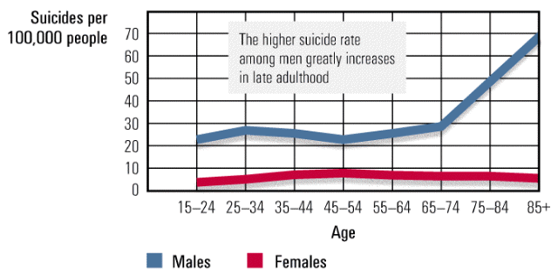
Mood Disorders- Suicide
Suicides per
100,000 people
70
60
50
40
30
20
10
0
The higher suicide rate
among men greatly
increases in late
adulthood
15-24 25-34 35-44 45-44 55-64 65-74 75-84 85+
Males
Females

Slide 46
Mood Disorders-Suicide
12%
10
8
6
4
2
0
Suicide rate,
ages 15 to 19
(per 100,000)
1960 1970 1980 1990 2000
Year

Slide 47
Mood Disorders-Depression
Brain
Chemistry
Low Serotonin
Low NE
Cognition
Irrational beliefs
Pessimistic
Explanatory Style
Altering any one component of the chemistry-cognition-mood circuit can alter the others
Mood

Slide 48
Mood Disorders-Depression
A happy or depressed mood strongly influences people’s ratings of their own behavior
Percentage of
observations
35%
30
25
20
15
Negative Positive
behaviors behaviors
Self-ratings

Slide 49
Mood Disorders-Depression
1
Stressful
experiences
The vicious cycle of depression can be broken at any point
4
Cognitive and
behavioral changes
2
Negative
explanatory style
3
Depressed
mood

Slide 50
Bipolar disorder

Slide 51
Mood disorders
  Bipolar I Disorder: a mood disorder in which the person alternates between the hopelessness and lethargy of depression and the overexcited state of mania
    Manic episode: A period of unjustified elevated mood and increased energy that lasts at least a week
    Grandiosity: High self-esteem or self-importance
    Pressured speech: Rapid speech
    Flight of ideas: Racing thoughts

Slide 52
Mood disorders
  Bipolar II disorder: A psychological disorder characterized by periods of major depression and periods of hypomanic episode
Hypomanic episodes: Similar to manic episodes, but less severe and of shorter duration

Slide 53
Bipolar Disorders
Mania
Major Depressive Episodes
Alternate with
Full Manic Episode
Major
Depression

Slide 54
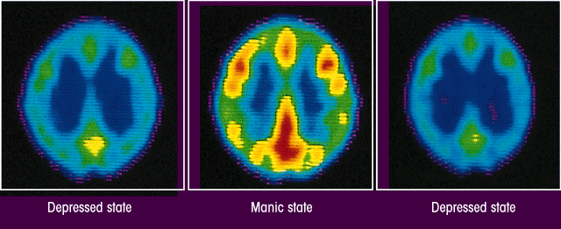
Mood Disorders-Bipolar
PET scans show that brain energy consumption rises and falls with emotional swings
Depressed state
Manic state
Depressed state

Slide 55
Neurotransmitters – Bipolar Disorders
Norepinephrine (NE)
Serotonin (SE)
Dopamine (DA).
If one or more of these enter the synapses this can lead to mania, and in reverse
If one or more of these don't enter the synapses, this leads to depression

Slide 56
schizophrenia

Slide 57
Schizophrenia
  Literal translation “split mind”
  A group of severe disorders characterized by:
    disorganized and delusional thinking
    disturbed perceptions
    inappropriate emotions and actions
  Diagnosed when symptoms persist for at least six months, are not due to some other condition, and cause significant impairment in daily functioning
  Schizophrenics often cannot work, manage a home or apartment successfully, or care for their basic needs.

Slide 58
Symptoms of Schizophrenia
Positive symptoms: Psychotic behaviors not seen in healthy people. People with positive symptoms often "lose touch" with reality. These symptoms can come and go. Sometimes they are severe and at other times hardly noticeable, depending on whether the individual is receiving treatment.
Hallucinations
Delusions
Thought Disorders
Movement Disorders

Slide 59
Hallucinations
Hallucinations: Imaginary sensations, such as seeing, hearing, or smelling things that do not exist in the real world
  Most common psychotic hallucination is hearing voices (70%)
  Seeing things (25%)
  Tactile hallucination: crawling sensations
  Note that olfactory hallucinations sometimes occur with seizure disorder (epilepsy)

Slide 60
Delusions
Delusions: False beliefs that psychotic individuals insist are true, regardless of overwhelming evidence against them

Slide 61
Common forms of delusions
  Grandiose: People suffer from the delusion that they have some great, unrecognized talent, knowledge, or insight. They may also believe that they have a special relationship with an important person or with God or that they are a famous person.
  Persecution: Delusions of persecution involve belief that you are being conspired against, cheated, spied on, followed, poisoned, maligned, or harassed.

Slide 62
Common forms of Delusions
  Reference: Belief that objects, events, or other people have particular significance to them/ everything one perceives in the world relates to one's own destiny.
Identity: Belief that they are someone else, such as Jesus Christ
Guilt: Belief that they have committed a terrible sin
Control: Belief that their thoughts and behaviours are being controlled by external forces
Notes:
Belief that objects, events, or other people have particular significance to them

Slide 63
Disorganized Thought & Speech
Disorganized Thinking
Trouble organizing thoughts or connecting them logically and talk in a garbled way that is hard to understand.
Loose association – Rapidly shifting from topic to topic with no connection between one thought and the next and give answers to unrelated questions
Circumstantial –speaking continuously, providing numerous irrelevant details and never getting to the point
Thought Blocking
Notes:
Disorganized thinking becomes apparent in patients' speech patterns as schizophrenia progresses. Affected people lose their train of thought during conversations, make loose associations of topics (tangentially jumping from one topic to another apparently at random, or on the barest of associations), and give answers to unrelated questions. Speech may be highly circumstantial, meaning that affected people may speak continuously, providing numerous irrelevant details and never getting to the point. Occasionally, speech is so disorganized that it becomes a completely jumbled "word salad" devoid of discernible meaning despite being full of words.

Slide 64
Disorganized Thought & Speech
Clanging (or clang)
Unusual speech in which the links in language are based on sound rather than meaning
Word salad
A severe breakdown of language in which words seem to be tossed together
Neologisms
Invented words
Notes:
Disorganized thinking becomes apparent in patients' speech patterns as schizophrenia progresses. Affected people lose their train of thought during conversations, make loose associations of topics (tangentially jumping from one topic to another apparently at random, or on the barest of associations), and give answers to unrelated questions. Speech may be highly circumstantial, meaning that affected people may speak continuously, providing numerous irrelevant details and never getting to the point. Occasionally, speech is so disorganized that it becomes a completely jumbled "word salad" devoid of discernible meaning despite being full of words.

Slide 65
Disorganized behavior
Disorganized behavior may range from simple problems sustaining goal-directed self-care behaviors such as personal hygiene to unpredictable and bizarre socially inappropriate outbursts
May not dress according to the weather, (i.e., they may wear a heavy coat in the middle of summer)
Wear odd or inappropriate makeup
May shout at people for no apparent reason, or they may mutter to themselves continuously, etc.
May even strip off their clothing and run naked through the streets, while chewing on road kill
Notes:
Disorganized behavior may range from simple problems sustaining goal-directed self-care behaviors such as personal hygiene to unpredictable and bizarre socially inappropriate outbursts. For example, people may not dress according to the weather, (i.e., they may wear a heavy coat in the middle of summer), they may wear odd or inappropriate makeup, they may shout at people for no apparent reason, or they may mutter to themselves continuously, etc. They may even strip off their clothing and run naked through the streets, while chewing on road kill. Most anything is possible.

Slide 66
Disorganized Movement
Agitated body movements
  Repeating certain motions over and over
Catatonic motor behavior
  Peoples' reaction to their surroundings becomes remarkably decreased
  May assume a rigid, uncomfortable looking posture and then not move for hours or days, resisting efforts to move them
  "waxy flexibility", meaning that they allow themselves to be moved into new positions, but do not move on their own.
Notes:
Catatonic motor behaviors are a type of disturbed behavior (and a negative as opposed to a positive symptom) that sometimes occurs when schizophrenia goes untreated. In catatonia, peoples' reaction to their surroundings becomes remarkably decreased. They may assume a rigid, uncomfortable looking posture and then not move for hours or days, resisting efforts to move them. Catatonic patients may also display "waxy flexibility", meaning that they allow themselves to be moved into new positions, but do not move on their own. Most of the time, this is not an act or a show but rather a genuine and unpremeditated symptom of the illness that patients cannot help. Catatonia is observed with less frequency today than in past years due to advances in treating schizophrenia.

Slide 67
Symptoms of Schizophrenia
Negative symptoms: Disruptions to normal emotions and behaviors.
  Flat affect: a person's face does not move or he or she talks in a dull or monotonous voice (the mask)
  Avolition: Lack of ability to begin and sustain planned activities, no initiative, no motivation
  Alogia: Speaking little, even when forced to interact, speech is vacant
  Anhedonia: Lack of pleasure in everyday life, no pleasure
  Asocial: No social interest, severe impairment in social relationship
Notes:
These symptoms are harder to recognize as part of the disorder and can be mistaken for depression or other conditions. “
Flat Affect -- “The Mask”
Avolition -- “No Initiative”
Alogia -- “Speech is Vacant”
Anhedonia -- “No Pleasure”
Asociality--”No social interest”

Slide 68
Subtypes of Schizophrenia
Paranoid: Preoccupation with delusions or hallucinations
Disorganized: Disorganized speech or behavior, or flat or inappropriate emotion
Catatonic: Immobility (or excessive, purposeless movement), extreme negativism, and/or parrot-like repeating of another’s speech or movements
Undifferentiated Schizophrenia symptoms without fitting one of the above types
or residual:

Slide 69
Explanations of schizophrenia
Genetic predisposition
Structural brain abnormalities
Neurotransmitter abnormalities
Prenatal abnormalities
Psychoactive medication
The Vulnerability-stress approach

Slide 70
Genetic Predisposition
Risk of Developing Schizophrenia
Identical twins……less than 50%
Child of 2 schizophrenic parents... 34-46%
Fraternal twins ….less than 20%
Children with 1 schizophrenic parent 12%
Siblings ….. Less than 10%

Slide 71
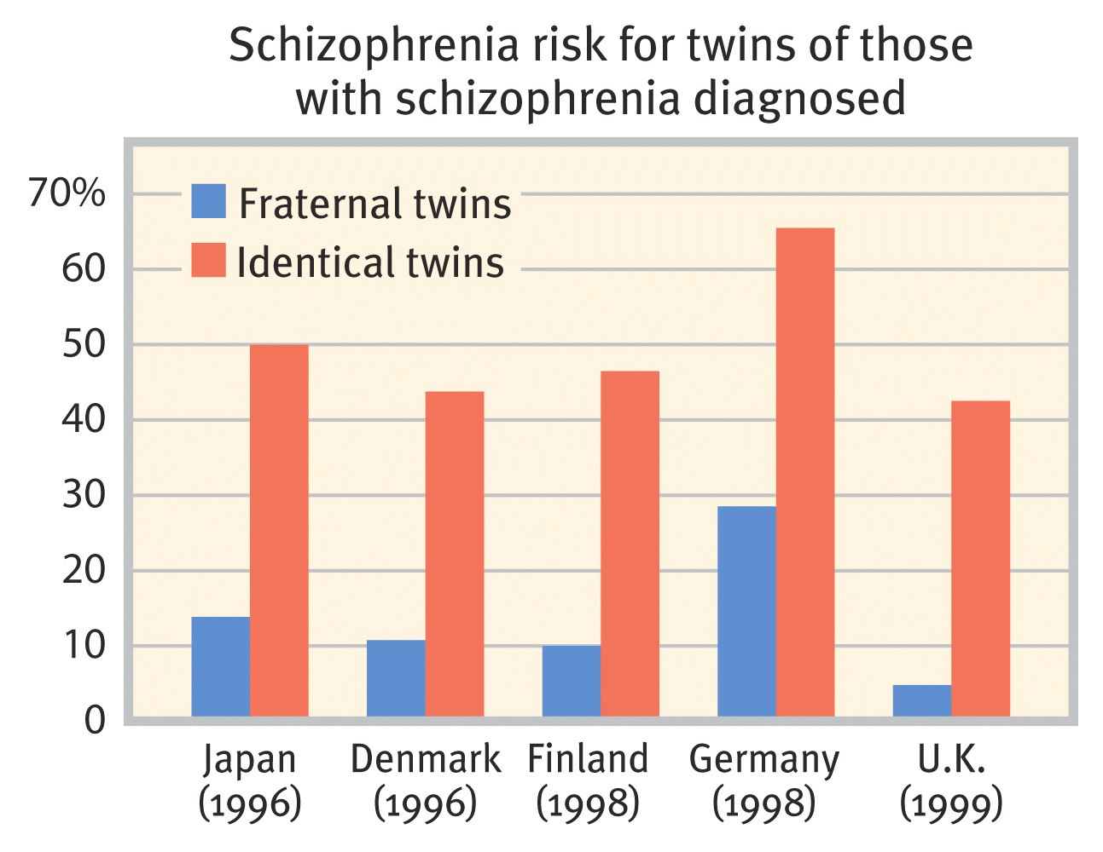

Slide 72
40
30
20
10
0
Lifetime risk
of developing
schizophrenia
for relatives of
a schizophrenic
General
population
Siblings
Children
Fraternal
twin
Children
of two
schizophrenia
victims
Identical
twin

Slide 73
Brain Abnormalities
Signs of cerebral damage
Decreased brain weight
Reduced numbers of neurons in the prefrontal cortex
Decrease in volume of the limbic regions
Abnormalities in the thalamus
Enlarged ventricles or spaces in the brain

Slide 74
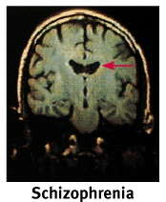
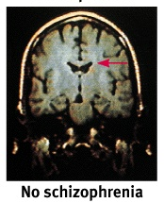
Ventricle Enlargement
Notes:
Ventricle enlargement

Slide 75
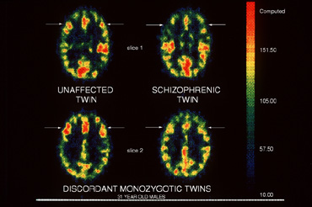
Hypofrontality

Slide 76
Neurotransmitter Abnormalities
Serotonin
  Hyperactive of the serotonin system
  Positive symptoms
Dopamine
  Increase of dopamine in the central nervous system
  Excess dopamine in the synapses
  Responsible for positive and negative symptoms
Notes:
Serotonin
hyperactive of the serotonin system
Positive symptoms
Glutamate
hypoactivity of the glutamatergic system
Dopamine
increase of dopamine in the central nervous system
responsible for positive and negative symptoms

Slide 77
Prenatal Abnormalities
Malnutrition
Infectious virus during prenatal development
Mother’s exposure to influenza virus during the second trimester of pregnancy

Slide 78
Vulnerability – Stress Explanation
Biological Vulnerability
Genetic predisposition
Birth complications that damage the brain
Prenatal damage due to viral infection
Stressful Experiences
Unstable family life
Extreme stress in late adolescence and early adulthood.

Slide 79
Dissociative disorders

Slide 80
Dissociative Disorders
Dissociative Disorders
  conscious awareness becomes separated (dissociated) from previous memories, thoughts, and feelings
Dissociative Amnesia
Dissociative Fugue
Dissociative Identity Disorder
Notes:
Depersonalizationderealization
disorder
A dissociative disorder
characterized by experiences
of being separate from
one’s mind or body and/or
experiences that other people
or objects are unreal

Slide 81
Dissociative Disorders
Dissociative amnesia
The person cannot remember personal information, typically for a specific event (e.g., death of a loved one) or period of time (e.g., the last six months), it can extend to one’s entire identity (Who am I?)
Dissociative fugue
A symptom that sometimes accompanies dissociative amnesia where the person travels to a new location
Notes:
Depersonalizationderealization
disorder
A dissociative disorder
characterized by experiences
of being separate from
one’s mind or body and/or
experiences that other people
or objects are unreal

Slide 82
Dissociative Disorders
Depersonalization-derealization disorder
A dissociative disorder characterized by experiences of being separate from one’s mind or body and/or experiences that other people or objects are unreal. They might feel detached from their emotions. Objects around them might appear distorted.
Dissociative Identity Disorder (DID)
A person exhibits two or more distinct and alternating personalities (aka Multiple Personality Disorder)
Notes:
Depersonalizationderealization
disorder
A dissociative disorder
characterized by experiences
of being separate from
one’s mind or body and/or
experiences that other people
or objects are unreal

Slide 83
Personality disorders

Slide 84
Personality disorders
Personality disorders
Psychological disorders characterized by dysfunctional self and interpersonal functioning and long-term maladaptive personality traits

Slide 85
Personality disorders
Borderline personality disorder
A psychological disorder characterized by a poorly developed or unstable self, low empathy, conflicted relationships, emotional instability, hypersensitivity, and risk-taking
Obsessive-compulsive personality disorder
A psychological disorder characterized by inflexibility, compulsiveness, perfectionism, and a focus on accomplishment

Slide 86
Personality disorders
Avoidant personality disorder
A psychological disorder characterized by avoidance of interpersonal relationships, low self-esteem, and anxiety with regard to social situations
Schizotypal personality disorder
A psychological disorder characterized by thinking and behaving in eccentric ways, limited or inappropriate emotions, and suspiciousness of others

Slide 87
Personality disorders
Narcissistic personality disorder
A psychological disorder characterized by a preoccupation with oneself
Antisocial (or dyssocial) personality disorder
A psychological disorder characterized by a focus on personal desires, a lack of concern for others, and impulsive or risky behavior
Psychopathy: A condition similar to antisocial personality disorder that includes arrogance, low empathy, impulsive behavior, and social deviance

Slide 88
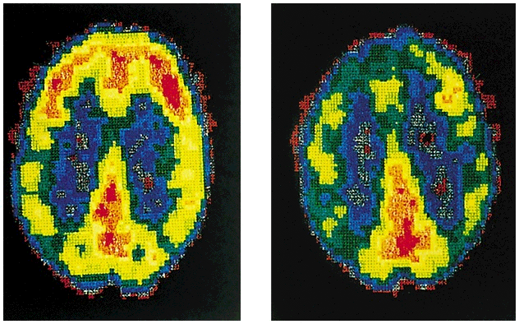
PET scans illustrate reduced activation in a murderer’s frontal cortex
Normal
Murderer

Slide 89


