Slide 1
Linear Models and Matrix Algebra IV
Pawin Siriprapanukul
CW Ch.5

Slide 2
Outline
Finding the Inverse Matrix
Cramer’s Rule
Application to Market and National-Income Models*
Leontief Input-Output Models*

Slide 3
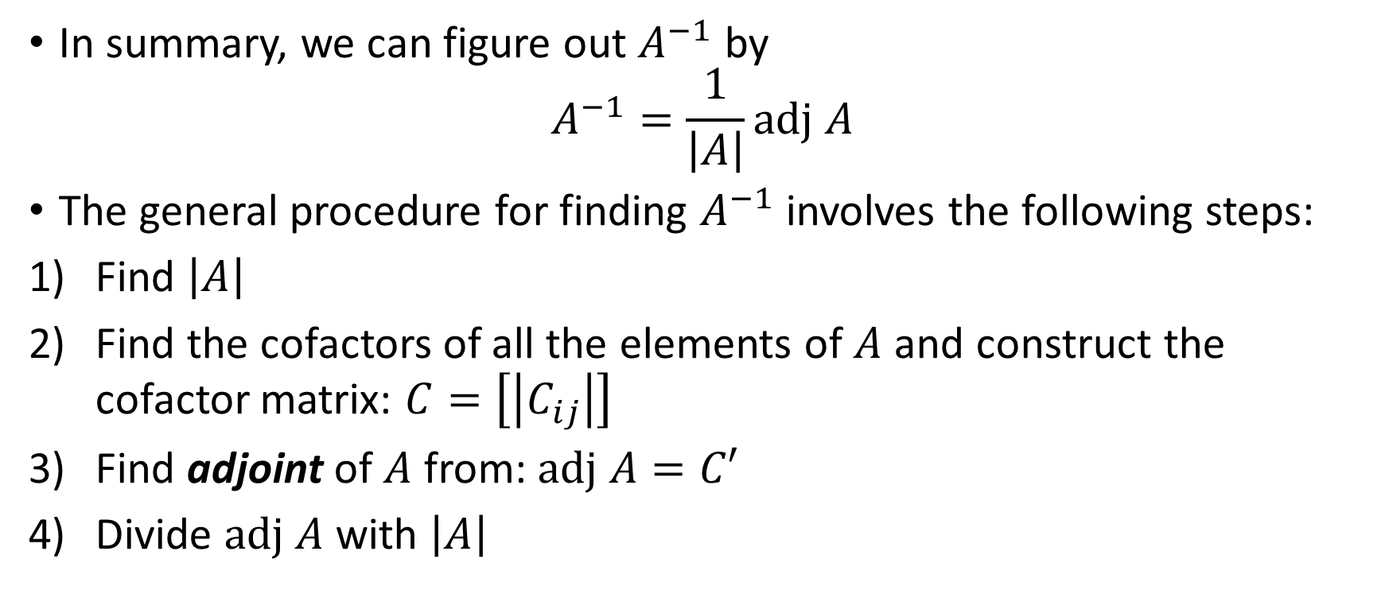
Finding the Inverse Matrix
In summary, we can figure out $A^{−1}$ by
$$A^{−1}=\frac{1}{\left|A\right|}adj A$$
The general procedure for finding $A^{−1}$ involves the following steps:
Find $\left|A\right|$
Find the cofactors of all the elements of $A$ and construct the cofactor matrix: $C=\left[\left|C_{ij}\right|\right]$
Find adjoint of $A$ from: $adj A=C′$
Divide $adj A$ with $\left|A\right|$

Slide 4
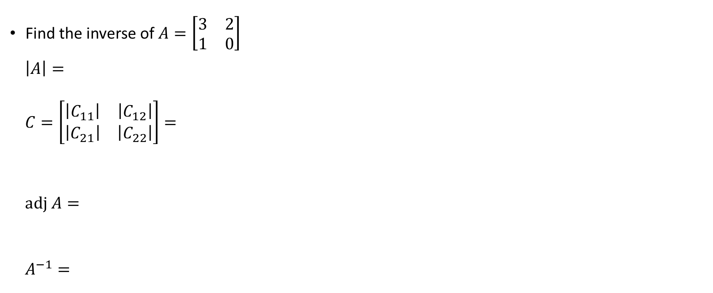
Example 1
Find the inverse of $A=\left[\begin{matrix}3 & 2 \\ 1 & 0\end{matrix}\right]$
$$\left|A\right|=$$
$$C=\left[\begin{matrix}\left|C_{11}\right| & \left|C_{12}\right| \\ \left|C_{21}\right| & \left|C_{22}\right|\end{matrix}\right]=$$
$$adj A=$$
$$A^{−1}=$$

Slide 5
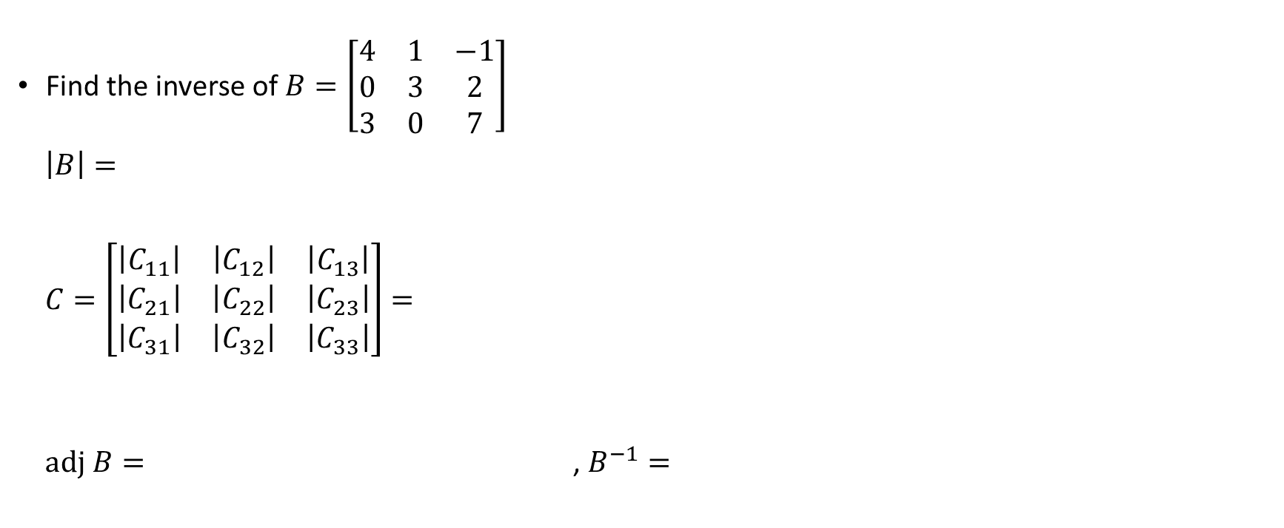
Example 2
Find the inverse of $B=\left[\begin{matrix}4 & 1 & −1 \\ 0 & 3 & 2 \\ 3 & 0 & 7\end{matrix}\right]$
$$\left|B\right|=$$
$C=\left[\begin{matrix}\left|C_{11}\right| & \left|C_{12}\right| & \left|C_{13}\right| \\ \left|C_{21}\right| & \left|C_{22}\right| & \left|C_{23}\right| \\ \left|C_{31}\right| & \left|C_{32}\right| & \left|C_{33}\right|\end{matrix}\right]=$
$adj B=$ , $B^{−1}=$

Slide 6
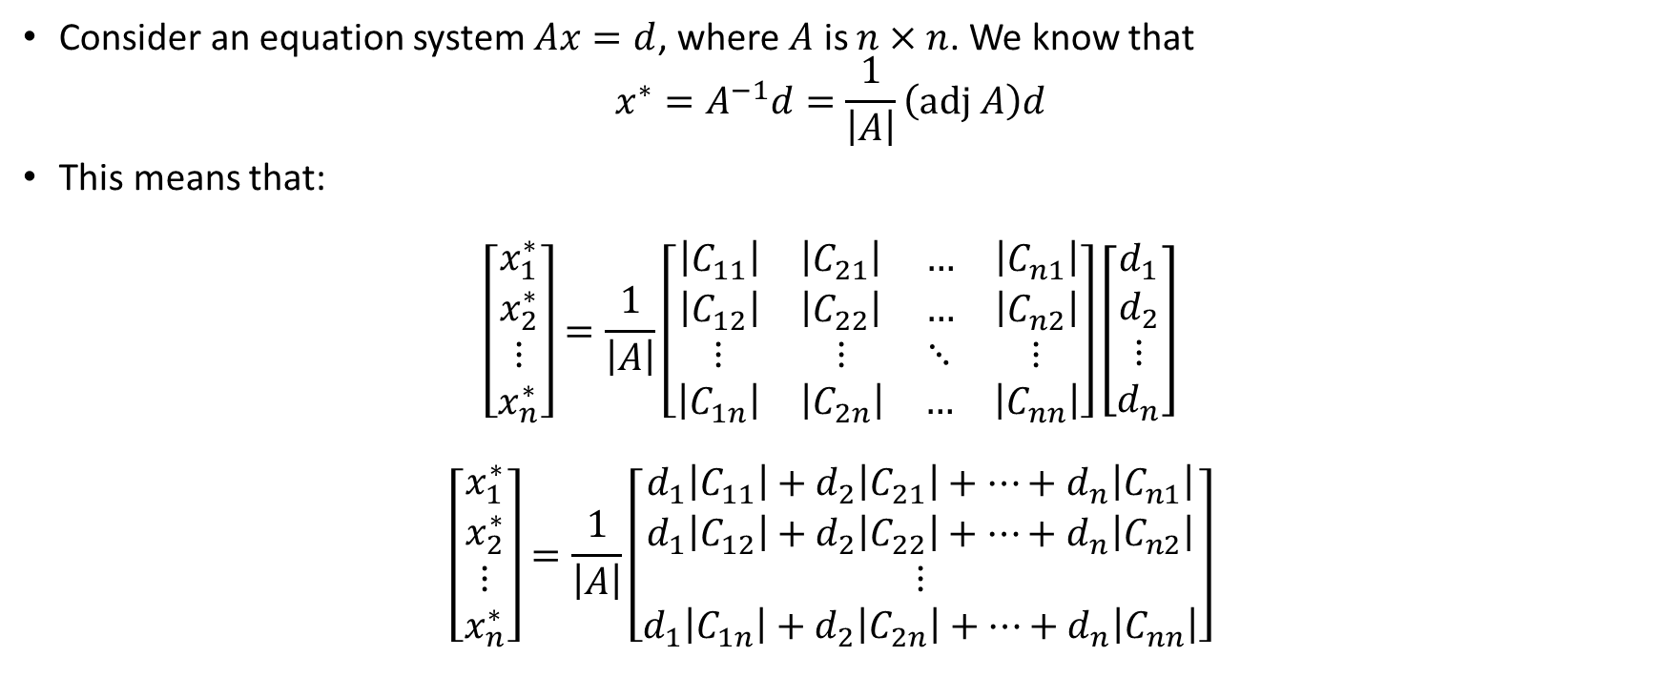
Cramer’s Rule
Consider an equation system $Ax=d$, where $A$ is $n×n$. We know that
$$x^{∗}=A^{−1}d=\frac{1}{\left|A\right|}\left(adj A\right)d$$
This means that:
$$\left[\begin{matrix}x_{1}^{∗} \\ x_{2}^{∗} \\ \begin{matrix}⋮ \\ x_{n}^{∗}\end{matrix}\end{matrix}\right]=\frac{1}{\left|A\right|}\left[\begin{matrix}\begin{matrix}\left|C_{11}\right| & \left|C_{21}\right| \\ \left|C_{12}\right| & \left|C_{22}\right|\end{matrix} & \begin{matrix}… & \left|C_{n1}\right| \\ … & \left|C_{n2}\right|\end{matrix} \\ \begin{matrix}⋮ & ⋮ \\ \left|C_{1n}\right| & \left|C_{2n}\right|\end{matrix} & \begin{matrix}⋱ & ⋮ \\ … & \left|C_{nn}\right|\end{matrix}\end{matrix}\right]\left[\begin{matrix}d_{1} \\ d_{2} \\ \begin{matrix}⋮ \\ d_{n}\end{matrix}\end{matrix}\right]$$
$$\left[\begin{matrix}x_{1}^{∗} \\ x_{2}^{∗} \\ \begin{matrix}⋮ \\ x_{n}^{∗}\end{matrix}\end{matrix}\right]=\frac{1}{\left|A\right|}\left[\begin{matrix}d_{1}\left|C_{11}\right|+d_{2}\left|C_{21}\right|+…+d_{n}\left|C_{n1}\right| \\ d_{1}\left|C_{12}\right|+d_{2}\left|C_{22}\right|+…+d_{n}\left|C_{n2}\right| \\ \begin{matrix}⋮ \\ d_{1}\left|C_{1n}\right|+d_{2}\left|C_{2n}\right|+…+d_{n}\left|C_{nn}\right|\end{matrix}\end{matrix}\right]$$

Slide 7
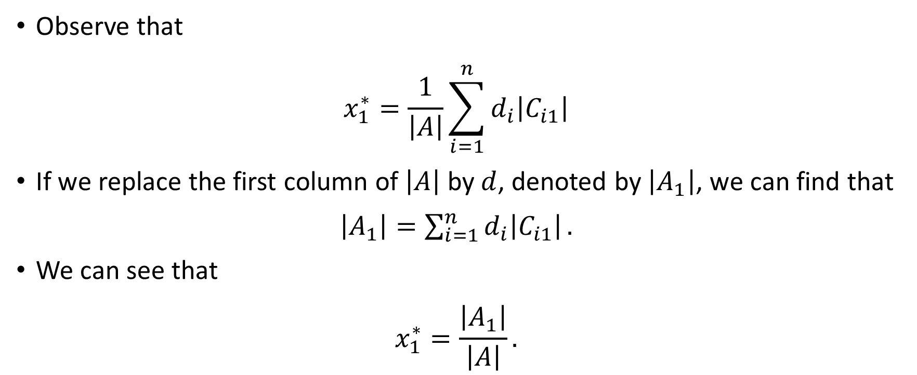
Cramer’s Rule
Observe that
$$x_{1}^{∗}=\frac{1}{\left|A\right|}\sum_{i=1}^{n}{d_{i}\left|C_{i1}\right|}$$
If we replace the first column of $\left|A\right|$ by $d$, denoted by $\left|A_{1}\right|$, we can find that
$\left|A_{1}\right|=\sum_{i=1}^{n}{d_{i}\left|C_{i1}\right|}.$
We can see that
$$x_{1}^{∗}=\frac{\left|A_{1}\right|}{\left|A\right|}.$$

Slide 8
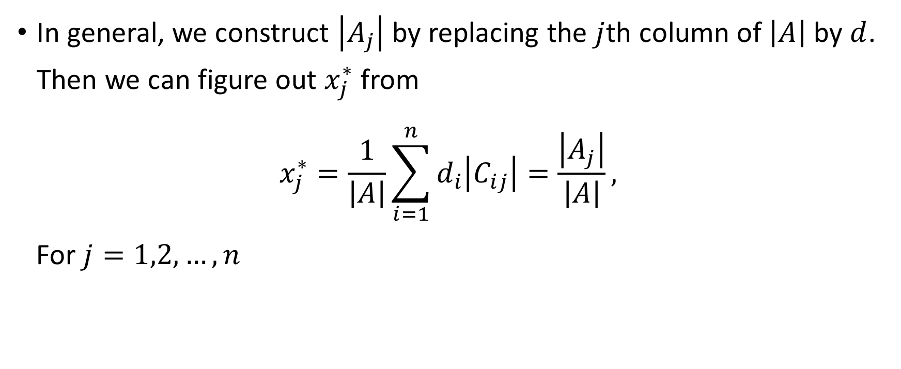
Cramer’s Rule
In general, we construct $\left|A_{j}\right|$ by replacing the $j$th column of $\left|A\right|$ by $d$. Then we can figure out $x_{j}^{∗}$ from
$$x_{j}^{∗}=\frac{1}{\left|A\right|}\sum_{i=1}^{n}{d_{i}\left|C_{ij}\right|}=\frac{\left|A_{j}\right|}{\left|A\right|},$$
For $j=1,2,…,n$

Slide 9
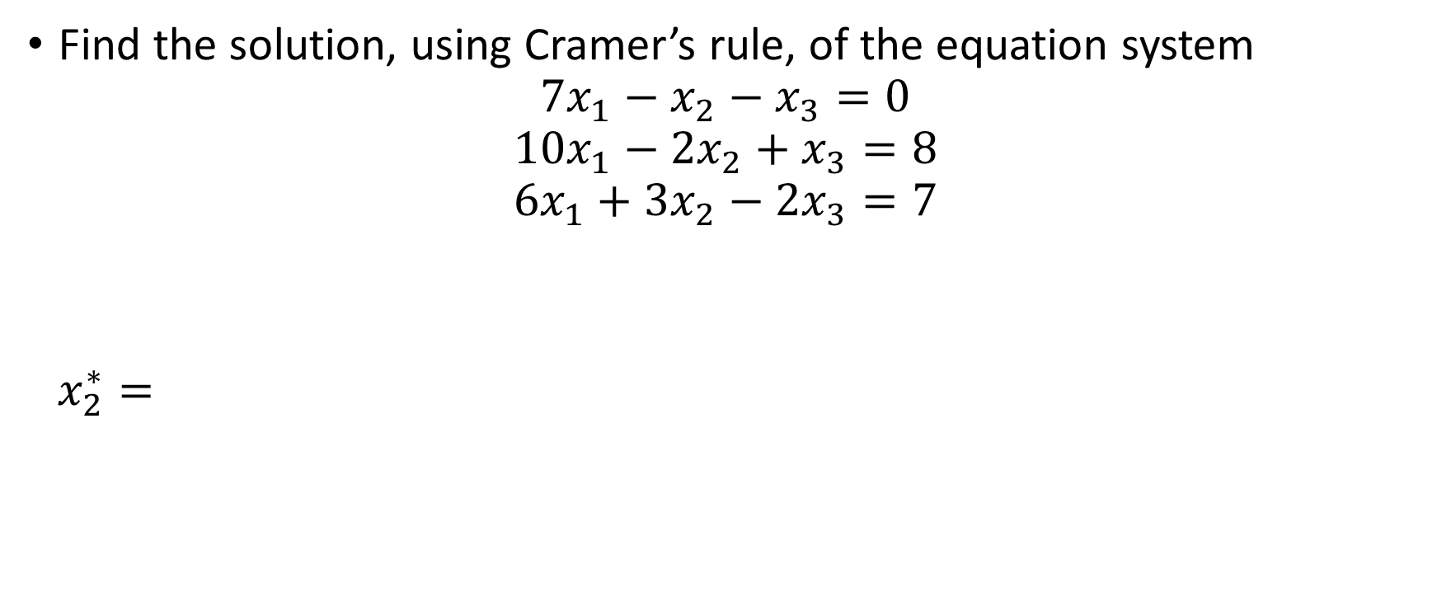
Example
Find the solution, using Cramer’s rule, of the equation system
$$7x_{1}−x_{2}−x_{3}=0$$
$$10x_{1}−2x_{2}+x_{3}=8$$
$$6x_{1}+3x_{2}−2x_{3}=7$$
$$x_{2}^{∗}=$$

Slide 10
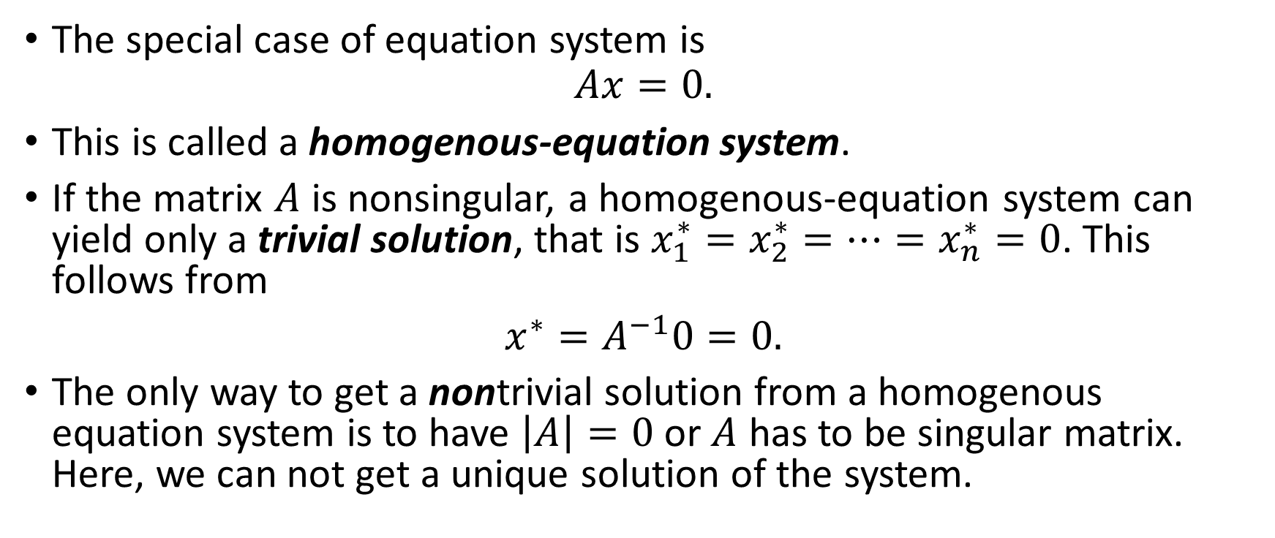
Note on Homogenous-Equation Systems
The special case of equation system is
$$Ax=0.$$
This is called a homogenous-equation system.
If the matrix $A$ is nonsingular, a homogenous-equation system can yield only a trivial solution, that is $x_{1}^{∗}=x_{2}^{∗}=…=x_{n}^{∗}=0$. This follows from
$x^{∗}=A^{−1}0=0.$
The only way to get a nontrivial solution from a homogenous equation system is to have $\left|A\right|=0$ or $A$ has to be singular matrix. Here, we can not get a unique solution of the system.

Slide 11
Matrix Algebra Vs Elimination of Variables
From computational point of view, matrix inversion and Cramer’s rule are not necessary more efficient than the method of successive eliminations of variables.
However, matrix methods have other merits:
  Compact notation for any linear-equation system
  Determinantal criterion for testing the existence of a unique solution
  Analytical expressions of the solution
  Under some circumstances, e.g. to solve at the same time several equation systems having an identical coefficient matrix, but different constant-term vectors, matrix method has an advantage.

Slide 12
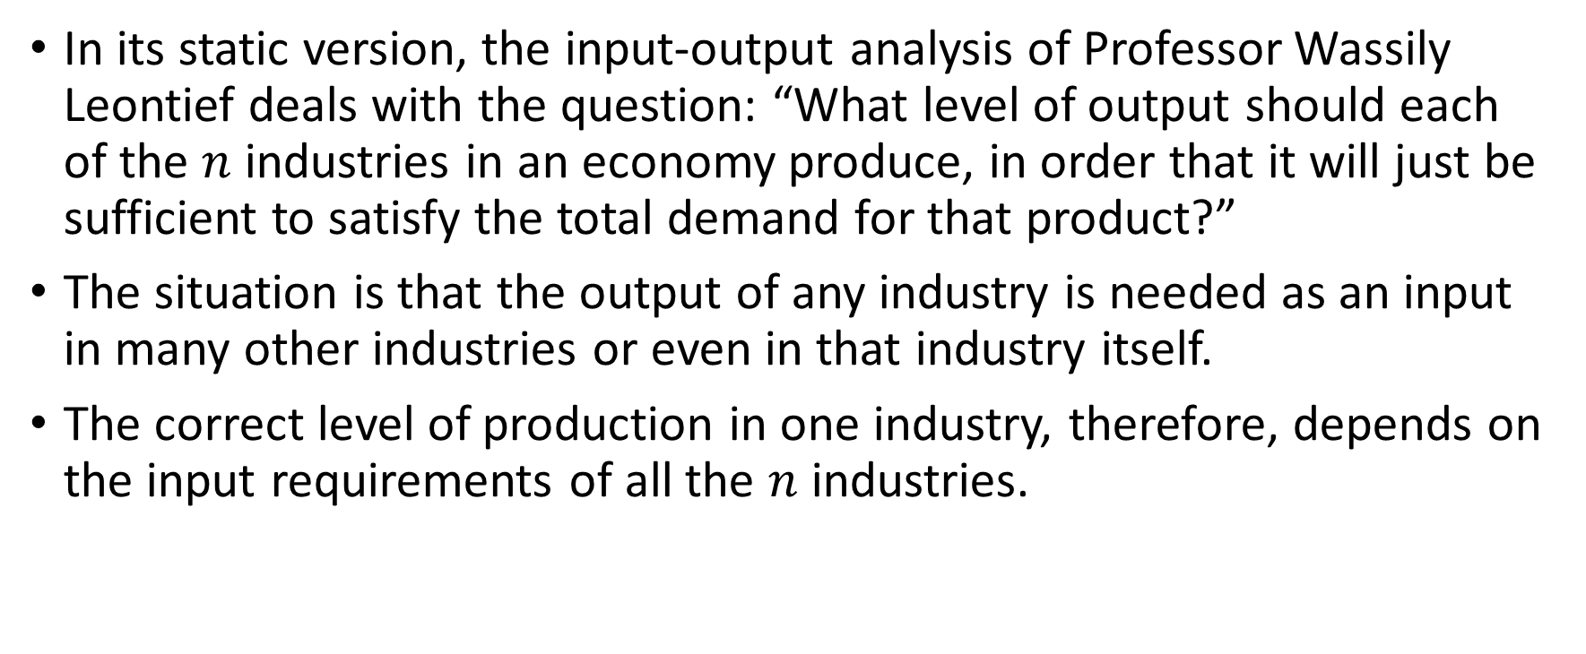
Leontief Input-Output Models
In its static version, the input-output analysis of Professor Wassily Leontief deals with the question: “What level of output should each of the $n$ industries in an economy produce, in order that it will just be sufficient to satisfy the total demand for that product?”
The situation is that the output of any industry is needed as an input in many other industries or even in that industry itself.
The correct level of production in one industry, therefore, depends on the input requirements of all the $n$ industries.

Slide 13
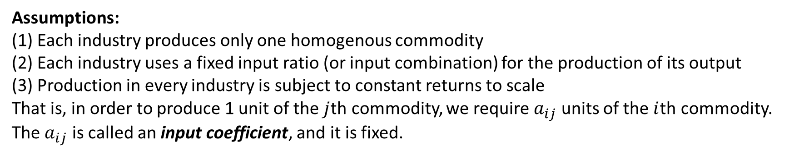
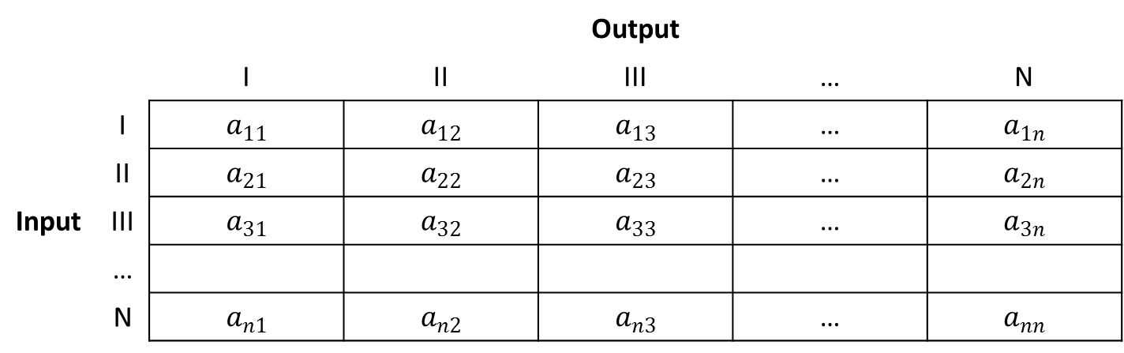
Structure of an Input-Output Model
 |  | Output
 |  | I | II | III | … | N
Input | I | $$a_{11}$$ | $$a_{12}$$ | $$a_{13}$$ | … | $$a_{1n}$$
 | II | $$a_{21}$$ | $$a_{22}$$ | $$a_{23}$$ | … | $$a_{2n}$$
 | III | $$a_{31}$$ | $$a_{32}$$ | $$a_{33}$$ | … | $$a_{3n}$$
 | …
 | N | $$a_{n1}$$ | $$a_{n2}$$ | $$a_{n3}$$ | … | $$a_{nn}$$
Assumptions:
Each industry produces only one homogenous commodity
Each industry uses a fixed input ratio (or input combination) for the production of its output
Production in every industry is subject to constant returns to scale
That is, in order to produce 1 unit of the $j$th commodity, we require $a_{ij}$ units of the $i$th commodity. The $a_{ij}$ is called an input coefficient, and it is fixed.

Slide 14
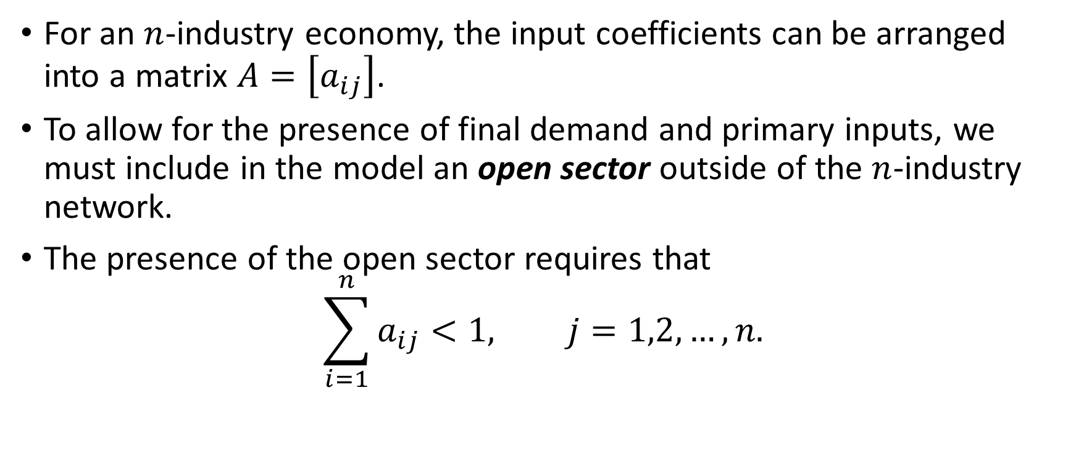
The Open Model
For an $n$-industry economy, the input coefficients can be arranged into a matrix $A=\left[a_{ij}\right]$.
To allow for the presence of final demand and primary inputs, we must include in the model an open sector outside of the $n$-industry network.
The presence of the open sector requires that
$$\sum_{i=1}^{n}{a_{ij}}<1, j=1,2,…,n.$$

Slide 15
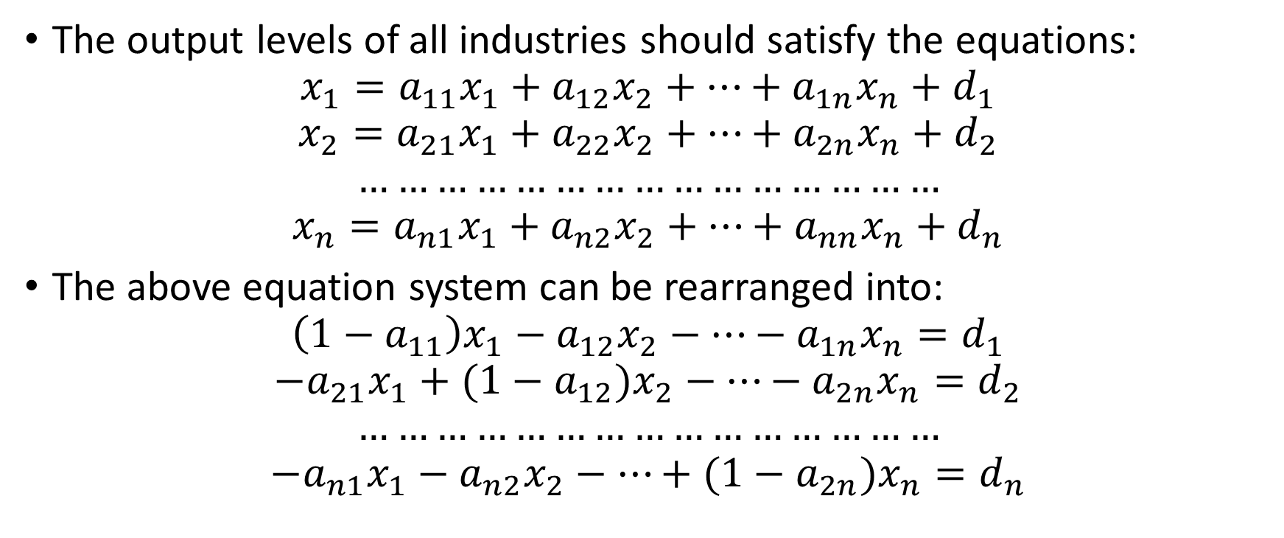
The Open Model
The output levels of all industries should satisfy the equations:
$$x_{1}=a_{11}x_{1}+a_{12}x_{2}+…+a_{1n}x_{n}+d_{1}$$
$$x_{2}=a_{21}x_{1}+a_{22}x_{2}+…+a_{2n}x_{n}+d_{2}$$
$$………………………………………$$
$$x_{n}=a_{n1}x_{1}+a_{n2}x_{2}+…+a_{nn}x_{n}+d_{n}$$
The above equation system can be rearranged into:
$$\left(1−a_{11}\right)x_{1}−a_{12}x_{2}−…−a_{1n}x_{n}=d_{1}$$
$$−a_{21}x_{1}+(1−a_{12})x_{2}−…−a_{2n}x_{n}=d_{2}$$
$$………………………………………$$
$$−a_{n1}x_{1}−a_{n2}x_{2}−…+(1−a_{2n})x_{n}=d_{n}$$

Slide 16
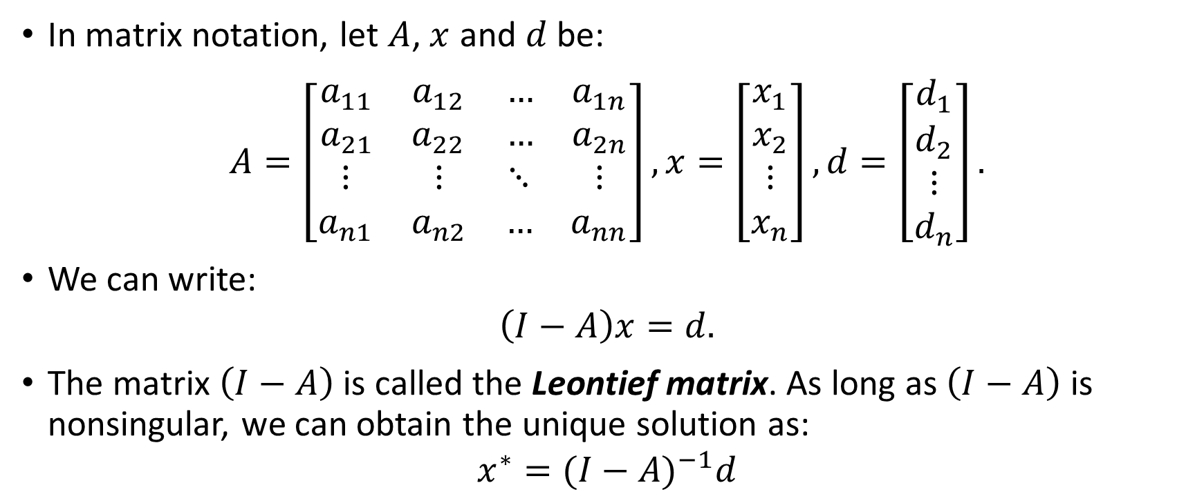
The Open Model
In matrix notation, let $A$, $x$ and $d$ be:
$$A=\left[\begin{matrix}\begin{matrix}a_{11} & a_{12} \\ a_{21} & a_{22}\end{matrix} & \begin{matrix}… & a_{1n} \\ … & a_{2n}\end{matrix} \\ \begin{matrix}⋮ & ⋮ \\ a_{n1} & a_{n2}\end{matrix} & \begin{matrix}⋱ & ⋮ \\ … & a_{nn}\end{matrix}\end{matrix}\right], x=\left[\begin{matrix}\begin{matrix}x_{1} \\ x_{2}\end{matrix} \\ \begin{matrix}⋮ \\ x_{n}\end{matrix}\end{matrix}\right],d=\left[\begin{matrix}\begin{matrix}d_{1} \\ d_{2}\end{matrix} \\ \begin{matrix}⋮ \\ d_{n}\end{matrix}\end{matrix}\right].$$
We can write:
$$\left(I−A\right)x=d.$$
The matrix $\left(I−A\right)$ is called the Leontief matrix. As long as $\left(I−A\right)$ is nonsingular, we can obtain the unique solution as:
$$x^{∗}={(I−A)}^{−1}d$$

Slide 17
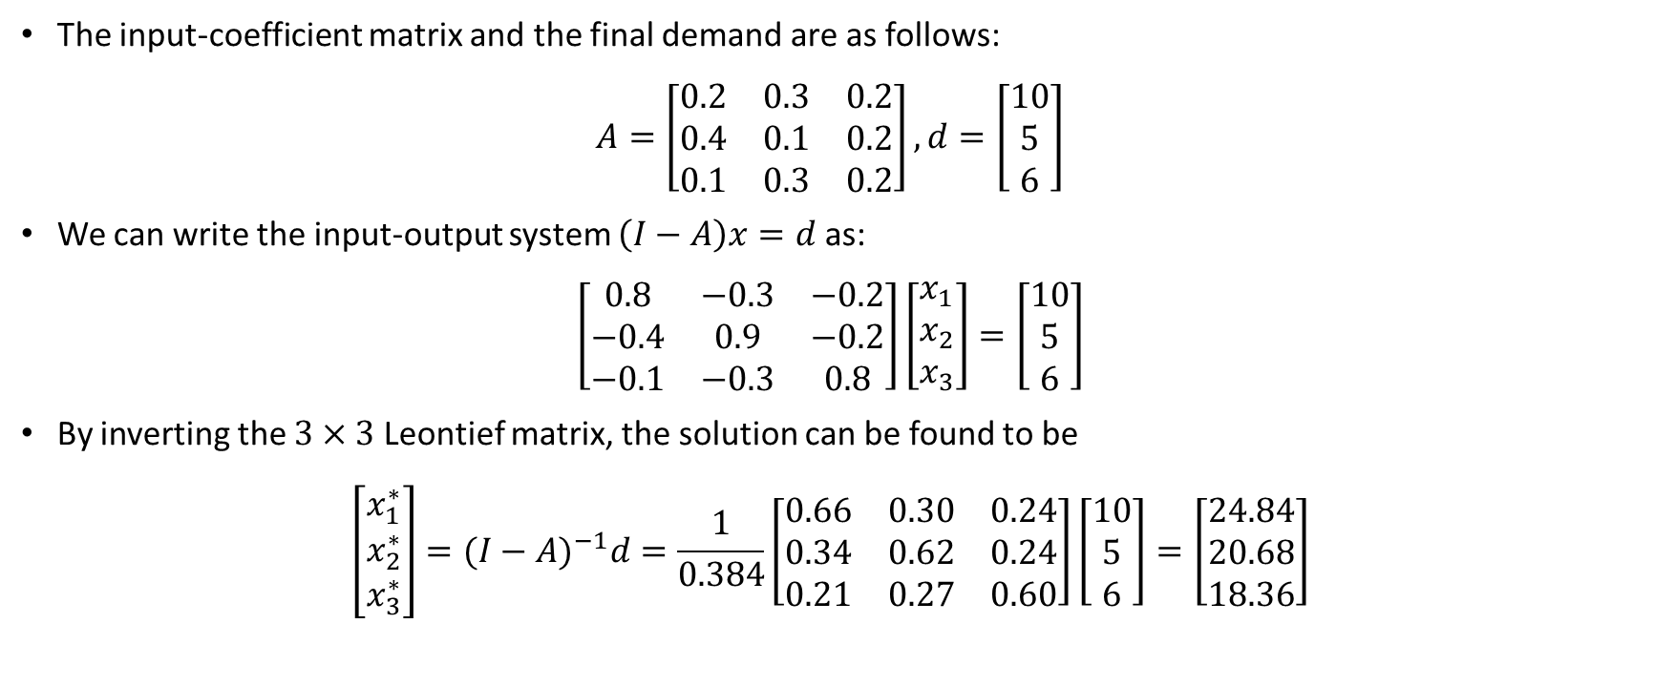
A Numerical Example
The input-coefficient matrix and the final demand are as follows:
$$A=\left[\begin{matrix}0.2 & 0.3 & 0.2 \\ 0.4 & 0.1 & 0.2 \\ 0.1 & 0.3 & 0.2\end{matrix}\right],d=\left[\begin{matrix}10 \\ 5 \\ 6\end{matrix}\right]$$
We can write the input-output system $\left(I−A\right)x=d$ as:
$$\left[\begin{matrix}0.8 & −0.3 & −0.2 \\ −0.4 & 0.9 & −0.2 \\ −0.1 & −0.3 & 0.8\end{matrix}\right]\left[\begin{matrix}x_{1} \\ x_{2} \\ x_{3}\end{matrix}\right]=\left[\begin{matrix}10 \\ 5 \\ 6\end{matrix}\right]$$
By inverting the $3×3$ Leontief matrix, the solution can be found to be
$$\left[\begin{matrix}x_{1}^{∗} \\ x_{2}^{∗} \\ x_{3}^{∗}\end{matrix}\right]={(I−A)}^{−1}d=\frac{1}{0.384}\left[\begin{matrix}0.66 & 0.30 & 0.24 \\ 0.34 & 0.62 & 0.24 \\ 0.21 & 0.27 & 0.60\end{matrix}\right]\left[\begin{matrix}10 \\ 5 \\ 6\end{matrix}\right]=\left[\begin{matrix}24.84 \\ 20.68 \\ 18.36\end{matrix}\right]$$

Slide 18
Assignment #3
Exercise 5.4 No. 5, 6
Exercise 5.5 No. 3
Exercise 5.7 No. 3 (Skip (b))

