Slide 1
Thailand Fiscal Policy Reform
(after 1997)
Chanin Mephokee
EE460

Slide 2
1997 crisis
High unemployment and negative growth
FIs had liquidity problem and many closed down
Restrictive Fiscal Policy (1997-1998): budget cut (worsen declining in AE)
Due to crisis, government revenue downed (0.136 and 0 .247 trillion baht) (2.483 trillion baht in 2016)

Slide 3
Expansionary policy
Chuan government in 1998 set up Miyazawa Plan ( 40 bill. baht)
Taksin government (2001-2003) set up Village Fund (0.1 Trillion baht)

Slide 4
Development
Budgeting Process
Taxation

Slide 5
Background
 |  |  |  | Limitations
Line-item budgetary system | 1959-1981 | 1.The Budget Procedure Act 1959. 2. Centralization under Budget Bureau; planning, preparation, execution, and evaluation. | Based on detailed lists of line items Based on negotiations | 1.Cannnot control expenditures 2.Did not reflex relation between resource allocation and output/outcome. So cannot evaluate performance.
Planning-Programming-Budgeting system (PPBS) | 1982=1999 | Centralized by Budget Bureau | Focused on how government initiatives were achieving their goals. emphasis on the linkage between budgeting and planning Based on negotiations | Strictly followed line-item framework. Overlapping projects

Slide 6
Line-Item Budgetary
Thailand
Millions of Baht/ Year Ending September 30
EXPENSE |  | Central Government - Budgetary
 |  | 2015 | 2014 | 2013
2 | EXPENSE | 2,470,351.7 | 2,443,090.9 | 2,414,051.7
21 | Compensation of employees | 741,744.6 | 718,118.0 | 709,079.0
211 | Wages and salaries | 718,375.8 | 696,852.0 | 688,807.0
212 | Employers' social contributions | 23,368.8 | 21,266.0 | 20,272.0
2121 | Actual employers’social contributions | 23,368.8 | 21,266.0 | 20,272.0
2122 | Imputed employers’social contributions | 0.0 | 0.0 | 0.0
22 | Use of goods and services | 507,145.5 | 483,983.5 | 446,269.7
23 | Consumption of fixed capital | 109,181.9 | 94,051.5 | 101,703.6
24 | Interest | 135,436.6 | 146,282.7 | 142,256.0
241 | To nonresidents | 1,203.7 | 1,307.0 | 1,332.0
242 | To residents other than general government | 134,232.9 | 144,975.7 | 140,924.0
243 | To other general government units | 0.0 | 0.0 | 0.0
25 | Subsidies | 115,170.4 | 124,211.0 | 107,857.0
251 | To public corporations | 113,463.4 | 117,511.0 | 101,614.0
252 | To private enterprises | 1,707.0 | 6,700.0 | 6,243.0
253 | To other sectors | 0.0 | 0.0 | 0.0
26 | Grants | 571,499.0 | 565,207.9 | 606,191.1
261 | To foreign governments | 1,209.4 | 1,007.0 | 1,120.0
2611 | Current | 1,209.4 | 1,007.0 | 1,120.0
2612 | Capital | 0.0 | 0.0 | 0.0
262 | To international organizations | 1,145.0 | 1,334.0 | 1,222.0
2621 | Current | 1,145.0 | 1,334.0 | 1,222.0
2622 | Capital | 0.0 | 0.0 | 0.0
263 | To other general government units | 569,144.5 | 562,866.9 | 603,849.1
2631 | Current | 513,662.7 | 541,241.5 | 583,702.8
2632 | Capital | 55,481.8 | 21,625.3 | 20,146.3
27 | Social benefits | 233,600.1 | 212,033.0 | 203,886.0
271 | Social security benefits | 0.0 | 0.0 | 0.0
272 | Social assistance benefits | 1,431.9 | 1,295.0 | 3,349.0
273 | Employer social benefits | 232,168.2 | 210,738.0 | 200,537.0
28 | Other expense | 56,573.7 | 99,203.3 | 96,809.3
281 | Property expense other than interest | 2.5 | 4.0 | 209.0
2811 | Dividends | 0.0 | 0.0 | 161.0
2812 | Withdrawals of income from quasi-corporations | 0.0 | 0.0 | 0.0
2813 | Property expense for investment income disbursements | 0.0 | 0.0 | 0.0
2814 | Rent | 2.5 | 4.0 | 48.0
2815 | Reinvested earnings on foreign direct investment | 0.0 | 0.0 | 0.0
282 | Transfers not elsewhere classified | 56,571.2 | 99,199.3 | 96,600.3
2821 | Current | 29,169.3 | 72,929.0 | 63,915.0
2822 | Capital | 27,401.9 | 26,270.3 | 32,685.3
283 | Premiums, fees, and claims related to nonlife insurance and standardized guarantee schemes | 0.0 | 0.0 | 0.0
2831 | Premiums, fees, and current claims | 0.0 | 0.0 | 0.0
28311 | Premiums | 0.0 | 0.0 | 0.0
28312 | Fees for standardized guarantee schemes | 0.0 | 0.0 | 0.0
28313 | Current claims | 0.0 | 0.0 | 0.0
2832 | Capital claims | 0.0 | 0.0 | 0.0
Last updated September 2016

Slide 7
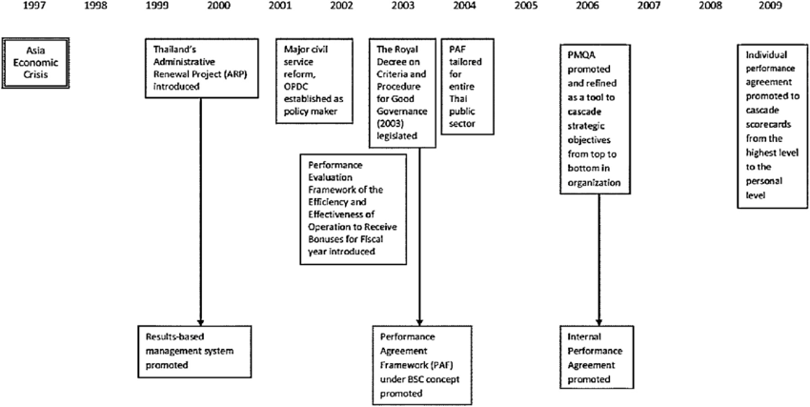

Slide 8
Performance Agreement Framework after 1997
1. Stage One; Development of the Results-Based Management system
2. Stage Two; Establishment of the Office of Public Sector Development Commission (OPDC) คณะกรรมการพัฒนาระบบข้าราชการ
3.Stage Three; Development of the Performance Agreement Framework
4. Stage Four: Refining and extending the Performance Agreement Framework (2006)

Slide 9
Stage One (1999)
Funded by the World Bank under the Budget Modernization Management. Introduced Performance-based budget system (PBBS)
Administrative Renewal Project (ARP), to focus more on measurable output and outcome, transparency and responsiveness. Introducing Result-Based Management system
Learnt from US Government Performance Review Act 1993 and UK Public Service Agreement 1993 (PSA). Both of which prescribed Result-Based Management system.
Balanced Scorecard concept, Self-assessment report, and Bonus as reward

Slide 10
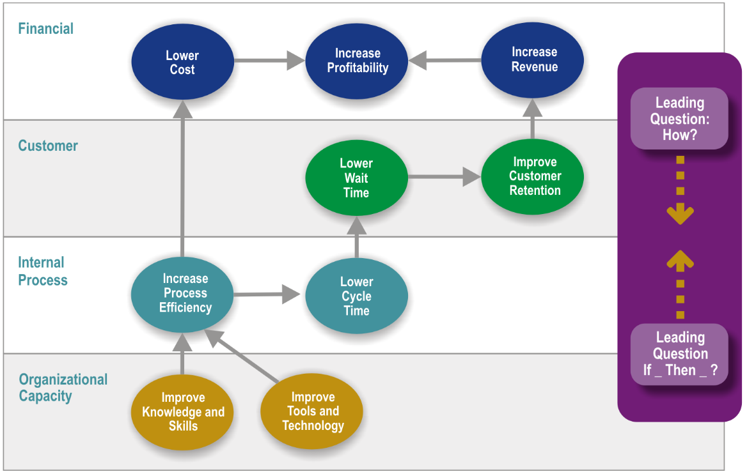
Balanced Scorecard

Slide 11
Result-Based Management system government organization must be able to response to the following issues
-Prospective (what) | Measures (how)
External | Customer, government concerns
Internal | Knowledge, ability, skill
Innovation | Research, Information
Financial | Cost effectiveness, corruption protection, Economy

Slide 12
Performance Evaluation Framework (PEF) continued for only 2 fiscal years (2001-2002)
Civil Service Commission (คณะกรรมการข้าราชการพลเรือน) could not conduct and enforce this new framework.
Balanced Scorecard was unsuccessful.

Slide 13
Stage Two
The Office of Public Sector Development Commission (OPDC) in the late 2002, responsible for developing performance management in public sectors (monitoring and evaluation)
Installation of junior entrepreneurs throughout public sector.

Slide 14
Stage Three
Royal Decree on Criteria and Procedure for good Governance 2003
Performance Agreement of the Public Sector (OPDC, 2004)
Balanced Scorecard was changed to KPI Scorecard, beginning with what will be measured and how to measure, rather than as a strategic score card.
The performance indicators were measured on a five-rating scale, where 5 = signified excellent, 4 = good, 3 = standards, 2 = need further improvement, and 1 = poor.
Self-assessment system.

Slide 15
Stage Four (2006)
Strengthening Performance Agreement Framework (PAF) and Self-assessment scorecard system.

Slide 16
Comments
Negotiation based still ( both on expected targets and actual performance)
Focused more on paper work, less in practices
Budget Bureau still holds monopoly power on budgeting
Line-item and negotiation still used in practice.

Slide 17
Budget Formation Process
 |  | Responsible Agencies
January | Budget Planning | BOT, NESDB, MOF, BOB
February-May | Budget Preparation | BOB, Government Agencies, Council of Ministries
June-September | Budget Adoption | Parliament
All Year | Budget Execution | BOB, Government Agencies
All Year | Budget Evaluation | BOB, Government Agencies

Slide 18
Budget Planning
The four agencies hold a joint meeting. The implications of the annual budget and its underlying policies are calculated in terms of surplus, balance or deficit. All key macroeconomic data factors are considered.

Slide 19
Budget Preparation
Around February, all departments and budget-dependent state enterprises submit budget requests to the Bureau of the Budget through the office of the Permanent Secretary of the Ministries.
Usually, the total amount of funding requested in all governmental budget requests is approximately two or three times more than the available government income.

Slide 20
The amount of the proposed budget of every agency is reduced by the Bureau of the Budget. The budget reduction is based on compromises and the negotiations between government agencies and the Bureau of the Budget.

Slide 21
Budget items are grouped into two main types: entitlements and capital expenditure.
Entitlements are comprised primary of salaries, wages, and public utility fees. This type of expenditure accounts for approximately 70% of the total budget.
Capital expenditures are for equipment , land, and construction.

Slide 22
Budget Adoption
House consideration of the Annual Budget Bill proceeds in three stages: the first involves consideration of the bill in principle; the second involves consideration of the amendments; and the third represents the final consideration.

Slide 23
(In million baht)
Fiscal Year | Total Budget | Budget Cuts | Percentage Cut
1997 | 984,000 | 12,419 | 1.3
1998 | 982,000 | 61,685 | 6.3
2001 | 910,000 | 3,869 | 0.4
2002 | 1,023,000 | 6,249 | 0.6
2003 | 999.900 | 5,375 | 0.5
2004 | 1,028,000 | 192,264 | 18.7
2005 | 1,200,000 | 17,705 | 1.5
2006 | 1,360,000 | 20,351 | 1.5

Slide 24
Budget Execution
Budget execution refers to disbursing funds according to the Annual Budget Act. Spending by all government agencies is controlled by the Bureau of the Budget. Before spending their budgets, government agencies must receive permission from the Bureau of the Budget.

Slide 25
Budget Evaluation
Budget evaluation refers to monitoring and accessing the spending of government agencies. It uses two important indicators, the progress of spending and the output of spending.

Slide 26
Central government Financial Statement at the end of September 30, 2016 in millions of baht
1 Revenue | 2,483,062.9
1.1 Tax | 2,115,044.2
2. Expense | 2,470,351.7
2.1 compensation on employees | 741,744.6
2.2 use of goods and services | 507,145.5
2.3 consumption on fixed capital | 109,181.9
3. Net Operating Balance (NOB) | 12,711.2
4 Net borrowing | 247,041.8

Slide 27
Top 5 best SOEs
 | Profits in Millions of baht
EGAT | 31,178.88
PTT Public
Krung Thai Bank Public
Government Saving Bank
PEA

Slide 28
Top 10 worst SOEs
 | Millions of baht
Thai Airways International | -13,046
Public Warehousing Organization
TOT Public
BMTA
Islamic Bank
MRTA
Marketing Organization for Farmers
Bangkok Dock Company
National Science Museum

Slide 29
Taxation
After 1997, the 5-year Strategic for Economic and Social Restructuring Plan (2005-2009) to realize sustained and quality economic growth
Tax is the biggest source of revenue (88%)
Local government still heavily relies on the central government for revenue

Slide 30
Tax Reforms
Introduction of Value Added Tax (1992)
  All products are taxed at the same rate at 10% (7% temporary)
  Some are replaced by higher excise tax ; automobiles, perfume and cosmetics, petroleum products, alcoholic beverage.
Comprehensive reform of tax structure
  Corporate income tax was set at 30% for all types of businesses (20% in 2016)
Reform on custom tariff structure
  Lower tariff rates and narrowed down ranges to
    1% for raw materials and inputs not produced locally, (upstream industries)
    5% for semi-finished products, (midstream industries)
    10% for finished products, products requiring extra protection, and luxury goods (downstream industries)

Slide 31
Issues
Low tax base
  Tax collection is relatively low as compared to the size of economy (18% of GDP)
  Only 10 million people are eligible for personal income tax and personal income tax fillings are only 6 million.
  Large informal sector./ numerous tax exemptions (mainly for the rich)
  Unfair sharing of tax burden (VAT, excise tax)
Direct versus indirect taxes
  Indirect tax are the predominant sources (60% of revenue)
  Businesses can shift indirect tax burden to others (VAT, excise tax, custom duties)
Decentralization
  Failed to reach 35% local government revenue target to central government revenue (20%)
Social responsible taxes
  Taxation is the economic instrument that can be used to internalize the externality cost (automobiles, petroleum)
  Sin taxes: taxes on products harmful to public health
  Tax incentive for people to look after their patents (30,000 baht allowance)

Slide 32
Direction on taxation reform
Achieving poverty alleviation and resolving income disparity (see Sweden Case)
  Tax higher income groups more
  Lessen tax burden for the lower-income group
  Estate tax/ inheritance tax/ gift tax.
Promoting national competitiveness
  Lower CIT rates (17% in Singapore and 20% in Vietnam)
  Lessen tax burden to SMEs and innovative activities (BOI)
Maintaining a safe and healthy society
  Increase tax rates on sin products and services, including product coverage
  Tax incentives on education, health care, community strengthening activities.
Furthering fiscal decentralization
  Local tax revenue reform
  Greater fiscal autonomy

Slide 33
Questions needed to be answered
CIT
  Different rates for different size (presently tax exempted for businesses with net profit not exceeding 0.3MB)
  Different rates for different activities
PIT
  More progressive tax rate
VAT
  Increase rate to 10% ?
  1% increase in VAT rate leads to 0.95% reduction in GDP.
Excise Tax
  Limit to tax only on harmful to public health/ against morality/ luxury/ receive government concession.
  Sugar contained Beverage, wool carpets, crystal, golf course, telecom services, lottery
Custom duties
  To promote investment (upstream or downstream or both?)
New taxes
  Revising Inheritance tax (presently exceeding 100 MB for 10%)
  Pet tax
  Revision of automobile tax (excise tax, registration fee)

Slide 34
Thailand PIT rates
Taxable Income in baht | Rates (%)
First 150,000 | 0
150,001-300,000 | 5
300,001-500,000 | 10
500,001-750,000 | 15
750,001-1,000,000 | 20
1,000,001-2,000,000 | 25
2,000,001-5,000,000 | 30
Over 5,000,000 | 35

Slide 35
PIT rates in Sweden
Taxable Income In USD | Rates in %
Less than 27,000 | 0
27,000-62,000 | 31
62,000-88,000 | 31+20
88,000 | 31+25

Slide 36
Central government revenue at the end of September 30, 2016 in millions of baht
1. Revenue | 2,483,063.9
2 Tax | 2,115,044.2
2.1 Tax on income | 895,204.9
2.1.1 PIT | 268,289.7
2.1.2 CIT | 626,915.2
2.2 VAT | 480,833.0
2.3 Excise | 435,145.6
2.4 Import duties | 100,155.9

Slide 37
External Government Debt Outstanding
(Sept, 2016)
Direct government ; 4,471,220.22 MOB
External ; 98,735.91 MOB
 | %
Multilateral Organization
1.1 World Bank | 10.23
1.2 ADB | 2.83
2. Foreign Government
2.1 JBIC | 40.69
3. International Capital Market
3.1 Syndication | 15.95
3.2 Bonds, PN | 9.06

Slide 38
Reading Lists
Sujjapongse, Somchai, Tax policy and reform in Asian countries: Thailand’s perspective, Journal of Asian Economics 16, 2005, 1012-1028.
Sutheewasinnon, P. et al., Development of a performance management system in the Thailand public sector: Isomorphism and the role and strategies of institutional entrepreneurs, ResearchGate, 2015

Slide 39
Question
Do you think Thailand fiscal reform after 1997 has been successful or not and why? (start from “what are the objectives of the reform?”)
Provide some policy suggestions for further fiscal reform. (objectives and example)

