Slide 1

MK 322 Retail Management
Chapter 9: Human Resource Management
Part I
By Ajarn Suwalya K.

Slide 2

Objectives of Human Resource Management (HRM)

Slide 3
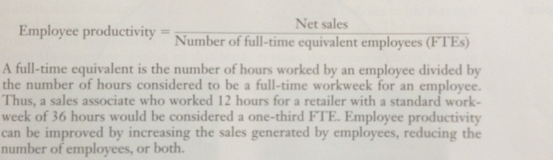
HRM Performance Measures
Productivity is the sales generated per employee calculated as follows
Notes:
1

Slide 4
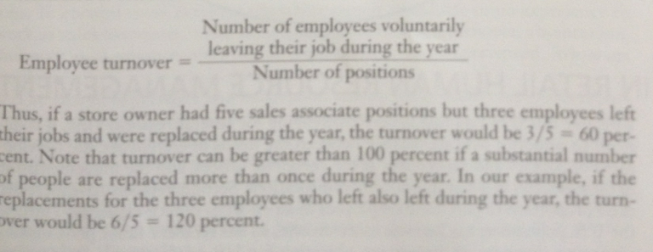
HRM Performance Measures
Turnover: Employee turnover is calculated as follows
Notes:
1

Slide 5

HRM Performance Measures
Engagement is emotional commitment by an employee to the organization and its goals
It goes beyond employee happiness and satisfaction
Engaged employees care about their work and company
Notes:
1

Slide 6
HRM Performance Measures
They don't just work for the paycheck or promotion
They are motivated to support retailer to improve customer satisfaction
They are less likely to leave the company
Retailers use employee surveys to measure employee engagement
Notes:
1

Slide 7
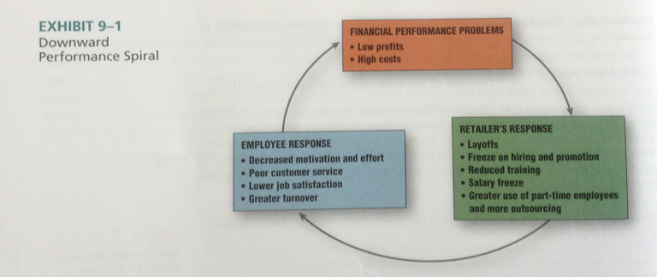
HRM Performance Measures
The mismanagement of HR can lead to a downward performance spiral
Notes:
1

Slide 8

Challenges in Retail HRM

Slide 9
Balancing the HR Triad
Many retailers feel that human resources are too important to be left only to the HR department
The full potential of a retailer's human resources is realized when three elements of the HR triad work together-HR professionals, store managers and employees
Notes:
1

Slide 10
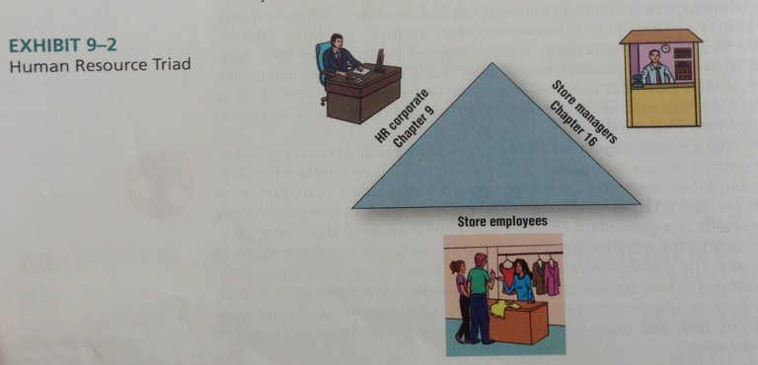
Balancing the HR Triad
Notes:
1

Slide 11
Expense Control
Retailers must control their expense if they are to be profitable
They are cautious about paying high wages to perform low-skill jobs
To control costs, people with little or no experience are hired, ie. Sales associates, bank tellers, waiters
Result is absenteeism, high turnover, poor performance
Poor appearance, manners, and attitudes have negative effect on sales and customer loyalty
Notes:
1

Slide 12
Part-Time Employees
One method of controlling expense
Computerized scheduling systems help retailers control costs, as well improve their service provision because they can match their staffing to customer demand on an hourly basis
Heavy staffing during events
Part-time employess are less expensive as they require no health or retirement benefits and little job security
Notes:
1

Slide 13
Utilizing Diverse Employee Group
Retailers in U.S. are increasing efforts to recruit,train,manage,and retain mature, minority, and handicapped workers
As for Thailand, more strict measures on employing ASEAN labor work force
Notes:
1

Slide 14
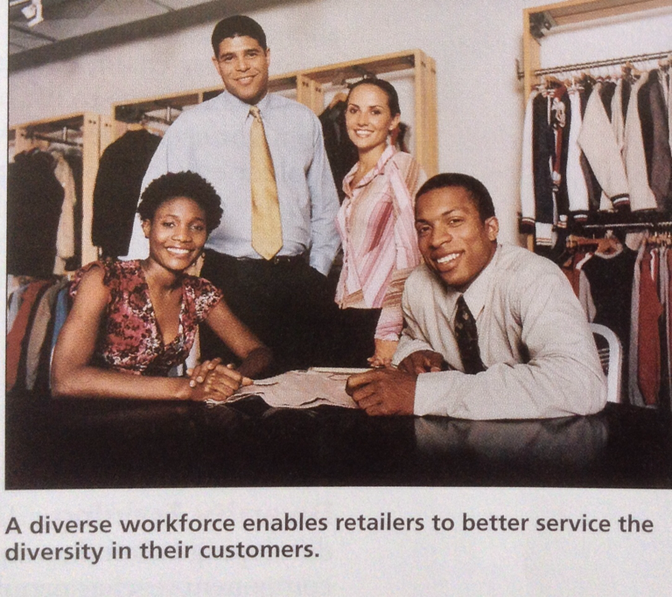
Utilizing Diverse Employee Group
Notes:
1

Slide 15

Designing the Organization Structure for a Retail Firm

Slide 16
Designing the Organization Structure
The organization structure identifies the activities to be performed by specific employees and determines the lines of authority and responsibility in the firm
The first step in developing the organization structure is to determine the tasks that must be performed
Notes:
1

Slide 17
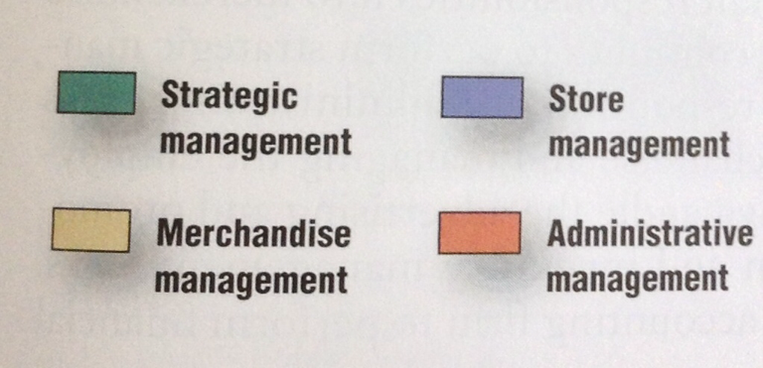
Designing the Organization Structure
Notes:
1

Slide 18
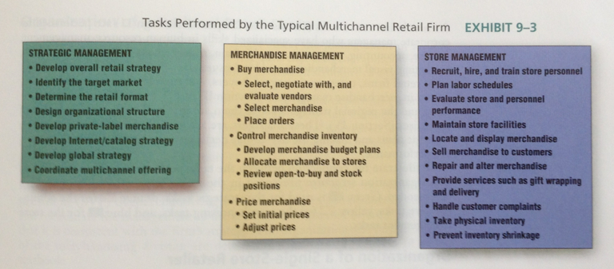
Designing the Organization Structure
Notes:
1

Slide 19
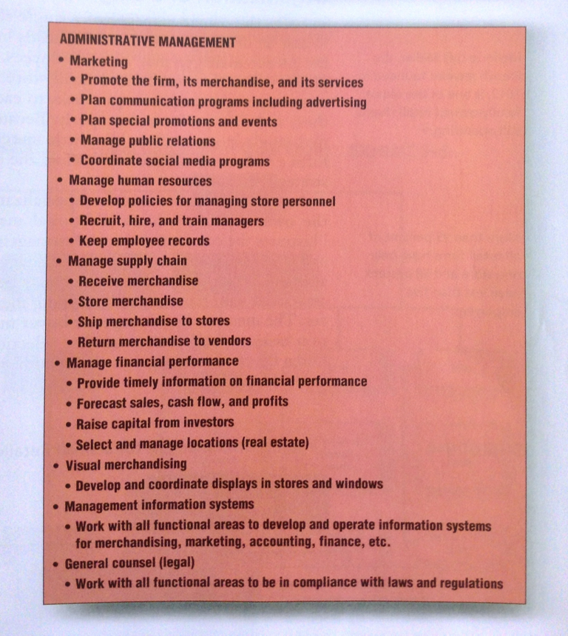
Designing the Organization Structure
Notes:
1

Slide 20

Organization of a Single Store Retailer
Because the number of employees is limited, single store retailers have little specialization
Each employee may perform a wide range of activities, while the owner-manager is responsible for all strategic decisions
Notes:
1

Slide 21
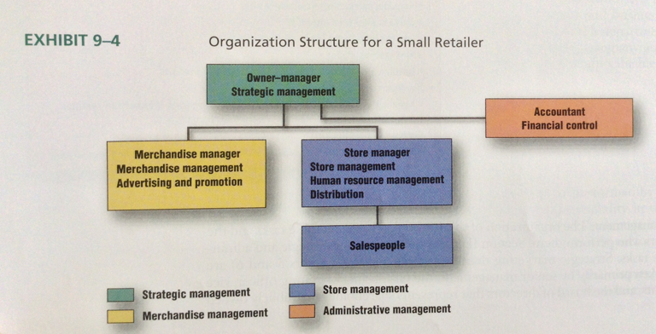
Organization of a Single Store Retailer
Notes:
1

Slide 22


