Slide 1
FN 281: Personal Finance
Thanachote Rungsitivat, CFA, FRM

Slide 2
Cash Management Strategy
Meeting Daily Money Needs
  Managing Cash – cash, check, credit/debit card
    Avoid overspending – through credit card – will need to payback using savings or borrowing leads to lower savings and future wealth.
    Failing to put unneeded funds in an interest-earning savings account or investment plan to achieve long term goals.
  Sources of Quick Cash
    Liquidate savings or borrow
      Savings account, Mutual Funds, Other investments, etc.
      Borrow – credit card, personal loan, etc.
      Both will reduce your net worth and your potential to achieve long-term financial security.

Slide 3
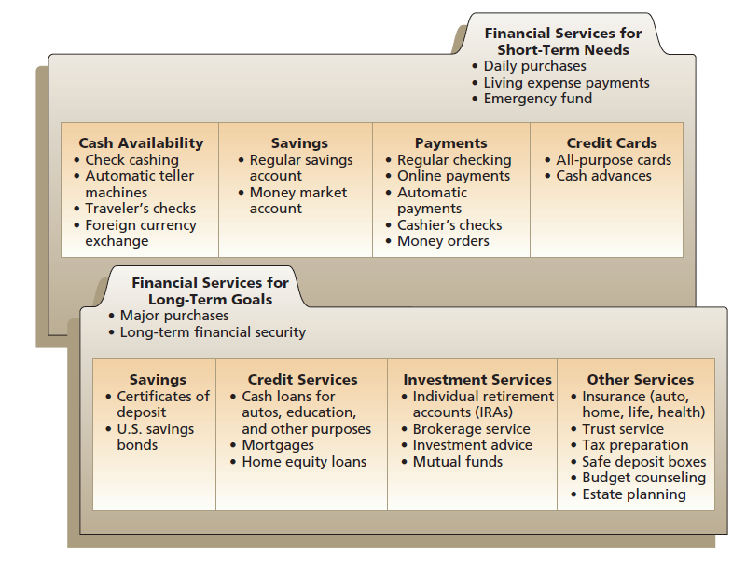
Cash Management Strategy

Slide 4
Types of Financial Services
Savings – safe storage of funds for future use. Selection commonly based on interest rate earned, liquidity, safety and convenience.
  Depository Protection Agency
Payment Services – The ability to transfer money to other parties. E.g. Current accounts, etc.
Borrowing – short term borrowing – credit cards and cash loan. Long term borrowing – home mortgage
Other financial services – insurance protection, investments, real estate purchases, tax assistance, financial planning, etc.

Slide 5
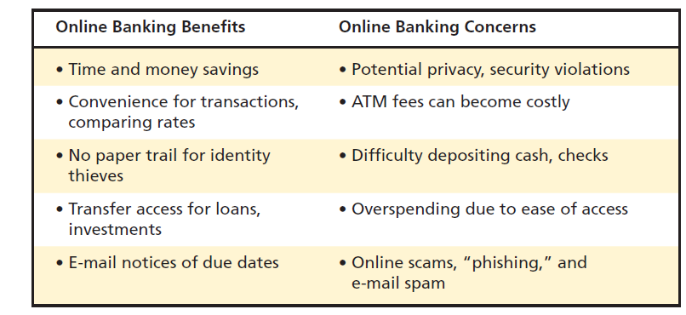
Online banking

Slide 6
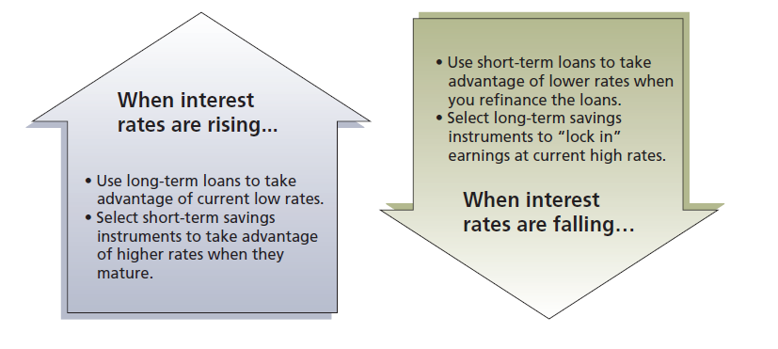
Opportunity Costs of Financial Services

Slide 7
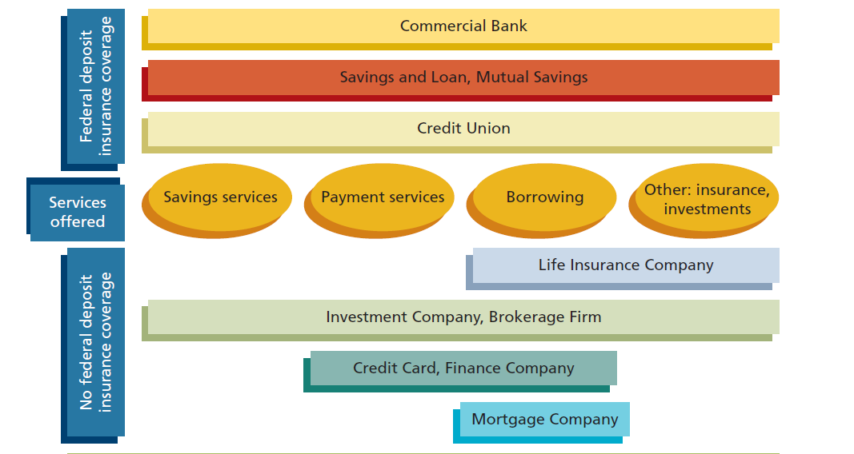
Financial Institutions

Slide 8
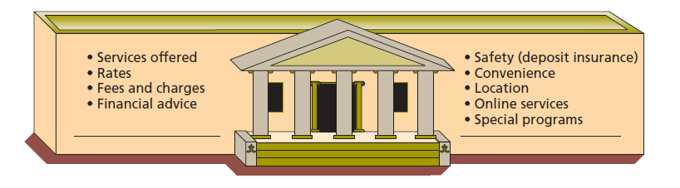
How should you choose a financial institution?

Slide 9
Case: Smith’s Situation
Smith has overspent, because he has made too many impulse purchases
Smith does not always have enough money in his current account to pay his current bills.
Smith occasionally has to use his savings to pay for everyday purchases.
Smith does not always put extra funds in a savings or investment account.

Slide 10
Case: Smith’s Situation
Analysis
  Smith realized that he does not manage his cash very well.
  He needs to understand how to manage his daily money needs effectively.
  He needs to understand that there are several financial services to meet a variety of his needs.
  He has not realized that there are opportunity costs associated with the way he uses these financial services.

Slide 11
Smith’s Choices
Deposit Institutions
  Commercial Banks
  Savings and Loan Associations
Other Financial Institutions
  Life Insurance Companies
  Investment Companies
  Finance Companies
  Mortgage Companies
  Pawnshops

Slide 12
Commercial Banks
Full range of financial services (most common for Smith – he also knows that if he chooses a large commercial banks, they often have higher creditability and more branches – making him easier to get money from his account if required)
  Current Account
  Savings Account
  Lending
  Other Services
Convenience of many full-branches services
DPA insurance for up to certain amount

Slide 13
Savings and Loan Association
Needs to be a member
Owned by depositors
Profits go to depositors by paying them higher rates of savings
Higher risk
Not highly regulated

Slide 14
Life Insurance Companies
Life Insurance Policies
  Provide financial security to dependents of policyholder
  Many policies have savings and investment features (Smith could be interested to put in his long term investments)
  Life Insurance Companies have expanded their services to include investment and retirement planning – also provide tax savings benefit.

Slide 15
Investment Companies
Also referred to as Fund Management Companies
Allow Many Different Investment Options
Offer Money Market Funds (Investment in bonds)
Pays a competitive interest rates on investments
Smith does not consider other type of financial institutions at this time.

Slide 16
Savings Plan
Savings Account
Bill of Exchange
Bonds

Slide 17
Evaluating Savings Plans
Rates of Return
  Compounding: The yield on your savings usually will be greater than the stated interest rate. Compounding refers to interest that is earned on previously earned interest.
  The more frequent the compounding, the higher the rate of return will be.

Slide 18
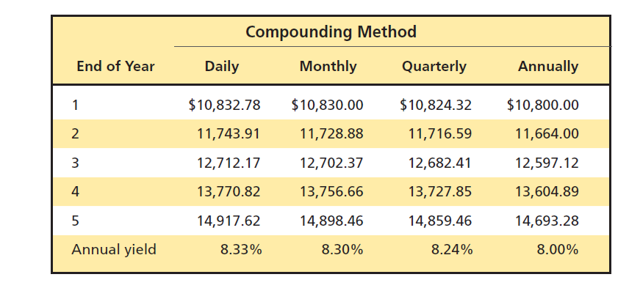
Annualized Percentage Yield (APY)
APY = 100 [(1 + Interest/Principal)^{365/days in term} – 1]

Slide 19
Inflation
The rate of return you earn on your savings should be compared with the inflation rate. When the inflation rate was over 10 percent, people with money in savings accounts earning 5 or 6 percent were experiencing a loss in the buying power of that money.
As inflation rate increases, the interest rates offers to savers should also increase. This gives you an opportunity to select savings option that will minimize the erosion of your money on deposits.

Slide 20
Tax considerations
The interest rate you earned are normally taxed at 15%. Look at the after tax interest rate return on your savings to compare.

Slide 21
Liquidity
Liquidity allows you to withdraw your money on short notice without a loss of principal or fees. Some savings plans (Fixed deposits) impose penalties for early withdrawal or have other restriction (amount xxx can be withdraw per day).

Slide 22
Safety
Depository Protection Agency coverage (ONLY for commercial banks)
Per Holder name per Bank
To diversify: deposit up to coverage amount will all commercial banks
Period | Coverage
11 Aug 2012 – 10 Aug 2015 | Baht 50 million
11 Aug 2015 – 10 Aug 2016 | Baht 25 million
11 Aug 2016 – Onwards | Baht 1 million

Slide 23
Restrictions and Fees
Other limitations can affect your choice of a savings program.
  Some institutions charge a transaction fee for withdrawal
  Some free offering in the beginning once you open account requires you to do something – maintaining minimum balance up to a certain amount for a certain time period. Failing to do so may causes you to make suboptimal decision during the account opening.

Slide 24
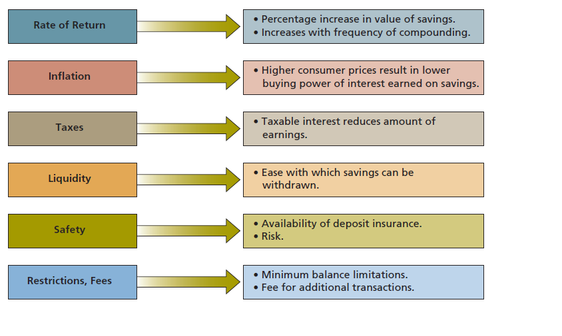
Evaluating Savings Plan

Slide 25
Factors Used to Evaluate Savings Options
Rate of Return
  Compounding
    How much will the account grow over time?
    How often is interest compounded?
    Look at full disclosure on all savings accounts of fees, interest rates and APY.
Inflation
  What is the interest rate Smith will earn compared to the rate of inflation?
  Does the interest rate change with market rates?

Slide 26
Factors Used to Evaluate Savings Options
Tax considerations
  Is the money Smith earns taxed?
Liquidity
  How easy is it to take money out of his savings account?
  Is there any penalty for withdrawing the money?

Slide 27
Factors Used to Evaluate Savings Options
Safety
  Is the savings account insured by DPA?
Restrictions/Fees
  Are there minimum balance requirements?
  What are the fees if Smith goes below the minimum balance requirements?
  Is there a transaction fee for withdrawal from the account?

Slide 28
Smith’s Savings Choice
Smith has decided to keep two savings accounts. He wants to keep his regular savings account, because it is liquid and does not require a minimum balance. He decides to keep his emergency fund in this account. He also decides to get a money market fund with an investment company. He knows this account s not insured but decides the additional interest he will receive is worth the risk.

Slide 29
Electronic Payment Methods
Can Smith check his account balances online?
Can Smith transfer funds electronically from one account to the other?
Can Smith get preauthorized payments for his regular bills?
Can Smith use his debit card to make purchases?
Can Smith pay his bills online?
Are there any fees for any of these services?

Slide 30
Factors Used to Evaluate Checking Accounts
Restrictions and Fees
  What are the minimum balance requirements and the penalties for going below this balance?
  Are there service charges?
  What are the check printing and overdraft fees?
Interest
  Does the account pay interest?
  How often does it pay interest?
Special Services
  Does the account have overdraft protection?
  Does the financial institution return cancelled checks?
  Are other services (safe deposit box, low-rate loans, etc) that may be used infrequently bundled with the account?

Slide 31
Payment Methods
Electronic Payments
  Debit Card
  Online Payments
  Stored-value cards – prepaid cards
  Smart Card (True money, Rabbit, etc)

Slide 32
Avoid Identity Theft
Use different signature on checks, withdrawal
Shred or burn financial information containing your name, account number, address, credit card number, etc.
Use passwords involving both letters and numbers
Subscribe to SMS services
Keep your credit card slips in a safe place.
Maintain up to date anti virus software.
Make sure you do not forget your ATM card in the machine.
Do not provide any financial information on a call as banks do not normally contact you for that.

Slide 33
Consumer Credit
Credit is an arrangement to receive cash, goods, or services now and pay for them in the future
Consumer credit refers to the use of credit for personal needs (except a home mortgage) by individuals and families, in contrast to credit used for business purposes
In January, you pay a bill for electricity that you used in December.

Slide 34
Choices
Draw on savings
Use Present earnings
Borrow against expected future income
Each of these alternatives has trade-offs

Slide 35
Uses and Misuses of Credit
Using credit to purchase goods and services may allow consumers to be more efficient or more productive or to lead more satisfying lives
  Medical emergency may leave a person strapped for funds.
  It may be possible to buy an item now for less money than it will cost later.
  But it probably is not reasonable to borrow for everyday living expenses or finance a Mercedes Benz when an Eco-car is all your budget allows.
Using credit increases the amount of money a person can spend to purchase goods and services now. But the trade-offs is that it decreases the amount of money that will be available to spend in the future. However, many people expect their incomes to increase an therefore expect to be able to make payments on past credit purchases and still make new purchases.

Slide 36
Questions you should consider
Do I have the cash I need for the down payment?
Do I want to use my savings for this purchase?
Does the purchase fit my budget?
Could I use the credit I need for this purchase in some better way?
Could I postpone the purchase?
What are the opportunity costs of postponing the purchase (a possible increase in price?)
What are the dollar costs and the psychological costs of using credit (interest, other finance charges, being in debt, etc.)

Slide 37
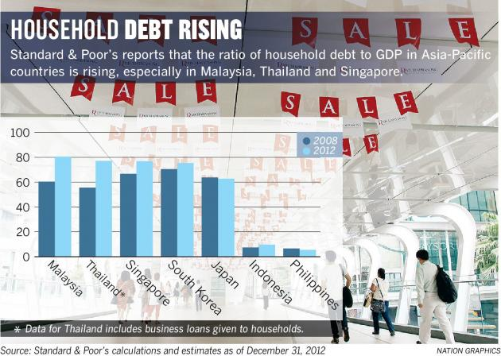
Economy

Slide 38
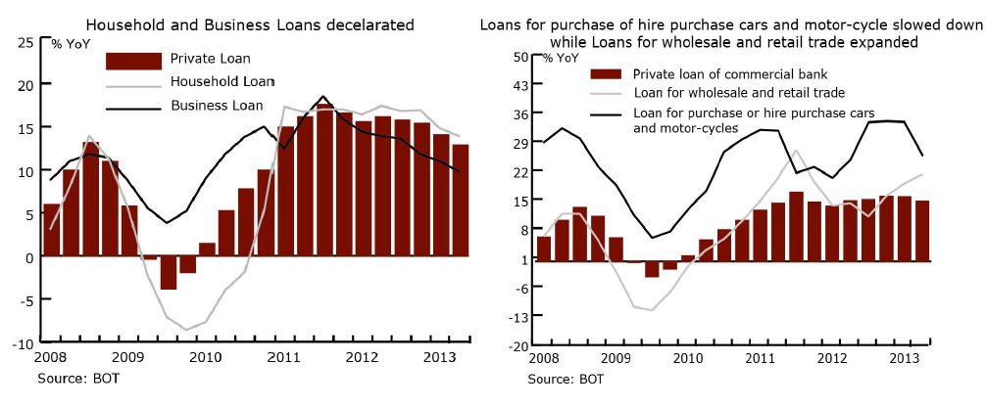
Thailand

Slide 39
Advantages of Credit
Consumer credit enables people to enjoy goods and services now
Credit card permit the purchase of goods even when funds are low.
Credit is more than a substitute for cash – many of the services it provides are taken for granted. Every time you turn on water tap, flick the light switch, use mobile phone – you are using credit.
It is safer to use credit – having credit card while travel rather than large sum of cash.
The use of credit cards can provide up to 45 days of float.
Benefits of credit card such as emergency services, fitness, discounts, etc.

Slide 40
Disadvantages of Credit
Temptation to overspend.
Failure to repay may result in loss of income, valuable property, reputation
Slower progress toward financial goals
It does not increase total purchasing power.
There is interest to it. Paying for purchases over a period of time is more costly than paying for them with cash. Be careful with compounding effect of interest on interest.

Slide 41
Types of Credit
Closed-End Credit
  Used for specific purpose and involves a specified amount (eg. Mortgage loans, Automobile loans, Installment loans)
  It usually involve a written agreement for each credit purchase. A down payment or trade-in may be required, with the balance to be repaid in equal monthly payments over a period of time. Generally, the seller holds title to the merchandise until the payments have been completed.
  Most common types of closed-end credit:
    Installment sales credit – make down payment and usually sign a contract to repay the balance plus interest and service charge in equal installments over a specific period
    Installment cash credit – direct loan of money for personal purposes – home improvements or vacation expenses. No down payment and make payments in specified amounts over a set period.
    Single lump-sum credit – a loan that must be repaid in total on a specific day.

Slide 42
Types of Credit
Open-End Credit
  Normally used to make small purchases at different store. Examples are credit card and overdraft lines.
  You can use open-end credit to make any purchases you wish if you do not exceed your line of credit – the maximum amount of credit the lender has made available to you.
  You may have to pay interest or other finance charges for the use/having of such credit.
    Credit card
    Smart Cards
    Debit Cards
    Gift Cards
    Travel/ Oil Card
    Home Equity Loans
    Car for Cash

Slide 43
Thank you

