Slide 1

Group Assignment 5
Retail Growth Strategies

Slide 2
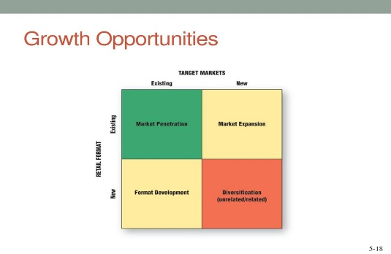
Group Assignment: Please refer the assignment to your group project category
Please analyze your retail project category in its current situation. ( does not necessarily have to be retail store of the project you are working)
Identify the 4 growth strategies they are implementing for your retail industry.
Analyze its success and failure ( could be both domestic and international examples)
Please create a power point slide presentation on each of the 4 growth strategy- one slide/strategy
Please create 4 pages ppt. slide maximum to be due next Tuesday March15th . Please design the 4 pages by using photos, graphs, charts, visuals to make the slides interesting ka.
Notes:
1

Slide 3
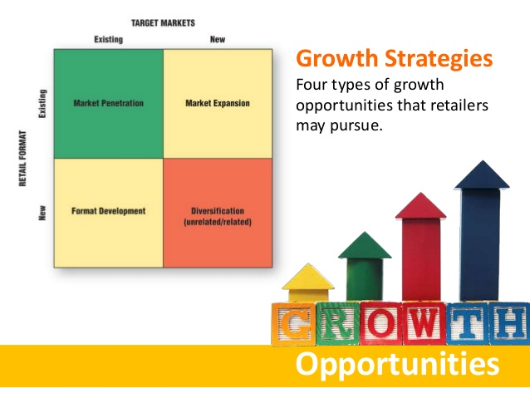
Notes:
1

