Slide 1

Mk 202 Last Group Work:
IMC, Price,Distribution
Group Presentation
You are to develop (design) for your new product at least one type of advertisement which could be for online, website, print ad (posters, magazine ad, or outdoor advertising, etc), or Television Commercial (TVC).
Please note:
1. You are to base your communications message on your new product positioning.
2. How good your ad is depends on “SMILE” criteria

Slide 2


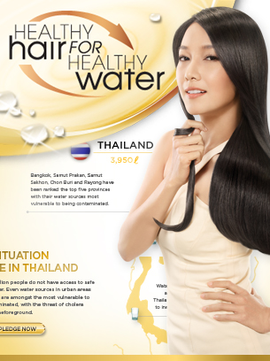


IMC Strategy for Pantene: No matter what Pantene ad you see, it strongly represents the brand through its clear, consistent and compelling communications via magazine, posters, launch events television or even its packaging..this is integrated marketing communications, the message is harmonized to build strong positioning for the brand.

Slide 3
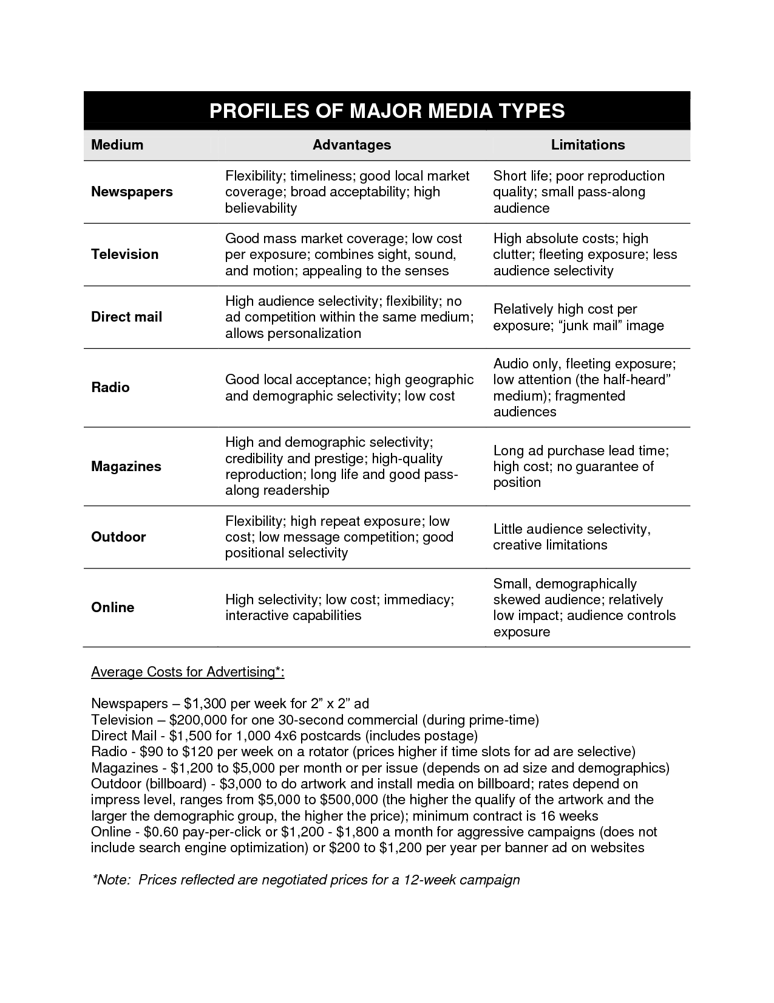

Slide 4
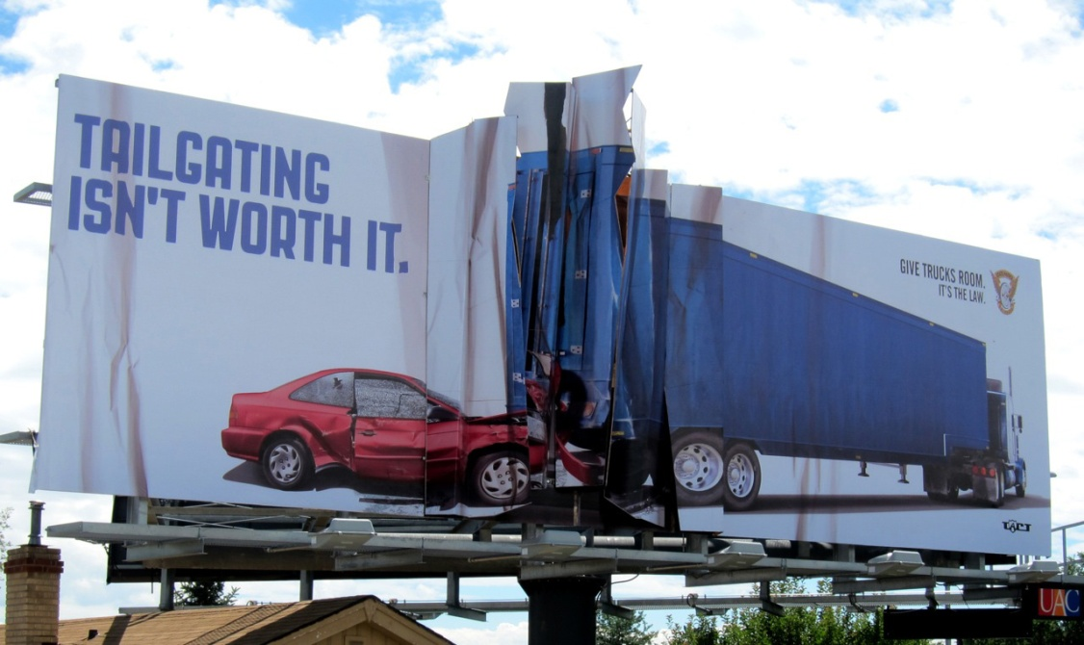
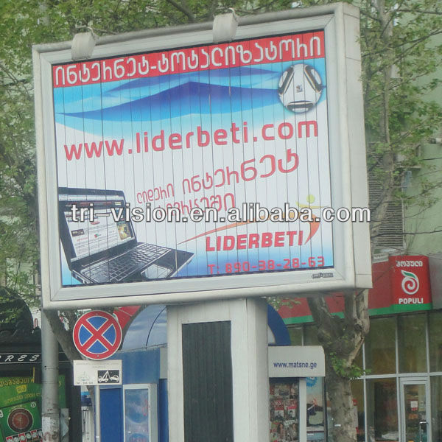
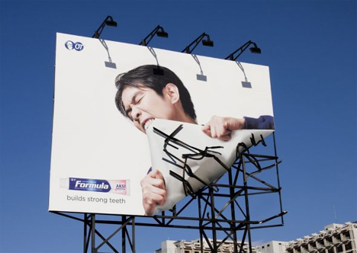
Outdoor Ads
Billboards
Tri-visions

Slide 5
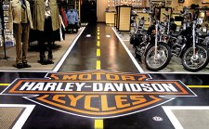
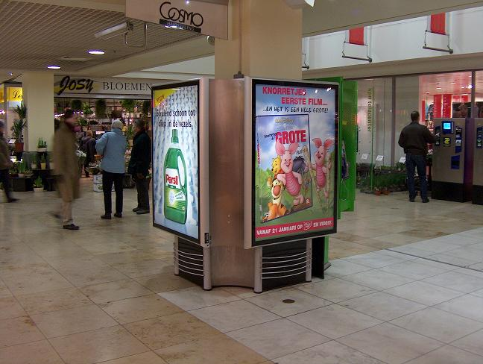
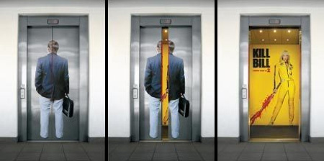
Indoor Ads
Floor vision
Elevator Ad

Slide 6

Magazine Ad

Slide 7
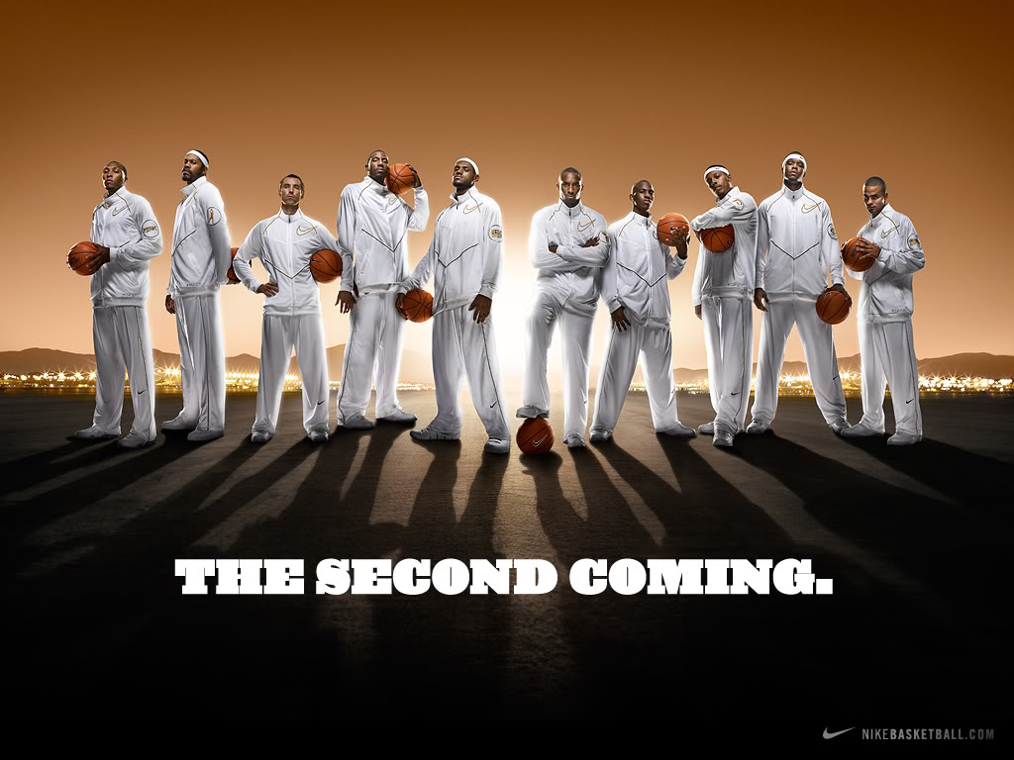
Billboard/Magazine Ad
Celebrity endorsers: LeBron James, Kobe Bryant, and a host of other NBA superstars lend their images to Nike brands.

Slide 8

Magazine Ad

Slide 9

Brochures

Slide 10
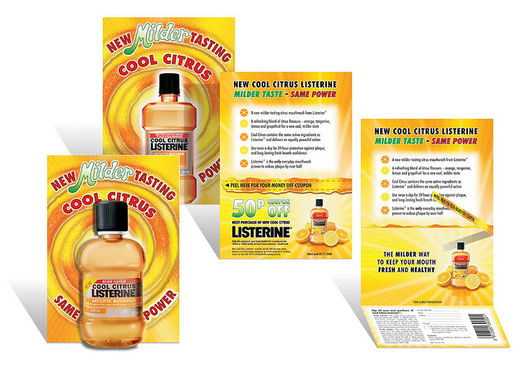
Sampling with leaflet

Slide 11
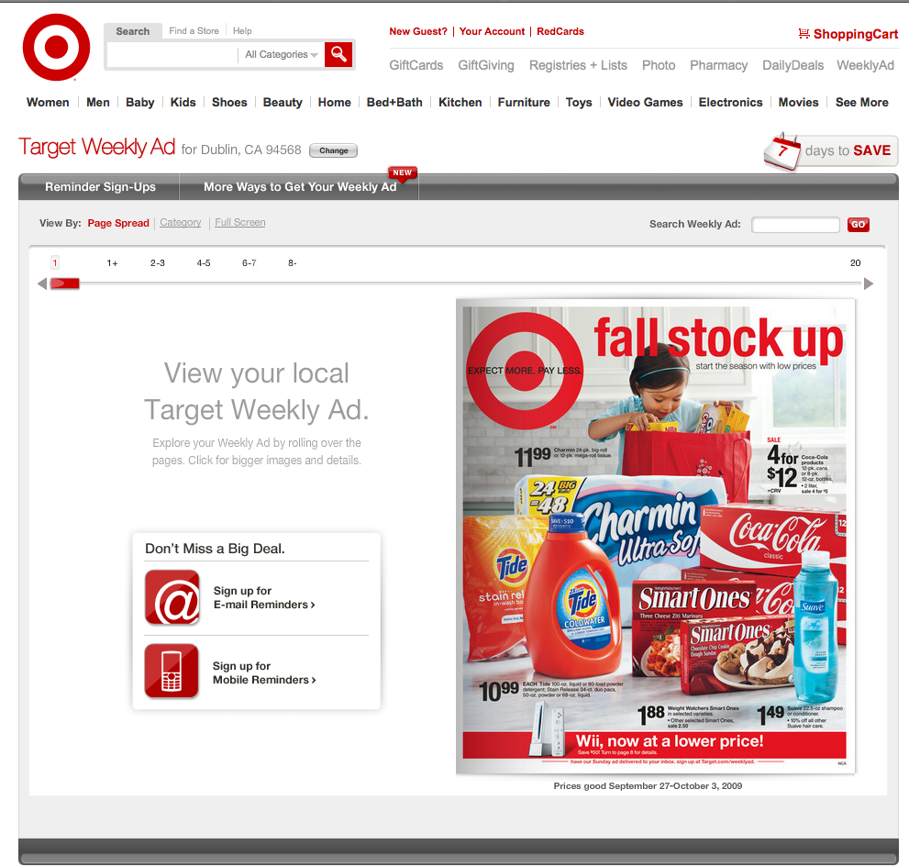
Online Ads

Slide 12
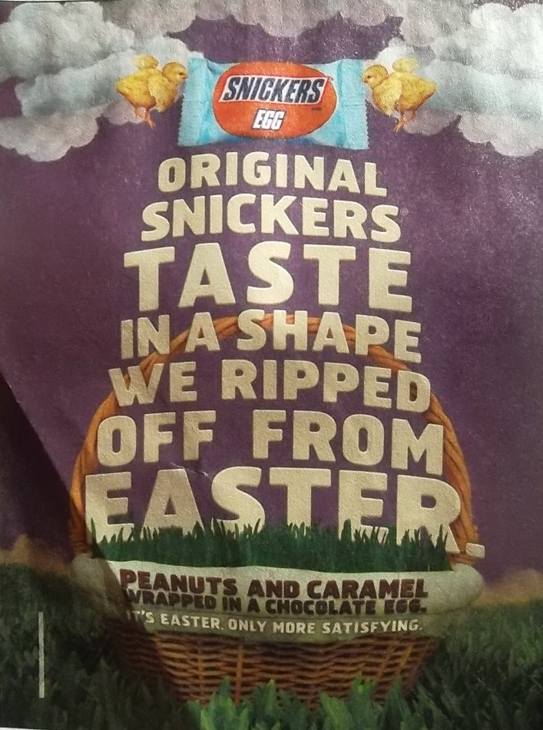
Print Ad
Example
From text:
Message format: To attract attention, advertisers can use novelty and contrast, eye-catching pictures and headlines, or distinctive formats, as in the Snickers ad.

Slide 13
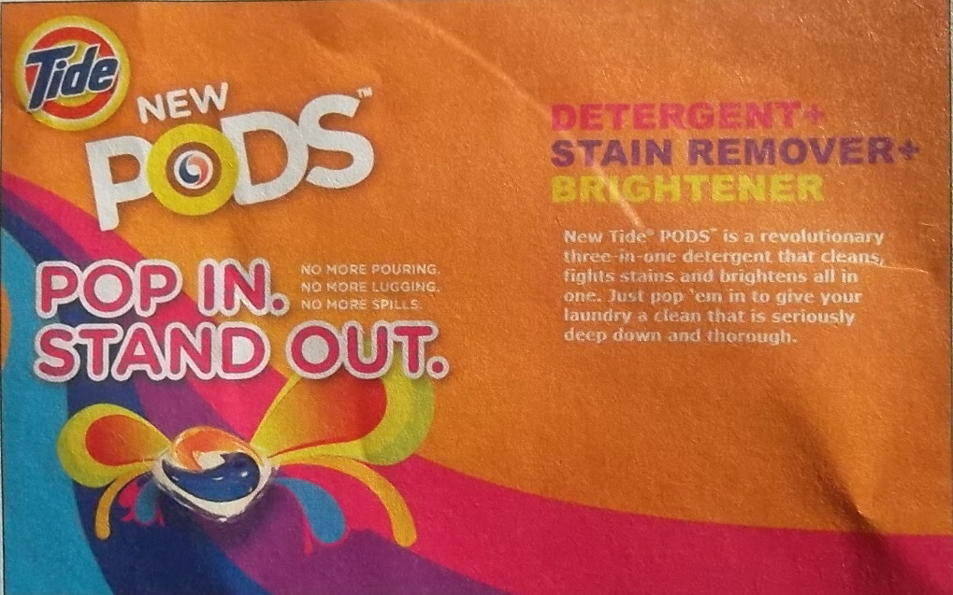
Print Ad Example from text:
Moving consumers through the buyer-readiness stages: P&G used an extensive $150 million marketing campaign to create awareness and knowledge for its innovative new laundry product. Tide Pods.

Slide 14
Final Group Presentation
Section 1: Dec 2
Section 2: Dec 4
You are to present a 10 minute presentation in this sequence:
1. Final Product
2. Pricing (lesson in next class)
3. Distribution
4. Promotion (IMC)
5. Key Lessons Learned

