Slide 1
FN 331: Financial Institutions Management
Class 6
Copyright © 2014 by the McGraw-Hill Companies, Inc. All rights reserved.
Notes:
1

Slide 2
Overview
This chapter discusses mutual funds and hedge funds:
  Activities of mutual funds
  Size, structure, and composition
  Balance sheets and recent trends
  Regulation of mutual funds
  Global issues
  Activities of hedge funds
  Regulation of hedge funds
Ch 5-2

Slide 3
Mutual Funds
Diversification opportunities enhanced for small investors
  Economies of scale
  Predominantly open-ended funds
Ch 5-3

Slide 4
Mutual Funds
Rapid growth in funds during the 1990s
Slower rate of growth in the industry in early 2000s than in 1990s
  Trading abuses contributed to slowdown
  20 percent drop in assets during 2008
Ch 5-4

Slide 5
Mutual Funds
2012:
  More than 7,000 stock and bond mutual companies
    Money market mutual fund – investing in money market securities with maturity less than 1 year. The fund is very liquid, low risk of default
    Balance fund – investing in both stock and bonds
  Total assets of $10.26 trillion
  More than 7,600 firms and $12.87 trillion if money market mutual funds included
Ch 5-5

Slide 6
Size, Structure, and Composition
  First mutual fund: Boston, 1924
    Slow growth, initially
  Advent of money market mutual funds, 1972
    Regulation Q – to impose the cap of interest on both deposit and lending in order to prevent the depository institutions to undertake risky transactions without considering the depositor’s principal.
    In 1970s, the Treasury bills offering more than 17% due to inflation already at 16%, and money market mutual fund being established in order to allow the retail investors to able to buy Treasury assets.
Ch 5-6

Slide 7
Size, Structure, and Composition
  Total net assets in mutual funds:
    1940: $0.5 billion
    1990: $1,065.2 billion
    2000: $6,964.6 billion
    2007: $12,001.5 billion
    2008: Dropped to $9,603.6 billion
    2009: $11,113.0 billion
    2010: $11,831.9 billion
    2012: $13,045.2 billion
Ch 5-7

Slide 8
Structure
Institutional funds
  80 percent of retirement plan investments (from pension fund / provident fund contribution, insurance premium for long-term investment)
  Low costs
    No additional distribution fees
  Risk levels set by retirement plan sponsors
Low barriers to entry in mutual fund industry
  Low concentration ratio and considerable competition
  No hindrance in opening mutual funds because the government foresee as investment savings rather than competition
Ch 5-8

Slide 9
Size, Structure, and Composition
  By asset size, mutual fund industry second most important FI group
  Recent inroads by commercial banks and insurance companies
    Mellon purchase of Dreyfus
    As of 2012, banks managed approximately 7% of mutual fund assets
    State Farm (more than 9,000 agents)
    As of 2012, insurance companies managed approximately 5% of mutual fund assets
Ch 5-9

Slide 10
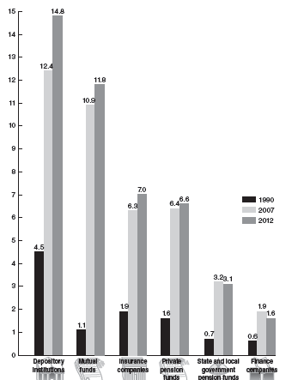
Assets of Major FIs: 1990, 2007, 2012
Ch 5-10
Notes:
10

Slide 11
Types of Mutual Funds
Types of long-term funds:
  Bond funds, equity funds, hybrid funds
Volatility of long-term funds share:
  74.3% of mutual fund assets, 1999
  2002, long-term funds dropped to 62.1% of assets, losing ground to MMMFs (Money Market Mutual Funds – T-bill offering very low interest rate)
  72.1% in 2007, 59.1% in 2008
  68.1% in 2009, 78.7% in 2012
Ch 5-11

Slide 12
Share of Long Term Funds
If MMMFs uninsured:
  Higher returns compared to deposits because MMMFs are not principal protected
  September 2008:
    Risk aversion of investors changed
    Run on Reserve Primary Fund (due to Lehman Brothers link)
Temporary extension of government insurance to MMMFs during the crisis
Ch 5-12

Slide 13
Mutual Funds
Money market mutual funds
  25.7% of assets, 1999
  37.9% of assets, 2002
  27.9% in 2007, 40.9% in 2008
  31.9% in 2009, 21.3% in 2012
As of 2012, 44.4 percent of US households owned mutual funds
  Down from 52 percent in 2001
Ch 5-13

Slide 14
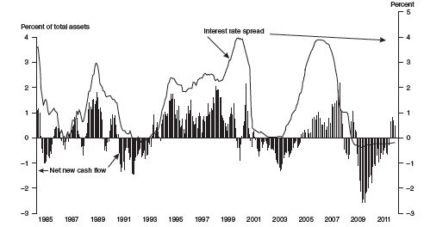
Interest Rate Spread and Net New Cash Flow to MMMFs
Ch 5-14
Notes:
14

Slide 15
Overview of Mutual Funds
  Objectives (and adherence to stated objectives), rates of return, and risk characteristics vary
Examples:
  Capital appreciation funds
  World equity
  Corporate bond
  High-yield bond
  World bond
  Government bond
Ch 5-15

Slide 16
Returns to Mutual Funds
  Income and dividends of underlying portfolio
  Capital gains on trades by mutual fund management
  Capital appreciation in values of assets held in the portfolio
    Marked-to-market – to reflect the actual value of the assets in the portfolio on daily basis, unrealized gain/loss.
    Net asset value (NAV) – value of equity in mutual fund divided by number of shares outstanding
Ch 5-16

Slide 17
Types of Funds
  Open-ended funds
    Comparable to most corporate securities traded on stock exchanges
  Closed-end investment companies
    Fixed number of shares
    Example: REITs
    May trade at premium or discount (but liquidity will be less than the open-ended funds)
    Exchange traded funds (ETFs) – innovative financial products, having combining features of mutual funds and stocks
  Load versus no-load funds
Ch 5-17

Slide 18
Load versus no-load funds
  Load fund – mutual fund with upfront sales or commission charge to be paid by investors.
  No-load funds – mutual fund that does not charge upfront fees or commission charges on the sales to investors.
Ch 5-18

Slide 19
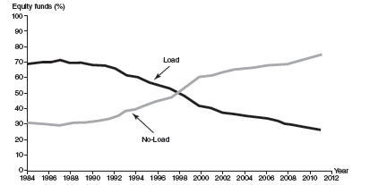
Load versus No-Load: Share of Assets
Ch 5-19
Notes:
19

Slide 20
Mutual Fund Costs
Two types of fees:
  Sales loads
    Generally, negative effect on performance outweighs benefits
    Short term versus long term investment horizon alters impact of loads on cost
  Fund operating expenses
    Management fee
    Fees in relation to distribution and other operating costs of mutual fund shares
Ch 5-20

Slide 21
Balance Sheet and Trends
Money Market Funds (MMFs)
  Key assets are short-term securities (consistent with deposit-like nature)
    2012: $2,076.9 billion (82.8% of total assets)
    2008: flight to safety, out of corporate and foreign bonds
  Most have share values fixed at $1 and adjust number of shares owned by the investor
  Significant liquidity risk highlighted during crisis
Ch 5-21

Slide 22
Balance Sheet and Trends
Long-term funds
  Stocks comprised over 70.0 % of asset portfolios in 2007 versus 55.5% in 2008
  Credit market instruments next most popular assets
  Shift to other securities such as credit market instruments (long-term corporate bonds) when equity markets not performing as well
Ch 5-22

Slide 23
Regulation of Mutual Funds
  One of the most closely regulated among non-depository FIs
  Primary regulator: SEC
    Emphasis on full disclosure and anti-fraud measures to protect small investors
    NASD supervises mutual fund share distributions
Ch 5-23

Slide 24
Regulatory Changes
Prosecutions in light of trading abuses in early 2000s
  Market timing
  Late trading
  Directed brokerage
  Improper fee assessments
Changes include SEC requirements for independent board members, reporting and disclosure requirements
Ch 5-24

Slide 25
Further Regulatory Changes
Increase in requirements for disclosure
  Enhanced transparency
  All listed companies in stock exchange around the world must submit the 3 financial statements (Balance Sheet, P&L account, CF statements) to SEC after the quarter end.
  In US. Sarbanes-Oxley Act of 2002 – requiring public limited companies (listed and non-listed, including mutual funds) to make sure that their board audit committees have at least one individual who is familiar with GAAP – Generally Accepted Accounting Principles and has experience in the internal auditing controls
Requirement for firms to have a chief compliance officer, 2004
Ch 5-25

Slide 26
Compliance Officer
  Reports directly to mutual fund directors (representatives of shareholders being selected by shareholders to oversee the performance of the management), not executives (fund managers) of the fund
  Responsible for reporting any wrongdoings
  Policing personal trading of fund managers
  Ensuring accuracy or reporting to regulators
  Reviewing fund business practices
Ch 5-26

Slide 27
Legislation
  Securities Act, 1933
  Securities Exchange Act,1934
  Investment Company Act, 1940
  Insider Trading and Securities Fraud Enforcement Act,1988
  Market Reform Act,1990
    Allows SEC to halt trading and introduce circuit breakers
    In Thailand, circuit breakers in 2009 when the Bank of Thailand announced capital control, URR – Unremunerated Reserve Rate of 30%
    In US, circuit breakers in 2008, after the Lehman brothers collapsed, twice until SEC US must close the stock exchange in 2 hours after opening
Ch 5-27

Slide 28
Global Issues
Worldwide growth in mutual fund investment curtailed by financial crisis
  $4.545 trillion in 1999 to $14.130 trillion in 2007
    Over 211% growth
  Decrease to $9.316 trillion in 2008
Ch 5-28

Slide 29
Global Issues
  Greatest development in countries with most advanced markets
  Late 1990s and early 2000s: declining Japanese markets
  Efforts to reduce barriers for U.S. mutual fund sponsors
    Europe, China and other Asian countries (Government allowing local investors to invest in foreign financial markets but in form of foreign mutual fund units)
Ch 5-29

Slide 30
Hedge Funds
Not technically mutual funds
  Prior to 2010, not subject to SEC regulation
    Bernard Madoff Investment Securities, Bear Stearns High Grade Structured Credit Strategies Fund
    Concern over systemic threats
    Systemic risk – risk of sudden shock in economy, creating damages to financial markets and economy as a whole
    Bank Run – all depositors wanting to withdraw their deposit at the same time but the Banks cannot accommodate
    When investors just selling their stocks / bonds at fire price, any price that they can sell.
High returns in 1990s
Ch 5-30

Slide 31
Hedge Funds
Organized as limited partnership
Small number of sophisticated investors
Higher risk / higher return
Common feature is use of leverage, taking high risk, borrowing 100% to invest
Ch 5-31

Slide 32
Hedge Funds
Near collapse of long-term capital management
  $3.6 billion bailout
  Precipitated SEC scrutiny of hedge funds
Ch 5-32

Slide 33
Types of Hedge Funds
More risky
  Market directional
Moderate risk
  Market neutral or value orientation
Risk avoidance
  Moderate, consistent returns with low risk as objectives
Fees
  Generally management fees and performance fees
Ch 5-33

Slide 34
Offshore Hedge Funds
Major centers include Cayman Islands, Bermuda, Dublin, and Luxembourg
Rules:
  Generally not burdensome
  Anonymity
  Tax advantages
Ch 5-34

Slide 35
Regulation of Hedge Funds
Prior to 2010: Generally unregulated
  Exemption for less than 100 investors
  Exemption if accredited
Scandals:
  Illegal trading with mutual funds
  2007: UBS Securities, Morgan Stanley
  2008: Bernard Madoff’s “ponzi scheme”
  2009: Galleon Group LLC
  Resulted in heightened scrutiny
Ch 5-35

Slide 36
Regulation of Hedge Funds
2010 Wall Street Reform and Consumer Protection Act:
  Register with SEC if assets > $100 million
  States will oversee if assets < $100 million
  Reports to SEC
  Federal Reserve oversight if size is too big
Ch 5-36

