Slide 1
Gender and development
EE463 Globalization and international development
Faculty of economics
Thammasat university

Slide 2
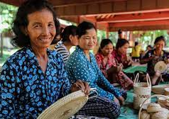
overview
As developing countries undergo rapid social and economic change, the absence of women’s participation means that the potential contribution of half of the population is either unutilized, which signifies an economic loss
Low levels of education, poor health and nutrition, and limited access to resources not only depress women’s quality of life, but also limit productivity, economic efficiency and growth

Slide 3
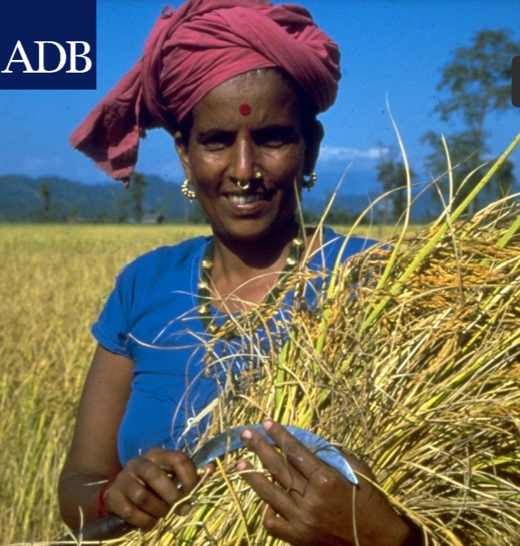
overview
There is a recognition of the need to improve the status of women and to promote their potential roles in development
Promoting and improving the status of women is important not only for reasons of equity and social justice but also because it makes economic sense and is good development practice
Investments in women are recognized as crucial to achieving sustainable development

Slide 4
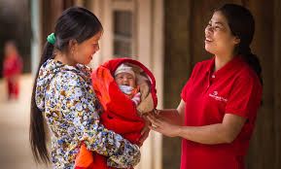
Benefits of investing in women
Investing in women’s health helps improve health and welfare of children, reduce health costs, and lower fertility, and infant and maternal morbidity and mortality rates, and reduce poverty
Investing in girls’ education benefits girls as well as the society, enhances future earning capacity, increases labor market access and opportunities and reduces health risks associated with childbirth

Slide 5
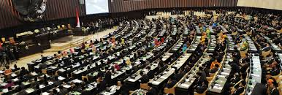

Benefits of investing in women
Improving women’s access to financial services contributes to poverty reduction as it enables women to contribute to household income and family welfare, thereby enabling transition out of poverty
Economic payoffs in terms of higher economic growth rates with women’s participation in the economy include improved productivity, reduced health and welfare costs, and a sound human resource foundation on which to build the economy

Slide 6
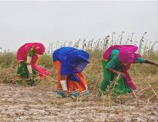
Benefits of investing in women
Discrimination against women entails costs not only for the individual, but also for the overall society; therefore it is imperative to promote, support, enhance, and ensure women’s participation and equitable share of the rewards of development
To capture the benefits of gender inclusiveness, development programs should include measures to expand women’s economic opportunities, increase their incomes, and promote improvements in health and education

Slide 7
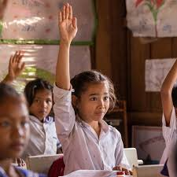
Gender representation
Addressing the issue of representation means looking at the representation of women and men as policy beneficiaries, as well as their representation in the labor force and in the decision making processes
Numbers are important; but also important is how gender relates to policy content, and better understanding how women and men would benefit; a gender responsive policy ensures that the needs of all citizens, women and men, are equally addressed

Slide 8
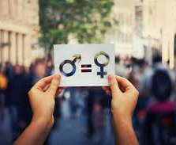
Gender mainstreaming
Gender mainstreaming is the integration of gender perspectives into the preparation, design, implementation, monitoring and evaluation of policies, regulatory measures and spending programs
Aim: to promote equality between women and men, and combating discrimination and address the issue of representation of women and men in a given policy area

Slide 9
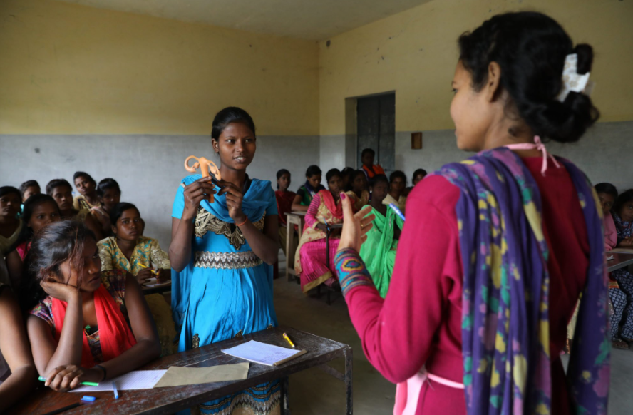
Gender mainstreaming
Gender mainstreaming seeks to avoid the creation or reinforcement of inequalities, which can have adverse effects on both women and men
It also implies analyzing the existing situation, with the purpose of identifying inequalities, and developing policies which aim to redress these inequalities and undo the mechanisms that caused them

Slide 10
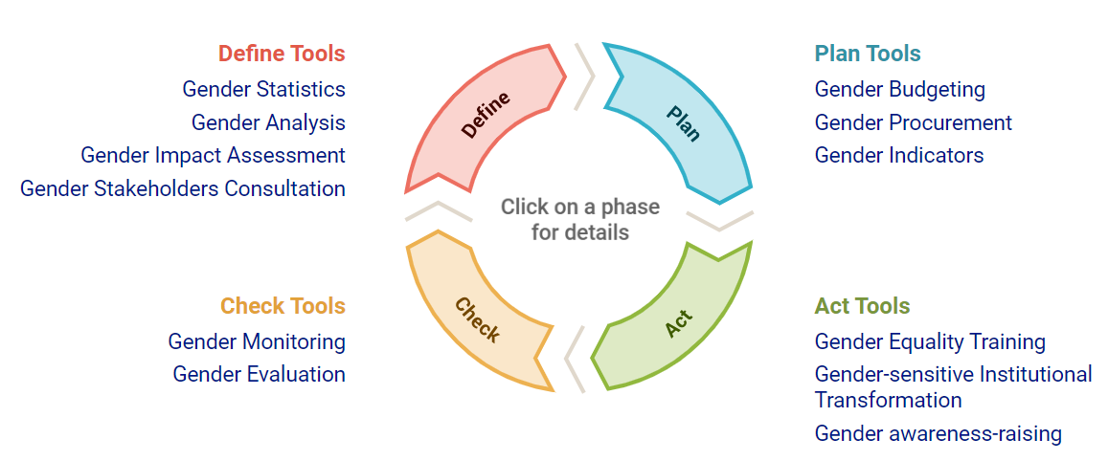
Gender mainstreaming cycle

Slide 11
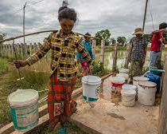
Water Supply and gender
In most societies, women have responsibility for managing household water supply, sanitation and health (for drinking, food preparation, personal hygiene, care of the sick, cleaning, washing and waste disposal)
Although women have knowledge on water resources, location, quality and storage methods, efforts towards improving water management and extending access to safe drinking water and adequate sanitation, often overlook the role of women

Slide 12
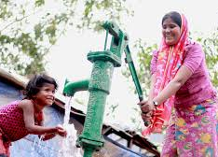
Water Supply and gender
Efforts to address water supply needs from the gender perspective:
Reduced time, health, and care-giving burdens from improved water services give women more time for productive activities, adult education, empowerment activities, leisure
Convenient access to water and sanitation facilities increase privacy and reduce risk to women of sexual harassment while gathering water

Slide 13
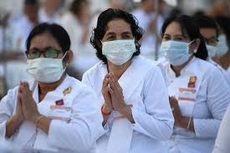
Health and gender
Men and women do not benefit from the same conditions in terms of health; poor women and girls are least likely to have access to appropriate care or to seek adequate treatment.
In many countries the availability and quality of health care is ineffective because of poor public health systems; this does not only affects women’s health but also places responsibilities on women in providing health care for their families

Slide 14
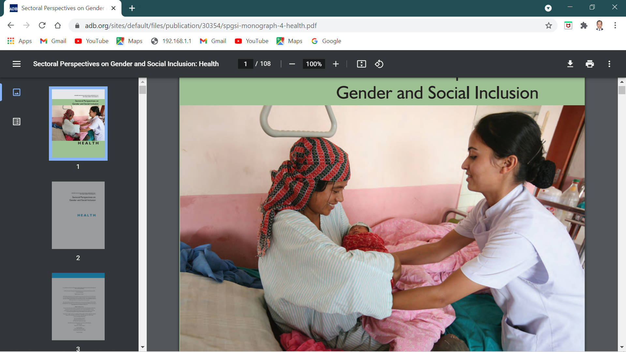
Health and gender
One area in which there should be a strong focus on women is the promotion of effective woman-to-woman services for maternal and child health.
In many countries unless health-care providers are female, accessible, and culturally sympathetic, women will not take advantage of the services that are available or obtain information to improve their health and that of their families

Slide 15
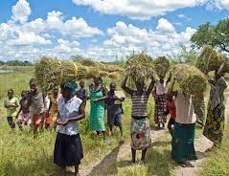
Agriculture and gender
Gender plays a vital role from the farm to market particularly in their role as agriculture producers and in ensuring food and nutritional security
Relative to men, women have less access to productive assets such as land and financial and extension services
Women tend to lack political voice. Gender inequalities result in less food being grown, less income earned, and higher levels of poverty and food insecurity

Slide 16
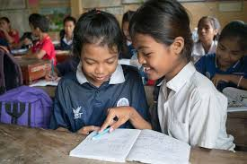
Education and gender
There exist multiple barriers to education for girls and women; these include distance to school, cultural norms and practices, school-related gender-based violence and early or forced marriage
Keeping girls in school and ensuring they can learn in a safe and supportive environment leads to many benefits for girls themselves, their families, their communities and societies

Slide 17
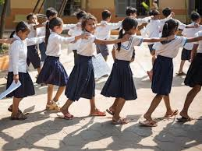
Education and gender
In 1990, 86 girls were enrolled in primary school for every 100 boys, compared with 67 girls in1960
The female labor force rate has grown at twice the rate of the male labor force; today 30% of women over 15 years are in the formal labor force in developing countries

Slide 18
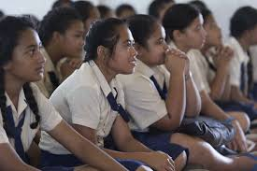
Education and gender
While progress has been made, there is still room for improvement
More young girls and women are attending primary and secondary school, but less than half are going on to attend college
Women are also still fighting to be fully represented in the job market

Slide 19
reference
https://www.adb.org/sites/default/files/institutional-document/32035/gender-policy.pdf

