Slide 1
Risk Management
International Best Practice
August 2014
Supreeya Nicola Cloe Pipatmanomai
1

Slide 2
Agenda
Overview
Criteria in Conducting Business
Product Program for Transaction
Market Risk Management & Control
Credit Risk Management
Operational Risk Management
Liquidity Risk Management

Slide 3
Overview
Notification of the Bank of Thailand No. SorNorSor 14/2551 set forth principles and operational details with regards to risk management for derivatives transactions where as commercial banks must comply with.
The notification focuses more on roles and responsibilities of the Board of Directors and senior executives who oversee and ensure commercial banks for having suitable effective risk management framework suitable to the nature, volume and complexity of transactions together with comprehensive Product Program approval process, all of which target for achieving comprehensive Risk Based Supervision process.

Slide 4
Criteria in Conducting Business
The Bank of Thailand requires commercial banks to conduct such business to comply with risk management principles as follows:
  Principles
  Roles and Responsibilities of Board of Directors and Senior Executives
  Policies and Strategies for Derivatives Transactions
  Product Program for Transaction
  Risk Management Policies and Strategies
  Risk Management System
  Internal Control and Audit Policies
  Clear and Documented Operational Procedures
  Personnel

Slide 5
Product Program for Transaction
Commercial Banks shall prepare Product Programs for all types of derivatives transactions prior to real transactions.
Such Product Programs must be signed by the heads of all relevant business units and approved by the Board of Directors prior to conducting the transaction.

Slide 6
Product Program for Transaction
Details of Product Programs must include the followings:
  Type and structure of the transaction
  Related risks and risk management
  Target customer group and customer suitability
  Detail of each transaction steps
  Pricing and fair valuation of transaction
  Approval authority of each management level
  Method of accounting for such transaction, tax system/methodology
  Procedures or guidelines under relevant Bank of Thailand notifications
  Preparation of relevant reports including reporting procedures and action when loss is higher than predetermined limit
  Legal issues related to such transaction
  Other necessary information

Slide 7
Market Risk Management & Control
7

Slide 8
Agenda
Price Risk
Products & Component Risk Factors
Measuring & Managing Price Risk?
Fair Valuation
Limit Process
Value at Risk
Back Testing
Stress Testing
Q&A

Slide 9
Price Risk
Risk of loss due to change in market prices such as:
Exchange rate
Interest Rate
Commodity prices
Equity prices
Credit spreads
Implied Volatilities

Slide 10
Products & Component Risk Factors
Risk Factor
Exchange
Implied
Credit
Correlation /
Product
Rate
Interest rate
Volatility
Spreads
Basis
Spot FX
l
Forward FX
l
l
FX Options
l
l
l
Loans/Deposits
l
Forward Rate Agreements
l
Interest Rate Future
l
Interest Rate Swaps
l
l
IR Options (Caps/Floors)
l
l
l
Certificates of Deposits
l
Govt Bills/Bonds
l
Corporate Bonds
l
l
l
Bond Futures
l
Repo & Reverse Repo
l
Credit Derivatives
l
l
l

Slide 11
Measuring & Managing Price Risk?
Value at Risk
Notional limits
Risk factor sensitivity limits
Stress testing
Loss triggers
Permitted product list

Slide 12
Aggregate Control Limits
Permitted Instruments
Permitted Currency and Tenors
Currency Limits
Concentration limit for fixed income securities
Etc.

Slide 13
Risk Measurement
Robust and consistent methodology
Across all risks and all portfolios
Daily full measurement
GM Risk Reports

Slide 14
Risk Monitoring
Independent of those taking risks
Clear, concise, timely and accurate reporting
Subject to periodic independent check (Internal Audit)
Market risk limits tied to risk appetite established and the market
Stress Testing to assess impact of changes in market / liquidity conditions

Slide 15
Risk Control
Risk Appetite – Limits based around VaR and the Greeks
Stop-Loss triggers
Communication to Senior Management

Slide 16
Fair Valuation
Commercial banks shall establish clear and suitable Mark-to-Market guidelines to determine fair values that reflects actual market value and must mark-to-market the outstanding at the end of every business day based on the following criteria:
  Commercial banks must comply with Thai Accounting Standards (TAS) or International Accounting Standards (IAS) (if TAS is not applicable). Commercial banks must use appropriate price or value to currently held position, e.g. in the case where commercial banks invest in any instruments, they shall use the bid price in fair valuation process.
  For Banking Book and Back-to-Back derivatives transactions, where the latter contains no market risk, the Bank of Thailand allows the commercial banks to mark-to-market those derivatives transactions at the end of each month.

Slide 17
Fair Valuation
Commercial banks must comply with the guidelines set forth by IAS39 Financial Instrument: Recognition and Measurement.
The current effective standard set reliable guidelines as follows:
  If available, use the quoted price in an active market to obtain fair value. This price is considered the most reliable.
  In absence of active trading in the market, use the following valuation techniques.
    The latest conducted price between knowledgeable person who is willing to conduct the transaction under normal business purposes as well as able to independently negotiate the price as unrelated party.
    Fair value of other instruments that are materially similar in nature to the valuing instrument.
    Discounted cash flow method.

Slide 18
Limits Process
Limits Process
Business Line
Strategies
Evaluate and Determine Risk Appetite (weeks at risk)
Translate Risk Appetite to Position and Capital Limits
Review and Approve by Board of Directors
Reassess Periodically
VaR Limits
Market Opportunities
Exposure Limits
Market depth and liquidity
Liquidity
Limits
Historical performance
Loss Triggers

Slide 19
Market Risk Management and Control
Second Session
19

Slide 20
Risk of Linear Derivatives
Net Open Position (NOP) of Foreign Exchange Position
  Unit in amount of Foreign Currency.
  NOP is based on net present value basis.
PV01, PVBP, DV01, IR Delta (Change in Present Value if 1 bp change in interest rate)
  Unit in $ Amount
  Required Market rates and Discount factor generated from market rates.
Steps for PV01
  Aggregate each cash flow into the bucket period (6m, 1y, 2y,…)
  Calculate PV for total cash flows
  Assume 1 bp shift in bucket period and recalculate PV
  The difference is the PV01.

Slide 21
ACL Risk Calculation Example
What is
1. Net Open Position
2. THB PV01
3. USD PV01
Forward Contract
  1 Yr Contract
  Rec USD 1M vs Pay THB 33M
Cross Currency Interest Rate Swap
  2 Yr Contract
  Notional USD 1M vs THB 33M
  Semi-annually coupon
  Rec THB 4% vs Pay USD 6M LIBOR
What is
1. Net Open Position
2. THB PV01
3. USD PV01

Slide 22
Forward Contract
PV market rate |  |  |  | spot rate | 34.00
 | 1 Yr IR rate | Disc. Factor | Cashflow | PV | THB term
THB Cashflow | 4.00% | 0.9615 | -33,000,000 | -31,730,769 | -31,730,769
USD Cash flow | 3.50% | 0.9662 | 1,000,000 | 966,184 | 32,850,242
PV assume 1 bp shift |  |  |  | spot rate | 34.00
 | 1 Yr IR rate | Disc. Factor | Cashflow | PV | THB term
THB Cashflow | 4.01% | 0.9614 | -33,000,000 | -31,727,718 | -31,727,718
USD Cash flow | 3.51% | 0.9661 | 1,000,000 | 966,090 | 32,847,068
 |  |  |  | THB PV01 | 3,051
 |  |  |  | USD PV01 | -3,174

Slide 23
CCS – Receive Side (fixed rate)

Slide 24
Value at Risk VaR Methodologies
It is….
  a statistical measure of potential loss measured at a 97.5% confidence over a 1day holding
  a portfolio risk measure that captures the effects of correlation and diversification.
  a ‘fungible’ risk metric, i.e. it can be applied to a wide variety of traded instruments.

Slide 25
VaR Methodologies
Variance Covariance
  Multiplies exposures by standard deviation of price changes
Exposures
Volatilities
σ*1.96 = 97.5%
Correlations
= VaR
2.5%
47.5%
50%
1.96σ
95% of area under the curve

Slide 26
Variance-Covariance VaR - 2 factors
VaR related to the variance of the portfolio P/L
Consider a portfolio with ‘exposures’ to two correlated market risk factors
An ‘exposure’, λ, is the product of the
  Sensitivity to market movement, w (eg. PV01 or an NOP)
  Volatility of the underlying market movement, σ
  λ = w σ
VaR is the square root of the total portfolio variance
This is the VaR at 1 standard deviation, which can then be scaled up to the appropriate confidence level and time horizon, as we’ve seen before.

Slide 27
VaR Methodologies
Historical Simulation
  Calculates the P&L for each day based on observed changes in price
Sensitivity Based P&L
Exposures
P&L Distribution
= VaR
OR
Time Series
Historical Price Changes
Revaluation P&L
Rank order of P&L results

Slide 28
VaR Methodologies
Monte Carlo Simulation
  Generates numerous random market scenarios using predetermined parameters for price volatility and correlation and calculates the P&L for each scenario
Exposures
Sensitivity Based P&L
P&L Distribution
OR
= VaR
Market Scenarios
Revaluation P&L
Volatility (σ)
Correlation (ρ)
Rank order of P&L results

Slide 29
VaR Methodologies
Method | Advantages | Disadvantages
Variance / Covariance | Easy to understand Least computational intensive Easiest to implement | Does not capture non-linear risks Assume normal distributed returns Does not capture fat tail events
Historical Simulation | Easy to understand Can capture non-linear risks Actual distribution Incorporate fat tail events | Can be data intensive Assume past is a fair representation of present
Monte Carlo Simulation | Can capture non-linear risks Produce a distribution of P&L changes | Computational intensive Does not capture fat tail events More difficult to understand

Slide 30
VaR Backtesting
To validate the VaR model
Required by regulators to assess the adequacy of the allocated market risk capital to cushion losses
Compare the daily VaR with losses due to the hypothetical change of the portfolio value
Possible reasons for VaR backtesting exceptions:
  Extreme Market movements (tail events)
  Outdated historical data to estimate volatilities and correlations
  VaR model deficiencies. Incomplete or missing risk factors in VaR model (for e.g. basis risk)

Slide 31
Stress Testing & Scenario Analysis
It is the P/L impact of an extreme but plausible market event
Important supplement to VaR
Good tool for highlighting concentration of risks in the whole portfolio

Slide 32
Stress Testing & Scenario Analysis
Distribution of Daily Revenues
Stress Test
1 day VaR
Iraq War
Sharp rise in US rates
HKD Devaluation
_
+

Slide 33
Credit Risk Management
33

Slide 34
Agenda
Credit Policy
Credit Process
Documentation

Slide 35
Credit Policy

Slide 36
Credit Risk Rating (Scorecard)
All counterparties are assigned a credit grade using the appropriate scorecard for their customer type and in compliance with our parental support policy
Credit Grade must be kept up-to-date at all times
Credit Grade represents the best estimate of the probability that the counterparty being graded will default in the 12 months after the date of grading

Slide 37
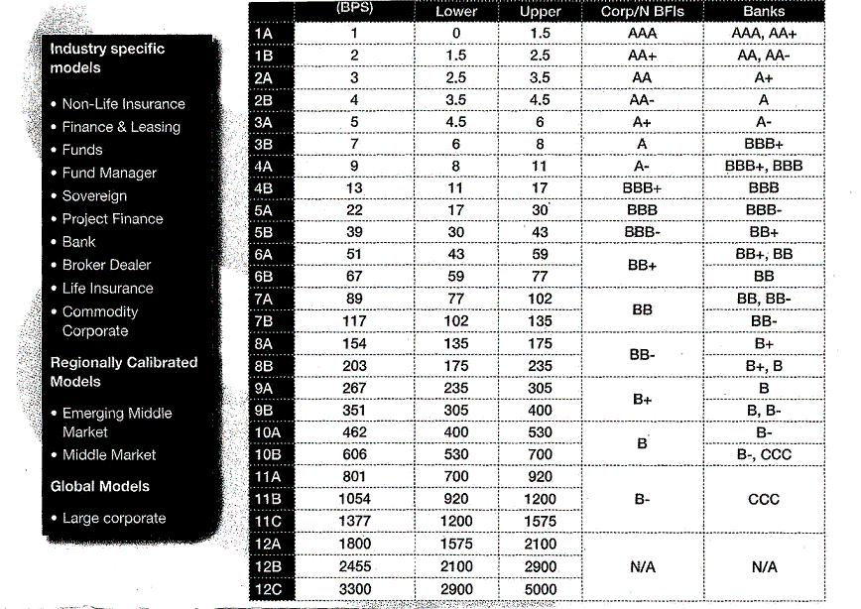
Credit Risk Rating (Scorecard)-cont’d

Slide 38
Financials & Non Financials
Financial Factors
Non-Financial Factors
Weight
Weight
Size
    Total Assets xxx%
Capital Adequacy / Leverage
    Leverage xxx%
    Interest Coverage xxx%
Profitability
    Total Expenses / Total Assets xxx%
    Return on Average Equity (ROAE) xxx%
Risk Profile / Asset Quality
    NPL / Total Loans xxx%
    Loan Loss Reserves / NPL xxx%
    Total Financials x%
Asset Quality yyy%
Source of Funding yyy%
Franchise Value / Market Position yyy%
Business Diversification yyy%
Management Quality yyy%
Risk Management Controls (Credit & Operational) yyy%
ALM / Market Risk yyy%
Financial Reporting * yyy%
Total Non-Financials y%
Note x%+y% = 100%

Slide 39
Parental Support
  Eligibility Criteria For Applying Parental Support
The eligibility of “Parental Support” as a valid support type is subject to the realization for ALL the following criteria, namely:
  Subsidiary bears the name, principal trade or brand name or acronym of the parent.
  Subsidiary is a regulated entity and a core business of the group.
  Parent is a major financial institution, has a net worth of > USD 125 million, and is regulated.
  The guarantor (Parent) must have a higher rating than that of its obligor (Subsidiary)

Slide 40
Parental Support (Cont’d)
  Government Group-Aggregation Rules
Criteria to classify entities as Government Risk and group for approval purposes
Central Governments or Central Government Departments
Central Banks (whether formally owned by the Government or not)
Entities owned or guaranteed by Central Governments, Central Government.
Departments or Central Banks subject to the following:-
i. The Government accepts responsibility for funding of the entities
ii. Day-to-day management is in the hands of Government officials
iii. For entities which are guaranteed, the instrument must be irrevocable and unconditional i.e. verbal or implied support is not acceptable
Where entities are run by professional management teams and can raise funds independent of the government, these should be classified as stand alone entities

Slide 41
Credit Process

Slide 42
Credit Monitoring & Control
Credit Authorities
Early Alert Report (EAR)
Accounts subject to Additional Review (ASTAR)
Local Portfolio Management Committee (LPMC)
Annual Review - Loan Application
- Country Underwriting Standards

Slide 43
Credit Authorities
Maximum amount of credit an individual can approve for one borrower group
Set based on LOSS GIVEN DEFAULT but subject to a gross exposure cap
Delegated for risk categories
  New credits
  Existing credits
  Temporary excess

Slide 44
Credit Applications Workflow
Relationship Manager /
Credit Services
■ Risk Assessment
■ review account strategy
■ submit LA/Score Sheet/Account Plan to MIRM
MIRM Approver / Credit Approver
Approved LA
Credit Admin (CRC)
■ Follow up credit documentation
■ Input limit into relevant systems

Slide 45
Early Alert Report (EAR)
An Early Alert Account is one that has risks or potential weaknesses of a material nature requiring monitoring, supervision, or close attention by management.
If these weaknesses are left uncorrected, they may result in deterioration of the repayment prospects for the asset or in the Bank’s credit position at some future date with a likely prospect of being downgraded to CG 12 or worse, within the next twelve months.

Slide 46
Symptoms of EAR

Slide 47
Account Subject to Additional Review
(ASTAR)
Excesses
Documents Deficiency
Approved Terms
Overdue
Exit strategy

Slide 48
Local Portfolio Management Committee
Responsible for the overall direction and management of the local credit portfolio within the policy framework of the Group Credit Policy as well as within the parameters of its own local credit policy (underwriting standards)
Activities
  Business Strategy Review
  Economic Review
  Review of Proper Exercise of Credit Authority and Process
  Credit Policy Review
  Portfolio Review

Slide 49
Stress Test
Market Volatility
  Commodity price : -
    Oil : Auto industry, Auto Leasing Companies, Energy
    Copper/Metal : Electrical wire, Construction
  FX :-
    THB strengthening : Exporter
  Interest Rate :-
    Mismatch asset & liability re-pricing period.
  Credit
    Exposure to subprime, CDO, CDS
Expectation of downgrade

Slide 50
Client Suitability
Example of Questions for classification :-
  Detail of Treasury Function / Treasurer / Finance Director, in terms of size, experience, product & market knowledge
  System used for managing and monitoring risk
  Normal product that client engage
  Financial needs and risks normally arise in the course of business
  Client’s written policy on financial risk management
  Client’s policy to use GM products to 1) hedge, 2) investment, 3) take positions to enhance returns or reduce cost.
  Who make decisions on risk management strategy
Classify client into category 1,2,3.

Slide 51
Products

Slide 52
CAT I, II, III
CAT I : Normal Limits, i.e O/D, Interbank,
Trade Finance (LATR, L/C), Guarantee,
Term Loans, Bonds
CAT II : FX and Derivatives Limits calculated on
LER* and/or PFE** basis, incl. repo.
CAT III: Settlement Limits
*Loan Equivalent Risk
**Potential Future Exposure

Slide 53
Pre-settlement Methodology
LER = Loan Equivalent Risk
methodology to calculate FX spot and forward exposure
2 constituents : MTM and Add on
MTM : generated from P&L process
Add-on = R X √(T) X P
where R = Risk Factor (based on ccy pair)
T = Time (in years)
P = Principal (USD equivalent)

Slide 54
Pre-settlement Methodology (Cont’d)
PFE = Potential Future Exposure
Based on a portfolio simulation to measure the credit risk on Derivatives and long dated FX transactions

Slide 55
Client Suitability
Example of Questions for classification :-
  Detail of Treasury Function / Treasurer / Finance Director, in terms of size, experience, product & market knowledge
  System used for managing and monitoring risk
  Normal product that client engage
  Financial needs and risks normally arise in the course of business
  Client’s written policy on financial risk management
  Client’s policy to use GM products to 1) hedge, 2) investment, 3) take positions to enhance returns or reduce cost.
  Who make decisions on risk management strategy
Classify client into category 1,2,3.

Slide 56
Documentation

Slide 57
Documentation
FX terms & conditions
GMRA (Repo)
ISDA
Mitigation➔ CSA (Credit Support Annex), and/or
Break Clause
Confirmation to be signed within 30 days

Slide 58
CSA
Annex to ISDA.
Benefits of collateral
  Mitigate credit risk
  More efficient use of credit lines
  Concerns about the Future
Eligible Collateral
  Cash (USD, THB) w/ interest (overnight cost of fund rate)
  US Treasuries, G7 sovereign bonds

Slide 59
Credit Support Amounts
Threshold Amount
  Level of acceptable credit exposure, i.e. USD 1 mio.
Minimum Transfer Amount
  Amount that must be exceeded before the Transferor is required to transfer Delivery Amount, i.e., USD 500,000
  Operation
Valuation date
  Daily, Weekly

Slide 60
Operational Risk Management
60
60

Slide 61
Agenda
Operational Risk Management and Assurance Framework (ORMAF)
Operational Risk Governance Process
Operational Risk Grading Matrix
WB Business Operational Risk Group (BORG)

Slide 62
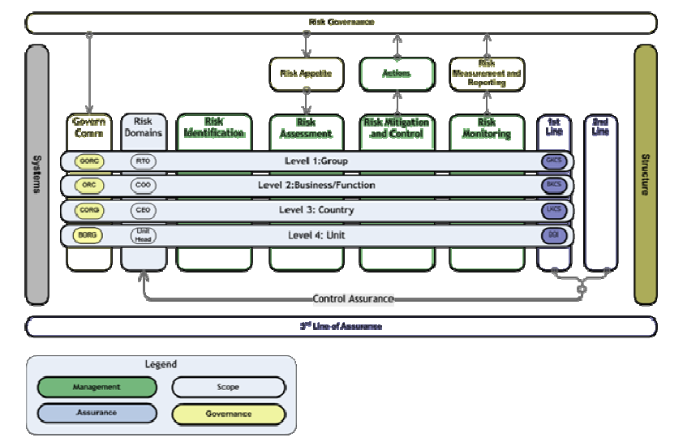
Operational Risk Management and Assurance Framework (ORMAF)

Slide 63
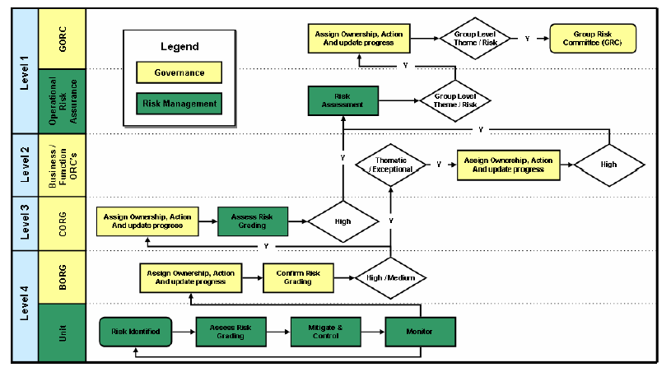
Operational Risk Governance Process

Slide 64
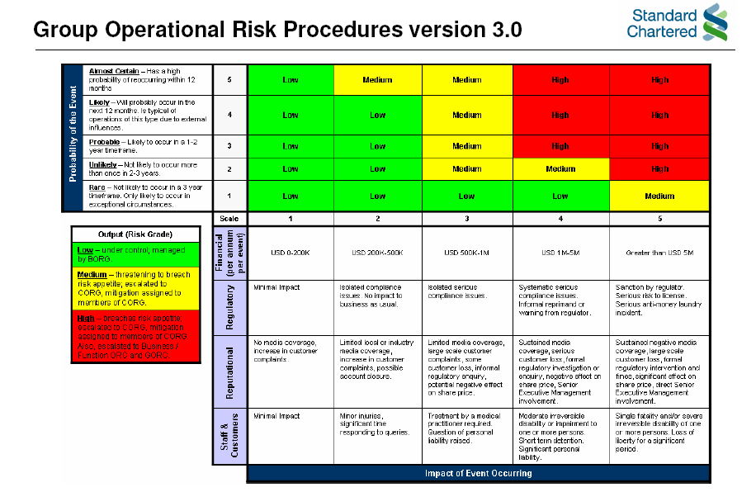
Operational risk Grading Matrix

Slide 65
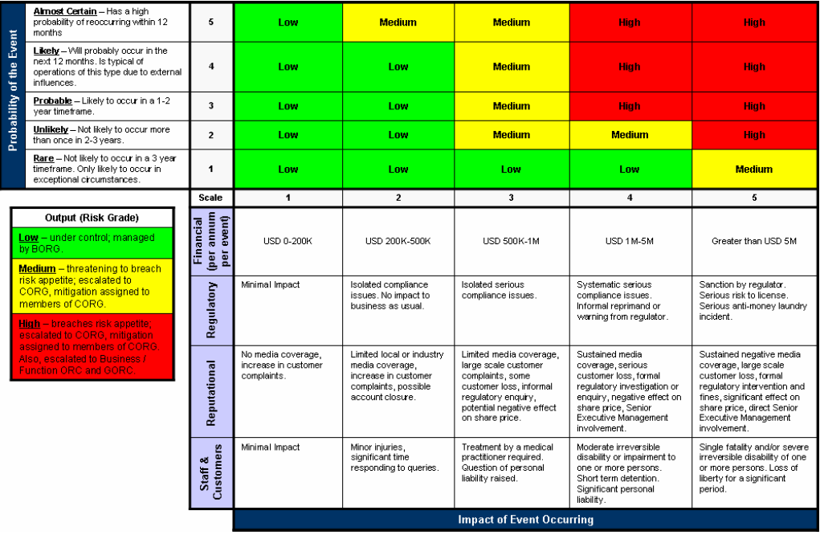
Operational risk Grading Matrix

Slide 66
WB Business Operational Risk Group
Purpose is to provide the Country Operational Risk Group (CORG) and WB Operational Risk Committee (WBORC) with assurance that operational risk in Wholesale Bank is being managed on an end-to-end basis commensurate with the Group’s appetite for earnings volatility or other potential non-financial impacts
Main Responsibilities:
  To oversee the implementation of and assure the Group’s operational risk management and assurance framework
  To ensure that risk appetite and tolerance for Operational Risk is implemented and embedded in Business Risk process and decision making
  To oversee the identification, assessment, mitigation and monitoring of Wholesale Bank level risks, ensuring that management focus is commensurate with the severity of potential impacts, and escalate to CORG and WBORC
  To provide the CORG with regular assessments of the WB’s operational risk profile

Slide 67
ORMA Framework
FM front office controls and monitors the following key control standards (KCS) on regular basis (quarterly, semi-annually and annually):
  GKCS (generic or group)
  BKCS (business)
  LKCS (local regulatory)
All Operational Risk issues and Operational Loss issues being captured into the Bank system, Phoenix.
All issues of Operational Risk and Operation Loss being discussed and tracked for the progress in FM BORG meeting on monthly basis.
FM BORG: Chairman (Head of FM), Members (FM Business Unit Heads and Operations, Product Control and Business Finance, and other related parties), Invitees (CORAM, L&C, Market Risk, Technology, HR and CRES), Secretary (BORM)

Slide 68
Liquidity Risk Management
68

Slide 69
Agenda
Liquidity
Liquidity Risk Management
Liquidity Risk Management Framework
Liquidity Tools and Measurement
Stress Testing
Interest Rate Risk and FTP
ALCO & ALM
69
Notes:
Sequence: Slide 2 of 17
Intent: Explain the agenda and objectives for the presentation
KEY POINTS TO STRESS:

Slide 70
Why is Liquidity Important?
Insufficient liquidity can lead to:
  - Failure to repay deposits on demand
  - A run on the bank
  Heavy losses
  Insolvency
Excess liquidity can lead to:
  - Missing profitable opportunities
  - Inefficient use of capital
70

Slide 71
Liquidity Risk Management
Objective
  Ensure we are in a position to meet outflows at all times
  Ensure we are in compliance with regulatory liquidity ratios at all times
Governance
  All liquidity risk is passed to the ALM. ALM is responsible for managing liquidity within the limits and according to the policies set by Local Board of Directors
  Country Head of Market Risk (Tactical) and CFO (Strategic) share the responsibility for control of Liquidity Risk
71

Slide 72
Liquidity Risk Management - General Terms
Maintain adequate liquidity at all times.
Control dependence on wholesale deposits.
Establish appropriate stock of marketable assets.
Monitor potential liquidity impact of off-balance sheet activity.
Diversify deposit maturity base and avoid concentration of resources.
Diversify asset base and limit long-term assets.
Maintain liquidity under normal conditions and stressed conditions.
Prepare & review Liquidity Contingency Plans.
72

Slide 73
Liquidity Management Framework
Businesses
Sources
Balance Sheet Management
Sources
Balance Sheet Management
& Uses of
ALCO
& Uses of
Funds
A/D ratio
Funds
A/D ratio
Commitments
Medium Term Funding
Commitments
Core balances
Asset concentrations
Capital Position / Plan
Asset concentrations
Medium Term Funding
Liability Concentrations
Liability Concentrations
On balance sheet cashflows
Liquidity Risk Management
On balance sheet cashflows
Liquidity Risk Management
Off balance sheet cashflows
Off balance sheet cashflows
Marketable Securities
Marketable Securities
Wholesale Borrowing
Normal Conditions
Wholesale Borrowing
Normal Conditions
Stress Conditions
ALM
Maximum Cumulative Outflow
Stress Conditions
Maximum Cumulative Outflow
Stress Test Cashflows
Wholesale Borrowing Guidelines
Stress Test Cashflows
Wholesale Borrowing Guidelines
Contingency Plan
Swapped Funds
Contingency Plan
Swapped Funds
Marketable Securities
Marketable Securities
Realisable value
Interaction
Interaction
Intraday Liquidity Management
Thailand Payment System
Intraday Liquidity Risk Management
73
Notes:
KEY POINTS TO STRESS:
Use the examples to explain the differences between the various liquidity tenure and interest rate risk
As the questions float up, seek floor participation for answers on expected liquidity tenor and interest rate risk.
Sequence: Slide 9 of 17
Intent: Explain the importance of funding type via example

Slide 74
Liquidity Tools and Measurement
Maximum Cumulative Outflow: The amount of net cash inflow/ outflow from all On-Balance Sheet and Off-Balance Sheet items under normal conditions over the next 30 calendar days. Normal conditions mean BAU customer behaviour for withdrawal and repayment of Assets / Liabilities.
Wholesale Borrowing Limit: A limit governing the amount which the Treasury can raise in the Wholesale/Interbank market, including Intragroup borrowing. Typical to cover short term liquidity.
Swapped Funds: Non-domestic funds swapped into local currency (Swapping In)
Local currency swapped into non-domestic funds (Swapping Out)
Advances/Deposit Ratio: Corporate and Retail Loans as a % of the Corporate and Retail deposits
Commitments Guideline : Amount of Customer Undrawn Committed Facilities
Medium Term Funding Ratio : Ratio of liabilities with maturity > 1 year to assets with maturity > 1 year
TACTICAL
STRATEGIC
74
Notes:
74

Slide 75
Maximum Cumulative Outflow (MCO)
Objective : To limit the maximum cash outflow from short term Asset – Liability mismatch
Definition : Total cumulative amount of net cash outflow on any one day
Horizon : overnight ; 1 week; 1 month
Limits based on:
  Wholesale borrowing capacity
  Assumptions of behavioral cash flows
  Non-core / Core methodologies
75

Slide 76
Example of MCO Reports
Daily Measurement and Monitoring by Independent Risk Unit
Limits are set on Day 1, Day 2-7, and Day 8 – 30
Negative MCO is assumed to be funded by the Wholesale Borrowing
76

Slide 77
Wholesale Borrowing Guideline
Objective: To limit dependence on volatile funds
Definition: Borrowings from Interbank, Intergroup and like
        i) By ALM / Financial Markets
        ii) Pricing at money market rates
        iii) Size is typical of money market transactions
Limit is based on:
        - bank’s borrowing capacity
        - maturity & depth of the local money markets
        - number of counterparties
        - borrowing in relation to total balance sheet
77

Slide 78
Swap Funds Guideline
Objective:
Swapping-in : To limit the amount of FCY to fund LCY assets ;
Swapping-out : To limit the amount of LCY to fund FCY assets ;
Definition: Local Currency Assets - Local Currency Liabilities
Swapping-in : LCY Assets > LCY Liabilities
Swapping-out : LCY Assets < LCY Liabilities
Limit is based on:
- Local balance sheet size
- Local FX market depth
- counterparty credit lines available
78

Slide 79
Stress Liquidity
Stress Liquidity conditions are generated by unanticipated deposit withdrawals coupled with the Bank’s inability to access financial markets.
To ensure that SCBT has sufficient funds available to survive a liquidity crisis
To manage Liquidity under stress conditions – the bank has to maintain a liquidity contingency plan
Liquidity Stress Test – regulatory requirement
79

Slide 80
Stress Testing Limit
Stress Liquidity conditions are assumed that the bank has unanticipated deposit withdrawals and cannot access normal financial markets.
Objective : To ensure that SCBT has sufficient funds to survive under stress assumptions (crisis situation)
Bank specific scenario (8 day survival period on daily monitoring)
Market wide scenario (30 day survival period on monthly monitoring)
Combined scenario
Quarterly liquidity stress test (for BOT purpose) : The bank must have surplus liquidity over 30 day survival period for all stress scenarios.
In case that the bank fails to pass the stress test, remedy actions from ALCO are required.
80

Slide 81
Stress Testing Limit (continued)
Key assumptions
Cannot apply statutory bond requirement for the bank’s liquidity
Intraday Liquidity Facility (ILF)
Securities Requirement for Settlement (SRS) – coming soon
Cannot apply trading bonds from the bank’s liquidity (to align with Basel III initiative)
Must have more liquidity for clients’ ILF services : need to exclude the biggest intraday liquidity facility limit provided to clients from the stress
More haircuts applied on securities (in case of stress situation)
More conservative rollover assumptions on B/S
81

Slide 82
Major qualification of good Fund Transfer Pricing (FTP)
  Transparent : visible to all parties
  Independent : verifiable by all parties and auditable
  Fair : reflective of marginal risk profile of the product being FTP’d to ALM
  Transactable : funds can be executed with reasonable depth of market liquidity
  Complete : encompasses all inflows/outflows from bank with minimal ‘special pricing’, in order to balance mismatch in balance sheet
Interest rate curves in Thailand : No one perfect curve !!
BIBOR cash curve : Money market cash curve liquid up to 3m. Longer tenors are difficult to develop as credit and tenor limit constraints from markets. BOT is convincing markets to apply this curve for benchmarking in many products.
FX implied swap curve : Rather liquid and transactable upto 1y. Currently, rates are distorted by USD liquidity shortage in on-shore market. BOT is the main USD contributor in swap market.
IRS curve : IRS/6mTHBFIX and IRS/3mBIBOR
Government bills/bonds curve : Risk-free curve
82
Notes:
82

Slide 83
ALM’s products to manage the bank’s interest rate risk and optimize the bank’s return
  Short-term products
  Money market (overnight to 3 months)
  Repo and Reverse repo (overnight to 3 months)
  Swap (overnight to 12 months)
  Paper issuance (B/Es and Short-term debentures)
  Treasury Bills / Deposit Facility (DF)
  Long-term products
  Government / BOT Bonds (Fixed rate / Floating Rate)
  Corporate / Bank Bonds
  Interest Rate Swap (IRS)
    Cash Flow Hedge (CFH)
    Fair Value Hedge (FVH)
    Economic Hedge
83
Notes:
83

Slide 84
Types of Hedges
  Cash flow hedge
    Used to change interest rate profile from float to fixed to manage interest rate risk
    Effectiveness between IRS floating rate index and floating rate profile of underlying hedged item must be proven
    MTM does not hit directly into PnL but stays in equity reserve
  Fair Value hedge
    Used to change interest rate profile from fixed to float to manage interest rate risk
    100% fully hedge enables MTM of IRS and hedged item to offset to have neutral impact on PnL
  Economic hedge
    Hedging which does not fall under the above two categories
    MTM hits PnL directly
84
Notes:
84

Slide 85
CFH with interest rate environment
  1. Uptrend Interest Rate
    Bank would like to lengthen liability duration to gain from rate hike expectations as floating rate liabilities are being re-priced at higher rates.
  2. Falling Interest Rate
    Bank wants to lengthen asset duration to gain from rate cut expectations as floating rate assets are being re-priced at lower rates.
  1. Uptrend Interest Rate
    Bank would like to lengthen liability duration to gain from rate hike expectations as floating rate liabilities are being re-priced at higher rates.
  2. Falling Interest Rate
    Bank wants to lengthen asset duration to gain from rate cut expectations as floating rate assets are being re-priced at lower rates.
Fixed Rate
Bank
External counterparty
Floating Rate
Floating Rate
Floating rate Liabilities
(3m and 6m TDs)
Fixed Rate
Bank
External counterparty
Floating rate
Floating Rate
Floating rate Assets
(Installment Loans, Mortgage Loans, Personal Loans, BIBOR bond)
85
Notes:
85

Slide 86
Relevant limits under zero tolerance circumstances
  Credit Limit / Country Limit
    Kingdom of Thailand (KOT)
    Corporate / Bank Limit and Intragroup Limit (SCB Solo and SCB Subsidairies)
  Risk Weighted Asset (RWA) Limit : to achieve RoRWA target
  Tenor Limit
  Holding Period Limit : not less than 3 month holding period for Available for Sale (AFS) portfolio
  Factor Sensitivity (FS) or PV01 Limit
    Net FS
    Gross FS
  Value at Risk (VaR)
  Management Action Trigger (MAT) : net of the rolling average PnL and MTM over the last 21 days.
86

Slide 87
Major qualification of good Fund Transfer Pricing (FTP)
  Transparent : visible to all parties
  Independent : verifiable by all parties and auditable
  Fair : reflective of marginal risk profile of the product being FTP’d to ALM
  Transactable : funds can be executed with reasonable depth of market liquidity
  Complete : encompasses all inflows/outflows from bank with minimal ‘special pricing’, in order to balance mismatch in balance sheet
Interest rate curves in Thailand : No one perfect curve !!
BIBOR cash curve : Money market cash curve liquid up to 3m. Longer tenors are difficult to develop as credit and tenor limit constraints from markets. BOT is convincing markets to apply this curve for benchmarking in many products.
FX implied swap curve : Rather liquid and transactable upto 1y. Currently, rates are distorted by USD liquidity shortage in on-shore market. BOT is the main USD contributor in swap market.
IRS curve : IRS/6mTHBFIX and IRS/3mBIBOR
Government bills/bonds curve : Risk-free curve
87
Notes:
87

Slide 88



















ALM’s responsibilities (continued)
Current Account
Cash Management
Trade
Financial Markets
GT
Mortgages
ALM
Corporate Financial
GMR
Credit Cards
Custody
Loans
(Personal & Corporate)
Savings Accounts
Structured & Time Deposits
Standard Chartered Bank’s Capital
88
Notes:
Page 88
Copyright © 2011 by Standard Chartered Bank
KEY POINTS TO STRESS:
Explain the role of ALM clearing in liquidity management:
ALM is the clearing house through which liquidity runs in and out.
The Bank looks at the liquidity profile of the products and assesses whether they are sticky money - and assigns a value to that liquidity before it hits ALM. We then use that sticky money to back term loans.
This “maturity transformation”, the assessment of the stickiness, is done by Group Treasury.
Service Provider
To manage the mismatch and risks (liquidity & interest rates) of the Group’s banking book
Make the balance sheets balance – ALM receives them in a range of currencies and tenors
Warehouse surfeit/standby liquidity for asset funding
Advise ALCO on liquidity conditions and balance sheet matters
To prudently manage the Group’s liquidity and regulatory statutory reserves portfolio
Ensure stress tests are met - FSA, local regulators and internal tests
To price money correctly based on supply and demand (ITP/ FTP)
Liquidity Provider
To raise and deploy funds in the wholesale and interbank market – secured and unsecured
Investment Manager
To generate P&L by expressing views around risks in the banking book
Manage duration mismatch
Proactively Hedge Interest rate risk and manage credit risk
Currency switching to capture specific opportunities
Invest surplus funds – actively manage portfolio
Sequence: 6 of 17
Intent: Discuss the role of ALM in Liquidity Management

Slide 89
ALM’s responsibilities
To prudently manage
  Bank’s Liquidity Risk
    Bank-wide liquidity
    Statutory reserve portfolio
    Discretionary portfolio
    Ensure that the bank has liquidity risk exposure within Group Market Risk (GMR) limits
  Bank’s Interest Rate Risk
    Interest rate profile from the Commercial book (except basis risk)
    Maximize the bank’s return through active ALM’s strategies (bills/bonds, swap, hedges)
    Ensure that the bank has interest risk exposure within Group Market Risk (GMR) limits
To maintain compliance with group policies & local regulations
To provide market intelligence to all stakeholders
To be a permanent member of Asset & Liability Committee (ALCO)
89
Notes:
Page 89
Copyright © 2011 by Standard Chartered Bank
KEY POINTS TO STRESS:
Explain the role of ALM clearing in liquidity management:
ALM is the clearing house through which liquidity runs in and out.
The Bank looks at the liquidity profile of the products and assesses whether they are sticky money - and assigns a value to that liquidity before it hits ALM. We then use that sticky money to back term loans.
This “maturity transformation”, the assessment of the stickiness, is done by Group Treasury.
Service Provider
To manage the mismatch and risks (liquidity & interest rates) of the Group’s banking book
Make the balance sheets balance – ALM receives them in a range of currencies and tenors
Warehouse surfeit/standby liquidity for asset funding
Advise ALCO on liquidity conditions and balance sheet matters
To prudently manage the Group’s liquidity and regulatory statutory reserves portfolio
Ensure stress tests are met - FSA, local regulators and internal tests
To price money correctly based on supply and demand (ITP/ FTP)
Liquidity Provider
To raise and deploy funds in the wholesale and interbank market – secured and unsecured
Investment Manager
To generate P&L by expressing views around risks in the banking book
Manage duration mismatch
Proactively Hedge Interest rate risk and manage credit risk
Currency switching to capture specific opportunities
Invest surplus funds – actively manage portfolio
Sequence: 6 of 17
Intent: Discuss the role of ALM in Liquidity Management

Slide 90
Assets & Liabilities Committee (ALCO)
Chairperson
(Normally) Country CEO
Chairperson
Country CEO
Country Chief Finance Officer (CFO)
Country Chief Risk Officer (CRO)
Country Head
Consumer
Banking (CB)
Retail Banking Product (CB)
Country Head
Origination Client Coverage (OCC)
Country Head
Financial Markets (FM)
Country Asset Liability Management (ALM)
Members
Economist
Market Risk Representative
ALCO Support
Recording Secretary
Others
Invitees
90
Notes:
KEY POINTS TO STRESS:
What is sticky deposits?
For e.g. Core CASA from CB and TB.
Non-Price Sensitive Core CASA is paid 1Y WAR rate as compared to the default 1M for Non-Core CASA.
What is maturity transformation?
Converting short term liabilities to long term assets (banks deal with a large number of lenders and borrowers and reconcile their conflicting needs)
Give examples of how a current account balance is transformed into a medium term loan
Sequence: Slide 8 of 17
Intent: Explain the importance of funding type

Slide 91
ALCO discussions and decisions at monthly meeting
Market Situation and Competition
Balance sheet : Current & Forecast
Capital Adequacy Ratio and Projection
Statutory and Group Compliance
Deposit concentration
Payment systems activities
Maturity Profiles - Interest rate risk & Liquidity
Market Risk and Liquidity Limits
Fund Transfer Pricing (FTP)
91

Slide 92
ALCO’s responsibilities
To ensures that the country balance sheet is managed in accordance with global & local regulatory requirements as well as group policies
To implement appropriate Fund Transfer Pricing (FTP) policy to support B/S growth effectively
To ensures that
  Liquidity and Capital ratios are well managed
  Risk inherent in payment systems is evaluated, quantified and managed
To review & approve
  Contingency plans for liquidity (at least annually)
  Concentration risk arising from borrowers and depositors
FTP Policy and attribution
is owned
by Finance
Commercial
Commercial
Bank Assets
ALM
Bank
is the
Liabilities
clearing centre
92
Notes:
Page 92
Copyright © 2011 by Standard Chartered Bank
KEY POINTS TO STRESS:
Explain the role of ALM clearing in liquidity management:
ALM is the clearing house through which liquidity runs in and out.
The Bank looks at the liquidity profile of the products and assesses whether they are sticky money - and assigns a value to that liquidity before it hits ALM. We then use that sticky money to back term loans.
This “maturity transformation”, the assessment of the stickiness, is done by Group Treasury.
Service Provider
To manage the mismatch and risks (liquidity & interest rates) of the Group’s banking book
Make the balance sheets balance – ALM receives them in a range of currencies and tenors
Warehouse surfeit/standby liquidity for asset funding
Advise ALCO on liquidity conditions and balance sheet matters
To prudently manage the Group’s liquidity and regulatory statutory reserves portfolio
Ensure stress tests are met - FSA, local regulators and internal tests
To price money correctly based on supply and demand (ITP/ FTP)
Liquidity Provider
To raise and deploy funds in the wholesale and interbank market – secured and unsecured
Investment Manager
To generate P&L by expressing views around risks in the banking book
Manage duration mismatch
Proactively Hedge Interest rate risk and manage credit risk
Currency switching to capture specific opportunities
Invest surplus funds – actively manage portfolio
Sequence: 6 of 17
Intent: Discuss the role of ALM in Liquidity Management

Slide 93
Q&A

