Slide 1
Financial Economics and the Psychology of Investing
FN 451

Slide 2
Our Class Today
Efficient markets and asset pricing
Comparing two different approaches EMH vs BF
Psychology and investments
Technical analysis: A simple example

Slide 3
What is market efficiency?

Slide 4
Return response to positive news
-t
0
+t
Announcement Date
Notes:
An efficient market is one where asset price incorporates news quickly and in a rational way. This news is available and timely to all.

Slide 5
Random walk and the EMH
Security
Prices
Time
Notes:
Let’s first visualize an efficient stock price.
It is random, no predictable pattern, but always reverting to the true value.
It responds fast and rationally to news.
Why? : Price react to information, and information arrival is random.
Formally in mathematics
Stock price movement is A submartingale is that the current value of the random variable is always less than or equal to the expected future value. (Smaller due to price discounting from equity risk premium.

Slide 6
EMH & Random price changes
Why are price changes random?
Beliefs: If an investors believes that a stock is under priced, he she will buy the stock, price will go up to the point where it is fairly priced
Information
  Prices react to information
  Flow of information is random
  Therefore, price changes are random

Slide 7
Gambler’s Fallacy
Investors may apply law of large numbers to small sequences.
  Example: fair coin tossing.
    THTHTHHHHHH -> P(T) = ?, P(H) = ?.
Which of the 2 sequences is more likely to occur in a fair coin tossing experiment?
  HHHHHHTTTTTTHHHHHH
  HHTHTHHTHTTHTHHTTH

Slide 8
Random walk and the EMH
Random Walk - stock prices are random
  Stock returns actually follow a submartingale process
  Expected return is positive over time
  Returns exhibit positive trend and random about the trend
Notes:
In probability theory, a martingale is a model of a fair game where knowledge of past events never helps predict future winnings. For example, game of heads of tails. Today’s price is a good estimate of tomorrow’s price. E(P(t+1)|P(1), P(2),…P(t)) = Pt
Submartingale E(P(t+1)|P1(1), P(2),…P(n)) >= Pt
A submartingale is that the current value of the random variable is always less than or equal to the expected future value. Formally, this means:
Expected price is positive over time
Positive trend and random about the trend
5. The difference between a random walk and a submartingale is the expected price change in a random walk is ______ and the expected price change for a submartingale is ______.
A. positive; zero
B. positive; positive
C. positive; negative
D. zero; positive
E. zero; zero

Slide 9
Forms of EMH
Weak: stock prices reflect all information available from historical market prices
  Charting and technical analysis won’t work
Semi-strong: stock prices reflect all public information available to investors
  Using past prices and public information, the investor cannot consistently find undervalued stocks.
Strong: stock prices reflect all public and private information
  No-one (insider or outsider) can consistently find undervalued stocks.
Notes:
True value = E(P*(t+1)|P(1),P(2)…P(t), I(1)…I(t), i(1)…i(t)) = P*(t)
Weakform:
E(P(t+1)|P(1),P(2)…P(t)) = P(t) not equal True value because some information is missing.
Who can do better? Someone with public and private information.
Semiform:
E(P’ (t+1)|P(1),P(2)…P(t), I(1)…I(t)) = P’(t) not equal to true value bec. some information also missing.
Who can do better? Someone with public and private information.
Strongform:
True value = E(P*(t+1)|P(1),P(2)…P(t), I(1)…I(t), i(1)…i(t)) = P*(t)
Who can do better? No body! No incentive to collect information. An IMPOSSIBILITY.

Slide 10
Technical analysis
Using prices and volume information to predict future prices
Examples
  Dow theory
    Primary trend lasting for several years
    Secondary trend reflects short-term deviation from main trend
    Tertiary or minor trends

Slide 11
Technical analysis
  Charting
    Moving averages: 1. average price is an indication of true value; 2. average price is an indication of long-run trends
    Price relative to industry prices
  Resistance level
Weak form EMH implies technical analysis should not work

Slide 12
Fundamental analysis
Uses earnings and dividend prospects of the firm, expectation of future interest rates, and risk evaluation of the firm to determine proper stock prices
  Starts with study of past earnings and examination of company balance sheet
  Supplement this analysis with detail economic analysis

Slide 13
Fundamental analysis
The objective is to attain insight into future performance of the firm that is not yet recognized by the rest of the market
It is not enough to identify GOOD firms, the trick is to find firms that are BETTER than EVERYONE ELSE’S ESTIMATE
Semi-strong form EMH implies fundamental analysis should not work

Slide 14
Market Conditions under EMH and Market Conditions Observed
EMH Market
Information is readily available, accurate and comes at no cost.
No transaction costs
No limits to arbitrage
Observed market conditions
Information is costly and can be inaccurate.
Transaction costs not zero.
There are limits to arbitrage

Slide 15
The representative investor in two different paradigms
EMH assumptions
Homogeneous
Choice over uncertainty based on expected utility theorem
Bayesian learning
Independence
BF assumptions
Heterogeneous
Choice over uncertainty exhibits loss aversion or fear of regret
Behavioural Heuristics & Decision Making Biases
  Representativeness
  Anchoring
  Overconfidence
  Framing
Social pressure to conform
  Herding

Slide 16
Why does it matter?

Slide 17
Implications for investment
Efficient market
Not so efficient
Assets are priced according to their true fundamental value.
Mutual funds perform equally well.
Investors use full and complete information set to arrive to investment decisions.
Investor sentiment creates disturbances to efficient prices.
Limitations to arbitrage does not counter irrational disturbances.

Slide 18
Implications for investments
No group of investors should be able to consistently beat the market using a common investment strategy.
Equity research and valuation would be a costly task that provided no benefits. The odds of finding an undervalued stock should be random (50/50).
A strategy of randomly diversifying across stocks or indexing to the market, carrying little or no information cost and minimal execution costs, would be superior to any other strategy.
It is easier to make abnormal return on small and mid-cap stocks.

Slide 19
Repercussions on corporate decision making
Perfect markets
  Timing the market in bond and equity issues is irrelevant as the market acknowledges true value of firm.
  The cost of capital accurately measures the firm’s risk and quality of management.
  Dividends are paid when the firm cannot earn minimum required rate of return to investors.
Imperfect markets
  Market timing is important.
  The market does not know your type so firms need to signal that they’re good.
  Minimum dividend payout may be necessary as shareholders cannot observe management effort and firm investment opportunity sets.

Slide 20
Implications for policy makers
For policy makers
It may be in the best market interest to curb short-term speculative trading.
Fund advertising, financial disclosures and reporting should be regulated for fair and accurate dissemination of information.
Protection of individual investors is important.

Slide 21
Is the market efficient?

Slide 22
Information leakage
-t
0
+t

Slide 23
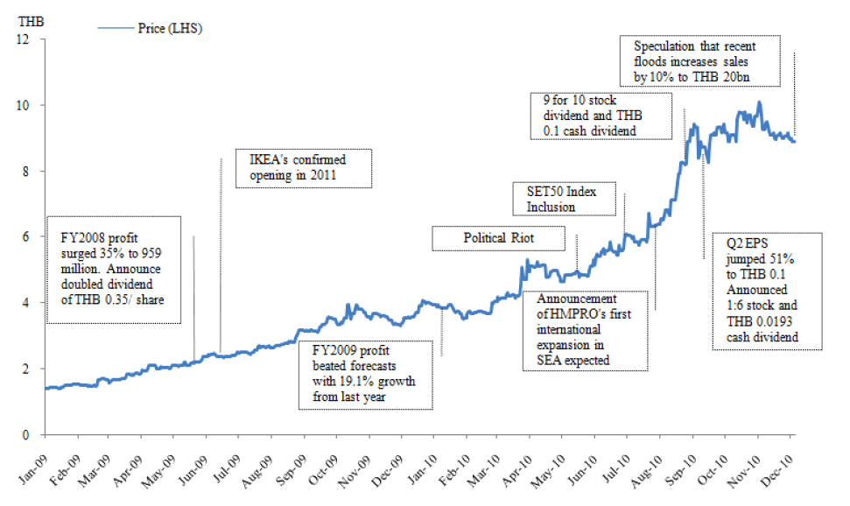
HMPRO price response to news

Slide 24
Earnings Announcement & Stock Price
Announcement day

Slide 25
Earnings Announcement & Stock Price
Announcement day

Slide 26
Earnings Announcement & Stock Price
Announcement day

Slide 27
Earnings Announcement & Stock Price
Announcement day

Slide 28
Psychology and investments

Slide 29
Investment choices
Q1: Choose one of the following investment choices:
  Opportunity 1:
  Win $100,000 with probability 0.1
  Lose $1.11 with probability 0.9
Opportunity 2:
  Win $39,996 with probability 0.5
  Lose $19,998 with probability 0.5

Slide 30
Prospect Theory
Proposed by two psychologists: Daniel Kahneman and Amos Tversky.
Gambles are evaluated relative to a reference point.
Decision maker analyzes “gains” and “losses” differently.
Incremental value of a loss is larger than that of a loss.
  “the hurt of a $1000 loss is more painful than the benefit of a $1000 gain”.

Slide 31
Prospect Theory Value Function
Utility
α > β
β
Relative
Loss
Reference point
x
RelativeGain
x
Anchor
α

Slide 32
Prospect Theory and Investor Behaviour
Why lottery tickets sell and why casino is good business
Tendency to sell winners too soon and hold on to losers too long.

Slide 33
Prospect Theory and Investment Applications
Investigate client’s loss aversion:
  What is the client’s reference point of regret?
  What is the client’s mental compartments? Investors have a “safe” part of their portfolio that they will not risk, and a “risky” part of their portfolio that they can have fun with
Lower moment portfolio selection
Downside risk betas
Use derivatives to protect downside losses
  Protective puts for equity indices
  Interest Collars

Slide 34
Representativeness
Using familiarity to make judgements.
Underweighting base rate information

Slide 35
Base rate probabilities: Example 1
Example 1: Amy loves to have fun. She enjoys hanging out with friends in downtown pubs and restaurants. When she goes out, Amy dresses fashionably.
What is Amy’s profession?
  Teacher
  Flight attendant
There is higher probability that Amy is a teacher. However, you may think she is a flight attendant based on observed characteristics. You are ignoring base rate probability.

Slide 36
Base Rate Probabilities: Example 2
Example 2: You have been called to a jury duty in a town where there are two taxi companies, Green Cabs Ltd. and Blue Taxi Inc. Green Cabs dominate the market with 85% of the taxis on the roads. On a misty winter night, a taxi sideswiped another car and drove off. A witness says it was a blue cab. The witness tested under conditions like those of the night of the accident and 80% of the time she correctly identifies the colour of the cab that is seen. That is regardless of whether she is shown a blue cab or a green cab, she gets the colour right 80% of the time.

Slide 37
Base Rate Probabilities: Example 2
What do you conclude based on this information?
  The probability that the sideswiper was Blue is 80%.
  It is more probable that the sideswiper was Blue, but the probability is less than 80%.
  It is just as probable that the sideswiper was Green as it was Blue.
  It is more likely than not that the sideswiper was Green

Slide 38
Base Rate Probabilities: Example 2
According to Kahneman and Tversky’s studies:
Most people think the swiper was Blue.
Bayes’ Theorem says “Green”
Base Rate Fallacy: People ignore the fact that most of the cabs in town are Green and focus on the witness.

Slide 39
Applying Bayes’ Theorem
Define probability of events
P(G) = Probability the taxi is green = 0.85
P(B) = Probability the taxi is blue = 0.15
P(W|B) = Conditional probability that witness identifies taxi is blue correctly = 0.8
We need to compute P(B|W).

Slide 40
Bayes’ Theorem
Note that P(G|W) = 0.59
IT IS MORE LIKELY THAT THE TAXI IS GREEN!

Slide 41
Representativeness and Investor Behaviour
Extrapolative expectations about asset prices.
Analysts tend to overestimate (underestimate) firms that have shown recent strong (weak) earnings performance.

Slide 42
What to do with representativeness?
Make use of historical data for better estimate of subjective probabilities.
Look before you leap into big investment decisions based on “rule-of-thumb” estimates.

Slide 43
Anchoring and investor behaviour
People form estimates based on some initial arbitrary values.
Examples
  Stock price reversals
  Use of benchmark market or industry P/E
  Charting tools such as “head and shoulders.”

Slide 44
What to do with anchoring?
Clients likely to prefer limit and range orders.
Good technical analysis should be based on good statistics.

Slide 45
Overconfidence and behaviour
People are overconfident in their judgements leading to overreaction or underreaction to news events.
Examples:
  Males earn lower net returns (after transaction costs) than females because they trade more aggressively. (Barber and Odean (2001)
  Volatility of longer term options move almost in lockstep with short term ones indicating that market puts too much focus on short-term innovations. (Stein 1989)
  Confident of Asian growth opportunities, management of many Asian companies are overleveraged and expanded aggressively prior to crisis in mid-1997.
  Underreaction of earnings announcements leads to empirical evidence on earnings announcement drift.

Slide 46
Dealing with overconfidence
Overconfidence definitely has impact on financial markets but still unclear how to quantify magnitude.
Be sure to analyze worse case scenario and avoid focus only on upside.

Slide 47
Herding
Uncertainty induces imitative behaviour.
This is a game where everybody believes he has inferior information relative to the others.
Examples:
  Mutual fund investment in similar stocks
  Stock analysts tend to converge to the mean when they forecast earnings.
  Excessive issuance of junk bonds by US companies in 1980s.

Slide 48
Dealing with herding
Putting your money in different mutual funds may not give you the diversification you really want.
If you decide to herd, be sure to get on the train early and get off it before trends reverse.

Slide 49
Repercussions on investment and asset pricing
Perfect markets: Assets are priced correctly. Mutual funds perform equally well. Investors use full and complete information set to arrive to investment decisions.
Imperfect markets: Investor sentiment creates disturbances to efficient prices. Limitations to arbitrage does not counter irrational disturbances.
  Analyze the worse case scenario avoid focus on upside.
  Investors hold on losers and sell winners so stop loss orders are helpful.
  People have “mental compartments” and so they hedge not against risk of future cash flows but against risk of a particular transaction.
  Dutch auctions or open IPOs can create a better market clearing price.
  Charting can help time purchase or sale of your investments because of anchoring.

Slide 50
Computer exercise
Technical analysis: Moving averages

Slide 51
Testing market efficiency

Slide 52
Empirical tests of market efficiency
Event studies
Tests patterns in the stock market
Testing some trading rules
Assessing performance of professional managers

Slide 53
Event studies
Measure unexpected return that results from an informational event such as
  Surprise earnings announcements
  Mergers and acquisitions
A firm’s return consists of a component related to fundamental risks and firm specific component

Slide 54
Event studies
1. Examine prices and returns over time
2. Returns are adjusted to determine if they are abnormal.
  Use Market model or other return models such as the Fama French three-factor model
    a. r_{t} = a_{t} + b_{trmt} + e_{t}
    (Expected Return)
    b. Excess Return =
    (Actual - Expected)
    e_{t} = Actual - (a_{t} + b_{trmt})
    c. Cumulate the excess returns over time:

Slide 55
Event studies
We use cumulative abnormal returns (CAR) over an event window to identify how information is incorporated in stock prices
If there is no new information CAR moves around 0

Slide 56
Homework
MSCI announced on November 12, 2012 that the following stocks on the SET namely BGH, CPN, and MAKRO has been included in the computation of its constituents index. Compute the CAR for period [-2, 5]. Do you detect any interesting pattern?

