Slide 1
What is psychology?
Psyche = mind
Logos = knowledge or study

Slide 2
What is psychology?
Psychology is a scientific study of behavior and mental processes.
Behavior (overt behavior) can be directly observed.
Mental process (covert behavior) can not be directly observed.

Slide 3
What are the goals of psychology?
1. Describing behavior
2. Understanding the causes of behavior
3. Predicting behavior
4. Controlling behavior / Influencing behavior

Slide 4
Pseudo-Psychologies
Pseudo means “false.” Any unfounded “system” that resembles psychology and is NOT based on scientific testing

Slide 5
Pseudo-Psychologies (cont.)
  Palmistry: Lines on your hands (palms) predict future and reveal personality
  Phrenology: Personality traits revealed by shape of skull and bumps on your head

Slide 6
Pseudo-Psychologies (Cont.)
Graphology: Personality revealed by your handwriting.
Astrology: The positions of the stars and planets at birth determine your personality and affect your behavior.

Slide 7
Pseudo-Psychologies (cont.)
Why does astrology often seem to work?
1. Uncritical Acceptance: Tendency to believe positive or unflattering descriptions of yourself.
2. Confirmation Bias: We remember or notice things that confirm our expectations and forget the rest.
3. Barnum Effect: Always have a little something for everyone.

Slide 8
Why is Psychology a science?
It uses the systematic methods of science to gather information.
Scientific Research: How to Think Like Psychologist

Slide 9
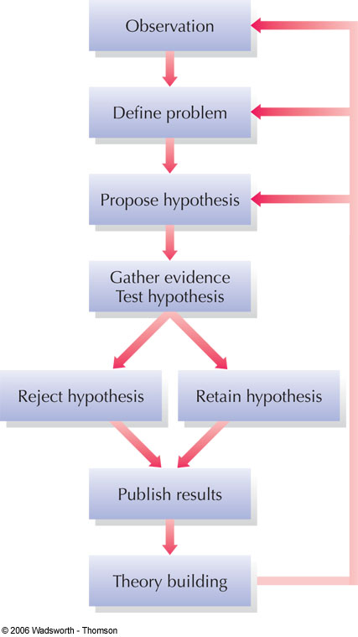
1
The Scientific Method
Six Basic Elements
2
3
4
5
6
Figure 1.5
Notes:
Figure 1.5 Psychologists use the logic of science to answer questions about behavior. Specific hypotheses can be tested in a variety of ways, including naturalistic observation, correlational studies, controlled experiments, clinical studies, and the survey method. Psychologists revise their theories to reflect the evidence they gather. New or revised theories then lead to new observations, problems, and hypotheses.

Slide 10
History of Psychology
1. Structuralism
“What are the elements of mind?”
Wilhelm Wundt “Father” of Psychology set up first lab (1879) to study conscious experience by using “introspection”.

Slide 11
History of Psychology (cont.)
2. Functionalism : William James
  “How the mind functions to adapt to our environment”
  Functionalism has major influences on modern psychology

Slide 12
History of Psychology (cont.)
3. Behaviorism: Watson & Skinner
  Psychology must study observable behavior.
  Behavior causes by conditioning and environment.

Slide 13
History of Psychology (cont.)
4. Gestalt Psychology : Wertheimer
Gestalt psychology studied thinking, learning, and perception as a whole units, not analyzing experiences into parts
“The whole is greater than the sum of its parts.”

Slide 14
History of Psychology (cont.)
5. Psychoanalytic: Freud
  Our behavior is largely influenced by our unconscious wishes, thoughts, and desires, especially sex and aggression.

Slide 15
History of Psychology (cont.)
6. Humanistic Psychology: Rogers and Maslow
Each person has innate goodness and is able to make free choices (free will). Contrast with Skinner and Freud (determinism)
We have psychological needs for love, self-esteem, creativity and spirituality.

Slide 16
Psychology Today: Three Complimentary Perspective on Behavior
1. Psychological Perspective
Include behaviorism, cognitive psychology, psychodynamic approach, and humanism
2. Biological Perspective
Behavior is influenced by brain and nervous system (biopsychology) and evolution and genetic (evolutionary psychology)
3. Sociocultural Perspective
Behavior is influenced by social and cultural environment

Slide 17
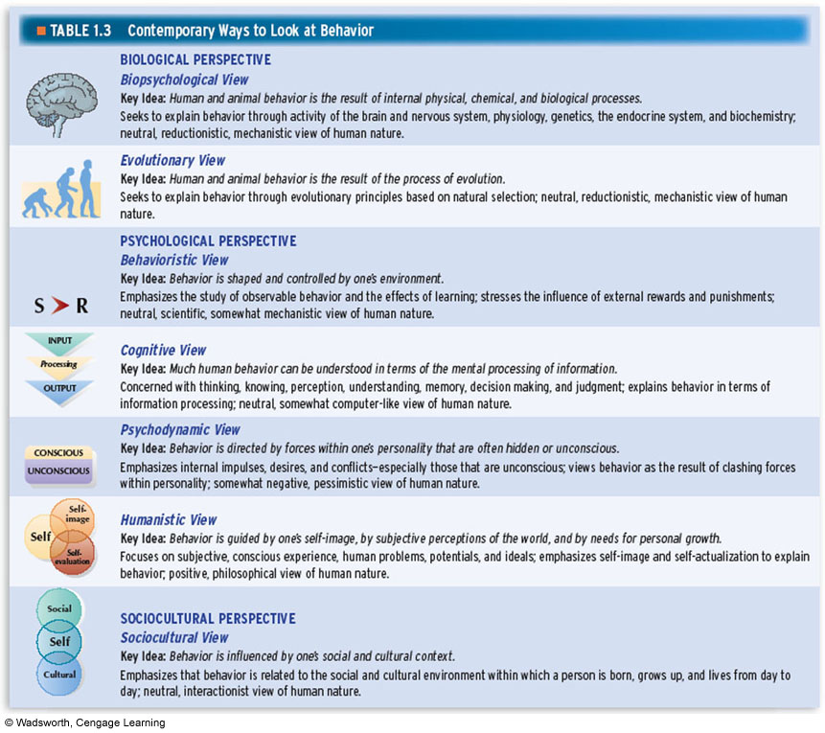

Slide 18
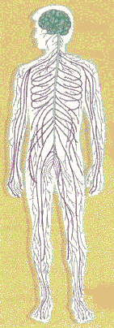
What are the major specialties in psychology?
1. Counseling Psychology
focuses primarily on educational, social and career adjustment
  2. Clinical psychology
    Study, diagnosis and treatment of psychological disorders
  3. Clinical neuropsychology
    Focuses on relationships between biological factors and psychological disorders

Slide 19
What are the major specialties in psychology? (cont.)
  4. Cognitive psychology
    Study human thinking and information processing abilities.
5. Cross-cultural psychology
    Focuses on the similarities and differences in psychological functioning across cultures and
    ethnic groups

Slide 20
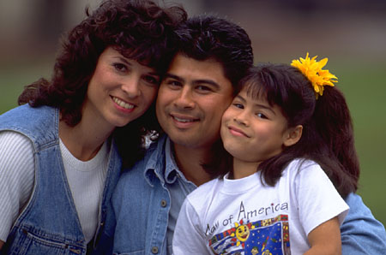
What are the major specialties in psychology? (cont.)
  6.Developmental psychology
    Study changes in behavior over the life span

Slide 21
What are the major specialties in psychology? (cont.)
  7. Health psychology
    Explores relationship between psychological factors and physical ailments or disease
    Industrial and Organizational Psychology
    Select job applicants, train employees, improve environments and human relations in organizations

Slide 22
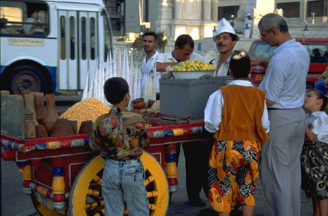
What are the major specialties in psychology? (cont.)
  9. Personality psychology
  Study personality traits and dynamics, develop theories and tests for assessing personality.
  10. Social psychology
    Study how people are affected by others, including attitude, conformity, friendship and helping behavior.
Notes:
Social psychology examines how people’s thoughts, feelings, and actions are affected by others. It is helpful to differentiate between this area and the field of sociology which examines social behavior.
Chapter 1 identifies child-rearing and perceptions of academic success as being examples of cross cultural psychology. This may also be applied to intelligence, psychotherapy, and family.

Slide 23
More Helping Professionals
Clinical psychologist
Psychiatrists: M.D.; usually use medications to treat problems; generally do not have extensive training in providing “talk” therapy
Psychoanalysts: Receive additional training post-Ph.D. or M.D. at an institute for psychoanalysis
(Free association and dream interpretation)

Slide 24
Types of Psychological Research
1. Nonexperimental Research
2. Experimental Research

Slide 25
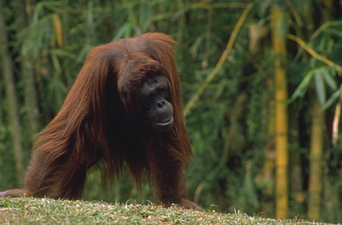
Nonexperimental Research Methods
2.Naturalistic observation
  Observation of naturally occurring behavior without intervention
1.Archival
research
  - Use of existing data in order to test a hypothesis
Notes:
Chapter 2 provides the example of using college records in order to determine if there are gender differences in academic performance
Although archival research is relatively inexpensive, it does present its problems: the data may not be in a form that allows the researcher to test a hypothesis fully, the information may be incomplete, and the records needed may not exist
Naturalistic observation provides an opportunity to observe natural behavior without intervention. Observer effect – the experimenter inadvertently being seen by the observed thereby influencing their behavior, and observer bias – tendency for an experimenter to be sensitive to supporting data are two shortcomings to overcome

Slide 26
Nonexperimental Research Methods
3.Correlational studies
  The relationship between two sets of variables is examined to determine whether they are associated, or “correlated”
Notes:
Variables are any behavior that can “vary”. It is helpful to have students brainstorm how many behaviors fit this definition
Correlational studies are helpful to identify variables that have some “co-relationship” but do not give any insights to cause effect relationships
TV and aggression, studying and academic performance are helpful examples of positive correlation. Self-esteem and depression is a good example of negative correlation

Slide 27
Nonexperimental Research Methods
3.Correlational studies (cont.)
Correlation does not mean “causation”
  Correlation ranges from -1 to +1
Notes:
Variables are any behavior that can “vary”. It is helpful to have students brainstorm how many behaviors fit this definition
Correlational studies are helpful to identify variables that have some “co-relationship” but do not give any insights to cause effect relationships
TV and aggression, studying and academic performance are helpful examples of positive correlation. Self-esteem and depression is a good example of negative correlation

Slide 28
Nonexperimental Research Methods
3.Correlational studies (cont.)
What type of correlation?
The greater the number of years of experience, the higher the income.
The greater the score on a depression inventory, the lower the score on a memory test.
Notes:
Variables are any behavior that can “vary”. It is helpful to have students brainstorm how many behaviors fit this definition
Correlational studies are helpful to identify variables that have some “co-relationship” but do not give any insights to cause effect relationships
TV and aggression, studying and academic performance are helpful examples of positive correlation. Self-esteem and depression is a good example of negative correlation

Slide 29
Nonexperimental Research Methods
4. The Clinical Method
  An in-depth, intensive investigation of an individual or small group of people
Notes:
The book “Sybil” is a prime example of a case study.
Case studies are beneficial in clinical psychology and often times include psychological testing. They are also helpful in the area of physiological psychology

Slide 30

Nonexperimental Research Methods
5. Survey research
  A sample of people are asked a series of questions about their behavior, thoughts, and attitudes in order to represent a larger population.
  Limitations:
  1. Biased sample
  2. Social Desirability
Notes:
As pointed out in the chapter, a sample of people is drawn from a population of interest. The methods of choosing the sample is critical in order to fairly represent the population as a whole. Problems occur when you have an insufficient number and/or a self-selection bias
Attrition and specificity of the questions are also major concerns in a survey

Slide 31
The Psychology Experiment –Where cause meets the effect
A study in which the investigator manipulates at least one variable (independent variable) while measuring at least one other variable (dependent variable)

Slide 32
The Psychology Experiment –Where cause meets the effect
Name the independent and dependent variable
-The effect of praise on performance.
-The effect of teaching methods on test scores.

Slide 33
The Psychology Experiment –Where cause meets the effect
Hypothesis
People study better while listening to music

Slide 34
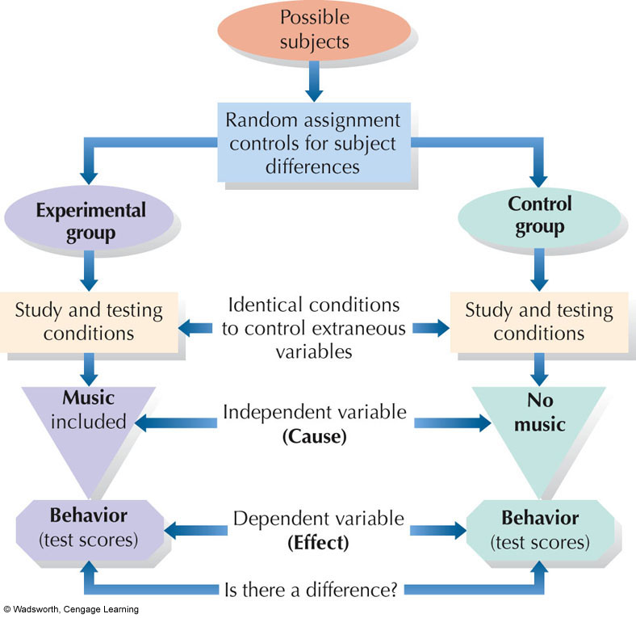
Notes:
FIGURE 1.6 Elements of a simple psychological experiment to assess the
effects of music during study on test scores

Slide 35
The Psychology Experiment –Where cause meets the effect
Important terminologies
1. Experimental group
The set of individuals who receive the treatment that the experiment designed to test.

Slide 36
Important terminologies
2. Control Group
The set of individuals who are treated in the same way as the experimental group except for the procedure that the experiment is designed to test.

Slide 37
Important terminologies
3. Extranious Variable
A variable that has an effect on the outcome (dependent variable), but it is not an independent variable e.g. temperature, time of the day, personality.

Slide 38
Important terminologies
4. Random Assignment
A selection method in which the experimenter assigns subjects to either the experimental group or control group using a procedure based on chance.

Slide 39
Important terminologies
5. Experimental bias
  Factors that distort how the independent variable affects the dependent variable in an experiment
    Experimenter expectations
    Participant expectations
Notes:
The unconscious tendency for researchers to be sensitive to their expectations during the course of research is offset by methods minimize bias – operational definitions, procedures, and formulating your hypothesis prior to the research
A discussion of the placebo effect is aided by the examination of medication research – Physicians Desk Reference that use placebos in a “placebo control group” and examine reported side effects and benefits by subjects

Slide 40
Important terminologies
5. Experimental bias (cont.)
Methods to help counteract bias
1.. Using blind observer who record data without knowing what the researcher is studying.
2. Using blind subjects
Participants do not know what the researcher is studying.
3. Using double -blind

Slide 41
Important terminologies
5. Experimental bias
Methods to help counteract bias (cont.)
4. Using Placebo
A placebo is a pill or other sham treatment that makes it very difficult for the subjects (single - blind) or the subjects and the observers (double- blind) to know who has received the treatment and who has not.

Slide 42
Reading Assignments
1. Psychology of Study
2. Psychology in Action – Psychology in the Media p. 32 -33.

Slide 43
Suggestions for separating high-quality information from misleading fiction
1. Be skeptical.
2. Consider the source of information.
3. Beware of oversimplifications, especially those motivated by monetary reasons.

Slide 44
Suggestions for separating high-quality information from misleading fiction (cont.)
4. Remember, “for example” is no proof.
5. Ask yourself if there was a control group.
6. Look for errors in distinguishing between correlation and causation

Slide 45
Suggestions for separating high-quality information from misleading fiction (cont.)
7. Be sure to distinguish between observation and inference

