Slide 1
Introduction and Early Trade Theories
EE451
Chayun Tantivasadakarn
Faculty of Economics, Thammasat University

Slide 2
Outline
Introduction
Merchandise Trade and Trade in Services
What is International Economics About?
Mercantilism

Slide 3
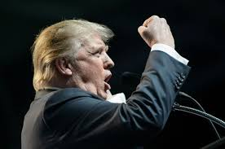
Introduction
The study of international economics has never been as important as it is now.
  Nations are more closely linked through trade in goods and services, through flows of money, and through investment in each others’ economies than ever before.
  World export value has increased from $2,035 bn. in 1980 to $6,357 bn. in 2000 with a growth rate of 6.1 per annum ($18,494 bn. in 2014).
  New events: BREXIT, Trumponomics, disruptive technology

Slide 4
World Export Value: 1980 – 2014 (US$)
$18.5 bn.
http://stat.wto.org/StatisticalProgram/WSDBStatProgramSeries.aspx?Language=E

Slide 5
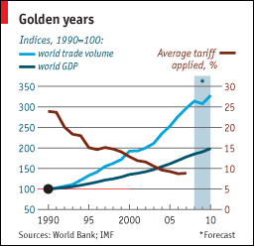
Average tariff rates vs. world trade volume

Slide 6
International trade: total world export and import is $7,004 bn.
Source: International Trade & the World Economy; Charles van Marrewijk

Slide 7
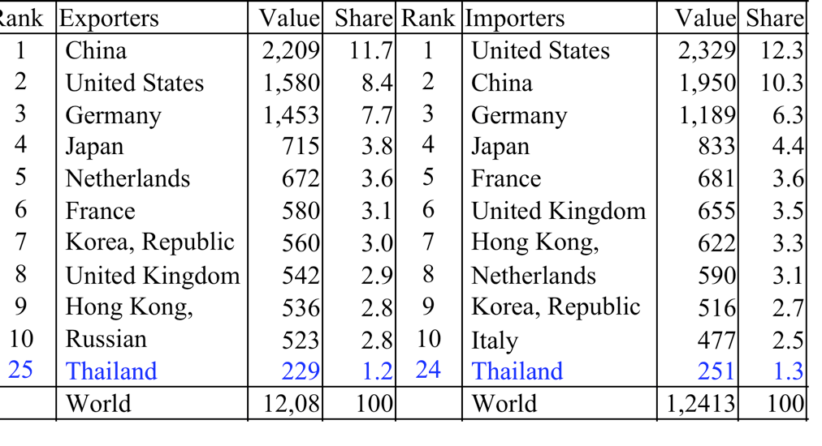
Leading exporters and importers in world merchandise trade, 2013
Billion Dollars
Source: WTO, http://www.wto.org/english/res_e/statis_e/its2014_e/its07_world_trade_dev_e.htm

Slide 8
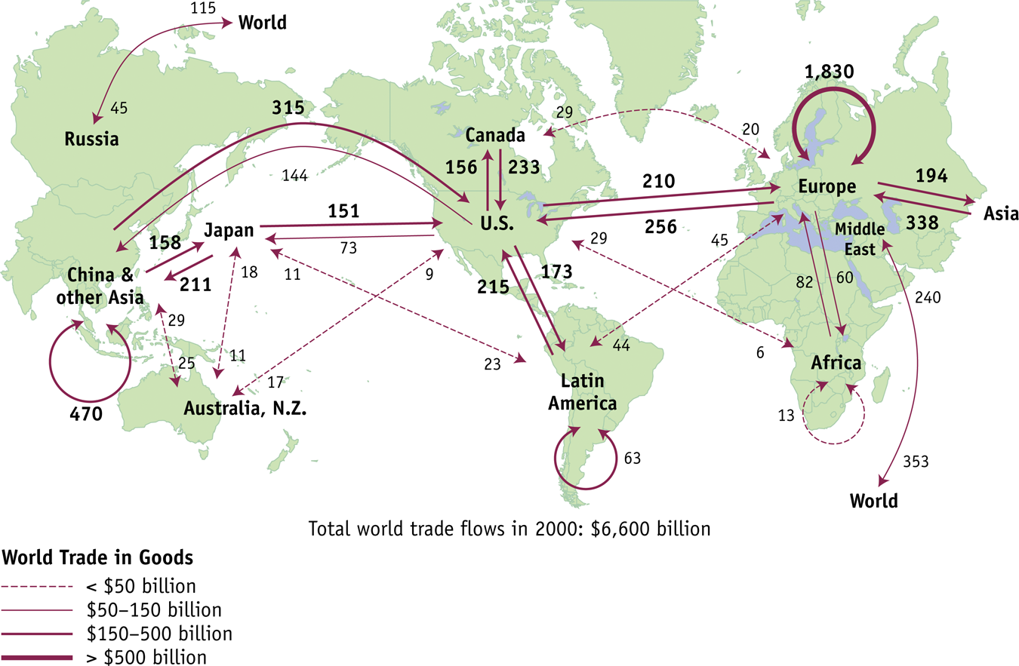
World Trade in Goods, 2000 ($ billions)
Feenstra and Taylor: International Economics, First Edition

Slide 9
Map of World Trade
European and U.S. Trade
  Trade within Europe is the largest, about 28% of world trade.
    Many countries
    Easy to ship between countries because import tariffs are low
    European Union (EU) countries have zero tariffs on imports from each other.
    EU has 25 members with two more joined in 2007.

Slide 10
Map of World Trade
European and U.S. Trade
  Europe and the U.S. together account for 35% of world trade flows.
  Differences among these countries explain some of the trade between them.
  Despite this, industrialized countries like the U.K. and U.S. have many similarities.

Slide 11
Map of World Trade
Trade in the Americas
  Trade between North, Central, and South America and the Caribbean totals 13% of all world trade.
  Most of this is within the North American Free Trade Area which consists of Canada, the U.S. and Mexico.
  Unlike the EU, it is unlikely that NAFTA will gain new countries any time soon.
    Trade between the NAFTA countries and Central and South America is relatively small and the distances are large.

Slide 12
Map of World Trade
Trade with Asia
  All exports from Asia total 28% of all world trade.
    Exports from China alone doubled from 2000 to 2005.
  Many reasons why Asia trades so much
    China’s labor is cheap.
    Japan can produce high quality goods efficiently.

Slide 13
Map of World Trade
Other Regions
  Oil and natural gas are exported from the Middle East and Russia.
    Exports from these two areas totaled another 10% of world trade.
  Africa accounts for only 2.5% of world trade.
    Very small given its size and population
    Many believe getting Africa out of poverty will require better linkages with the world through trade.

Slide 14
Composition of world merchandise trade value
https://www.un.org/development/desa/dpad/wp-content/uploads/sites/45/publication/DevIssues7-Fig3.jpg

Slide 15
Degree of openness: (X+M)/GDP
Group of countries 2000 2020
NAFTA 5 6
MERCOSUR 6 5
EU 30 9 14
OPEC 29 3 2
ASEAN 16 26
Great China 7 8
Sub Saharian Africa 9 8
World 16 20
Source: UNCTAD/WTO
Q: What is the degree of openness for Thai and its implications?

Slide 16
Degree of openness: (X+M)/GDP
Q: What is the degree of openness for Thai and its implications?
In year 2006 2014
Exports = 4,838.2 7,313.1 M.Baht
Imports = 4,830.3 7,403.9 M.Baht
GDP = 7,830.3 9,211.6 M.Baht
(X+M)/GDP*100 123.1% 159.8%

Slide 17
Thailand Export Markets 1995 - 2014
11%
26.1%
10.3%
10.5%
9.6%

Slide 18
Thailand Import Markets 1995 - 2014
10.9%
12.8%
8.6%
15.6%

Slide 19
Trade in Services: 1999
More than 20 % of world exports are trade in services, worth about $1 trillion
Exports $billion %
US 167.5 (16.4)
France 100.8 (9.9)
Japan 53.2 (5.2)
Thailand 11.2 (1.1)
Imports billion %
US 113.4 (11.5)
Germany 111.9 (11.3)
Japan 100.7 (10.2)
Thailand 11.8 ( 1.2)

Slide 20
Trade in Services: 2006
Billion Dollars
Source: WTO, http://www.wto.org/english/res_e/statis_e/its2007_e/its07_world_trade_dev_e.htm

Slide 21
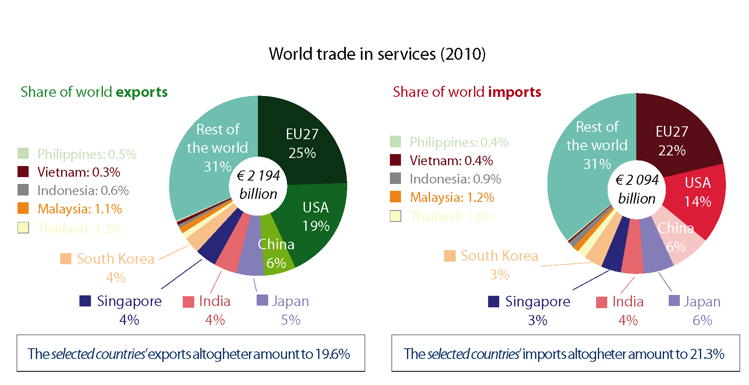
Trade in Services: 2010
https://libraryeuroparl.files.wordpress.com/2012/11/fig-3-v2.png

Slide 22
What is International Economics About?
The Pattern of Trade (who sells what to whom?)
  Technology, resources, market structure, and government policy determine the trade pattern of several goods.

Slide 23

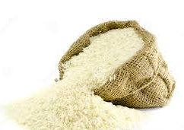


What is International Economics About?
There are two types of trade:
  Inter-industry trade: trade of different products categories across countries.
    Thailand exports rubber to the US. While the US. exports mobile phones to Thailand
  Intra-industry trade: trade of similar product categories across countries.
    the US. and Europe simultaneously import and exports cars to each other.

Slide 24
What is International Economics About?
The Gains from Trade
  Many people are skeptical about importing goods that a country could produce for itself.
  When countries sell goods to one another, all countries benefit.
  Trade and income distribution
    International trade might hurt some groups within nations.
    Trade, technology, and wages of high and low-skilled workers.

Slide 25
What is International Economics About?
Trade policies
  International economics deals with economic interactions that occur between independent nations.
  The role of governments in regulating international trade and investment is substantial.
  International trade institutions play important role in regulating the trade policy of each nation.

Slide 26
Early Trade Theories and
The Classical Trade Theory

Slide 27
Mercantilism
Mercantilist doctrine:
  the national wealth depends on the amount of precious metals (specie) that country is holding.
    Acquisition of precious metals is the mean for increasing wealth. --> Colonialism.
  Zero-sum game: One country’s gain is at the expense of another. --> trade surplus is preferred to trade deficit.
  Need strong government to regulate the economy.
    exchange of precious metals regulation, monopoly

Slide 28
Challenge to Mercantilism
David Hume: price-specie-flow mechanism
  From the quantity theory of money: MV = PY
    trade surplus
    accumulation of gold
    increase M
    increase prices and wages
    reduce competitiveness and trade surplus

Slide 29
Challenge to Mercantilism
Adam Smith: laissez faire and absolute advantage
  the national wealth depends on its productive capacity.
  Growth in productive capacity is fostered in free market.
  Self-interest leads individuals to specialize in and exchange goods based on their own special abilities.
  Countries should specialize in and export those commodities in which they had an absolute advantage.

Slide 30
Analysis of absolute cost advantage
International trade based on differences in technology
assumptions
2 countries; USA and Japan
2 goods; Food and Cars
1 factor of production; labor L
Constant returns to scale; CRS
Labor mobility between sectors, not between countries
Perfect competition
No transport costs
unit labor requirement
= units of labor required to produce one unit of a final good
By assumption this is independent of the number of laborers active in a sector (CRS), but may differ between the two countries.
Let be the unit labor requirement for good F in USA, etc.

Slide 31
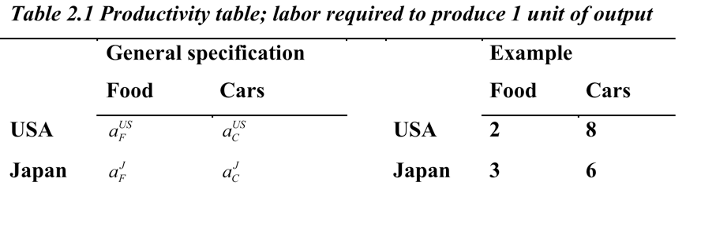
Analysis of absolute cost advantage
Note that the USA is more efficient than Japan for the production of Food (requires 2 < 3 laborers), while Japan is more efficient than the USA in the production of cars (requires 6 < 8 laborers).
USA has an absolute advantage in Food while Japan has an absolute advantage in cars.
In autarky (without international trade) both countries will produce both goods if consumers demand both Food and Cars.

Slide 32
Analysis of absolute cost advantage
Both countries can gain from international trade through specialisation (USA producing more food and Japan producing more cars):
Suppose the USA produces 1 car less, this frees up 8 laborers.
These 8 laborers can now produce 8/2 = 4 units of food
To keep the production level of cars constant, Japan should make 1 car more. This requires 6 laborers.
These 6 laborers could have made 6/3 = 2 units of food.
Conclusion: USA Japan change world prod.
production of cars: -1 +1 0
production of food: +4 -2 +2
The extra production represents gains from trade
What if one country has no absolute advantage in any good?

Slide 33


Useful websites for this course:
Deardorff's Glossary of International Economics http://www-personal.umich.edu/~alandear/glossary/
WTO
http://wto.org/english/res_e/res_e.htm
ASEAN: http://www.aseansec.org/

Slide 34
Question
A company consists of a manager and a secretary. The manager is more able in both executive and typing works than the secretary.
Should the manager do all works or concentrate on the work he or she has comparative advantage?
Supplementary reading
“World Trade Report, 2016” at
https://www.wto.org/english/res_e/booksp_e/world_trade_report16_e.pdf

