Slide 1
Macroeconomics:
The Basics (week 3)
Thorn Pitidol
Faculty of Economics, Thammasat University
EE212, Semester 2/2556

Slide 2
Agendas
Mapping the circular flow of macro-economy
GDP and its measurement
Nominal/real GDP, GDP growth, and GDP per capita
Price indexes and inflation rates
Unemployment rates

Slide 3
Questions
If you are the government, what information do you need to make decisions on macro-economic policies?
  What indicators?
  What do the indicators reflect?
  How useful are the indicators?

Slide 4
Mapping the circular flow of macro-economy
The measurement of macroeconomic indicators is geared toward measuring the “aggregate behaviours” of economic agents
  For example; households, firms, government
In the Thai context, measurements are carried out by different government units
  For example: BOT, NESDB, NSO, and MOF
  Note that the detailed calculation techniques constantly evolves.

Slide 5
Mapping the circular flow of macro-economy
The “circular flow” diagram captures the important aspects of “aggregate behaviours” in the economy
Basic circular flow diagram (without the government,
financial institutions, and the foreign sector)

Slide 6
Mapping the circular flow of macro-economy
The “circular flow” diagram captures the important aspects of “aggregate behaviours” in the economy
Circular flow diagram with the government,
financial institutions, and the foreign sector

Slide 7
GDP and its measurement
The circular flow shows the ways to measure GDP
  GDP =
    Final goods and services =
    Question: Is GDP a flow or a stock variable? Does the product from the previous year or period count?
    Question: Is GDP a good measure?

Slide 8
GDP and its measurement
Three approaches to GDP measurement
  What did you learn from the circular flow diagram?
  In a simple economy
  GDP, therefore, can be measured from three sides: production side, expenditure side, and income side

Slide 9
GDP and its measurement
GDP measurement: production side
  The most direct method
    Summing up the value of all final goods and services produced in each sector
  GDP =

Slide 10
Calculating GDP Production Side
Value-added method
Example:
 | Pork | Noodle | Pork-meatballs | Pork-meatball Noodle
Input Costs | 0 | 0 | Pork | Noodle & Pork-meatballs
Rent | 0 | 5 | 10 | 50
Wages | 10 | 15 | 10 | 100
Value of output | 20 | 30 | 40 | 200

Slide 11
GDP of Thailand (Production Side) (Unit: Million Baht)
Table 3 Gross domestic product
at current market prices by economic activities
 |  |  |  |  |  |  |  | (Millions of Baht)
 | 2004 | 2005 | 2006 | 2007 | 2008r | 2009r | 2010r | 2011p
Agriculture | 646,344 | 700,380 | 790,175 | 848,688 | 978,015 | 940,559 | 1,129,222 | 1,271,524
Agriculture, hunting and forestry | 538,264 | 594,289 | 681,162 | 750,109 | 881,238 | 839,862 | 1,027,228 | 1,168,409
Fishing | 108,080 | 106,091 | 109,013 | 98,579 | 96,777 | 100,697 | 101,994 | 103,115
Non-agriculture | 6,297,555 | 6,885,947 | 7,575,167 | 8,189,087 | 8,681,620 | 8,650,163 | 9,580,592 | 9,848,994
Mining and quarrying | 175,486 | 222,124 | 257,607 | 278,906 | 315,185 | 305,700 | 339,692 | 366,608
Manufacturing | 2,058,746 | 2,268,623 | 2,548,507 | 2,790,778 | 2,980,979 | 2,859,089 | 3,358,410 | 3,297,910
Electricity, gas and water supply | 213,348 | 222,359 | 241,130 | 249,938 | 265,431 | 282,870 | 298,675 | 304,693
Construction | 197,014 | 226,654 | 245,217 | 263,388 | 266,943 | 271,297 | 303,008 | 281,877
Wholesale and retail trade; repair of motor vehicles,
motorcycles and personal and household goods | 1,057,009 | 1,135,238 | 1,219,311 | 1,311,135 | 1,388,318 | 1,430,697 | 1,568,885 | 1,630,226
Hotels and restaurants | 229,937 | 231,321 | 255,239 | 277,778 | 298,874 | 285,537 | 311,346 | 338,644
Transport, storage and communications | 546,587 | 566,820 | 620,610 | 690,709 | 701,781 | 701,195 | 734,884 | 743,791
Financial intermediation | 367,364 | 417,155 | 448,643 | 493,043 | 523,609 | 543,844 | 561,392 | 640,996
Real estate, renting and business activities | 515,545 | 563,549 | 620,819 | 642,703 | 667,114 | 642,744 | 703,633 | 741,957
Public administration and defence; compulsory social security | 393,384 | 437,976 | 482,560 | 530,042 | 577,397 | 614,852 | 652,464 | 703,436
Education | 261,662 | 289,227 | 319,071 | 349,617 | 372,103 | 391,702 | 410,474 | 435,803
Health and social work | 114,850 | 125,326 | 135,858 | 143,781 | 149,829 | 152,178 | 156,987 | 166,112
Other community, social and personal service activities | 158,401 | 171,043 | 171,857 | 158,057 | 164,375 | 158,323 | 170,593 | 186,207
Private households with employed persons | 8,222 | 8,532 | 8,738 | 9,212 | 9,682 | 10,135 | 10,149 | 10,734
Gross domestic product, (GDP) | 6,943,899 | 7,586,327 | 8,365,342 | 9,037,775 | 9,659,635 | 9,590,722 | 10,709,814 | 11,120,518
plus : Net primary income from the rest of the wold | -302,148 | -341,440 | -312,290 | -305,508 | -313,144 | -331,321 | -476,313 | -344,427
Gross national product, (GNP) 1/ | 6,641,751 | 7,244,887 | 8,053,052 | 8,732,267 | 9,346,491 | 9,259,401 | 10,233,501 | 10,776,091
less : Consumption of fixed capital | 1,019,111 | 1,134,099 | 1,226,298 | 1,289,666 | 1,463,103 | 1,486,739 | 1,590,776 | 1,732,667
Taxes on production and imports less subsidies | 699,545 | 774,442 | 867,824 | 895,447 | 884,048 | 934,664 | 1,102,521 | 1,104,693
National income, (NI) 2/ | 4,923,095 | 5,336,346 | 5,958,930 | 6,547,154 | 6,999,340 | 6,837,998 | 7,540,204 | 7,938,731
Per capita GDP (Baht) | 107,606 | 116,535 | 127,571 | 136,851 | 145,297 | 143,353 | 159,105 | 164,512
Per capita GNP (Baht) | 102,923 | 111,290 | 122,809 | 132,225 | 140,587 | 138,400 | 152,029 | 159,417
Per capita NI (Baht) | 76,290 | 81,973 | 90,873 | 99,138 | 105,282 | 102,208 | 112,017 | 117,442
Population (1,000 Heads) | 64,531 | 65,099 | 65,574 | 66,041 | 66,482 | 66,903 | 67,313 | 67,597
Note : 1/ GNP = GNI (Gross national income)
2/ NI = NNP (Net national product) at factor cost

Slide 12
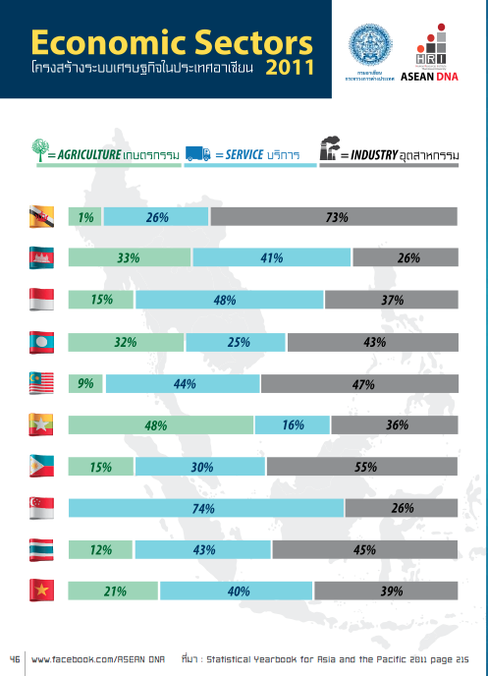

Slide 13
GDP and its measurement
GDP measurement: expenditure side
  Total value of all categories of expenditure on “final” goods and services
    Categories are divided according to types of spender
      Each type of spender designates “who” spends
    GDP =
      GDP =

Slide 14
GDP and its measurement
GDP measurement: expenditure side
  More details on C + I + G + (X-M)
Component | Meaning
Private Consumption Expenditure (C) | Total value of spending on final consumption of goods and services, as spent by households or non-profit seeking organisations.
Government Consumption Expenditure (G) | Total government spending on final goods and services

Slide 15
2.3.3 Expenditure Approach
Component of GDP | Meaning
Gross Capital Formation (I)
Gross Fixed Capital Formation | Investments in constructions and equipments that are used in the production process and last longer than 1 year.
Change in Inventories | Difference between demand and supply of goods within one accounting year. ***A convenient way to think of this is to think of goods that have been produced but have not yet been sold.

Slide 16
2.3.3 Expenditure Approach
Component of GDP | Meaning
Exports and Imports of Goods and Services (X-M) | Export of goods: values of final goods exported to foreign countries. Export of services: value of services in transportation and tourism, and other services such as communication services, insurance services, sold to foreign countries. Import of goods: values of final goods imported from foreign countries Import of services: values of services bought from foreign countries.

Slide 17
Calculating GDP Expenditure Side
Example:
 | 2009
Private Consumption Expenditure | 5,000,000
General Government Consumption Expenditure | 1,500,000
Gross Fixed Capital Formation | 2,200,000
Change in Inventories | -200,000
Plus : Exports of Goods and Services | 6,000,000
Exports of Goods | 5,000,000
Exports of Services | 1,000,000
Less : Imports of Goods and Services | 5,000,000
Imports of Goods | 4,000,000
Imports of Services | 1,000,000
Expenditure on Gross Domestic Product
Plus : Statistical Discrepancy | 0
Gross Domestic Product, (GDP)

Slide 18
GDP of Thailand (Expenditure Side) 2009-2011 (Unit: Million Baht)
 | 2009 | 2010 | 2011
Private Consumption Expenditure | 5,117,711 | 5,590,151 | 5,922,912
General Government Consumption Expenditure | 1,520,219 | 1,678,702 | 1,781,186
Gross Fixed Capital Formation | 2,232,018 | 2,593,168 | 2,897,315
Change in Inventories | -238,816 | 149,393 | 54,664
Plus : Exports of Goods and Services | 6,190,058 | 7,145,554 | 7,942,726
Exports of Goods | 5,157,644 | 6,060,184 | 6,675,068
Exports of Services | 1,032,414 | 1,085,370 | 1,267,658
Less : Imports of Goods and Services | 5,286,372 | 6,547,273 | 7,749,631
Imports of Goods | 4,036,590 | 5,122,935 | 6,160,220
Imports of Services | 1,249,782 | 1,424,338 | 1,589,411
Expenditure on Gross Domestic Product | 9,534,818 | 10,609,695 | 10,849,172
Plus : Statistical Discrepancy | 55,904 | 100,119 | 271,346
Gross Domestic Product, (GDP) | 9,590,722 | 10,709,814 | 11,120,518

Slide 19
GDP and its measurement
GDP measurement: income side
  Summing up the production related income earned by all people and organisations
  But in order to get to the number of GDP, the calculation needs further steps

Slide 20
GDP and its measurement
GDP vs GNP
  GDP measures the total value of goods and services newly produced within the “geographical boundary” of a nation
  GNP =

Slide 21
GDP and its measurement
GDP measurement: additional measures (in relation to GDP)
  GDP → GNP
  Net National Product (NNP): GNP less depreciation
  National Income (NI): Total income earned by factors of production
    **In case statistical discrepancy is zero, NNP equals NI
  Personal Income (PI): Total income accrued to households
  Disposable Personal Income: Total income available for household to spend
  How to get from GDP to other measurements?

Slide 22
GDP and its measurement
GDP measurement: additional measures (in relation to GDP)
    GDP
    Equals: GNP
      Less:
    Equals: Net National Product (NNP)
      Less:
    Equals: National Income

Slide 23
GDP and its measurement
GDP measurement: additional measures (in relation to GDP)
    National income
      Less: Amount of national income not going to households
    Equals: Personal income
      Less:
    Equals:
      Less: Personal consumption expenditures, personal interest payments, and transfer payments made by households
    Equals: Personal saving

Slide 24
Calculating GDP Income Side
Example:
 | 2009
Gross Domestic Product, (GDP) | 9,000,000
Net Income Payment from Abroad | -500,000
Gross National Product (GNP)
Depreciation | 1,500,000
NNP (Net National Product)
Statistical Discrepancy | 0
NI (National Income)
 | 2009
Compensation to employees | 3,000,000
Household mixed income/operating surplus | 2,500,000
Household property income (rent + interest) | 500,000
Government property income (rent + interest) | -10,000
Corporate profit | 1,010,000
NI (Net Income)
Statistical Discrepancy | 0
NNP (Net National Product)
Depreciation | 1,500,000
Gross National Product (GNP)
Net Income Payment from Abroad | -500,000
Gross Domestic Product, (GDP)
 | 2009
NI (National Income) | 7,000,000
Income not going to household | 2,000,000
PI (Personal Income)
Personal income taxes | 1,000,000
Disposable personal income

Slide 25
GDP of Thailand (Income Side) 2009-2011 (Unit: Million Baht)
 | 2009 | 2010 | 2011
Compensation of employees | 2,943,149 | 3,169,279 | 3,386,816
Households mixed income and operating surplus | 2,438,626 | 2,722,930 | 2,876,830
Households property income | 305,623 | 370,102 | 339,761
Interest | -11,179 | -24,745 | -22,239
Distributed income of corporations | 236,168 | 311,149 | 280,760
Investment income disbursments | 101,439 | 107,625 | 109,435
Rent | - | - | -
General government property income | -12,152 | -15,597 | -1,225
Interest | -87,588 | -98,343 | -105,964
Distributed income of corporations | 65,489 | 71,075 | 89,442
Investment income disbursments | - | - | -
Rent | 9,947 | 11,671 | 15,297
Appropriated corporation profit | 1,162,752 | 1,293,490 | 1,336,549
Net national product at factor cost, (NNP) | 6,837,998 | 7,540,204 | 7,938,731
Plus : Consumption of fixed capital (depreciation) | 1,486,739 | 1,590,776 | 1,732,667
Taxes on production and imports less subsidies | 934,664 | 1,102,521 | 1,104,693
Gross national product, (GNP) 1/ | 9,259,401 | 10,233,501 | 10,776,091
Less : Net primary income from the rest of the world | -331,321 | -476,313 | -344,427
Gross domestic product, (GDP) | 9,590,722 | 10,709,814 | 11,120,518

Slide 26
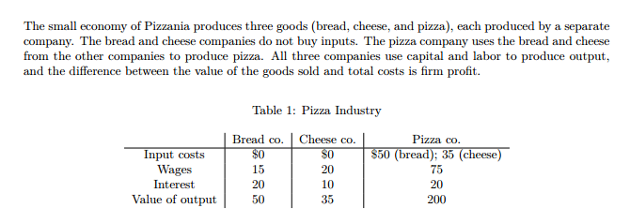
GDP and its measurement
GDP measurement: calculation exercise
Calculate GDP from production side (value added approach), expenditure side, and income side

Slide 27
GDP growth, Nominal/Real GDP, and GDP per capita
Measuring the GDP growth
  Can we simply compare the value of GDP from each year?
    Complications arise as prices keep on changing every year. The change in GDP can be due to change in price rather than in the real value of goods and services.
    Thus, the distinction has to made between nominal VS real GDP before the reliable measurement of growth in GDP can be obtained
      Nominal GDP =
      Real GDP =

Slide 28
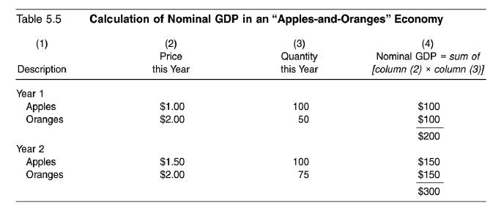
GDP growth, Nominal/Real GDP, and GDP per capita
Nominal GDP = GDP at current price

Slide 29
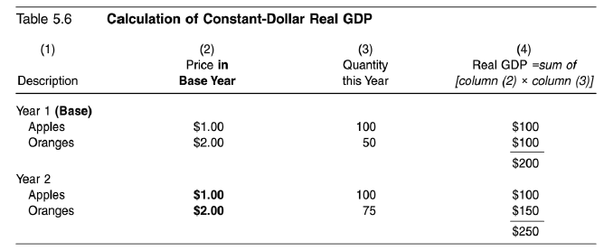
GDP growth, Nominal/Real GDP, and GDP per capita
Real GDP = GDP at base year price

Slide 30
GDP growth, Nominal/Real GDP, and GDP per capita
GDP Deflator
GDP Growth
GDP per capita

Slide 31
Thailand Real and Nominal GDP (US Dollars), 1980-2012

Slide 32
Thailand GDP per capita (local currency unit: Baht), 1980-2012

Slide 33
GDP per capita 2012, PPP (constant 2005 international)
Unit: 1,000 US Dollars
Source: World Bank

Slide 34
GDP per capita 2012, PPP (constant 2005 international)
Unit: 1,000 US Dollars
Source: World Bank

Slide 35
Thailand GDP growth and GDP per capita growth, 1980-2012
Source: World Bank

Slide 36
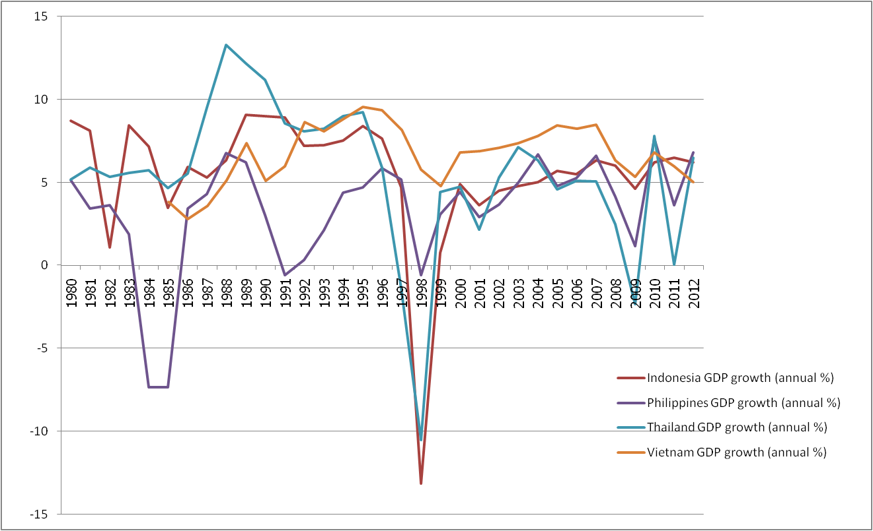
GDP growth, selected countries, 1980-2012
Source: World Bank

Slide 37
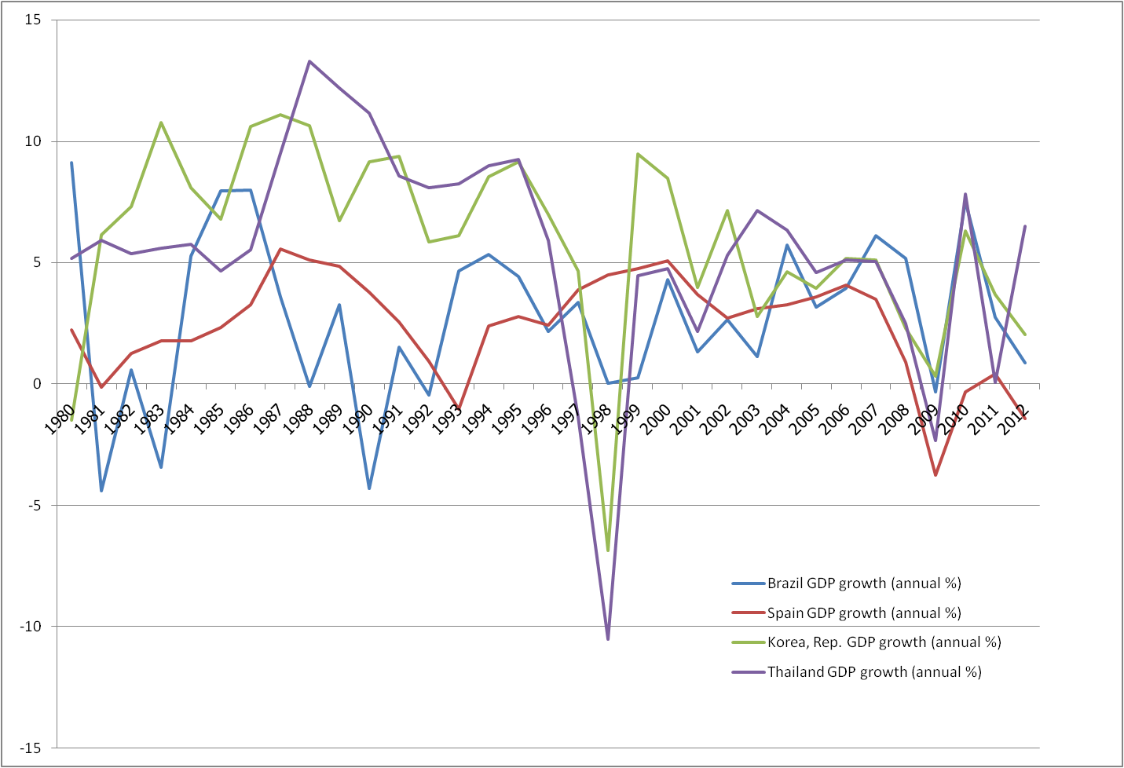
GDP growth, selected countries, 1980-2012
Source: World Bank

Slide 38
GDP growth, Nominal/Real GDP, and GDP per capita
Exercise: calculate real GDP growth
 | Quantity |  | Price |  | Nominal GDP₁ | Nominal GDP₂ | Real GDP₁ (Base Year = Y1) | Real GDP₂ (Base Year = Y1
 | Year 1 (Q₁) | Year 2 (Q₂) | Year 1 (P₁) | Year 2 (P₂) | Q₁ x P₁ | Q₂ x P₂ | Q₁ x P₁ | Q₂ x P₁
Goods A | 6 | 6 | 5 | 6
Goods B | 7 | 7 | 3 | 5
Goods C | 10 | 12 | 7 | 9

Slide 39
Price indexes and inflation rates
Why measuring the changes in price?
  Price change in itself has crucial implications for the economy
    Inflation =
    Deflation =
  Inflation leads to a decline in the value of money
    Question: How would inflation affect the following parties?
      Debtors, employers, salary earners

Slide 40
Price indexes and inflation rates
Measurement of price changes
  Price Indexes (measuring change in prices for the same basket of goods and services)

Slide 41
Price indexes and inflation rates
Examples of calculation
 | 2010 (Base Year) |  |  | 2011
 | Quantity (Q₁) | Price (P₁) | Spending = P₁xQ₁ | Price (P₂) | Spending = P₂xQ₁
Goods A | 12 | 15 |  | 17
Goods B | 4 | 45 |  | 60
Goods C | 18 | 15 |  | 15
Total value of spending
Price Index
Price Index for 2011 =
Inflation Rate for 2011 =

Slide 42
Price indexes and inflation rates
Types of price indexes
  Consumer Price Index (CPI):
  Producer Price Index (PPI):

Slide 43
Price indexes and inflation rates
CPI vs GDP Deflator
  GDP Deflator concerns prices of all goods and services in the economy, whereas CPI takes into account only prices of goods and services bought by consumers.

Slide 44
Price indexes and inflation rates
Real interest rate
  The difference between the interest rate on a loan and the inflation rate
  Why using the real interest rate to calculate the return from loans?
    Example: You lend 100 bath to a friend. The inflation rate will be 10 percent. The interest rate you charge is 15 percent. What return from your loan will you actually receive?

Slide 45
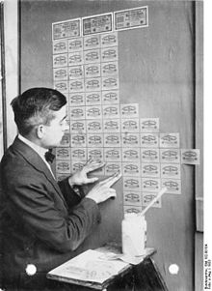
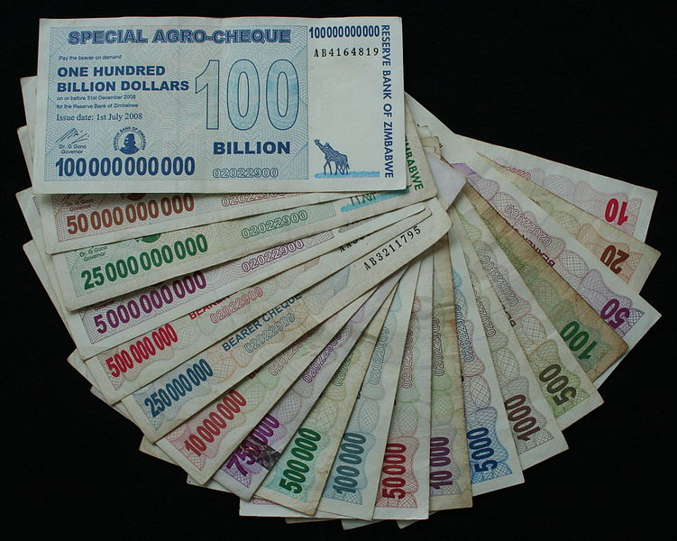
Price indexes and inflation rates
Hyper-inflation
Weimar Republic
Zimbabwe

Slide 46
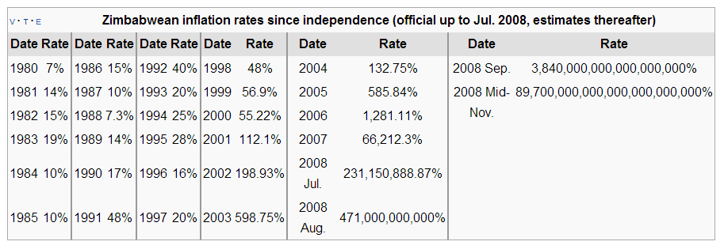
Price indexes and inflation rates
Zimbabwe hyperinflation

Slide 47
Price indexes and inflation rates
CPI and PPI for Thailand, 2000-2010
CPI Year Base 2007, PPI Year Base 2000

Slide 48
CPI, Thailand, 2013 (Base Year = 2011)
Description | weight | Jan. | Feb. | Mar. | Apr. | May. | Jun. | Jul. | Aug. | Sep. | Oct.
ALL COMMODITIES | 100 | 104.44 | 104.66 | 104.73 | 104.9 | 105.15 | 105.31 | 105.42 | 105.41 | 105.58 | 105.76
FOOD AND NON - ALCOHOLIC BEVERAGES | 33.48 | 106.59 | 106.51 | 106.79 | 107.99 | 108.93 | 108.85 | 108.62 | 108.79 | 108.96 | 109.62
RICE, FLOUR AND CEREAL PRODUCTS | 3.44 | 102.45 | 102.59 | 102.62 | 102.89 | 103.1 | 103.24 | 103.3 | 103.36 | 103.58 | 103.8
MEATS, POULTRY AND FISH | 6.35 | 103.07 | 105.13 | 105.16 | 106.45 | 107.09 | 107.49 | 108.06 | 109.49 | 109.73 | 109.5
EGGS AND DAIRY PRODUCTS | 1.77 | 101.02 | 102.18 | 101.68 | 101.7 | 104.3 | 106.18 | 104.35 | 105.35 | 107.71 | 107.56
VEGETABLES AND FRUITS | 3.95 | 116.49 | 110.46 | 113.55 | 120.7 | 126 | 123.05 | 120.97 | 118.82 | 117.91 | 123.03
SEASONINGS AND CONDIMENTS | 1.77 | 105.92 | 105.89 | 105.85 | 105.87 | 105.81 | 106.05 | 105.97 | 105.9 | 106.38 | 106.91
NON-ALCOHOLIC BEVERAGES | 1.76 | 103.65 | 103.76 | 103.75 | 103.63 | 103.81 | 103.81 | 103.91 | 103.98 | 103.9 | 104.14
PREPARED FOOD AT HOME | 8.97 | 107.94 | 108.26 | 108.21 | 108.49 | 108.66 | 108.72 | 108.48 | 108.76 | 108.88 | 108.99
FOOD AWAY FROM HOME | 5.46 | 104.73 | 104.99 | 104.8 | 105.05 | 105.07 | 105.26 | 105.6 | 105.65 | 105.8 | 106.02
APPAREL AND FOOTWARE | 3.06 | 101.29 | 101.29 | 101.3 | 101.42 | 101.9 | 102.01 | 102.02 | 102.03 | 102.11 | 102.15
HOUSING AND FURNISHING | 24.14 | 104.53 | 104.55 | 104.55 | 104.58 | 104.36 | 104.45 | 104.47 | 104.49 | 104.91 | 104.97
MEDICAL AND PERSONAL CARE | 6.54 | 101.76 | 101.85 | 101.82 | 101.83 | 101.84 | 101.93 | 101.92 | 102.02 | 102.07 | 102.11
TRANSPORTATION AND COMMUNICATION | 25.54 | 102.41 | 103.33 | 103.2 | 102.28 | 102.18 | 102.75 | 103.47 | 103.15 | 103.1 | 102.75
RECREATION AND EDUCATION | 6.03 | 100.66 | 100.71 | 100.8 | 100.75 | 100.74 | 100.94 | 100.94 | 100.98 | 100.98 | 101.11
TOBACCO AND ALCOHOLIC BEVERAGES | 1.2 | 107.78 | 107.78 | 107.85 | 107.84 | 107.84 | 107.94 | 107.95 | 107.95 | 109.21 | 111.49
NON-FOOD AND BEVERAGES | 66.52 | 103.05 | 103.42 | 103.38 | 103.04 | 102.94 | 103.22 | 103.51 | 103.41 | 103.57 | 103.52
RAW FOOD AND ENERGY | 26.91 | 108.55 | 109.13 | 109.42 | 109.9 | 110.69 | 111.05 | 111.46 | 111.26 | 111.62 | 111.99
RAW FOOD | 15.52 | 107.03 | 106.56 | 107.28 | 109.66 | 111.59 | 111.28 | 110.8 | 110.99 | 111.2 | 112.4
ENERGY | 11.4 | 111.28 | 113.25 | 112.96 | 110.92 | 110.21 | 111.45 | 113.05 | 112.32 | 112.89 | 112.16
EXCLUDE RAW FOOD AND ENERGY | 73.09 | 102.79 | 102.88 | 102.87 | 102.93 | 102.98 | 103.07 | 103.07 | 103.14 | 103.23 | 103.35
Source : Bureau of Trade and Economic Indices, Ministry of Commerce

Slide 49
PPI, Thailand, 2013 (Base Year = 2005)
Description | weight | Jan. | Feb. | Mar. | Apr. | May. | Jun. | Jul. | Aug. | Sep. | Oct.
Total Index | 100 | 139.6 | 139.9 | 139.5 | 139.5 | 141 | 139.4 | 138.5 | 138.7 | 140.1 | 139.7
Products of agriculture | 10.14 | 211.6 | 212 | 214.7 | 224.5 | 238.4 | 219.7 | 207.4 | 206.2 | 214.9 | 218.1
Crops | 7.05 | 244.9 | 243.9 | 247.2 | 258.8 | 276.8 | 249.4 | 231.5 | 228.9 | 240.5 | 244
Live-stocks | 1.7 | 130.3 | 133.4 | 133.6 | 139.5 | 145.2 | 146.9 | 146.6 | 148.6 | 148.2 | 144.9
Product of forestry | 0.05 | 135.2 | 135.2 | 135.2 | 135.2 | 135.2 | 135.2 | 135.2 | 135.2 | 135.2 | 135.2
Fish and other fishinng products | 1.34 | 121.5 | 125.1 | 127.4 | 132.6 | 134.3 | 136.9 | 139 | 141.1 | 145.6 | 154.6
Mining products | 2.92 | 103.9 | 105.3 | 102.1 | 98.9 | 99.7 | 101.9 | 105.3 | 106.9 | 108.4 | 106
Lignite, petroleum & natural gas | 2.44 | 90.4 | 91.9 | 88.2 | 84.8 | 85.7 | 88 | 91.7 | 93.5 | 95.1 | 92.5
Metal ores and other mining | 0.49 | 141.5 | 141.7 | 142.7 | 142.1 | 142.1 | 142.7 | 142.8 | 142.9 | 143.2 | 143
Manufactured products | 86.94 | 129.5 | 129.7 | 129 | 128 | 128.1 | 128.4 | 128.8 | 129 | 129.5 | 128.8
Food products,beverages & tobacco | 14.5 | 154.4 | 154.9 | 154.9 | 155.8 | 155.9 | 156.5 | 156.9 | 156.8 | 155.9 | 156
Textiles and textiles products | 7.59 | 115 | 115 | 113.9 | 114 | 114.4 | 114.7 | 115.2 | 114.9 | 114.9 | 114.9
Leather, leather products and footwears | 1.81 | 103.3 | 103.3 | 103.3 | 103.1 | 103.2 | 103.7 | 103.7 | 103.9 | 103.9 | 104
Wood and wood products | 1.08 | 127.5 | 127 | 127.9 | 126.9 | 127.1 | 127.5 | 128 | 127.7 | 127.8 | 127.6
Pulp, paper, paper products and printing | 1.85 | 110.7 | 110.7 | 111 | 110.9 | 111 | 111.1 | 111.2 | 111.2 | 111.4 | 111.5
Petroleum products | 9.09 | 146.2 | 148.7 | 145.7 | 140.4 | 142.2 | 145.7 | 149.2 | 150.9 | 154.1 | 149.6
Chemicals and chemical products | 5.06 | 113.5 | 113.8 | 114.1 | 113.3 | 112 | 112.1 | 112.7 | 112.9 | 113.9 | 113.8
Rubber and plastic products | 3.72 | 142.9 | 140.4 | 138 | 134.5 | 136.9 | 135.8 | 133.1 | 132.9 | 135.5 | 133
Non metallic mineral products | 2.87 | 121.4 | 121.6 | 121.8 | 121.9 | 122 | 122.2 | 122.3 | 122.6 | 122.6 | 122.7
Basic metals and fabricated metal products | 4.73 | 119.4 | 119.7 | 119.8 | 118.7 | 117.8 | 115.7 | 117.8 | 115.9 | 116.4 | 117.7
Machinery and equipment N.E.C. | 5.22 | 105.6 | 105.6 | 105.1 | 105.3 | 105.4 | 105.6 | 105.7 | 105.7 | 105.7 | 105.7
Electrical equipment N.E.C. | 15.7 | 99.3 | 99.3 | 99.3 | 99.2 | 99.1 | 99.1 | 99 | 98.9 | 98.9 | 98.9
Transpor equipment | 8.66 | 108.9 | 109.3 | 109.5 | 109.5 | 109.5 | 109.5 | 109.6 | 109.6 | 109.6 | 109.6
Other manufactured goods | 5.03 | 204.8 | 202.3 | 198.7 | 192 | 189 | 188 | 184.6 | 188.5 | 190.4 | 186.7
Source : Bureau of Trade and Economic Indices, Ministry of Commerce

Slide 50
Inflation rate in Asean countries, 2011
ร้อยละต่อปี
18.68
7.58
5.48
5.36
5.24
5.02
4.65
3.81
3.17
2.02

Slide 51
Unemployment Rate
Unemployment
What is wrong with unemployment?

Slide 52
Unemployment Rate
Types of unemployment
  Frictional:
  Cyclical: occurs through the recession of the economy.
  Structural:
    With structural unemployment, markets cannot adapt to correct the unemployment problem.
  Seasonal:

Slide 53
Unemployment Rate
Actual calculation (Thai case)
Total Population (age > 15)
In the labour force
Not in the labour force
Housewives
Studying
Others
Employed
Seasonal unemployed
Unemployed
Unemployment = (Unemployed/Total Labour Force) x 100

Slide 54
Thailand Unemployment Rate (%) (1998-2010)
Source: BOT

Slide 55
Unemployment Rate 2011
% of total labour force

Slide 56
Unemployment Rate 2011
% of total labour force

