Slide 1
Foreign Direct investment
EE361 Economies of clmv
Faculty of economics
Thammasat university

Slide 2
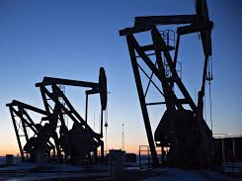
overview
Private foreign investments through companies/firms; this comprises
Foreign direct investments by large multinational corporations such as Exxon, Toyota, Hyundai, Coca Cola and
Foreign portfolio investments in the form of stocks, bonds in developing countries’ credit and equity markets
This presentation focuses on foreign direct investment in CLMV

Slide 3

Foreign direct investment
Multinational corporation (MNC): corporation that conducts and controls productive activities in more than one country
Most MNCs are based in North America, Europe and Japan; and more recently, PR China, South Korea, Taiwan and Brazil
MNCs and resources they bring provide development opportunities but may also pose serious problems for developing countries in which they operate

Slide 4
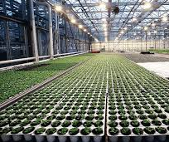
Foreign direct investment
Historically MNCs focused on extractive and primary industries, mainly petroleum, nonfuel minerals, and agribusiness
Thereafter MNCs became more involved in export-oriented agriculture and local food processing
More recently, MNCs operate in manufacturing operations, finance and services
Production now geared for export to MNCs home country and other developed markets rather than for the host country

Slide 5
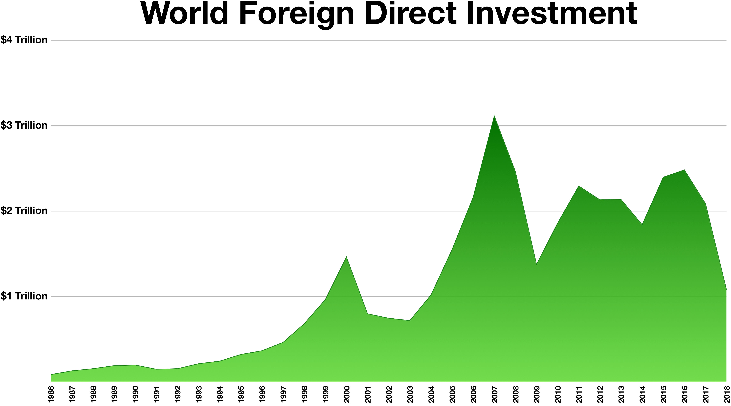
Foreign direct investment trends
Foreign direct investment trends worldwide,1986-2018:
gradual rise from 1986-2000; decline thereafter, up to 2004 followed by increase up to 2008
rebound in 2009; slight dip in 2014 but rebound thereafter
developed countries are recipients of a major share of FDI

Slide 6
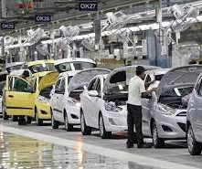
Impacts of foreign direct investment
MNCs fill the resource gap in terms of available supply of domestic savings, foreign currency, government revenues and human capital skills and the desired level of need for these resources to achieve development targets
MNCs also fill the gap between: targeted foreign exchange requirements and those derived from net export earnings plus net foreign aid; targeted tax revenues and locally-raised taxes; needed and available management, technology and skills

Slide 7

Impacts of foreign direct investment
MNCs crowd out private businesses Although MNCs provide capital, they may lower domestic savings and investment rates substituting private savings, stifling competition through special arrangements, failing to re-invest their profits, and raising local capital
Reduced foreign exchange earnings in the long run although the initial impact of MNC investment is to improve foreign exchange position of the recipient country

Slide 8
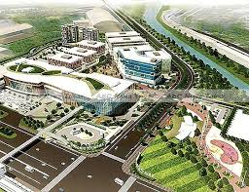
Impacts of foreign direct investment
Less-than-expected contribution to public revenues although MNCs contribute to public revenue through corporate taxes in reality the contribution is considerably less because of tax holidays, subsidies, and transfer pricing
Little impact on developing local resources MNCs’ management, entrepreneurial skills, technology may have little impact on developing local sources

Slide 9
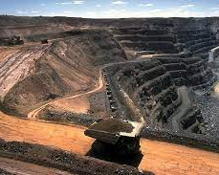
Impacts of foreign direct investment
Impact of MNCs on development is uneven; in some cases MNCs reinforce dualistic economic structures and exacerbate inequalities by promoting the interests of local factory managers above workers
MNCs use their economic power to influence government policies in directions that are unfavorable to development

Slide 10
Foreign direct investment in clmv
Sources and industry targets vary for CLMV countries. Cambodia received investment from more diversified sources, with China and ASEAN investors leading. In Lao PDR, Chinese companies were the overwhelmingly largest investors, accounting for more than 77 per cent of investment
In Myanmar, ASEAN remained the largest source of investment (48 per cent), led by companies based in Singapore, the United States and the European Union. In Vietnam, Japan, the Republic of Korea and ASEAN were the principal investors contributing to 67 per cent of investment.

Slide 11
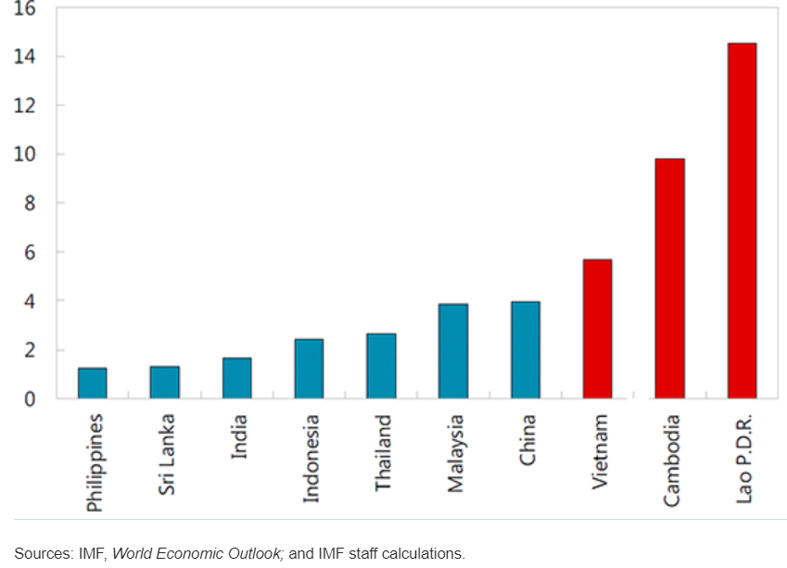
Foreign direct investment in clmv
FDI as share of GDP (no data for Myanmar)
Lao PDR is relatively dependent on FDI, which comprises about 15% of GDP

Slide 12
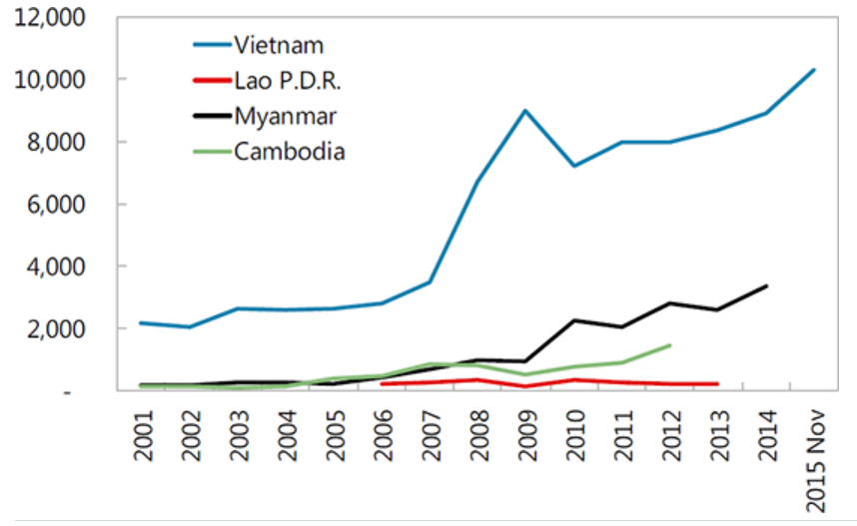
Foreign direct investment in clmv
Vietnam is the largest recipient of FDI among CLMV; in 2014 it received over $8 billion, while Myanmar received almost $3 billion and Cambodia and Lao PDR under $1 billion

Slide 13
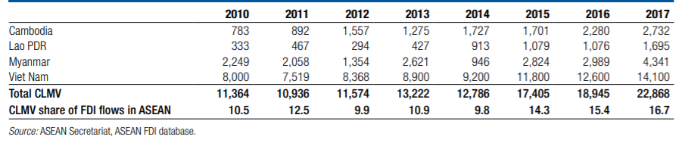
Foreign direct investment in clmv

Slide 14
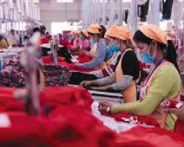
Foreign direct investment in clmv
Cambodia: rapid expansion of FDI-driven garments exports is a major source of employment and reducing poverty; FDI has expanded into other labor-intensive export industries, such as shoes, toys, and wood products and lately, real estate and finance
Car-parts maker Yazaki Corporation opened new factory in Koh Kong province in 2012, using it to supply wire harnesses to auto plants in Thailand

Slide 15
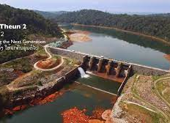
Foreign direct investment in clmv
Lao PDR: foreign investment in hydroelectric power and mining is boosting GDP growth and employment
Nikon Corporation established a new factory in Savannakhet in 2013, which took over some production processes from its existing factory in Thailand
With the China–Lao railway project to be completed by 2021, Chinese companies have been actively involved in construction activities

Slide 16
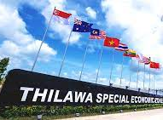
Foreign direct investment in clmv
Myanmar has not seen much FDI in the manufacturing sector, however it is liberalizing its economy and currently establishing special economic zones which has further economic potential
Other important areas of FDI are mining and extractive industries
In Thilawa, the Japanese-backed special economic zone, started operations in 2015

Slide 17
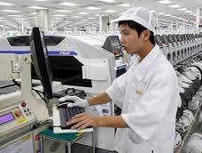
Foreign direct investment in clmv
Vietnam: FDI inflows went first to light manufacturing, but more recently into electronics, power generation, real estate and construction, and machinery manufacturing
Rising demand, cost advantages and regional production networks are driving increasing investment in the automotive industry
With its open investment policy, infrastructure, and low cost skilled labor Vietnam has become a major production center for global technology manufacturers

Slide 18
Implications of CLMV FDI for thailand
The new influx of FDI has implications for Thailand because it is strategically situated between CLMV
Thailand can profit by serving as a more advanced hub for manufacturing, services, logistics and transport that connects the increasing FDI throughout the Greater Mekong Subregion

Slide 19
summary
Foreign direct investment is mainly channeled through multinational corporations; historically MNCs were engaged in extractive/primary commodities, but currently more on manufacturing, finance and services
MNCs bring advantages as well as disadvantages to the recipient country; although MNCs bring capital, technology and skills, the can also use their economic power to influence government policies in directions that are unfavorable to development

Slide 20
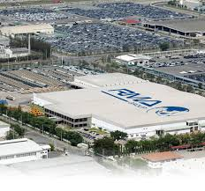
summary
To capitalize on the benefits, government should be capable of negotiating the terms and conditions of investments
Sources and industry targets vary for CLMV countries; Cambodia is the most diversified in terms of FDI source, and the target isndustries are shfting from garments to light manufacturing; in Lao PDR, PR China tops the list, with investments in hydropower and rail transportation; in Myanmar, ASEAN countries, particularly Singapore, generate most of the FDI which are geared toward extractive industries

Slide 21
summary
Vietnam receives the largest share of FDI, although the percentage of FDI to GDP is lowest among CLMV countries; Japan, Korea and ASEAN countries are the largest sources of FDI

