Slide 1
PY200/PY211 General Psychology
Development 2

Slide 2
Adolescence: Becoming an Adult
What major physical, social, and cognitive transitions characterize adolescence?

Slide 3
Adolescence: Becoming an Adult
Developmental stage between childhood and adulthood

Slide 4
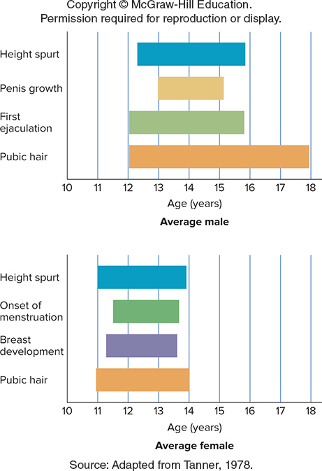
Physical Development: The Changing Adolescent
Puberty: Period at which maturation of the sexual organs occurs beginning at about age:
  11 or 12 years for girls
    Menstruation
  13 or 14 years for boys
    Spermarche

Slide 5
Moral and Cognitive Development: Distinguishing Right from Wrong
Kohlberg’s theory of moral development
  Suggests that the changes in moral reasoning can be understood as a three-level sequence
    Preconventional morality
    Conventional morality
    Postconventional morality
  Difficulty with the theory - Pertains to judgments, not moral behavior
  Moral development in women
    Difference exists in the way each gender views moral behavior

Slide 6
Erikson’s Theory of Psychosocial Development (1)
Identity-versus-role-confusion stage
  Occurring in adolescence
  Major testing to determine one’s unique qualities
Intimacy-versus-isolation stage
  Occurring in early adulthood
  Focused on developing close relationships

Slide 7
Erikson’s Theory of Psychosocial Development (2)
Generativity-versus-stagnation stage
  Occurring in middle adulthood
  Take stock of our contributions to family and society
Ego-integrity-versus-despair stage
  Occurring in late adulthood
  Focused on review of life’s accomplishments and failures

Slide 8
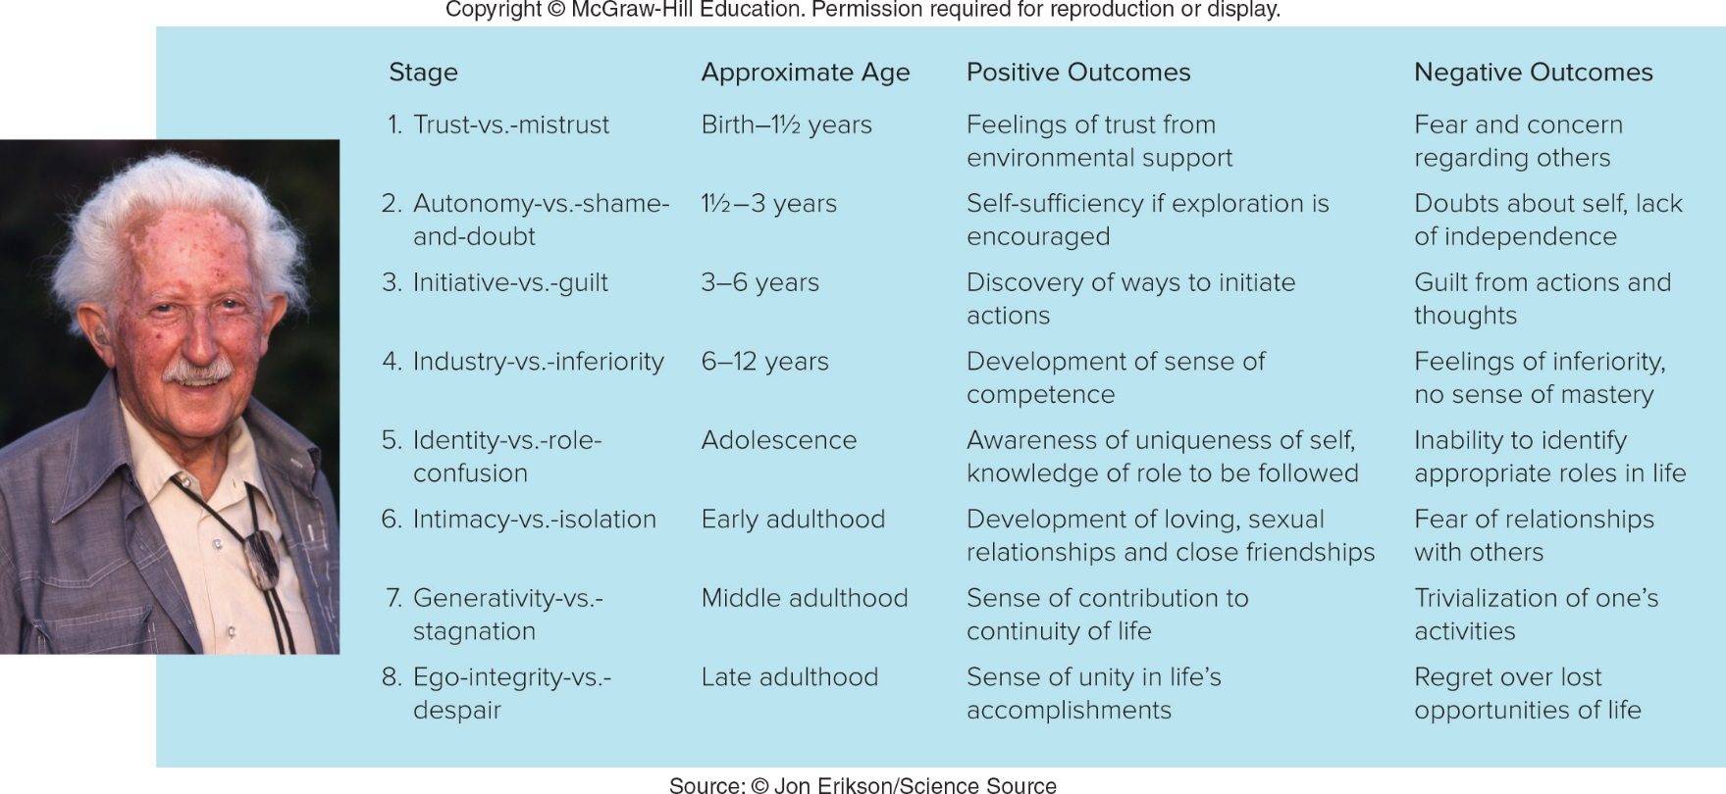
Erikson’s Theory of Psychosocial Development (2)

Slide 9
Stormy Adolescence: Myth or Reality?
Adolescent egocentrism - State of self-absorption in which a teenager views the world from his own point of view
  Imaginary audience - Belief that everybody is looking at them
  Personal fables - Belief that one’s experience is unique, exceptional, and shared by no one else

Slide 10
Social Development: Finding Oneself in a Social World
Adolescent suicide: Third leading cause of death for adolescents
  Warning signs
    School problems
    Frequent incidents of self-destructive behavior
    Loss of appetite or excessive eating
    Withdrawal from friends and peers
    Sleeping problems
    Signs of depression, tearfulness, or overt indications of psychological difficulties
    Preoccupation with death
    Putting affairs in order
    Explicit announcement of suicidal thoughts

Slide 11
Adulthood
What are the principal kinds of physical, social, and intellectual changes that occur in early and middle adulthood, and what are their causes?
How does the reality of late adulthood differ from the stereotypes about that period?
How can we adjust to death?

Slide 12
Adulthood
Emerging adulthood: Period beginning in the late teenage years and extending into the mid-twenties

Slide 13
Physical Development: The Peak of Health
For most people, early adulthood marks the peak of physical health
  Around age 25, the body becomes slightly less efficient and more susceptible to disease
Menopause: Women stop menstruating and are no longer fertile
  Treated through hormone therapy (HT) with hormones estrogen and progesterone
    Risks associated with HT

Slide 14
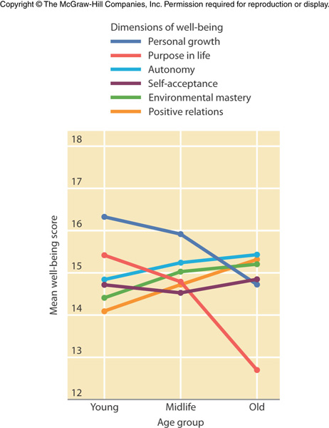
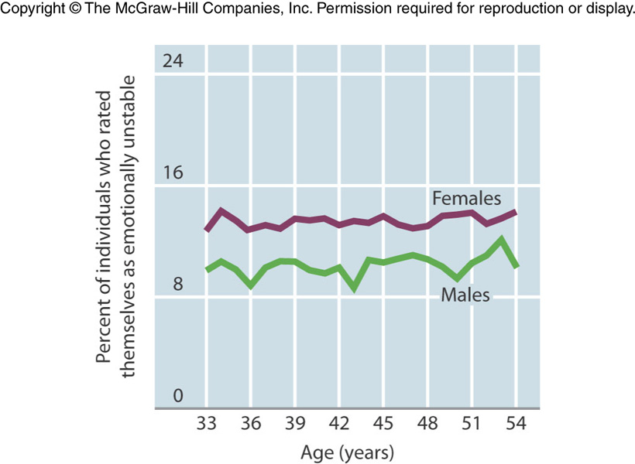
Social Development: Working at Life
People typically launch themselves into careers, marriage, and families during this period
Midlife transition - Period when people may begin to question their lives
  Little evidence for an actual midlife crisis
Notes:
Longitudinal study on Emotional Instability and Age (McCrae & Costa, 1990)
Cross-Sectional Data on Age and Well-Being (Keyes & Ryff, 1998)

Slide 15
Marriage, Children, and Divorce: Family Ties
Changes in marriage and divorce trends have doubled the number of single-parent households in the United States over the last two decades
Probability of divorce
Economic and emotional consequences for the single-parent households
  Often economically less well off
  Children: parents’ divorce may result in obstacles establishing close relationships later in life
  Children: may blame themselves, or feel pressure to take sides

Slide 16
Physical Changes in Late Adulthood: The Aging Body
Genetic preprogramming theories of aging
  Suggest that human cells have a built-in time limit to their reproduction and that they are no longer able to divide after a certain time
Wear-and-tear theories of aging
  Suggest that the mechanical functions of the body simply stop working efficiently

Slide 17
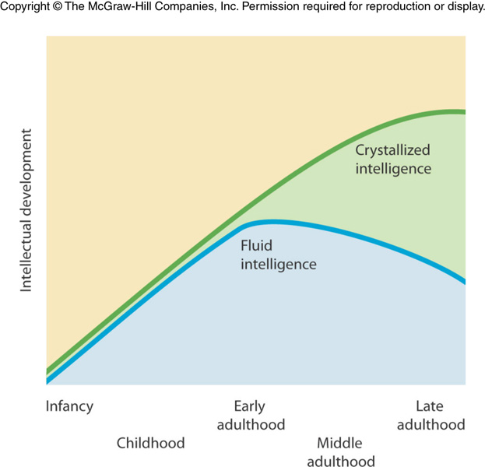
Cognitive Changes: Thinking About – and During - Late Adulthood
Fluid intelligence - Information-processing skills such as memory, calculations, and analogy
  Shows decline in late adulthood
Crystallized intelligence - Based on the accumulation of information, skills, and strategies learned through experience
  Remains steady and in some cases improves

Slide 18
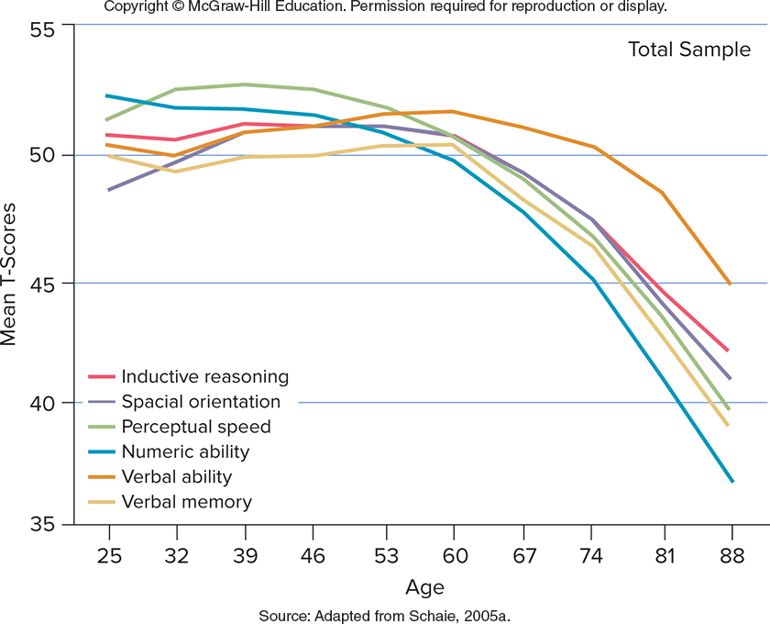
Cognitive Changes: Thinking About – and During - Late Adulthood
Notes:
Seattle Longitudinal Study

Slide 19
Cognitive Changes: Thinking About – and During – Late Adulthood
Social world of late adulthood: Old but not alone
  Activity theory of aging: Suggests that successful aging is characterized by maintaining the interests and activities of earlier stages of life
  Life review: Process by which people examine and evaluate their lives

Slide 20
Adjusting to Death
Five stages of facing impending death suggested by Elisabeth Kübler-Ross
  Denial
  Anger
  Bargaining
  Depression
  Acceptance

