Slide 1
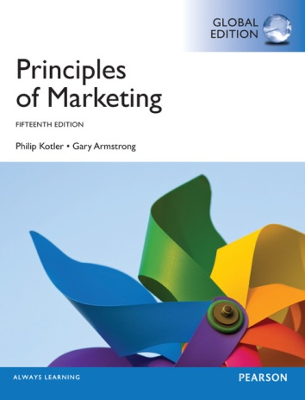
Distribution Channels Strategy II
CHAPTER 13: Retailing and Wholesaling
MK 202 Fundamentals of Marketing
By Aj.Suwalya Khemvaraporn

Slide 2
Objective Outline
Objective 1: Explain the roles of retailers in the distribution channel and describe the major types of retailers.
Objective 2: Describe the major retailer marketing decisions.
Objective 3: Explain the roles of wholesalers in the distribution channel and describe the 3 Major Groups of wholesalers
Objective 4: Describe the major wholesaler marketing decisions.

Slide 3
Objective 1
Retailing

Slide 4
Retailing
Retailing: All the Activities involved in selling goods or services directly to the final consumers for their personal, non-business use.
Retailer: A business whose sales come primarily from retailing
Shopper marketing: Using in-store promotions and advertising to extend brand equity to “the last mile” and encouraging favorable point-of-purchase decisions.

Slide 5
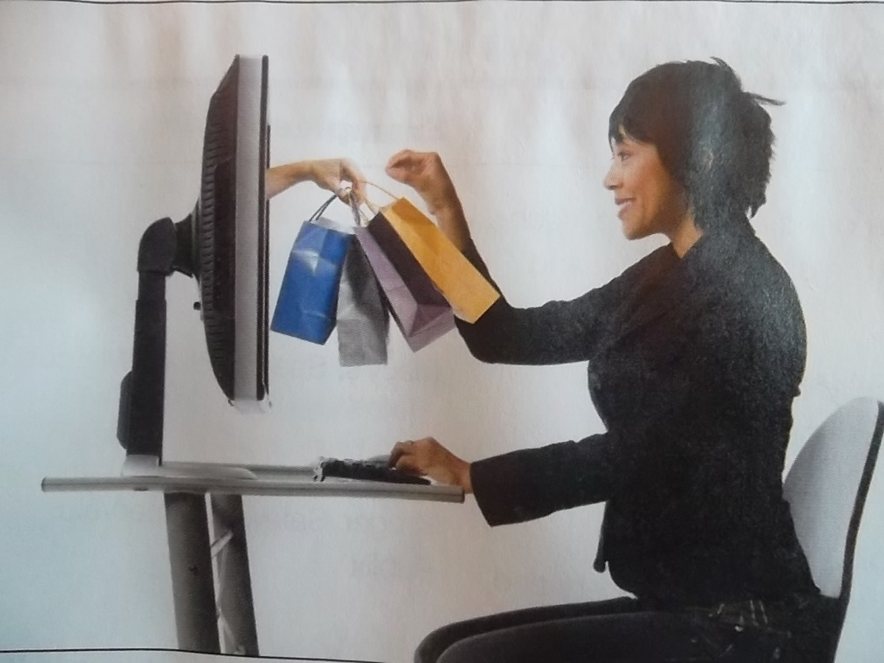
Retailing
Shopper marketing: The dramatic growth of digital shopping has added a new dimension to “point of purchase”. Influencing consumer’s buying decisions as they shop involves efforts aimed at in-store, online and mobile shopping.

Slide 6
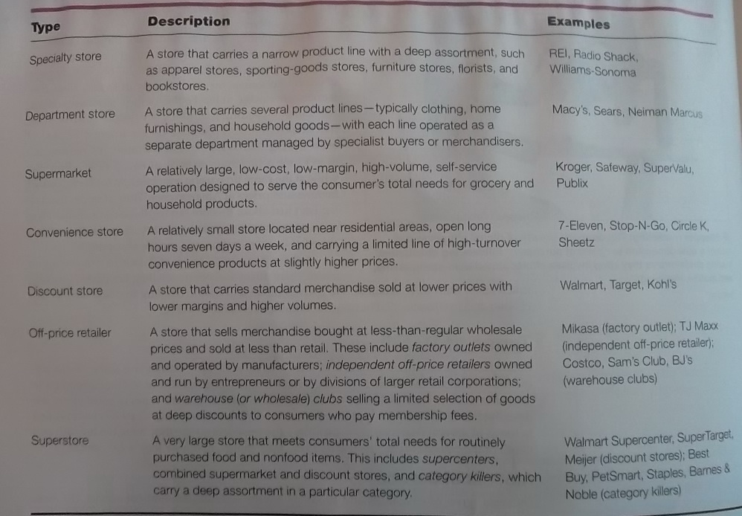
Figure 13.2
Table 13.1 Major Store Retailer Types

Slide 7
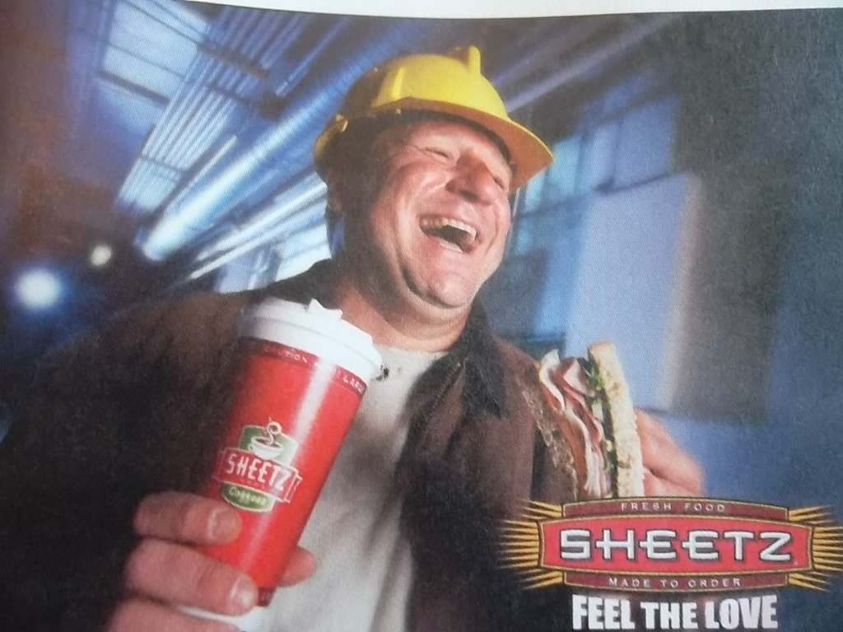
Convenience stores: Sheetz positions itself as more than just a convenience store. Driven by its Total Customer Focus mission and the motto-”Feel the Love” Sheetz aims to provide “convenience without compromise.”

Slide 8
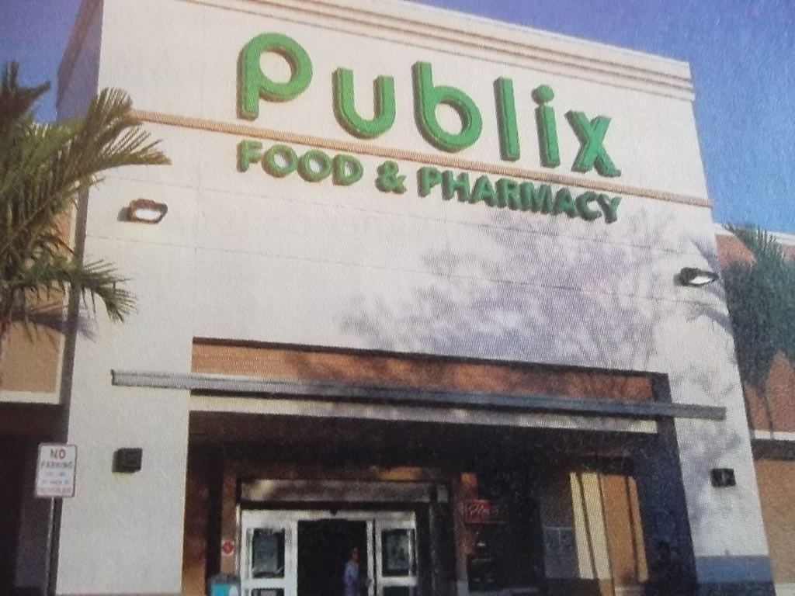
Despite recent belt-tightening by consumers, the Publix supermarket chain has succeeded by lowering prices and helping customers get the most out of today’s tighter food budgets.

Slide 9
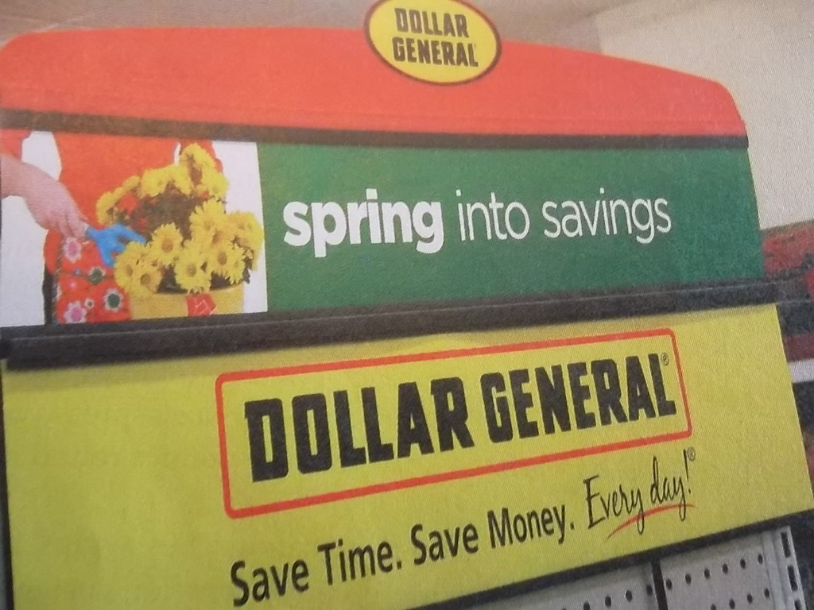
Discounter Dollar General, the nation’s largest small-box discount retailer, makes a powerful value promise for the times: “Save time, Save money. Every day.’

Slide 10
Objective 2
Retailing Marketing Decisions

Slide 11
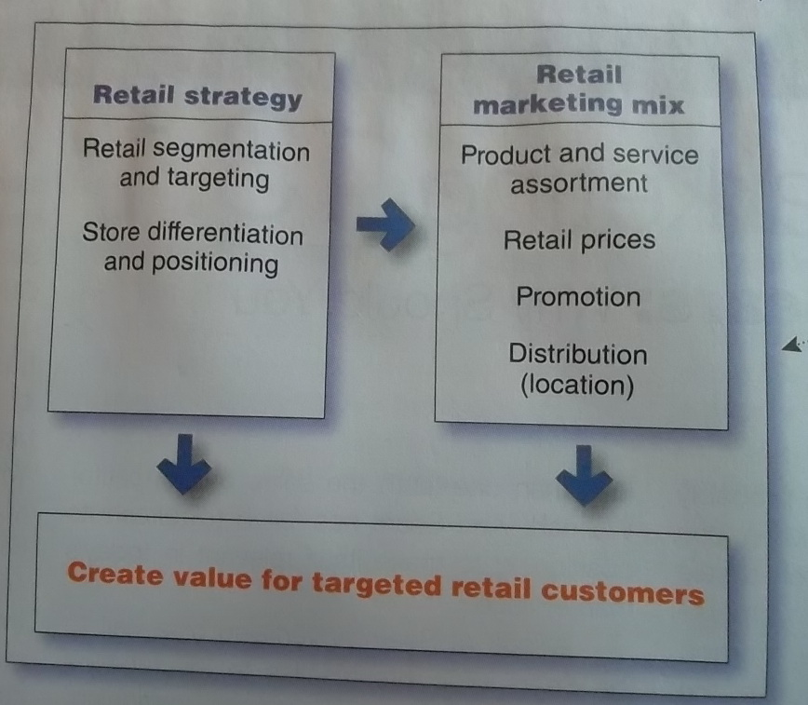
Retailing
Figure 13.1 Retailer Marketing Strategies
As with other types of marketers, the name of the game for retailers is to find the customer-driven marketing strategy and mix that will let them create value for customers and capture value in return. Remember Target’s “Expect more. Pay Less “value proposition? And Olive Garden’s “When you’re here, you’re family.

Slide 12

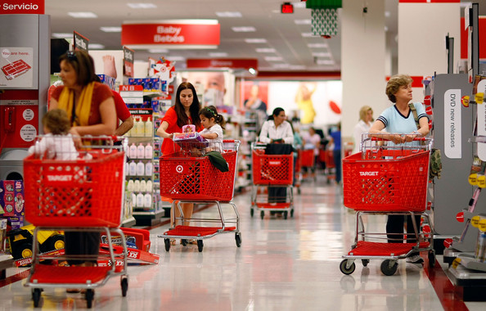

Slide 13
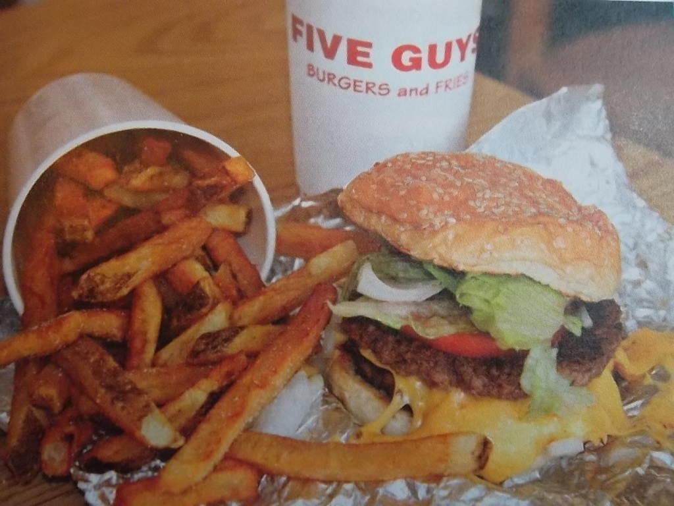
Retail targeting and positioning: Give Guys Burger and Fries succeeds by positioning itself strongly away from McDonald’s and other large fast-foods giants. The menu is very limited, but what you can get at Five Guys you simply can’t get at McDonalds.

Slide 14
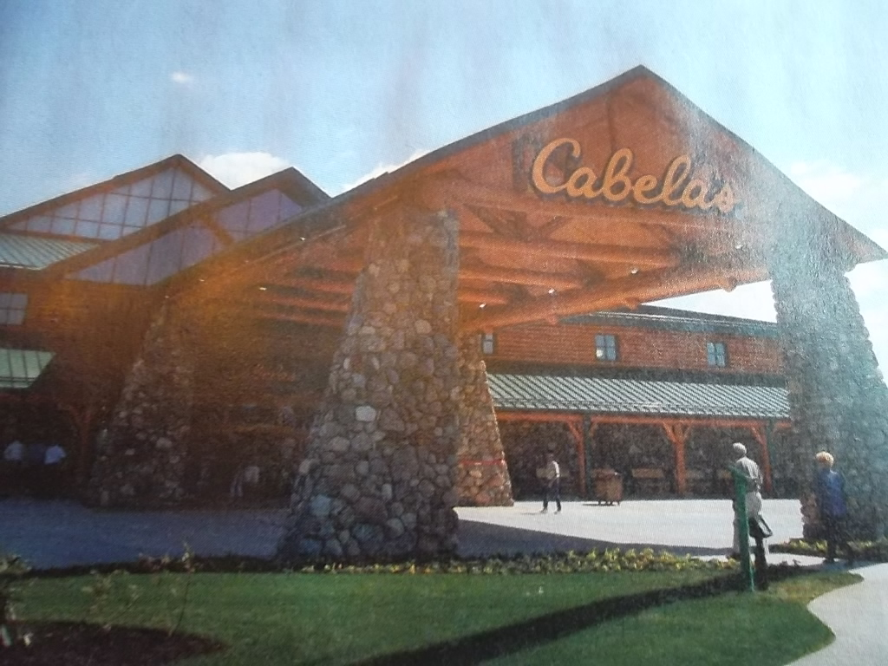
Store atmosphere: Cabela’s real magic lies in the experiences it creates for those who visit. “This is more than a place to go get fishhooks…we wanted to create a sense of wonder.

Slide 15
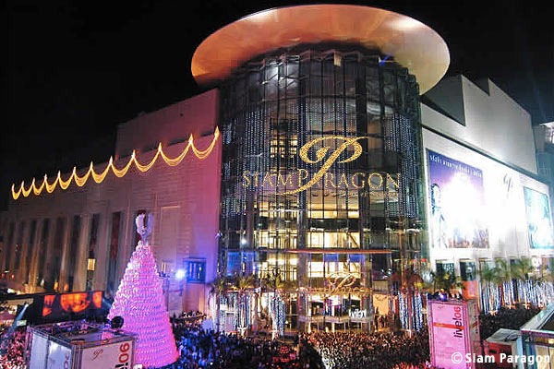
Siam Paragon: Department store

Slide 16
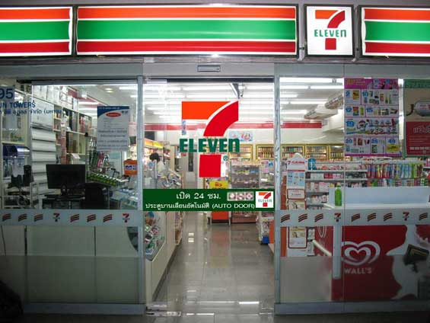
7-Eleven: Convenience Store

Slide 17
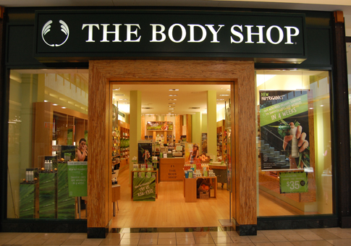

Slide 18
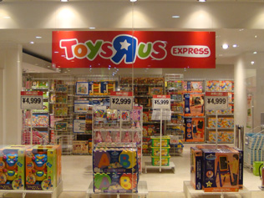
New retail forms: many retailers-such as Toys “R” Us- are setting up limited-time “pop-up” stores that let them promote their brands to seasonal shoppers and create buzz in busy areas. (pop up stores-temporarily)

Slide 19
Objective 3
Wholesaling

Slide 20
Wholesaling
Wholesaling: All the activities involved in selling goods and services to those buying for resale or business use.
Wholesaler: A firm engaged primarily in wholesaling activities.

Slide 21
Wholesaling
3 Major Groups
1. Merchant wholesaler: An independently owned wholesale business that title to the merchandise it handles.
2a. Broker: A wholesales who does not take title to goods and whose function is to bring buyers and sellers together and assist in negotiation.
2b.Agent: A wholesaler who represents buyers or sellers on a relatively permanent basis, performs only a few functions,and does not take title to goods.
3. Manufacturers’ sales branches and offices: Wholesaling by sellers or buyers themselves rather than through independent wholesalers

Slide 22
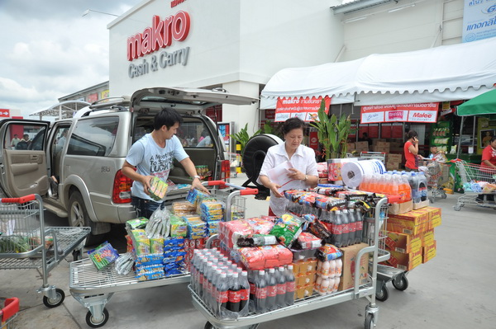

Slide 23
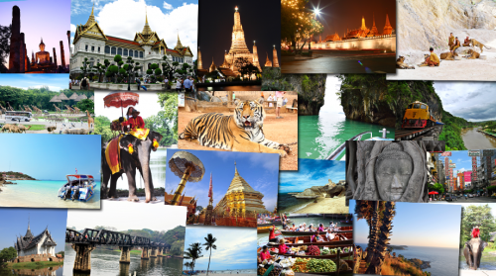


Slide 24
Objective 4
Wholesaling Marketing Decisions

Slide 25
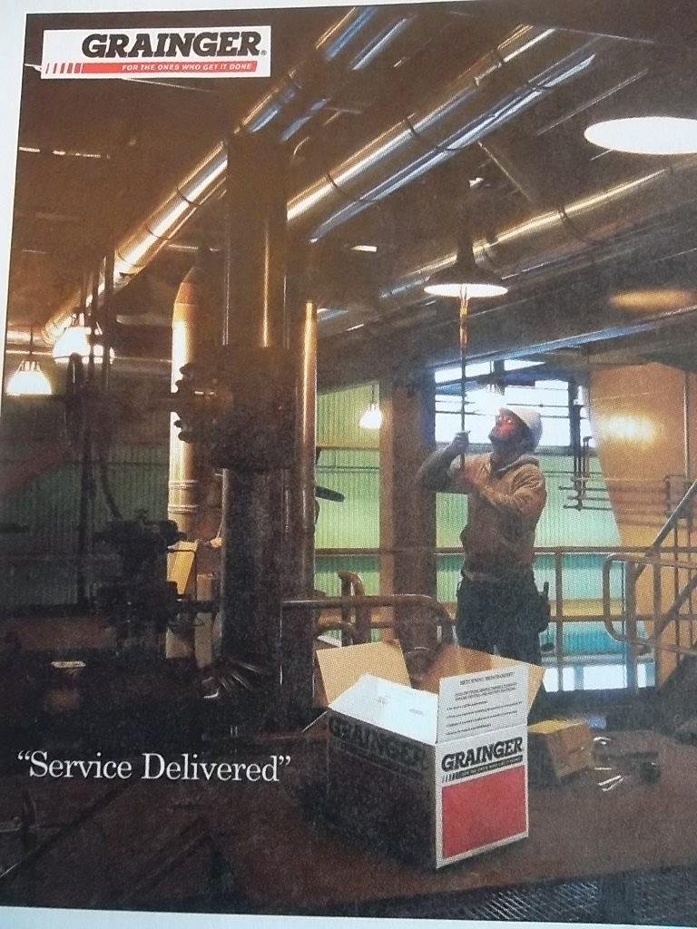
Wholesaling: Many of the nation’s largest and most important wholesalers-like Grainger- are largely unknown to final consumers. But they are very well known and much valued by the business customers they serve.

Slide 26
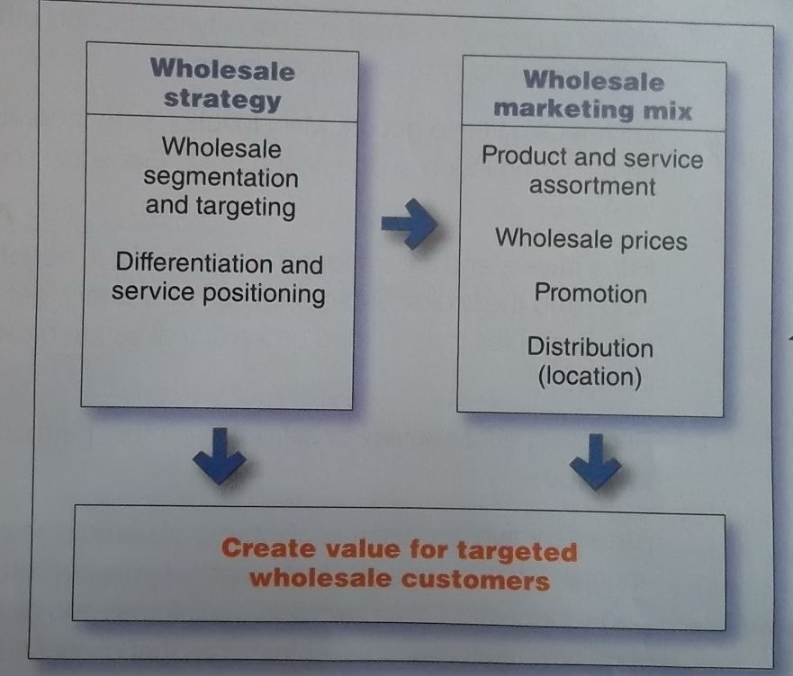
Wholesaling
Figure 13.2 Wholesaler Marketing Strategies
Why does this figure look so much like Figure 11.1. You guessed it. Like retailers, wholesalers must develop customer-driven marketing strategies and mixes that create value for customers and capture value in return. For example Grainger helps its business customers “save time and money by providing them with the right products to keep their facilities up and running.

Slide 27
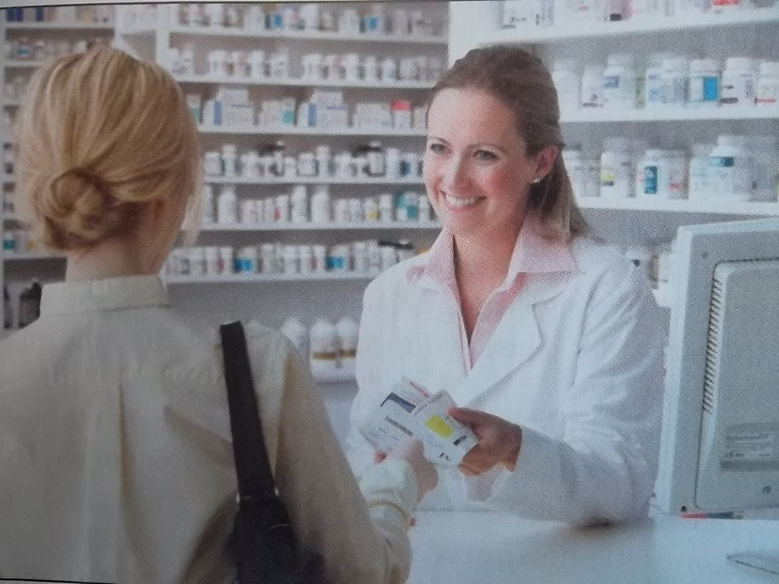
Trends in Wholesaling
Pharmaceuticals wholesaler McKesson helps its retail pharmacist customers be more efficient by offering a wide range of online resources. Retail pharmacists can even use the McKesson system to maintain medical profiles on their customers.

