Slide 1


How to generate New Product Concepts?
MK 312
Shortcuts
Ajarn Suwalya K.

Slide 2

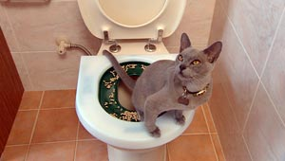
New Product :
Required Inputs to the Creation Process
Form (the physical thing created, or, for a service, the set of steps by which the service will be created)

Slide 3


Required Inputs to the Creation Process
Technology (the source by which the form is to be attained)

Slide 4
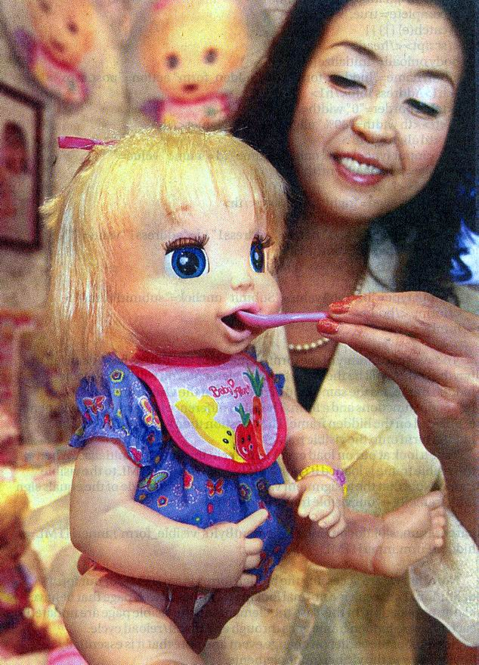
Required Inputs to the Creation Process
Benefit/Need (benefit to the customer for which the customer sees a need or desire)
Technology permits us to develop a form that provides the benefit.

Slide 5
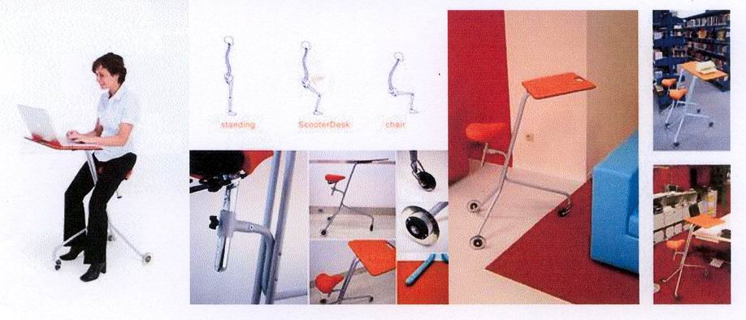
Some Patterns in Concept Generation
Customer has a NEED, which a firm finds out about. It calls on its TECHNOLOGY to produce a FORM that is then sold to the customer.
A firm has a TECHNOLOGY that it matches with a given market group, and than finds out a NEED that group has, which is then met by a particular FORM of product.
A firm envisions a FORM of product, which is then created to use of a TECHNOLOGY and then given to customers to see if it has any BENEFIT.

Slide 6

What is a Product Concept?
A product concept is a verbal or prototype statement of what is going to be changed and how the customer stands to gain or lose.
Rule: You need at least two of the three inputs to have a feasible new product concept, and all three to have a new product.

Slide 7
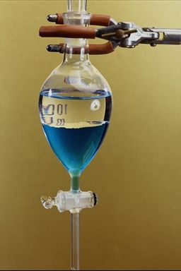
Why Do You Need a Product Concept and Not Just an Idea?
Needed to judge whether it is
worthy of development
Potential customers do not have enough information to judge the worthiness of an idea: the product concept gives them the required information.
Ex.: Would a taxi operator like cars with a 10 cents per mile operating cost? (need)
  Not if it used Caterpillar tractor technology instead of wheels! (need plus technology)

Slide 8
New Product Concepts and the
New Product
Figure 4.4
C
Need
Form
C
C
“C”=
Concepts
Technology
New
Product

Slide 9
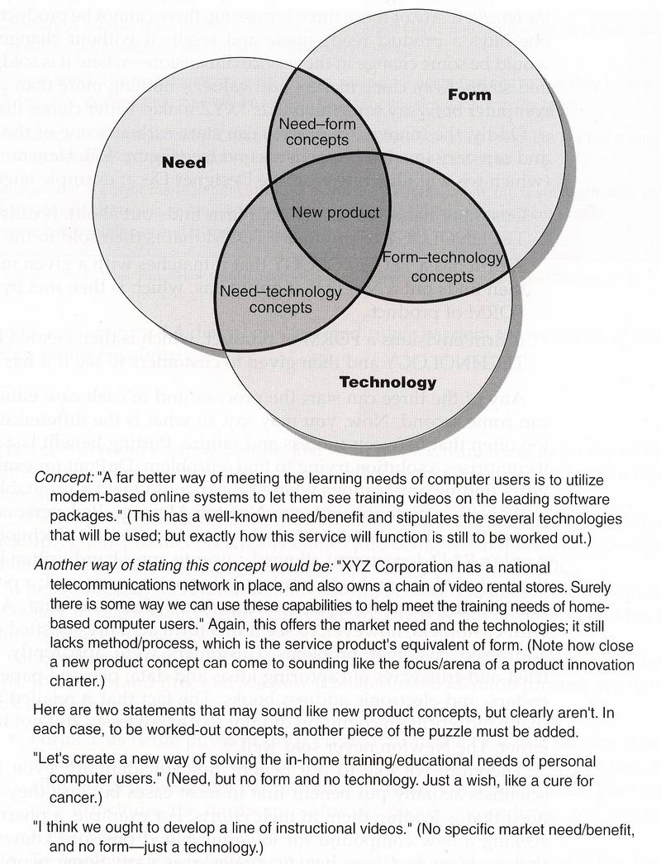
Figure 4.4 The New Product Concept

Slide 10

The Designer Decaf Example
Benefit: “Consumers want decaffeinated espresso that tastes identical to regular.”
Form: “We should make a darker, thicker, Turkish-coffee-like espresso.”
Technology: “There’s a new chemical extraction process that isolates and separates chemicals from foods; maybe we can use that for decaffeinating espresso coffee.”
Why would each of these taken individually not
be a product concept?

Slide 11

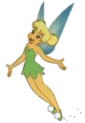
What is a New Product Concept?
Webster’s says a concept is an
idea or an abstract notion.
The promise is open to four interpretations:
The producer’s perception of the features of the new product.
The consumer’s perception of the features of the new product.
The producer’s estimate of the benefits delivered by that set of features
The consumer’s estimate of the benefits delivered by that set of features

Slide 12
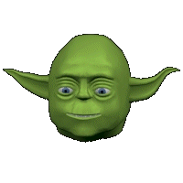
Many Ideas Are Eliminated Before Concept Testing
PIC eliminates most new product ideas even before they are developed into concepts.
Ideas of the following types are excluded:
  Ideas requiring technologies the firm does not have.
  Ideas to be sold to customers about whom the firm has no close knowledge.
  Ideas that offer too much (or too little) innovativeness.
  Ideas wrong on other dimensions: not low cost, too close to certain competitors, etc.

Slide 13
How to Start?
Problem Analysis
Analytical Attributes Techniques

Slide 14

Problem Analysis: General Procedure
1. Determine product or activity category for study.
2. Identify heavy users.
3. Gather set of problems associated with product category.
  Avoid “omniscient proximity” -- rate importance of benefits and levels of satisfaction.
4. Sort and rank the problems according to severity or importance. – extent of problem and frequency of importance

Slide 15

Problem Analysis Applied to the Cell Phone
Figure 5.2
Keeping the unit clean.
Breaks when I drop it.
Battery doesn’t stay charged long enough.
Finding it in dark.
Battery dies in mid-conversation.
Who “out there” hears me?
Dropped calls.
Looking up numbers.
Voice fades in and out.
Hard to hold.
The call doesn’t go through
Avoiding “ If you want sales, push 1” etc.
Health risks?
Can’t cradle between ear and shoulder.
Antenna breaks off.
Flip cover breaks off.
My arm and ears get tired
Disruptive instrument.
Can’t see facial/body language.
Rings too loud/too soft.
Wrong numbers.
Fear of what ringing might be for.
Knowing when is the best time to call people.
Here are 24 cell phone problems that came up in a consumer study. See if you can generalize to a smaller number of problems. Then select the one big problem that sounds most productive for cell phone new products people.

Slide 16


The Bothersomeness Technique of Scoring Problems
Figure 5.3

Slide 17

What are Analytical Attribute Techniques?
Basic idea:. products are made up of attributes -- a future product change must involve one or more of these attributes

Slide 18
What are Analytical Attribute Techniques?
Three types of attributes: features, functions, benefits.
Theoretical sequence: feature permits a function which provides a benefit.
So the Analytical attribute techniques allow us to create new product concepts by changing one or more of its current attribute.

Slide 19
Gap Analysis
Gap Analysis – is a statistical technique with immense power under certain circumstances. Its maps of the market are used to determine how various products are perceived by how they are positioned on the market map.

Slide 20
Gap Analysis
Determinant gap map (produced from managerial input/judgment on products)
AR perceptual gap map (based on attribute ratings by customers)
OS perceptual map (based on overall similarities ratings by customers)

Slide 21

Determinant attributes
Determinant attributes – attributes that both differentiate and are important.
Determinant gap maps are speedy and cost-efficient, but have the weakness of being driven by only managerial judgment. Customer perceptions may be quite different.

Slide 22
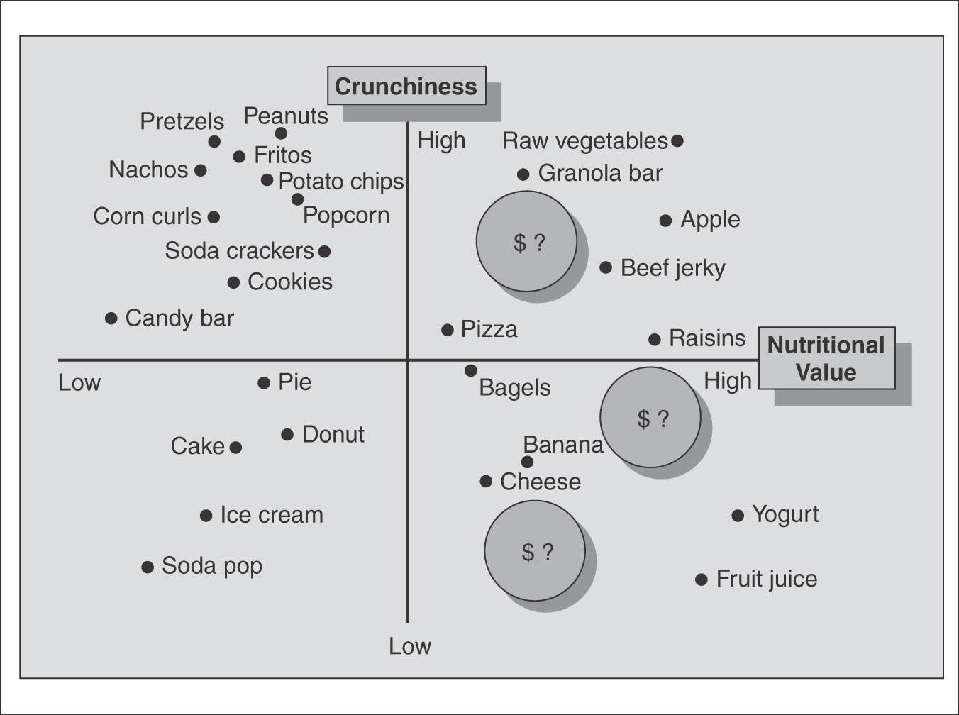
A Determinant Gap Map
Figure 6.2

Slide 23
Relationships Analysis
Household cleaning products example used six dimensions:
  Instrument used, ingredients used, objects cleaned, type of container, substances removed, texture or form of cleaner

Slide 24


Slide 25
Concept Testing
Why is it so important?

Slide 26
What Is a Product Concept Statement?
A statement about anticipated product features (form or technology) that will yield selected benefits relative to other products or problem solutions already available.
Example: “A new electric razor whose screen is so thin it can cut closer than any other electric razor on the market.”
Recall the importance of getting responses to product concepts and not simply ideas (Chapter 4).

Slide 27

Purposes of Concept Testing
To identify very poor concepts so that they can be eliminated.
To estimate (at least crudely) the sales or trial rate the product would enjoy (buying intentions, early projection of market share).
To help develop the idea (e.g. make tradeoffs among attributes).

Slide 28
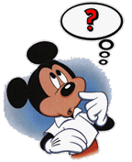
Procedure for a Concept Test
Prepare concept statement
Clarify specific purposes
Decide format(s)
Select commercialization
Determine price(s)
Select respondent type(s)
Select response situation
Define the interview
Conduct trial interviews
Interview, tabulate, analyze

Slide 29

Some Key Issues in Concept Testing
CONCEPT STATEMENT: narrative, drawing, model?
RESTPONDENT GROUP: Lead users? Large users?
RESTPONSE SITUATION SEQUENCE: Believable? Important : Where? How?
INTERVIEWING? Interesting? Would it work? What problems do they see? Would they buy?
TEST PROCEDURE: change and implement, study findings.

Slide 30

Product Concept
So product concept is a statement about anticipated product features (form or technology) that will yield selected benefits relative to other products or problem solutions already available.

Slide 31

The Purposes of Concept Testing
The concept testing is part of the pre-screening process, preparing management team to do the full screening of the idea just before beginning serious technical work.
The first purpose of the concept test is to identify the very poor concept so it can be eliminated.

Slide 32
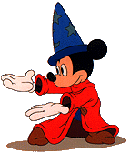
The Purposes of Concept Testing
The buying intention question appears in almost every concept test.
The very classic five-point question: How likely would you buy a product like this, if we made it.
Definitely would buy.
Probably would buy.
Might or might not buy.
Probably would buy.
Definitely would not buy.

Slide 33

Preparing the Interviewing Sequence - Qualitative
One to one interview or focus group to understand and interpret comments about the new concept.
1. Uniqueness of the concept
2. Believability of the concept
3. Importance of the problem
4. Their interest in the concept
5. Is it realistic, practical and useful?
6. Their reaction to the price
7. Problems they see in use

Slide 34
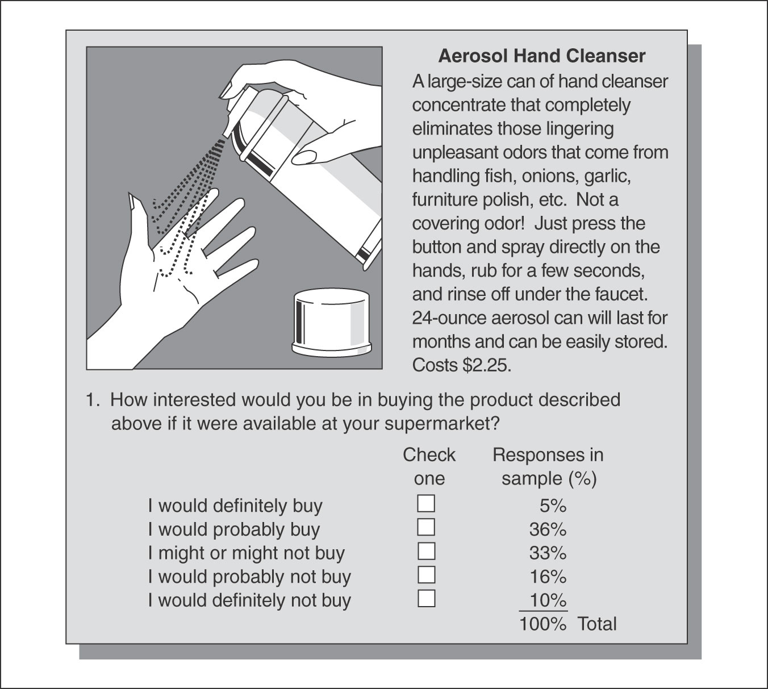
Mail Concept Test -- Sketch
Figure 9.2

Slide 35
Mail Concept Test -- Verbal Description
Figure 9.1
Here is a tasty, sparkling beverage that quenches thirst, refreshes, and makes the mouth tingle with a delightful flavor blend of orange, mint, and lime.
It helps adults (and kids too) control weight by reducing the craving for sweets and between-meal snacks. And, best of all, it contains absolutely no calories.
Comes in 12-ounce cans or bottles and costs 60 cents each.
1. How different, if at all, do you think this diet soft drink would be from other available products now on the market that might be compared with it?
Very different ( ) ( ) ( ) ( ) Not at all different
2. Assuming you tried the product described above and liked it, about how often do you think you would buy it?
More than once a week ( ) ( ) ( ) ( ) ( ) ( ) Would never buy it

