Slide 1
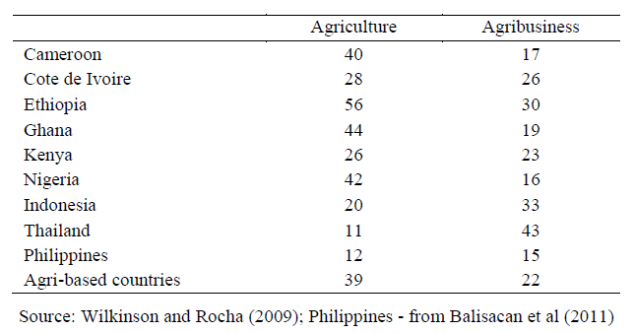
Share of Agricultural sector to GDP
https://dirp4.pids.gov.ph/ris/dps/pidsdps1315.pdf

Slide 2
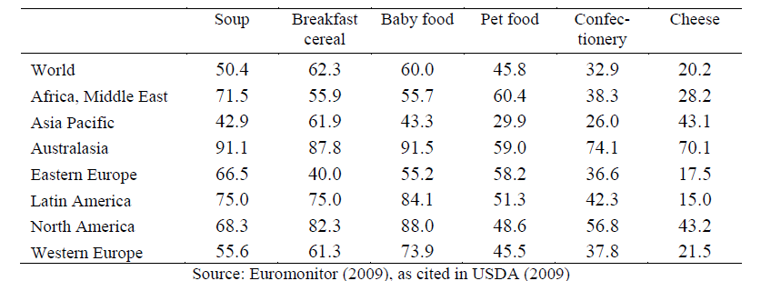
4-Firm Concentration Ratios
https://dirp4.pids.gov.ph/ris/dps/pidsdps1315.pdf

Slide 3
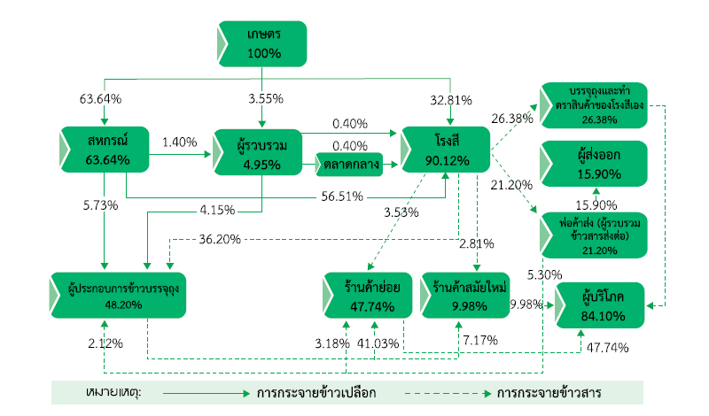

Supply chain of Jasmine Rice
Farmers
Rice mill brand/packing
Cooperatives
Middlemen
Rice Mills
Export
Wholesale market
Retails
Modern trade
Wholesale traders
Packing firms
Consumers
http://www.greennet.or.th/en/library/book/1835

