Slide 1
International Bond Market
Chapter Twelve
Notes:
This chapter continues coverage of international capital markets with a discussion of the structure of the international bond market.

Slide 2
Chapter Outline
The World’s Bond Markets: A Statistical Perspective
Foreign Bonds and Eurobonds
Types of Instruments
  Straight Fixed-Rate Issues
  Euro-Medium-Term Notes
  Floating-Rate Notes
  Equity-Related Bonds
  Dual-Currency Bonds
Currency Distribution, Nationality, Type of Issuer
International Bond Market Credit Ratings
Eurobond Market Structure & Practices
  Primary Market
  Secondary Market
  Clearing Procedures
International Bond Market Indices
12-2

Slide 3
The World’s Bond Markets: A Statistical Perspective
The total market value of the world’s bond markets are about 50% larger than the world’s equity markets.
The U.S. dollar, the euro, the pound sterling, and the yen are the four currencies in which the majority of domestic and international bonds are denominated.
Proportionately more domestic bonds than international bonds are denominated in the U.S. dollar (44.0 percent versus 40.4 percent) and the yen (14.1 percent
versus 2 percent) while more international bonds than domestic bonds are denominated in the euro (41.5 percent versus 14.7 percent), and the pound sterling (9.3 percent versus 5.6 percent).
12-3

Slide 4
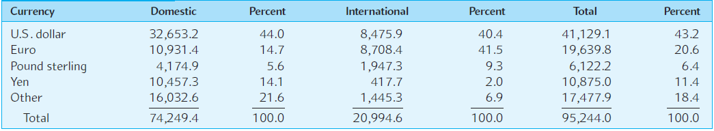
EXHIBIT 12.1
Amounts of Domestic and International Bonds Outstanding (at year-end 2014 in billions of U.S.D.
12-4

Slide 5
Foreign Bonds and Eurobonds
Bearer bonds and registered bonds
National security registrations
Withholding taxes
Recent regulatory changes
Global bonds
12-5

Slide 6
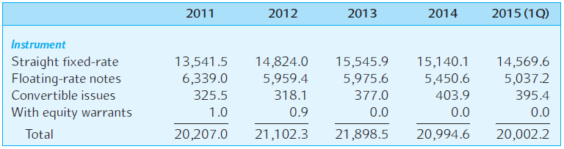
EXHIBIT 12.2
International Bonds Amounts Outstanding Classified by Major Instruments (in billions of U.S.D.)
12-6

Slide 7
Bearer Bonds and Registered Bonds
Bearer bonds are bonds with no registered owner. As such they offer anonymity, but they also offer the same risk of loss as currency.
Registered bonds are bonds where the owner’s name is registered with the issuer.
U.S. security laws require Yankee bonds sold to U.S. citizens to be registered.
12-7

Slide 8
National Security Registrations
Yankee bonds must meet the requirements of the SEC, just like U.S. domestic bonds.
Many borrowers find this level of regulation burdensome and prefer to raise U.S. dollars in the Eurobond market.
Eurobonds sold in the primary market in the United States may not be sold to U.S. citizens.
Of course, a U.S. citizen could buy a Eurobond on the secondary market.
12-8

Slide 9
Withholding Taxes
Prior to 1984, the United States required a 30 percent withholding tax on interest paid to nonresidents who held U.S. government or U.S. corporate bonds.
The repeal of this tax led to a substantial shift in the relative yields on U.S. government and Eurodollar bonds.
This lends credence to the notion that market participants react to tax code changes.
12-9

Slide 10
Security Regulations That Ease Bond Issuance
Shelf Registration (SEC Rule 415)
  Allows the issuer to preregister a securities issue, and then offer the securities when the financing is actually needed.
SEC Rule 144A
  Allows qualified institutional investors to trade private placements.
  These issues do not have to meet the strict information disclosure requirements of publicly traded issues.
12-10
Notes:
The International Finance in Practice box, “Around the Markets: Sarbanes-Oxley Backfires in Bonds as Unregistered Sales
Surge,” discusses how international companies are starting to prefer issuing Yankee bonds in the private placement market in the U.S. to avoid costly information disclosure required of registered bonds.

Slide 11
Global Bonds
A global bond is a very large international bond offering by a single borrower that is simultaneously sold in North America, Europe, and Asia.
  Global bond issues were first offered in 1989.
Global bonds denominated in U.S. dollars and issued by U.S. corporations trade as Eurobonds overseas and domestic bonds in the U.S.
12-11

Slide 12
Deutsche Telekom Global Bond
The largest corporate global bond issue to date is the $14.6 billion Deutsche Telekom multicurrency offering. The issue includes:
  Three U.S. dollar tranches with 5-, 10-, and 30-year maturities totaling $9.5 billion.
  Two euro tranches with 5- and 10-year maturities totaling €3 billion.
  Two British pound sterling tranches with 5- and 30-year maturities totaling £950 million.
  One 5-year Japanese yen tranche of ¥90 billion.
12-12

Slide 13
Types of Instruments
Straight fixed-rate debt
Floating-rate notes
Equity-related bonds
Zero coupon bonds
Dual-currency bonds
Composite currency bonds
12-13

Slide 14
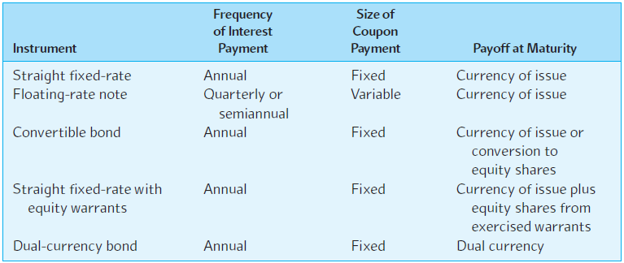
EXHIBIT 12.3
Typical Characteristics of International Bond Market Instruments
12-14

Slide 15
Straight Fixed-Rate Debt
These are “plain vanilla” bonds with a specified coupon rate and maturity and no options attached.
Since most Eurobonds are bearer bonds, coupon dates tend to be annual rather than semi-annual.
The vast majority of new international bond offerings are straight fixed-rate issues.
12-15

Slide 16
Floating-Rate Notes
Just like an adjustable rate mortgage.
Common reference rates are 3-month and 6-month U.S. dollar LIBOR.
Since floating-rate notes reset every 6 or 12 months, the premium or discount is usually quite small.
…as long as there is no change in the default risk.
12-16

Slide 17
Equity-Related Bonds
There are two types of equity-related bonds: convertible bonds and bonds with equity warrants.
12-17

Slide 18
Convertible Bonds
A convertible bond issue allows the investor to exchange the bond for a predetermined number of equity shares of the issuer.
  The floor-value of a convertible bond is its straight fixed-rate bond value.
  Convertibles usually sell at a premium above the larger of their straight debt value and their conversion value.
Investors are usually willing to accept a lower coupon rate of interest than the comparable straight fixed coupon bond rate because they find the conversion feature attractive.
12-18

Slide 19
Bonds with Equity Warrants
These bonds allow the holder to keep the bond but still buy a specified number of shares in the firm of the issuer at a specified price.
  They can be viewed as straight fixed-rate bonds with the addition of a call option (or warrant) feature.
  The warrant entitles the bondholder to purchase a certain number of equity shares in the issuer at a pre-stated cash price over a predetermined period of time.
With a convertible bond, you surrender the bond to get the shares. With equity warrant bonds you pay cash and keep the bond.
12-19

Slide 20
Zero Coupon Bonds
Zero coupon bonds are sold at a large discount from face value because there is no cash flow until maturity.
In the U.S., investors in zeros owe taxes on the “imputed income” represented by the increase in present value each year, while in Japan, the gain is a tax-free capital gain.
Pricing is very straightforward:
PAR
PV =
(1 + r)^{T}
12-20

Slide 21
Dual-Currency Bonds
A straight fixed-rate bond with interest paid in one currency and principal in another currency.
Japanese firms have been big issuers, with coupons in yen and principal in dollars.
Good option for an MNC financing a foreign subsidiary.
¥
¥
¥
¥
$
0
1
3
4
N – 1
N
12-21

Slide 22
Composite Currency Bonds
Denominated in a currency basket, like the SDRs or ECUs, instead of a single currency.
Often called currency cocktail bonds.
Typically straight fixed-rate debt.
12-22

Slide 23
Characteristics of International Bond Market Instruments
Instrument
Frequency of Payment
Size of Coupon
Payoff at Maturity
Straight-fixed rate Annual Fixed Currency of issue
Floating rate note Every 3 to 6 months Variable Currency of issue
Convertible bond Annual Fixed Currency of issue or conversion to equity shares
Straight fixed-rate with Annual Fixed Currency of issue
equity warrants plus conversion to
equity shares
Zero coupon bond None Zero Currency of issue
Dual currency bond Annual Fixed Dual currency
12-23

Slide 24
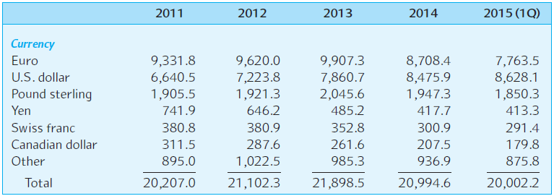
EXHIBIT 12.4
Currency Distribution of International Bonds
Amounts Outstanding (in billions of U.S.D.)
12-24

Slide 25
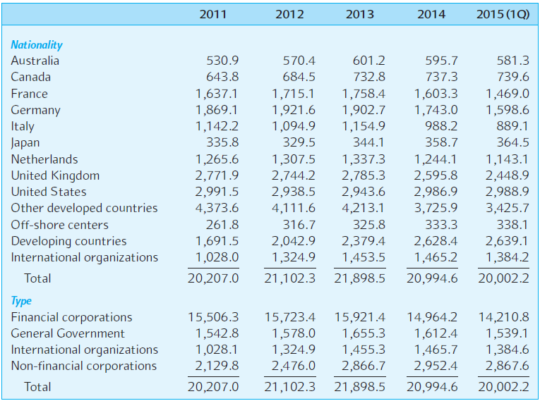
EXHIBIT 12.5 International Bond Amounts Outstanding Classified by Nationality and Type of Issuer (in billions of U.S.D.)
12-25

Slide 26
International Bond Market Credit Ratings
Fitch IBCA, Moody’s, and Standard & Poor’s sell credit rating analysis.
Focus on default risk, not exchange rate risk.
Assessing sovereign debt focuses on political risk and economic risk.
12-26

Slide 27
Eurobond Market Structure
Primary market
  Very similar to U.S. underwriting.
Secondary market
  OTC market centered in London.
    Comprised of market makers as well as brokers.
    Market makers and brokers are members of the International Capital.
  Market Association (ICMA), a self-regulatory body based in Zurich.
Clearing procedures
  Euroclear and Cedel handle most Eurobond trades.
12-27

Slide 28
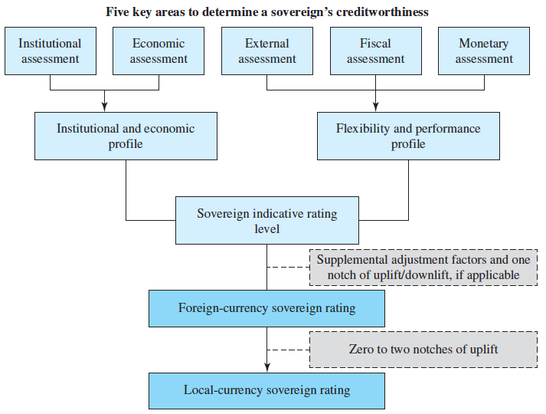
EXHIBIT 12.7 Standard and Poor’s Sovereign Rating Framework
12-28

Slide 29
Assessing the Five Main Sovereign Rating Factors
The analysis of each of the five key factors consists of quantitative and qualitative elements.
Some factors, such as the robustness of political institutions, are primarily qualitative, while others such as those relating to the real economy, debt, and external liquidity use mostly quantitative indicators.
Notes:
Excerpted from S&P Global Ratings Sovereign Rating Methodology , as revised on June 7, 2016. www.standardandpoors.com

Slide 30
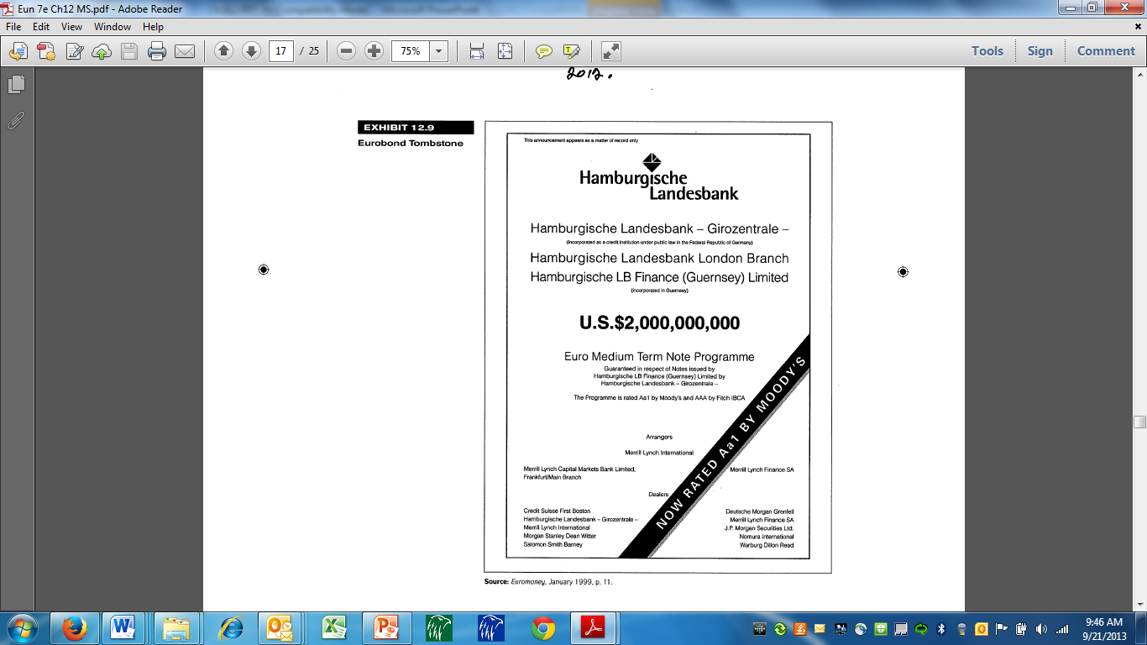
Eurobond Tombstone
12-30

Slide 31
Eurobond Practices: Primary Market
A borrower desiring to raise funds by issuing Eurobonds to the investing public will contact an investment banker and ask it to serve as the lead manager of an underwriting syndicate that will bring the bonds to market.
The underwriting syndicate is a group of investment banks, merchant banks, and the merchant banking arms of commercial banks that specialize in some phase of a public issuance.
The lead manager will sometimes invite co-managers to form a managing group to help negotiate terms with the borrower, ascertain market conditions, and manage the issuance.
12-31
Notes:
Given that in any year the Eurobond segment of the international bond market accounts for approximately 80 percent of new offerings, it is beneficial to know something about the Eurobond market structure and practices.

Slide 32
Eurobond Practices: Primary Market
The managing group, along with other banks, will serve as underwriters for the issue. They will commit their own capital to buy the issue from the borrower at a discount from the issue price.
  The discount, or underwriting spread, is typically in the 2 to 2.5 percent range. By comparison, the spread averages about 1 percent for domestic issues.
  Most of the underwriters, along with other banks, will be part of a selling group that sells the bonds to the investing public.
12-32

Slide 33
Eurobond Practices: Secondary Market
Eurobonds initially purchased in the primary market from a member of the selling group may be resold prior to their maturities to other investors in the secondary market.
The secondary market for Eurobonds is an over-the-counter market with principal trading in London. However, important trading is also done in other major European money centers, such as Zurich, Luxembourg, Frankfurt, and Amsterdam.
12-33

Slide 34
Eurobond Practices: Secondary Market
The secondary market consists of market makers and brokers connected by an array of telecommunications equipment.
Market makers stand ready to buy or sell for their own account by quoting two-way bid and ask prices.
Market makers trade directly with one another, through a broker, or with retail customers.
  The bid-ask spread represents a market maker’s only profit; no other commission is charged.
12-34

Slide 35
Clearing Procedures
Eurobond transactions in the secondary market require a system for transferring ownership and payment from one party to another.
Two major clearing systems, Euroclear and Clearstream International, handle most Eurobond trades.
  Euroclear is based in Brussels and is operated by Euroclear Bank.
  Clearstream is located in Luxembourg.
12-35

Slide 36
Clearing Procedures
Both clearing systems operate in a similar manner.
  Each clearing system has a group of depository banks that physically store bond certificates.
  Members of either system hold cash and bond accounts. When a transaction is conducted, electronic book entries are made that transfer book ownership of the bond certificates from the seller to the buyer and transfer funds from the purchaser’s cash account to the seller’s.
Physical transfer of the bonds seldom takes place.
12-36

Slide 37
Other Functions of the Clearing System
Euroclear and Clearstream perform other functions associated with the efficient operation of the Eurobond market.
  (1) The clearing systems will finance up to 90 percent of the inventory that a Eurobond market maker has deposited within the system.
  (2) The clearing systems will assist in the distribution of a new bond issue. The clearing systems will take physical possession of the newly printed bond certificates in the depository, collect subscription payments from the purchasers, and record ownership of the bonds.
  (3) The clearing systems will also distribute coupon payments. The borrower pays to the clearing system the coupon interest due on the portion of the issue held in the depository, which in turn credits the appropriate amounts to the bond owner’s cash accounts.
12-37

Slide 38
International Bond Market Indices
There are several international bond market indices.
JPMorgan and Company
  Domestic bond indices.
  International government bond index for 18 countries.
  Widely referenced and often used as a benchmark.
  Appears daily in The Wall Street Journal.
12-38

Slide 39
Summary
This chapter introduces and discusses the international bond market.
The chapter presents a statistical perspective of the market, noting its size, an analysis of the market segments, the types of instruments issued, the major currencies used to denominate
international bonds, and the major borrowers by nationality and type.
Trading practices of the Eurobond market are examined, as are credit ratings for international bonds and international bond market indexes.
12-39

