Slide 1
Systemic Vulnerability and Sustainable Economic Growth Part 2
Skills and Upgrading in Southeast Asia
Monthien Satimanon

Slide 2
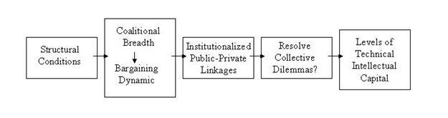
Putting them all together Part 1

Slide 3
Theory of Coalitional origins
“Rational actors form coalitions only as broad as necessary to achieve their ends because payoffs must be shared among the members of the winning coalition. Again, as mentioned in chapter one, these coalitions are made up of actors who vote for, or otherwise provide support to, the ruling elite. They may or may not be formally incorporated into the political system into parties or other political units. Fewer members of a winning coalition mean more rewards per actor”.

Slide 4
Theory of Coalitional origins
“Inter-elite conflict for political power is one reason elites might expand their ruling coalition (Waldner 1999).”
“Important impetus for coalitional breadth is the means by which governments generate wealth necessary to buy political support. Every government must generate revenues to stay in power. When revenues can be generated easily through relationships with a small number of industries or sectors, then Riker’s logic prevails and coalitions are kept narrow and small.”

Slide 5
Theory of Coalitional origins
“On the other hand, when revenues can only be generated by extracting small amounts from numerous people, such as with extensive and comprehensive tax systems, pressure mounts on the government to expand the coalitional size. In return for taxation, the government must reward those that supported them. This is an extension of the argument made in Shafer (1994)”.

Slide 6
Theory of Coalitional origins
If anything about pressures to allow coalitional actors to participate in policy processes.
Upgrading an economy requires massive amounts of technology and information, which must be derived from and shared with as many of the intellectual resources and capital in a society as possible. The more difficult and complex the technological demands of the industries that create a nation’s wealth, the broader and more participative the coalition must be to support the country’s political economy.

Slide 7
Theory of Coalitional origins
In contrast, when societies depend on less technologically demanding industries, such as selling raw materials and natural resources to generate wealth, the processes usually require less participation from a narrower coalition.

Slide 8
Theory of Coalitional origins
Once created, coalitional structure has feedback effects. Narrow coalitions create incentives for elites to implement rents that encourage fragmentation, resulting in further coalitional narrowing. Without broad input, those in power create institutions and policies that benefit themselves and in the process marginalize the rest of society politically, economically, and socially.

Slide 9
Theory of Coalitional origins
Broader coalitions allow more participation. Participants, in turn, push for institutions that benefit themselves. The more people who participate in policy processes, the more likely the outcome will be compensation in the form of public goods (Bueno de Mesquita 2000). The result is reduced income inequality, which facilitates consolidation, rationalization, and cooperation, which also leads to further coalitional expansion.

Slide 10
Theory of Coalitional origins
Resource Curse
Revenue generation
Inter-Elite Conflict
Technology and Revenue Generation

Slide 11
Theory of Coalitional origins
Domestic Fragmentation
External Threat
Interactions with the above factors in coalitional origins.

Slide 13
How Broad and Participative Coalitions Lead to Good Policy
Broad, cross-cutting coalitions, which encourage all actors to be actively engaged in policy making processes, facilitate the intensive cooperation, information sharing, careful monitoring, and appropriate enforcement necessary to overcome collective dilemmas that hinder the formation of institutions necessary for skills development.

Slide 14
How Broad and Participative Coalitions Lead to Good Policy
The important causal mechanism between coalitional breadth and participation on the one hand and institutional linkages within society on the other is side payments. Side payments are those remunerations given by the elite to social actors in return for political support.

Slide 15
How Broad and Participative Coalitions Lead to Good Policy
The type, timing, and duration of side payments create preferences for institutions that will maximize the payoffs to individuals in the coalition. As the size of the coalition increases, ceteris paribus, coalition members’ share of supplied private goods decreases making the utility calculus for cooperation more favorable by lessening the difference between belonging and not belonging to the winning coalition (Bueno de Mesquita, et. al., 1999).

Slide 16
How Broad and Participative Coalitions Lead to Good Policy
When leaders must rely on a broad range of social actors for political support, they tend to provide public goods as the most efficient form of side payments in return for political support. Furthermore, as resource endowments decrease, the likelihood rises that ruling elites will provide public goods as side payments to coalition members (Doner, Ritchie, Slater 2005; Root 1996).

Slide 17
How Broad and Participative Coalitions Lead to Good Policy
But public goods are more difficult to design and implement and require more cooperation and interaction among the coalitional actors than is necessary to provide private goods. The provision of more advanced public goods requires more intensive cooperation to design, implement, monitor, and maintain (enforce).

Slide 18
How Broad and Participative Coalitions Lead to Good Policy
Narrow coalitions have less need for connective public-private linkages and therefore do not create the institutions necessary to facilitate these linkages, or, if they already exist, allow them to weaken and decay.
The provision of public goods is important for several reasons. Most importantly, public goods increase equality. Political processes underlying institutional formation and maintenance reflect power asymmetries among the various parties involved (Knight 1992).

Slide 19
How Broad and Participative Coalitions Lead to Good Policy
Game theoretic, rational choice frameworks assume intentional actors, strategic options, and payoffs associated with certain choices (Scharpf, 1997).
Providing public goods creates an environment where all members of society can gain in influence and power, in turn influencing the institutional structure in ways that pay off for them personally. Since by definition all have access to these goods, income equality is enhanced.

Slide 20
How Broad and Participative Coalitions Lead to Good Policy
Income equality is important because lower inequality increases the purchasing power of low-income families for superior goods, such as education and training (Birdsall, et. al., 1997).
Education and training, in turn, advance an individual’s earning potential, further reducing income inequalities and providing further resources with which to participate in the institutional system. In short, equality puts more people in a position to be linked to the policy process if the political institutional structure allows it.

Slide 21
How Broad and Participative Coalitions Lead to Good Policy
The linkages I speak of are less like the ones theorized by developmental state scholars and more like the “embedded autonomy” envisioned by Peter Evans (1994). Whereas the developmental scholars suggested that the state could control all state-society relationships, scholars such as Richard Doner (1992) and Weiss (1995) recognized that all the players in government-private sector relationships were critical to the interaction.

Slide 22
How Broad and Participative Coalitions Lead to Good Policy
It is true that productive public-private relationships are not possible in an environment of minimalist states or acquiescent societies. Capacity for statecraft remains a necessary ingredient, but in conjunction with an assertive and involved private sector (Doner and Hawes, 1995).

Slide 23
How Broad and Participative Coalitions Lead to Good Policy
The relationship between the state and private sector needs to increasingly function in an integrated, more balanced and interdependent way. More balanced public-private linkages facilitate good economic policy in at least three ways.

Slide 24
How Broad and Participative Coalitions Lead to Good Policy
First, they better balance multiple preferences of both the state and society for resource allocation, including economic growth, domestic stability, and external security. Second, they facilitate balanced negotiation and complex bargaining with a broader range of actors in a more demanding environment.

Slide 25
How Broad and Participative Coalitions Lead to Good Policy
Third, they create autonomy for the state from any single, dominating interest. The state is therefore able to formulate neutral, technocratic policy and to demand help from the private sector to monitor and assist in compliance and enforcement. At the same time, such state-society relationships demand transparency and accountability from the government on policy direction and decisions. Trust and legitimacy come from repeated cooperative interactions, which the state cannot break if it desires continued future cooperation from a naturally skeptical and profit-oriented private sector (Ritchie and Hicken 2002).

Slide 26
Putting them all together Part 2
Systemic vulnerability influences the breadth and participation of political coalitions through the nature, type, and timing of side payments. Coalitional breadth and participation shapes the linkages among economic actors in society. These linkages or the lack thereof, what Evans called “embedded autonomy,” facilitate policy processes and institutional creation in an endogenous fashion that in turn influences skills development and upgrading.

Slide 27
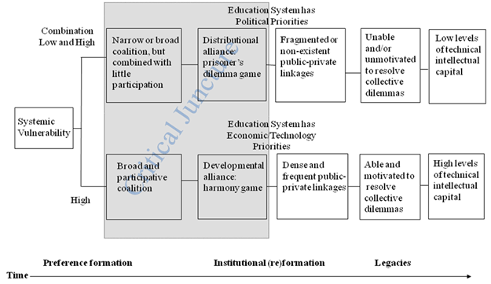
Putting them all together Part 2

