Slide 1
Comparative Statics and the Concept of Derivative IV
Pawin Siriprapanukul
CW Ch. 8

Slide 2
Outline
Total Derivatives
Derivatives of Implicit Functions
Comparative Statics of General-Function Models
Limitations of Comparative Statics

Slide 3

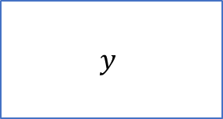

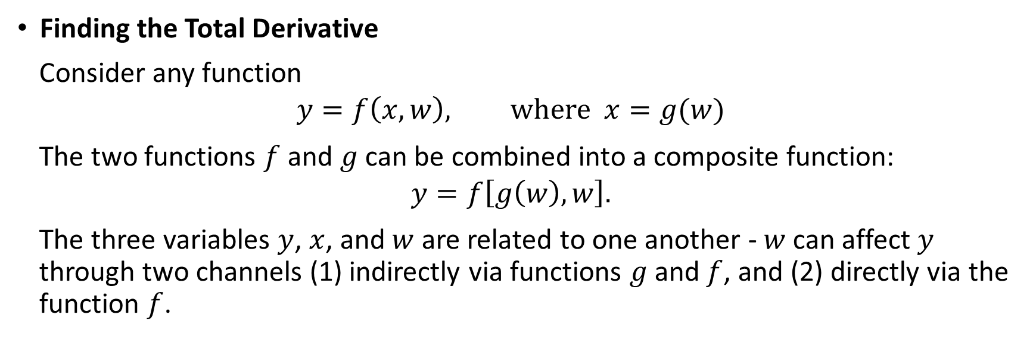



Total Derivatives
Finding the Total Derivative
Consider any function
$$y=f\left(x,w\right), where x=g(w)$$
The two functions $f$ and $g$ can be combined into a composite function:
$$y=f\left[g\left(w\right),w\right].$$
The three variables $y$, $x$, and $w$ are related to one another - $w$ can affect $y$ through two channels (1) indirectly via functions $g$ and $f$, and (2) directly via the function $f$.
$$y$$
$$f$$
$$x$$
$$g$$
$$w$$
$$f$$

Slide 4
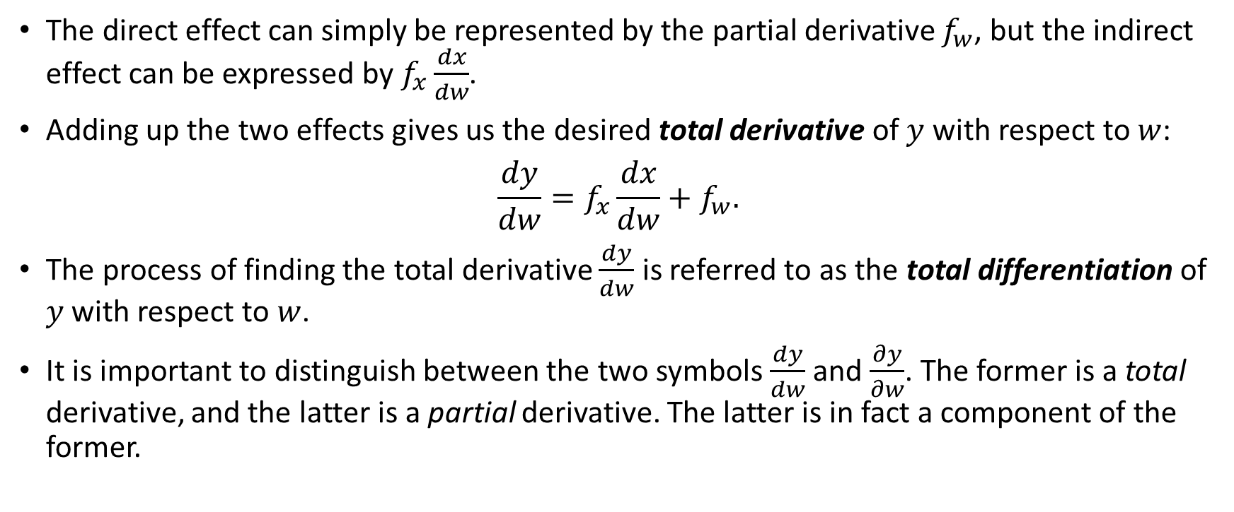
Total Derivatives
The direct effect can simply be represented by the partial derivative $f_{w}$, but the indirect effect can be expressed by $f_{x}\frac{dx}{dw}$.
Adding up the two effects gives us the desired total derivative of $y$ with respect to $w$:
$$\frac{dy}{dw}=f_{x}\frac{dx}{dw}+f_{w}.$$
The process of finding the total derivative $\frac{dy}{dw}$ is referred to as the total differentiation of $y$ with respect to $w$.
It is important to distinguish between the two symbols $\frac{dy}{dw}$ and $\frac{∂y}{∂w}$. The former is a total derivative, and the latter is a partial derivative. The latter is in fact a component of the former.

Slide 5
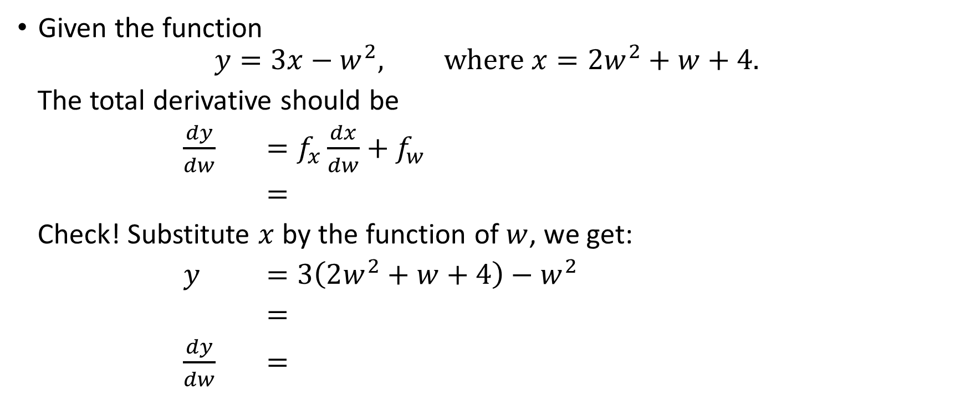
Example
Given the function
$$y=3x−w^{2}, where x=2w^{2}+w+4.$$
The total derivative should be
$\frac{dy}{dw}$ $=f_{x}\frac{dx}{dw}+f_{w}$
$=$
Check! Substitute $x$ by the function of $w$, we get:
$y$ $=3\left(2w^{2}+w+4\right)−w^{2}$
$=$
$\frac{dy}{dw}$ $=$

Slide 6
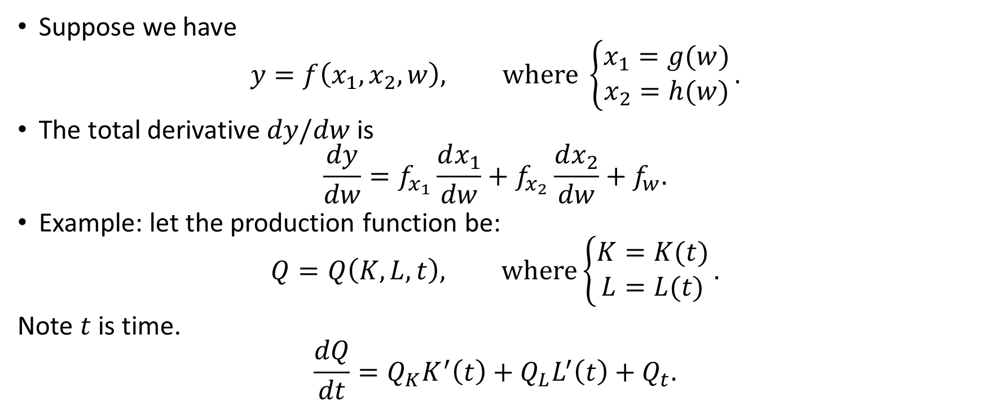
A Variation
Suppose we have
$$y=f\left(x_{1},x_{2},w\right), where \left\{\begin{matrix}x_{1}=g(w) \\ x_{2}=h(w)\end{matrix}\right..$$
The total derivative $dy/dw$ is
$$\frac{dy}{dw}=f_{x_{1}}\frac{dx_{1}}{dw}+f_{x_{2}}\frac{dx_{2}}{dw}+f_{w}.$$
Example: let the production function be:
$$Q=Q\left(K,L,t\right), where\left\{\begin{matrix}K=K(t) \\ L=L(t)\end{matrix}\right..$$
Note $t$ is time.
$$\frac{dQ}{dt}=Q_{K}K^{′}\left(t\right)+Q_{L}L^{′}\left(t\right)+Q_{t}.$$

Slide 7
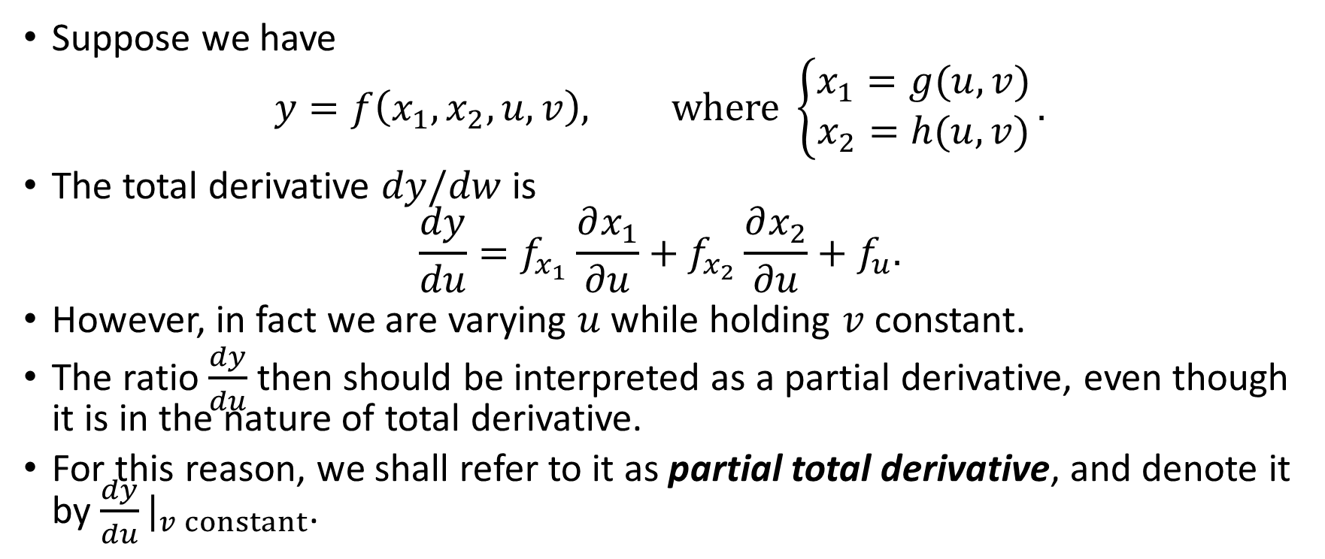
Another Variation
Suppose we have
$$y=f\left(x_{1},x_{2},u,v\right), where \left\{\begin{matrix}x_{1}=g(u,v) \\ x_{2}=h(u,v)\end{matrix}\right..$$
The total derivative $dy/dw$ is
$$\frac{dy}{du}=f_{x_{1}}\frac{∂x_{1}}{∂u}+f_{x_{2}}\frac{∂x_{2}}{∂u}+f_{u}.$$
However, in fact we are varying $u$ while holding $v$ constant.
The ratio $\frac{dy}{du}$ then should be interpreted as a partial derivative, even though it is in the nature of total derivative.
For this reason, we shall refer to it as partial total derivative, and denote it by ${\frac{dy}{du}|}_{v constant}$.

Slide 8
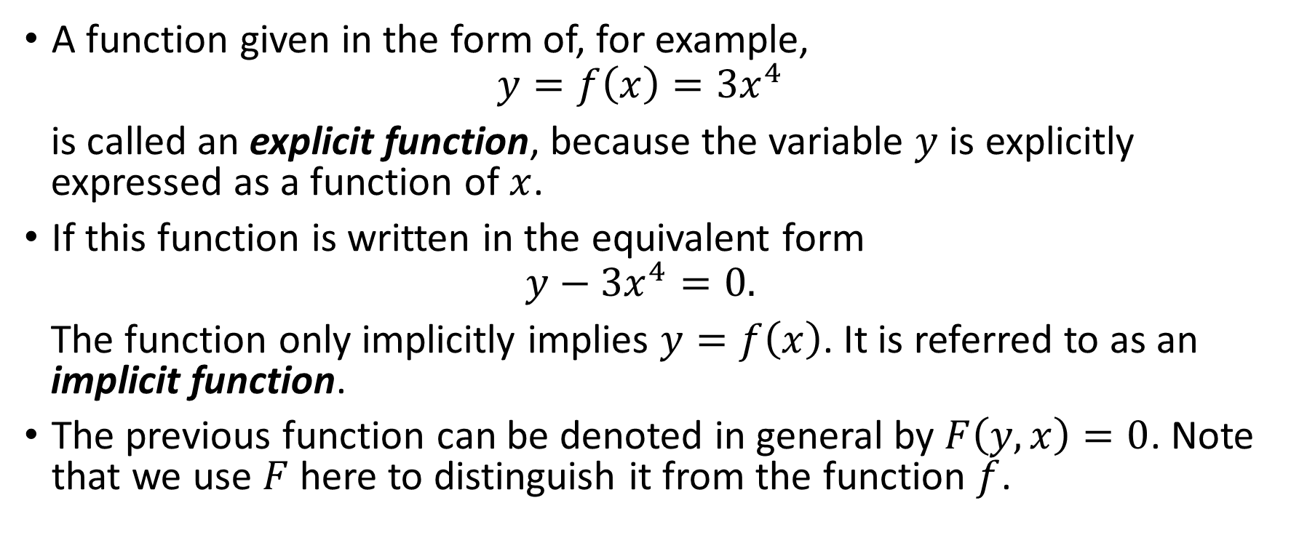
Implicit Functions
A function given in the form of, for example,
$$y=f\left(x\right)=3x^{4}$$
is called an explicit function, because the variable $y$ is explicitly expressed as a function of $x$.
If this function is written in the equivalent form
$$y−3x^{4}=0.$$
The function only implicitly implies $y=f\left(x\right)$. It is referred to as an implicit function.
The previous function can be denoted in general by $F\left(y,x\right)=0$. Note that we use $F$ here to distinguish it from the function $f$.

Slide 9
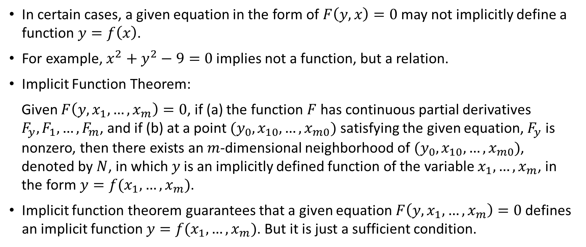
Implicit Functions
In certain cases, a given equation in the form of $F\left(y,x\right)=0$ may not implicitly define a function $y=f\left(x\right)$.
For example, $x^{2}+y^{2}−9=0$ implies not a function, but a relation.
Implicit Function Theorem:
Given $F\left(y,x_{1},…,x_{m}\right)=0$, if (a) the function $F$ has continuous partial derivatives $F_{y},F_{1},…,F_{m}$, and if (b) at a point $(y_{0},x_{10},…,x_{m0})$ satisfying the given equation, $F_{y}$ is nonzero, then there exists an $m$-dimensional neighborhood of $(y_{0},x_{10},…,x_{m0})$, denoted by $N$, in which $y$ is an implicitly defined function of the variable $x_{1},…,x_{m}$, in the form $y=f(x_{1},…,x_{m})$.
Implicit function theorem guarantees that a given equation $F\left(y,x_{1},…,x_{m}\right)=0$ defines an implicit function $y=f(x_{1},…,x_{m})$. But it is just a sufficient condition.

Slide 10
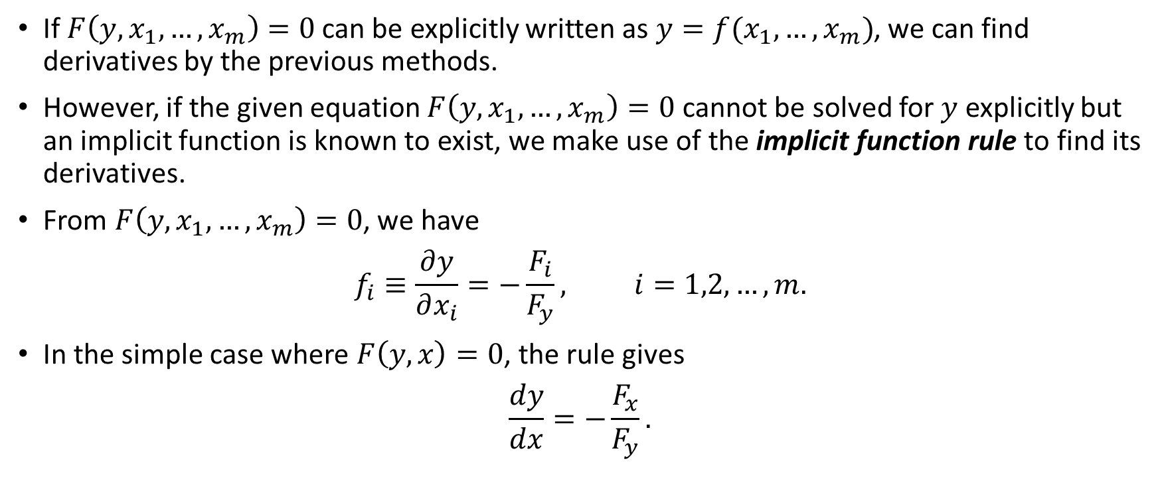
Derivatives of Implicit Functions
If $F\left(y,x_{1},…,x_{m}\right)=0$ can be explicitly written as $y=f(x_{1},…,x_{m})$, we can find derivatives by the previous methods.
However, if the given equation $F\left(y,x_{1},…,x_{m}\right)=0$ cannot be solved for $y$ explicitly but an implicit function is known to exist, we make use of the implicit function rule to find its derivatives.
From $F\left(y,x_{1},…,x_{m}\right)=0$, we have
$$f_{i}≡\frac{∂y}{∂x_{i}}=−\frac{F_{i}}{F_{y}}, i=1,2,…,m.$$
In the simple case where $F\left(y,x\right)=0$, the rule gives
$$\frac{dy}{dx}=−\frac{F_{x}}{F_{y}}.$$

Slide 11
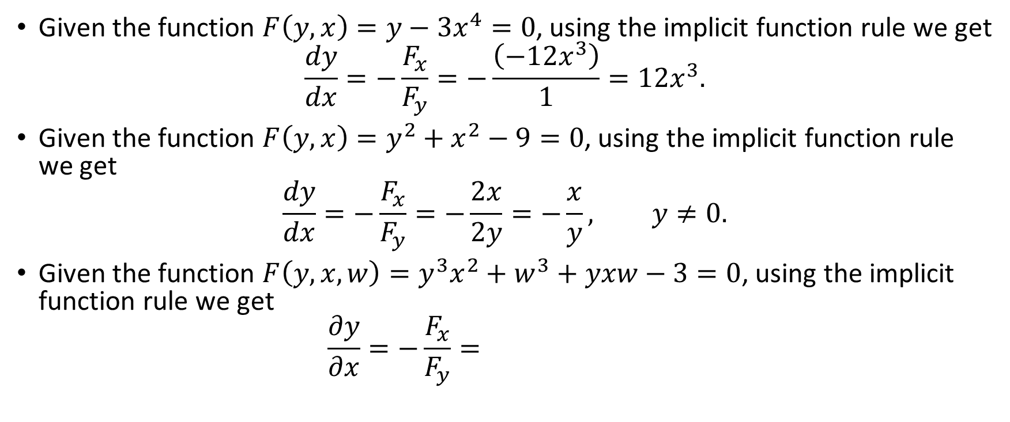
Examples
Given the function $F\left(y,x\right)=y−3x^{4}=0$, using the implicit function rule we get
$$\frac{dy}{dx}=−\frac{F_{x}}{F_{y}}=−\frac{\left(−12x^{3}\right)}{1}=12x^{3}.$$
Given the function $F\left(y,x\right)=y^{2}+x^{2}−9=0$, using the implicit function rule we get
$$\frac{dy}{dx}=−\frac{F_{x}}{F_{y}}=−\frac{2x}{2y}=−\frac{x}{y}, y≠0.$$
Given the function $F\left(y,x,w\right)=y^{3}x^{2}+w^{3}+yxw−3=0$, using the implicit function rule we get
$$\frac{∂y}{∂x}=−\frac{F_{x}}{F_{y}}=$$

Slide 12
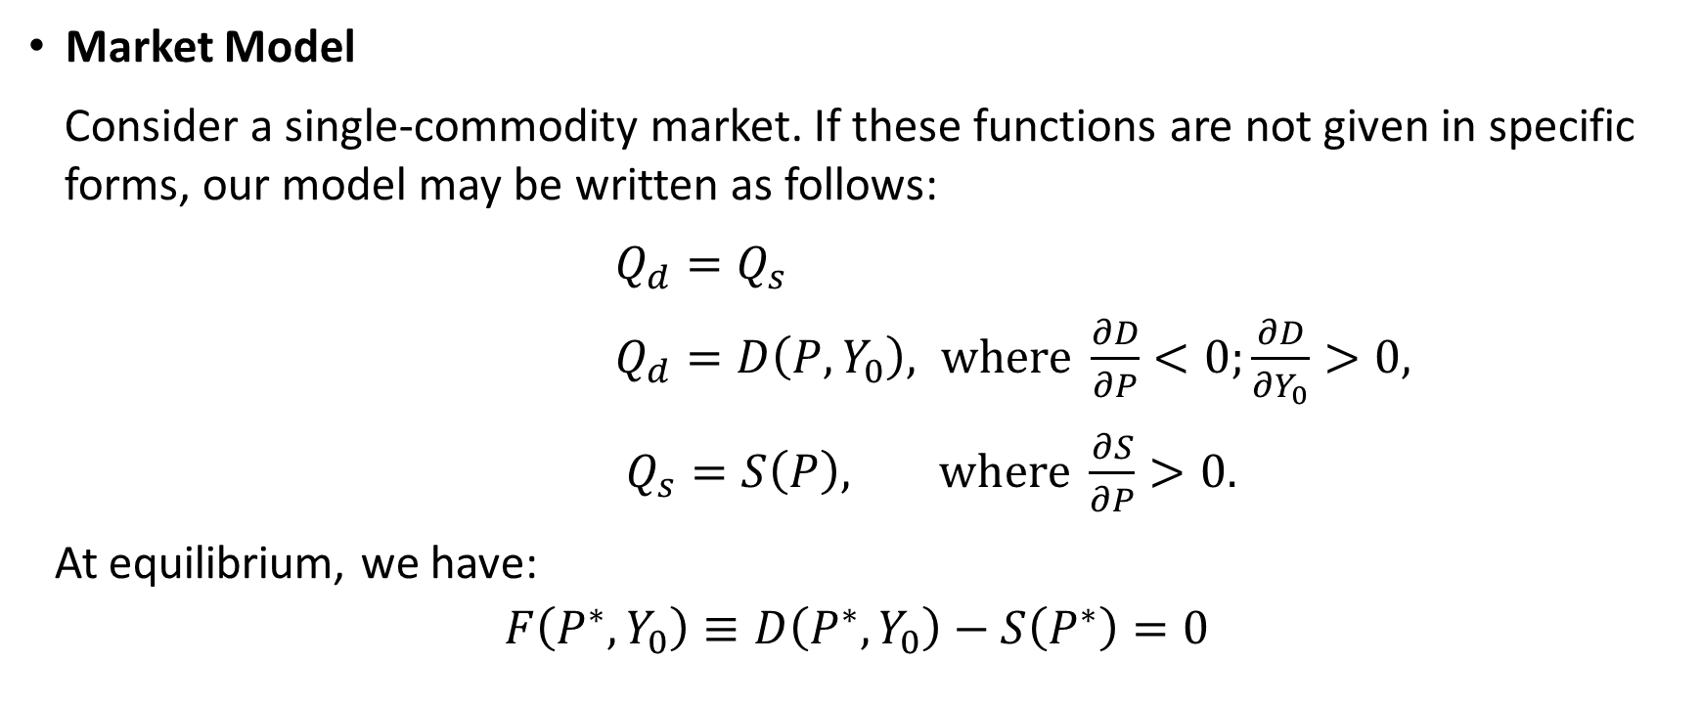
Comparative Statics of General-Function Models
Market Model
Consider a single-commodity market. If these functions are not given in specific forms, our model may be written as follows:
$Q_{d}=Q_{s}$
$Q_{d}=D\left(P,Y_{0}\right), where \frac{∂D}{∂P}<0;\frac{∂D}{∂Y_{0}}>0,$
$Q_{s}=S\left(P\right), where \frac{∂S}{∂P}>0.$
At equilibrium, we have:
$$F\left(P^{∗},Y_{0}\right)≡D\left(P^{∗},Y_{0}\right)−S\left(P^{∗}\right)=0$$

Slide 13
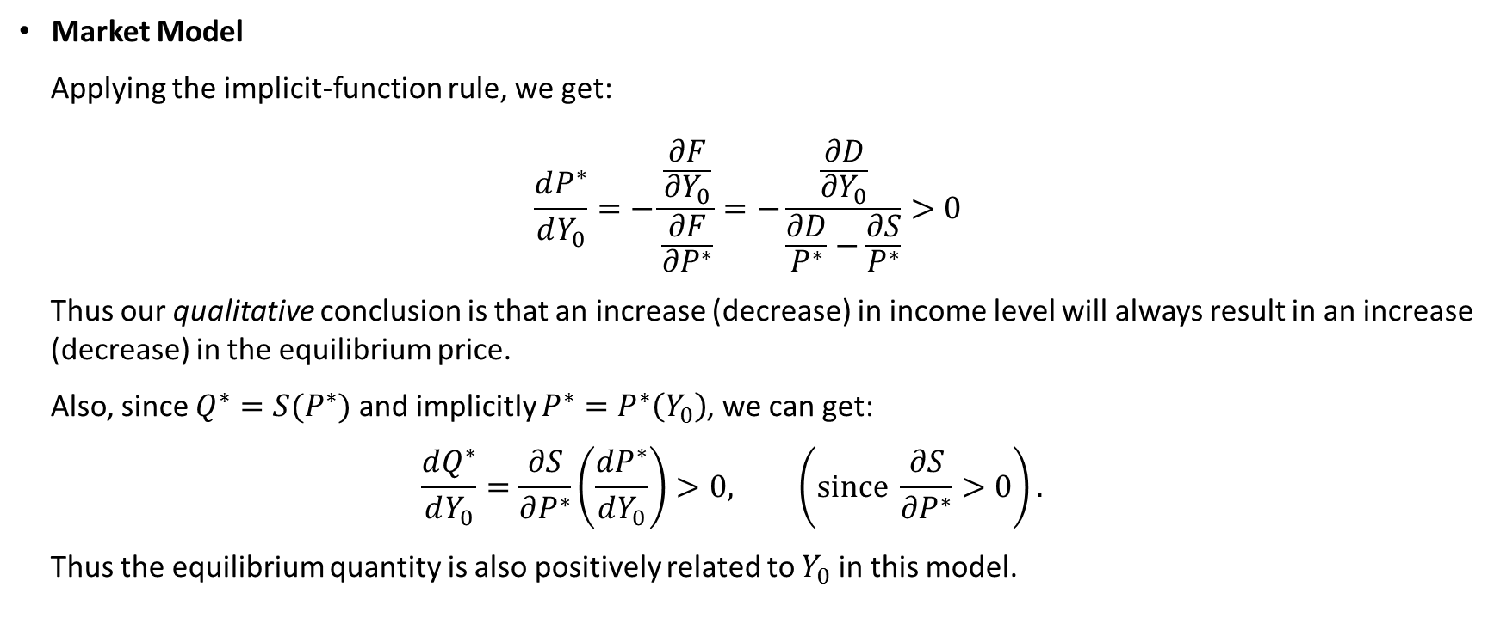
Comparative Statics of General-Function Models
Market Model
Applying the implicit-function rule, we get:
$$\frac{dP^{∗}}{dY_{0}}=−\frac{\frac{∂F}{∂Y_{0}}}{\frac{∂F}{{∂P}^{∗}}}=−\frac{\frac{∂D}{∂Y_{0}}}{\frac{∂D}{P^{∗}}−\frac{∂S}{P^{∗}}}>0$$
Thus our qualitative conclusion is that an increase (decrease) in income level will always result in an increase (decrease) in the equilibrium price.
Also, since $Q^{∗}=S(P^{∗})$ and implicitly $P^{∗}=P^{∗}\left(Y_{0}\right)$, we can get:
$$\frac{dQ^{∗}}{dY_{0}}=\frac{∂S}{∂P^{∗}}\left(\frac{dP^{∗}}{dY_{0}}\right)>0, \left(since \frac{∂S}{∂P^{∗}}>0\right).$$
Thus the equilibrium quantity is also positively related to $Y_{0}$ in this model.

Slide 14
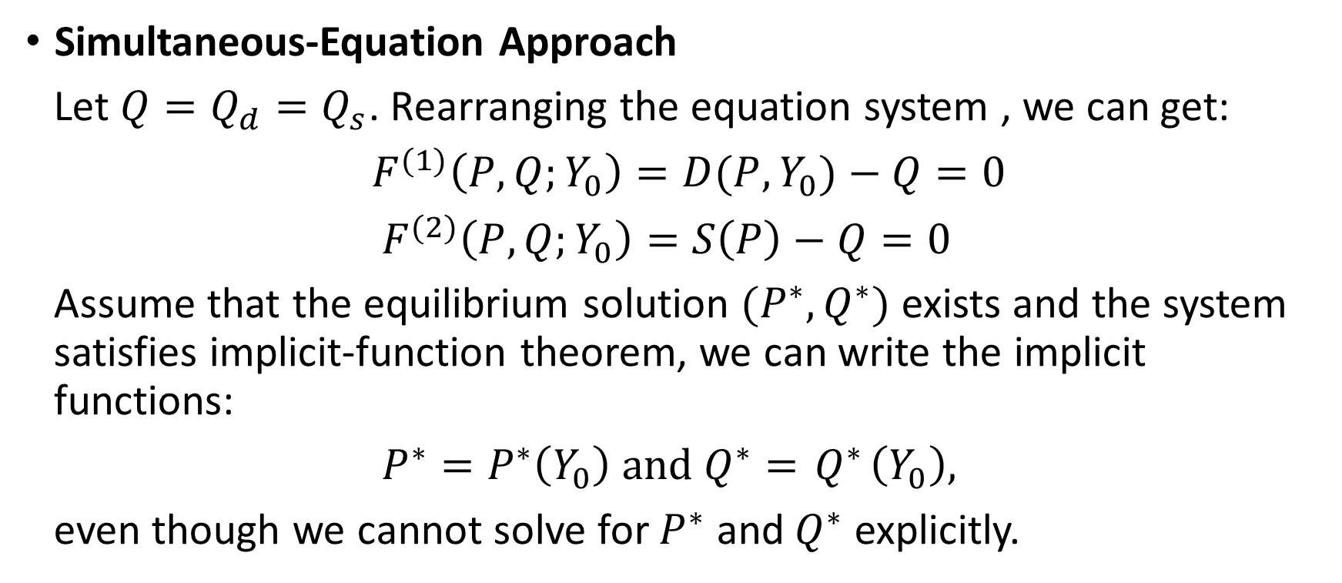
Comparative Statics of General-Function Models
Simultaneous-Equation Approach
Let $Q=Q_{d}=Q_{s}$. Rearranging the equation system , we can get:
$F^{(1)}\left(P,Q;Y_{0}\right)=D(P,Y_{0})−Q=0$
$F^{(2)}\left(P,Q;Y_{0}\right)=S\left(P\right)−Q=0$
Assume that the equilibrium solution $(P^{∗},Q^{∗})$ exists and the system satisfies implicit-function theorem, we can write the implicit functions:
$P^{∗}=P^{∗}\left(Y_{0}\right) and{ Q}^{∗}={ Q}^{∗}\left(Y_{0}\right),$
even though we cannot solve for $P^{∗}$ and${ Q}^{∗}$ explicitly.

Slide 15
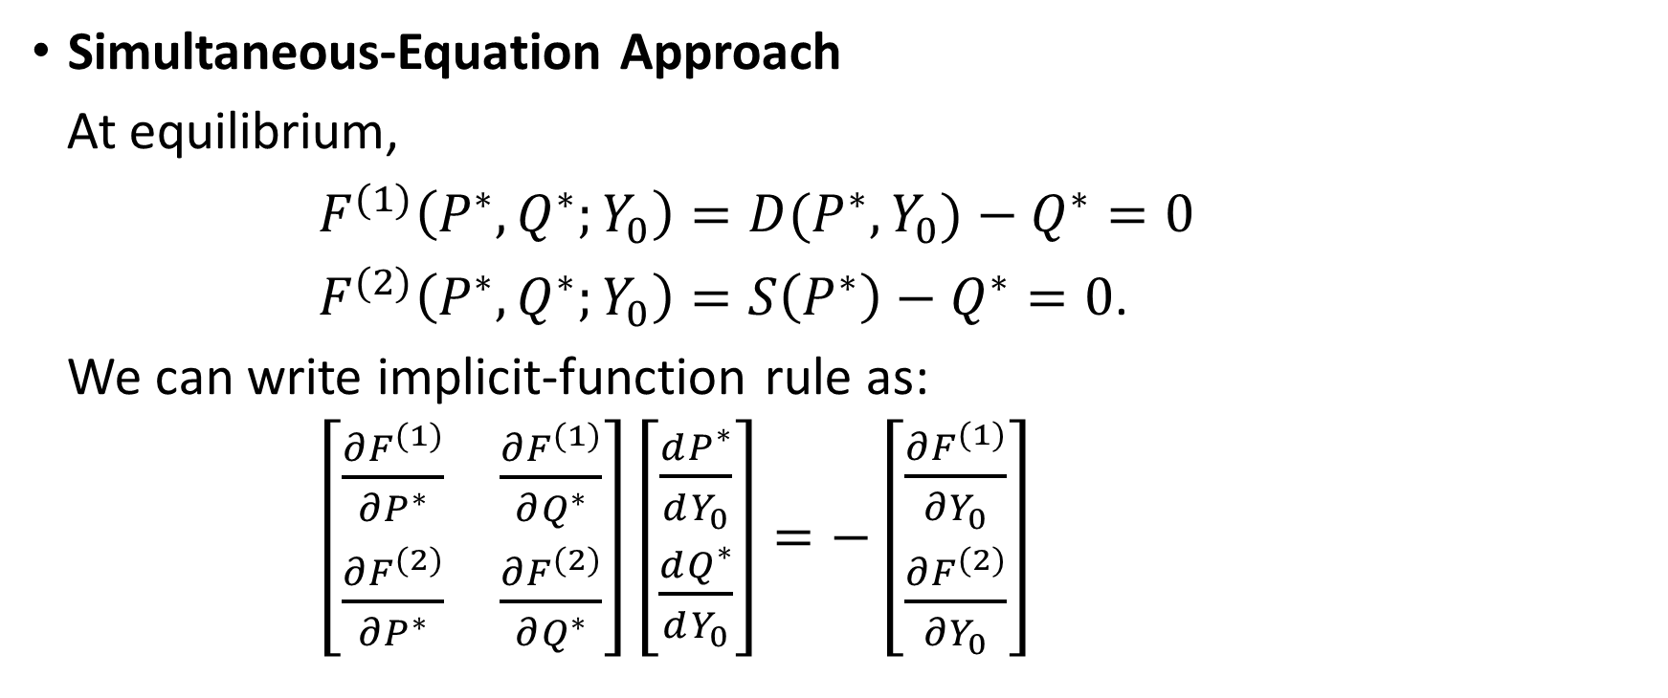
Comparative Statics of General-Function Models
Simultaneous-Equation Approach
At equilibrium,
$F^{(1)}\left(P^{∗},Q^{∗};Y_{0}\right)=D(P^{∗},Y_{0})−Q^{∗}=0$
$F^{(2)}\left(P^{∗},Q^{∗};Y_{0}\right)=S\left(P^{∗}\right)−Q^{∗}=0$.
We can write implicit-function rule as:
$\left[\begin{matrix}\frac{∂F^{(1)}}{∂P^{∗}} & \frac{∂F^{(1)}}{∂Q^{∗}} \\ \frac{∂F^{(2)}}{∂P^{∗}} & \frac{∂F^{(2)}}{∂Q^{∗}}\end{matrix}\right]\left[\begin{matrix}\frac{dP^{∗}}{dY_{0}} \\ \frac{dQ^{∗}}{dY_{0}}\end{matrix}\right]=−\left[\begin{matrix}\frac{∂F^{(1)}}{∂Y_{0}} \\ \frac{∂F^{(2)}}{∂Y_{0}}\end{matrix}\right]$

Slide 16
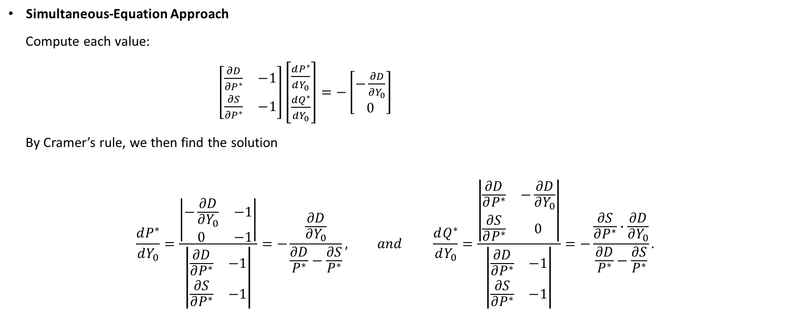
Comparative Statics of General-Function Models
Simultaneous-Equation Approach
Compute each value:
$\left[\begin{matrix}\frac{∂D}{∂P^{∗}} & −1 \\ \frac{∂S}{∂P^{∗}} & −1\end{matrix}\right]\left[\begin{matrix}\frac{dP^{∗}}{dY_{0}} \\ \frac{dQ^{∗}}{dY_{0}}\end{matrix}\right]=−\left[\begin{matrix}−\frac{∂D}{∂Y_{0}} \\ 0\end{matrix}\right]$
By Cramer’s rule, we then find the solution
$$\frac{dP^{∗}}{dY_{0}}=\frac{\left|\begin{matrix}−\frac{∂D}{∂Y_{0}} & −1 \\ 0 & −1\end{matrix}\right|}{\left|\begin{matrix}\frac{∂D}{∂P^{∗}} & −1 \\ \frac{∂S}{∂P^{∗}} & −1\end{matrix}\right|}=−\frac{\frac{∂D}{∂Y_{0}}}{\frac{∂D}{P^{∗}}−\frac{∂S}{P^{∗}}}, and \frac{dQ^{∗}}{dY_{0}}=\frac{\left|\begin{matrix}\frac{∂D}{∂P^{∗}} & −\frac{∂D}{∂Y_{0}} \\ \frac{∂S}{∂P^{∗}} & 0\end{matrix}\right|}{\left|\begin{matrix}\frac{∂D}{∂P^{∗}} & −1 \\ \frac{∂S}{∂P^{∗}} & −1\end{matrix}\right|}=−\frac{\frac{∂S}{∂P^{∗}}∙\frac{∂D}{∂Y_{0}}}{\frac{∂D}{P^{∗}}−\frac{∂S}{P^{∗}}}.$$

Slide 17
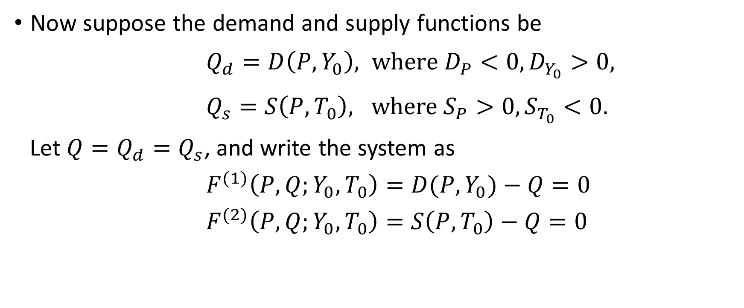
Example
Now suppose the demand and supply functions be
$Q_{d}=D\left(P,Y_{0}\right), where D_{P}<0,D_{Y_{0}}>0,$
$Q_{s}=S\left(P,T_{0}\right), where S_{P}>0,S_{T_{0}}<0.$
Let $Q=Q_{d}=Q_{s}$, and write the system as
$F^{(1)}\left(P,Q;Y_{0},T_{0}\right)=D(P,Y_{0})−Q=0$
$F^{(2)}\left(P,Q;Y_{0},T_{0}\right)=S\left(P,T_{0}\right)−Q=0$

Slide 18
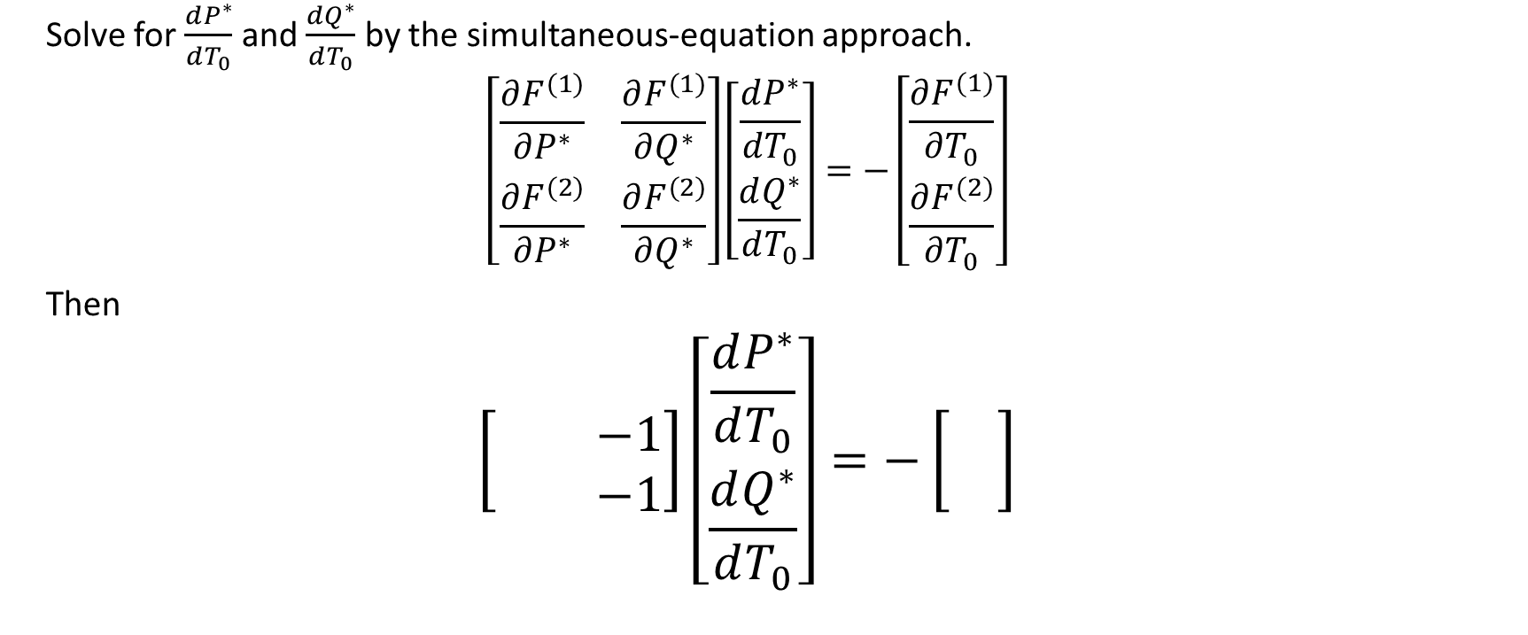
Example (cont.)
Solve for $\frac{dP^{∗}}{dT_{0}}$ and $\frac{dQ^{∗}}{dT_{0}}$ by the simultaneous-equation approach.
$$\left[\begin{matrix}\frac{∂F^{(1)}}{∂P^{∗}} & \frac{∂F^{(1)}}{∂Q^{∗}} \\ \frac{∂F^{(2)}}{∂P^{∗}} & \frac{∂F^{(2)}}{∂Q^{∗}}\end{matrix}\right]\left[\begin{matrix}\frac{dP^{∗}}{dT_{0}} \\ \frac{dQ^{∗}}{dT_{0}}\end{matrix}\right]=−\left[\begin{matrix}\frac{∂F^{(1)}}{∂T_{0}} \\ \frac{∂F^{(2)}}{∂T_{0}}\end{matrix}\right]$$
Then
$$\left[\begin{matrix} & −1 \\ & −1\end{matrix}\right]\left[\begin{matrix}\frac{dP^{∗}}{dT_{0}} \\ \frac{dQ^{∗}}{dT_{0}}\end{matrix}\right]=−\left[\begin{matrix} \\ \end{matrix}\right]$$

Slide 19
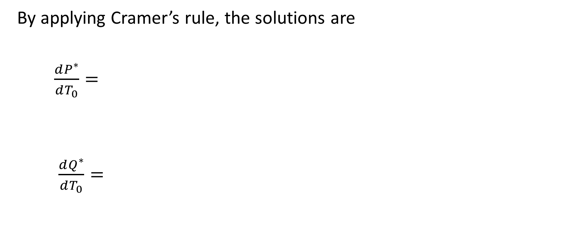
Example (Cont.)
By applying Cramer’s rule, the solutions are
$\frac{dP^{∗}}{dT_{0}}=$
$\frac{dQ^{∗}}{dT_{0}}=$

