Slide 1


Chapter 5
Strategic Marketing Planning
MK 312 Marketing Management
By
Aj.Suwalya K.

Slide 2
MK 312 Today’s Happenings
Chapter 5
Break
SWOT presentations
Each team please upload files during break and prepare at your laptop. Only one team to present and I will go to each team to review your SWOT

Slide 3

Figure 1.1: The stages of building a
marketing plan

Slide 4
Ch. 5 - Learning objectives
After studying this chapter you should be able to:
■ understand the importance of strategic marketing planning
■ identify the main steps in strategic marketing planning
■ develop an appropriate business mission statement
■ describe the criteria for stating good strategic marketing objectives
■ understand how portfolio models are used to select alternatives
■ explain the advantages and disadvantages of using strategic models like Ansoff’s growth matrix, and the BCG and GE models.

Slide 5
The strategic planning process
The planning process itself is a systematic way of approaching the following questions, and they will be used as a framework for this chapter.
■ What business are we in? (vision and mission statement)
■ Where are we today?
■ Where do we want to go? (strategic objectives)
■ How do we get there?

Slide 6
The strategic planning process
The ’How do we get there?’ question involves the following strategic analysis:
- Estimation of the planning gap, and problem diagnosis
The search for strategic alternatives (Ansoff ’s growth matrix, Porter’s three generic strategies, the BCG and GE models)
Strategy evaluation and selection
Estimating financial consequences/How can progress be measured? (marketing metrics)

Slide 7

The vision and mission statement
■ The business mission statement describes ‘who we are and what’s the overall purpose of our business’
■ The business vision statement describes ‘where we wish to go’, ‘what we wish to become’; it provides a mental image of the successful accomplishment of the mission; it is typically:
– short
– idealistic and imaginative
– enthusiasm-inspiring
– ambitious

Slide 8


Unilever’s Purpose - Mission
Unilever's Purpose
At the heart of the corporate purpose, which guides us in our approach to doing business, is the drive to serve consumers in a unique and effective way. This purpose has been communicated to all employees worldwide.
Unilever's mission is to add Vitality to life. We meet everyday needs for nutrition, hygiene and personal care with brands that help people feel good, look good and get more out of life.
Our deep roots in local cultures and markets around the world give us our strong relationship with consumers and are the foundation for our future growth. We will bring our wealth of knowledge and international expertise to the service of local consumers – a truly multi-local multinational.
Our long-term success requires a total commitment to exceptional standards of performance and productivity, to working together effectively, and to a willingness to embrace new ideas and learn continuously.
To succeed also requires, we believe, the highest standards of corporate behaviour towards everyone we work with, the communities we touch, and the environment on which we have an impact.
This is our road to sustainable, profitable growth, creating long-term value for our shareholders, our people, and our business partners.

Slide 9
Vision and Mission statement
Mission statements should be driven by three factors:
  The organization’s heritage is its history-where it has been, what it has done well and what it has done poorly. A good mission statement cannot ignore previous events and how they have shaped the organization.
  Resources refer to everything the organization can manage, such as cash reserves, recognized brands, unique technologies and talented employees.
  The environment is everything happening currently that affects the company’s ability to achieve objectives or implement strategies, both inside and outside the organization.

Slide 10
Vision and Mission
Statements

Slide 11
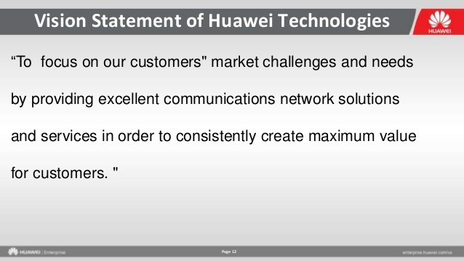

Slide 12
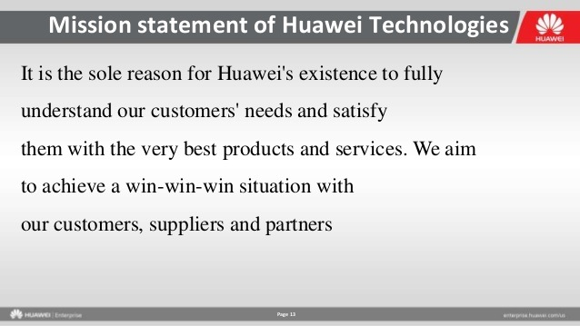

Slide 13
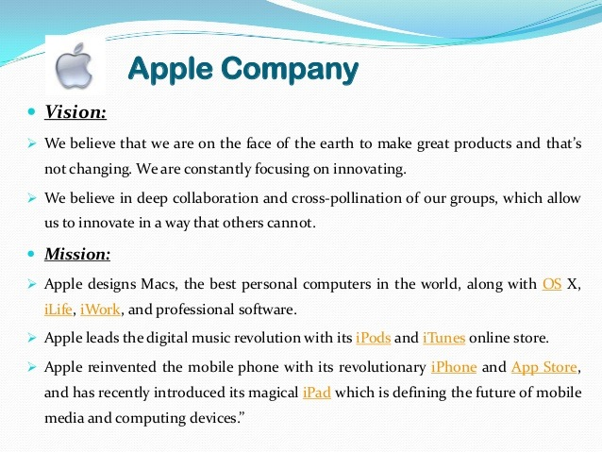

Slide 14
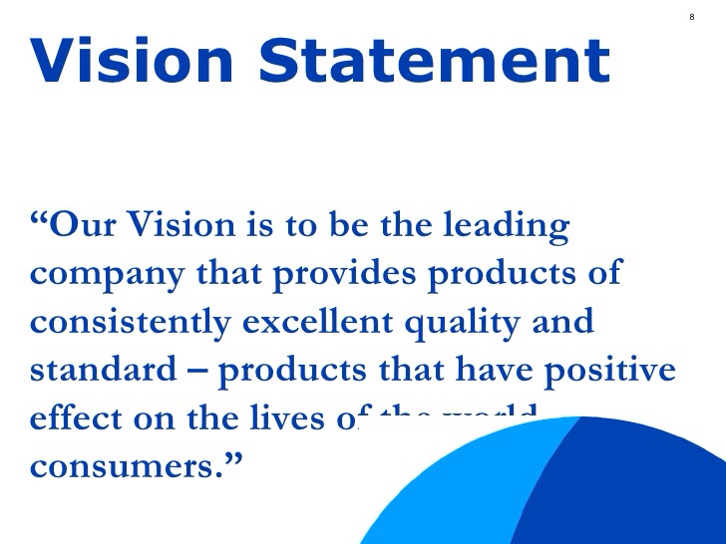
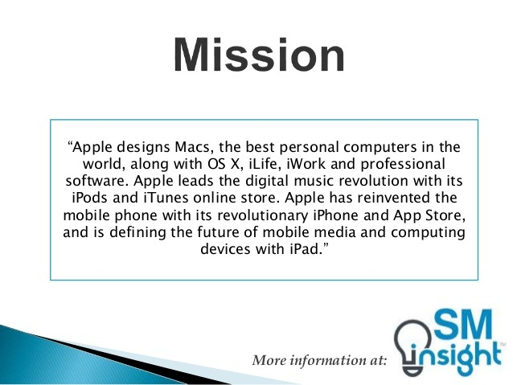

Slide 15
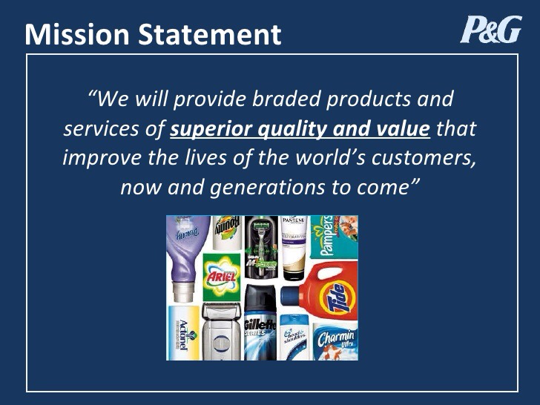

Slide 16
Strategic objectives
Strategic management also requires that firms set strategic objectives: specific and measurable performance standards for strategically important areas.
Whereas a mission statement may set broad goals, such as ‘being the best company in the world; strategic objectives must specify what it means to be the ‘best’.

Slide 17
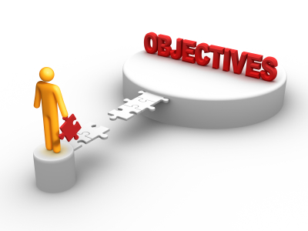
Effective objectives
To be effective, objectives must be specific in terms of:
■ the performance dimension being measured
■ the measures most appropriate for the performance dimension
■ the target value for each measure
■ the time by which the target should be achieved.

Slide 18

Estimation of the planning gap and problem diagnosis
What do the ‘facts’ suggest will be the future if the firm takes no action to change current strategies?
Such a prediction is know as a ‘reference projection’
A reference projection is the future that can be expected in the absence of planned change.
The reference projection is compared with ‘target projection’, or the setting of tentative goals, which the firm sets for itself.
The planning (performance) gap is the difference between the target and the reference projections.

Slide 19
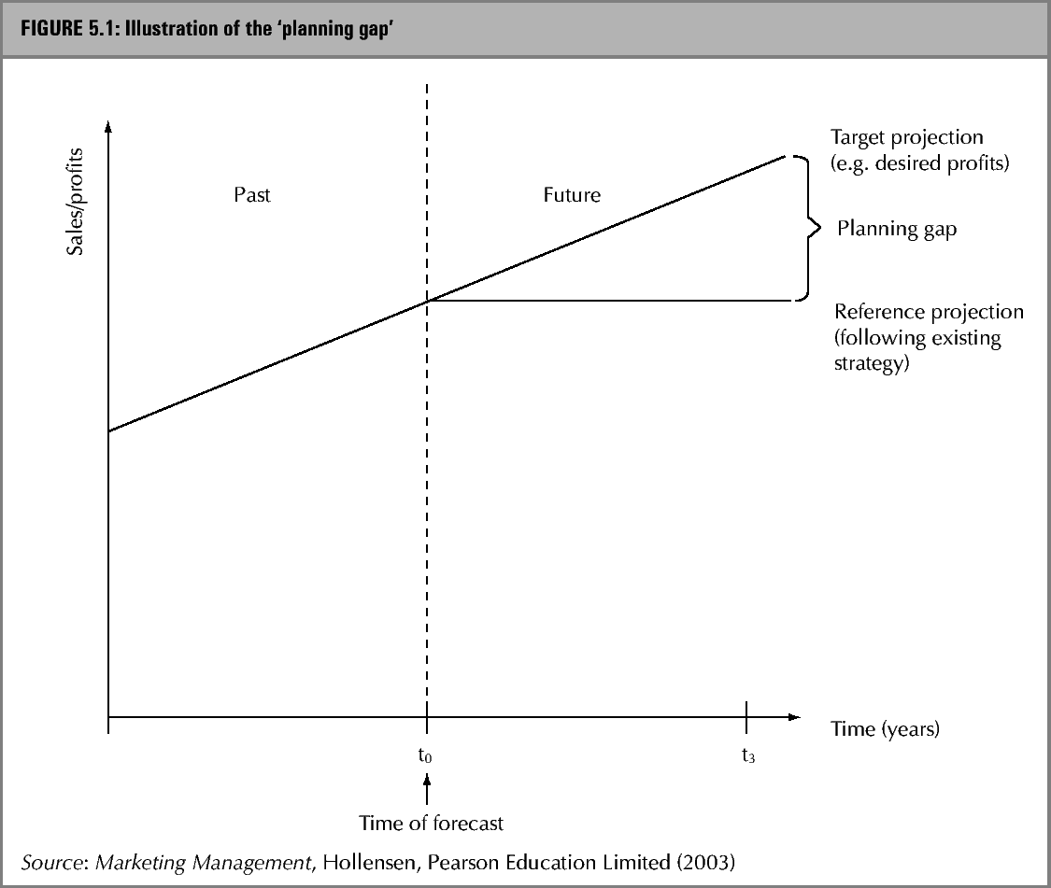
The planning gap

Slide 20
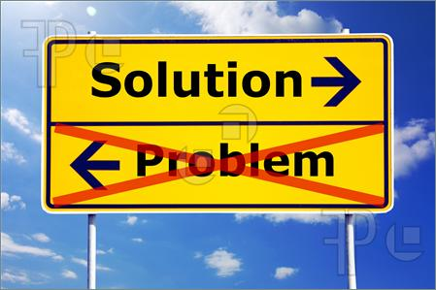
Problem diagnosis
The recognition of a problem situation is not in itself the identification of the actual problem. We do not discover a problem, we diagnose one.
Problem diagnosis aims to identify the type of solution that applies, which is the first step on the road to developing and actual solution.
Just as diagnosing a failure to start a car as being due to some electric fault is the first step towards getting the car started again.
We cannot understand a problem without understanding what would count as a solution, just as we cannot understand and objective without understanding what would count as an achievement.

Slide 21


Exhibit 5.1 Starbucks considers India as a new market

Slide 22
The search for strategic alternatives for closing the ‘planning gap’
The strategic options for closing the planning gap should not only fit the problematic situation and take account the trends and competition, but should also exploit the firm’s core competencies and strengths.
Where the solution is other than a crises one, there is time for more reflective planning, guided by:

Slide 23
The search for strategic alternatives for closing the ‘planning gap’
The situation as revealed by the performance gap
The perceived problem
The strengths, weaknesses, opportunities, and threats identified in the historical review/situation analysis.
Current strategies and policies
Existing capabilities or competencies.
  The strategy search process should always allow for
  possibility of inspiration, which may beat anything
  arrived at by methodical analysis.

Slide 24
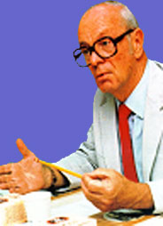
Ansoff’s generic strategies for growth
One aspect of strategic management is the development of specific strategies for achieving company objectives.
Strategies must respond to the environment and provide specific guidelines for decision-making.
Because organizations face unique combinations of internal and external factors, the strategies developed by any one organization are unlikely to be entirely adaptable to any other organization.
At a more general level, however, it is possible to discern recurring patterns in strategies adopted by organizations.
These recurring patterns are called generic strategies.

Slide 25

Ansoff’s generic strategies for growth
If we elaborate on the ‘planning gap’ where the ‘gap’ is filled up with Ansoff’s expansion strategies (Ansoff, 1965)

Slide 26
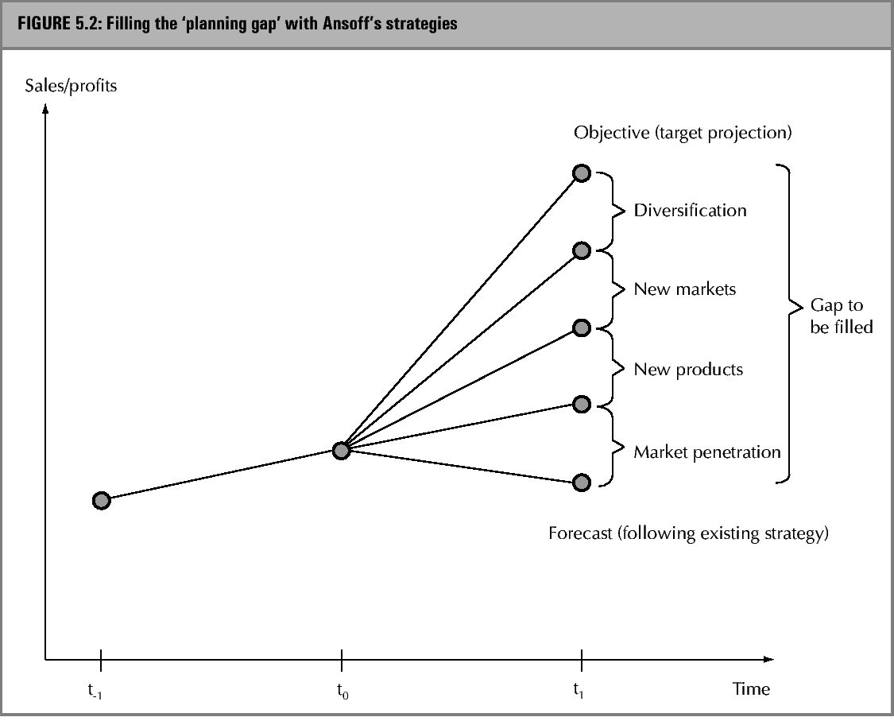
Filling the gap with Ansoff’s strategies

Slide 27

Market penetration strategies
Organizations seeking to grow by gaining a larger market share in their current industry or market follow a penetration strategy. The following alternatives are available:
  Increase market share on current market with current products.
  Increase product share (increase frequency of use, increase quantity used, new applications).
Penetration strategies can be very successful when the company has a technological or production advantage that allows it to take market share away from competitors while still operating profitably.

Slide 28

New product strategies
Organizations can also remain within their established industries or markets and seek expansion by introducing new products and services in current market.
This is also known as technology development strategy.
Product development strategies are in peril if competitors can easily copy the new product being introduced by using lower manufacturing or delivery costs.
This strategy may take the following forms:
  Product improvements
  Product line extensions
  New products for the same market

Slide 29

New market strategies
Existing products for new markets
For example
baby powder for face
Utaitip as make-up
Or expanding into other countries

Slide 30
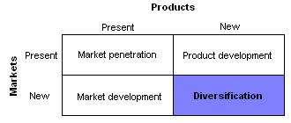
Diversification strategies

Slide 31
Diversification strategies
The term ‘diversification’ is frequently associated with expansion into areas unrelated to the company’s current operations in order to offset cyclical downturns in one area with cyclical growth in other areas.
Diversification was popular with many large companies in the 1970’s and gave rise to legendary conglomerates.

Slide 32

Diversification strategies
Pursuing a growth strategy by introducing new products or technologies in new markets or industries is called diversification.
The following alternatives are available:
  Vertical integration (forward integration or backward integration)
  Diversification into related businesses (concentric diversification)
  Diversification into unrelated businesses (conglomerate diversification)

Slide 33
VERTICAL INTEGRTION
The term vertical integration is a type of related diversification that describes a style of nearly total ownership and control. The degree to which a firm owns its upstream suppliers and its downstream buyers determines how vertically integrated it is. Note, however, that there is no ratio or quantifiable measure to denote this.
Vertically integrated companies are united through a hierarchy and share a common owner. Usually each member of the hierarchy produces a different product or service, and the products are combined to satisfy a common need

Slide 34
CONCENTRIC DIVERSIFICATION
Concentric diversification occurs when a firm adds related products or markets. The goal of such diversification is to achieve strategic fit. Strategic fit allows an organization to achieve synergy. In essence, synergy is the ability of two or more parts of an organization to achieve greater total effectiveness together than would be experienced if the efforts of the independent parts were summed. Synergy may be achieved by combining firms with complementary marketing, financial, operating, or management efforts. Breweries have been able to achieve marketing synergy through national advertising and distribution. By combining a number of regional breweries into a national network, beer producers have been able to produce and sell more beer than had independent regional breweries.

Slide 35
CONGLOMERATE DIVERSIFICATION
Conglomerate diversification occurs when a firm diversifies into areas that are unrelated to its current line of business. For example, Unilever launching Baby Products to a new market.
Synergy may result through the application of management expertise or financial resources, but the primary purpose of conglomerate diversification is improved profitability of the acquiring firm. Little, if any, concern is given to achieving marketing or production synergy with conglomerate diversification.
One of the most common reasons for pursuing a conglomerate growth strategy is that opportunities in a firm's current line of business are limited. Finding an attractive investment opportunity requires the firm to consider alternatives in other types of business. Philip Morris's acquisition of Miller Brewing was a conglomerate move. Products, markets, and production technologies of the brewery were quite different from those required to produce cigarettes.

Slide 36
Market Potential
The most difficult to estimate to make is probably that of ‘market potential’ in the whole market, including all segments.
In the B2C market, it is often achieved by determining the maximum potential individual usage and then extrapolating this by the maximum number of potential customers (in B2B market it would be the maximum number of firms).

Slide 37
Filling the gap with Ansoff’s strategies

Slide 38
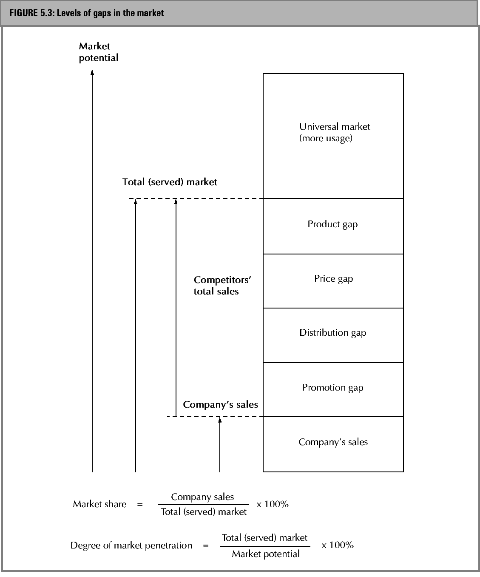
Lervels of gaps in the
Market:

Slide 39

Porter’s three generic strategies
According to Porter (1985), forging successful strategy begins with understanding of what is happening in one’s industry and deciding which of the available competitive niches one should attempt to dominate.
Combining the dimensions of distinctive advantage and business scope in a matrix results in the strategic orientation typology.

Slide 40
Porter’s three generic strategies
A cost leadership orientation suggests that the company will try to be the low-cost producer in the markets and industries in which it competes, as in the case of Texas Instruments.
Differential advantage orientation occurs when the organization focuses on staying ahead of its competitors in the technological and performance stakes.

Slide 41

Porter’s three generic strategies
Focused cost advantage and focused differentiation are similar to the broader strategies, but have limited target markets.
  An organization with a focused cost orientation seeks to be a low-cost producer in only one product line or in a limited geographical market.

Slide 42
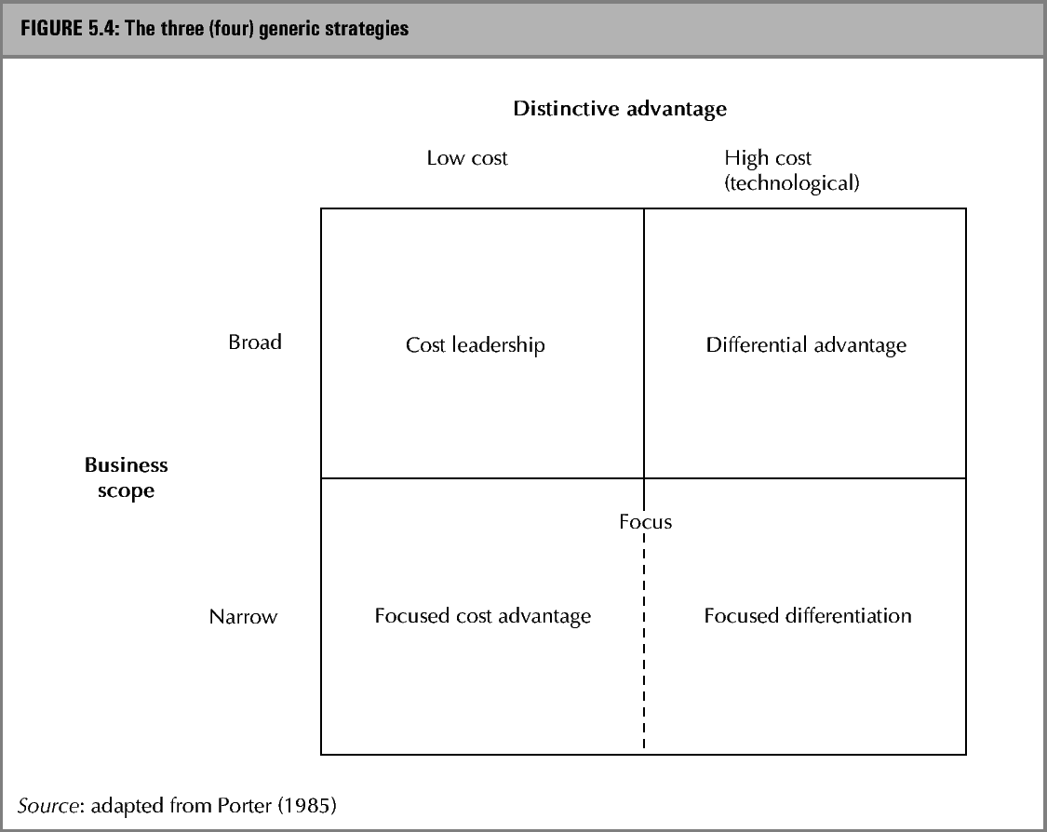
Porter’s generic strategies

Slide 43
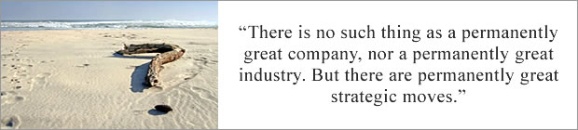
Kim & Mauborgne, 2009

Slide 44
What is Blue Ocean Strategy?
1.BOS is the result of a decade-long study of 150 strategic moves spanning more than 30 industries over 100 years (1880-2000).
2.BOS is the simultaneous pursuit of differentiation and low cost.
3.The aim of BOS is not to out-perform the competition in the existing industry, but to create new market space or a blue ocean, thereby making the competition irrelevant.
4.While innovation has been seen as a random/experimental process where entrepreneurs and spin-offs are the primary drivers – as argued by Schumpeter and his followers – BOS offers systematic and reproducible methodologies and processes in pursuit of blue oceans by both new and existing firms.
5.BOS frameworks and tools include: strategy canvas, value curve, four actions framework, six paths, buyer experience cycle, buyer utility map, and blue ocean idea index.
6.These frameworks and tools are designed to be visual in order to not only effectively build the collective wisdom of the company but also allow for effective strategy execution through easy communication.
7.BOS covers both strategy formulation and strategy execution.
8.The three key conceptual building blocks of BOS are: value innovation, tipping point leadership, and fair process.
9..While competitive strategy is a structuralist theory of strategy where structure shapes strategy, BOS is a reconstructionist theory of strategy where strategy shapes structure.
10.As an integrated approach to strategy at the system level, BOS requires organizations to develop and align the three strategy propositions: value proposition, profit proposition and people proposition.
Kim & Mauborgne, 2009

Slide 45
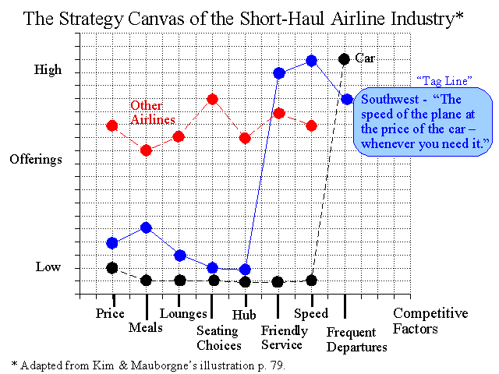
Blue Ocean Strategic Canvas

Slide 46
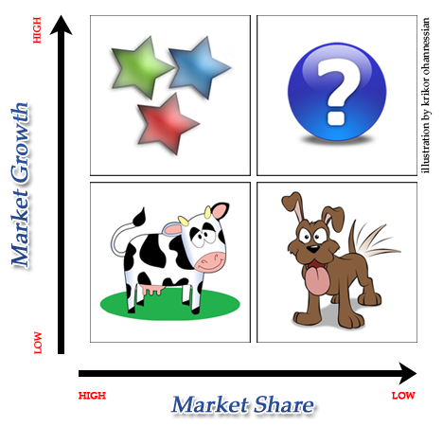
The BCG portfolio matrix model
A good planning system must guide the development of strategic alternatives for each of the company’s current business and new business possibilities.
It must also provide management’s review of these strategic alternatives and for corresponding resource-allocation decisions.

Slide 47
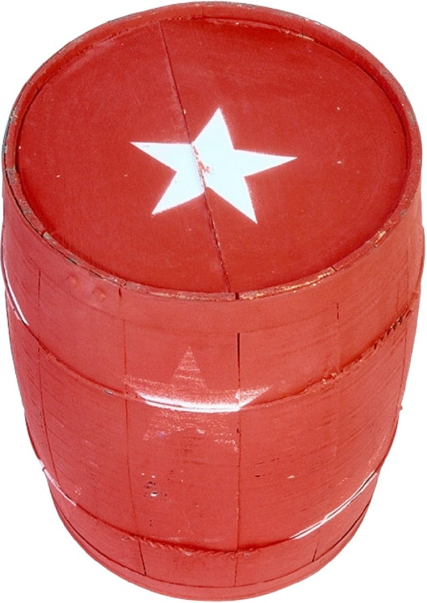
Classification of the BCG Boxes
Stars: High-growth market leaders are called stars. They generate large amounts of cash, but the cash they generate from earnings and depreciation is more than offset by the cash that must be put back in the form of capital expenditure and increased working capital.

Slide 48
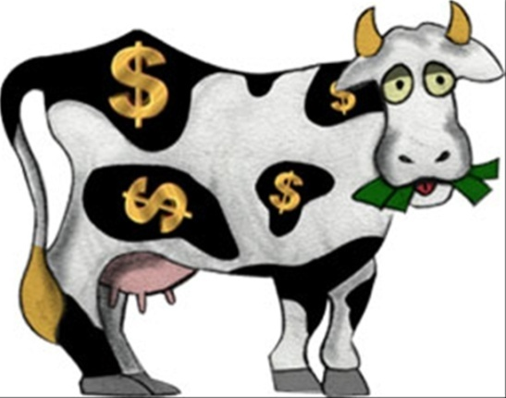
Classification of the BCG Boxes
Cash cows: are characterized by low growth and high market share. They are net providers of cash. Their high earnings, coupled with their depreciation, represent high cash inflows and they need very little in a way of reinvestment. Thus these businesses generate large cash surpluses that help to pay dividends and interest, provide dept capacity, supply funds for research and development, meet overheads and also make cash available for investment in other products.

Slide 49

Classification of the BCG Boxes
Question marks: products in a growth market with a low share are categorized as question marks. Because of growth, these products require more cash than they are able to generate on their own. If nothing is done to increase market share, a question mark will simply absorb large amounts of cash in the short run and later, as growth slows down, becomes a dog.

Slide 50

Classification of the BCG Boxes
Dogs: Products with low market share positioned in low-growth situations are called dogs. Their poor competitive position condemns them to poor profits. Because growth is low, dogs have little potential for gaining sufficient share to achieve viable cost positions. Usually they are net users of cash. Their earnings are low, and the reinvestment required just to keep the business together eats cash inflow. The business, therefore, becomes a cash trap that is likely to regularly absorb cash unless further investment is rigorously avoided. An alternative is to convert doges into cash.

Slide 51
The BCG – model

Slide 52
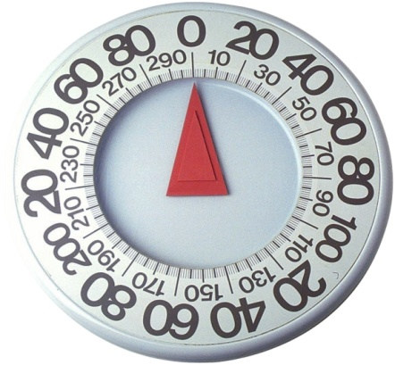
The BCG portfolio matrix model
The portfolio matrix represents a real advance in strategic planning in several ways:
  It encourages top management to evaluate the prospects of each of the company’s business individually and to set tailored objectives for each business based on the contribution it can realistically make to corporate goals.
  It stimulates the use of externally focused empirical data to supplement managerial judgment in evaluating the potential of a particular business.
  It explicitly raises the issue of cash flow balancing as management plant for expansion and growth.
  It gives managers a potent new tool for analyzing competitors and for predicting competitive responses to strategic moves.
  It provides not just a financial but also a strategic context for evaluating acquisitions and divestitures.

Slide 53
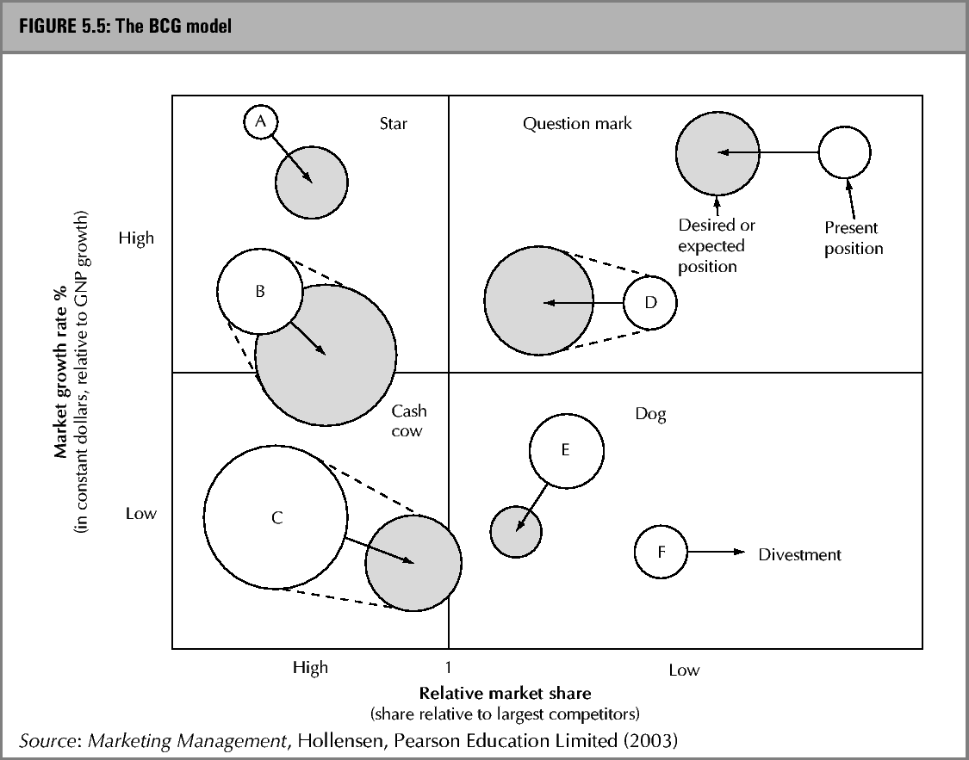
The BCG – model

Slide 54
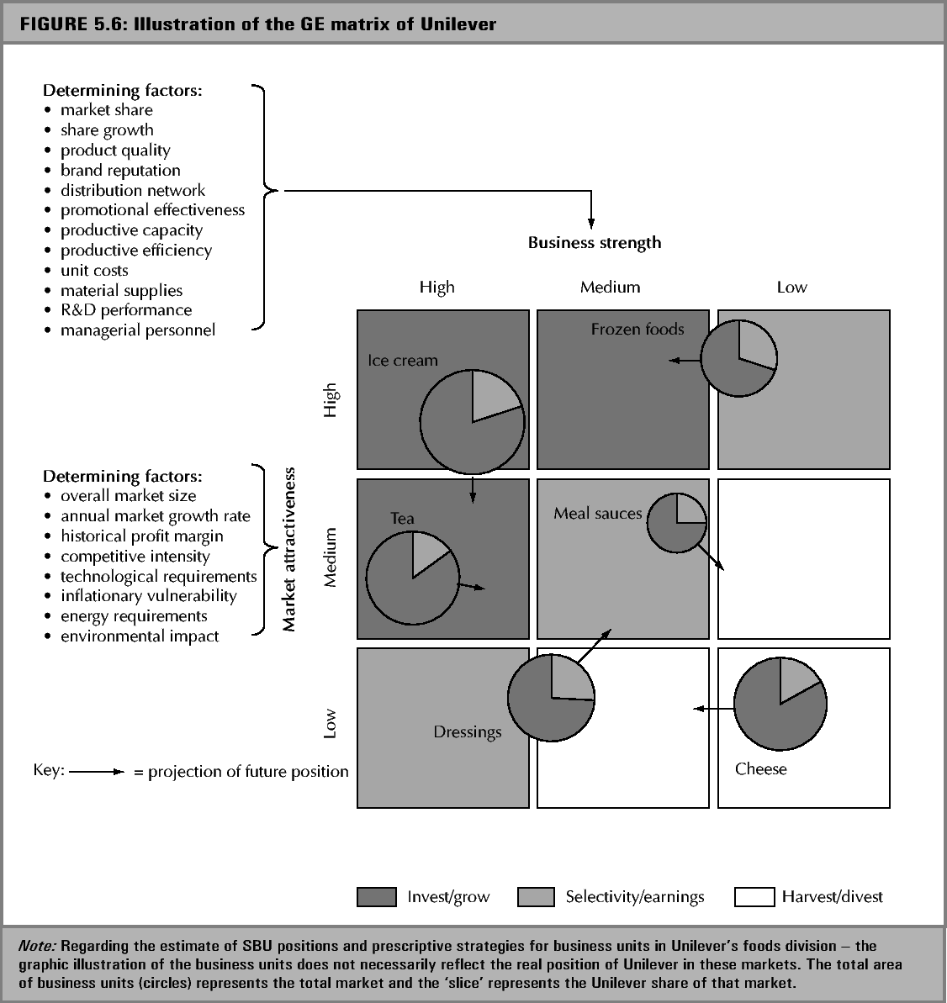
The Unilever portfolio matrix

Slide 55
Strategy evaluation and selection
The adequacy of a strategy may be evaluated using the following criteria:
  Suitability- Is there a sustainable advantage?
  Validity- Are the assumptions about the external environment realistic?
  Feasibility - Do we have skills, resources and commitment?
  Internal consistency – does the strategy hang together?

Slide 56
Strategy evaluation and selection
Continued….
Vulnerability – What are the risks and contingencies?
Workability – Can we retain our flexibility?
Appropriate time horizon – Do we allow enough time for implementation?

Slide 57

Financial consequences
        Most forms of corporate strategic analysis have to include not only a financial evaluation of the current position but also an assessment of the financial impact of future strategic choices.
Very important has been the development of so-called ABC (Activity Based Costing) which, broadly, attempts to shift the focus of cost analysis towards individual elements in the various business activities or processes involved in the development and delivery of products and services.

Slide 58
Group Homework: Recap Information Gathering insights to prepare for next steps
You are to identify and extract 5 insights (major findings) from focal company and 5 insights from your competitor
It should reflect your presentations from Chapter 1-4
The insights should be useful for your next steps and impact your major decisions about expanding your business
Each team is to present 2 pages powerpoint slides due next week(5 mins presentation per group).

Slide 59
Group Homework: Review Exhibits from
Chapter 1- 6 in text for discussion
Please review exhibits (mini cases) in the text indicated in the handouts
I will be randomly asking each team to recap, no need to submit powerpoint slides; ready for class discussion
Next week we will discuss in class

