Slide 1

Money transfer
Features
Types I
Types II
Types III
Type IV
Type V
Type VI
Benefits

Slide 2
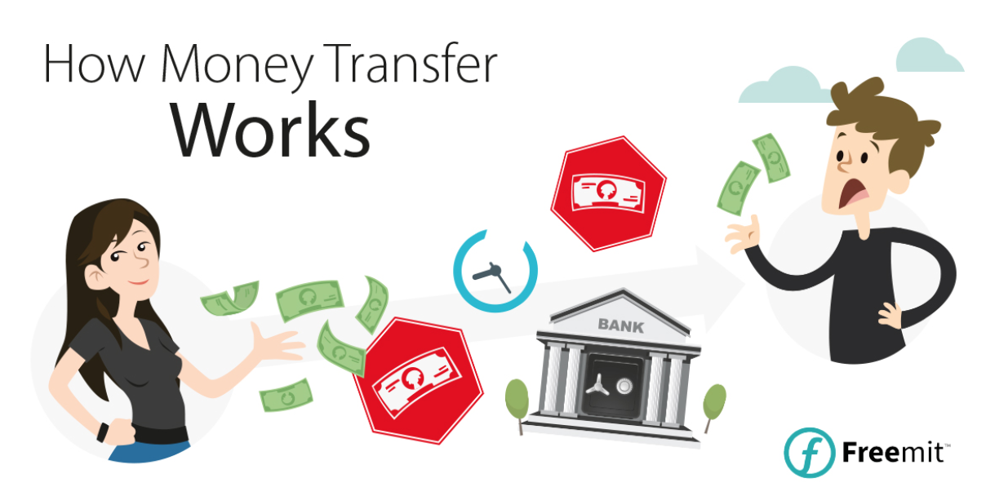
Features
Types I
Types II
Types III
Type IV
Type V
Type VI
Benefits

Slide 3








Features
SENDER
A person wants to send money to someone in another country so they go to a bank and place an order.
ORIGINATOR BANK
The bank verifies funds are available and creates an electronic order. This is stuffed into a queue of orders that will all be sent at once
ORIGINATOR FEE
The bank charges an Originator Fee to start the foreign transaction. This is often about $45.
FOREIGN EXCHANGE HIDDEN FEE (3-7%)
U.S. FEDERAL RESERVE
The Federal Reserver clears the overall batch from the bank by verifying it has the funds available to cover the transfer. This takes about three business days.
The batch of orders leaves the bank and moves through the Federal Reserver Clearing System
Features
Types I
Types II
Types III
Type IV
Type V
Type VI
Benefits

Slide 4



EUROPEAN CENTRAL BANK
The European Central Bank receives the transaction data and clears the transfers for the receiving bank.
More batching! The orders go into another queue to be sent to the foreign bank.
RECEIVER BANK
The overseas bank receives the funds from the European Central Bank and prepares a credit for the receiving account while verifying, again, that the funds are valid.
RECEIVER
The receiver finally gets a notice that the cash is in their account. It has been about five days since the original order was placed.
Features
Types I
Types II
Types III
Type IV
Type V
Type VI
Benefits
Features

Slide 5

Types of money transfer
1.Foreign Exchange Providers (FX Brokers or Money Transfer Providers)
FX brokers are companies who specialize in international money transfer such as transferring large amounts of money for purchasing a property, starting up a business, or sending regular payments abroad. These are the core group of companies that are listed on FXcompared.
Features
Types I
Types II
Types III
Type IV
Type V
Type VI
Benefits

Slide 6
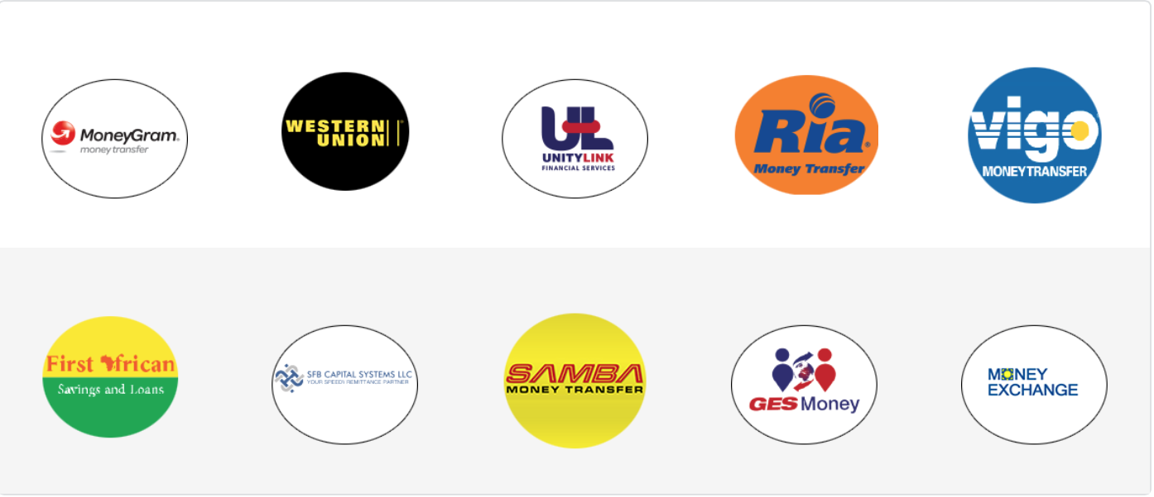

MTOs are companies that only offer money transfer services, usually through agents, and only send money between countries. They do not generally require you to open an account and are usually easy to find in high streets, where they can be located in various locations from post offices to hairdressers.
2. Money Transfer Operators (MTOs)
Features
Types I
Types II
Types III
Type IV
Type V
Type VI
Benefits

Slide 7

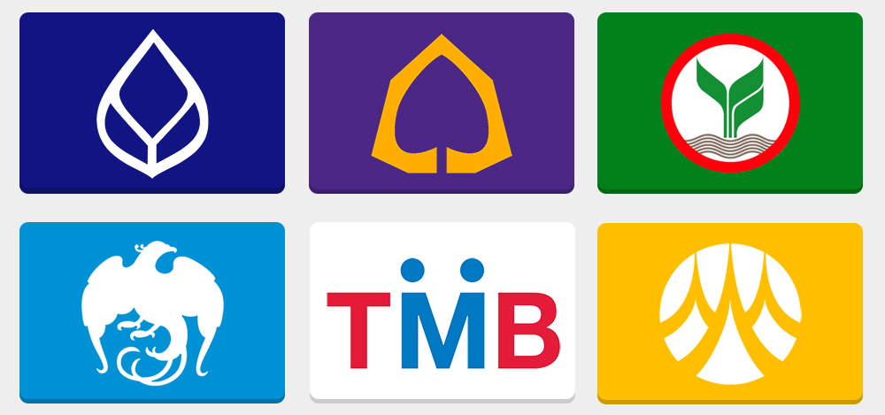
3.Traditional Banks
Most banks offer money transfer services, however in most cases you must either apply for or hold an account with the bank you use. Banks typically have strict restrictions on the amounts you can send overseas, tend to charge higher fees, offer less competitive exchange rates, and take longer to transfer your money.
Features
Types I
Types II
Types III
Type IV
Type V
Type VI
Benefits

Slide 8







4. Online Money Transfer Services/Internet Money Transfers
Money can be sent over the internet through secure online services, often for a very small fee, but you will need to have a bank account or credit card and access to the internet, or at least an e-mail address, to transfer the money; you will also have to register your details online. The person you are sending the money to may also need a bank account and access to the internet (or an e-mail address) such as paypal
Features
Types I
Types II
Types III
Type IV
Type V
Type VI
Benefits

Slide 9
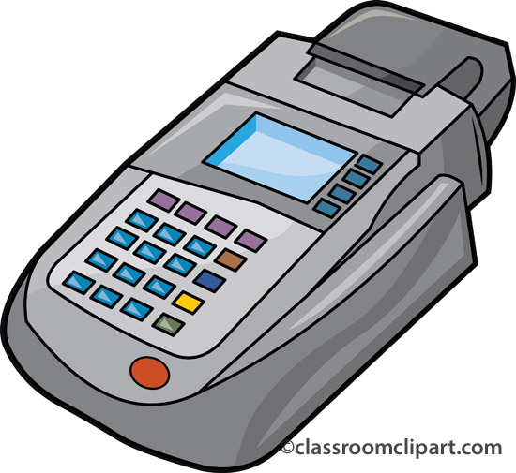
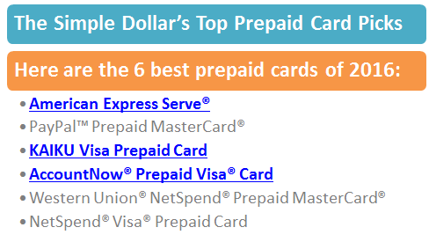

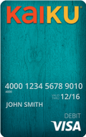

5. Prepaid Money Cards
A prepaid card operates in the same way as a credit card or debit card . Prepaid cards are available in selected shops, or can be ordered through the companies online. Not only are they useful for sending money overseas, they can also be used instead of travel money when travelling and for online purchases. They are also accepted at ATM's globally for withdrawing funds.
Features
Types I
Types II
Types III
Type IV
Type V
Type VI
Benefits

Slide 10
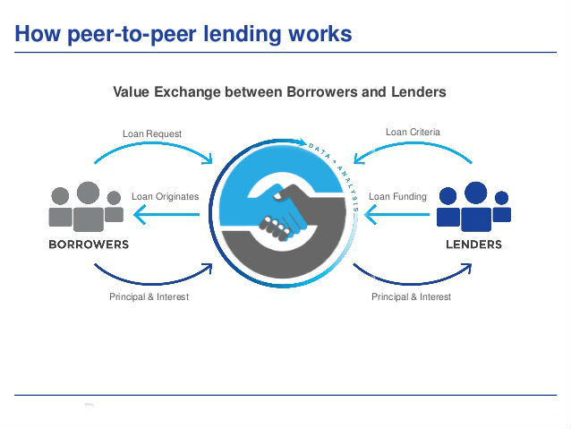

6. Peer-to-Peer Money Transfer Providers
Peer to peer has added a new type of company to the world of foreign currency exchange by allowing senders and receivers of different currencies to set their own rates and trade directly with each other, cutting out the banks’ fees and exchange rate margins in the process.
Features
Types I
Types II
Types III
Type IV
Type V
Type VI
Benefits

Slide 11

Benefits To Customer
Features
Types I
Types II
Types III
Type IV
Type V
Type VI
Benefits

Slide 12






MAIN BENEFITS
SPEED
SECURITY
PRIVACY
FLEXIBILITY
CONVENIENT
Features
Types I
Types II
Types III
Type IV
Type V
Type VI
Benefits

Slide 13

MAIN BENEFITS
SPEED
SECURITY
PRIVACY
FLEXIBILITY
CONVENIENT
Features
Types I
Types II
Types III
Type IV
Type V
Type VI
Benefits

Slide 14
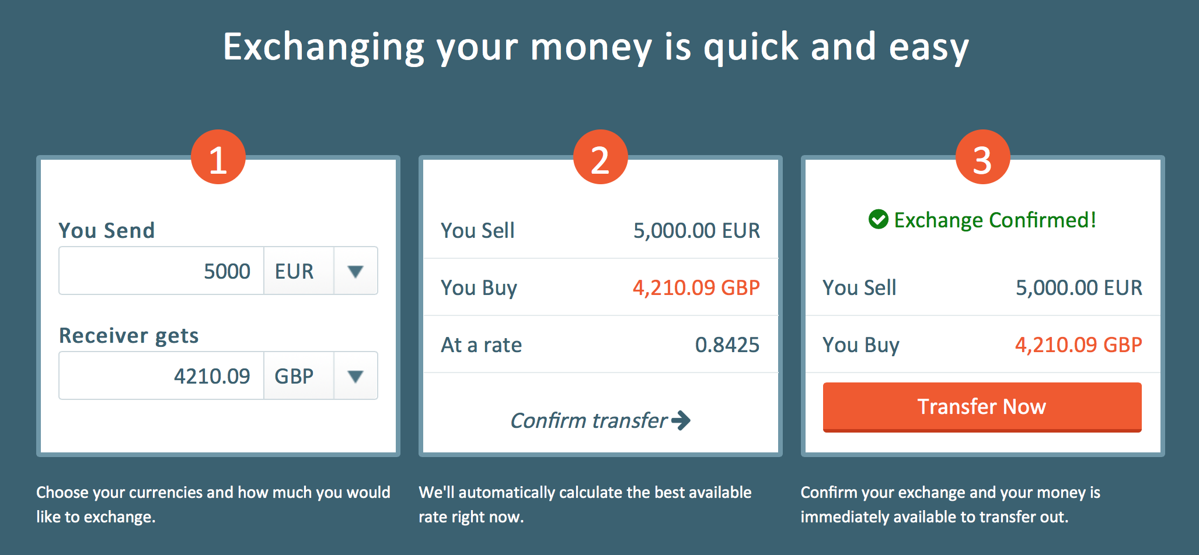
“easier to manage your finances”
“processed within a
day or two”
“avoid late charges”
,
Features
Types I
Types II
Types III
Type IV
Type V
Type VI
Benefits

Slide 15
MAIN BENEFITS
SPEED
SECURITY
PRIVACY
FLEXIBILITY
CONVENIENT
Features
Types I
Types II
Types III
Type IV
Type V
Type VI
Benefits

Slide 16
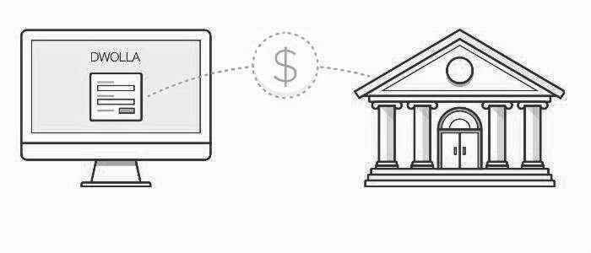
“Prevent from being stolen or lost.”
“Reduce the risk.”
“Provide instant confirmation that your payment was made.”
Features
Types I
Types II
Types III
Type IV
Type V
Type VI
Benefits

Slide 17
MAIN BENEFITS
SPEED
SECURITY
PRIVACY
FLEXIBILITY
CONVENIENT
Features
Types I
Types II
Types III
Type IV
Type V
Type VI
Benefits

Slide 18

“Send money online in a few simple steps”
“No more long lines or crowded place”
Effortless
Features
Types I
Types II
Types III
Type IV
Type V
Type VI
Benefits

Slide 19


Slide 20

Member
1.Thawanhatai Kruayatidee 5704642403
2.Pajaree Khampor 5704641405
3.Sukita Mongkolsuntonchot 5704642072
4.Phimkarn Taesakun 5704641660
5.Apichaya Thanombooncharoen 5704640118

