Slide 1

MK 322 Retail Management
Chapter 2: Types of Retailers Part II
By Ajarn Suwalya K.

Slide 2
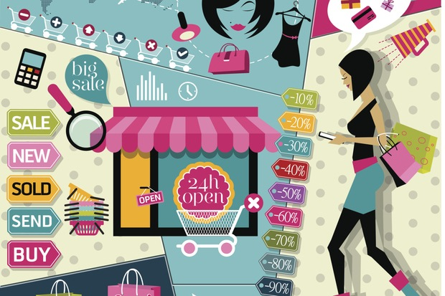
General Merchandise Retailers

Slide 3
Department Stores
Department stores: A retailer that carried a wide variety and deep assortment, offers considerable customer services, and is organized into separate departments for displaying merchandise.
Notes:
1

Slide 4
Department Stores
Soft Goods: are nondurable or consumer goods which have shorter lifespan such as cosmetics, clothing and bedding.
Hard Goods: are manufactured items that are expected to last several years, such as appliances, furniture, and consumer electronics.
Notes:
1

Slide 5
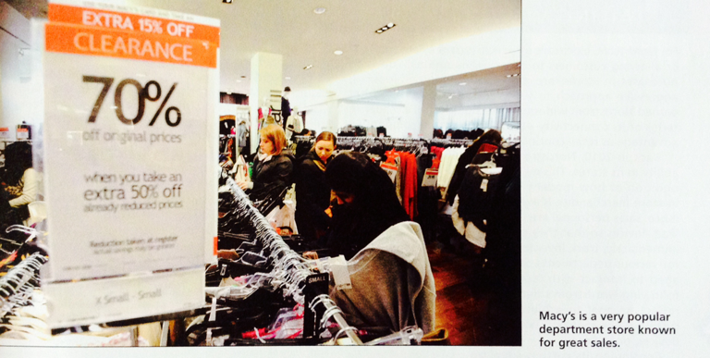
Department Stores
Notes:
1

Slide 6
Department Stores
They are categorized in three tiers:
The first tier includes upscale, high fashion chains with exclusive designer merchandise and excellent customer service such as Neiman Marcus, Bloomingdale's, Nordstrom and Saks Fifth Avenue.
Notes:
1

Slide 7
Department Stores
The second tier includes retailers selling modestly priced merchandise with less customer service. Traditional department stores include Macy's and Dillards
Notes:
1

Slide 8
Department Stores
The third tier is value oriented catering towards more price-conscious consumers. Sears, JC Penny, and Kohl's are examples.
Notes:
1

Slide 9
Department Stores
To deal with eroding market share, they are
1. Increasing the amount of exclusive merchandising they sell
2. Increasing their use of private-label merchandise
3. Expanding their mulichannel presence
Notes:
1

Slide 10
Full-Line Discount Stores
Full-Line Discount Stores: retailers offer a broad variety of merchandise, limited service, and low prices.
Larger chains are Walmart, Target and Kmart
Notes:
1

Slide 11
Category Specialists
Category specialists: are big-box stores that offer a narrow but deep assortment of merchandise
Category Killers: offer a complete assortment in a category and kill a category of merchandise for other retailers. Using their category dominance and buying power, they buy products at low prices and are ensured of supply when items are scarce.
Notes:
1

Slide 12
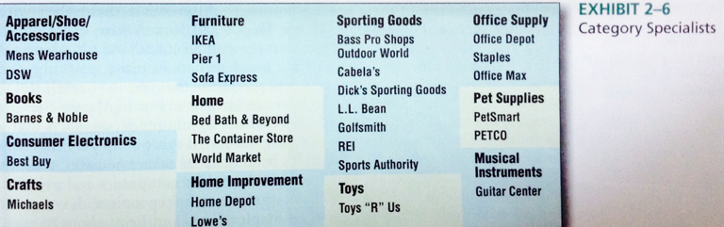
Category Specialists
Notes:
1

Slide 13
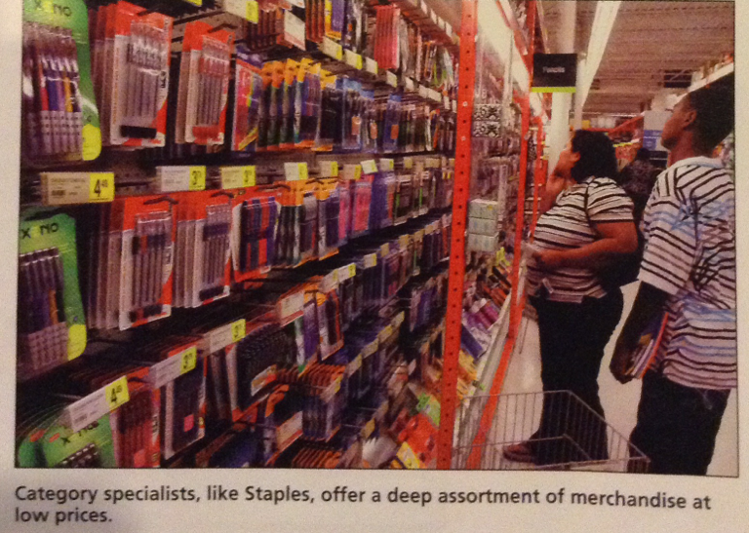
Category Specialists
Notes:
1

Slide 14
Speciality Stores
Speciality Stores: concentrate on a limited number of complementary merchandise and provide a high level of service.
Tailor their retail strategy toward very specific market segments by offering deep, but narrow assortments and sales associate expertise
Examples: Victoria Secret, Sephora
Manufactures open their own speciality store- Coach, Samsonite,Godiva, Levi's
Notes:
1

Slide 15
Speciality Stores
Another growing speciality store sector
Thrift store: merchandise is donated and proceeds go to charity (Goodwill Industries)
Consignment shop: a store that accepts used merchandise from people and pays them after it is sold
Resale stores earn national revenues of more than $13 billion
Notes:
1

Slide 16
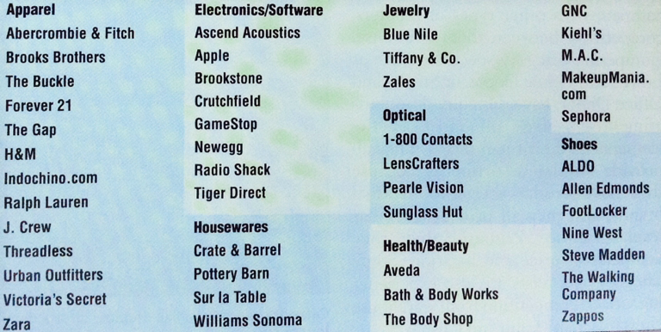
Speciality Stores
Exhibit 2-7
Speciality Store Retailers
Notes:
1

Slide 17
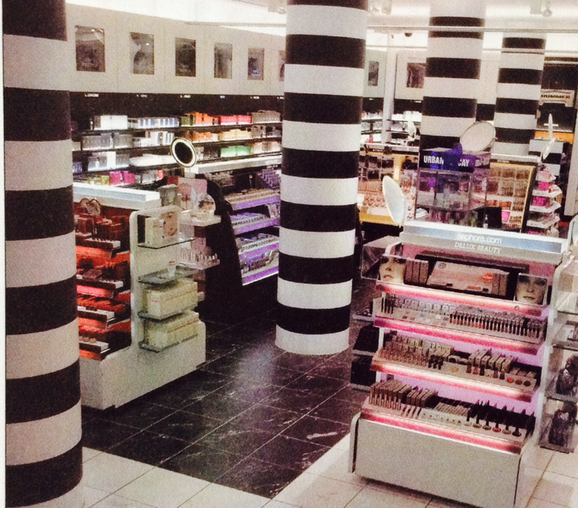
Speciality Store
Sephora is an innovative speciality store selling perfume and cosmetics.
Notes:
1

Slide 18
Drugstores
Drugstores: are specialty stores that concentrate on health and beauty care (HBC) products.
Many drugstores have steadily increase space devoted to cosmetics.
Prescription pharmeceuticals often represent almost 65 percent of drugstore sales.
Notes:
1

Slide 19
Extreme-Value Retailers
Extreme-Value Retailers: or called dollar stores are small discount stores that offer a broad variety, bit shallow assortment of household goods, health and beauty care (HBC) products and groceries.
2 largest in states –Dollar General and Family Dollar
Notes:
1

Slide 20
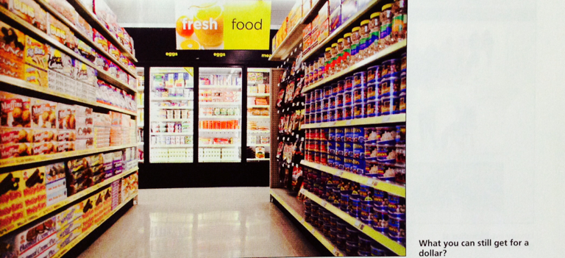
Extreme-Value Retailers
Notes:
1

Slide 21
Off-Price Retailers
Off-Price retailers: offer an inconsistent assortment of brand-name merchandise at a significant discount off the manufacturer's suggested retail price (MSRP).
Off-price retailers are able to sell brand-name and even designer-label merchandise at 20-60 percent lower than the manufacturer's suggested retail price because of unique buying and merchandising practices.
Much of the merchandise is bought opportunity from manufacturers that have overruns, canceled orders, forecasting mistakes causing excess inventory, closeouts and irregulars.
l
Notes:
1

Slide 22
Off-Price Retailers
Closeouts: are end-of-season merchandise that will not be used in the following seasons.
Irregulars: are merchandise with minor mistakes in construction
Flash sales: online twist to offline retailing as each day at the same time, members receive an e-mail that announces the deals available.
Notes:
1

Slide 23
Off-Price Retailers
Outlet stores: are off-price retailers owned by the manufacturers or retailers.
Factory outlets are owned by manufacturers. They view outlet stores as an opportunity to improve their revenues from irregulars, production overruns, and merchandise returned by retailers.
Notes:
1

Slide 24
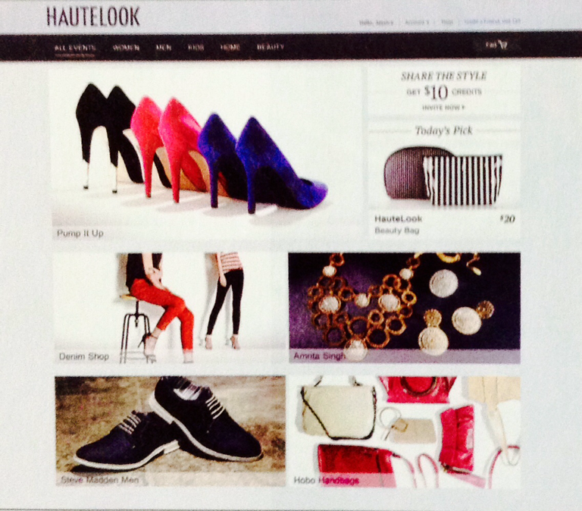
Off-Price Retailers
Luxury Merchandise at great prices.
Notes:
1

Slide 25

Service Retailing

Slide 26
Service Retailing
Service retailer: Organization that offers consumers services rather than merchandise. Examples includes banks, hospitals, health spas, doctors, legal clinics, entertainment firms and universities.
Notes:
1

Slide 27
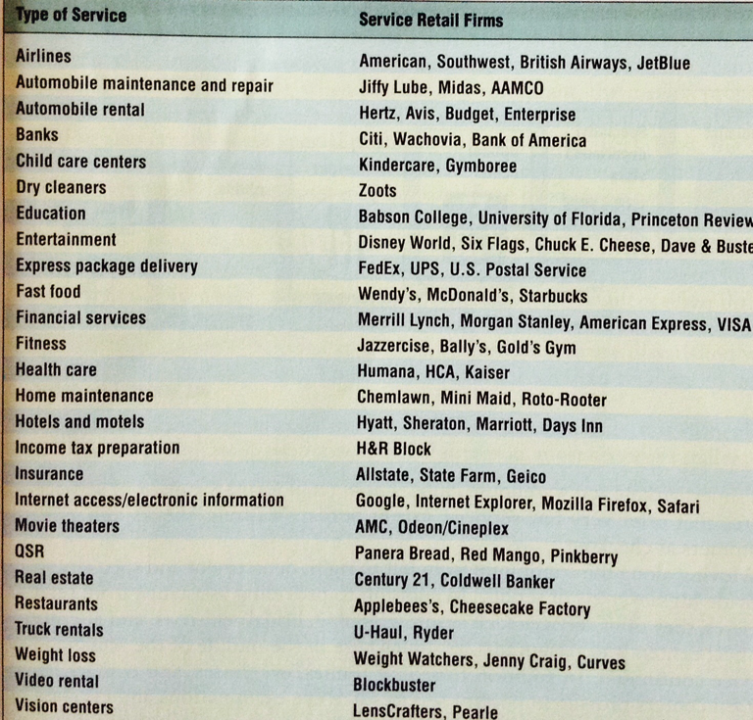
Service Retailing
Exhibit 2-8
Services Retailers
Notes:
1

Slide 28
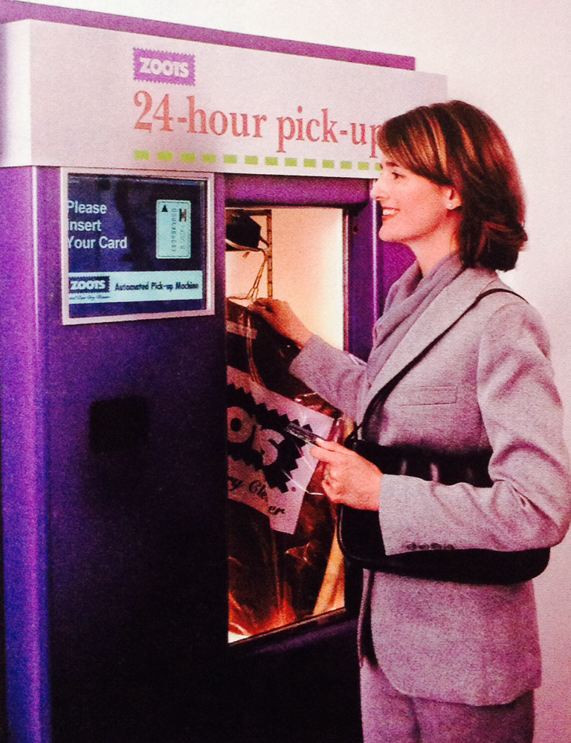
Service Retailing
Going to Zoots to pick up laundry and dry cleaning is as easy as going to an ATM machine.
Notes:
1

Slide 29
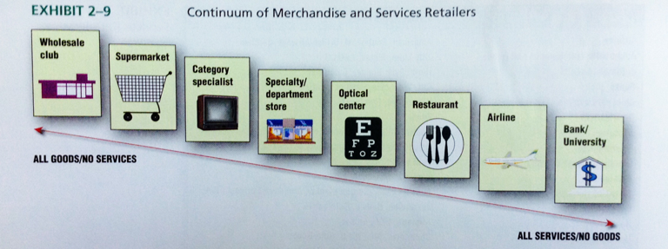
Service Retailing
Notes:
1

Slide 30
Difference between Service and Merchandise Retailers
Intangibility: services are less tangible than products- customers cannot see or touch them.
Simultaneous Production and Consumption:products are typically made in a factory, stored and sold by a retailer, and the used by consumers in their homes. Service providers create and deliver the service as customers are producing it.
Notes:
1

Slide 31
Difference between Service and Merchandise Retailers
Perishability:services cannot be saved, stored, or resold
Inconsistency: Products can be produced by machines with very tight quality control, so customers could be assured that all boxes of Cheerios will be identical. But because services are performances produced by people(employees and customers) no two services will be identical.
Notes:
1

Slide 32

Types of Ownership

Slide 33
Types of Ownership
Independent, Single-Store Establishments: many retail start-ups are owner managed which means management has direct contact with customers and can respond quickly to their needs.
Retail Chain: a company that operates multiple retail units under common ownership and usually has centralized decision making for defining and implementing its strategy
Notes:
1

Slide 34
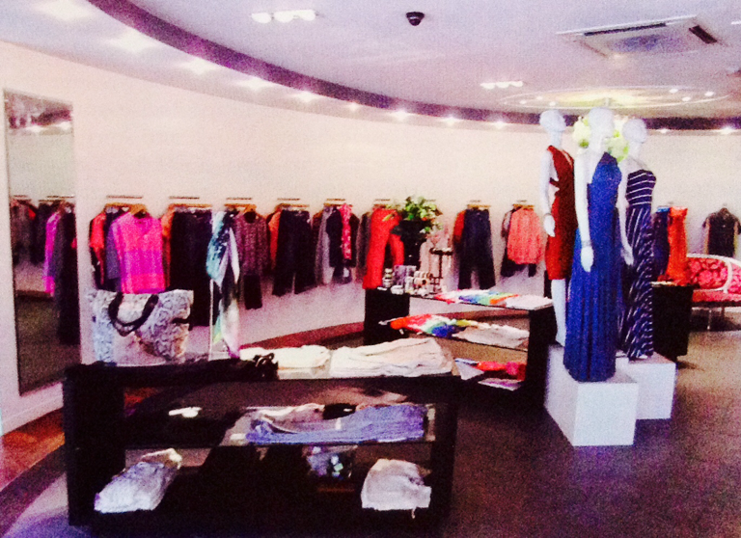
Types of Ownership
The secret of success to the Dressing Room in the United Kingdom is the owner's attention to understanding what her customers want.
Notes:
1

Slide 35
Types of Ownership
Franchising:a contractual agreement in which the franchisor (the company) sells the rights to use its business trademark, service mark, or trade name, or another commercial symbol of the company, to the franchisee for a one-time franchise fee and an ongoing royalty fee typically expressed as a percentage of gross monthly sales.
Notes:
1

Slide 36
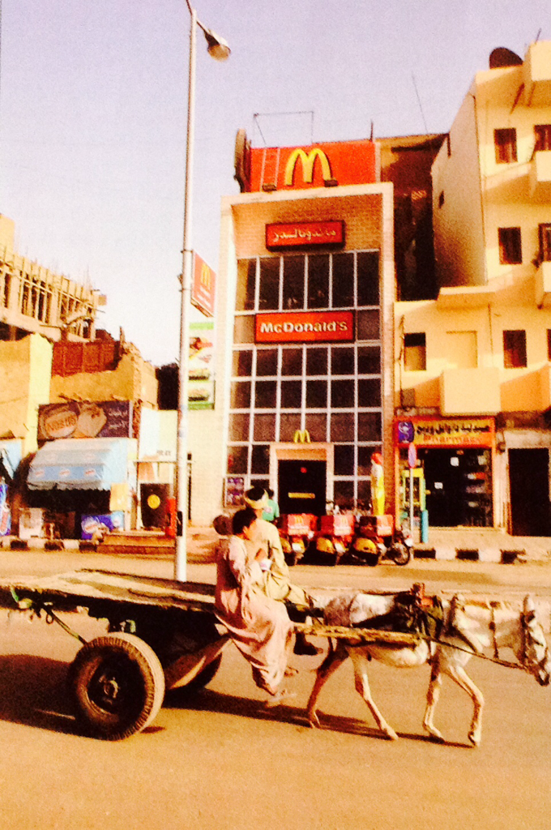
McDonald's franchises are growing all over the world
Notes:
1

Slide 37


