Slide 1
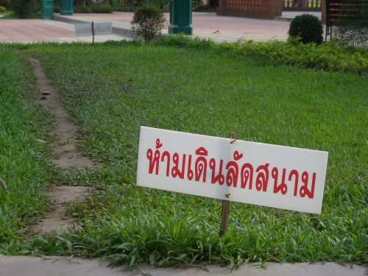

Slide 2
What is the law?
Classical/Traditional definition:
"A body of rules fixed and enforced by a sovereign political authority.“
-John Austin, ca.18th Century
Natural reason:
““An embodiment of Reason”, whether in the individual or the community.”
-Plato & Aristotle

Slide 3
What is the law?
Legal Realism:
"The prophecies of what the courts will do ... are what I mean by the law."
-Oliver Wendell Holmes (1920)
"What officials do about disputes,“
-Karl Llewellyn (1951)
“A tool of oppression used by capitalists to control the proletariat.” [Guess?]

Slide 4
What is the law?
Sociology:
"Law…exist if it is externally guaranteed by the probability of coercion (physical or psychological) to bring about conformity or avenge violation, and is applied by a staff of people holding themselves specially ready for that purpose."
-Max Weber
Politics:
"Law is the formal glue that holds fundamentally disorganised societies together.“
-Thomas Hobbes (1651)

Slide 5
Is the law matter?
What is the purpose of having law?
Could that purpose being achieved by not using the law?
Why is it matter?

Slide 6
What does law has to do with economics?
Or What does economics has to do with law?
Do they share the similarities?
What is the ultimate objective of law?
What is the ultimate objective of economics?
Can both objective coincide?

