Slide 1
Post 1932 Urban Economy
Thai Economic History
Thorn Pitidol
1/2018

Slide 2
Topics
Phibun's economic nationalism
Pridi and the reorientation of government and business
The Effects of Economic Nationalism (A.Suehiro)

Slide 3
Phibun’s Economic Nationalism
The military faction in the People's Party had anti-capitalist ideas.
  Urban business seen as exploiting peasants
  Chinese seen as foreign
“We now dominate the Chinese, who have to do whatever we want them to“
  Phraya Songsuradej

Slide 4
Phibun’s Economic Nationalism
The widening gap between the Khanarat's military faction and the Chinese business community
  Japan factor
    Chinese Business leaders VS Luangwichit and Phibun’s Fascism
  Policies to free peasants from the domination of businesses.
    Drive out foreign (Western and Chinese) businesses by forming government's own enterprises and new industries
    Gov't investment in cotton and paper mills, slaughterhouse and silk plant.

Slide 5
Excluding the Chinese
The campaign "a Thai economy for the Thai people“ (เศรษฐกิจไทยเพื่อคนไทย)
  Thai peasants selling rice to and buying manufactures from organsiations run by Thai gov't to exclude the Chinese)

Slide 6
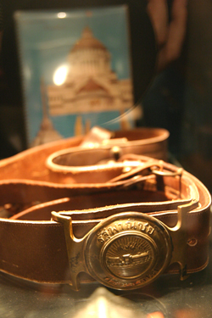

Excluding the Chinese

Slide 7
Excluding the Chinese
From 1937-9, more measures to control the economic presence of Chinese immigrants
  Restriction of immigration
  Law and regulations to exclude Chinese from economic activities
  Government tried to control Chinese businesses
    Salt and tobacco trade placed under gov't monopoly

Slide 8
State's control of urban economy
A plan to control 1) rice trade; 2) distribution of goods; 3) investing in import-substitution manufacturing
Gov't set up or took a stake in a number of businesses.
  "Thai Rice Company"
  “Thai Niyom Phanit”
  A stake in shipping, insurance, and banks businesses

Slide 9
State's control of urban economy
From 1930s to 1940s, a number of industrial enterprises under full or partial gov't ownership.
  Public utilities such as railways, electricity, and water works.
  But also production of consumer goods such as textiles, soaps, paper, cigarettes.
    To replace European imports
World War II led to further increases in state enterprises

Slide 10
Pridi and the reorientation of government and business
Despite “economic nationalism” Bangkok-based Chinese businesses still grew in the 1940s, How?
The roles of civilian faction
  Protective measures for domestic businesses, and uses of gov't funds and power to help private businesses
Retreat of colonial businesses
Resulting in the reorientation of the relationship between business and the gov't in 1950s

Slide 11
Khanarat’s Civilian Faction Approach
The civilian leaders of Khanarat handled the implementation of economic nationalism differently from the military’s plan
  Promoting joint ventures between the gov't and private businesses
  Facilitate Chinese businesses
    Capital injection, political protection, and sometimes monopolistic privilege
  Politicians get share of the revenue in return

Slide 12
Khanarat’s Civilian Faction Approach
Pridi revised vision of economics management
  Returning to proposals made by his earlier urban entrepreneurs allies.
  Renegotiated the trade deals to enabled the import tariffs to be raised.
  An instrumental role in founding the central bank.

Slide 13
Khanarat’s Civilian Faction Approach
In contrast to the military’s attempt to extend state control over industries, Pridi group brought state's capitals to join with private businesses
  Private businesses as partners to state's companies
    Big five families (such as Wanglee, Lumsum, Bulasuk) cooperated as partners and sub-contractors.
  State’s funds to set up banks such as Bank of Asia. Pridi’s group also founded Bank of Ayudhaya

Slide 14
New State-Business Relationship
State-private business partnership led to the "reciprocal relationship"
  Pridi supporters and his business partners occupied position of board of directors in gov't enterprises
  In return, members of Pridi's group were invited onto boards of the private companies
  Through such a relations, Pridi's group was able to gain affluence and support for their political power.

Slide 15
New State-Business Relationship
At the same time, the change in context also gave Thailand's domestic capitals opportunities
  War and Japanese invasion caused decline of Western businesses and European trade
  The chance to produce products to substitute for the declined import goods.
    Domestic businesses such as ice factories, water plants, oil factories expanded.

Slide 16

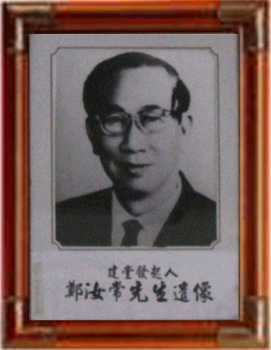

Emerging Businesses
Many trading and retailing businesses of the second generation Chinese began their rise in this period.

Slide 17
New State-Business Relationship
More domestic banks founded through the emerging network of Chinese businesses and their pool of assets.
  Providing services beyond the earlier banks owned by rice barons.
  Bangkok Bank provided the key example.
Banks founded from new group of businesses. For example, Srinakorn Bank, Saha-Thanakarn Bank.

Slide 18
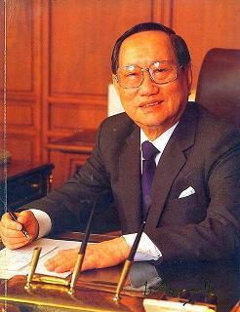
Bangkok Bank
Founded by Taechew familities and led by Chin Sophonpanich
Bangkok Bank first specialised in trasferring remittance back to China and facilitating import-export trade

Slide 19
Military-Business Relations
The new military group after 1947 followed Pridi’s path
  The Ratchakru group replacing Pridi’s group
  Ratchakru’s relationship with Bangkok Bank.
    Bangkok Bank made into the largest local bank.
    Members of military group invited to sit on the banks' board
Ratchakru group extended their power over a number of state enterprises.
  Military leaders skimmed revenue of enterprises
  Founded companies through foreign aids, and formed industries to provide supply to gov't

Slide 20
Military-Business Relations
The new era of military-business relations began after 1947
  Military-politicians extending their power to gain business opportunities. Entrepreneurs responded by inviting military politicians to act as advisors or board of directors
  The tradition of "special shares" set aside for "benefactors"
Major businesses and banks had forged alliances with key figures in 1947 Coup.

Slide 21
The Result of Economic Nationalism (A.Suehiro)
Who were the "Thais" that benefited the most from "Thai Economy for Thai People"?
  The policies led to the emergence of the new group of "bureaucratic capitalist"
  The benefits actually fell to bureaucrats and political groups.
  All signified the realignment of the military and bureaucrats role in Thailand’s capitalism.

Slide 22
The Result of Economic Nationalism (A.Suehiro)
How far did the "Thai Economy for Thai People" policies negatively affected the Chinese?
  State enterprises still required cooperation from the Chinese big players
  The policies forced the realignment of the Chinese, rather than excluding them.
  The Chinese who are willing to be assimilated as Thais became the new partners of bureaucrats

Slide 23
Bureaucratic Capitalist Development (1947-1957) (A.Suehiro)
The interval b/w Phibun second return and Sarit rise (1947-1957) saw the continuation of economic nationalism, with:
  An even faster rise in the number of state owned enterprises with military leaders sitting in the board.
  The newly emerged group of Chinese "bankers"

Slide 24
Bureaucratic Capitalist Development (1947-1957) (A.Suehiro)
The implications of the aforementioned development during 1947-1957:
  The continuation of bureaucratic capitalism led to the under-development of Thai industrial sector.
  The sector was dominated by inefficient state enterprises
  The new Chinese bankers' were founded still on families' and personal network

Slide 25
Bureaucratic Capitalist Development (1947-1957) (A.Suehiro)
The European businesses eventually return
  Their banking and insurance business were already taken over by the Chinese.
  Divert their business to import of consumer products, and started to manufacture toiletries, sanitation, and pharmaceutical products.
The “pioneer” in Thailand’s industrialization?

