Slide 1
Business Intelligence workshop using Excel 2013, 2016

Slide 2
Excel tools for BI
Extract/
Transform/Load
Power Query
Data Manipulation
Power Pivot
Presentation
PowerView (Create interactive dashboards)
PivotTables
PowerMap
Change Data Types, Rename columns, clean up data
Manage data relationships
Understand dimensions of data

Slide 3
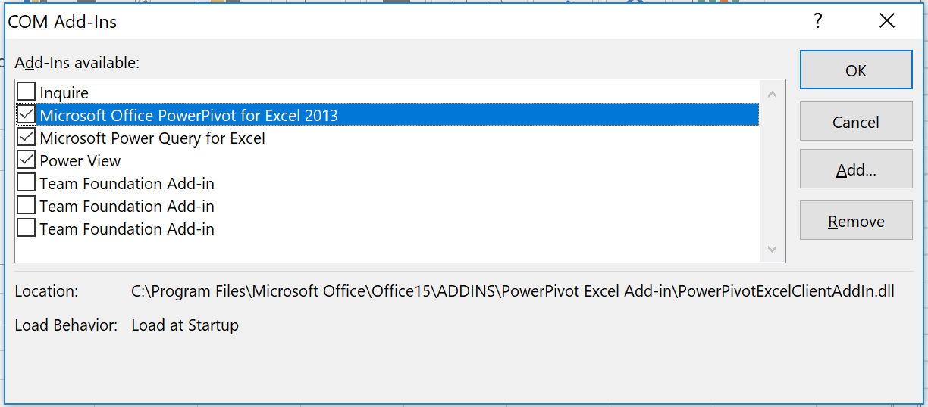
Activate add-ins for Excel 2013
File > Options > Add-Ins > Manage > COM Add-ins
Notes:
Download power query → https://www.microsoft.com/en-us/download/details.aspx?id=39379&CorrelationId=0121b337-9671-45b2-80a3-5ffcc2923052

Slide 4
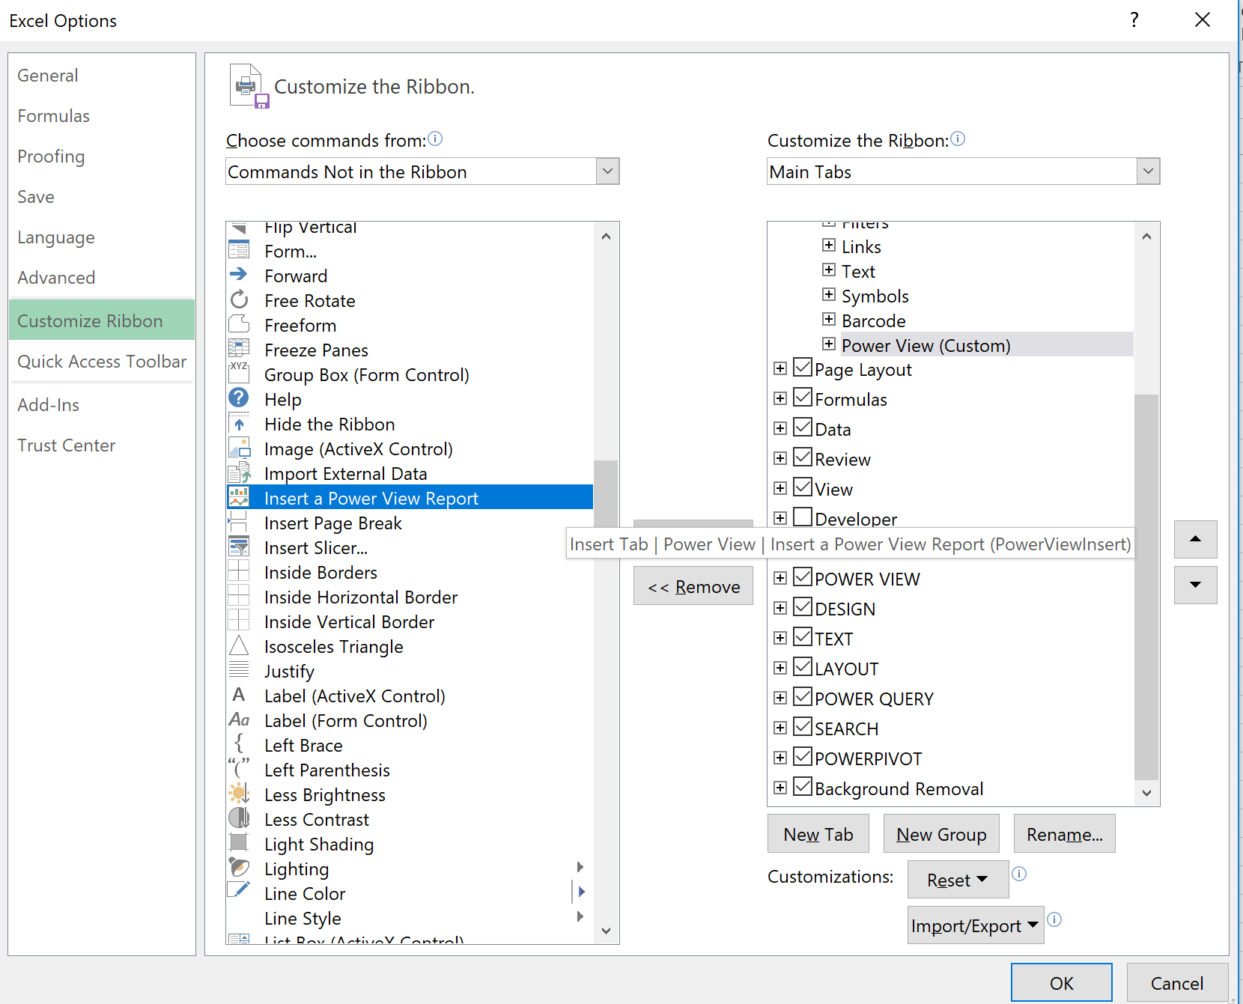
Add Power View to insert Ribbon
File > Options > Add-ins > Manage > COM Add-ins > Make sure power view is checked
Insert ribbon > customize ribbon > Click on Insert and then new group
Choose commands from: Commands Not in the Ribbon > Insert a Power View Report

Slide 5
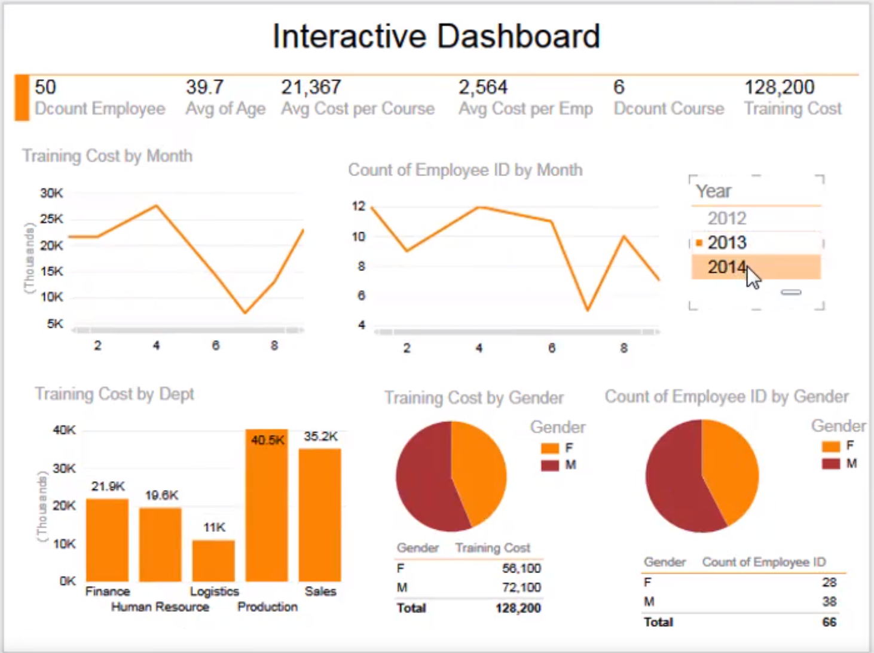

Slide 6
Cleaning, transforming and loading data
Power Query
  Power Query allows you to download from several data sources
  In Excel 2016, Go to Data > Get Data
  Normally one sheet is loaded to one table
  Unless you choose to append (add data from one sheet to another)
  Merge – look up for related values and merge those values to the destination table
  Group by

Slide 7
Working with Data model
Power pivot
  Loading data to power pivot
  Creating relationships in power pivot
  Analyzing Data with Power pivot
    Total costs, no. of employees trained, and no. of courses by suppliers
    Costs and no. of courses attending by each employee & allow a user to see the overall picture of the two numbers by department
  Creating calculated columns e.g. weekday, name of month, date
  Creating calculated fields e.g. total training costs, no. of employees, avg costs per course

Slide 8
Working with data model (cont’)
Create pivot charts
  Total training cost by department
  Total number of employees who had training by gender
  Total number of employees who had training by courses
  Average cost per employees by suppliers

Slide 9
Visualizing data
Power View
  Tables & Cards
  Column and Bar Graph
  Line Graph
  Interactive Dashboards

