Slide 1
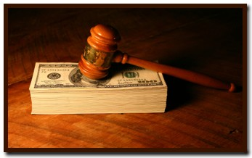

EE403 Law and Economics

Slide 2
What is the Law?
Requirement for the law to exist
Law is something that control human behaviour
Why do we want to control the behaviour?
Is there any alternative to control our behaviour?

Slide 3
Controlling Behaviour
Everyone is utility maximiser (or profit maximiser)
Behaving or committing the action that maximise our utility (or profit)
Our action may interfere with other’s utility

Slide 4

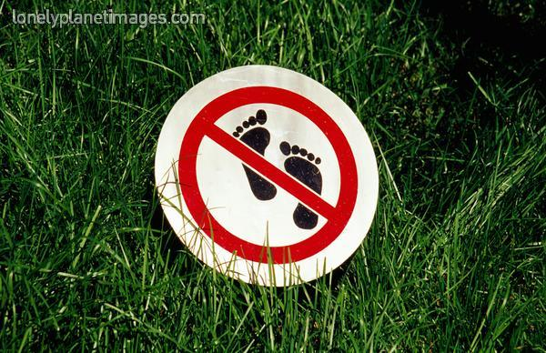

Slide 5
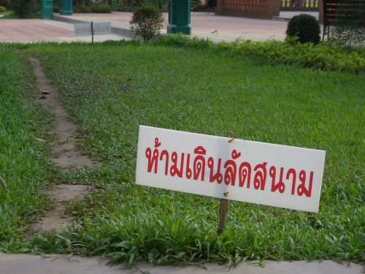

Slide 6
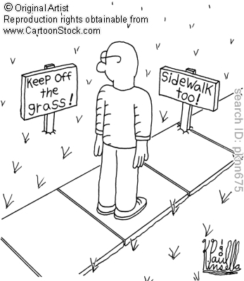

Slide 7
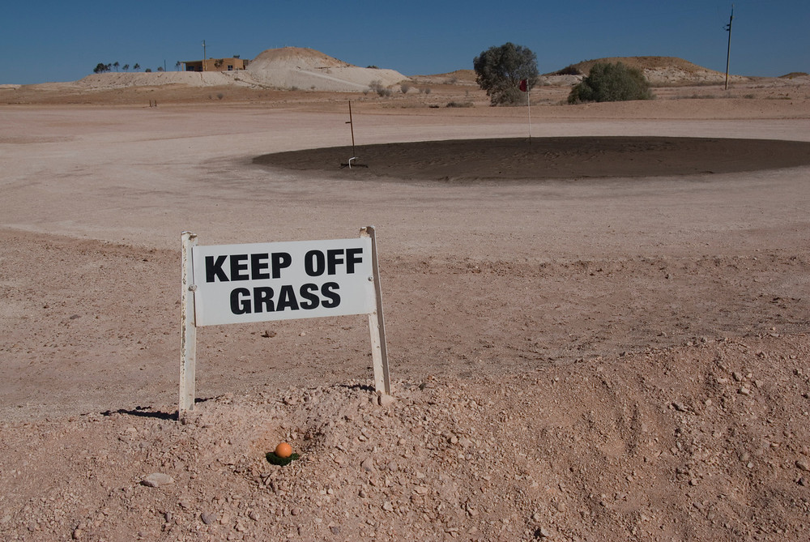

Slide 8
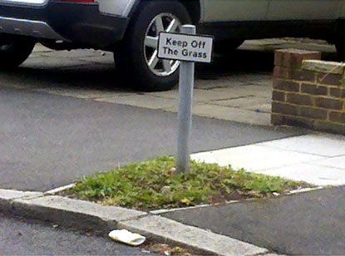

Slide 9
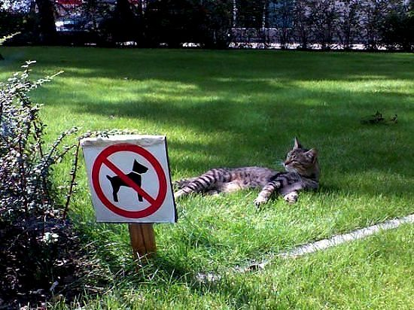

Slide 10
Morals, Norms, and the Law
Morals
Norms
Law
What are the differences?

Slide 11
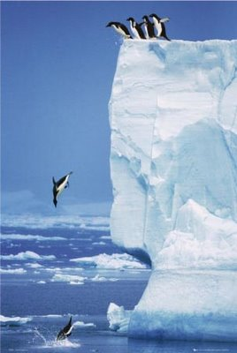

Slide 12
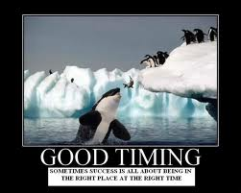

Slide 13
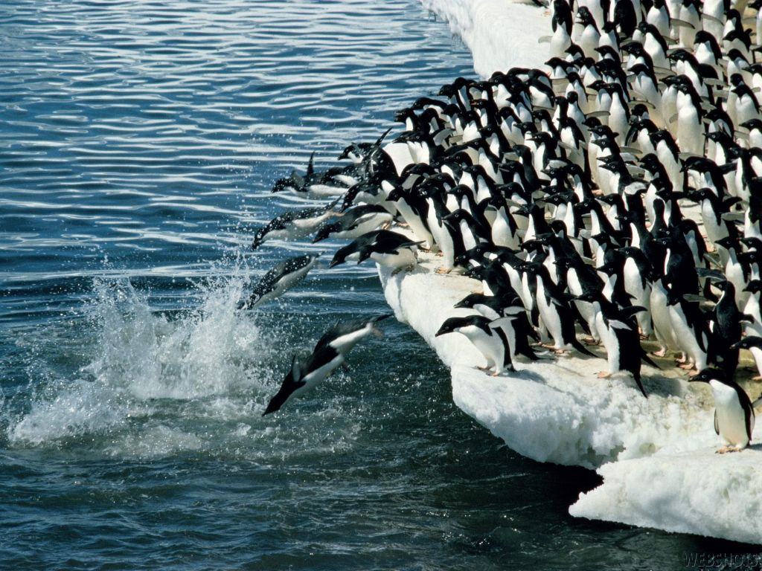

Slide 14
Morals, Norms, and the Law
Morals
  Self
    What is deemed to be right or wrong?
Norms
  Others
    What others do?
    Not doing the same: social sanction
Law
  Social Institutions
    Legal Binding Force: there is a consequence and the one who enforce it
    Legal Authority: backed by the state and sovereignty

Slide 15
Legal Systems
Civil Law (scientifically ‘deduction’)
  Codified Legislation/Established Legal Concepts
    General & Simplified Principles
  Interpretation of Law
    Trying to fit the factual evidence to the principles
Common Law (scientifically ‘induction’)
  Judges make law: trying to find the legal principle from the evidence
  Existing Verdicts are principles of law unless ‘there is significant difference’ – stare decisis

Slide 16
Law and Economics
Both are social sciences
Studying human behaviour
Yardsticks/Benchmarks
  Economics: Efficiency
  Law: Justices
Both deal with ‘resources’ but in different ways
  Economics: anything that bring human ‘satisfaction’ or ‘utility’ – shall be allocated since it is limited

Slide 17
Law and Economics
Both deal with ‘resources’ but in different ways
  Economics: anything that bring human ‘satisfaction’ or ‘utility’ shall be efficiently allocated since it is limited
  Law: rights and responsibilities shall be allocated in order to induce justice
Both share the same ‘ultimate goal’ – social welfare maximisation
  How to achieve it?

Slide 18

Means/Ends Analysis
Ends: the goal
Means: how to get to that goal
Different means can get to the same end
  What is different?
  The difference is the mean itself
  Economically speaking…????
“The end does not (always) justify the means”
St Thomas Aquinas, Summa Theologica

Slide 19
Social Welfare Maximisation
Law
Economics
Rights and responsibilities shall be exercised lawfully
Does not harm anyone
Section 421 CCC “The exercise of right in which harming others is considered unlawful”
Pareto efficiency: someone is better-off without making anyone worse-off

Slide 20
Social Welfare Maximisation
Law
Economics
Section 420 CCC ““A person who, willfully or negligently, unlawfully injures the life, body, health, liberty, property or any right, is said to commit a wrongful act and is bound to make compensation therefor.”
If the justice has been impaired, there must be compensation
Kaldor-Hick efficiency: someone must be sufficiently better-off to compensate everyone has been made worse-off to be indifferent.

Slide 21
“Law and Economics”
Interdisciplinary social science
To reduce the ‘dogmatic’ nature of the law
Use economics to analyse:
  Why does it exist?
  Does it induce efficiency?
  If not, how can the law be improved?
  Is there any contradiction with justice?
  Is the judicial economy justified?
Economic Analysis of Law

Slide 22
“Questions of Milinda” - I
“Is there any being who transmigrates from this body to another?”
“No there is not.”
“If so, would there not be an escape from the result of evil deeds?”
“Yes there would be an escape if they were not to be reborn but there would not be if they were to be reborn.
This mind and body process commits deeds either pure or
impure, and because of that kamma (karma) another mind and body
process is reborn. Therefore this mind and body is not free
from its evil deeds.”
“Give me an illustration.”

Slide 23
“Questions of Milinda” - I
“If a thief were to steal another man’s mangoes,
would he deserve punishment?”
“Indeed he would.”
“But the mangoes he stole were not those that the
owner had planted; why should he deserve punishment?”
“Because those that he stole resulted from the others.”
“Just so, O king, this mind and body process commits
deeds either pure or impure, and because of that kamma
another mind and body process is reborn. Therefore this
mind and body is not free from its evil deeds.”

Slide 24
“Questions of Milinda” - II
“What is it, Nàgasena, that is reborn?”
“Mind and Matter (Name and Form).”
“Is it this very mind and matter that is reborn?”
“No, it is not, but by this mind and matter deeds are
done and because of those deeds another mind and matter is reborn; but that mind and matter is not thereby released from the results of its previous deeds.”
“Give me an illustration.”
“It is like a fire that a man might kindle and, having
warmed himself, he might leave it burning and go away.

Slide 25
“Questions of Milinda” - II
Then, if that fire were to set light to another man’s field and the owner were to seize him and accuse him before the king, and he were to say, ‘Your majesty, I did not set this man’s field on fire. The fire that I left burning was different to that which burnt his field. I am not guilty’.
Would he deserve punishment?”
“Indeed, yes, because whatever he might say the latter fire resulted from the former one.”
“Just so, O king, by this mind and matter deeds are done and because of those deeds another mind and matter is reborn; but that mind and matter is not thereby released from the results of its previous deeds.”

Slide 26
“Questions of Milinda” - III
'Give me a further illustration.‘
'Suppose, O king, a man were to choose a young girl in marriage, and give a price for her and go away.
And she in due course should grow up to full age, and then another man were to pay a price for her and marry her.
And when the first one had come back he should say: "Why, you fellow, have you carried off my wife?"
And the other were to reply: "It's not your wife I have carried off! The little girl, the mere child, whom you chose in marriage and paid a price for is one; the girl grown up to full age whom I chose in marriage and paid a price for, is another.“
Now if they, thus disputing, were to go to law about it before you, O king, in whose favour would you decide the case?'

Slide 27
“Questions of Milinda” - III
'In favour of the first.‘
'But why?‘
'Because, in spite of whatever the second might say, the grown-up girl would have been derived from the other girl.‘
'Just so, great king, it is one name-and-form which has its end in death, and another name-and-form which is reborn. But the second is the result of the first, and is therefore not set free from its evil deeds.'

Slide 28
“Questions of Milinda” - IV
'Give me a further illustration.‘
'Suppose a man, O king, were to buy of a herdsman a vessel of milk, and go away leaving it in his charge, saying: "I will come for it to-morrow;“ and the next day it were to become curds.
And when the man should come and ask for it, then suppose the other were to offer him the curds, and he should say: "It was not curds I bought of you; give me my vessel of milk."
And the other were to reply: "Without any fault of mine your milk has turned to curds."
Now if they, thus disputing, were to go to law about it before you, O king, in whose favour would you decide the case?'

Slide 29
“Questions of Milinda” - IV
'In favour of the herdsman.‘
'But why?‘
'Because, in spite of whatever the other might say, the curds were derived from the milk.‘
'Just so, great king, it is one name-and-form that finds its end in death, and another that is reborn. But that other is the result of the first, and is therefore not thereby released from its evil deeds (its bad Karma).‘
'Very good, Nâgasena!'

Slide 30
Ex Ante vs Ex Post
Consider a certain point in time
Something happens at that time – incident
Things happened before that incident is called ex ante
Things happening after that incident is called ex post

Slide 31
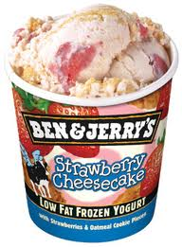
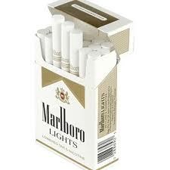
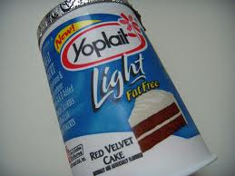
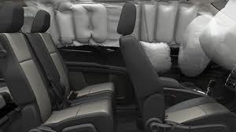

Ex Ante vs Ex Post: Some examples
Low-Fat Product
Car’s Safety Equipments
Cigarettes

