Slide 1
Financial Crisis and
Balance Sheet of the bank
Martina Watcharawaratorn
25 November 2017

Slide 2
Subprime mortgage and Financial Crisis in 2008.
Assumption:
Home price do not decline
Home purchase is a foundation of wealth.
Speculators have intention to buy and sell home, taking profit from the price appreciation.
People believe that the price will continue to raise indefinitely.
People borrow money from a bank to buy home. Bank issue loan to poor rating borrower, without collateral.
Structuring and sale of mortgage-backed securities had started.
Rating agencies assigned AAA to MBS based on the assumption that the price would not fall. Investor purchased those MBS believing that the MBS were secured and safe. Investors were led to believe that they could be repaid principal and interest in a timely fashion.
Home prices down 20% from its peak in 2006.
As the price began to decline, homeowners rush to sell their home for profit but they are unable to find a buyer.
Outstanding balance on their mortgages were greater than their market value of their home.
Home owner defaulted on their loan.
Subprime mortgage are issued to household with below-average credit or income histories and are considered risky.
Assumption:
Home price do decline
Ref: RBSF Economic Letter 2012-15 | May 14, 2012

Slide 3
Liquidity Risk to Commercial Bank
Financial Institution provides liquidity to depositors and creditors by standing ready to provide them cash on demand.
Bank run: liquidity risk stemmed from the possibility of bank runs. These are episodes in which depositors lose faith in their bank and withdraw their money, either because of concerns about the bank’s financial condition or because they worry that others might stage runs.
Consequence: Banks could be insolvent by initiating a chain reaction that forced a fire sale of illiquid loans.
Solution: Enforce reserve requirements tied to deposits, deposit insurance, and the availability of liquidity from central banks, the lenders of last resort.
Ref: RBSF Economic Letter 2012-15 | May 14, 2012

Slide 4
Liquidity Risk to Commercial Bank
Liquidity risk has come less from deposit outflows and more from exposure to a range of lending and interbank financial arrangements. These include undrawn loan commitments, obligations to repurchase securitized assets, margin calls in the derivatives markets, and withdrawal of funds from wholesale short-term financing arrangements.
For example, banks today often lend by extending credit lines that borrowers can tap on demand, or by making other kinds of loan commitments. Increases in borrower use of these commitments make this business risky. When the overall supply of liquidity falls, borrowers draw on funds from existing credit lines en masse.
Thus, in the 2007–08 financial crisis, nonfinancial firms lost access to short-term funds when the commercial paper market dried up. Commercial paper issuers turned instead to prearranged backup lines at banks to refinance their paper as it came due. Banks were obligated to fund such loans. As a result, funds became less available for new lending.
Ref: RBSF Economic Letter 2012-15 | May 14, 2012

Slide 5
Liquidity Risk to Commercial Bank
Banks finance their balance sheets with more than just deposits and equity capital. Other liabilities include uninsured wholesale deposits, repurchase agreements, and other short-term unsecured debt instruments.
These sources became scarce during the crisis.
For example, repurchase agreements, known as repos, were often used to finance risky assets such as private-label mortgage-backed securities. Gorton and Metrick (2011) show that, in the middle of 2007, mortgage-backed securities could be almost completely financed with short-term borrowed funds in the repo market. However, by the fourth quarter of 2008, only about 55% of each dollar invested in such securities could be financed this way.
Banks that used repos to finance purchases of mortgage-backed securities faced an unpleasant choice. They could sell their securities holdings into a falling market and take a big loss. Or they could find new, and presumably expensive, sources of credit.
Ref: RBSF Economic Letter 2012-15 | May 14, 2012

Slide 6
Liquidity Risk to Commercial Bank
Balance sheet:
Banks more exposed to liquidity risk increased their holdings of liquid assets most.
They also reduced new lending most.
Liquidity exposure affected behavior along several dimensions.
  On the asset side, banks holding securities with low liquidity, such as mortgage-backed securities, expanded their cash buffers during the crisis and decreased new lending. Such banks were worried about their ability to finance securitized assets. They protected themselves by hoarding liquidity, to the detriment of borrowers.
  On the liability side, banks that relied more on wholesale sources of funding cut new lending significantly more than banks that relied predominantly on traditional deposits and equity capital for funding.
Ref: RBSF Economic Letter 2012-15 | May 14, 2012

Slide 7
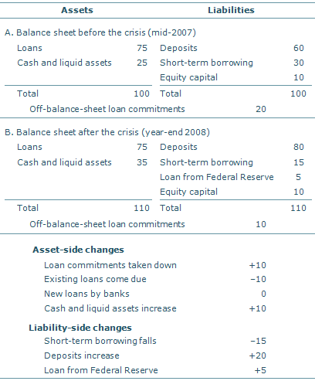
Balance Sheet before the crisis
The balance sheet of a hypothetical bank might have adjusted to these liquidity pressures.
It compares the bank’s balance sheet at the beginning of 2007 and the end of 2008.
Prior to the crisis, the bank holds $75 billion in loans on its balance sheet, with an additional $20 billion in off-balance-sheet loan commitments and credit lines, a total credit supply of $95 billion.
The bank also holds $25 billion in cash and other liquid assets.
On the liability side, the bank finances these investments 60% with traditional deposits, 30% with wholesale short-term debt, and 10% with equity.
During the crisis, borrowers take down funds from existing commitments, lowering the off-balance-sheet account from $20 to $10 billion and increasing loans on the balance sheet by $10 billion.
the bank loses half its short-term funds as markets dry up. At the same time, $20 billion of traditional deposits flow in and the bank is able to borrow an additional $5 billion from the Federal Reserve. However,
Ref: RBSF Economic Letter 2012-15 | May 14, 2012

Slide 8
Balance Sheet after the crisis
During the crisis, borrowers take down funds from existing commitments, lowering the off-balance-sheet account from $20 to $10 billion and increasing loans on the balance sheet by $10 billion.
the bank loses half its short-term funds as markets dry up. At the same time, $20 billion of traditional deposits flow in and the bank is able to borrow an additional $5 billion from the Federal Reserve.
However, under pressure on both the asset and liability sides of its balance sheet, the bank seeks to increase its cash holdings from $25 to $35 billion as protection against further disruptions.
The bank has no choice but to scale back its overall provision of credit. In this example, new lending ceases, with total credit falling from $95 billion to $85 billion as some loans reach maturity.
Ref: RBSF Economic Letter 2012-15 | May 14, 2012

