Slide 1
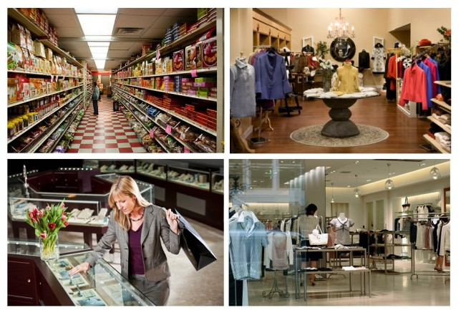
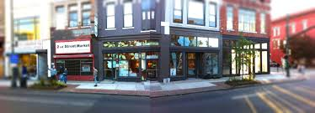
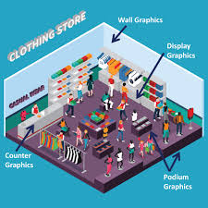
Group Assignment 11: Next Steps
Retail Store Layout, Merchandising Planogram ,Window Display

Slide 2
Project Next Steps:
Step 1: Continue to Design your store layout, merchandising planogram, and window display. Best to focus on theme once you confirm your STP and Retail Store Concept.
Step 2: Then conduct one-on-one in-depth interview with your target consumer on your new retail concept, store layout, merchandising planogram, window display, etc.. Don’t forget to develop Aim, Objectives, Questions.
Step 3: Analyze the findings and use it to improve your design and final visuals which should be as realistic and detail as possible.
Step 4: Prepare findings to be included in the final presentation due on May 11.

Slide 3
Guidelines for Interview
Conduct Consumer one to one in-depth interview: for one student per one customer in your target group
Your objective is to find out your customers’ attitudes and feelings about your new retail and how your could improve them.
Results should measure customers purchase intention.
Questions to focus on:
1. What does your customer like about your new retail?
2. What does your customer dislike about your new retail?
3. What to improve about your new retail?
4. Any other suggestion

Slide 4
Designing Expectations
For your project final presentation which will be judged on CREATIVITY, PURCHASE INTENT, STRATEGIC FIT
You are challenged to design your store layout. Please make sure it follows the trend, include experiential marketing and interactive with customers. - You are to design both the interior and exterior of your retail. - Please be as detailed as possible and use guidelines on the text (chapter 17) to design your layout, it should generate as much profit and revenue as much as possible ( example supermarket layout) - Create signage and store name and logo
You are challenged to design your merchandising Planogram by - Breadth and Depth of Product and Services - Detail of products/services- menu (should be exclusive), and pricing
You are challenged to design your window display – main attraction at front end to bring in customers
Draft Due next week May 4th, 2021

