Slide 1
EE 415 / EE 418
Game theory
Lecture 1 Introduction
Chaiyuth Punyasavatsut

Slide 2
Course materials and evaluation
Main Texts: Robert Gibbons, Game Theory for Applied Economists.
Good substitutes is Osborn, M. J. An Introduction to Game Theory.
Concise text is MasCollel et al. Microeconomics Theory.
Grading: 3 HWs, one presentation (or small paper), midterm and final: 30:10:30:40

Slide 3
Objectives
Study application of game theory under complete and incomplete information and under static and dynamic
Four sections covered:
Static game with complete information
Dynamic game with complete information
Static game with incomplete information
Dynamic game with incomplete information.
Four different equilibrium concepts

Slide 4
About Game theory: overview
Gaming and Strategic Decisions : when your opponent reacts to your actions, what should you do?
Game is any situation in which players (the participants) make strategic decisions.
  Ex: firms competing with each other by setting prices;
  Ex: group of consumers bidding against each other in an auction
Strategic decisions result in payoffs to the players: outcomes that generate rewards or benefits
Game theory studies interactive decision-making, the outcome of each player depends on the actions of all
When making your choice, you must recognize that other are also thinking about yours, taking yours into their thinking, and so on

Slide 5
About Game theory : overview
Game theory tries to determine optimal strategy for each player
Strategy is a rule or plan of action for playing the game
Optimal strategy for a player is one that maximizes the expected payoff
We consider players who are rational – they think through their actions
If you do not care about other player’s reaction, it is not a strategic decision. Ex: Monopolist sets his output price, or competitive firms make their decisions

Slide 6
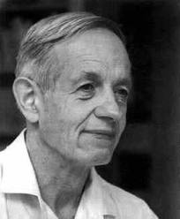
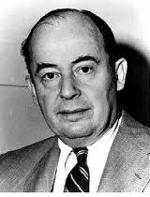
Two Johns: Father of game theory

Slide 7
Applications
Business and Finance
Industrial economics
International trade and finance
Macro (time-inconsistent policy: deviate from long-run policy that influence private-sector expectation)
Development economics
Biology, history
Real life situation : GPA racing, prisoner’s dilemma; No excuse for late submission, power of commitment
Sports: which passing shot?
Work place: dating game, power of credible signal (revealing information); Love me or not, screening device (eliciting information)

Slide 8
Let’s play: classroom games
1. Guessing half of the average
Need 10 students
Write a integer number between 0 and 100
Find the average
The student whose choice is closest to half of the average is the winner.

Slide 9
Let’s play: classroom games
2. The Ultimatum Game
Two players
Player A offers a split of a 100 Baht bill
If B agrees, then the game is over.
If B refuses, it is then B’s turn to offer a split, but now the bill reduced to 80 Baht
If A agrees, then the game is over. Both get paid the agreed split.
If A refuses, the game is over and neither get anything.

