Slide 1
L&E Points from
“Questions of Milinda”
Q1: Mango
Who shall be the lawful owner of the mango?
A man?
A Thief?
How the right of owning mango shall be allocated?
How would it affect economic efficiency?
Any existing legal provisions on this matter?
Agreeable with economics?

Slide 2
Q1
If a man is the lawful owner of the mango, what is the consequence?
If a thief is the lawful owner of the mango (the fruit is not owned by a tree-owner), what is the consequence?
What is the point? What is the efficiency we want to attain?
Maximising mangoes?
How can the legal rule achieve that?
Who does it better?

Slide 3
L&E Points from
“Questions of Milinda”
Q2: Fire
Who shall be responsible for fire?
Who shall be responsible for the damage?
A Man or a Field Owner?
Is damage caused by fire?
Is fire caused by anyone’s behaviour?
How would it affect economic efficiency?
Any existing legal provisions on this matter?
Agreeable with economics?

Slide 4
Q2
If a man who lit the fire shall be responsible for land damage, what is the consequence?
If the landowner shall be responsible for damage in his own land, what is the consequence?
What is the point? What is the efficiency we want to attain?
Reducing the fire damage and its spread?
How can the legal rule achieve that?
Who does it better?

Slide 5
L&E Points from
“Questions of Milinda”
Q3: A Girl
Who shall marry the girl?
A first or a second man?
Is the first man’s action considered as ‘engagement’?
What is the economic meaning of engagement?
How would it affect economic efficiency?
Any existing legal provisions on this matter?
Agreeable with economics?

Slide 6
Q3
If a first man can marry the girl, what is the consequence?
If a husband (a second man) can still be a husband, what is the consequence?
What is the point? What is the efficiency we want to attain?
Maximising combined wealth? Reproduce?
How can the legal rule achieve that?
Who does it better?

Slide 7
L&E Points from
“Questions of Milinda”
Q4: Milk, Curd, Butter, and Ghee
Who is the owner of milk?
A seller or a buyer?
How would it affect economic efficiency?
Any existing legal provisions on this matter?
Agreeable with economics?

Slide 8
Q4
If a buyer is the owner of the milk, what is the consequence?
If a seller is the owner of the milk, what is the consequence?
What is the point? What is the efficiency we want to attain?
Maximising value/utility?
How can the legal rule achieve that?
Who does it better?

Slide 9
Main Points of Study in L&E
Q1: Property Right (civil) and Criminal Offence
Q2: Wrongful Act/Tort (civil) and Criminal Offence
Q3: Family (civil)
Q4: Property Right and Contract (civil)

Slide 10
Shared Points from 4 Examples
Q1: Mango
Q2: Fire
Q3: Girl
Q4: Milk and Curd
??? What do they have in common???

Slide 11
What is missing?
In absence of property right

Slide 12
Buyer and Seller
Buyer
How do you know that the product is owned by the seller since all products are identical? The product may be stolen.
Once you know that it might be stolen and the seller can get away with it, why don’t you steal from others rather than buy?
Even though you decided to buy, how can you be sure that the seller won’t steal it back from you and resell it again?
Condition for stealing???

Slide 13
Buyer and Seller
Seller
How can you be sure that your product is bought not stolen (either by prospective customer/other sellers)?
Do you have to produce the product yourself?
Would stealing from others cheaper (other sellers/your own customer)?
Will you produce anything if stealing is common?

Slide 14
Without Property Right
Lack of incentive to produce and to exchange
NOT MANY THINGS ARE THERE FOR US
TO STEAL

Slide 15
Property Right
Definition
What can the owner do with his/her property?
What can be privately owned?
Why does property right exist?
How can one acquire property right?

Slide 16
Definition of Property Right
A bundle of rights determines what an ‘owner’ can do with his property
Also known as ‘ownership’
Rights (Section 1336 in CCC)
  use
  dispose
  earn the benefit
  recall it from unlawful possessor
  prevent others to unlawfully intervene with the property
  create other rights over that property including pledge and mortgage.

Slide 17
Definition of Property Right
Such right must be recognised by the state and other people within
A state recognises it by providing the protection
  Protection is
    legalising the right (legislative power)
    enforcing the right (administrative and judicial powers)
With enforcement, others will recognise your right.

Slide 18
Definition of Property Right –
Latin Mottos
Nemo dat quod non habet.
  no one [can] give what he does not have

Slide 19
Private Property
Although only law can determine the property right, the law shall observe the reality
Things that can be owned, shall be owned?
Why?
What can be owned?
“Private Good” and its property
  Rivalry and
  Excludability/Exclusivity

Slide 20
Private Property
Section 137: “Things, in legal sense, are corporeal objects.”
Section 138: “Property includes things as well as incorporeal objects, susceptible of having a value and of being appropriated.”
Having value
  Rivalry – reduction of available resource → more scarcity
Being Appropriated
  Excludability – prevention of others to access/use your resource

Slide 21
Reasons of having Property Right
Avoid destructive competition
Protecting property right by state reduces the private cost of property protection
  Of course, this is the reasons why state can collect tax
Decision of individual which is the best for own property: incentive to produce/use efficiently
  Usage
  Maintenance
A basis for negotiation (using same standard)

Slide 22
Acquisition of Property Right
Possession
  Res nullius – property without owner
  Res derelictæ
  Feræ naturæ – not yet a property/wild/undomesticated
  Bona vacantia – ownerless
  Rule of First Possession/Appropriation
Accession
Negotiation
Legal Mandates

Slide 23
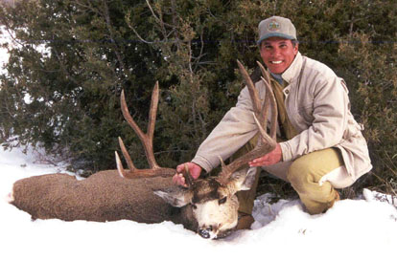

Slide 24


Slide 25


Slide 26
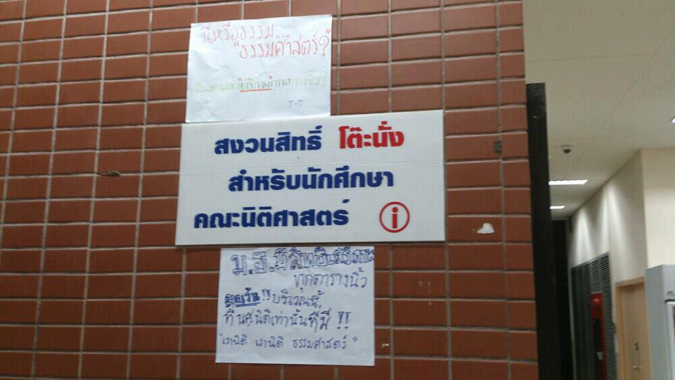

Slide 27
Summary on Property Rights
Property right or ownership is a bundle of rights entitling the owner to utilise a particular resource + duties to perform on that resource too (use + maintain, for example)
Private Property must be:
  Excludable – ex ante: incentive for investing; ex post: incentive for maintaining
  Rival – ex ante: incentive for acquiring new property; ex post: efficient consumption/utilisation

Slide 28
Summary on Property Rights
Property right is essential for efficient solution on the disputable use of resource (necessary condition)
  It acts as a basis for negotiation
  Disputing parties know what they have and what they are fighting for
Under some circumstances (described by Coase), just assigning and enforcing property rights would allow disputing parties to settle for the most economically efficient solution
  Well-defined and well-enforced property right

Slide 29
Summary on Property Rights
However, the circumstance that Coase mentioned is a ‘sufficient condition’ – a low transaction cost between disputing parties
Court/fiat ruling does not matter if both necessary and sufficient conditions are valid
Court ruling does matter if anyone of both conditions is invalid → inefficient outcome
  No property right has been defined
  High transaction cost between disputing parties
Ruling can alter the outcome (may not be efficient but can improve from the inefficient one)

Slide 30
Summary on Property Rights
When the property right has not been defined, it could possibly be:
  The law does not recognise it yet (e.g., just been discovered) OR
  It is not the private property
    Non-rival
    Non-excludable
    Both = public good
Legal ruling is important
  Defining
  Inventing new legal rules
    Including assign the right to the state/government for public goods

Slide 31
Summary on Property Rights
Providing the Coase theorem is held
Economically efficient outcome from negotiation
It is noted that some outcomes are different from the court verdict
  Private agreement
  Both are better off
  Both want that agreement to be enforced
  How can they be ascertained?
    Ex post opportunism/Moral hazard – behaving strategically to take advantage of the other.
    Ex ante opportunism/Adverse selection – selecting inefficient outcome

