Slide 1

Treasury Products
BY
Kitipong Sae-tang 5504640458
Krit Satapanapitakkit 5504640540
Peamdej Jombunud 5504641068
Ekkasit Sitthirotchanawan 5504640276
Techin Udomsinwatana 5504641852
Thanawin Cheunchomlada 5504641936
Ruethaiphat Mekvoravut 5604641455

Slide 2

What is Treasury Product?
Treasury service by commercial bank/ financial institution
Currency risk management
  Manage financial risk, response to market condition
  Higher return on portfolio
Different characteristics and condition for each treasury product
Interest rate risk
introduction
FOREX option
Dual-Currency Deposit
Precious Metal
Interest Rate Futures
Interest Rate Swap
Fixed-Income Securities

Slide 3
Our Examples
FOREX Option
Dual-Currency Deposit
Precious Metal
Interest Rate Futures
Interest Rate Swap
Details
Product description & characteristic
Requirement
Condition
Application process
Pros and cons
introduction
FOREX option
Dual-Currency Deposit
Precious Metal
Interest Rate Futures
Interest Rate Swap
Fixed-Income Securities

Slide 4


FOREX OPTION
What is “OPTIONS”?
An option is a contract that gives the buyer the right, but not the obligation, to buy(call) or sell(put) an underlying asset at a specific price on or before a certain date.
introduction
FOREX option
Dual-Currency Deposit
Precious Metal
Interest Rate Futures
Interest Rate Swap
Fixed-Income Securities

Slide 5
FOREX OPTION
How does Forex really “WORK”?
You import goods from the US, and need to pay USD 100,000 in
six months time to your supplier. Buy Call on USD/THB
The forward rate for USD/THB for six months is 40THB/USD
1
2
3
USD/THB : 35THB/USD
USD/THB : 40THB/USD
USD/THB : 45THB/USD
You are better off not
exercising the option
You are indifference
You are better off
exercising the option
35-40 = -5 THB
40-40 = 0 THB
45-40 = 5 THB
Out of the money
At the money
In the money
introduction
FOREX option
Dual-Currency Deposit
Precious Metal
Interest Rate Futures
Interest Rate Swap
Fixed-Income Securities

Slide 6
FOREX OPTION
So what are the “Pros & Cons”?
Leverage up your investment.
Provides a guaranteed Protected Rate for 100% of your exposure.
Allows you to benefit from favourable currency moves
No margin calls (no future liability)
Consequently, by trading on Options, you take much higher risk per amount invested.
The flexibility is traded with a premium that you need to pay upfront.
introduction
FOREX option
Dual-Currency Deposit
Precious Metal
Interest Rate Futures
Interest Rate Swap
Fixed-Income Securities

Slide 7
Dual-Currency Deposit
What is Dual Currency Deposits?
introduction
FOREX option
Dual Currency Deposits
Precious Metal
Interest Rate Futures
Interest Rate Swap
Fixed-Income Securities

Slide 8
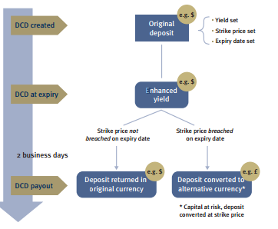
Dual-Currency Deposit
introduction
FOREX option
Dual-Currency Deposit
Precious Metal
Interest Rate Futures
Interest Rate Swap
Fixed-Income Securities

Slide 9
Dual-Currency Deposit
There are 2 possible outcomes.
1.) Exchange rate is above the strike price at maturity, then the capital and interest will be repaid in the investment currency.
2.) Exchange rate is below the strike price at maturity, then the capital and net interest are converted into the reference currency on the basis of the exercise price and are repaid in that foreign currency.
Note : Exchange rate is linked currency /base(initial) currency.
introduction
FOREX option
Dual-Currency Deposit
Precious Metal
Interest Rate Futures
Interest Rate Swap
Fixed-Income Securities

Slide 10
Dual-Currency Deposit
Benefits
Provides you with an enhanced interest rate that is better than the current base rate
Ideal for those with a multicurrency portfolio.
Increased portfolio diversification.
Risks
Exchange rate risk
Currencies are extremely volatile and impossible to predict, particularly in the short-run.
Credit risk
introduction
FOREX option
Dual-Currency Deposit
Precious Metal
Interest Rate Futures
Interest Rate Swap
Fixed-Income Securities

Slide 11
Precious Metal
Precious metal can be considered depending on rarity and economic value: Gold, Silver, Platinum, Pladium
Under uncertain time
Pro. -Safe Haven
-Hedge for purchasing power
-Insurance for other investment
Con. -Low profit
-additional cost
introduction
FOREX option
Dual-Currency Deposit
Precious Metal
Interest Rate Futures
Interest Rate Swap
Fixed-Income Securities

Slide 12
Interest Rate Futures
What is “FUTURES”?
introduction
FOREX option
Dual-Currency Deposit
Precious Metal
Interest Rate Futures
Interest Rate Swap
Fixed-Income Securities

Slide 13
Interest Rate Futures
Interest Rate Futures
  Contract to buy or sell government bond in the future
  Suppose we buy the “Interest rate futures”
    If interest rate increased, price of bonds will fall
    The buyer loss while the seller gain
  Hedging against interest rate risk
    Example: A project value may decreased if interest rate increased
    Selling the futures contract
introduction
FOREX option
Dual-Currency Deposit
Precious Metal
Interest Rate Futures
Interest Rate Swap
Fixed-Income Securities

Slide 14


Interest Rate Swap
Product description
Agreement between two parties to exchange streams of interest cash flows based on specified principal amount.
Main types
Fixed-for-Fixed swaps
Fixed-for-Floating or “Plain Vanilla” swaps
Floating-for-Floating or “Basis” swaps
(MLR, LIBOR etc.)
introduction
FOREX option
Dual-Currency Deposit
Precious Metal
Interest Rate Futures
Interest Rate Swap
Fixed-Income Securities

Slide 15
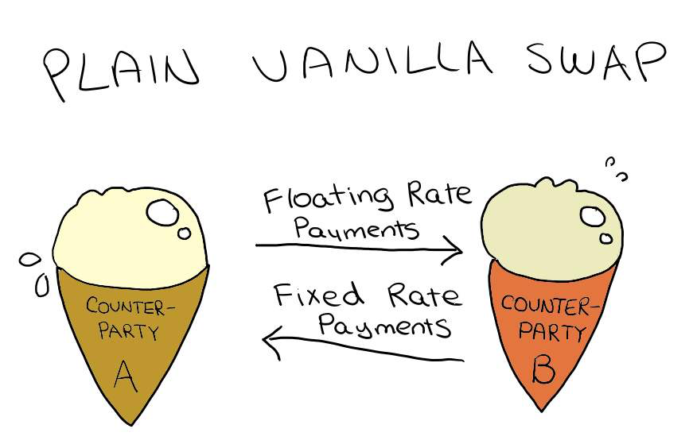
Interest Rate Swap: Fixed-For-Floating swaps
introduction
FOREX option
Dual-Currency Deposit
Precious Metal
Interest Rate Futures
Interest Rate Swap
Fixed-Income Securities

Slide 16
Interest Rate Swap : Fixed-For-Floating swaps
8.65%
A
B
LIBOR+0.70%
LIBOR+1.5%
8.5%
FLOATING
FIXED
NET: 9.45%:
NET: LIBOR+0.55%
introduction
FOREX option
Dual-Currency Deposit
Precious Metal
Interest Rate Futures
Interest Rate Swap
Fixed-Income Securities

Slide 17
Interest Rate Swap: Potential Benefits and Risks
Benefit of uses
Manage credit risk
Hedge potential losses
Earn income through speculation
Risks
Interest rate risk
Credit risk
Manage debt and risk more effectively!!!
introduction
FOREX option
Dual-Currency Deposit
Precious Metal
Interest Rate Futures
Interest Rate Swap
Fixed-Income Securities

Slide 18
Fixed-Income Securities
Provides a return in the form of fixed periodic payments and the eventual return of principal at maturity
Payment can be in a form of coupon payment or interest payment
“Suitable for risk averse investors”
Examples; Treasury bills
Treasury bonds
Certificate of Deposit
introduction
FOREX option
Dual-Currency Deposit
Precious Metal
Interest Rate Futures
Interest Rate Swap
Fixed-Income Securities

Slide 19
Fixed-Income Securities
Treasury Bills
A short-term debt obligation backed by the government with a maturity of less than one year
Issued through a competitive bidding process at a discount from par
      “Do not pay interest before maturity”
introduction
FOREX option
Dual-Currency Deposit
Precious Metal
Interest Rate Futures
Interest Rate Swap
Fixed-Income Securities

Slide 20
Fixed-Income Securities
Treasury Notes / Bonds
A marketable, fixed-interest government debt security with a maturity of between 1 to 10 years for Treasury notes and more than 10 years for bonds.
Initially sold through the auction
Can be sold in the secondary market
“Make interest payment
semi-annually until maturity”
introduction
FOREX option
Dual-Currency Deposit
Precious Metal
Interest Rate Futures
Interest Rate Swap
Fixed-Income Securities

