Slide 1
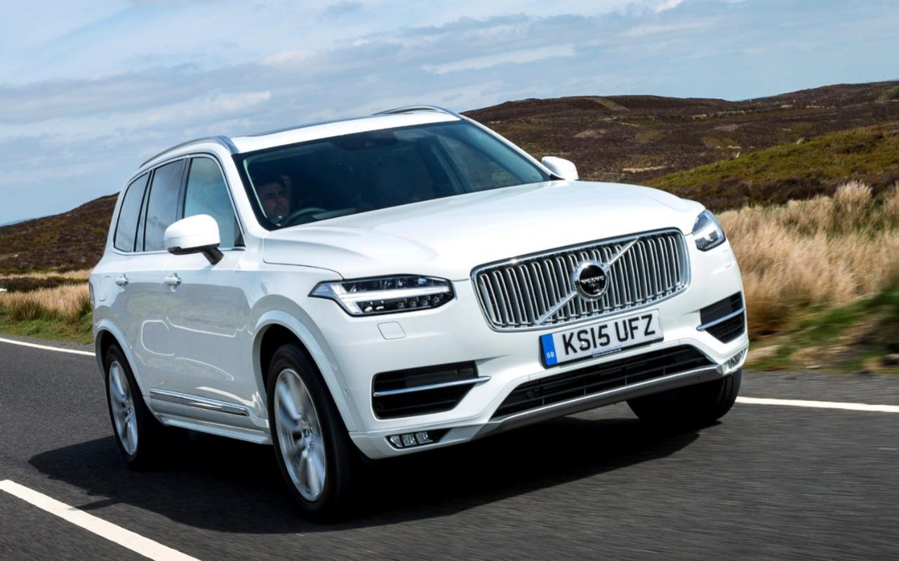
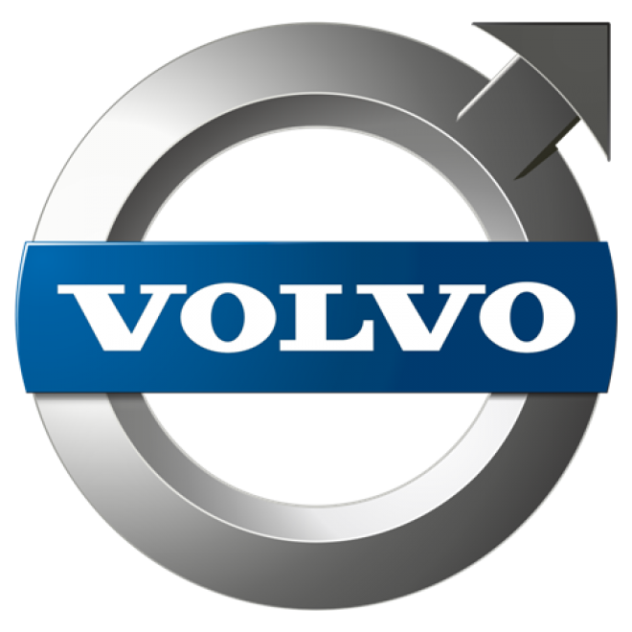
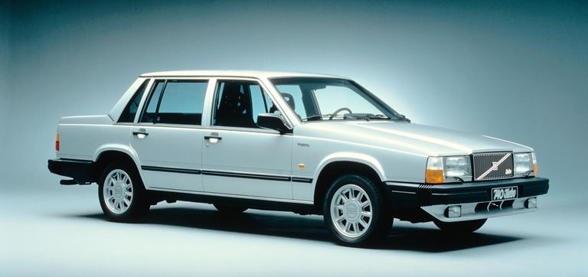
Volvo PV
Volvo Group

Slide 2
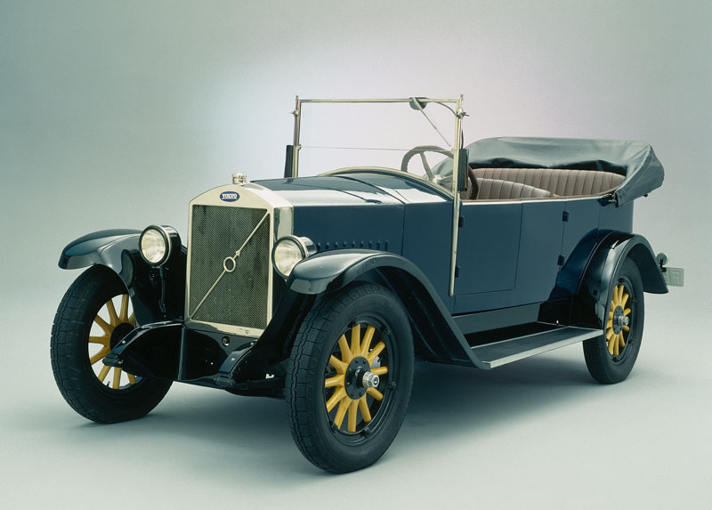
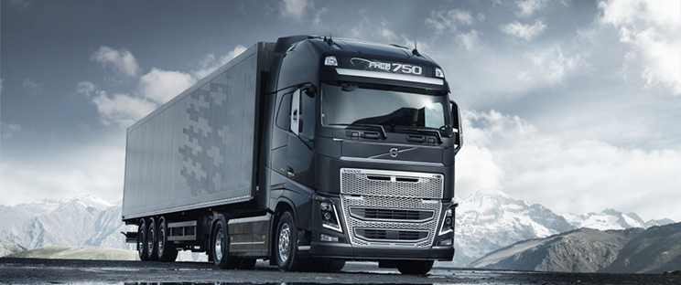
Early history
Founded in 1926 as a subsidiary of bearing innovator SKF in Gothenburg, Sweden
Volvo is Latin for “I am rolling”
The first car, ÖV4 Jakob, drives out of the factory in 1927
Soon, Volvo started building trucks. This became a critical factor in the early successes of Volvo
The truck building became the most profitable part of the company

Slide 3
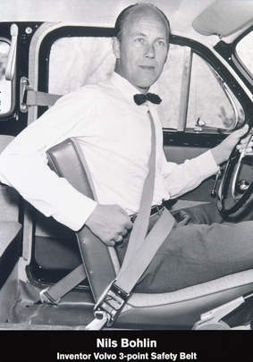
Post second world war
Sweden’s neutrality during the war allowed the intact Swedish industry to flourish post war
After the war, Volvo was the only company in the world to produce personal cars, trucks, busses and tractors
In relation with the establishment in North America, Volvo developed and patented the three point seat belt
Exporting to North America really accelerated growth
70s: oil crisis and management issues
80s: success again
A struggling Volvo AB sells Volvo Personal Cars to Ford for 6.4 billion USD in 1999. The motive was the struggle to compete as a small car manufacturer among global car groups

Slide 4
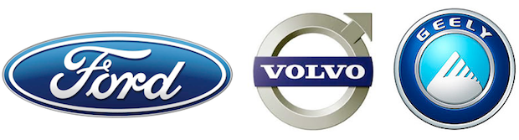
Entering the new millennium
Under Ford’s ownership, Volvo got new conditions
Many new models were developed that sold very well. This in contrast to rest of Ford.
This time, a struggling Ford agrees to sell Volvo to Chinese Geely for 1.8 billion USD
Manufacturing now takes place in Gothenburg and Skövde, Gent in Belgium, and in Chengdu in China
503 127 Volvo cars were sold in 2015. An all time record!

Slide 5
Some statistics ☺☺☺
Nr of employed per region

Slide 6
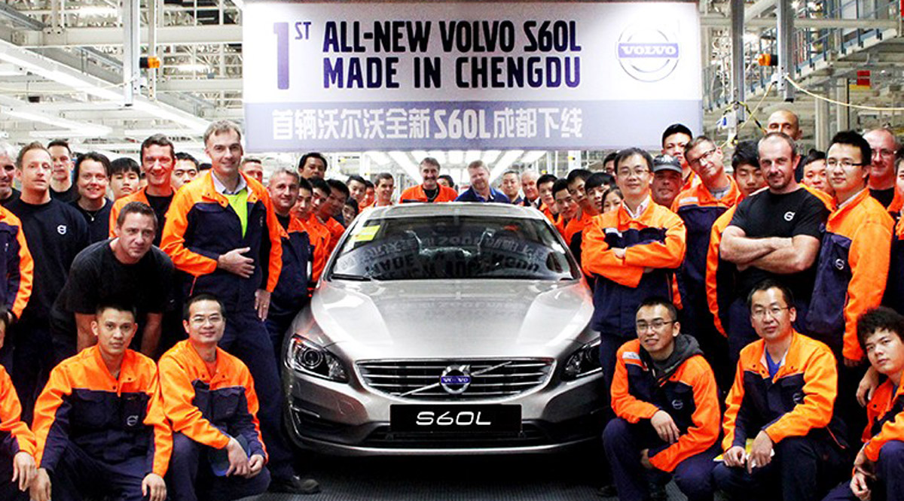
Deindustrialization
Sweden is being deindustrialized
Swedish industry developing worse then rest of Europe since 2009, and it is a worrying trend
Sweden came out of the great recession in 2008 better off than most countries, but due to increased consumption
The result might be decreased future growth and increased inequality as workers that used to work in the industry now switches to lower paying jobs
One of Europe's fastest urbanizations
Manufacturing of Volvo cars has stayed on Sweden
Many Swedish companies are being sold off before they get very big, and production moves out of Sweden

Slide 7
Volvo in Thailand
Perceived as a luxury car
In Sweden it is strongly associated with suburban, middle class life
Volvo has a long-standing presence in Thailand through Thai Swedish Assembly Co, which is entirely owned by Volvo
From January to September 2016 645 Volvos were sold in Thailand, making it the tenth most sold car with a share of 0.3 %
Topping the list is Toyota with a 29.7 % share

Slide 8
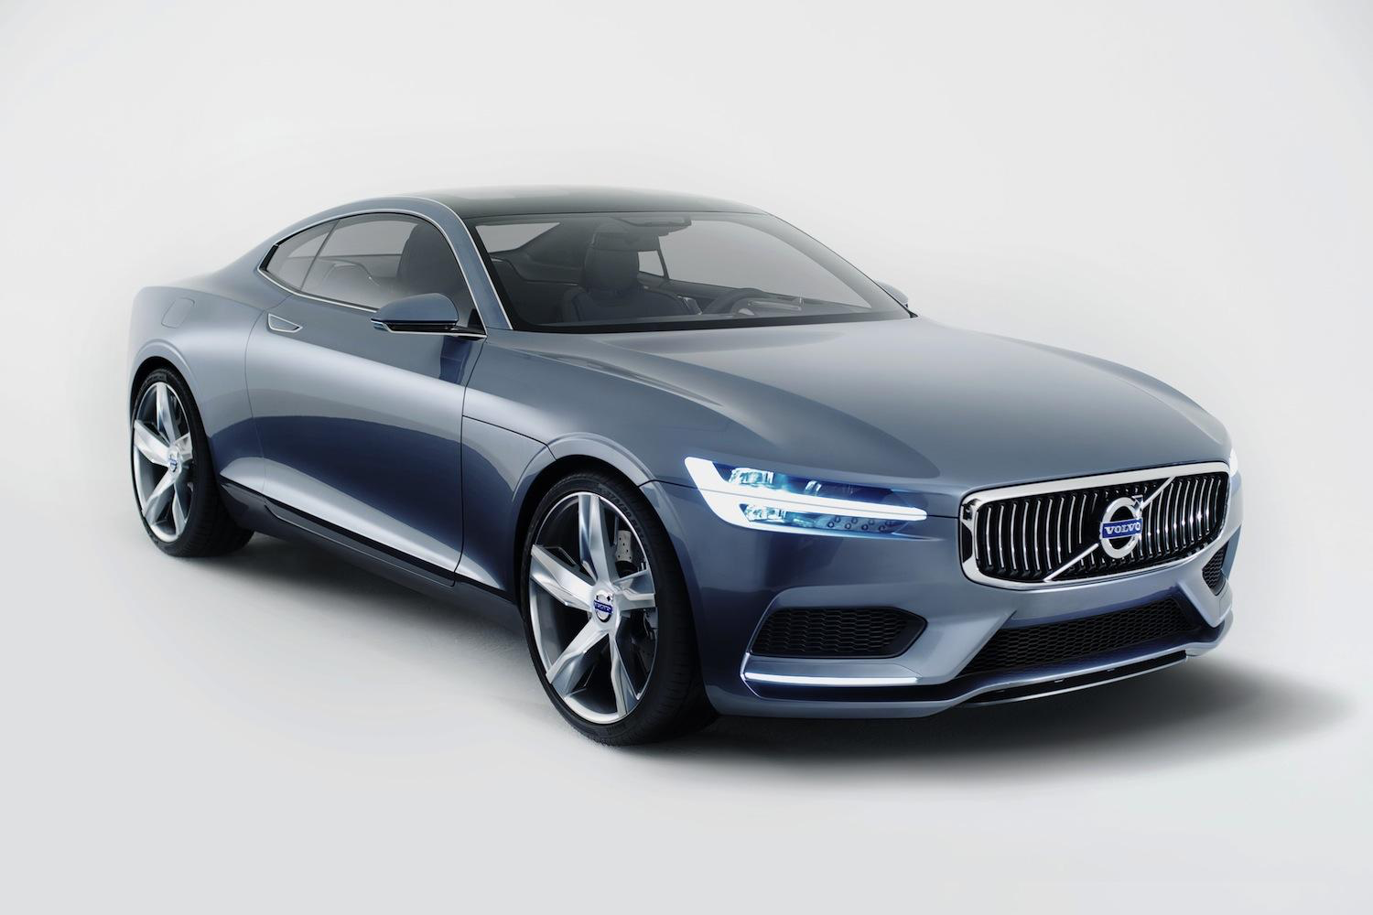
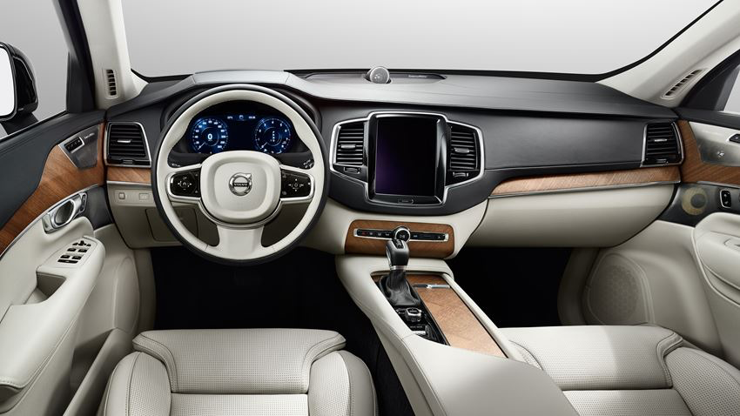
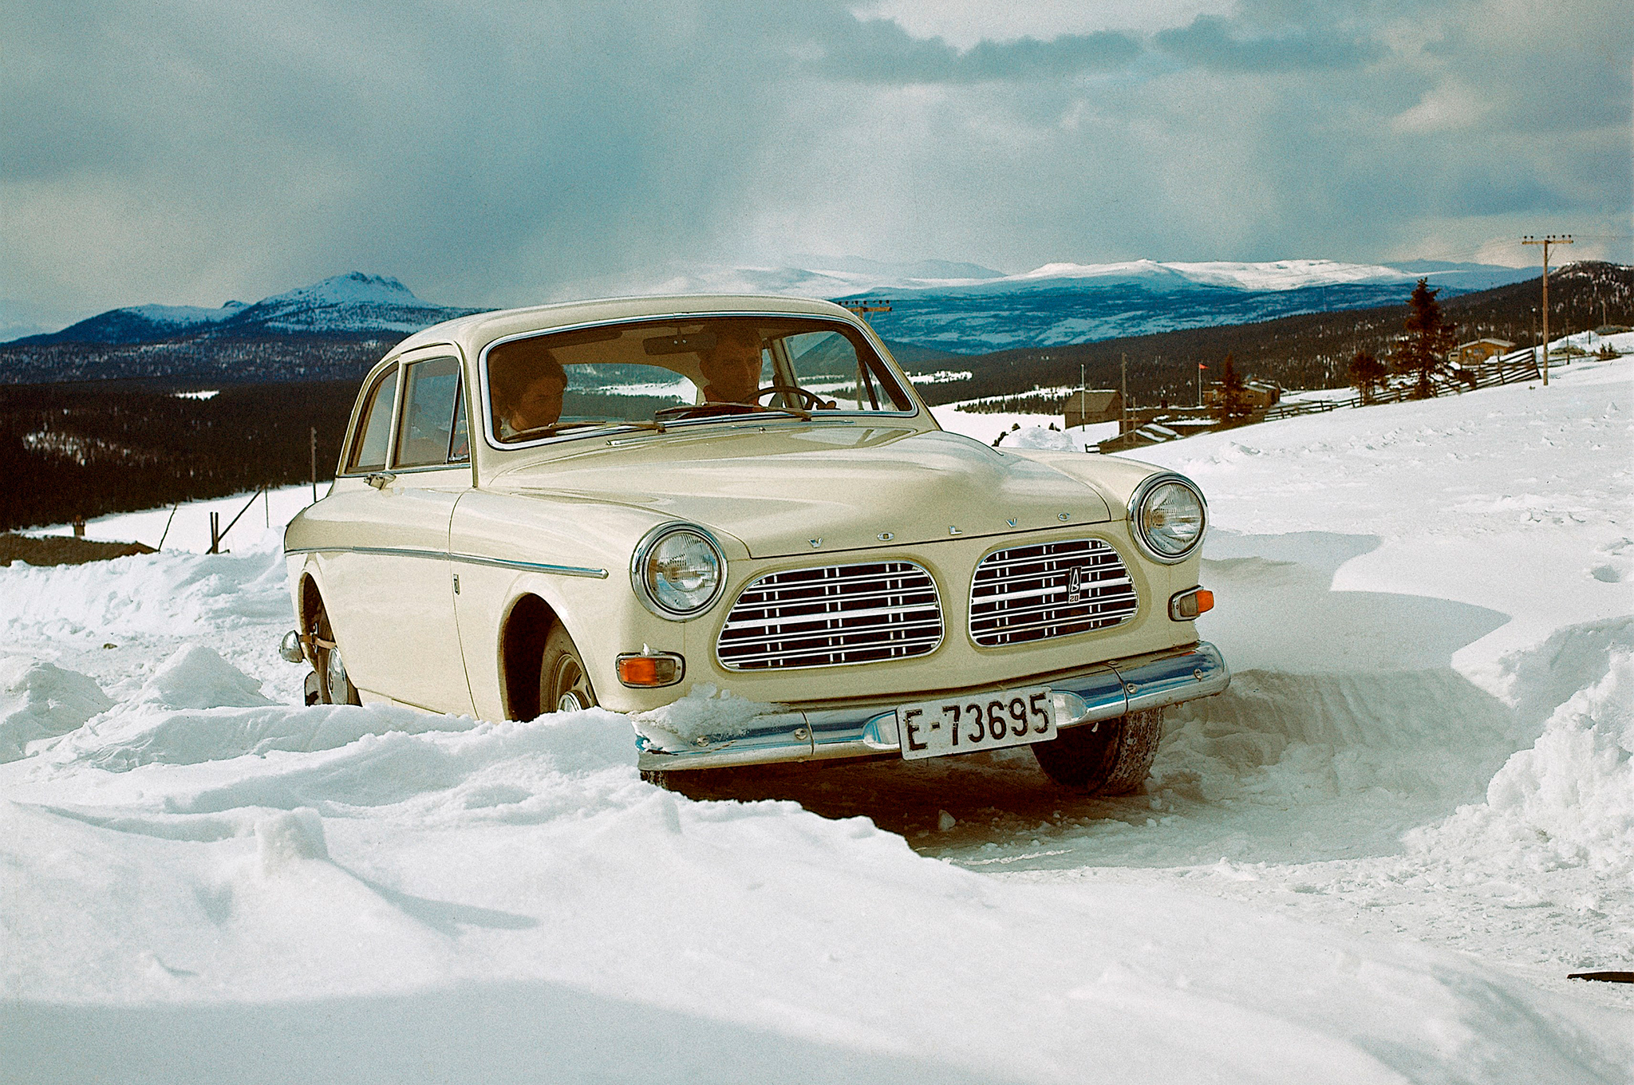
Thanks!

