Slide 1


MK 201 Principles of Marketing
Consumer Insights
Session 3
By Ajarn Suwalya K.
Section 2

Slide 2
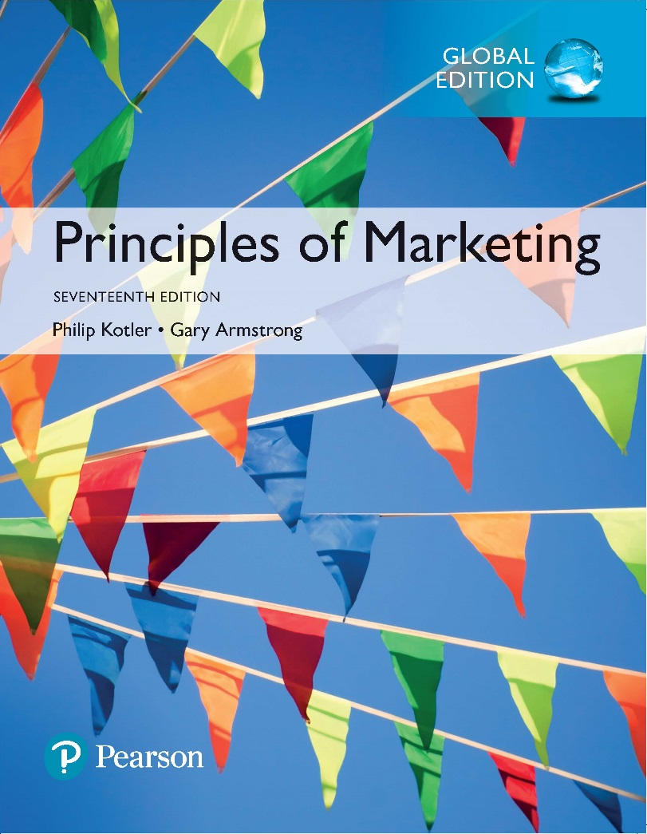
Principles of Marketing
Seventeenth Edition
Chapter 4
Managing Marketing Information to Gain Customer Insights
Copyright © 2018 Pearson Education Ltd. All Rights Reserved.

Slide 3
Learning Objectives
4-1 Explain the importance of information in gaining insights about
the marketplace and customers.
4-2 Define the marketing information system and discuss its parts.
4-3 Outline the steps in the marketing research process.
4-4 Explain how companies analyze and use marketing
information.
4-5 Discuss the special issues some marketing researchers face,
including public policy and ethics issues.

Slide 4
Learning Objective 1
Explain the importance of information in gaining insights about the marketplace and customers.

Slide 5

Marketing Information and
Customer Insights
Customer insights are fresh marketing information-based understandings of customers and the marketplace that become the basis for creating customer value, engagement, and relationships.

Slide 6
Marketing Information and Customer Insights
Customer insights
Fresh and deep insights into customer needs and wants
Important but difficult to obtain
  Needs and buying motives not obvious
  Customers usually can’t tell you what and why
Better information and more effective use of existing information

Slide 7

Marketing Information and Customer Insights
Managing Marketing Information
  Companies are forming customer insights teams
    Include all company functional areas
    Collect information from a wide variety of sources
    Use insights to create more value for their customers

Slide 8

Marketing Information and Customer Insights
Managing Marketing Information
  Marketing information system (MIS) refers to the people and procedures dedicated to assessing information needs, developing the needed information, and helping decision makers to use the information to generate and validate actionable customer and market insights.

Slide 9
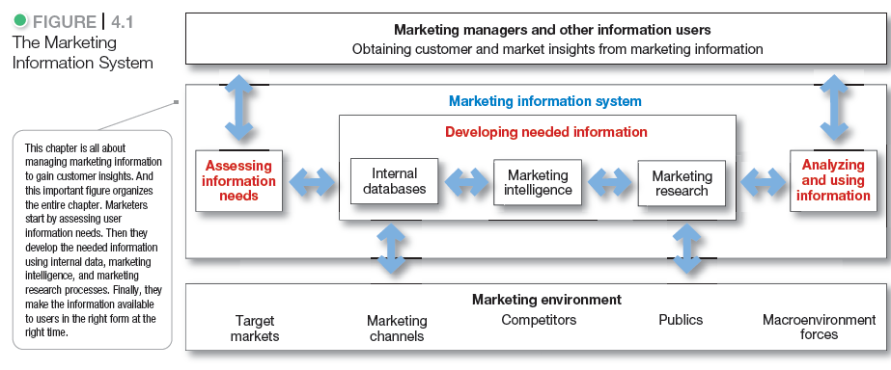
Marketing Information and Customer Insights

Slide 10
Learning Objective 2
Define the marketing information system and discuss its parts.

Slide 11

Assessing Marketing Information Needs
A marketing information system (MIS) provides information to the company’s marketing and other managers and external partners such as suppliers, resellers, and marketing service agencies.

Slide 12
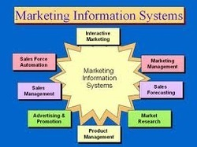

Slide 13
Assessing Marketing Information Needs
Characteristics of a Good MIS
Balancing the information users would like to have against what they need and what is feasible to offer
User’s Needs
MIS Offerings

Slide 14
Developing Marketing Information
Marketers obtain information from:
Internal data
Marketing intelligence
Marketing research

Slide 15

Developing Marketing Information
Internal Data
Internal databases are collections of consumer and market information obtained from data sources within the company network.

Slide 16

Developing Marketing Information
Competitive Marketing Intelligence
Competitive marketing intelligence is the systematic collection and analysis of publicly available information about consumers, competitors, and developments in the marketing environment.

Slide 17
Learning Objective 3
Outline the steps in the marketing research process.

Slide 18
Marketing Research
Marketing research is the systematic design, collection, analysis, and reporting of data relevant to a specific marketing situation facing an organization.

Slide 19
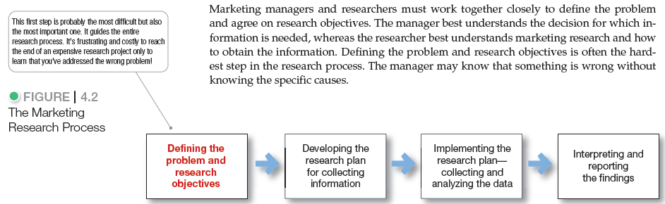
Marketing Research

Slide 20
Marketing Research
Defining the Problem and Research Objectives
Exploratory research
Descriptive research
Causal research

Slide 21
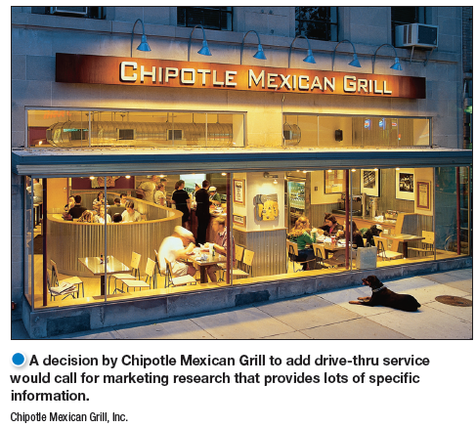
Marketing Research
Developing the Research Plan
Outlines sources of existing data
Spells out the specific research approaches, contact methods, sampling plans, and instruments to gather data

Slide 22
Marketing Research
Developing the Research Plan
Management problem
Research objectives
Information needed
How the results will help management decisions
Budget

Slide 23
Marketing Research
Developing the Research Plan
Secondary data is information that already exists somewhere, having been collected for another purpose.
Primary data is information collected for the specific purpose at hand.

Slide 24
Marketing Research
Gathering Secondary Data
Advantages
Disadvantages
- data may not be
Relevant
Accurate
Obtained quickly
Lower cost
Cannot collect otherwise
Current
Impartial

Slide 25
Marketing Research
Primary Data Collection
Research Approaches
Contact Methods
Sampling Plan
Research Instruments

Slide 26
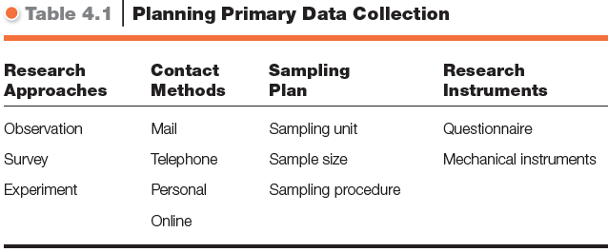
Marketing Research

Slide 27

Marketing Research
Primary Data Collection
Research Approaches
Observational research involves gathering primary data by observing relevant people, actions, and situations.
Ethnographic research involves sending trained observers to watch and interact with consumers in their “natural environments.”

Slide 28

Marketing Research

Slide 29
Marketing Research
Primary Data Collection
Research Approaches
Survey research involves gathering primary data by asking people questions about their knowledge, attitudes, preferences, and buying behavior.
Experimental research involves gathering primary data by selecting matched groups of subjects, giving them different treatments, controlling related factors, and checking for differences in group responses.

Slide 30

Marketing Research
Focus Group—Personal Contact Method
  Six to 10 people
  Trained moderator
  Challenges
    Expensive
    Difficult to generalize from small group
    Consumers not always open and honest

Slide 31
Marketing Research
Online Contact Methods
Low cost
Speed
Higher response rates
Good for hard to reach groups
Advantages

Slide 32

Marketing Research
Primary Data Collection
Sampling Plan
A sample is a segment of the population selected for marketing research to represent the population as a whole.
  Who is to be studied?
  How many people should be studied?
  How should the people be chosen?

Slide 33
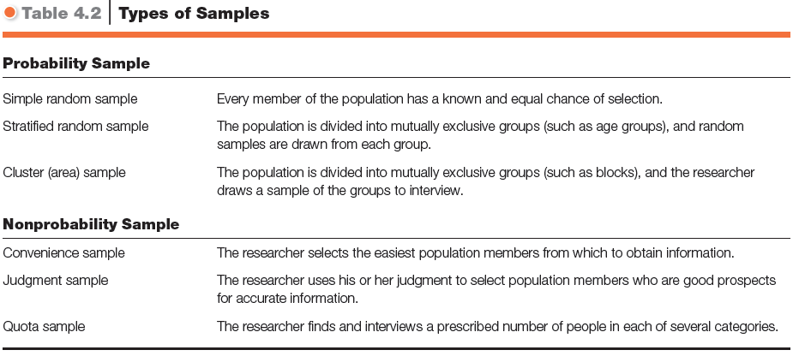
Marketing Research

Slide 34

Marketing Research
Primary Data Collection
Research Instruments--Questionnaires
Most common
In person, by phone, or online
Flexible
Researchers must be careful with wording and ordering of questions
  Closed-ended
  Open-ended
Useful in exploratory research

Slide 35
Marketing Research
Primary Data Collection
Mechanical Research Instruments
Mechanical devices
People meters
Checkout scanners
Neuro-
marketing

Slide 36
Marketing Research
Collecting the information
Processing the information
Analyzing the information
Interpret findings
Draw conclusions
Implementing the Research Plan
Interpreting and Reporting Findings
Report to management

Slide 37
Learning Objective 4
Explain how companies analyze and use marketing information.

Slide 38

Analyzing and Using Marketing Information
Customer Relationship Management (CRM)
CRM involves managing detailed information about individual customers and carefully managing customer touch points to maximize customer loyalty.

Slide 39
Analyzing and Using Marketing Information
Customer Relationship Management
CRM Touchpoints
Customer purchases
Sales force contacts
Service and support calls
Web and social media sites
Satisfaction surveys
Credit and payment interactions
Marketing research studies

Slide 40
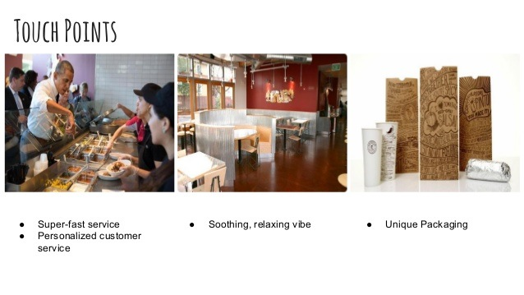

Slide 41
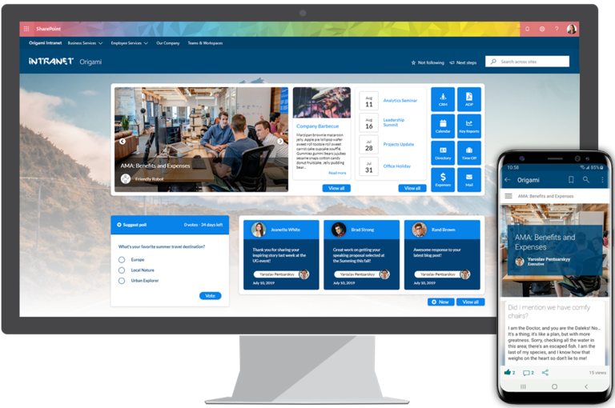
Analyzing and Using Marketing Information
Distributing and Using Marketing Information
Information distribution involves making information available in a timely, user-friendly way.
  Intranet
  Extranet

Slide 42
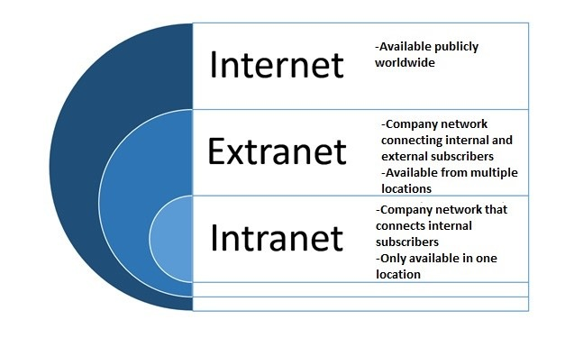

Slide 43
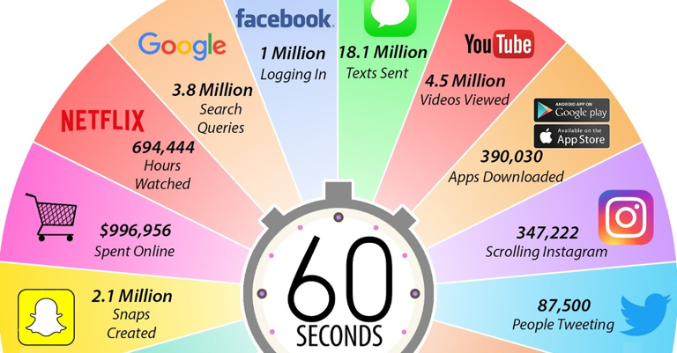

Slide 44
Learning Objective 5
Discuss the special issues some marketing researchers face, including public policy and ethics issues.

Slide 45
Other Marketing Information Considerations
Marketing Research in Small Businesses and Nonprofit Organizations
International Market Research
Public Policy and Ethics
Customer privacy
Misuse of research findings

Slide 46
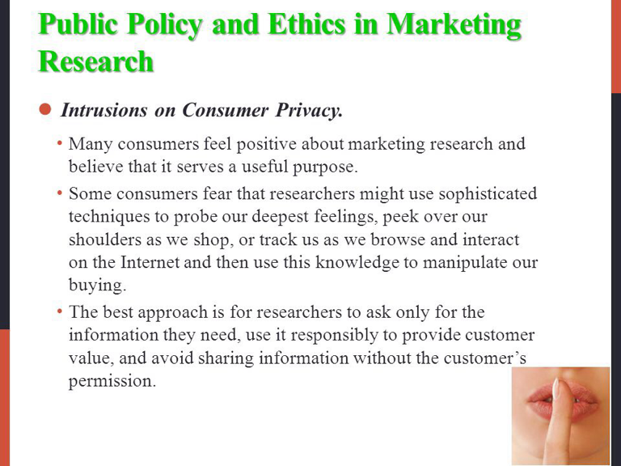

Slide 47


