Slide 1
Trade in Cambodia, LaoS, Myanmar and vietnam
EE361 ECONOMIES of CLMV
Faculty of economics
Thammasat university

Slide 2
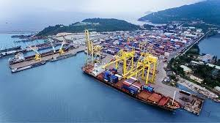
Economic growth in GMS*
Economic growth in the Greater Mekong Subregion (including CLMV) during 2000-2008 has been impressive; average annual growth rate was 6.1%.
During the economic global economic slowdown of 2008, GDP growth slowed down to 0.6%, but accelerated to 7.3% thereafter
Trade and trade policies pursued by CLMV countries have contributed to the overall economic growth in these countries
* GMS=Greater Mekong Subregion

Slide 3
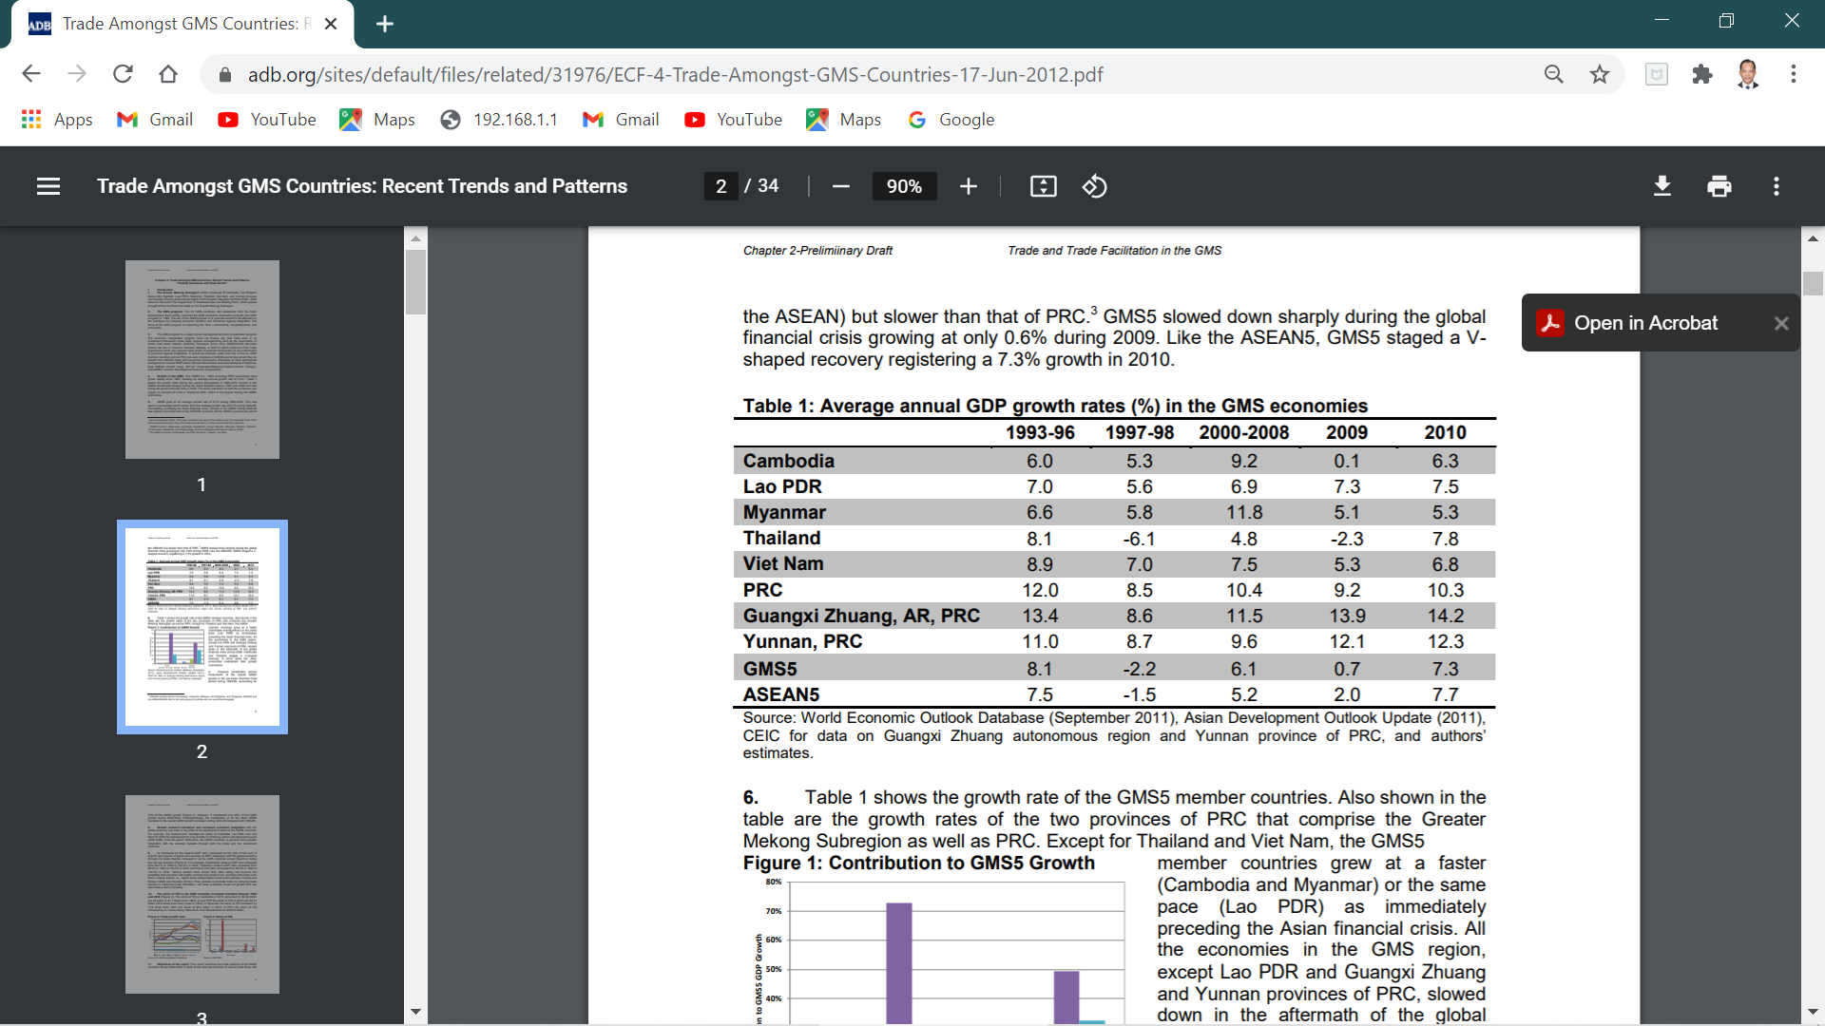
GDP growth of GMS countries
Several observations:
In general, GDP growth of CLMV has been robust (>5% per year)
During financial crisis of 1998, CLMV unlike Thailand, were relatively de-linked from the global economy, therefore impact of crisis was low.

Slide 4
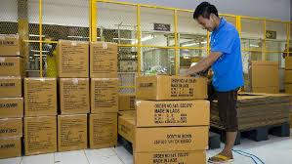
Trade policies in clmv
Greater outward orientation and increased economic integration with the global economy has been a key pillar of the development plans of Cambodia, Lao PDR, and Viet Nam
Easing of restrictions on FDI provided an impetus to trade and growth. Examples: relocation of garment factories from South Korea, Taiwan, and PR China to Cambodia; FDI in agriculture, forestry and mining in Lao PDR

Slide 5

Trade policies in clmv
Location of production processes across borders, further aided by advances in transportation has enabled increased intra-regional trade with GMS. Examples:
Viet Nam has benefited from setting up of regional production networks, enabling easy access to finance for trade and consumption

Slide 6

Trade policies in clmv
Cross-border trade facilitation
Ratification of cross border trade agreement (CBTA) in GMS countries
CBTA: a comprehensive legal instrument that includes non-physical measures for cross-border land transport; allows vehicles, goods and people to cross national borders through the GMS road transport system.
All GMS countries have ratified CBTA: Lao PDR, Thailand and Viet Nam – 1999; Cambodia – 2001; PR China – 2002; Myanmar – 2003

Slide 7
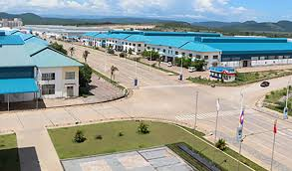
Trade policies in clmv
Development of special economic zones (SEZ)
SEZ: an area in which business and trade laws are different from the rest of the country; which aims to attract foreign investment, generate employment and increase trade balance and generate foreign currency through exports.

Slide 8
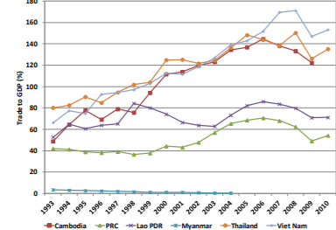
Outcomes of increased trade
Trade-to-GDP ratio* and integration with the global economy through the trade channel increased in all the GMS countries except Myanmar
* calculated as the ratio of the sum of exports and imports of goods and services to GDP

Slide 9
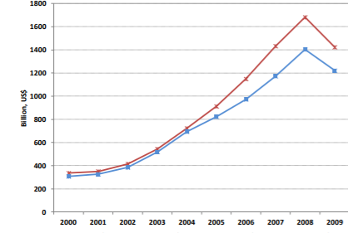
Outcomes of increased trade
Total intraregional exports of the GMS countries grew at an average annual rate of 7.4%, from $336 billion in 2000 to $1,423 billion in 2009.
During the same period, total imports increased from $307 billion to $1,223 billion with an average annual growth rate of 16.6%.

Slide 10
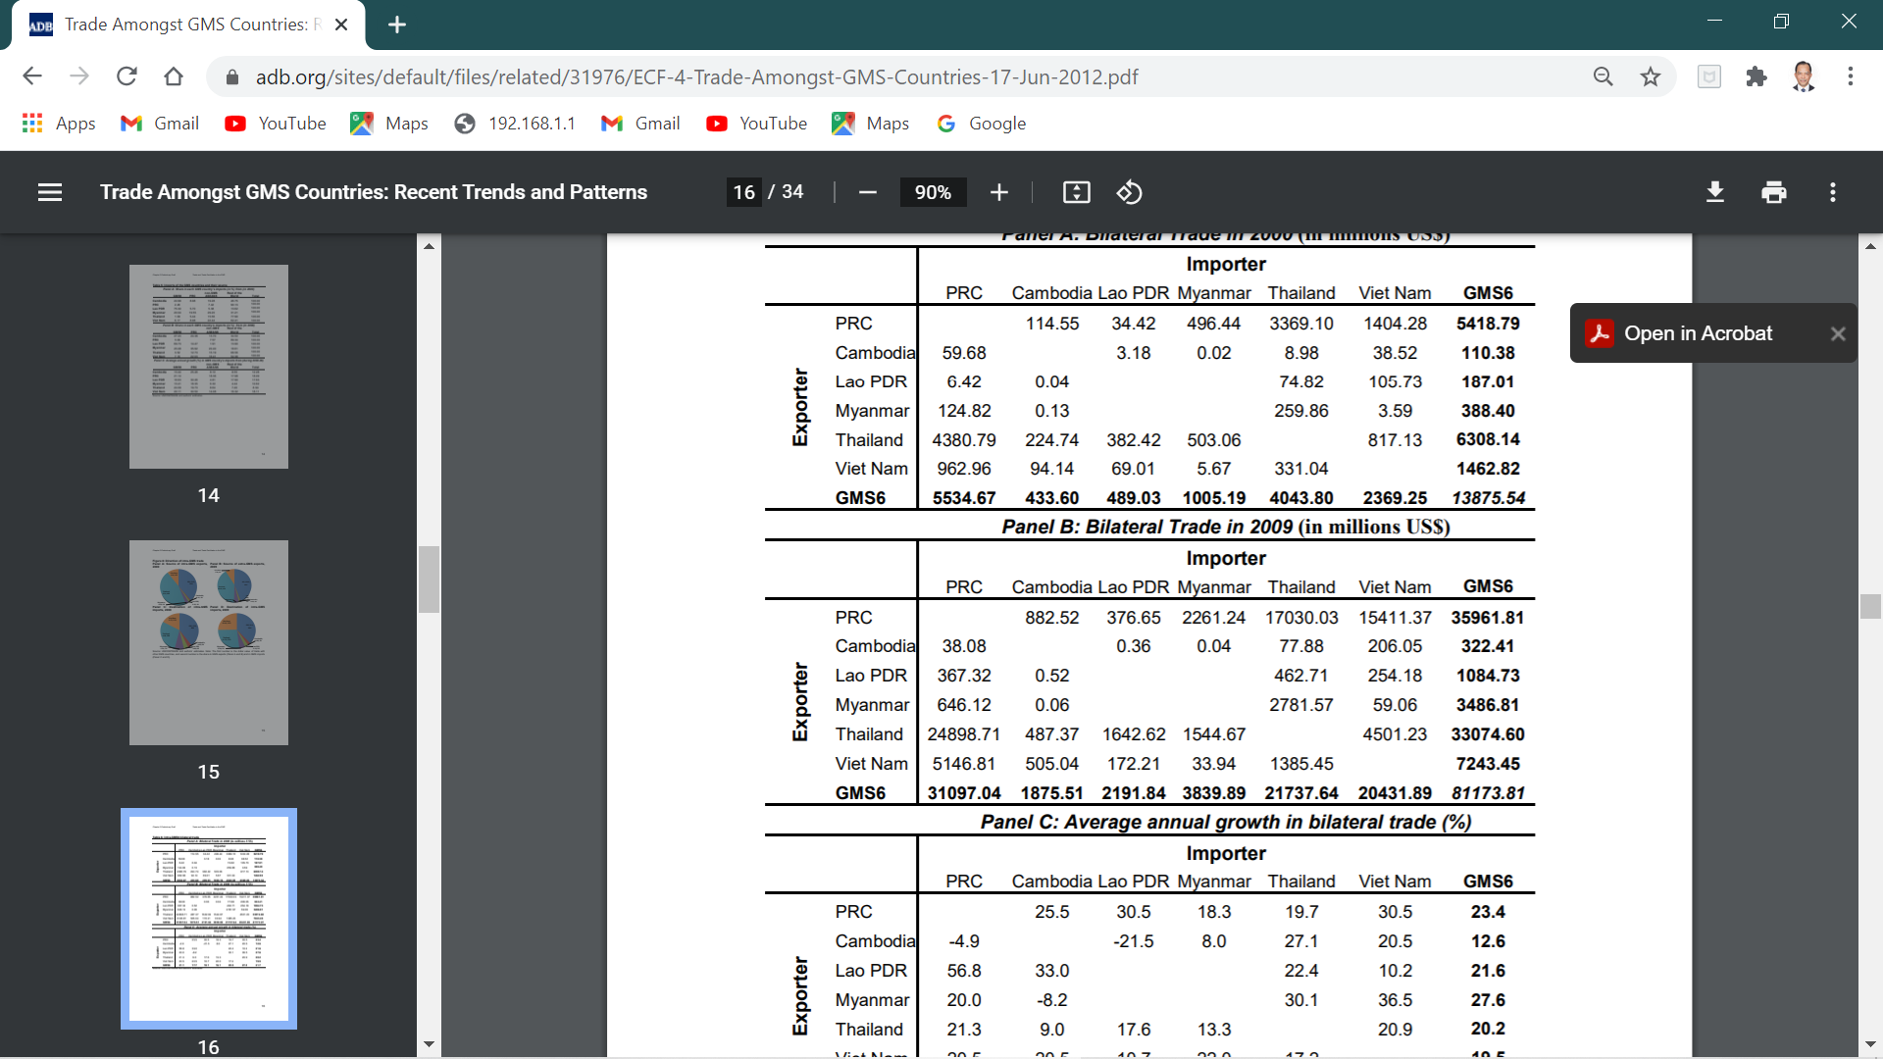
Bilateral trade within gms
2000
Bilateral trade between GMS countries (including CLMV) with PR China has increased substantially from 2000 to 2009
Trade amongst countries is uneven. Some countries carry deficits, while others carry surplus
Thailand and Viet Nam account for a large share of trade flows within the GMS.
2009

Slide 11
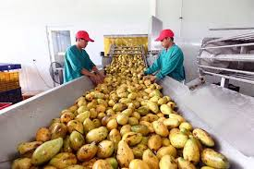

Bilateral trade within gms
From PRC exports to GMS were mostly machinery and transport equipment; chemicals; non-metallic minerals; and textiles, apparels, and travel goods
Export baskets of Lao PDR and Myanmar comprise largely of primary products.
The composition of Viet Nam’s export basket has changed; its export basket consisted of 60% primary products in 2000, but that share declined to 34% by 2009 due to increased manufacturing and services

Slide 12

Bilateral trade within gms
Cambodia’s overall export basket is dominated by manufacturing products, mainly garments. Relocation of garment factories from South Korea, Taiwan, and PR China to Cambodia helped stimulate garment exports from Cambodia.
However, composition of Cambodia’s export basket differs by destination; in 2009 exports to GMS comprised largely of primary products (90%) while primary products accounted for only 10% of the total exports to the rest of the world

Slide 13
Key findings
Total GMS trade has grown rapidly during 2000-2009; intra-regional trade (including with PR China) has grown faster than its countries’ overall global trade.
The composition of exports varies across the GMS countries; high value added manufacturing products are largely from Thailand followed by Viet Nam.
Exports of Cambodia, Lao PDR, and Myanmar to the world consists largely of low value added goods such as textiles, apparels, and of primary products; this indicates that these countries are not yet a part of the regional production networks

Slide 14
Key findings
In general, greater outward orientation in the GMS countries, through both the trade and investment channels, has fueled integration with the global economy
Policies to promote trade (reducing trade barriers, improving trade facilitation), have had a positive impact on growth and reduce poverty; however the distribution of the benefits of trade to the wider population will need to be assessed

