Slide 1
Topic 5
Input and
Production Functions
(Chapter 6)

Slide 2
Key Definitions
Productive resources, such as labor and capital equipment, that firms use to manufacture goods and services are called inputs or factors of production.
The amount of goods and services produces by the firm is the firm’s output.
Production transforms a set of inputs into a set of outputs
Technology determines the quantity of output that is feasible to attain for a given set of inputs.

Slide 3
Key Definitions
The production function tells us the maximum possible output that can be attained by the firm for any given quantity of inputs.
The production set is a set of technically feasible combinations of inputs and outputs.
Production Function:
  Q = output
  K = Capital
  L = Labor

Slide 4
Total Product – Single Input (K is constant)
Total Product Function: A single-input production function shows how total output depends on the level of the one input.
Increasing Marginal Returns to Labor: An increase in the quantity of labor increases total output at an increasing rate.
Diminishing Marginal Returns to Labor: An increase in the quantity of labor increases total output but at a decreasing rate.
Diminishing Total Returns to Labor: An increase in the quantity of labor decreases total output.

Slide 5
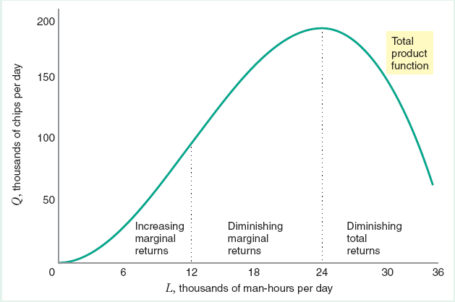
Total Product – Single Input (K is constant)
Single-Input: L is variable while K is constant.

Slide 6
The Marginal Product
Definition: The marginal product of an input is the change in output that results from a small change in an input holding the levels of all other inputs constant.
MP_{L} = ΔQ/ΔL
  (holding constant all other inputs)
MP_{K} = ΔQ/ΔK
  (holding constant all other inputs)
Example: Q = K^{1/2}L^{1/2}
MP_{L} = (1/2)L^{-1/2}K^{1/2}
MP_{K} = (1/2)K^{-1/2}L^{1/2}

Slide 7
The Average Product & Diminishing Returns
Definition: The average product of an input is equal to the total output that is to be produced divided by the quantity of the input that is used in its production:
AP_{L} = Q/L AP_{K} = Q/K
Example:
AP_{L} = [K^{1/2}L^{1/2}]/L = K^{1/2}L^{-1/2} AP_{K} = [K^{1/2}L^{1/2}]/K = L^{1/2}K^{-1/2}
Definition: The law of diminishing marginal returns states that marginal products (eventually) decline as the quantity used of a single input increases.

Slide 8
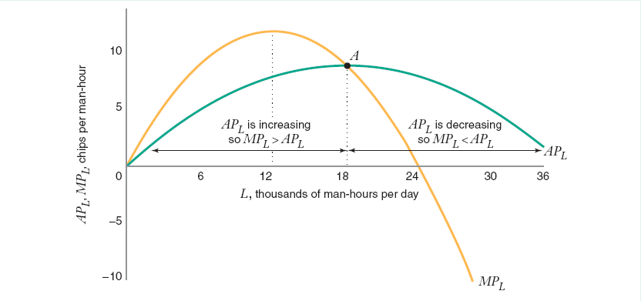
Total, Average, and Marginal Products
Single-Input: L is variable while K is constant.

Slide 9
Total, Average, and Marginal Products
Single-Input: L is variable while K is constant.
When AP is increasing in L, MPL > APL.
When AP is decreasing in L, MPL < APL.
When AP does not increase or decrease, MPL = APL.

Slide 10
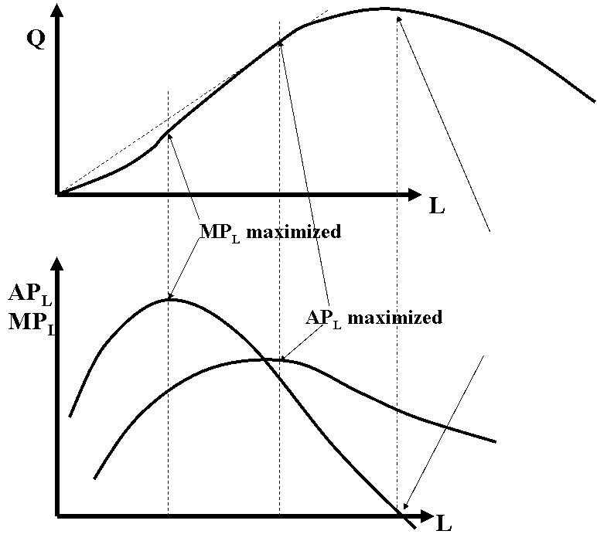
Total, Average, and Marginal Products
Single-Input: L is variable while K is constant.
TP_{L} is maximized where MP_{L} is zero.
TP_{L} falls where MP_{L} is negative.
TP_{L} rises where MP_{L} is positive.

Slide 11
Isoquants (for 2-input production)
Definition: An isoquant traces out all the combinations of inputs (labor and capital) that allow that firm to produce the same quantity of output
Example: Q = K^{1/2}L^{1/2}
What is the equation of the isoquant for Q = 20?
20 = K^{1/2}L^{1/2}
=> 400 = KL
=> K = 400/L
Slope = dK/dL

Slide 12
Isoquants (for 2-input production)

Slide 13
Isoquants (for 2-input production)
K
Isoquant for Q = 20:
All combinations of (L,K) along the
isoquant produce 20 units of output.
Q = 20
Slope = ΔK/ΔL < 0
Q = 10
L
0

Slide 14
Marginal Rate of Technical Substitution
Definition: The marginal rate of technical substitution (MRTS) is the rate at which capital can be reduced for every one-unit increase in labor, holding the quantity of output constant.
MRTS_{L,K} = -ΔK/ΔL (for a constant level of output)
Example
MRTS = 4
The firm can reduce capital by 4 units if it wants to employ one more labor. In doing so, the output will not change.

Slide 15
Marginal Rate of Technical Substitution
MRTS_{L,K} = -ΔK/ΔL = MPL/MPK
Proof

Slide 16
Marginal Rate of Technical Substitution
Different ways to think about MRTS
The rate at which the quantity of capital that can be decreased for every unit of increase in the quantity of labor, holding the quantity of output constant,
or
The rate at which the quantity of capital that can be increased for every unit of decrease in the quantity of labor, holding the quantity of output constant

Slide 17
Marginal Rate of Technical Substitution
If both marginal products are positive, the slope of the isoquant is negative.
If we have diminishing marginal returns, we also have a diminishing marginal rate of technical substitution - the marginal rate of technical substitution of labor for capital diminishes as the quantity of labor increases, along an isoquant – isoquants are convex to the origin.
For many production functions, marginal products eventually become negative. We don’t graph parts of the isoquants where marginal products are negative.

Slide 18
Marginal Rate of Technical Substitution
Diminishing MRTS

Slide 19
Marginal Rate of Technical Substitution

Slide 20
Elasticity of Substitution
Definition: The elasticity of substitution, σ, measures how the capital-labor ratio, K/L, changes relative to the change in the MRTS_{L,K}. It measures of how easy is it for a firm to substitute labor for capital.

Slide 21
Elasticity of Substitution
Example: Suppose that:
    MRTS_{L,K}^{A} = 4, K^{A}/L^{A} = 4
    MRTS_{L,K}^{B} = 1, K^{B}/L^{B} = 1
    ΔMRTS_{L,K} = MRTS_{L,K}^{B} - MRTS_{L,K}^{A} = -3
σ = [Δ(K/L)/ΔMRTS_{L,K}]*[MRTS_{L,K}/(K/L)] = (-3/-3)(4/4) = 1

Slide 22
Elasticity of Substitution

Slide 23
Elasticity of Substitution
K
"The shape of the isoquant indicates the degree of substitutability of the input."
σ = 0
σ = 1
σ = 5
σ = ∞
L
0

Slide 24
Inputs are Perfect Substitutes σ = ∞

Slide 25
Inputs are Perfect Complements σ = 0

Slide 26
Cobb-Douglas Production Function
Q = AK^{α}L^{β} where A, α, and β are positive.
Cobb-Douglas function has the following properties:
  MPK and MPL > 0.
  MPK and MPL are diminishing w.r.t. their inputs.
  That is, dMPK/dK < 0 and dMPL/dL < 0.
  Elasticity of Substitution = σ = 1

Slide 27
CES Production Function
CES stands for Constant Elasticity of Substitution.
where a, b, and σ are positive.
σ is the elasticity of substitution, σ ϵ [0, ∞).
It combines all three types of production functions:
  Cobb-Douglas
  Perfect Substitutes
  Perfect Complements

Slide 28
CES Production Function

Slide 29
Returns to Scale
(Positive) Marginal Return or Marginal Product tells us how output will increase when one more input is added.
Returns to Scale tells us how output will increase when BOTH inputs are added.
For example, when we double inputs (K and L double), will the output double too?

Slide 30
Returns to Scale
Let λ > 1 represent the amount by which both inputs, labor and capital, increase.
A Production Function F(K,L) is said to have
Increasing returns when F(λK, λL) > λF(K, L).
Decreasing returns when F(λK, λL) < λF(K, L).
Constant Returns when F(λK, λL) = λF(K, L).

Slide 31
Returns to Scale
Increasing returns when F(λK, λL) > λF(K, L):
A proportional increase in all inputs results in a greater than proportional increase in output.
Decreasing returns when F(λK, λL) < λF(K, L):
A proportional increase in all inputs results in a less than proportional increase in output.
Constant Returns when F(λK, λL) = λF(K, L):
A proportional increase in all inputs results in the same proportional increase in output.

Slide 32
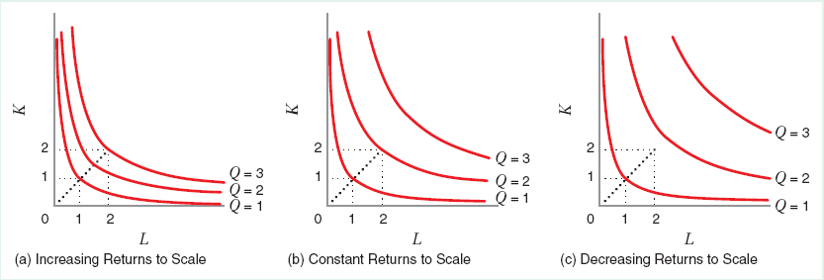
Returns to Scale

Slide 33
Technological Progress
Definition: Technological progress (or invention) shifts the production function by allowing the firm to achieve more output from a given combination of inputs (or the same output with fewer inputs).
That is, it increases “productivity”, measured by MPK and MPL.
Capital-saving technological progress causes MPL to increase relative to MPK, and hence a rise in the MRTS_{L,K}.
Labor-saving technological progress causes MPK to increase relative to MPL, and hence a fall in the MRTS_{L,K}.

Slide 34
Neutral Technological Progress

Slide 35
Labor-Saving Technological Progress
e.g. better capital equipment

Slide 36
Capital-Saving Technological Progress
e.g. better skills of labor

