Slide 1
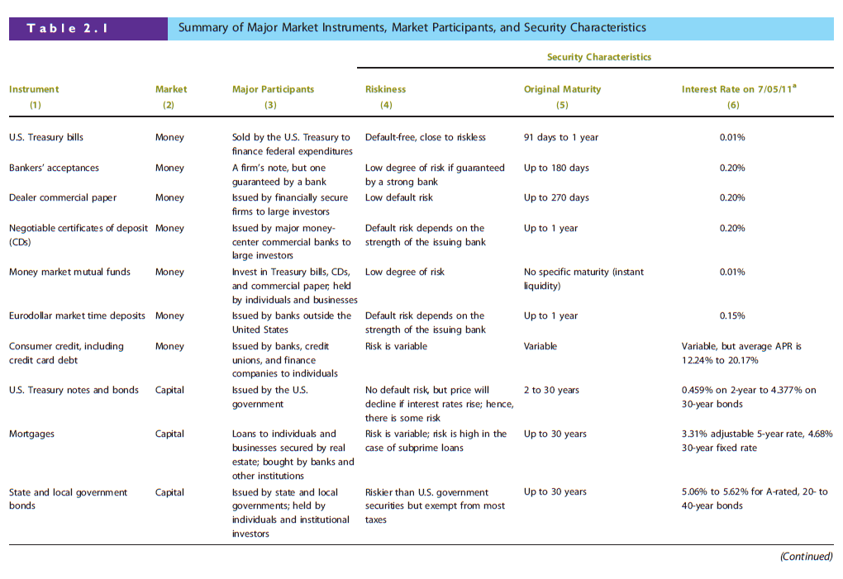
Chapter 2: Financial Markets and Institutions

Slide 2
Chapter 2: Financial Markets and Institutions

Slide 3
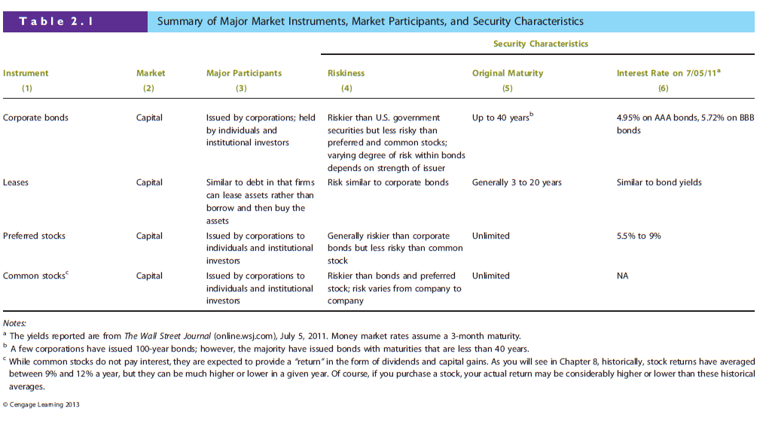
Chapter 2: Financial Markets and Institutions

Slide 4
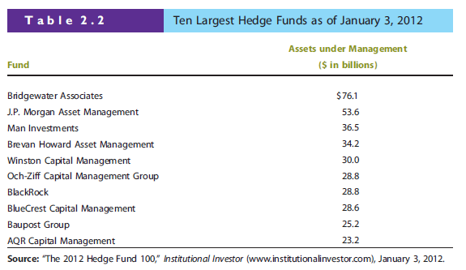
Chapter 2: Financial Markets and Institutions

Slide 5


Slide 6
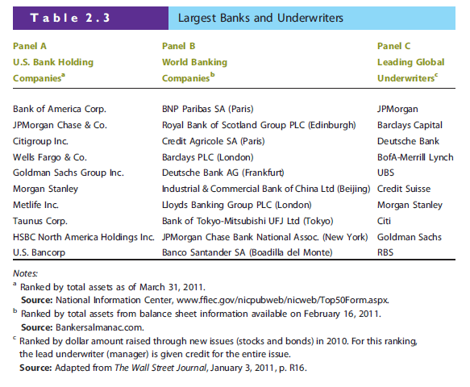
Chapter 2: Financial Markets and Institutions

Slide 7
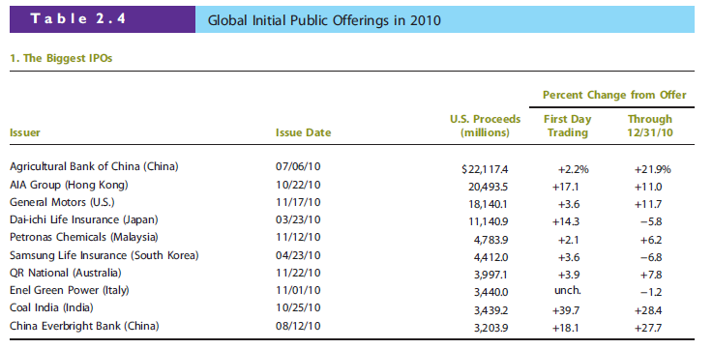
Chapter 2: Financial Markets and Institutions

Slide 8
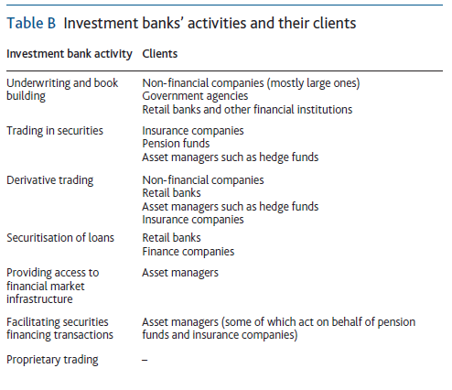

Slide 9
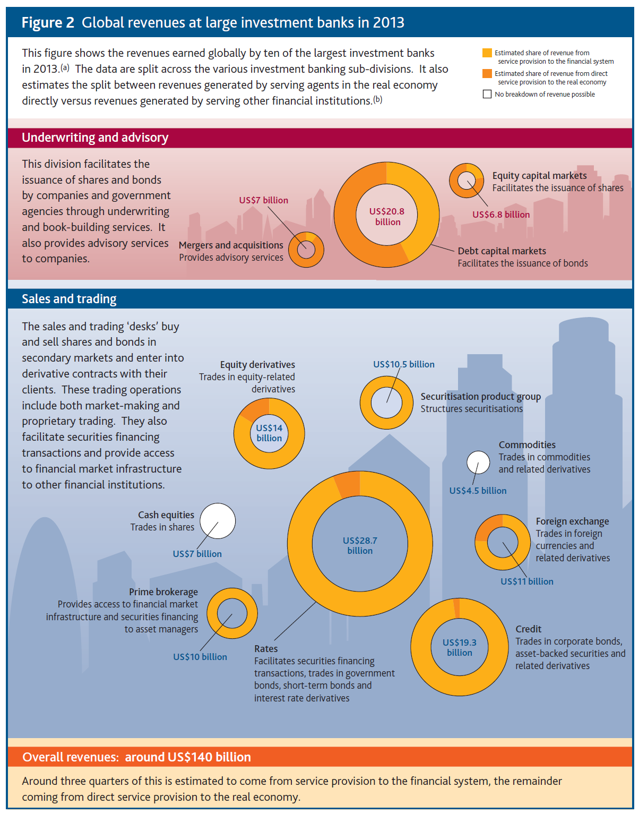

Slide 10
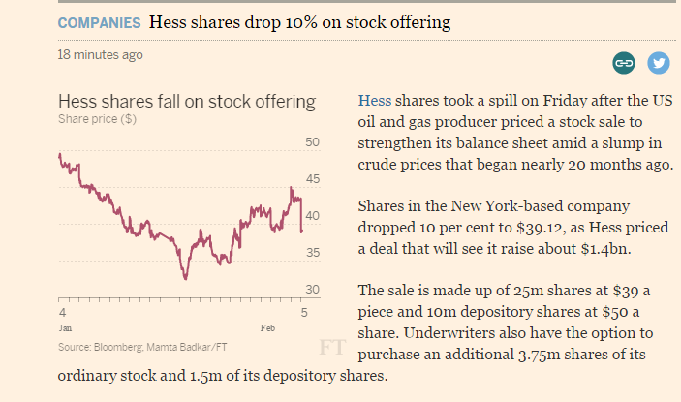
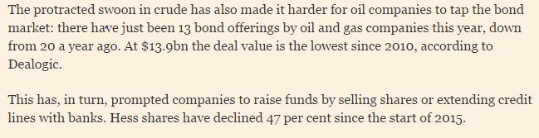

Slide 11
Financial Statements, Cash Flow, and Taxes
Chapter 3
Key Financial Statements
Balance Sheet
Income Statement
Statement of Cash Flows
Statement of Stockholders’ Equity
Free Cash Flow
Federal Tax System
Notes:
-I think this chapter might be hard to follow esp. if students have weak accounting background (like me) so it’s better to go slowly
-There are many terms so have to make sure to explain each term so that students can follow
-So many abbreviations like MVA, AT,…

Slide 12
Objectives
List each of the key financial statements and identify the kinds of information they provide to corporate managers and investors.
Estimate a firm’s free cash flow and explain why free cash flow has such an important effect on firm value.
Discuss the major features of the federal income tax system.

Slide 13
The Annual Report
Balance sheet – provides a snapshot of a firm’s financial position at one point in time.
Income statement – summarizes a firm’s revenues and expenses over a given period of time.
Statement of cash flows – reports the impact of a firm’s activities on cash flows over a given period of time.
Statement of stockholders’ equity – shows how much of the firm’s earnings were retained, rather than paid out as dividends.

Slide 14
A Glimpse into the health of companies
Every publicly listed company must provide annual reports to the public
  Used to send it by post
  Now available online at the company website under investor relations
  disney investor relations
  Every 3 months, listed companies must also produce quarterly reports to provide financial data to the public.

Slide 15
What is a balance sheet (simplified)
balance sheet

Slide 16
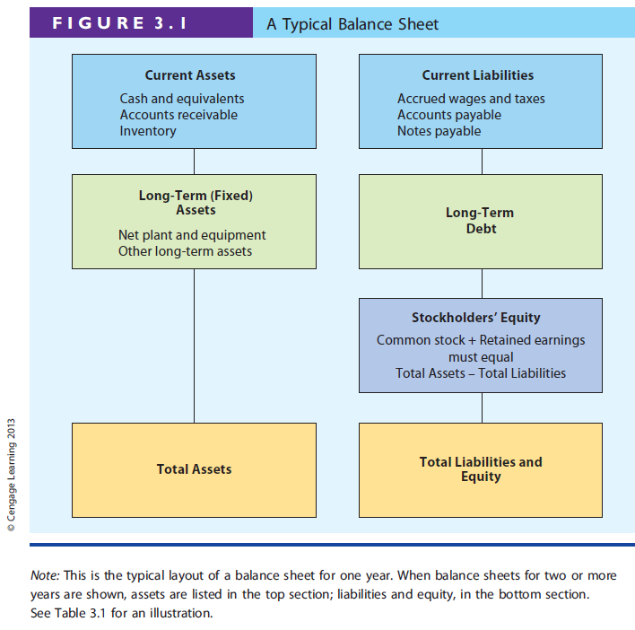

SNAPSHOT
Notes:
-There are some examples of balance sheets that I copied if from ‘Exhibit PTT slides’ folder na ka may be it will help you explain the material but since it’s too small to read I put them together in word file ‘Chapter 3 extra’ na ka.

Slide 17
Balance Sheet For Allied Food Products
It tells you net worth of this company
It also tells you the financial strength
A single year’s balance sheet is insufficient to reveal how well the company is run
  How assets are financed ( funded)
  Equity is increasing or decreasing

Slide 18
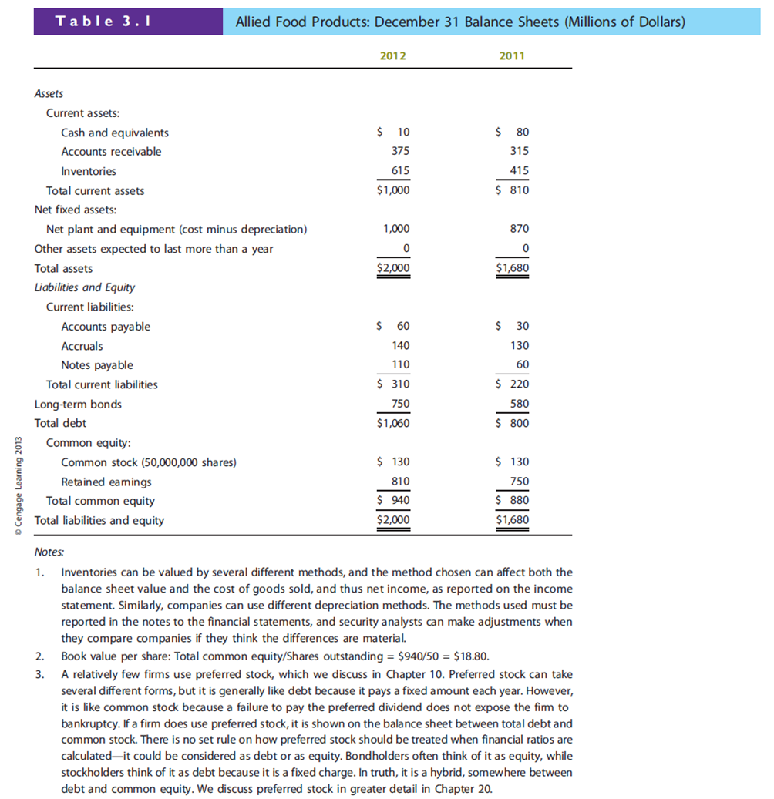

Slide 22


Slide 24
Net Working Capital= Current Assets- Current Liablities
Net Operating Working Capital= Current Assets- Current Liablities +Notes Payable

Slide 25
Depreciation
Accounting recognition of declining values of fixed assets
It can be used to reduce taxable income hence leads to lower taxes owed to the government (IRS)

Slide 26
Market VS book values
Allied purchasd its headquarter in Chicago in 1988
Value of the assets must be reported at the historical cost (what it paid in 1988) less depreciation
Market Values are much higher than the book values
If a company has problems, price can fall well below its book value

Slide 27
Balance Sheet is not static
Assets could vary enormously throughout the year
  Cash
  Inventories
  Accounts payable/ accounts receivable
  For example, retailers hold large inventories before the christmas shopping season. (seasonal adjustments)

Slide 28
If a firm reports $20 million of retained earnings on its balance sheet, could its directors declare a $20 million cash dividend without having any worries about what they were doing?

Slide 29
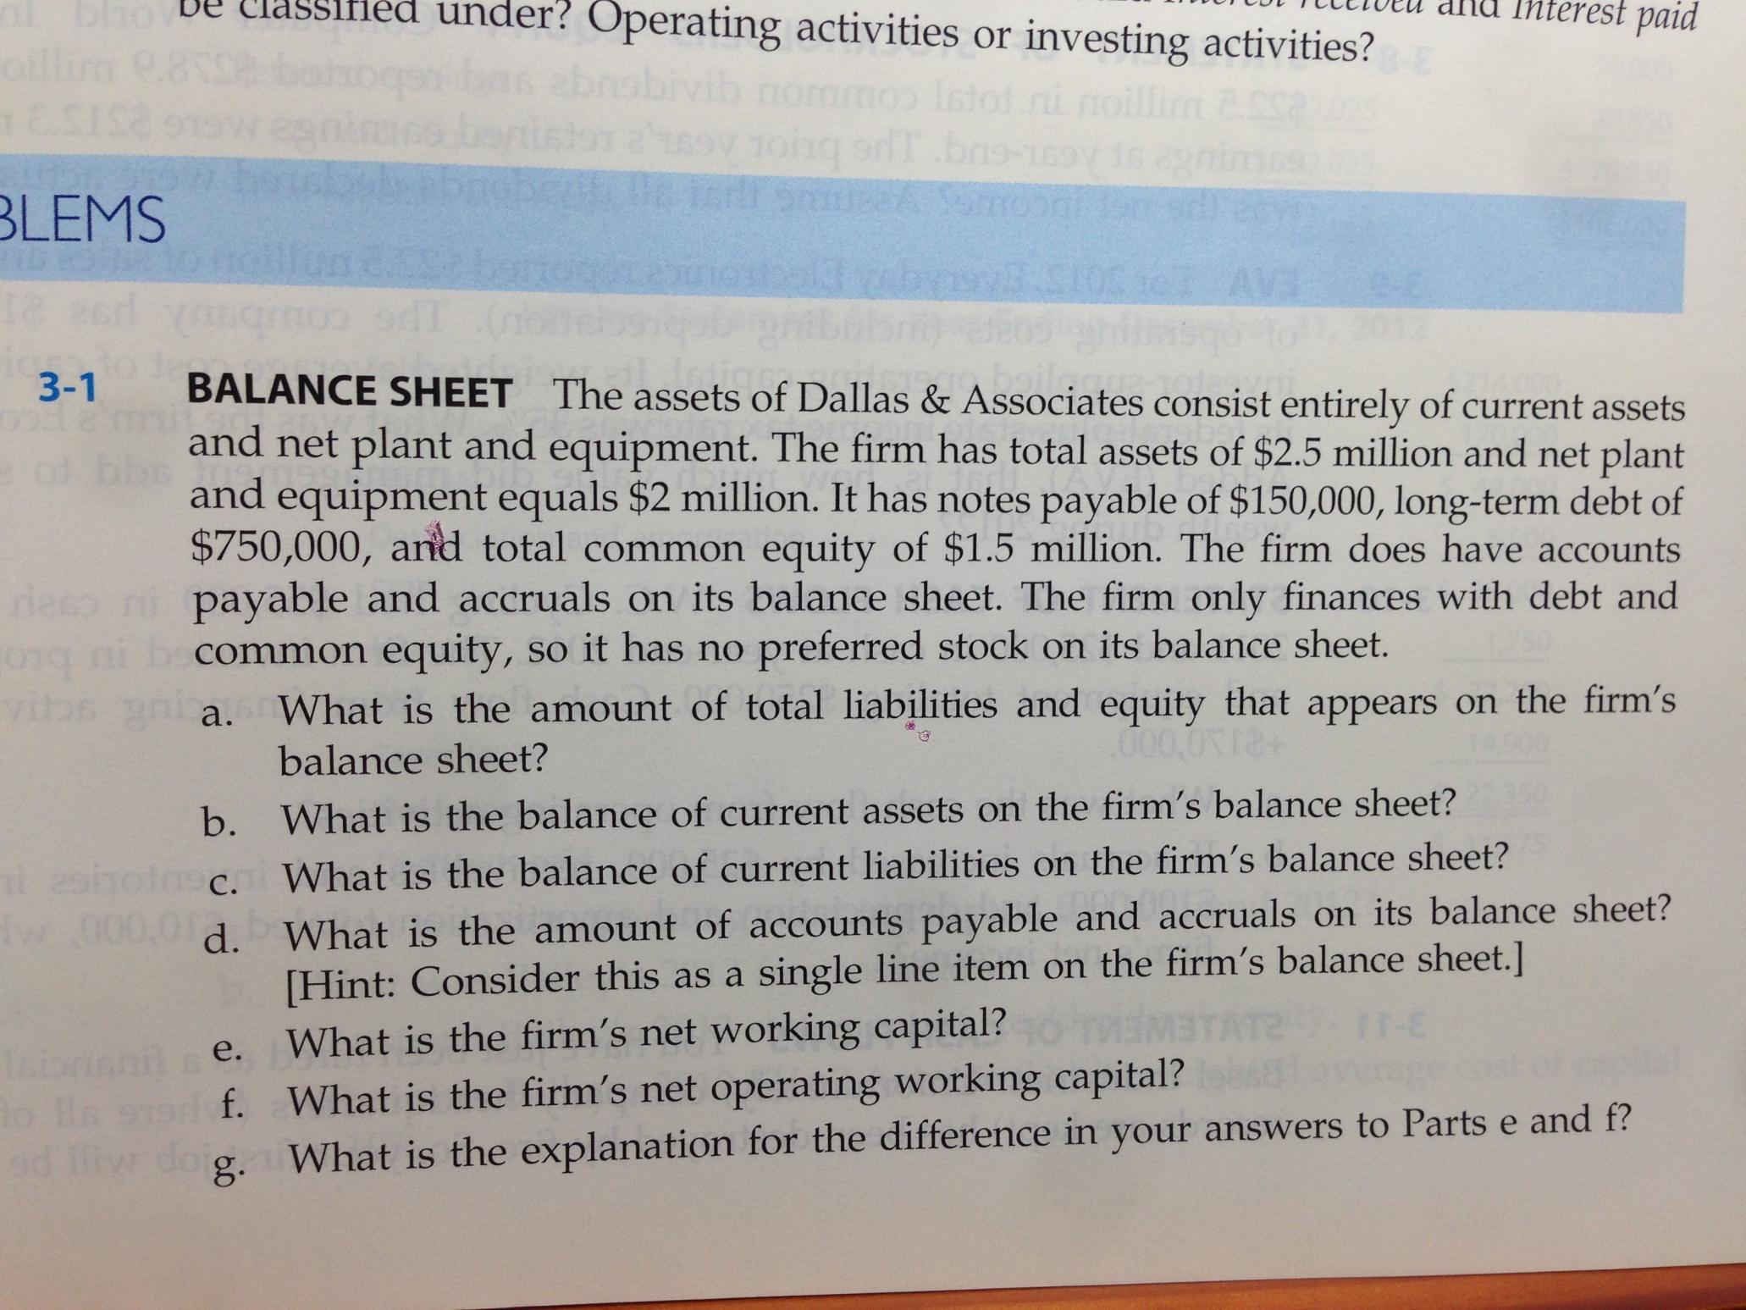

Slide 30
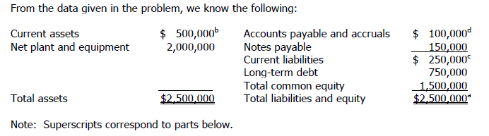

Slide 31
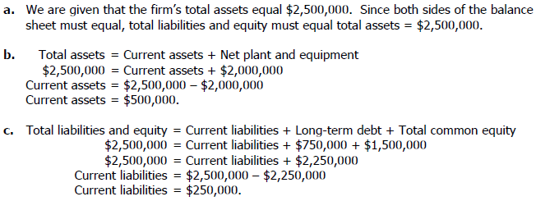

Slide 32
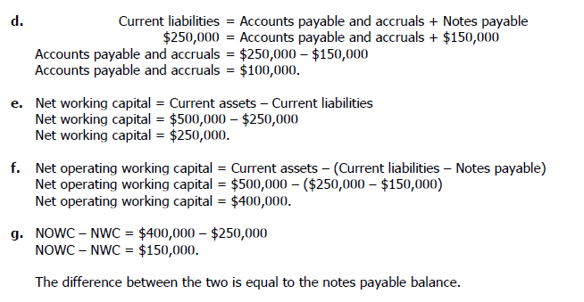

Slide 33
Income statement
Captures what has happened to the firm in terms of operation , sales, profits etc
Contrast this with the Balance Sheet

Slide 34
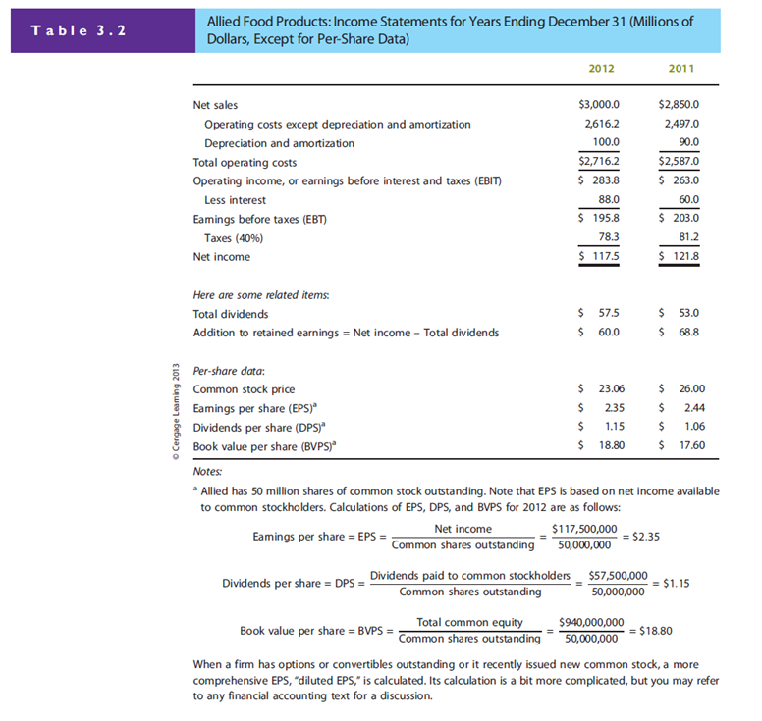

Slide 37
(Net Income/ no of shares) Earnings per share is the bottom line

Slide 41
Operating Income VS Net Income
Why are they not equal?
  What else contributed to net income
Which one should we pay more attention to?
  Why? If we want to buy a business, what number should we really look at?
Amateurs( speculators) typically focus on EPS , but there s a big difference between operating income and non-operating income

Slide 42
Operating income
Derived from regular core business
Calculated before taking into account of interest expenses and taxes
Different firms have different amount of debt, tax structures (carry backs and carry forwards) and different non-operating assets( stocks or bonds , real estate or other investment in other companies)
Also, net income differs depending on how firms finance itself ( debt or equity)

Slide 43
Which one is likely to report higher net income?
Is it always the case?
  Apple computer issued bonds back in 2011 even though it is awash with cash ( why borrow cash if you already have ample cash with you)
Operating income is much more stable than the net income ( agree?)

Slide 44
Depreciation & Amortization
Depreciation ( tangible assets)
Amortization( intangible assets)
  Disney reported higher D&A from its amortization of Lucasfilm ( which owned star wars, indiana jones)
Why are D&A not the same as Asset purchase?
  Time dimension is important.
Both of them write off the costs of assets over its life ( this is subject to variations)
They are not cash expenses therefore the concept of EBITDA is introduced as managers sometimes are more concerned over the cash generation
Net income= dividends+ retained earnings

Slide 45
STATEMENT OF CASH FLOWS

Slide 46
Cash flows
This is to be used in conjunction with balance sheet and income statement to check consistencies and accounting irregularities
This traces the movement of cash over a period of time ( monthly, quarterly, annually)
Income statement is recorded on an accrual basis as opposed to on actual cash movements
Beware of firms which record positive net incomes , but continue to lose cash
It differentiates between cash and non-cash charges

Slide 47
What generates cash?
Accounts payable
Accrued wages and taxes
Reduction in inventories
Sale of assets
Loans from banks, capital markets
Issuance of Bonds/ Stocks

Slide 48
What loses cash
Accounts receivable
Inventory buildup
Investment in securities or long-term assets
Bond buybacks, stock buybacks
Repayment of bank loans
Dividend payments to stockholders

Slide 49
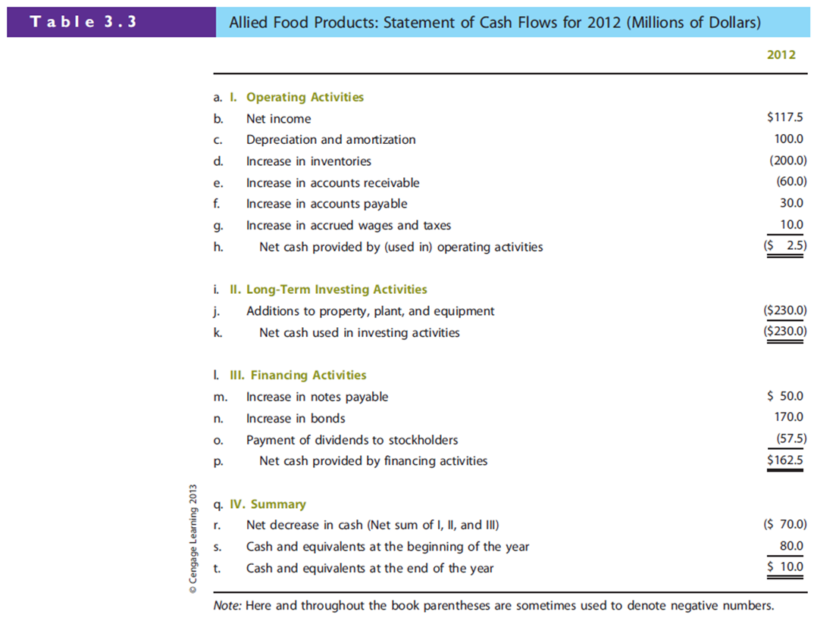

Slide 51
So what should we make of Allied Cash Flows?
Is firm running positive cash flow over time
Is cash position stable year to year
Long term investment should equal depreciation over time.

Slide 52
Massaging the numbers
Accounting fraud can take place both in income statement (more often) and statement of cash flows(less common).
Cash is harder to fabricate as it involves actual cash movement ( provided that the auditor is honest and reliable)
In 2005 Ford, GM and other companies overstated their operating cash flows, the most important section of the cash flow statement

Slide 53
GM reported more than twice as much as from operations (7.6 bn VS 3.5 bn)
HOW?
When GM sold cars to dealers, it should list the transactions as Account Receivable, but instead GM recorded these as “ Loans to dealers” and reported them as financing activity
The net cash position was NOT affected, but it made GM appear stronger than it really was

Slide 54
Try it with Allied Food in Table 3.3
Let s try to massage the book for Allied Food and see what happens

Slide 55
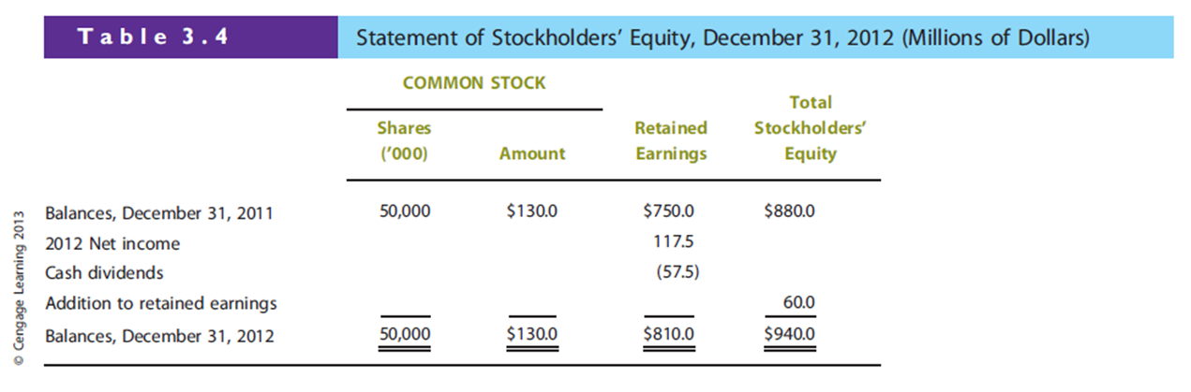
Retained Earnings are not the same as cash in hand.
They represent reinvestment in to the company over time
since the company s inception

Slide 56
USES and Limitations of financial statements
How large is the firm
Growing or shrinking?
Profitable or loss-making
Cash cows or Cash strapped firms

Slide 57
Mind the GAAP please
GAAP (generally accepted accounting principles)
Subject to interpretations
Especially on inventories valuation and depreciation and amortization

Slide 58
Financial Shenanigans
Ignore or disregard GAAP compleltely
  Worldcom, Enron, Tyco
Led to Sarbanes-Oxley Act (SOX)

Slide 59
FREE CASH FLOWS (FCF)
Not reported by the financial statements as prepared by accountants
FCF defined as” the amount of cash that could be withdrawn from a firm without harming its ability to operate of produce future cash flows”

Slide 60
FCF = [EBIT(1-T) + Depreciation & Amortization]
    - [Capital Expenditures + Change in NOWC]
Negative Free cash flows means the business cannot generate cash to invest and expand , hence in need of extra funding from the capital market or bank loans

Slide 61
Most analysts regard FCF as the most important number that can be developed from the financial statements , even more important than net income
FCF shows how much cash can be disbursed to its investors ( Owners Earning).
FCF can be used to calculate stock valuation and capital budgeting

Slide 62
Market Value Added and Economic Value Added
MVA = market value- book value
think of MVA as the premium over the book value
Maybe because of the risk sentiment ( bullish or bearish markets)
EVA= Net operating profit after taxes (NOPAT) – Annual dollar cost of capital
    Represents the true economic profit over the year
    Differs from the net income, having taken into account of the cost of capital

Slide 63
TAXES

Slide 64
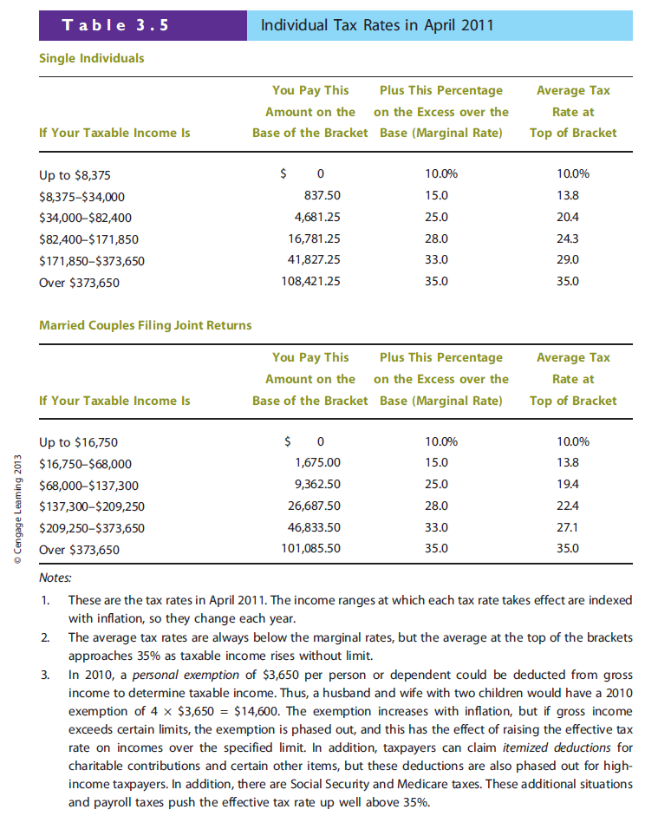

Slide 65
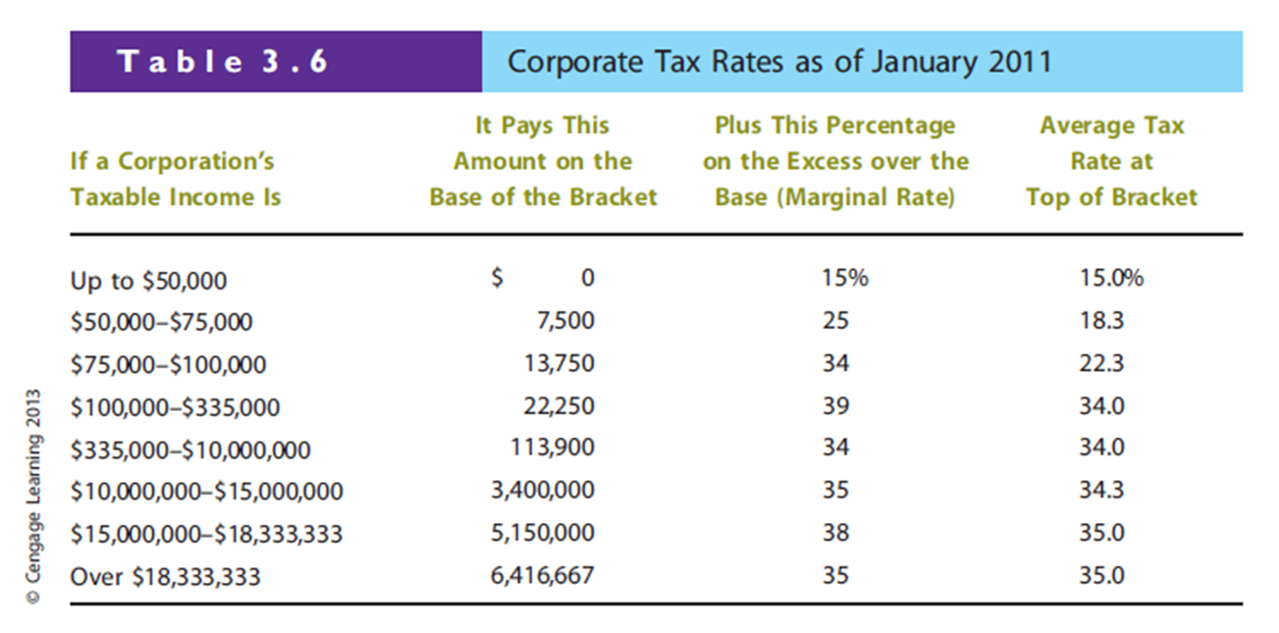

Slide 66
Corporate Loss Carry-back and Carry-Forward
Operating losses can be carried back to the preceding two years or carried forward for the next twenty years and used to offset taxable income in those years.
Can use this to reduce net income in previous years and in the future periods

Slide 67
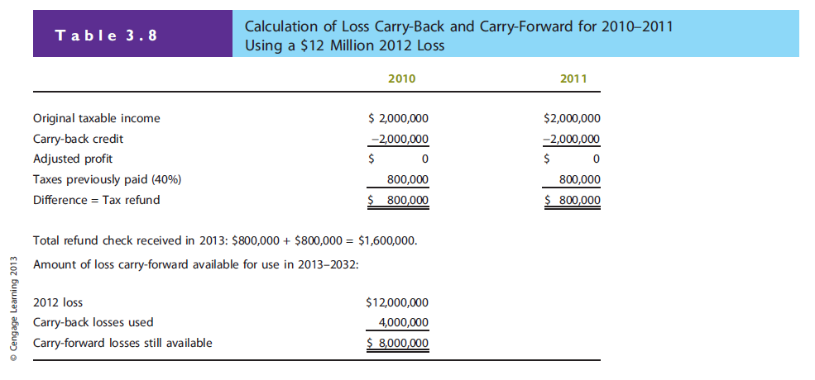

Slide 68
Interest and Dividends paid
Interest paid can be deducted from operating income but dividends paid cannot be used.
DEPRECIATION
  Also plays an important role in income tax calculations
  The larger the depreciation, the lower the tax bill and therefore higher operating cash flows

Slide 69
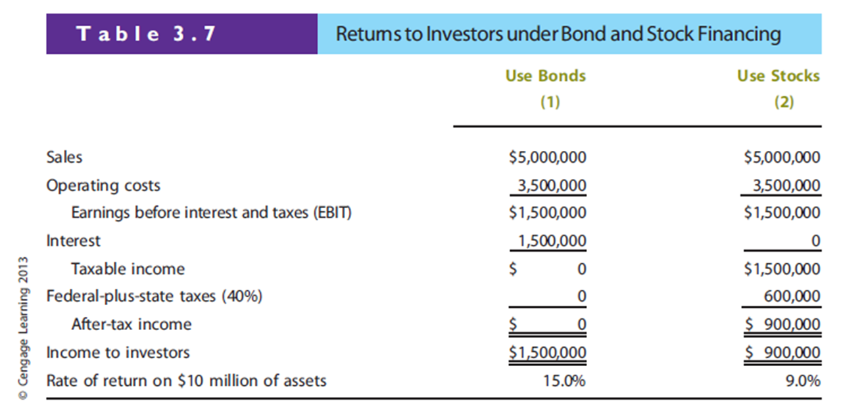

Slide 70
Overview of D’Leon Inc.
Snack food company that underwent major expansion in 2011.
So far, expansion results have been unsatisfactory.
  Company’s cash position is weak.
  Suppliers are being paid late.
  Bank has threatened to cut off credit.
Board of Directors has ordered that changes must be made!
Notes:
-This example includes everything but it’s a lot! So should explain slowly or even print it out separately in A4 so that they can read the situation easier
I always feel that when there is this kind of example, Prof. loses me since the set up of the example so I cannot follow up the whole examples.

Slide 71
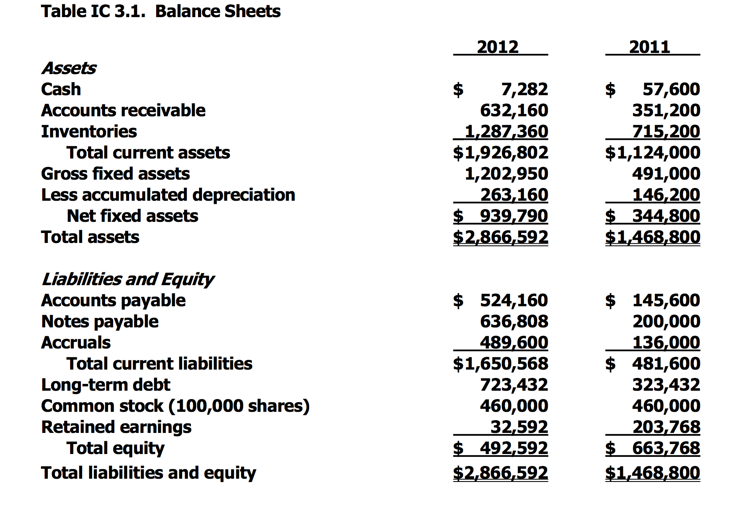

Slide 72
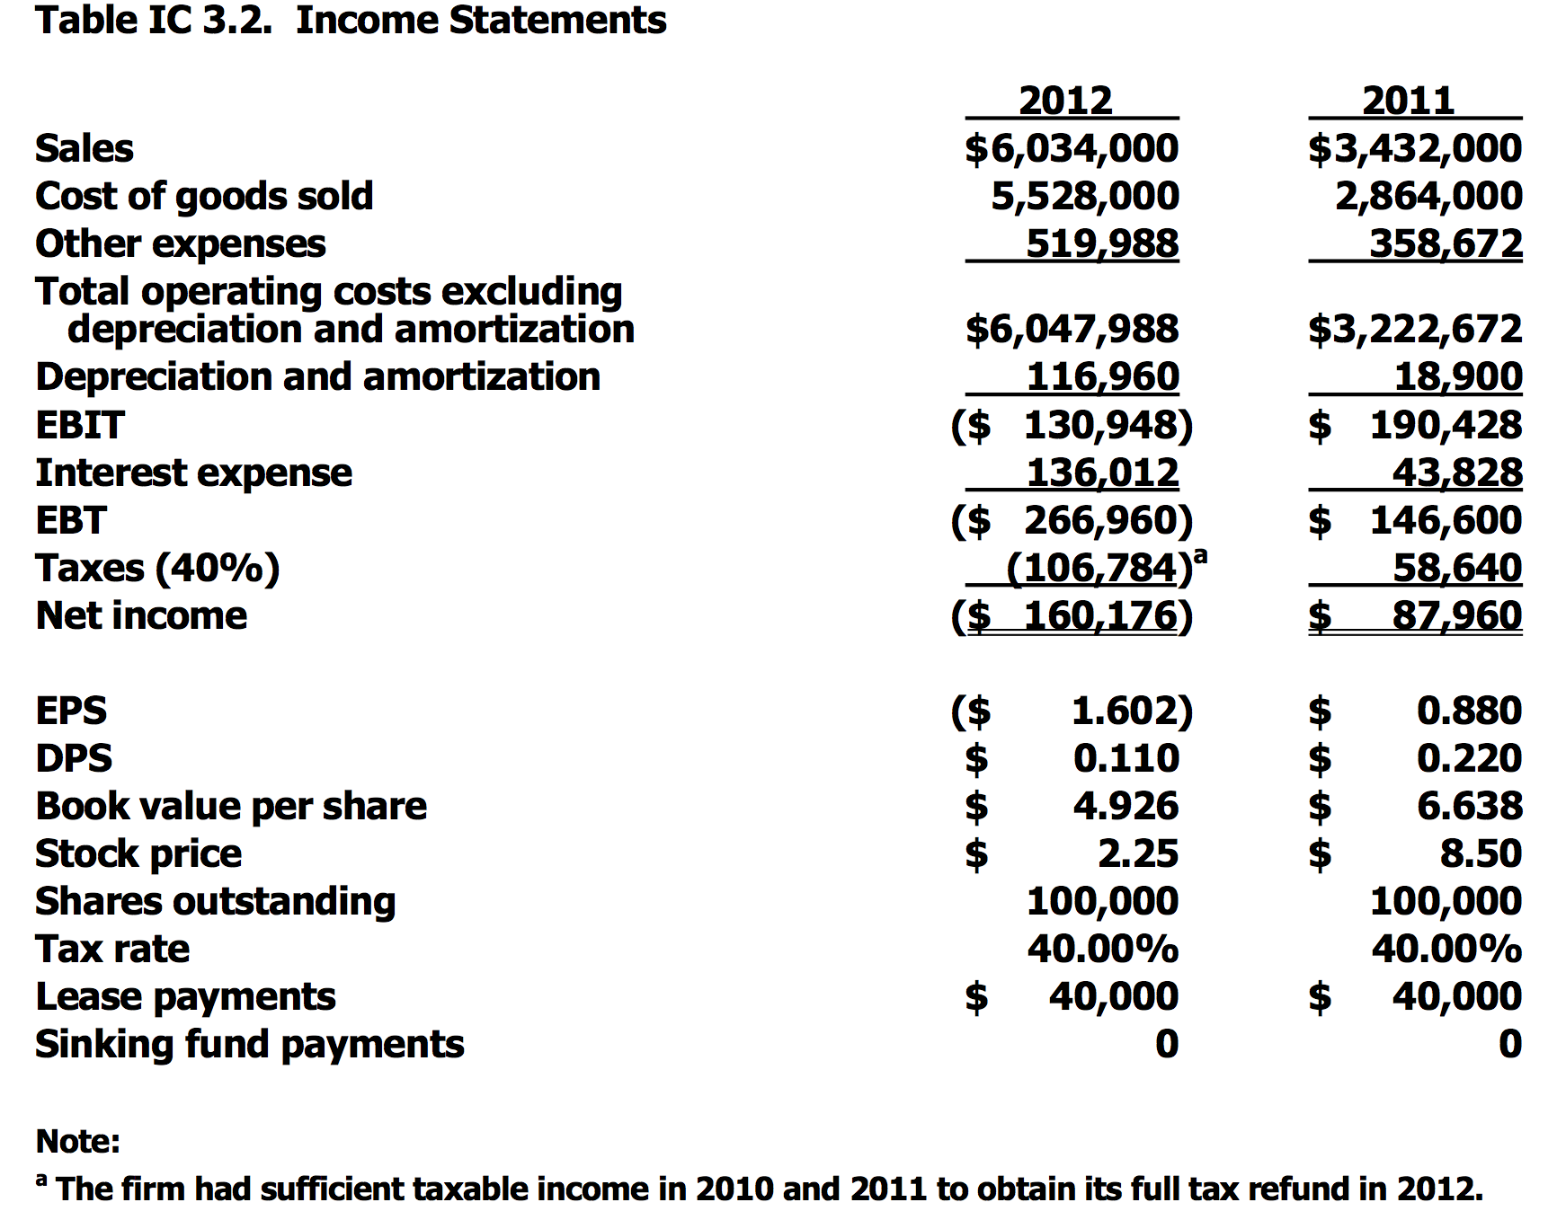

Slide 73
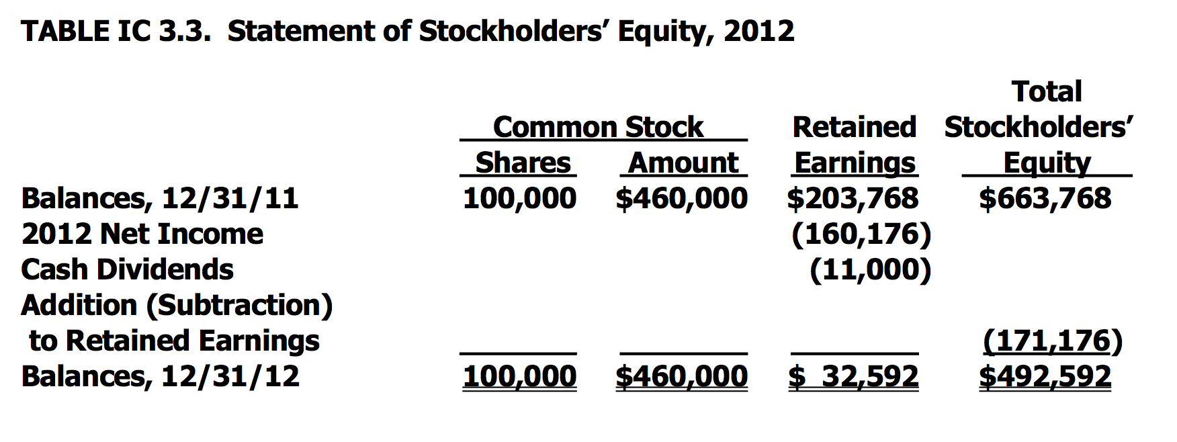

Slide 74
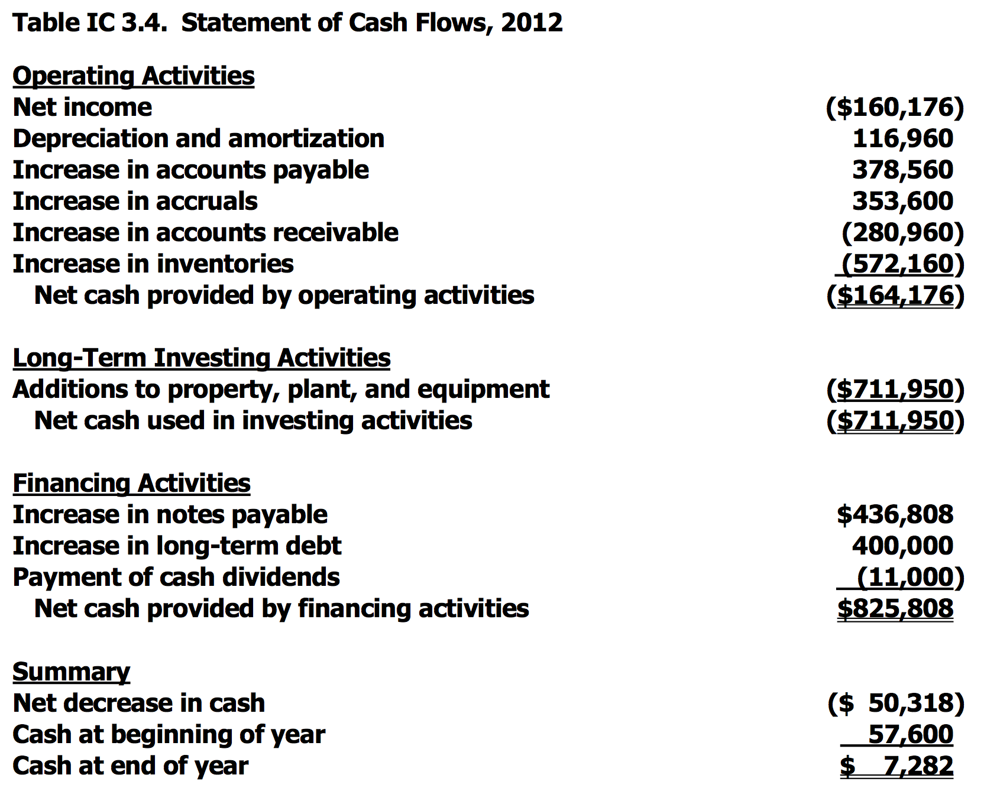

Slide 75
Other Data
No. of shares
EPS
DPS
Stock price
Lease pmts
2012
100,000
-$1.602
$0.11
$2.25
$40,000
2011
100,000
$0.88
$0.22
$8.50
$40,000

Slide 76
Statement of Stockholders’
Equity (2012)
Total
Common Stock
Retained
Stockholders’
Shares
Amount
Earnings
Equity
Balances,
12/31/11
100,000
$460,000
$203,768
$663,768
2012 Net income
(160,176
)
Cash dividends
(11,000)
Addition (subtraction)
to retained earnings
(171,176
)
Balances, 12/31/12
100,000
$460,000
$ 32,592
$492,592

Slide 77
Statement of Cash Flows (2012)
Operating
Activities
Net income
($160,176)
Depreciation and amortization
116,960
Increase in accounts payable
378,560
Increase in accruals
353,600
Increase in accounts receivable
(280,960)
Increase in inventories
(572,160
)
Net cash provide
d by operating activities
(
$164,176
)

Slide 78
Statement of Cash Flows (2012)
Long
-
Term Investing Activities
Additions to property, plant,
&
equipment
(
$
711,950
)
Net cash used in investing activities
(
$
711,950
)
Financing Activities
Increase in notes payable
$
436,808
Increase in long
-
term debt
400,000
Payment of cash dividends
(11,000
)
Net cash provided by financing activities
$
825,808
Summary
Net decrease in cash
($
50,318)
Cash at beginning of year
57,600
Cash at end of year
$
7
,282

Slide 79
Conclusions about D’Leon’s Financial Condition from Its Statement of CFs
Net cash from operations = -$164,176, mainly because of negative NI.
The firm borrowed $836,808 to meet its cash requirements.
Even after borrowing, the cash account fell by $50,318.

Slide 80
Did the expansion create additional after-tax operating income?
AT operating income = EBIT(1 – Tax rate)
AT operating income₁₂ = -$130,948(1 – 0.4)
= -$130,948(0.6)
= -$78,569
AT operating income₁₁ = $114,257

Slide 81
What effect did the expansion have on net operating working capital?
Notes:
-Explain what is NOWC

Slide 82
Assessment of the Expansion’s Effect on Operations
2012
2011
Sales
$6,034,000
$3,432,000
AT oper. inc.
-
78,569
114,257
NOWC
913,042
842,400
Net income
-
160,176
87,960

Slide 83
What was the free cash flow (FCF) for 2012?
FCF₁₂ = [-$130,948(1 – 0.4) + $116,960] –
[($1,202,950 – $491,000) + $70,642]
= -$744,201
Is negative free cash flow always a bad sign?
Notes:
-Explain what is FCF and its importance.

Slide 84
Performance Measures for Evaluating Managers
Accounting statements insufficient for evaluating managers’ performance because they do not reflect market values.
Performance Measures
  MVA = Difference between market value and book value of a firm’s common equity.
  P₀ x Number of shares – Book value.
  EVA = Estimate of a business’ true economic profit for a given year.
Investor-supplied capital
Cost of capital
EBIT(1 – T) – x
Notes:
-More explanation because I always don’t understand the concept of them.
-What is MVA?
-What is EVA?

Slide 85
What was D’Leon’s MVA in 2012 and 2011?
MVA₁₂ = ($2.25 x 100,000) – $492,592
= -$267,592
MVA₁₁ = ($8.50 x 100,000) – $663,768
= $186,232
Shareholder wealth has been destroyed!

Slide 86
What is the relationship between EVA and MVA?
If EVA is positive, then AT operating income > cost of capital needed to produce that income.
Positive EVA on annual basis helps to ensure MVA is positive.
MVA is applicable to entire firm, while EVA can be calculated on a divisional basis as well.

Slide 87
Does D’Leon pay its suppliers on time?
Probably not.
A/P increased 260%, over the past year, while sales increased by only 76%.
If this continues, suppliers may cut off D’Leon’s trade credit.

Slide 88
Does it appear that D’Leon’s sales price exceeds its cost per unit sold?
NO, the negative after-tax operating income and decline in cash position shows that D’Leon is spending more on its operations than it is taking in.

Slide 89
What if D’Leon’s sales manager decided to offer 60-day credit terms to customers, rather than 30-day credit terms?
If competitors match terms, and sales remain constant...
  A/R would ↑.
  Cash would ↓.
If competitors don’t match, and sales double...
  Short-run: Inventory and fixed assets ↑ to meet increased sales. A/R ↑, Cash ↓. Company may have to seek additional financing.
  Long-run: Collections increase and the company’s cash position would improve.

Slide 90
How did D’Leon finance its expansion?
D’Leon financed its expansion with external capital.
D’Leon issued long-term debt which reduced its financial strength and flexibility.

Slide 91
Would D’Leon have required external capital if they had broken even in 2012 (Net income = 0)?
YES, the company would still have to finance its increase in assets. Looking to the Statement of Cash Flows, we see that the firm made an investment of $711,950 in net fixed assets. Therefore, they would have needed to raise additional funds.

Slide 92
What happens if D’Leon depreciates fixed assets over 7 years (as opposed to the current 10 years)?
No effect on physical assets.
Fixed assets on the balance sheet would decline.
Net income would decline.
Tax payments would decline.
Cash position would improve.

Slide 93
Tax Treatment of Various Uses and Sources of Funds
Interest paid: tax deductible for corporations (paid out of pre-tax income), but usually not for individuals (interest on home loans being the exception).
Interest earned: usually fully taxable (an exception being interest from a “muni”).
Dividends paid: paid out of after-tax income.

Slide 94
Tax Treatment of Various Uses and Sources of Funds
Dividends received: most investors pay 15% taxes through 2012. The rate is scheduled to rise after 2012.
  Investors in the 10% or 15% tax bracket pay 0% on qualified dividends through 2012.
  Dividends are paid out of net income which has already been taxed at the corporate level, this is a form of “double taxation”.
  A portion of dividends received by corporations is tax excludable, in order to avoid “triple taxation.”

Slide 95
More Tax Issues
Tax Loss Carry-Back and Carry-Forward – since corporate incomes can fluctuate widely, the Tax Code allows firms to carry losses back to offset profits in previous years or forward to offset profits in the future.
Capital gains – defined as the profits from the sale of assets not normally transacted in the normal course of business, capital gains for individuals are generally taxed as ordinary income if held for a year or less, and at the capital gains rate if held for more than a year. Corporations face somewhat different rules.

