Slide 1
Bangkok Expressway
EE382 Economics of Transportation

Slide 2
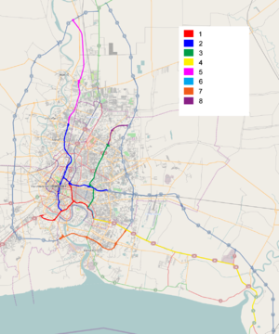

Slide 3
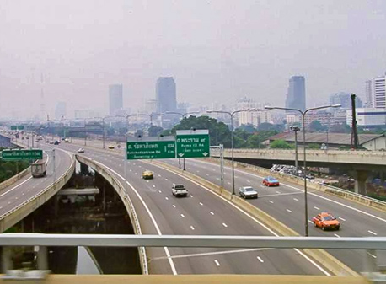
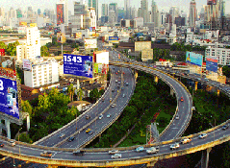
1.Chaloem Maha Nakhon Expressway
(First Stage Expressway System)

Slide 4
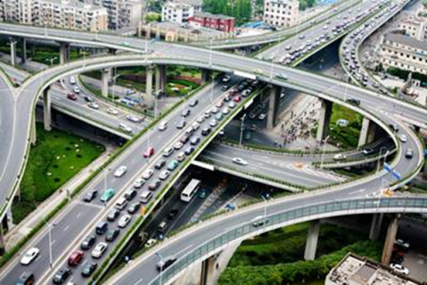
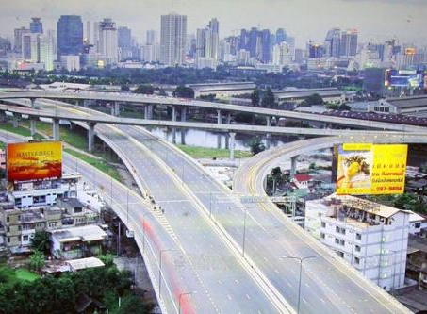
3.Chalong Rat Expressway
(Ramindra – At Narong Expressway)
2.Si Rat Expressway
(Second Stage Expressway System)

Slide 5
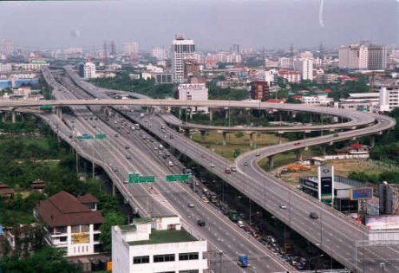
4.Burapha Withi Expressway
(Bang Na Expressway)

Slide 6
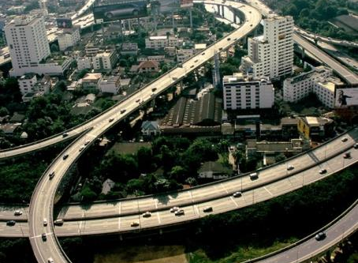
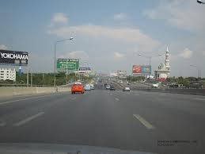
5.Udon Ratthaya Expressway (Bang Pa-in – Pak Kret Expressway)
6.Third stage expressway System, S1 section (At Narong - Bang Na)

Slide 7
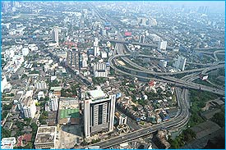
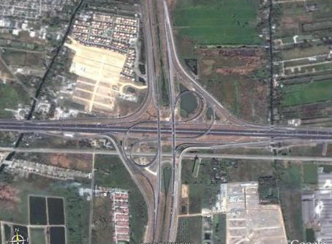
7.Bang Phli – Suk Sawat Expressway
(South Kanchanaphisek ring road)
8.Ramindra Outer Ring
Road Expressway

Slide 8
EXAT & BECL
EXAT or ETA
    Expressway Rapid and Transit Authority
      First-stage toll expressway
BECL
    Bangkok Expressway Company Limited
      Second-stage expressway

Slide 9
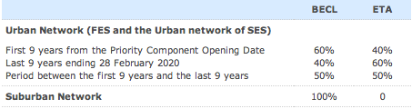
Revenue Sharing

Slide 10
Easy Pass
Electronic Toll Collection System
Capable of electronically charging a toll to registered car
Improve traffic flow through toll collection areas
  Reduce congestion at toll station
  Eliminate the delay on toll road

Slide 11
Easy Pass
Manual toll collection lanes handle about 450 vehicles per hour
With Easy pass system, it can process 1,200 vehicles per hour.

Slide 12
Increase in Toll
As of 1st September 2013
Toll increase in three expressways
  The Chalerm Mahanakorn Expressway
  The Si Rat Expressway
  The Burabhawithi Expressway

Slide 13
Increase in Toll
Raised by 5-10 baht
Additional amount of 10-30 satang per kilometer for the section beyond the first 20 kilometers on the Burabhawithi expressway

Slide 14
Economic Effects
Decline in traffic volume
Increase in revenue

Slide 15
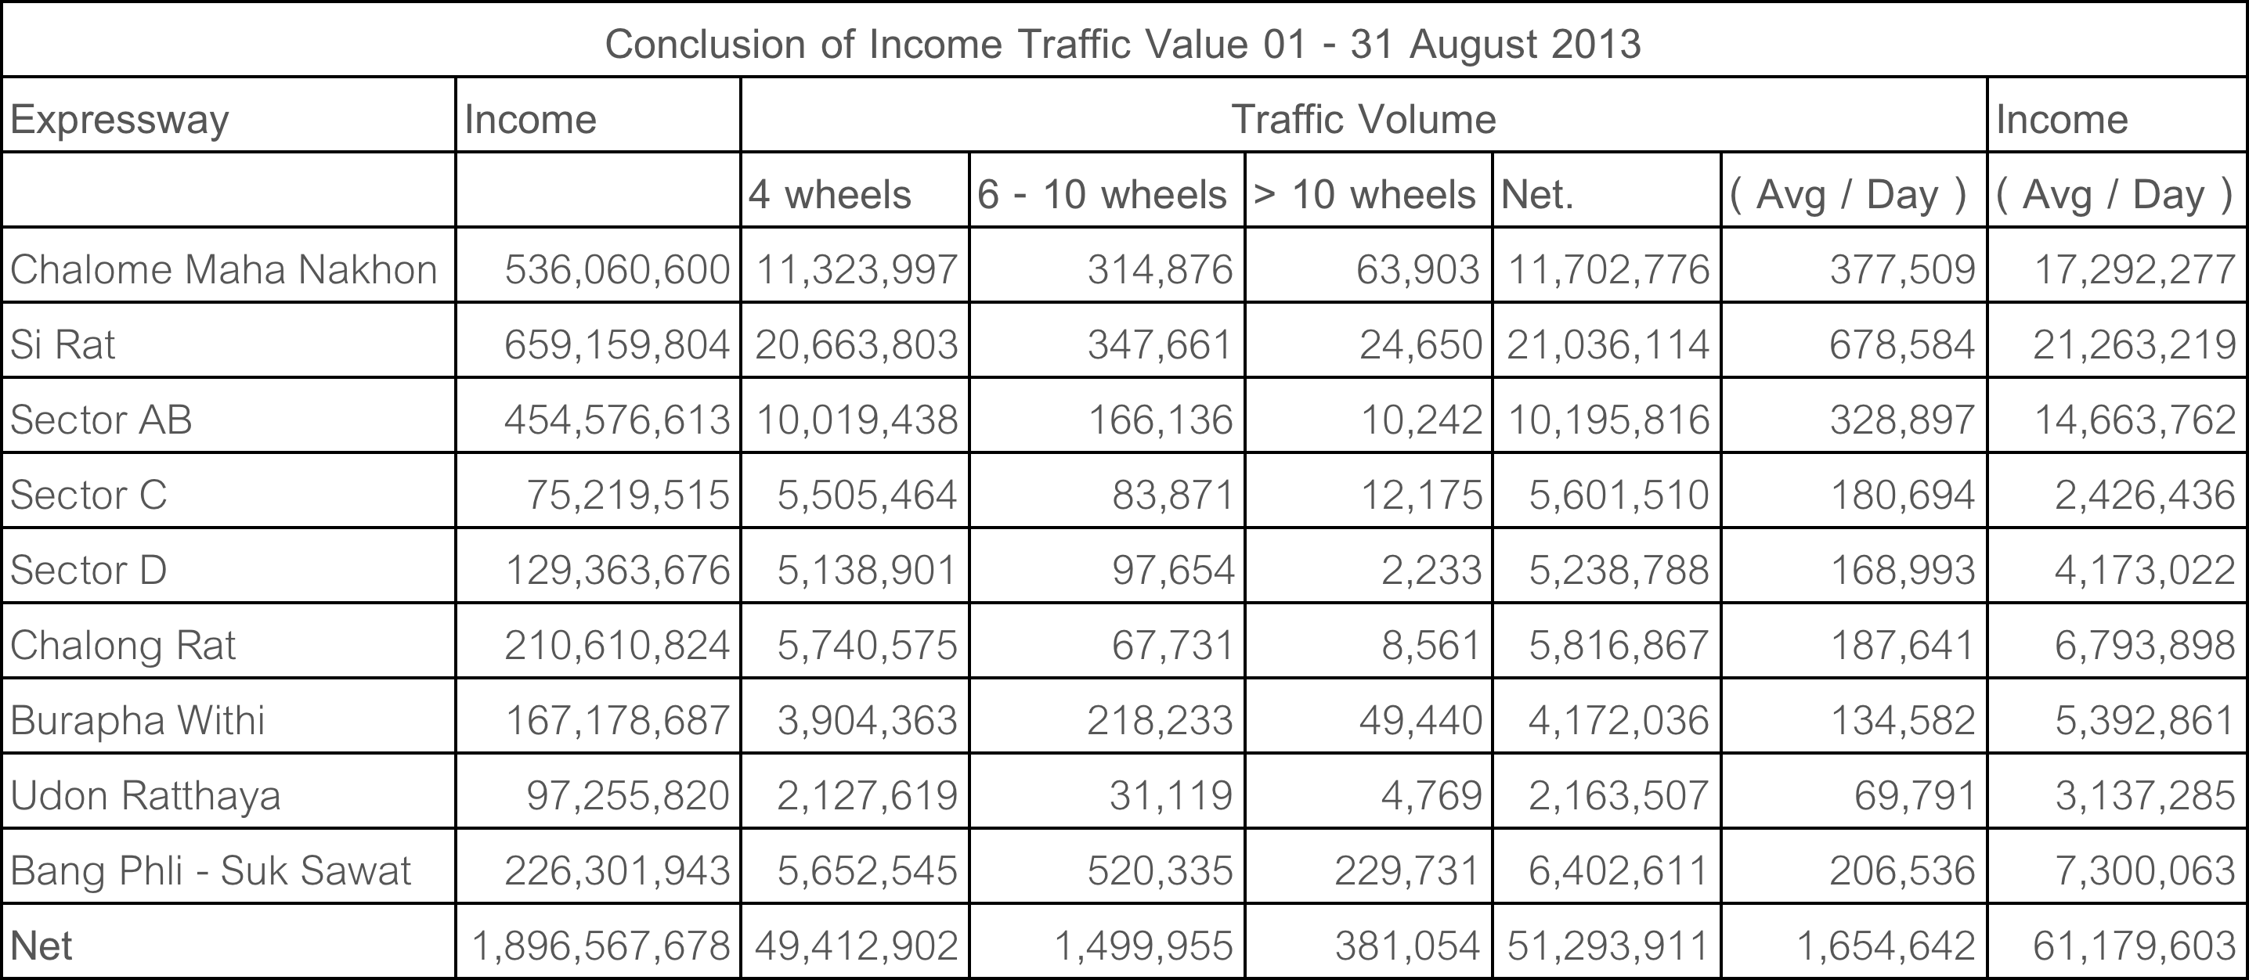
Source: www.exat.co.th

Slide 16
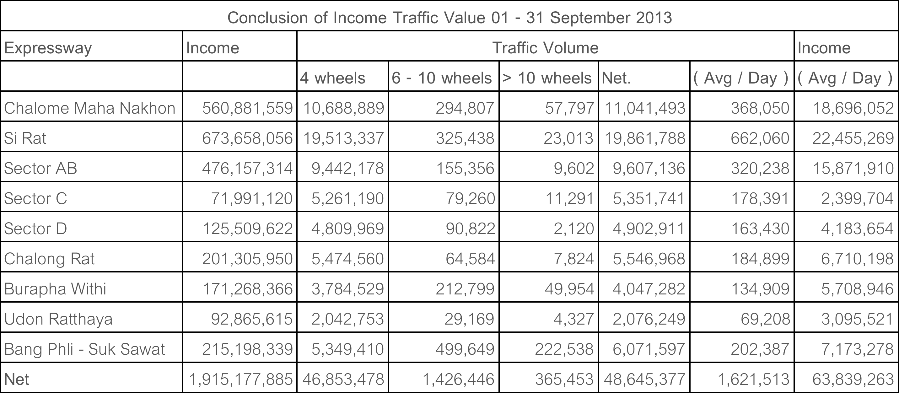
Source: www.exat.co.th

Slide 17
Change in traffic volume between August and September
 | Change in volume | Elasticity
4 wheels | -5.18% | -0.47
6-10 wheels | -4.90% | -0.69
More than 10 wheels | -4.09% | -0.52
Net | -5.16% | -0.55
Average per day | -2% | -

Slide 18
Change in income between August and September
month-on-month | 0.98%
Average per day | 4.35%

Slide 19
Simple Economic reasoning
Price
Gain in revenue
Loss in revenue
P₁ = initial toll fee
P₂ = new toll fee
Q₁ = traffic volume before fee rise
Q₂ = traffic volume after fee rise
P₂
P₁
Demand for expressway
Q₂
Q₁
Quantity/time

Slide 20
Simple Economic reasoning
Revenue increase more than offset effect of traffic decline
Demand for expressway in Bangkok is price inelastic

Slide 21
Psychological Effects
Drivers mostly resent toll fee increases
Cut back usage
Convenience of reduced transport time has overwhelmed the effect of higher toll fee

Slide 22
Side effects
Technical problems with the easy pass
Some driver cannot use easy pass because of server problems that miscalculate the remaining balance on some easy pass accounts
Heavy congestion during the first couples of days

Slide 23
Side effects
Some are confused and refrain from using easy pass altogether
Causing further congestion on the expressway
Should improve the server capability of handling information to improve customers’ confidence and thus making easy pass an effective way of reducing traffic on the expressway

Slide 24
Members
5504640151
5504640821
5504640938
5504641605

