Slide 1

Orange County Bankruptcy
FN323 Credit Analysis, Group 2

Slide 2
Introduction
Background
Investment Strategies
  -Introduction
  -Instruments
  -Risks and Losses
Result
Remedies
Suggestions

Slide 3
Background
Orange County is located in CA, USA.
Since 1970s, the city’s economy was expanding, leading immigrants to move in. This group of people was lower class citizen and needed government support.
1990s – Economic downturn. Unemployment rate increased. To be able to pay for the increased in social welfare, the government had to find a new way of earning money without raising tax.

Slide 4
Background
Strategy of Robert Citron (Treasurer of Orange county) “REVERSE REPURCHASE AGREEMENT”:
  Investment pool from local government and public agencies. Accumulated 7.6 billion.
  Used the money to borrow money to invest in derivatives, inverse floaters, and long term bonds that paid high yields. He then borrowed more money, with derivatives as collateral. The deposit increased to $20.6 billion.
  For this strategy to work: it requires the interest rate of the load to be lower than the returns on the investments. Profit comes from the spread.

Slide 5
Background
Background
Citron had been using this strategy since 1980. It worked at that time because the market interest rate was low.
However, FED raised the interest rate to help lower the inflation rate. Interest rate went from 3.25 to 5.5 percent within a year.
The state agencies who initially lent money to investment pool feared if Orange County could not return the money.
They recalled the money.
Orange County could not pay back the loan and filed for bankruptcy.

Slide 6
Investment Strategies

Slide 7
Introduction
In December 1994, Orange County stunned the markets by announcing that its investment pool had suffered a loss of $1.6 billion.
This was the largest loss ever recorded by a local government investment pool, and led to the bankruptcy of the county shortly thereafter.
This loss was the result of unsupervised investment activity of Bob Citron, the County Treasurer, who was entrusted with a $7.5 billion portfolio belonging to county schools, cities, special districts and the county itself.
Citron was viewed as a wizard who could painlessly deliver greater returns to investors.
Citron delivered returns about 2% higher than the comparable State pool

Slide 8
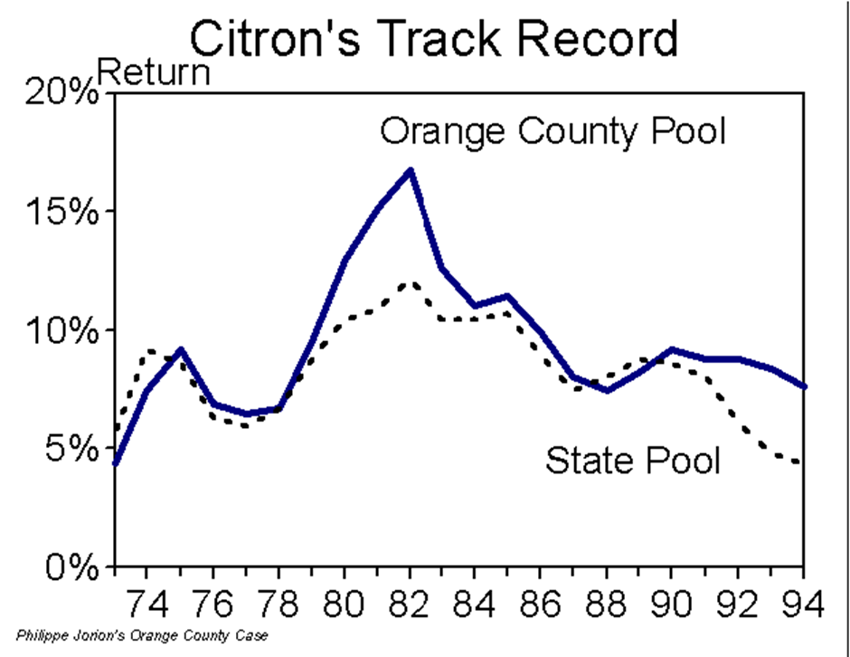

Slide 9
Citron was able to increase returns on the pool by investing in derivatives securities and leveraging the portfolio to the hilt.
Some local school districts and cities even issued short-term taxable notes to reinvest in the pool thereby increasing their leverage even further
public warnings, notably by John Moorlach, who ran for Treasurer in 1994, that the pool was too risky. Unfortunately, he was widely ignored and Bob Citron was re-elected.
The investment strategy worked excellently until 1994, when the Fed started a series of interest rate hikes that caused severe losses to the pool
Initially, this was announced as a “paper” loss
Shortly thereafter, the county declared bankruptcy and decided to liquidate the portfolio, thereby realizing the paper loss

Slide 10
Instruments
Reverse Repurchase Agreement
Inverse Floater

Slide 11
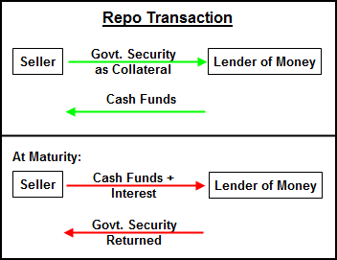
Reverse Repo
A form of short-term borrowing for dealers in government securities. The dealer sells the government securities to investors, usually on an overnight basis, and buys them back the following day.
For the party selling the security (and agreeing to repurchase it in the future) it is a repo; for the party on the other end of the transaction, (buying the security and agreeing to sell in the future) it is a reverse repurchase agreement.

Slide 12
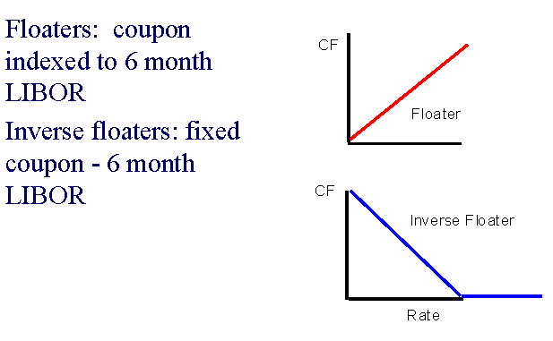
Inverse Floater
A bond or other type of debt whose coupon rate has an inverse relationship to a benchmark rate.
An inverse floater adjusts its coupon payment as the interest rate changes. When the interest rate goes up the coupon payment rate will go down because the interest rate is deducted from the coupon payment.
Notes:
You would want to invest in an inverse floater if the benchmark rate is high and you think the rate will decrease in the future at a faster rate than the forwards show.
With an inverse floater, as interest rates fall, the coupon rate rises because less is taken off.

Slide 13
BUSINESS REVIEW JANUARY/FEBRUARY 1997
Orange County and Derivative Securities
Orange County, California, declared bankruptcy in December 1994 after an investment fund run by the county treasurer reported losses that eventually amounted to $1.7 billion.
The OCIP did hold derivative securities, which amounted to about 40 percent of invested funds. But OCIP lost about 20 percent of its investors’ funds because of a risky bet on the direction of interest rates that turned out to be terribly wrong.

Slide 14
BUSINESS REVIEW JANUARY/FEBRUARY 1997
The county’s investment strategy was essentially to borrow short and lend long. [Usually, long-term interest rates are higher than short-term interest rates because the short-term return to holding long-term bonds is risky.]
Merrill Lynch introduced him to a new strategy: "step-up double inverse floaters." These securities were tied to interest rates, paying progressively more as interest rates fell.
Rates had been falling and Citron was convinced they would keep falling for years.

Slide 15
The Portfolio
Bob Citron was implementing a big bet that interest rates would fall or stay low
The $7.5 billion of investor equity was leveraged into a $20.5 billion portfolio
Citron pledged his securities as collateral and reinvested the cash in new securities, mostly 5-year notes issued by government-sponsored agencies, this is through the reverse repurchase agreement
The portfolio leverage magnified the effect of movements in interest rates. This interest rate sensitivity is also known as duration.

Slide 16
The OCIP got more bang for its buck by leveraging up its investment: the pool posted the long-term bonds as collateral and borrowed against them at the short-term interest rate. It then took the borrowed money and purchased more long-term bonds.
The strategy was profitable as long as interest rates stayed the same or declined. But in February 1994 interest rates began rising. When interest rates rise, the price of bonds falls. As a result, the long-term bonds in the OCIP declined in value at the same time that the cost of short-term borrowing was rising.
The OCIP also invested in interest rate derivative securities called inverse floaters. These derivatives gain value when interest rates fall and lose value when they rise. When interest rates rose in 1994, these securities took a big hit. The losses in the OCIP can be approximately broken down as follows.

Slide 17
The initial value of the OCIP portfolio was $7.6 billion. Through leverage, however, the total value of invested funds was on the order of $20 billion. The OCIP had a $12 billion investment in fixed-rate bonds that had an average maturity of four years. When interest rates rose in 1994 these bonds lost about $360 million. About $8 billion of OCIP funds were invested in inverse floaters, which lost about $620 million. Short-term borrowing of about $12.4 billion led to additional losses, through the payment of interest, on the order of $620 million.

Slide 18
Recapture: the Concept of Duration
In the fixed-income market, duration is an essential tool for risk management, as it measures the sensitivity of an asset price to movements in yields
The sensitivity of the bond price to changes in yields:
Change in Bond Return = - Duration x 1/(1+y)
x Yield Change

Slide 19
Duration and Risk
Duration, or interest rate bets, can be increased either by investing in securities with longer duration, or by leveraging the portfolio.
Example: . Assume for instance that investors put $100 million in a portfolio. This can be used to buy a 5-year note. Next, the note can be pledged as collateral (in a reverse repo in exchange) for cash. The portfolio manager has the cash but is obligated to purchase back the note at a fixed price in the future, and therefore is still exposed to price movements.

Slide 20
In the meantime, the cash can be used to invest in another $100 million 5-year note. This process can be repeated a second time, for a total holding of $300 million. As the initial investment was only $100 million, the leverage ratio is 3:1. Therefore, any price movement will be accentuated by a factor of 3. In other words, the portfolio duration is now
Price Change = - 4 x $300 million x 1/(1+y) x Yield Change
Price Change = - 12 x $100 million x 1/(1+y) x Yield Change.
Relative to the initial $100 million investment, the duration is now of 12 years. The risk of the 3:1 leverage portfolio is therefore similar to that of a longer-term bond.

Slide 21
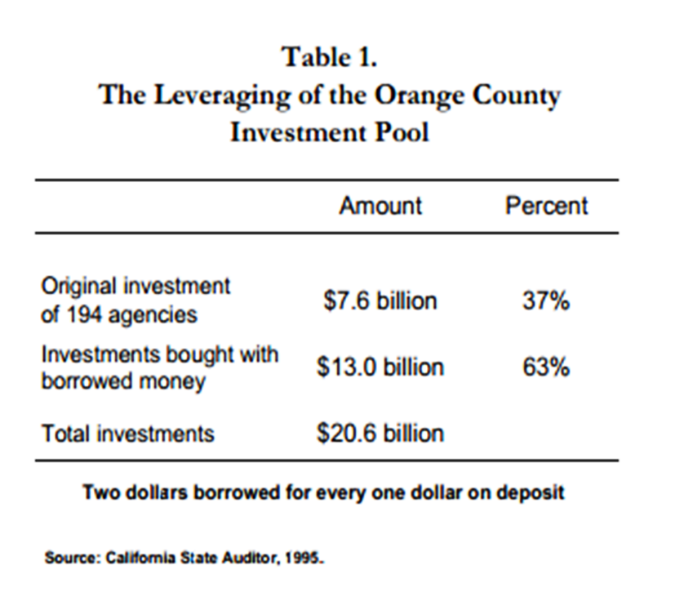

Slide 22
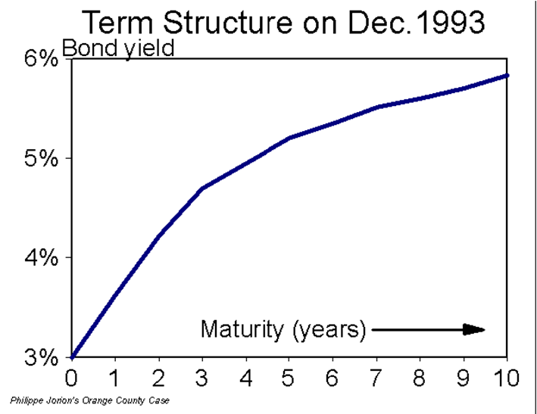
The duration was further amplified by the use of structured notes
Citron's main purpose was to increase current income by exploiting the fact that medium-term maturities had higher yields than short-term investments
On December 1993, for instance, short-term yields were less than 3%, while 5-year yields were around 5.2%.
With such a positively sloped term structure of interest rates, the tendency may be to increase the duration of the investment to pick up an extra yield
This, of course, comes with a greater risk.

Slide 23
The strategy worked fine as long as interest rates went down.
In February 1994, however, the Federal Reserve Bank started a series of six consecutive interest rate increases, which led to a bloodbath in the bond market.
The large duration led to a $1.6 billion loss.

Slide 24
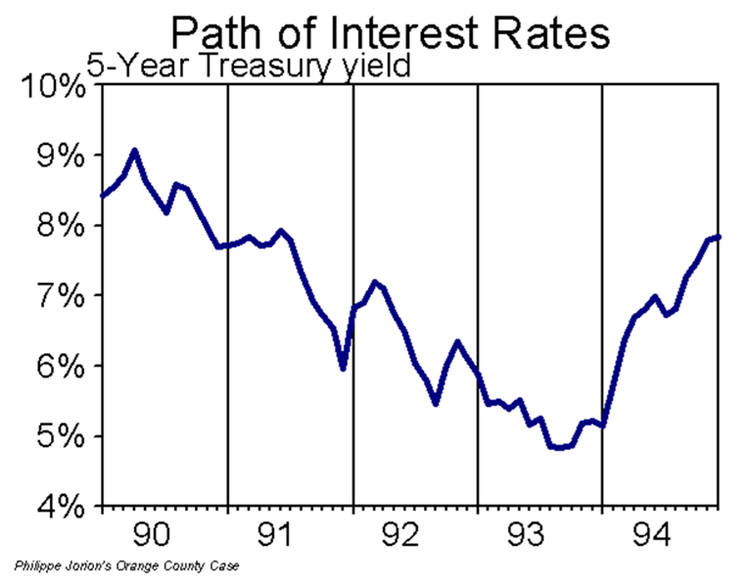

Slide 25
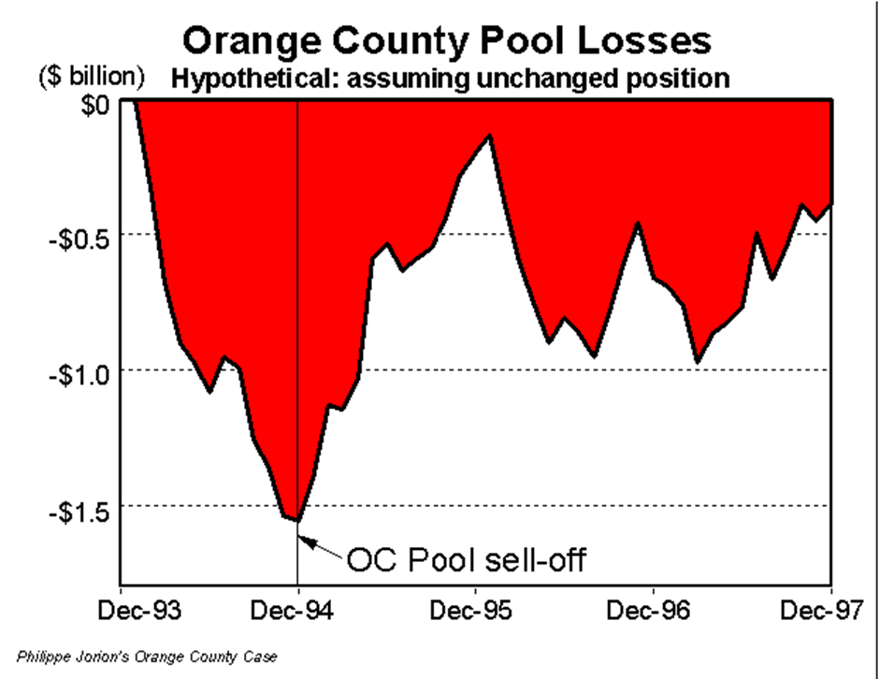

Slide 26
Consequences
Financial institution and any company who lent fund to invest with orange county were afraid that orange county would not be able to pay to debt so they recalled their fund back.
Not able to pay the debt, finally, orange county had gone bankrupt and loss 1.6 billion.
Robert L. Citron was knocked on the door at Santa Ana home. He was presented letter of resignation and force to resigned because of his reckless on investment.
The bankruptcy caused interests to hike within the county, threatening to make it more expensive for many localities to borrow.
The effect impacted across state. Investment institution which invested in orange county incurred loss. For example, Merrill Lynch’s shares declined on the New York stock Exchange.

Slide 27
Consequences
Consequences
It caused damage impact on bond market; the bonds from most California issuers were quoted at sharp drops in prices and whereas yield dramatically increased. The Dow Jones industrial average declined by 10.43. CUYAHOGA COUNTY, OHIO's highly leveraged $1.8 billion fund also lost $137 million when bond prices fell.
Dropped it credit rating; Orange County's bonds ,earlier, had been rated AA by both Moody's Investors Service and S& P, a very high investment grade rating. Later, S& P cut its rating to CCC.
Government cut expenditure and slowed down the public service because tax increases were very hard to get in California.

Slide 28
Remedies
The country negotiate with financial company and other institution who put investment with orange country so they divided the pool and paid back investment to them and promised to repay the rest later
Finding new source of loan by divert tax funds from other county agencies so that orange country could repay their debt and they also issued the $1 billion bond.
Reduce spending and human resource...
Increase sales tax by 0.5%
Change organization structure, to increase management and monitoring for official
The county sold $880 million bond in order to repay debt on existing bonds, pay for bankruptcy litigation, etc.
This make orange county able to repay their debt in June 12, 1996 which mean the Orange County’s was able to repay debt within 18 months.

Slide 29
Suggestions
Diversify risk
  Investing 100 percent of portfolio could generate higher return, as higher risk comes with higher return.
  High return is accompanied with high risk, however.
  Bob Citron can make better investment by completely diversifying his portfolio via investing in different instruments, such as mortgage, stock market, gold, and etc.( as long as their correlation are not equal to one)
Monitor needed
  From both private and public sectors
  In monitoring how much risk the county was exposed to
  The state government should closely monitor the fiscal conditions of its local governments, rather than wait for serious problems to surface.

Slide 30
Suggestions
Implement explicit Risk Management Strategies
  For example, a fixed or some acceptable range of VAR
  Specified particular types of investment instruments and underlying assets that the portfolio concentrated on (risk-oriented)
  Form an efficient investment team that will able to keep a real-time track with current economic situation and will able to predict future policies that might have any potential impacts on the value of the portfolio
  Conduct frequent portfolio valuation

Slide 31
Suggestions
Suggestions
Other suggested tools
  Dealing with substantially high interest rate risk, the county could invest in other types of bonds such as putable bond, when the interest rate increase they can have the right to sell back the bond.
  Forward Rate Agreement is also recommended, when the interest rate was decreasing they can enter into this agreement to fix their portfolio interest rate.
  Sell future contract with bond underlying asset
  Other tools such as interest rate swaps and options.
Lower the leverage risk
  Too high leverage ratio give the pools much higher risk, they could reduce this risk by lowering the leverage ratio.
  Otherwise, after they leverage their investment they could invest in other sector where volatility would not depend on interest rate

Slide 32
Reference
Philippe Jorion's, (2011) "Orange County Case: Using Value at Risk to Control Financial Risk" retrieved Nov 27/11/13 from http://merage.uci.edu/~jorion/oc/case.html
Keith Sill, (2013) "The Economic Benefits and Risks Of Derivative Securities" retrieved Nov 27/11/13 from http://www.phil.frb.org/.../january-february/brjf97ks.pdf
AXEL KOESTER. “Today, Orange County...”. Businessweek Archives. Web. 22 Nov. 2013. http://www.businessweek.com/stories/1994-12-18/today-orange-county-dot-dot-dot
"Robert Citron Was a Hard-to-hate Villain in O.C.'s Bankruptcy." The Orange County Register. N.p., n.d. Web. 22 Nov. 2013. <http://www.ocregister.com/articles/citron-383795-county-money.html>.
Norris, Floyd. "ORANGE COUNTY'S BANKRUPTCY: THE OVERVIEW; Orange County Crisis Jolts Bond Market." The New York Times. The New York Times, 08 Dec. 1994. Web. 22 Nov. 2013. <http://www.nytimes.com/1994/12/08/business/orange-county-s-bankruptcy-the-overview-orange-county-crisis-jolts-bond-market.html>.
Investopedia.com (2013), “Reverse Repurchase Agreement”, Retrieved Nov 22, 2013, from http://www.investopedia.com/terms/r/reverserepurchaseagreement.asp

Slide 33
Reference
Mamtanarula.weebly.com (2013), “Repo rate and Reverse Repo rate” Retrieved Nov 22, 2013, from http://mamtanarula.weebly.com/1/category/repo%20rate%20and%20reverse%20repo%20rate/1.html
Michael J. Fleming and Kenneth D. Garbade, “Repurchase Agreements with Negative Interest Rates” Retrieved Nov 22, 2013, from http://www.newyorkfed.org/research/current_issues/ci10-5/ci10-5.html
TERI SFORZA, “Robert Citron was a hard-to-hate villain in O.C.'s bankruptcy” Retrieved Nov 22, 2013, from http://www.ocregister.com/articles/citron-383795-county-money.html
Wikipedia.com (2013), “Early 1990s recession” Retrieved Nov 22, 2013, from http://en.wikipedia.org/wiki/Early_1990s_recession
Investopedia.com (2013), “What was Robert Citron's role in Orange County, California's bankruptcy? “ Retrieved Nov 22, 2013, from http://www.investopedia.com/ask/answers/08/orange-county-bankruptcy.asp

Slide 34
Q & A

