Slide 1
Part 2
Trade theories

Slide 2
Trade Theories
Mercantilism
Classical Trade Theory
- Absolute advantage concept
- Comparative advantage concept
Neo-Classic Trade Theory
Heckscher-Ohlin Theory
Alternative Theories

Slide 3
2.1 Mercantilism
A collection of economic thought in Europe during the period between 1500 and 1750.
Philosophy
“A country’s wealth is measured by its holdings of precious metals (specie)”
Colonialism
Trade surplus is preferred to trade deficit

Slide 4
2.1 Mercantilism
Trade is a Zero-sum game: One country’s gain is at the expense of another
Need strong government to regulate the economy
    Government policy to discourage importation and encourage exportation
    Exchange of precious metals regulation, policy to discourage exportation of specie
    Close regulation of production
    Controls of labor through craft guild and ensure low wage
Paradox of mercantilism
“To be rich, a country needed to have a lot of poor people”

Slide 5
The Challenge to Mercantilism
In early 1700s, questions began to emerge regarding the logic of mercantilism
David Hume’s challenge: The price specie flow mechanism
Adam Smith challenge: Absolute advantage
In 18th century
David Ricardo: Comparative advantage
Book: “The Principles of Political Economy and Taxation”
Classical Trade Theory

Slide 6
David Hume’s mercantilism challenge (1975)
--- the price specie flow mechanism
Key argument: maintaining a trade surplus forever is impossible.
Trade Surplus (Exports > Imports)
Accumulation of gold (net inflow of specie)
Increase in Money Supply
Increase in prices and wages
Reduce ability to export, Import tends to increase
Reduce trade surplus until Exports = Imports

Slide 7
David Hume’s mercantilism challenge (1975)
--- the price specie flow mechanism
Trade Deficit (Exports < Imports)
Reduce amount of gold accumulated (net outflow of specie)
Decrease in Money Supply
Decrease in prices and wages
Increase ability to export, Import tends to decrease
Reduce trade deficits until Exports = Imports

Slide 8
Adam Smith’s mercantilism challenge
--- Absolute advantage and laissez faire
The national wealth depends on its productive capacity
Growth in productive capacity is fostered in free market
Self-interest leads individuals to specialize in and exchange goods based on their own special abilities
Countries should specialize in and export those commodities in which they had an absolute advantage
If countries trade according to this principle, all will gain from trade (trade will be mutually beneficial)
Trade is a positive-sum game

Slide 9
2.2 Classical Trade Theory
Related principle
Adam Smith
The Principle of Absolute Advantage
The Principle of Comparative Advantage
----constant opportunity cost case-----
David Ricardo

Slide 10
Principle of absolute advantage—Adam Smith
International trade based on different technology
Assumptions
2 countries, 2 goods
1 factor of production, labor
In each country, all labor has the same qualifications
Constant units of labor required to produce one unit of a final good
Price and cost of each good produced depends on units of labor required to produce the good (different technology)

Slide 11
Concept
Principle of absolute advantage
Each country should produce a good it has absolute advantage (can produce efficiently). Then countries should export those goods in which they can produce efficiently, and import those which they cannot
Division of labor between countries
Each country gains from trade

Slide 12
Principle of absolute advantage
The country will have absolute advantage in production of a good under the following condition
To produce the same amount of good
less
Country A uses factor of productions _______than Country B
Country A has absolute advantage in production of that good

Slide 13
Example 1(Principle of Absolute Advantage) --- Table 1
Unit of labor used to produce 1 unit of good
shirt (good X)
watch (good Y)
Thailand (country A)
3
XA
6
YA
USA (country B)
8
XB
2
YB
In Autarky (without international trade) both countries will produce both goods if consumers demand both Shirts and Watches
Thailand is more efficient than USA in the production of shirt
(require less unit of labor to produce shirt, 3<8)
Thailand has absolute advantage in shirt production
USA is more efficient than Thailand in the production of watch
(require less unit of labor to produce watch, 2<6)
USA has absolute advantage in watch production
Thailand exports shirt and USA exports watch

Slide 14
Example 2 (Principle of Absolute Advantage) --- Table 3
Unit of labor used to produce 1 unit of good
shirt (good X)
watch (good Y)
Thailand (country A)
12
XA
24
YA
USA (country B)
4
XB
3
YB
USA is more efficient than Thailand in the production of shirt
(require less unit of labor to produce shirt, 4<12)
USA has absolute advantage in shirt production
USA is more efficient than Thailand in the production of watch
(require less unit of labor to produce watch, 3<24)
USA has absolute advantage in watch production
No Trade (under Absolute advantage principle)

Slide 15
Limits to Adam Smith’s Absolute Advantage principle
If one country has an absolute advantage in the production of both (or all) goods, Smith would say that that country cannot gain from trade.
But David Ricardo’s Principle of Comparative Advantage (1817) took Smith’s work farther: even in the above example, trade can be mutually beneficial!

Slide 16
Principle of comparative advantage—David Ricardo
Adam Smith’s absolute advantage and David Ricardo’s comparative advantage emphasizes on International trade based on different technology
2.4.1 Assumptions (similar to absolute advantage assumptions)
2 countries, 2 goods
1 factor of production, labor
In each country, all labor has the same qualifications
Constant units of labor required to produce one unit of a final good (fixed technology in each country although the technology can differ between them)
The relative value of commodity is based solely its relative labor content ---- see explanation later

Slide 17
2.4 Principle of comparative advantage---David Ricardo
2.4.1 Assumptions (similar to absolute advantage assumptions)
Fixed endowment of resource (labor)
Factor of production (labor) mobile internally, immobile internationally
Full employment
Perfect competition in good market
No government intervention
No transportation cost

Slide 18
2.4.2 Concept of Principle of Comparative Advantage
Unit of labor used to produce 1 unit of good
Good X
Good Y
Country A
XA
YA
Country B
XB
YB
Compared to Country B, Country A has relative units of labor used in the production of Good X less than Good Y
If
XA
YA
XB
YB
Country A has comparative advantage in the production of Good X
Country B has comparative advantage in the production of Good Y
Country A should export Good X
Country B should export Good Y

Slide 19
Example 2 (Principle of Comparative Advantage) --- Table 3
Unit of labor used to produce 1 unit of good
shirt (good X)
watch (good Y)
Thailand (country A)
12
XA
24
YA
USA (country B)
4
XB
3
YB
XA
=
12
3
YA
=
24
8
XA
YA
=
1
3
=
1
XB
4
YB
XB
YB
Compared to USA (Country B), Thailand (Country A) has relative units of labor used in the production of Shirt (Good X) less than Watch (Good Y)
__________has comparative advantage in _______ production
Thailand
Shirt
__________has comparative advantage in _______ production
USA
Watch
Thailand exports shirt and USA exports watch

Slide 20
Extension of the classical trade model
The classical model in monetary term
Multiple commodities case

Slide 21
Test of classical trade model
G.D.A. MacDougall (1951) in an article “British and American Exports: A Study Suggested by the Theory of Comparative Costs”
Employed 1937 data on US and UK export of 25 commodities to other countries

Slide 22
Explanation of Classical trade model by Neo-Classic tools
Concept of Opportunity cost and Production possibility frontier
In each country economy, the increase in production of one product imply the decrease in the production of another product.
Classic assumes constant opportunity cost

Slide 23
Example 3 (Principle of Comparative Advantage) --- Table 4
Unit of labor used to produce 1 unit of good
shirt (good X)
watch (good Y)
Thailand (country A)
3
XA
6
YA
USA (country B)
8
XB
2
YB
XA
=
3
YA
=
6
3
XA
YA
2
=
1
XB
8
YB
XB
YB
Compared to USA (Country B), Thailand (Country A) has relative units of labor used in the production of Shirt (Good X) less than Watch (Good Y)
__________has comparative advantage in _______ production
Thailand
Shirt
__________has comparative advantage in _______ production
USA
Watch
Thailand exports shirt and USA exports watch

Slide 24
Example 3 (Principle of Comparative Advantage) --- Table 4
Unit of labor used to produce 1 unit of good
shirt (good X)
watch (good Y)
Thailand (country A)
3
XA
6
YA
USA (country B)
8
XB
2
YB
Opportunity cost of production of shirt (X) in Thailand (A) = _____ unit of Y
0.5
Opportunity cost of production of shirt (X) in USA (B) = _____ unit of Y
4
Opportunity cost of production of shirt (X) in Thailand (A) ______ than USA
less
__________has comparative advantage in _______ production
Thailand
Shirt
__________has comparative advantage in _______ production
USA
Watch
Thailand exports shirt and USA exports watch

Slide 25
Example 3 (Principle of Comparative Advantage) --- Table 4
Unit of labor used to produce 1 unit of good
shirt (good X)
watch, (good Y)
Thailand (country A)
3
XA
6
YA
USA (country B)
8
XB
2
YB
Opportunity cost of production of watch (Y) in Thailand (A) = _____ unit of X
2
Opportunity cost of production of watch (Y) in USA (B) = _________unit of X
(1/4) = 0.25
Opportunity cost of production of watch (Y) in Thailand (A) ______ than USA
more
__________has comparative advantage in _______ production
Thailand
Shirt
__________has comparative advantage in _______ production
USA
Watch
Thailand exports shirt and USA exports watch

Slide 26
Gains from trade under constant cost case
watch (Y)
watch (Y)
Y = 12-X
16
CIC₂^{B}
G
I
Y = 16-4X
12
CIC₁^{B}
A*
8
B*
8
Y = 16-X
6
E
CIC₂^{A}
4
A
4
B
CIC₁^{A}
0
F
0
3
H
J
4
12
4
8
16
shirt (X)
shirt (X)
Y = 6-0.5X
Thailand (A)
USA (B)
From Example 3, Table 4
If the endowment of labor in Thailand = 36 units
the endowment of labor in USA = 32 units

Slide 27
2.3 Neo-Classical Trade Theory
Update Ricardian analysis to include
Increasing opportunity cost
Factor of production besides labor
Explicit demand consideration

Slide 28
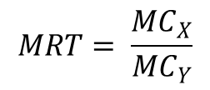
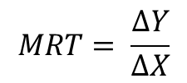
PPC---Increasing opportunity cost case
Slope of PPC = Marginal Rate of Transformation (MRT)
good Y
or
ΔY
PPC
ΔX
ΔY
Note: X₁X₂ = X₃X₄
ΔX
good X
X1
X2
X3
X4

Slide 29
Community Indifference Curve, CIC)
Individual Indifference Curve ----- IC
    Represent individual welfare
    Combination of good X and Y that yields the same level of satisfaction for each individual
    Ordinal utility, transitivity, diminishing MRS
    No intersections in IC map
    IC map does not change within the period of analysis

Slide 30
Community Indifference Curve, CIC)
Community Indifference Curve ----- CIC
(Cannot add individual IC to get CIC)
    Represent community (country) welfare
    Combination of good X and Y that yields the same level of well-being for the community
    Ordinal utility, transitivity, diminishing MRS
    No intersections in CIC map
    CIC map does not change within the period of analysis

Slide 31
Community Indifference Curve, CIC)
Caution interpreting CIC
    Move along IC does not imply constant utility of each individual consumer
    Shift of IC (suppose to the right) does not imply the improvement of each individual welfare

Slide 32

Autarky Equilibrium (Equilibrium before trade)
The autarky equilibrium (Point E) takes into account both supply and demand
At point E, the country is on the highest CIC possible, given production constraint of the PPC
At point E,
Y
Community indifference
Curve (CIC)
A
E
Y₁
Price line
B
PPF
X₁
X

Slide 33
Autarky Equilibrium (Equilibrium before trade)
Y
Y
PPCB
PB = 4
CIC₁^{B}
PPCA
A
CIC₁^{A}
B
PA = 1
X
X
Note:
,

Slide 34
Gains from trade under increasing opportunity cost case
Y
Pw = 2
Y
Pw = 2
PPCB
PB = 4
A*
CIC₁^{B}
PPCA
B’
CIC₂^{B}
CIC₂^{A}
A
CIC₁^{A}
B
M
A’
PA = 1
B*
N
X
X
Note:
,

Slide 35
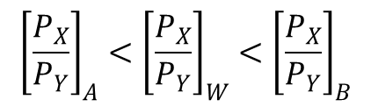
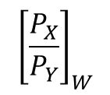
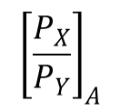
Note
After trade, each country gains from trade at different level.
Suppose country A has high demand in good Y and country B has low demand in good X.
Country A will gain from trade less compared to country B
is closer to
After trade, each country will increase production of product that it has comparative advantage. However, we can see that at equilibrium production point of country A (Point A’) and country B (Point B’), each country produce both goods.
Incomplete specialization

Slide 36
Terms of Trade, TOT
Terms of Trade is sometimes called
Commodity terms of trade
Net barter terms of trade
World relative price

Slide 37
Terms of Trade, TOT
Import good of country A
Price of export good of country A
TOT of country A
Y
P_{X}
=
=
X
P_{Y}
Export good of country A
Price of import good of country A
Import good of country B
Price of export good of country B
=
X
P_{Y}
TOT of country B
=
Y
P_{X}
Export good of country B
Price of import good of country B
TOT of country A =
1
TOT of country B
TOT of country B
TOT of country A

Slide 38
PPC can be different due to
1. Different technologies in two countries
Classical Trade Theory
Constant opportunity cost
(straight line PPC)
Neo-Classical Trade Theory
Increasing opportunity cost
(concave PPC)
2. Different relative factor of production (K and L) availability in
two countries
Heckscher-Ohlin Trade Theory
3. Different technologies and different relative factor of
production (K and L) availability in two countries

Slide 39
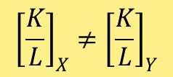
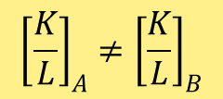
Heckscher-Ohlin Model assumptions
2 countries (A and B), 2 commodities (X and Y), 2 factors of production (K and L)
Identical technology across countries - the same production functions in both countries
3) Constant Return to Scale production functions in both commodities and both countries
4) Each good has different relative factor intensities and no factor intensity reversal
Two goods have different factor intensities at common factor price, and the difference hold for all possible factor price ratios in both countries
5) Each country’s endowment of factors is fixed
6) Each country has different relative factor abundance
7) Perfect competition in all markets

Slide 40
Heckscher-Ohlin Model assumptions
8) Perfectly mobile factors within each country (but immobile internationally)
  Same wage rate earned in both industries of each country
  Same rental rate earned in both industries of each country
9) Identical and homothetic preferences across countries
  A poorer country will buy less of both rice and airplane, but in the same ratio as a richer country facing the same prices
  Not a realistic assumption, but it allows us to focus attention on the differences in resources as the sole reason for trade
10) Goods are traded freely without transportation costs, market distortions, and government interventions

Slide 41
Factor Abundance concept
Focus on supply side
Physical definition
Country A is the labor-abundant country
Country B is the capital abundant country
Price definition
Focus on D & S
Country A is the labor-abundant country
Country B is the capital abundant country

Slide 42
Factor Intensity concept
In country A and country B if
X is L-intensive good
Y is K-intensive good

Slide 43
Heckscher-Ohlin Theorem
Concept
A country will export the commodity that uses relatively intensively the factor that country has in relative abundance.
A country will import the commodity that uses relatively intensively the factor that is relatively scarce in that country
Alternative name
Factor Proportion Theory
Factor Endowment Theory

Slide 44
4.7 Heckscher-Ohlin Theory
Factor Proportion Theory
Factor Endowment Theory
For example
If country A is the L-abundant country
small
or
small
small
Country A will export good X (L-intensive good)
If country B is the K-abundant country
large
or
large
large
Country B will export good Y (K-intensive good)
Note: X is L-intensive good, Y is K-intensive good

Slide 45
H-O Theory – Physical definition
Y
Country A is L-abundant country
PPC_{B}
Country B is K-abundant country
P_{B}
B₁
B₀
E
O₂
A₀
CIC₁
CIC₀
P_{A}
O₁
A₁
PPC_{A}
P_{E}
X
0
***After trade, all that is required is an equal sloped TOT line for both countries, not necessary a common line***

Slide 46

Factor Price Equalization Theorem
Concept
International trade will equalize relative factor price among trading partners
Let’s say at
₌

Slide 47
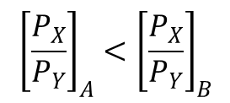
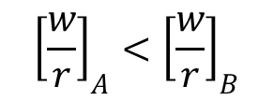
Suppose
X is L-intensive good
Y is K-intensive good
Before Trade
Country A has comparative advantage in the production of good X
Country B has comparative advantage in the production of good Y

Slide 48
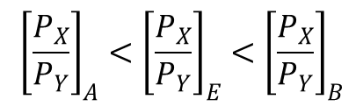
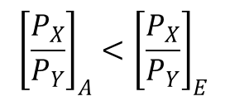


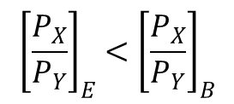



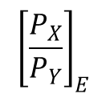
Suppose
X is L-intensive good
Y is K-intensive good
After Trade
In country A, production of X
Demand for L
w
In country A, production of Y
Demand for K
r
to
In country B, production of X
Demand for L
w
In country B, production of Y
Demand for K
r
to
When relative factor price is at
Relative output price moves to

Slide 49
Reasons why don’t we observe factor price equalization
Factor intensity reversal
Significant transportation costs
Trade restrictions: tariffs and quotas
Market distortions: monopolies, labor union
Non CRTS technology
Not identical technology
Factor-intensity reversal
Heterogeneous factor
Even though FPE is unlikely, trade can result in strong tendencies in that direction.

Slide 50
The Stolper-Samuelson Theorem
As trade commences,
  the owners of the relatively abundant factor will find their real incomes rising
  the owners of the relatively scarce factor will find their real incomes falling.

Slide 51
Relax H-O Model assumption (one by one)
Relax assumption (9) “Identical and homothetic preferences across countries”
“Demand reversal” case
see section 4.7.1
Relax assumption (4) “Each good has different relative factor intensities and no factor intensity reversal”
“Factor intensity reversal” case
see section 4.9
Relax assumption (10) “Goods are traded freely without transportation costs, market distortion and government intervention”
Transportation cost
See AFC chapter 8, p.142-143
Imperfect competition
See AFC chapter 8, p.144-145
Relax assumption (8) “Perfect mobile factor within each country (but immobile internationally)”
“Specific factor model” case
See AFC chapter 8, p.145-149
We will also learn this model further in chapter 5 of outline

Slide 52
Testing the H-O model
(Chapter 9 in AFC, 2010)
Leontief test
Other tests

Slide 53
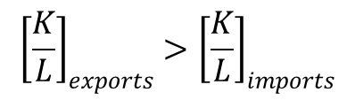
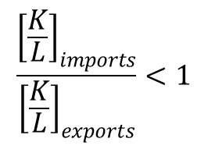
Leontief test
1950s: Leontief conducts the first important test of H-O model
Using U.S. data (in 1947) Leontief calculated
  Average capital and labor embodied in U.S. exports
  Average capital and labor embodied in U.S. imports
Presumably, the U.S. was relatively K-abundant at that time
  Therefore, according to the H-O model,
    the U.S. should tend to export K-intensive good
    the U.S. should tend to import L-intensive good
  That is the (K/L) ratio for U.S. exports should be greater than (K/L) ratio of U.S. imports
Leontief statistics

Slide 54
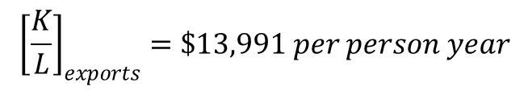
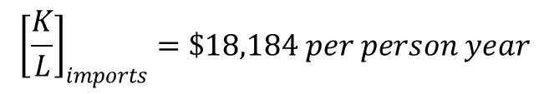
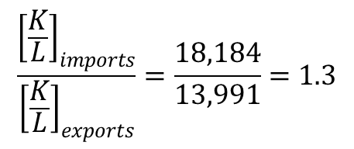
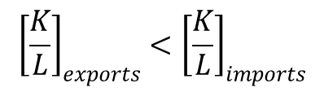
Leontief test
Leontief found that
Contradict to H-O prediction

Slide 55
4.11.1 Leontief test
Many research studies try to explain “Leontief Paradox”
Do any of these explanations “rescue” the H-O model, or is the model just “wrong”?

Slide 56
Leontief test
Possible explanation for the Leontief Paradox:
It was impossible for Leontief to get information on the amount of K and L used to produce imports
He used data on U.S. technology to calculate estimated amounts of K and L used in imports from abroad
Remember? H-O model assumes identical technology across countries

Slide 57
Leontief test
Possible explanation for the Leontief Paradox:
Assumption of H-O model might be too restrictive
Demand reversal
Factor intensity reversal
Tariff structure
Non-identical technologies across countries
Adding other factors of production or categorized existing factor of production
Land and natural resources
Skilled and unskilled labor

Slide 58
Other tests of H-O
Test of H-O model in other countries
Test of H-O model by relaxing some assumptions
---- Read more in Chapter 9 of AFC (2010)”

Slide 59
Summary
The Heckscher-Ohlin model, in which two goods are produced using two factors of production, emphasizes the role of resources in trade.
The Heckscher-Ohlin theorem predicts that a country will export the commodity which uses intensively its abundant factor and import the commodity which uses intensively its scarce factor.
International trade tends to equalize factor prices. Complete FPE is not observed due to transportation costs, barriers to trade, distortions, differences in technology and inputs.

Slide 60
Summary
The owners of a country’s abundant factors gain from trade, but the owners of scarce factors lose.
A rise in the relative price of the labor-intensive good will shift the distribution of income in favor of labor:
  The real wage of labor will rise in terms of both goods, while the real income of capitalists will fall in terms of both goods.

Slide 61
Summary
Empirical evidence is mixed on the Heckscher-Ohlin model
  Most researchers do not believe that differences in resources alone can explain the pattern of world trade or world factor prices.
  However, H-O is still an useful model that can be used to explain trade.

Slide 62
2.5 Alternative Theories
Specific Factor Model
Economies of Scale
  Kemp model and external economies of scale
  Natural Monopoly --- Internal economies of scale
  Krugman model and monopolistic competition --- Internal economies of scale
Dumping
  Monopoly and dumping
  Reciprocal dumping
Imitation Lag Hypothesis and the Product Cycle Theory
The Linder Theory
The Gravity Model
Intra industry trade

Slide 63
2.5.1 The Specific Factor Model, SFM
H-O model assumes free mobility of factors between sectors which can only happen in the long run.
In the short run, some factors, such as capital and land take a long time to be converted from one industry to others.
This model assumes that capital is fixed and specific to one sector and land is fixed and specific to another sector but labor still freely mobile.
It is a short run version of H-O model.

Slide 64
Assumptions in SFM
L = Labor
K = Capital
Production of two commodities
  Good X: garment industry: use factor of production L and K
  Good Y: agricultural sector: use factor of production L and T
Three kinds of factors of production L, K, T
Q_{X} = f (K, L_{X}) , Q_{Y} = f (T, L_{Y})
L_{x} + L_{Y} = L
T = Land
(Mobile factor)
Specific factors
Economy is at full employment level

Slide 65
Summarize: Effect of changes in relative product price on income distribution (of various owners of factors of productions)
A relative price increase of a good
  increases the real return of the specific factor used in that industry
  reduces the real return of the other specific factor
  has an unambiguous effect on the mobile factor
Free trade affects the real returns in the short run differently from the long run.
Different group of specific factors may support free trade differently in the short run.

Slide 66
Compared H-O and SFM
 | H-O | SFM
Production function
Long-run
Short-run
(variable factor and fixed factor)
(only variable factors)
Factor movement
Specific Factor &
Mobile Factor
Mobile Factor
Adjustment of factor price
Clear
Unclear
Income distribution
Clear
Unclear

Slide 67
2.5.2 Economies of Scale
Note: H-O assumes CRTS technology (which implies no economies of scale)
Kemp model
Later model
External Economies of Scale & Int. Trade
Internal Economies of Scale & Int. Trade
External Economies of scale
  The cost per unit depends on the size of the industry but not necessarily on the size of any one firm.
  An industry will typically consist of many small firms and be perfectly competitive.
Internal Economies of scale
  The cost per unit depends on the size of an individual firm but not necessarily on that of the industry.
  The market structure will be imperfectly competitive with large firms having a cost advantage over small.

Slide 68
2.5.3 Dumping
  Dumping occurs when a firm sells a product abroad at a price that is either less than the price it charges in its local market, or less than its average cost to produce the product.
  Why any firm want to do that?
To gain market share in the host country market
Then drives competitors out of that market
Finally, the firm can exercise monopoly power
Monopoly dumping
Reciprocal dumping

Slide 69
2.5.4 The Imitation Lag Hypothesis and The Product Cycle Theory
This group of theories concern about the dynamic comparative advantage which changes over time

Slide 70
The Imitation Lag Hypothesis (Michael Posner)
When a new product is invented in country A, there are two sorts of lags that delay the production of the good in country B
  Imitation lag: There is a delay in transmission or diffusion of technology from country A to country B.
  ---- Relax assumption of H-O that both countries
  have the same technologies -----
  Demand lag: There is a delay in consumer acceptance in country B after the new product is introduced in country A.

Slide 71
The Imitation Lag Hypothesis (Michael Posner)
Suppose USA first invent and produce the good, and suppose
    Imitation lag = 3 years
    Demand lag = 1 year
production
consumption
0
1
2
3
Thailand import from USA

Slide 72
The Product Cycle Theory
The Product Cycle Theory (Raymond Vernon): the life cycle of the new product has 3 stages
  New product stage
  Maturing product stage
  Standardized product stage
6

Slide 73
The Product Cycle Theory
New product stage:
  The product is produced and consumed only in Developed countries (DCs) where the demand is located.
  No international trade.

Slide 74
The Product Cycle Theory
Maturing product stage:
  product standards start to emerge and mass production process and economies of scale start to be realized.
  Foreign demand in other DCs starts to grow. There is export from the original DC to other DCs.
  The original DC starts to invest in other DCs to lower the production costs via FDI. Exports from the original DC are displaced by the production in these new production sites.
  The original DC may start to import from these new plants.

Slide 75
The Product Cycle Theory
Standardized product stage:
  Product characteristics and production process are well known.
  Production may shift to the developing countries (LDCs) to utilize lower labor costs.
  LDCs export the product to DCs.

Slide 76
The Product Cycle Theory
Production and consumption
Consumption in DC
Imports
Exports
Production in DC
Time
New product stage
Maturing product stage
Standardized product stage

Slide 77
The Linder Theory
In the H-O model, the pattern of trade is determined by relative resource endowments.
A model by Linder (1961) focuses mainly on the demand side.
Basic idea is that a country produces stuff to satisfy domestic demand; these goods will be likely exports (and imports, too).

Slide 78
The Linder Theory: An example
What products will country I and II trade?
C, D, and E.
I
A
B
C
D
E
II
C
D
E
F
G
III
E
F
G
H
J

Slide 79
The Linder Theory: An example
What products will country II and III trade?
I
E, F, and G.
A
B
C
D
E
II
C
D
E
F
G
III
E
F
G
H
J

Slide 80
The Linder Theory: An example
What products will country I and III trade?
I
E only.
A
B
C
D
E
II
C
D
E
F
G
III
E
F
G
H
J

Slide 81
The Linder Theory: An example
So trade will involve goods for which there is overlapping demand.
Implication: trade should be most intense between countries with similar levels of per capita income.

Slide 82
The Linder Theory: An example
This theory would explain two things that H-O cannot:
  why most trade is between the industrialized countries, which all have (presumably) very similar resource endowments.
  why a country might import and export the same product (intra-industry trade).

Slide 83
The Linder Theory: An example
The theory has been subjected to a barrage of tests.
  Sailors, et al. (1973), Thursby and Thursby (1987), and McPherson, Redfearn and Tieslau (2000) and others found evidence to support the Linder theory.
  Hoftyzer (1984), Kennedy and McHugh (1983) and others found evidence against the theory.

Slide 84
Gravity Model
The focus is on explaining trade volume (does not focus on the composition of trade)
The model uses equation to predict the volume of trade on bilateral basis between any two countries
Variables normally put in the equation to explain the size of trade or flow of exports from a country A to country B are
  National income variable for country B
  National income variable for country A
  Measures of distance between country A and B
  Some other variables such as population size, economic integration arrangement etc.
(+)
(+)
(-)

Slide 85
Intra-industry trade
Classical, neoclassical to H-O trade theories tend to emphasize on trade in different goods or inter-industry trade between developed and developing countries.
But most trade between developed countries involve goods in the same industry or intra-industry trade. (cars, vine, etc.)
The Grubel-Lloyd (GL) index
X_{i} and M_{i} are export and import good in the same industry (industry i)
If X_{i} = 0 or M_{i} = 0
IIT_{i} = 0
No intra-industry trade
If X_{i} = M_{i}
IIT_{i} = 1

Slide 86
Intra-industry trade
Possible reasons for intra-industry trade
(AFC, ch. 10 p. 194-196)
Product differentiation
Transportation costs
Dynamic economies of scale --- learning by doing
Degree of product aggregation
Differing income distributions in countries (see graph in the next slide)
Differing factor endowment and product variety (Mary intra-industry trade with H-O
  Different varieties of a good are exported by countries with different relative factor endowments.

Slide 87
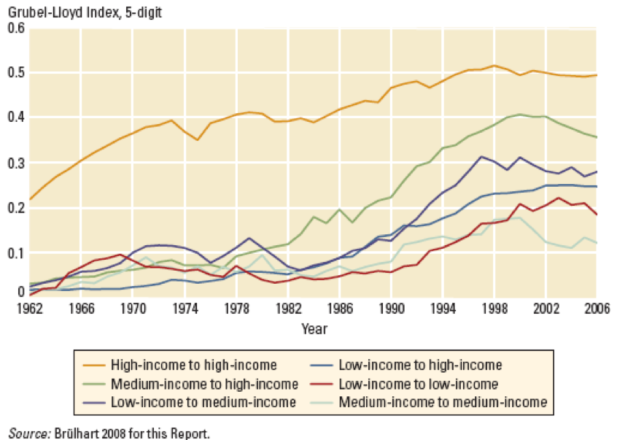
Intra-industry Trade: GL index
Chayun Tanti

